Slide 1

Main Topics
Smart X.
What AVR?
AVR Types.
Why AVR?
AVR Structure.
How To program AVR Chip?

Slide 2


Smart X

Slide 3
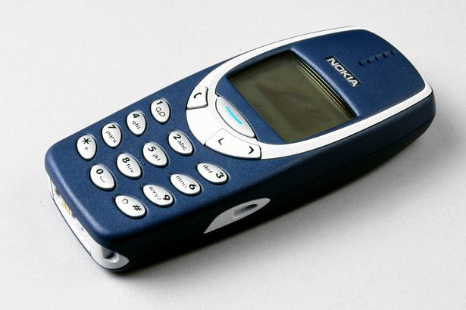


Slide 4


Slide 5


Slide 6
What AVR?
➔AVR is a Microcontroller, From Atmel.
➔ There are 2 types of AVR : DIP (Dual in-line Package) & SMD (Surface Mount Device)

Slide 7
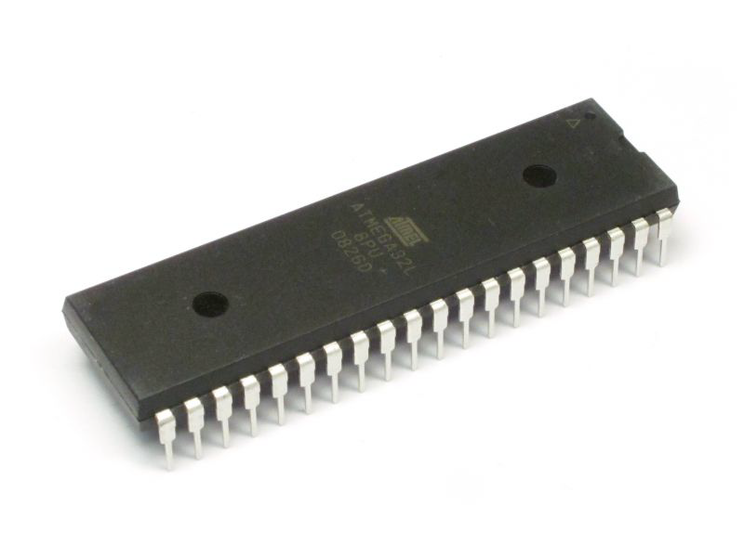
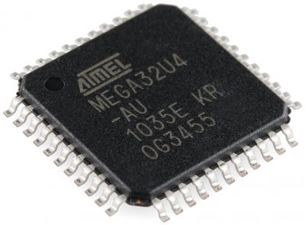
AVR Types
Dual in-line Package
Surface Mount Device

Slide 8
Why AVR?
Cheap .
Small in area and available in many vergins , you can a suitable one.
Easy to program comparing with other microcontrollers.

Slide 9
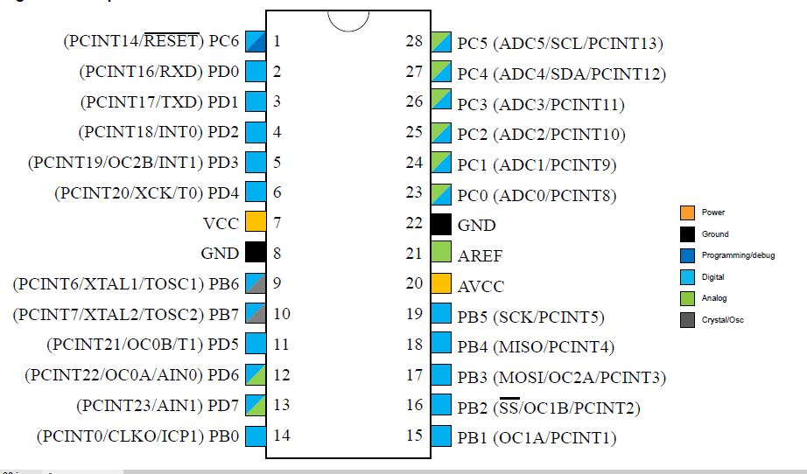
AVR Structure

Slide 10
How To program AVR Chip?
➔First Write your code on any IDE support C programming Language.
Then compile it & convert it to HEX. File.
Finally burn the HEX. File on AVR chip by USBISP programmer.

Slide 11
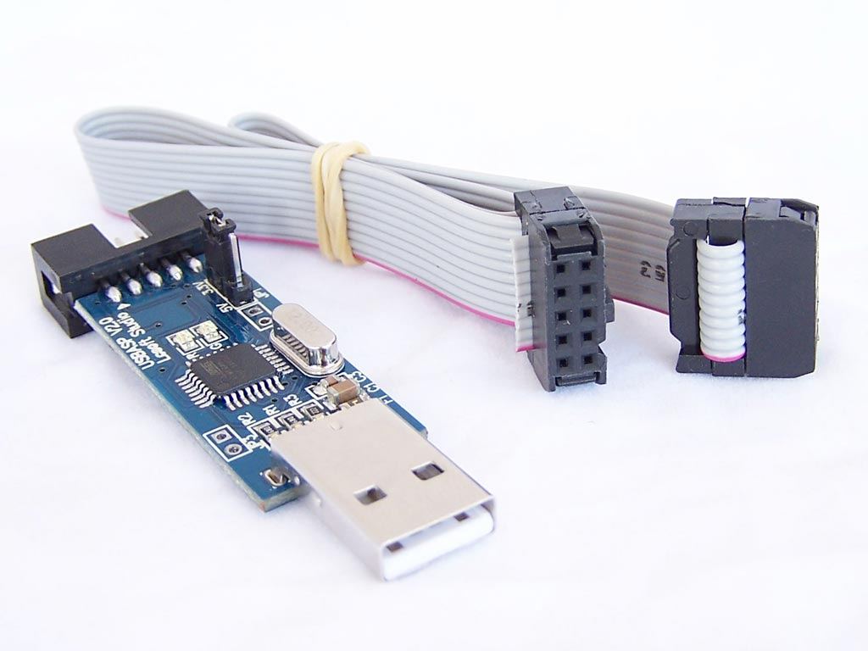
USBISP programmer

Slide 12

The Magic of Arduino

Slide 13
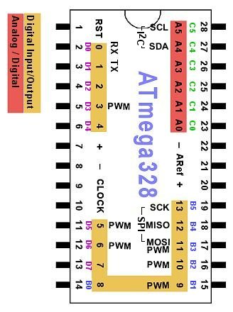
Atmega 328 Pin out

Slide 14
Atmega 328 Pin out
➔Digital Pins from 0 → 13.
Analog pins from 0 → 5.
Pin 8 & 22 connected to Ground.
Pin 7 , 20 & 21 Connected to Vcc.
Pin 9 & 10 for External CLK.
➔ NOTE : CLK tells us How many commands will be executed per second.

Slide 15
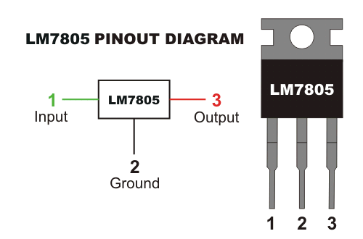
Operating Voltage
➔ AVR works only with 5 v , if a higher voltage is applied may damage it ! But we deal with 9 v battery to solve this
use Voltage Regulator 7805.

Slide 16
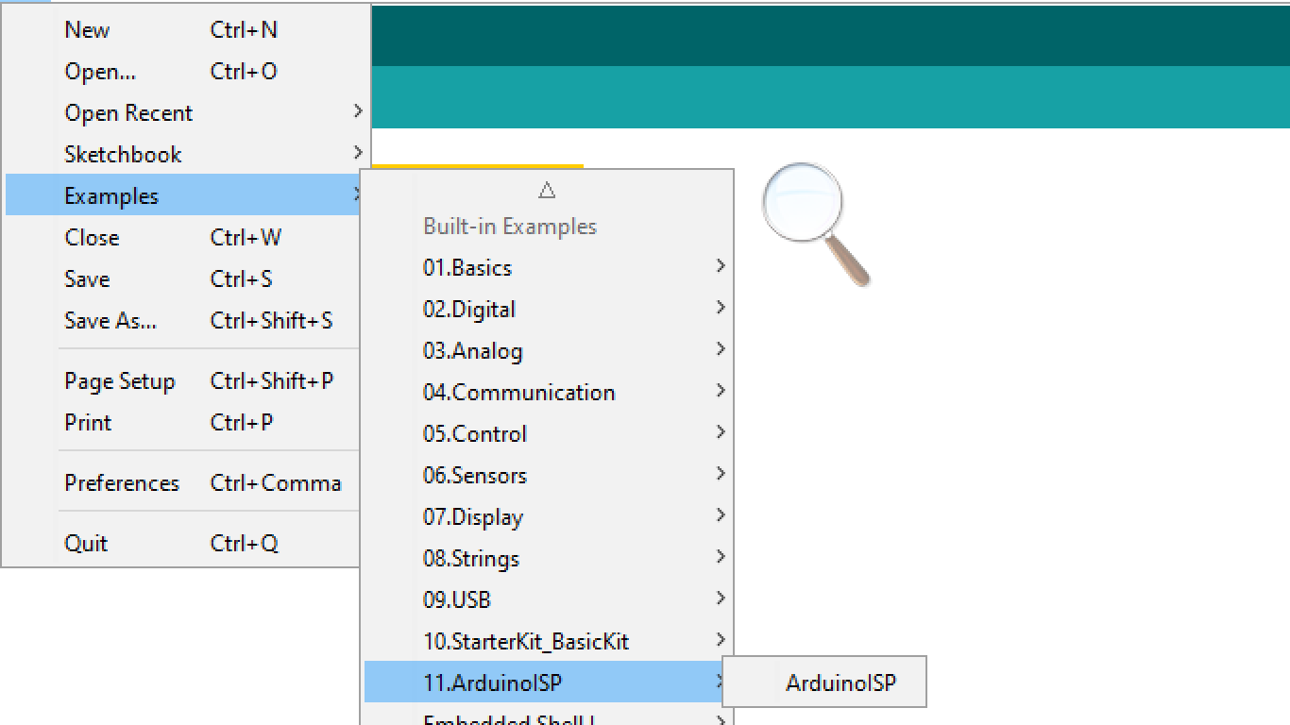
Preparing the Arduino to act as USBISP.

Slide 17
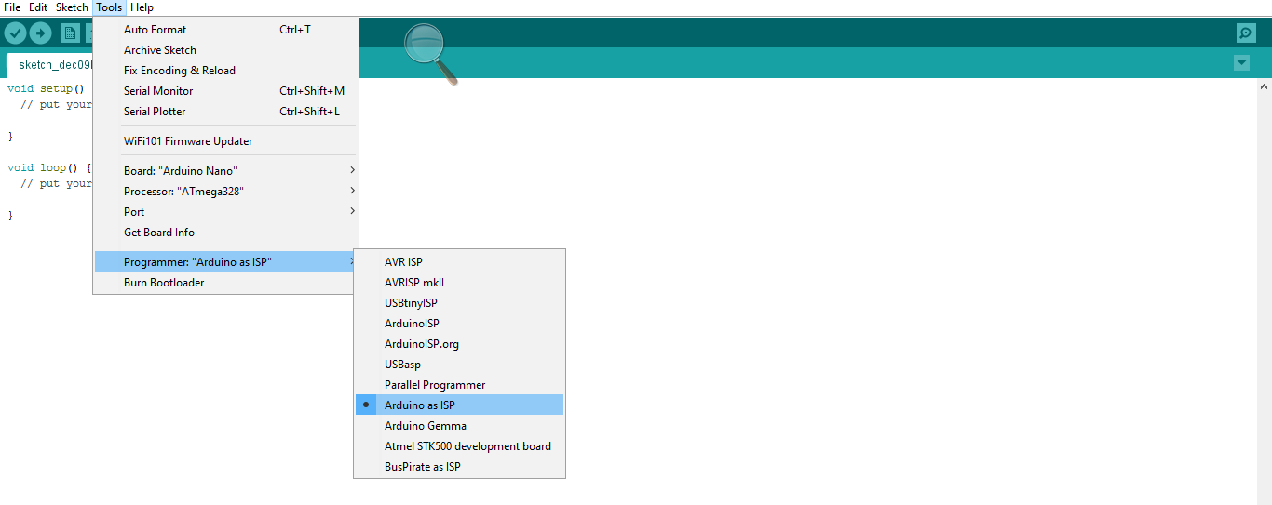

Slide 18
Connect the Arduino to the Atmega with the following connections:
Arduino D13 to ATmega pin 19 (SCK).
Arduino D12 to ATmega pin 18 (MISO).
Arduino D11 to ATmega pin 17 (MOSI) .
Arduino D10 to Atmega pin 1 (RESET).
Don’t Forget to connect the Vcc & Ground.
Note that we connect a 22 pF cap . With CLK pins To the Ground.

Slide 19
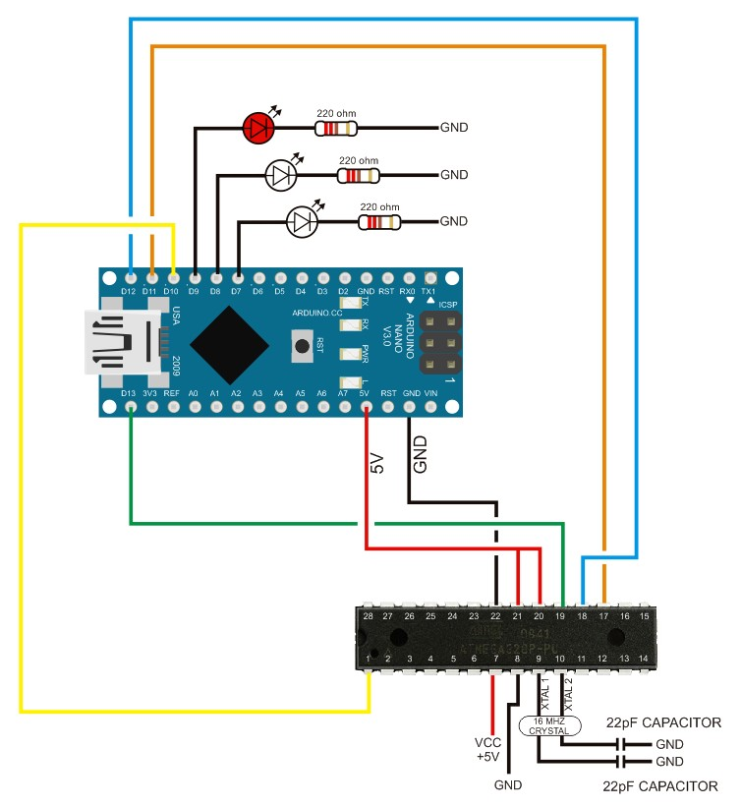

Slide 20
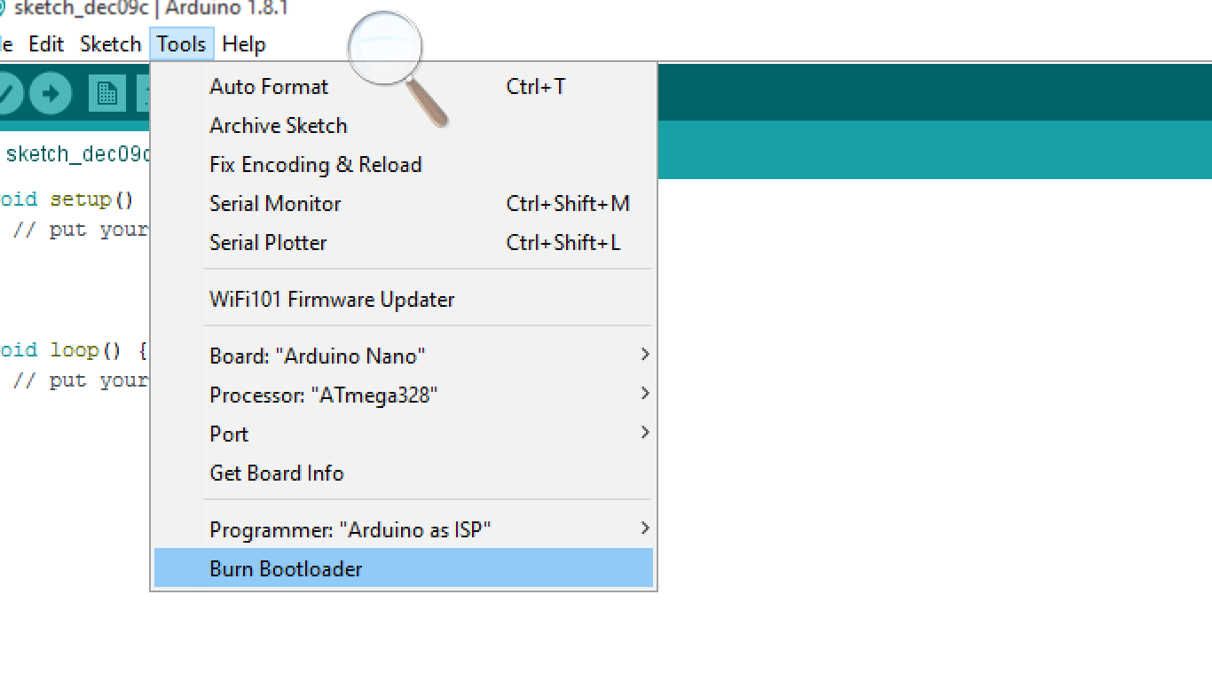
Burning Bootloader

Slide 21
Example :
You are asked to design a traffic light system with this requirements :
1) the Green light will be on for 18 Seconds.
2) then the green will be off and the Yellow will be flashing for 5 times.
3) After the 5th flashing the red will be on for 18 Second.

Slide 22
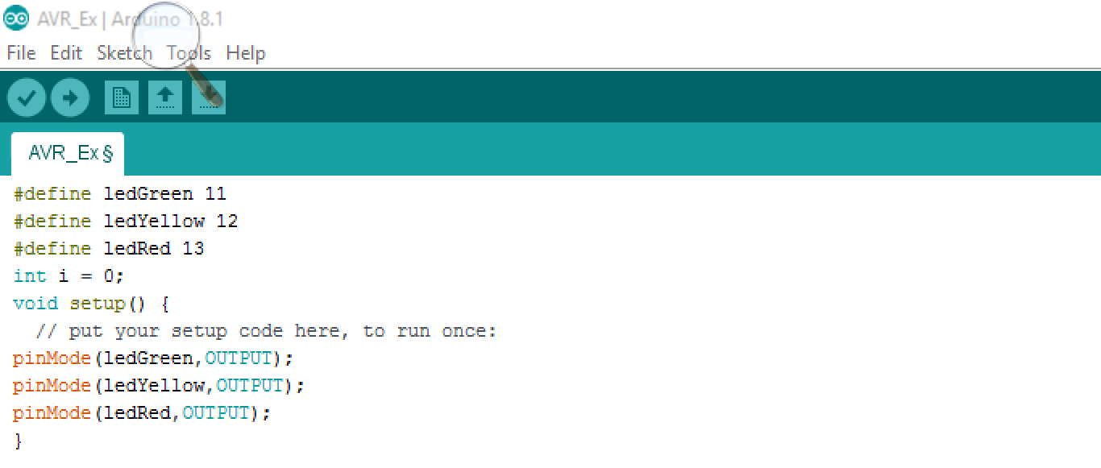
Code

Slide 23
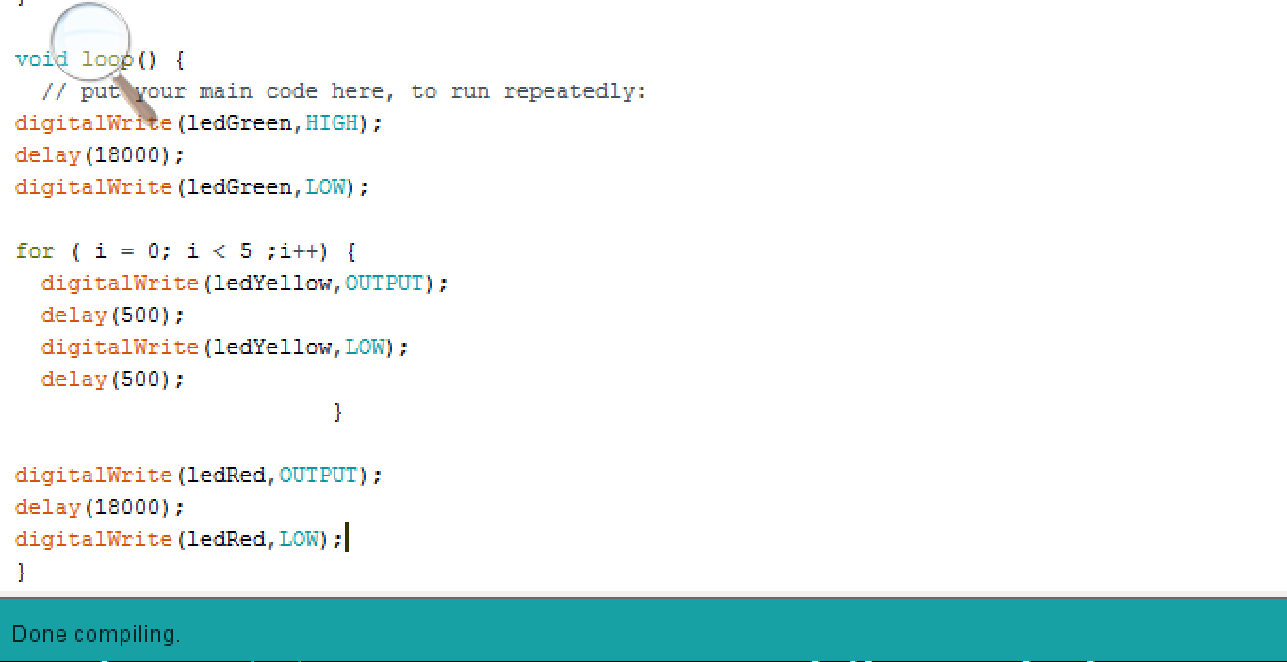

Slide 24
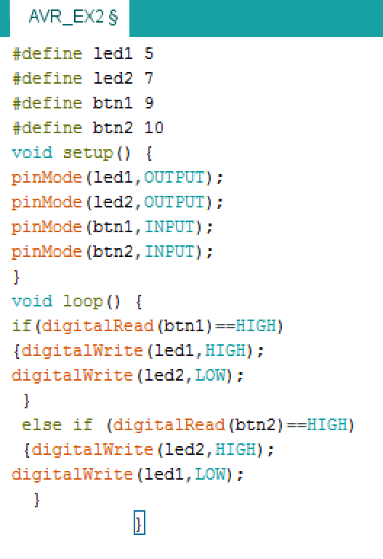
Another Example

Slide 25
Summery
Arduino as USBISP.
Arduino IDE support C language and can create the HEX. File.
Arduino IDE is a strong tool to program AVR .

Slide 26

Questions?

Slide 27


