Slide 1
Financial Literacy ECO330T Budgets

Slide 2
What is a Budget
An identification and list of expected expenses and income during a particular period.

Slide 3
How to Set Up a Budget
No one wants to budget. Everyone wants to spend freely. But budgeting is a financial reality for everyone—whether you’re a recent graduate or not. Building a budget is a crucial step towards financial success.

Slide 4
Building a Budget in 4 Steps:
Track your expenses.
Whether you write your expenses down on paper or you use an expense management app, write down the expenses that take money out of your bank account—rent, utilities, groceries, travel, leisure, personal care, etc. This is the start of your budget. Make sure you’re noting what’s fixed and what’s variable month to month over a three month period.

Slide 5
Building a Budget in 4 Steps:
2. Scrutinize your variable expenses.
This is where you’ll need to reign in your spending if you want to save money. Decide what’s worth spending your money on out of the variable expenses. Is it dining out? Taking trips? Shopping sprees? Take a look into what you can and cannot live without. If you’ve never budgeted before, this is the hard part.

Slide 6
Building a Budget in 4 Steps:
3. Deduct monthly savings.
If you want to be smart about saving money for the future, start taking away a portion of your paycheck every time you get paid. It doesn’t have to be a lot of money, but taking away even $50 from a paycheck each month will lay in a solid foundation for the future. But if you do this, you’ll need to factor it into your monthly budget.

Slide 7
Building a Budget in 4 Steps:
4. Set the budget.
Once you’ve figured out your monthly income, deducted your fixed expenses, managed and deduced your variable expenses, and taken out some savings, your monthly available spend is there. Many people follow the “50-30-20” rule. This sets 50% towards fixed expenses (rent, utilities, and food), 30% to variable expenses (your leisure expenses), and 20% towards savings and debt repayment.

Slide 8
Budget Example in Canvas
Excel Sheet - Goals, Objectives, Budget.xlsx

Slide 9
Budget Example from Prior PFP
FinancialPlan - Student Example One.docx

Slide 10
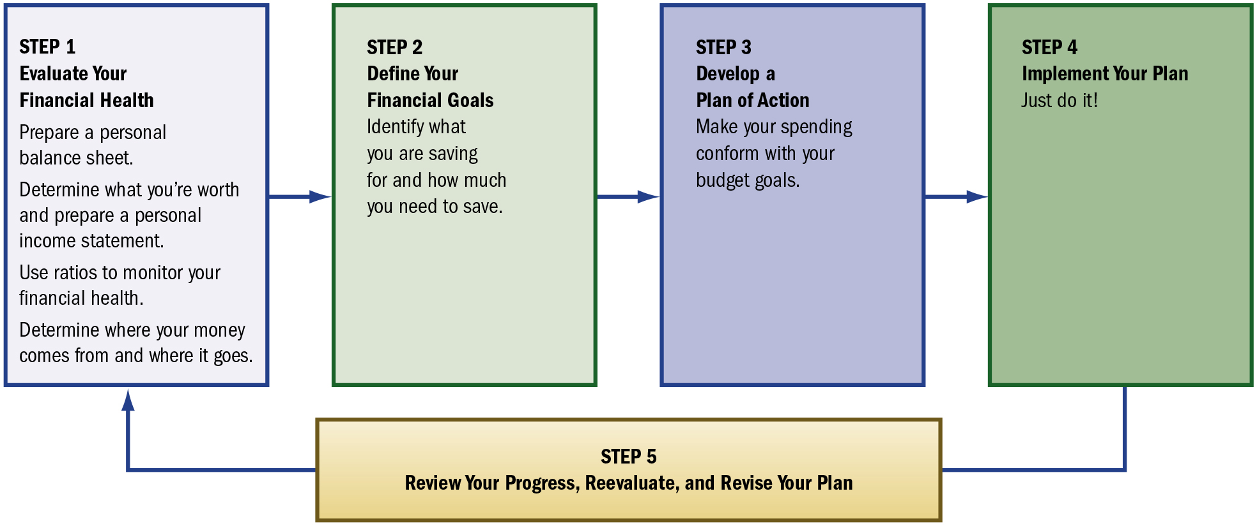
The Budgeting and Planning Process: Evaluating Your Financial Health and Developing a Plan of Action
Notes:
Long Description:
The steps of the process in sequence are as follows: • Step 1: Evaluate Your Financial Health ◦ Prepare a personal balance sheet. ◦ Determine what you’re worth and prepare a personal income statement. ◦ Use ratios to monitor your financial health. ◦ Determine where your money comes from and where it goes. • Step 2: Define Your Financial Goals ◦ Identify what you are saving for and how much you need to save. • Step 3: Develop a Plan of Action ◦ Make your spending conform with your budget goals. • Step 4: Implement Your Plan ◦ Just do it! • Step 5: Review Your Progress, Reevaluate, and Revise Your Plan The fifth step leads back to the first step.

Slide 11
Using a Balance Sheet to Measure Your Wealth
A snapshot of your financial status at a particular time
A balance sheet details:
Assets you own
Debt or liabilities you owe
Your net worth or equity

Slide 12
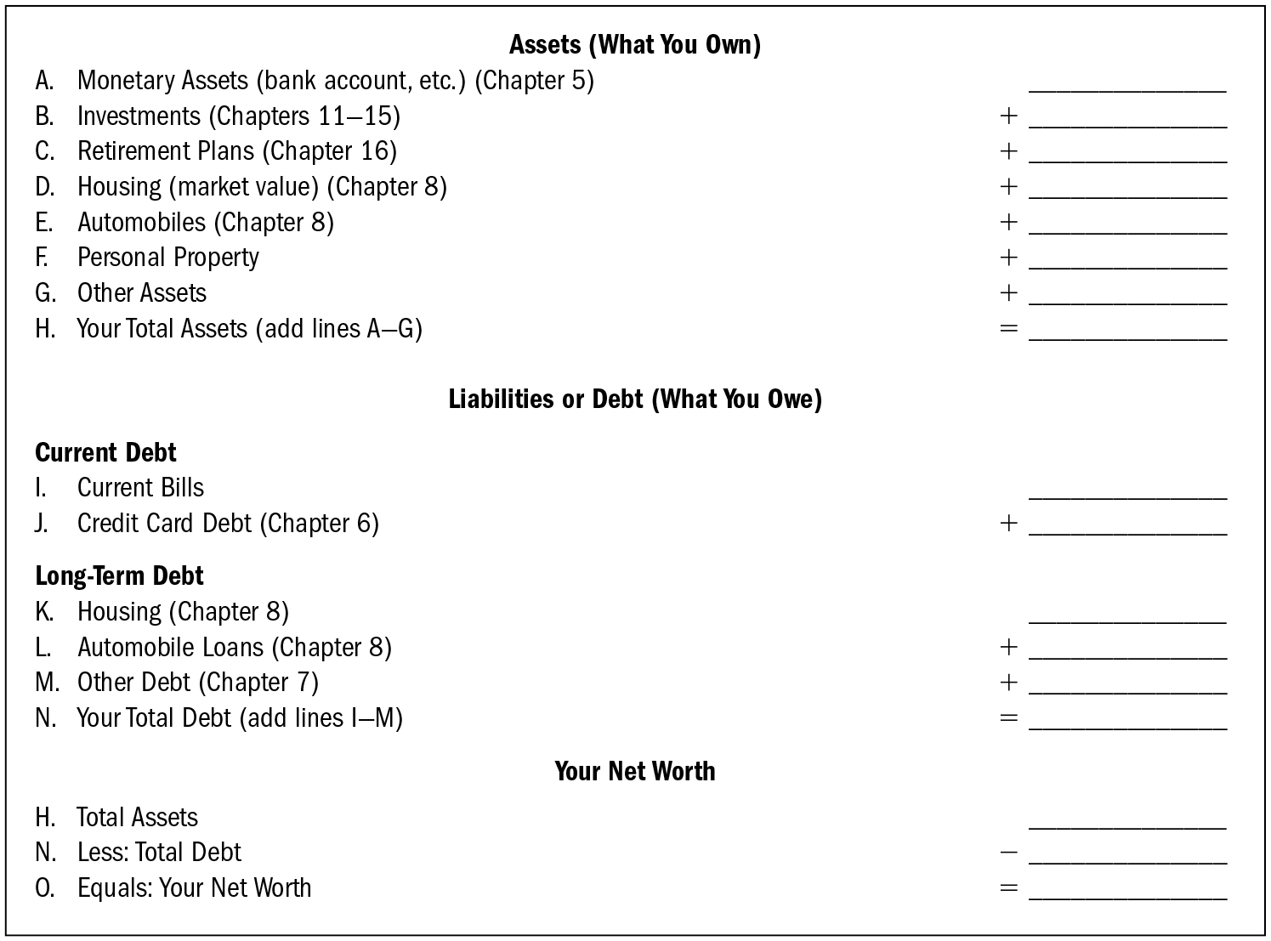
Personal Balance Sheet
Notes:
Long Description:
The chart has three sections for assets, liabilities, and net worth. Entries in each section has a blank space against them in the right for accounting calculation. The data from each section of the chart are as follows: Assets (what you own) A. Monetary Assets (bank account, etcetera.) (Chapter 5): blank B. Investments (chapters 11 to 15): plus blank C. Retirement plans (chapter 16): plus blank D. Housing (market value) (chapter 8): plus blank E. Automobiles (chapter 8): plus blank F. Personal property: plus blank G. Other assets: plus blank H. Your Total Assets (add lines A to G): equals blank Liabilities or debt (what you owe) Current Debt I. Current bills: blank J. Credit card debt (chapter 6): plus blank Long-term debt K. Housing (chapter 8): blank L. Automobile loans (chapter 8): plus blank M. Other debt (chapter 7): plus blank N. Your total debt (add lines I to M): equals blank Your Net Worth H. Total assets: blank N. Less: Total debt: minus blank O. Equals: Your net worth: equals blank.

Slide 13
Assets: What You Own
Assets are your possessions even if you owe money on them.
List assets using their current fair market value.

Slide 14
Assets: What You Own
Monetary assets—cash or other liquid assets
Investments—including common stocks, mutual funds, and bonds
Retirement plans—I R A s, 401(k) or 403(b) plans, company pension plans
Tangible assets—physical assets
House, vehicles, furniture, jewelry, collectibles, etc.

Slide 15
Liabilities: What You Owe
A liability is debt that must be repaid in the future.
List only the unpaid balances for:
Current liabilities (must be paid off within the next year)—utility bills, insurance premiums, or credit card balances
Long-term liabilities (due over a period longer than a year)—home, car, or student loans
Other loans—other installment loans, bank loans, or insurance policy loans

Slide 16
Net Worth: A Measure of Your Wealth
Net worth
total assets
total liabilities
If liabilities
assets, negative net worth and insolvent
If liabilities
assets, positive net worth
Good level of net worth depends on your goals and your place in the financial life cycle.

Slide 17
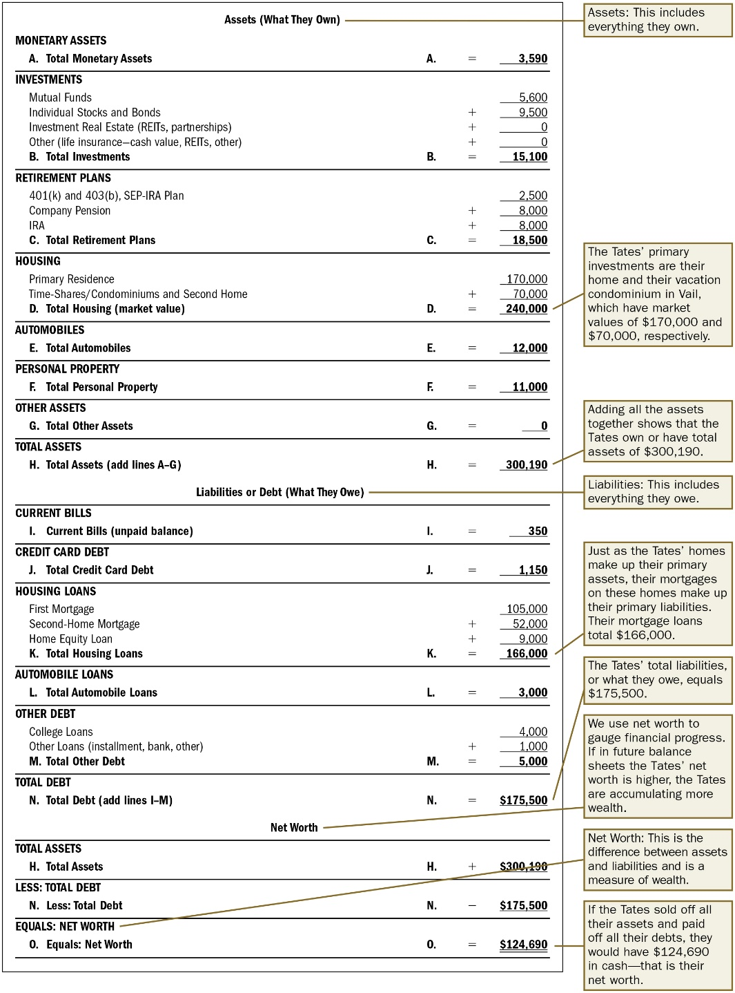
Balance Sheet Example
Notes:
Long Description:
The entries from the table with their annotations and accounting calculation are as follows: • Assets (What They Own): The annotation reads, Assets: This includes everything they own. ◦ Monetary assets ‒ A. Total monetary assets: A equals 3,590 ◦ Investments ‒ Mutual funds 5,600 ‒ Individual stocks and bonds plus 9,500 ‒ Investment real estate (REITs, partnerships) plus 0 ‒ Other (life insurance: cash value, REITs, other) plus 0 ‒ B. Total investments: b equals 15,100 ◦ Retirement plans ‒ 401(k) and 403(b), SEP-I R A plan 2,500 ‒ Company pension plus 8,000 ‒ I R A plus 8,000 ‒ C. Total retirement plans: C equals 18,500 ◦ Housing ‒ Primary residence 170,000 ‒ Time-shares slash condominiums and second home plus 70,000 ‒ D. Total housing (market value): D equals 240,000 The annotation for D reads, The Tates’ primary investments are their home and their vacation condominium in Vail, which have market values of 170,000 dollars and 70,000 dollars, respectively. ◦ Automobiles ‒ E. Total automobiles: E equals 12,000 ◦ Personal Property ‒ F. Total personal property: F equals 11,000 ◦ Other Assets ‒ G. Total other assets: G equals 0 ◦ Total assets ‒ H. Total assets (add lines A to G): H equals 300,190 The annotation for H reads, Adding all the assets together shows that the Tates’ own or have total assets of 300,190 dollars. • Liabilities or debt (what they owe) The annotation reads, Liabilities: This includes everything they owe. ◦ Current Bills ‒ I. Current Bills (unpaid balance) I equals 350 ◦ Credit Card Debt ‒ J. Total Credit Card Debt: J equals 1,150 ◦ Housing loans ‒ First mortgage 105,000 ‒ Second-home mortgage plus 52,000 ‒ Home equity loan plus 9,000 ‒ K. Total housing loans: K equals 166,000 The annotation for K reads, Just as the Tates’ homes make up their primary assets, their mortgages on these homes make up their primary liabilities. Their mortgage loans total 166,000 dollars. ◦ Automobile loans ‒ L. Total automobile loans: L equals 3,000) ◦ Other debt ‒ College loans 4,000 ‒ Other loans (installment, bank, other) plus 1,000 ‒ M. Total other debt: M equals 5,000 ◦ Total debt ‒ N. Total debt (add lines I to M): N equals 175,500 dollars The annotation for N reads, The Tates’ total liabilities, or what they owe, equals 175,500 dollars. • Net Worth The annotation reads, We use net worth to gauge financial progress. If in future balance sheets the Tates’ net worth is higher, the Tates are accumulating more wealth. ◦ Total assets ‒ H. Total assets: H equals plus 300,190 dollars ◦ Less: Total debt ‒ N. Less: Total debt: N equals minus 175,500 dollars ◦ Equals: Net worth The annotation reads, Net worth: This is the difference between assets and liabilities and is a measure of wealth. ‒ O. Equals: Net worth: O equals 124,690 dollars The annotation for O reads, If the Tates sold off all their assets and paid off all their debts, they would have 124,690 dollars in cash, that is their net worth.

Slide 18
Using an Income Statement to Trace Your Money
Financial motion picture—tells you where your money has come from and where it has gone over some period of time
Reflects net income (income less expenditures)
Record on the cash basis

Slide 19
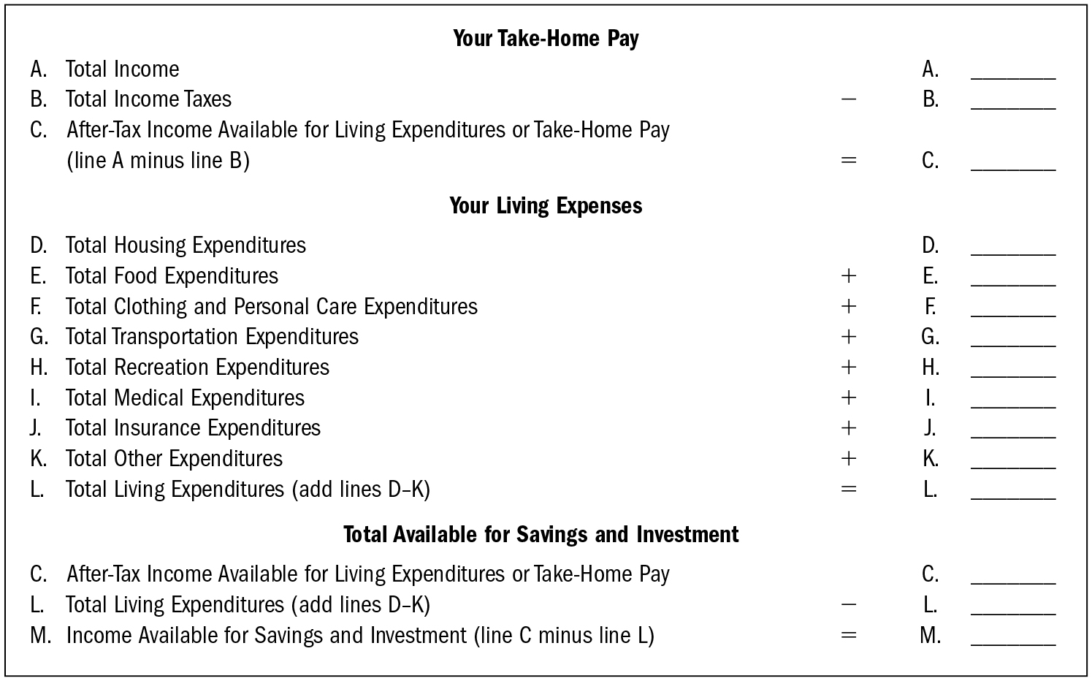
A Simplified Income Statement
Notes:
Long Description:
The income statement shows three sections. Each section represents economic units in the left and the blank space for corresponding accounting values with mathematical operators in the right. The data from the statement are as follows: First section: Your Take-Home Pay A. Total income A blank space. B. Total income taxes minus B blank space. C. After-tax income available for living expenditures or take-home pay (line A minus line B) equals C blank space. Second section: Your living expenses D. Total housing expenditures D blank space. E. Total food expenditures plus E blank space. F. Total clothing and personal care expenditures plus F blank space. G. Total transportation expenditures plus G blank space. H. Total recreation expenditures plus H blank space. I. Total medical expenditures plus I blank space. J. Total insurance expenditures plus J blank space. K. Total other expenditures plus K blank space. L. Total living expenditures (add lines D to K) equals L blank space. Third section: Total available for savings and investment C. After-tax income available for living expenditures or take-home pay C blank space. L. Total living expenditures (add lines D to K) minus L blank space. M. Income available for savings and investment (line C minus line L) equals M blank space.

Slide 20
Income: Where Your Money Comes From
Income or cash inflows:
Wages, salary, bonuses, tips, royalties, and commissions
Other sources: family income, government payments (veterans benefits, welfare), retirement income, investment income
Subtract federal, state, social security taxes from earnings to calculate your take-home pay.

Slide 21
Expenditures: Where Your Money Goes
Cash transactions may not leave a paper trail.
Classify your expenditures by category.

Slide 22
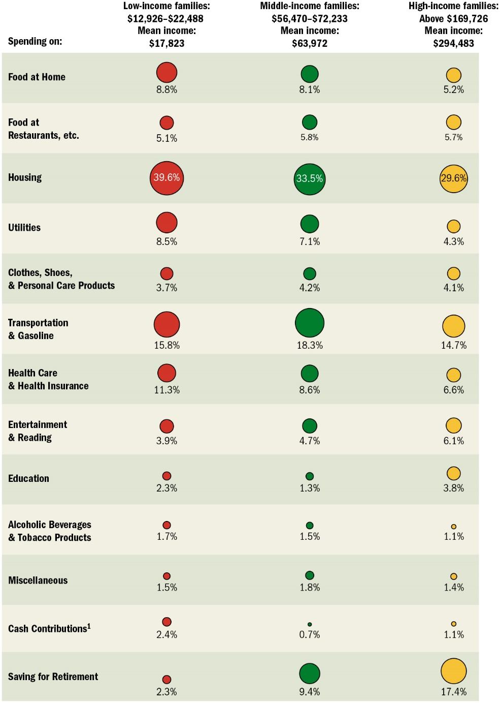
How Americans Spent Their Money in 2020
Note: Because some family units spend more or less than their income, totals may exceed 100%.
Source: Consumer Expenditures (U.S. Department of Labor, U.S. Bureau of Labor Statistics, December 2020).
Notes:
Long Description:
The table shows following column headers: spending on, low-income families: 12,926 to 22,488 dollars with mean income 17,823 dollars, middle-income families: 56,470 to 72,233 dollars with mean income 63,972 dollars, and high-income families: above 169,726 dollars with mean income 294,483 dollars. From left to right, the expense followed by the percentage of spending by low-income families, middle-income families, and high-income families is as follows: • Food at home: 8.8 percent; 8.1 percent; 5.2 percent • Food at Restaurants, etcetera: 5.1 percent; 5.8 percent; 5.7 percent • Housing: 39.6 percent; 33.5 percent; 29.6 percent • Utilities: 8.5 percent; 7.1 percent; 4.3 percent • Clothes, shoes, and personal care products: 3.7 percent; 4.2 percent; 4.1 percent • Transportation and gasoline: 15.8 percent; 18.3 percent; 14.7 percent • Health care and health insurance: 11.3 percent; 8.6 percent; 6.6 percent • Entertainment and reading: 3.9 percent; 4.7 percent; 6.1 percent • Education: 2.3 percent; 1.3 percent; 3.8 percent • Alcohol beverages and tobacco products: 1.7 percent; 1.5 percent; 1.1 percent • Miscellaneous: 1.5 percent; 1.8 percent; 1.4 percent • Cash Contributions: 2.4 percent; 0.7 percent; 1.1 percent; • Saving for Retirement: 2.3 percent; 9.4 percent; 17.4 percent. A note reads, because some family units spend more that their income, totals may exceed 100 percent. Another note for cash contribution reads, cash contributions include cash contributed to people or organizations outside the consumer unit, including alimony and child support payments; care of students away from home; and contributions to religious, educational, charitable, or political organizations.

Slide 23
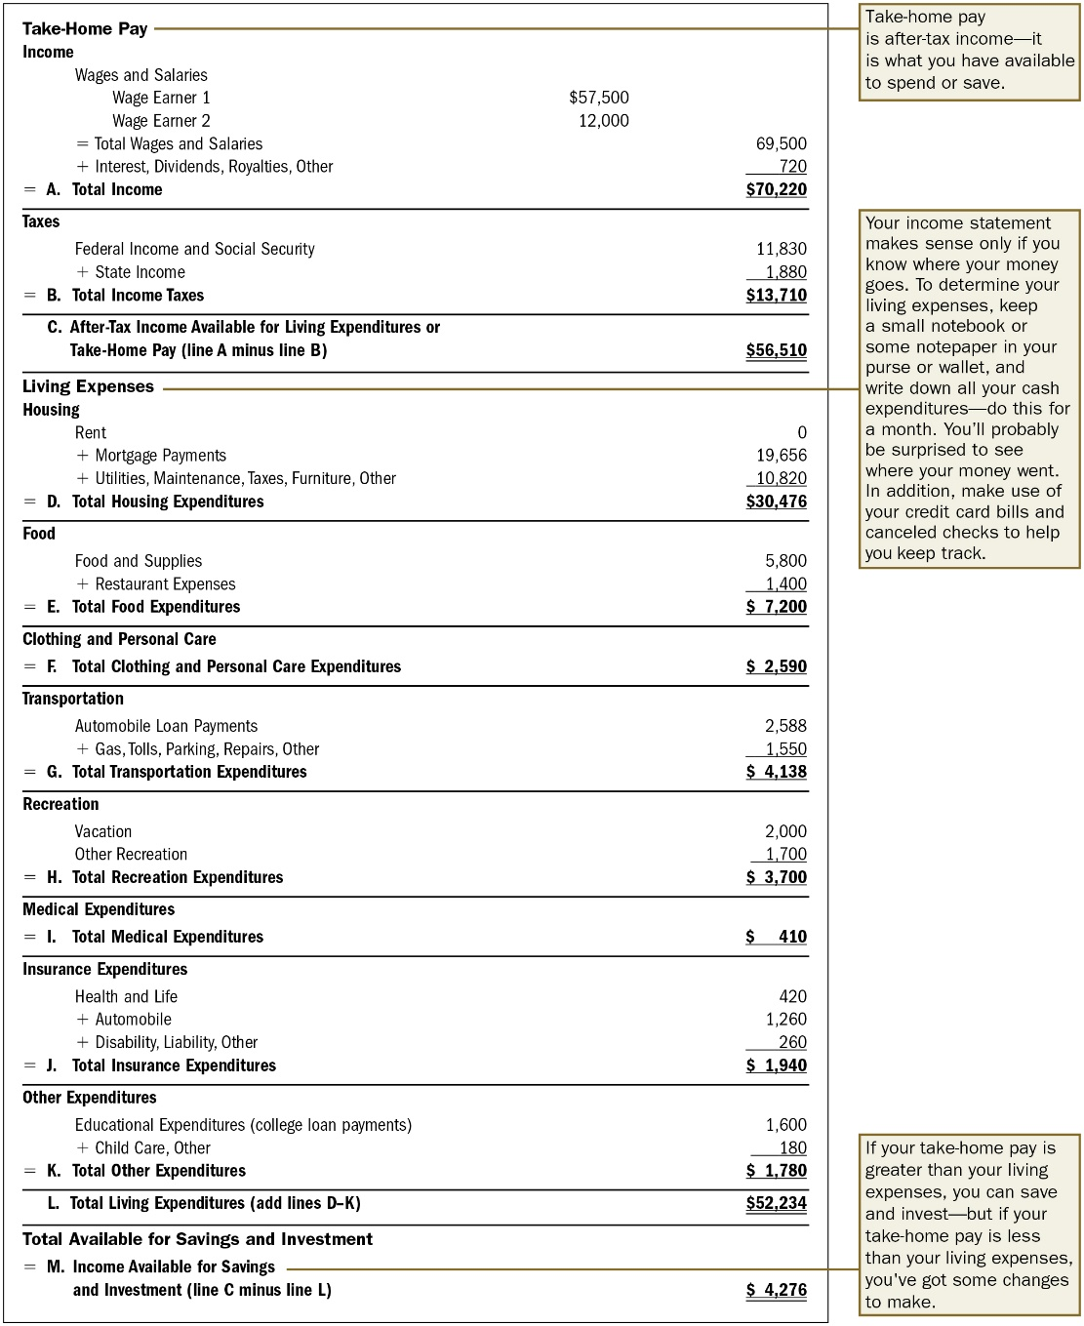
A Personal Income Statement Example
Notes:
Long Description:
The entries from the statement with their annotations and accounting calculation are as follows: Take-home pay. Annotation reads, Take-home pay is after-tax income—it is what you have available to spend or save. • Income ◦ Wages and salaries ‒ Wage Earner 1: 57,500 dollars ‒ Wage Earner 2: 12,000 dollars ◦ Equals total wages and salaries: 69,500 dollars ◦ Plus interest, dividends, royalties, other: 720 dollars • Equals A. Total income: 70,220 dollars. • Taxes ◦ Federal income and social Security: 11,830 dollars ◦ Plus state income: 1,880 dollars • Equals B. Total income taxes 13,710 dollars. •C. After-Tax income available for living expenditures or take-home pay (line A minus line B): 56,510 dollars. Living expenses Annotation reads, Your income statement makes sense only if you know where your money goes. To determine your living expenses, keep a small notebook or some notepaper in your purse or wallet, and write down all your cash expenditures—do this for a month. You’ll probably be surprised to see where your money went. In addition, make use of your credit card bills and cancelled checks to help you keep track. • Housing ◦ Rent: 0 ◦ Plus mortgage payments: 19,656 dollars ◦ Plus utilities, maintenance, taxes, furniture, other: 10,820 dollars • Equals D. Total housing expenditures: 30,476 dollars. • Food ◦ Food and supplies: 5,800 dollars ◦ Plus restaurant expenses: 1,400 dollars • E. Total food expenditures: 7,200 dollars. • Clothing and personal care • Equals F. Total clothing and personal care expenditures: 2,590 dollars. • Transportation ◦ Automobile loan payments: 2,588 dollars ◦ Plus gas, tolls, parking, repairs, other: 1,550 dollars • Equals G. Total transportation expenditures: 4,138 dollars. • Recreation ◦ Vacation: 2,000 dollars ◦ Other recreation: 1,700 dollars • Equals H. Total recreation expenditures: 3,700 dollars. • Medical expenditures • Equals I. Total medical expenditures: 410 dollars. • Insurance expenditures ◦ Health and life: 420 dollars ◦ Plus automobile: 1,260 dollars ◦ Plus disability, liability, other: 260 dollars • Equals J. Total insurance expenditures: 1,940 dollars. • Other expenditures ◦ Educational expenditures (college loan payments): 1,600 dollars ◦ Plus child care, other: 180 dollars • Equals K. Total other expenditures: 1,780 dollars ◦ L. Total living expenditures (add lines D to K): 52,234 dollars. • Total available for savings and investment • Equals M. Income available for savings and investment (line C minus line L): 4,276 dollars. Annotation for Income available for savings reads, If your take-home pay is greater than your living expenses, you can save and invest, but if your take-home pay is less than your living expenses, you've got some changes to make.

Slide 24
Using Ratios: Financial Thermometers
Financial ratios allow you analyze data in the balance sheet or income statement and then compare it to targets.
Ratios help you understand how you are managing financial resources.

Slide 25
Question: Do I Have Enough Liquidity to Meet Emergencies?
Should be greater than 1.0
Aim for above 2.0
Should aim for 3 to 6 months of liquid assets

Slide 26
Question: Can I Meet My Debt Obligations?
Should decrease as you get older
By calculating the ratio between your assets and your debts, you get your “debt ratio.” This is something the banks are very interested in. A debt ratio below 30% is excellent. Above 40% is critical. Lenders could deny you a loan.

Slide 27
Question: Am I Saving as Much as I Think I Am?
Effective saving is by paying yourself first.

Slide 28
Record Keeping
Without records, it’s difficult to prepare taxes.
By tracking expenses, you know how much and where you are spending.
It’s also easier for someone to step in during an emergency and understand your financial situation.

Slide 29
Record Keeping Steps
Track your financial dealings.
The best system is one that you will use.
Credit card and check expenditures are easy to track, but cash expenditures are more difficult to track.
Consider Mint, Goodbudget, or Quicken.
File and store your financial records so they are readily accessible.

Slide 30
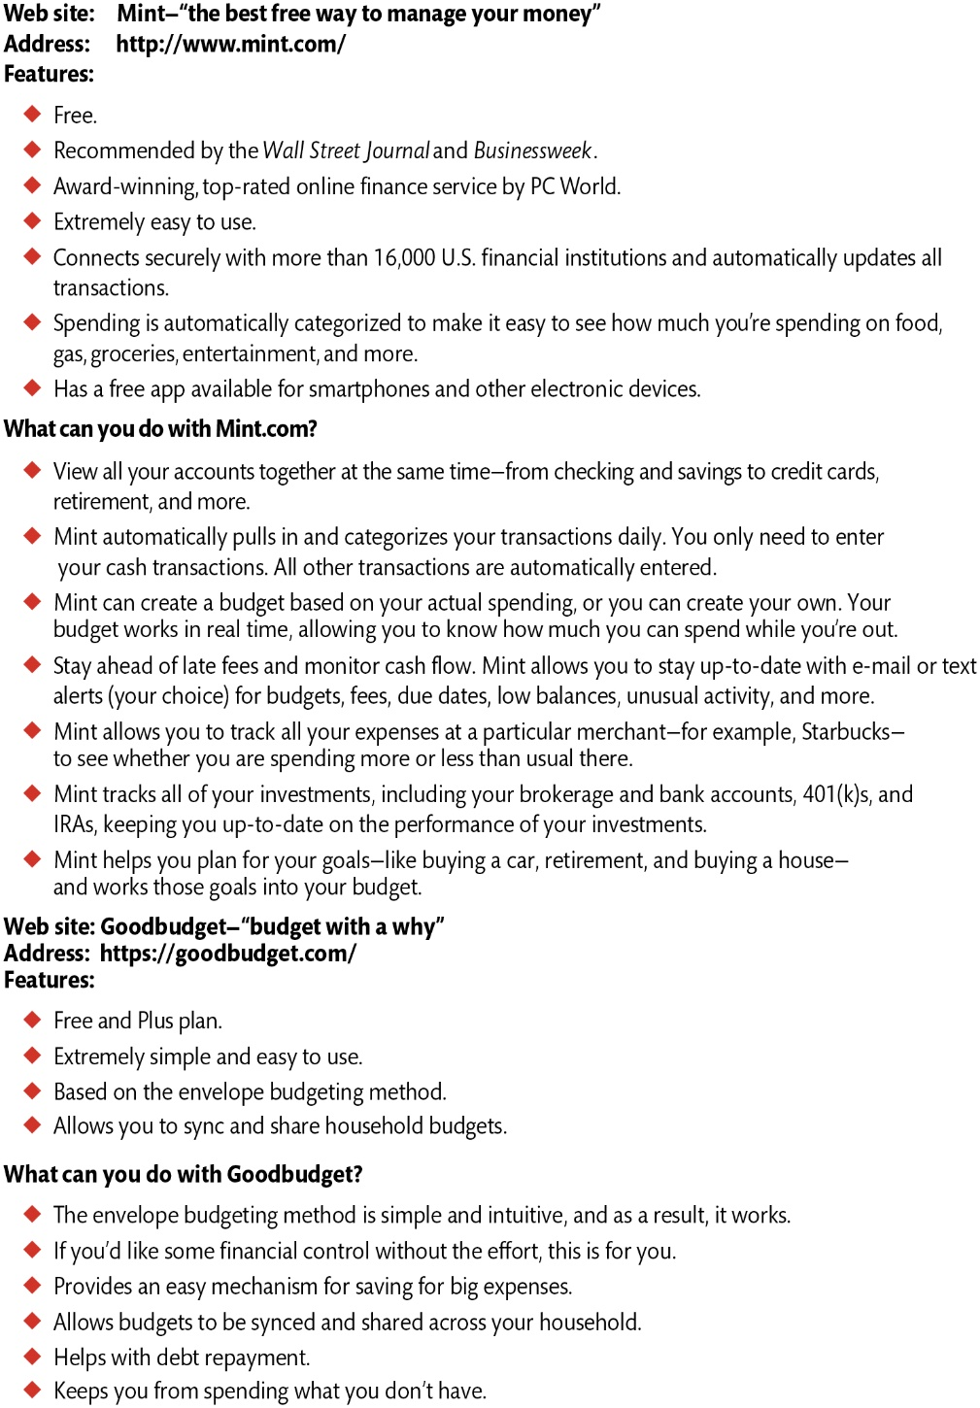
Web-Based Financial Planning with Mint and Goodbudget
Notes:
Long Description:
Web site: Mint — “the best free way to manage your money” Address: h t t p colon double forward slash w w w dot mint dot com slash Features: • Free. • Recommended by the Wall Street Journal and Business Week. • Award-winning, top-rated online finance service by P C World. • Extremely easy to use. • Connects securely with more than 16,000 U.S. financial institutions and automatically updates all transactions. • Spending is automatically categorized to make it easy to see how much you are spending on food, gas, groceries, entertainment, and more. • Has a free app available for smart phones and other electronic devices. What can you do with Mint dot com? • View all your accounts together at the same time — from checking and savings to credit cards, retirement, and more. • Mint automatically pulls in and categorizes your transactions daily. You only need to enter your cash transactions. All other transactions are automatically entered. • Mint can create a budget based on your actual spending, or you can create your own. Your budget works in real time, allowing you to know how much you can spend while you’re out. • Stay ahead of late fees and monitor cash flow. Mint allows you to stay up-to-date with e-mail or text alerts (your choice) for budgets, fees, due dates, low balances, unusual activity, and more. • Mint allows you to track all your expenses at a particular merchant, for example, Starbucks, to see whether you are spending more or less than usual there. • Mint tracks all of your investments, including your brokerage and bank accounts, 401(k)s, and I R As, keeping you up-to-date on the performance of your investments. • Mint helps you plan for your goals, like buying a car, retirement, and buying a house, and works those goals into your budget. Web site: Good budget—“budget with a why” Address: h t t p s colon double forward slash good budget dot com slash Features: • Free and Plus plan. • Extremely simple and easy to use. • Based on the envelope budgeting method. • Allows you to sync and share household budgets. What can you do with Good budget? • The envelope budgeting method is simple and intuitive, and as a result, it works. • If you should like some financial control without the effort, this is for you. • Provides an easy mechanism for saving for big expenses. • Allows budgets to be synced and shared across your household. • Helps with debt repayment. • Keeps you from spending what you don’t have.

Slide 31
Putting It All Together: Budgeting
Evaluate your financial health by using the balance sheet and income statement:
To set financial goals
To achieve financial goals
Develop a plan of action and cash budget using the income statement.
Monitor your progress using the balance sheet and income statement.

Slide 32
Developing a Cash Budget
Plan for controlling cash inflows and outflows.
Allocate dollar amounts for different spending categories.
A cash budget is an estimation of cash inflows and outflows over a specific period of time, which can be weekly, monthly, quarterly, or annually. A cash budget will help you determine whether you have sufficient cash to continue operating over the given time frame.

Slide 33
Preparing a Cash Budget
Estimate anticipated after-tax income or take-home pay from most recent annual personal income statement (updated with expected changes for the current year).
Estimate fixed and variable living expenses.
Estimate income available for saving and investing: subtract anticipated living expenditures from anticipated take-home pay.

Slide 34
Implementing the Cash Budget
Try it for a month.
Compare actual expenditures in each category with budget amounts at the end of the month.
Evaluate whether you should change budget estimates or exert self-control.
Stick your desired budget for a month within an envelope system.

Slide 35
Summary
Use a balance sheet to determine the level of wealth that you or your family has accumulated on a given date.
Use an income statement to understand where your money comes from and goes to be able to save enough to meet goals.
Use financial ratios as targets or standards in managing financial resources.

Slide 36
Summary
A sound record-keeping system makes tax preparation and tracking of spending easier.
Use a budget to plan and evaluate spending and saving.
Professional financial planners can help by validating your plan or developing a plan.

