Slide 1
Personal Financial Plan Rubric
Define Goals
Short term (0-2 years or until graduated)
Intermediate term (2-10 years)
Long term (10+ years)
Explain current situation or anticipated situation for each time-period and how you plan to attain goals
Assess Current Financial Situation
Assets
Debts
Income
Expenses
Micro Factors
Short term (0-2 years or until graduated)
Intermediate term (2-10 years)
Long term (10+ years)
Macro Factors
Insurance
Health
Life
Auto
Property
Estate Planning
Wills
Living will/health care directive
Trusts
7. Retirement Planning
Determine future expenses
Adjust for inflation
Apply 4% withdrawl
Determine monthly payout amount
If 50/30/20 Rule how much monthly payout will need?
Taxes?
Derive present value start (PV)
Calculate target asset value (FV)
Calculate return needed
Pre-retirement
Post-retirement
8. State Investment Plan(s) to achieve needed return
Pre-retirement
Short term (0-2 years)
Intermediate term (2-10 years)
Long term (10+ years)
Post-retirement
Employer Plan(s)?
Matching 401K?
Add emergency savings fund
How?
9. Other
DB Plan?
Social Security?
Taxes?
10. Strategy to Assess Results

Slide 2
Projecting needs
To estimate savings needed for retirement, you need to estimate:
required expenses
required savings at retirement
the time until retirement
return on savings until retirement and the return on savings after retirement
Inflation and tax effects
Some factors in your favor
matching DC from employer
DB retirement plan (?)
Social Security
tax advantage retirement strategies

Slide 3
Planning Steps
Expenses
What are my expenses pre-retirement?
What will my expenses be post-retirement?
How much $ do I need when I retire?
4% rule?
80% of pre-retirement income rule?
Investment return
What return do I need pre-retirement and post-retirement?
How do I achieve that? What investment strategies and returns do I need now and in the future.

Slide 4
“4% Rule”
The 4% rule is a popular retirement withdrawal strategy that suggests retirees can safely withdraw the amount equal to 4 percent of their savings during the year they retire and then adjust for inflation each subsequent year (Bankrate).
The traditional 4% rule has served retirees well for decades but may no longer be relevant due to rising costs and increased market volatility. Retirees should consider using a rate closer to 3.3% withdrawal rate instead, as well as looking into other sources of income (Motley Fool).

Slide 5
“80% of pre-retirement income rule”
Suggests that you will need 80% of your pre-retirement income per year in retirement. This percentage is based on the fact that some major expenses drop after you retire, like commuting, retirement-plan contributions, mortgage.

Slide 6
Example: You need a portfolio of $1,100,000 by the time you are 67 to live comfortably. You are 38 years old now so you have 29 years left to retirement. Your total wealth now is $240,000 which includes a portfolio of stocks, bonds and other investments. You are able to save and invest $5,500 each year until retirement. What return is needed?
Why $1,100,000?
If I withdraw 4% per year = $44,000
That should cover my expenses, etc
(My current expenses are about $44,000)
44,000/.04 = 1,100,000
Future Value = $1,100,000 Payments (annual saving) = $5,500 Time to retirement (N) = 29 Present Value = $240,000
Return needed = 4.23%
How?
Treat it like an annuity
FV = PV(1 + i)^{n} + [ PMT(1 + i)^{n} - 1 ] / i

Slide 7
Need to make adjustments
1. Inflation
Your target is actually higher than $44,000
$44,000 in 29 years = $78,137 with 2% inflation
Apply 4% withdraw = $1,953,425 (78,137/.04 = $1,953,425 not $1,100,000)
You actually need 6.55% annual return pre-retirement
Payments (annual saving) = $5,500
Time to retirement (N) = 29
Present Value = $240,000
Future Value = $1,953,425
2. Will I earn a return after I retire? Yes
Value (PV) when I retire = $1,953,425
Withdrawls = $78,137
Time to death = 25 (retire when 67, live to 92)
Annual return post retirement = 3%
No payments
Ending Value at 92 = $1,241,220
But there will be inflation erosion over the 25 years!
$78,137 in 25 years at 2% inflation = $128,192

Slide 8
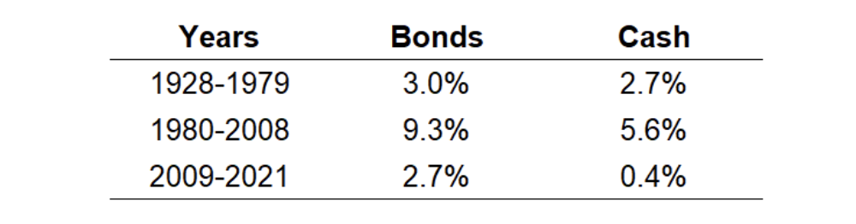
Reasonable Return Expectation
Historical Total Returns (nominal)
Period (start-of-year to end-of-2022) | Average annual S&P 500 return
5 years (2018-2022) | 7.51%
10 years (2013-2022) | 10.41%
20 years (2003-2022) | 7.64%
30 years (1993-2022) | 7.52%
A 50/50 stock/bond portfolio = 5.25% annual
A 75/25 stock/bond portfolio = 6.38% annual
Assumes stocks 7.5% annual return
Bonds 3% annual return
Bonds = 10 year Treasuries
Cash = 3 month T-bills

Slide 9
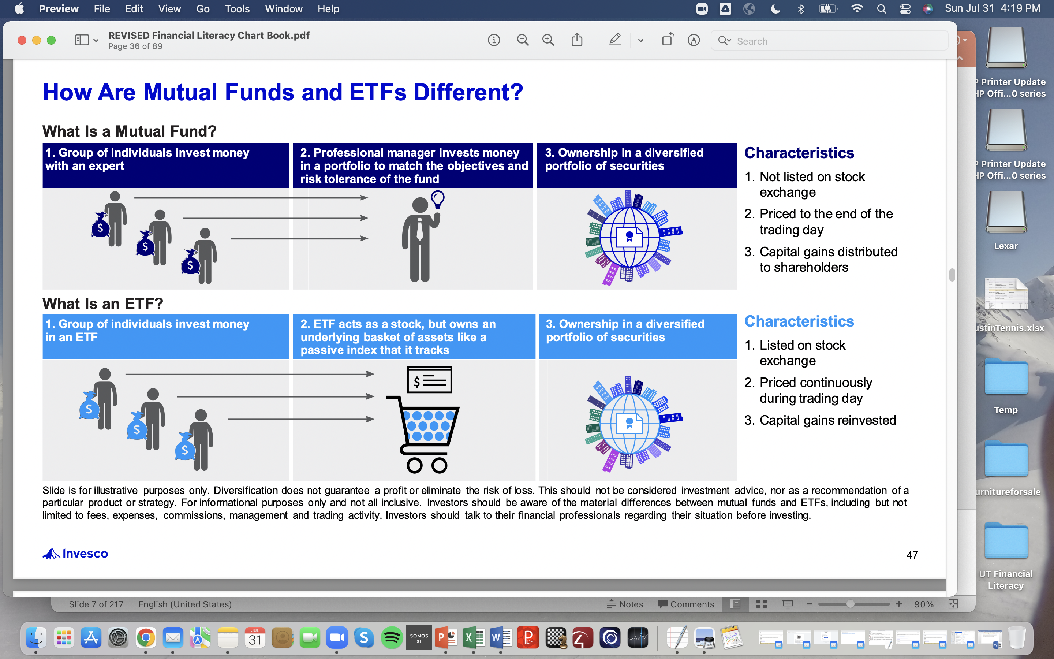

Slide 10
Some summary points
Saving is simply not spending
The first reason to save is so you can spend in the future
A second reason to save is to help achieve your long-term goals as part of your financial plan
A third reason is to be prepared for emergencies
A fourth reason is for the discipline
“Separate”
Social Security is financed through a dedicated payroll tax. Employers and employees each pay 6.2 percent of wages up to the taxable maximum of $147,000 (in 2022), while the self-employed pay 12.4 percent
Average worker puts 10% of income (including employer contributions) into workplace retirement plans.
Retirement savings takes between 10-12% of income, a good savings goal = 20%
Save 6 months worth of spending in an emergency fund
Different than cash account in investment portfolio

Slide 11
Post Retirement
Your Age | Year of Retirement | Begin Assets | Withdrawl Rate | Withdrawl $ | Annual Return | End Assets |  | Begin Assets | Withdrawl Flat | End Assets |  | Begin Assets | Withdrawl Inflation Adj | End Assets
67 | 1 | 1,953,425 | 0.04 | 78,137 | 0.03 | 1,931,547 |  | 1,953,425 | 78,137 | 1,931,547 |  | 1,953,425 | 78,137 | 1,931,547
68 | 2 | 1,931,547 | 0.04 | 77,262 | 0.03 | 1,909,913 |  | 1,931,547 | 78,137 | 1,909,012 |  | 1,931,547 | 79,700 | 1,907,402
69 | 3 | 1,909,913 | 0.04 | 76,397 | 0.03 | 1,888,522 |  | 1,909,012 | 78,137 | 1,885,801 |  | 1,907,402 | 81,294 | 1,880,892
70 | 4 | 1,888,522 | 0.04 | 75,541 | 0.03 | 1,867,371 |  | 1,885,801 | 78,137 | 1,861,894 |  | 1,880,892 | 82,920 | 1,851,911
71 | 5 | 1,867,371 | 0.04 | 74,695 | 0.03 | 1,846,456 |  | 1,861,894 | 78,137 | 1,837,270 |  | 1,851,911 | 84,578 | 1,820,353
72 | 6 | 1,846,456 | 0.04 | 73,858 | 0.03 | 1,825,776 |  | 1,837,270 | 78,137 | 1,811,907 |  | 1,820,353 | 86,270 | 1,786,106
73 | 7 | 1,825,776 | 0.04 | 73,031 | 0.03 | 1,805,327 |  | 1,811,907 | 78,137 | 1,785,783 |  | 1,786,106 | 87,995 | 1,749,055
74 | 8 | 1,805,327 | 0.04 | 72,213 | 0.03 | 1,785,108 |  | 1,785,783 | 78,137 | 1,758,875 |  | 1,749,055 | 89,755 | 1,709,079
75 | 9 | 1,785,108 | 0.04 | 71,404 | 0.03 | 1,765,114 |  | 1,758,875 | 78,137 | 1,731,160 |  | 1,709,079 | 91,550 | 1,666,055
76 | 10 | 1,765,114 | 0.04 | 70,605 | 0.03 | 1,745,345 |  | 1,731,160 | 78,137 | 1,702,614 |  | 1,666,055 | 93,381 | 1,619,854
77 | 11 | 1,745,345 | 0.04 | 69,814 | 0.03 | 1,725,797 |  | 1,702,614 | 78,137 | 1,673,211 |  | 1,619,854 | 95,249 | 1,570,344
78 | 12 | 1,725,797 | 0.04 | 69,032 | 0.03 | 1,706,468 |  | 1,673,211 | 78,137 | 1,642,927 |  | 1,570,344 | 97,154 | 1,517,386
79 | 13 | 1,706,468 | 0.04 | 68,259 | 0.03 | 1,687,356 |  | 1,642,927 | 78,137 | 1,611,733 |  | 1,517,386 | 99,097 | 1,460,838
80 | 14 | 1,687,356 | 0.04 | 67,494 | 0.03 | 1,668,458 |  | 1,611,733 | 78,137 | 1,579,604 |  | 1,460,838 | 101,079 | 1,400,552
81 | 15 | 1,668,458 | 0.04 | 66,738 | 0.03 | 1,649,771 |  | 1,579,604 | 78,137 | 1,546,511 |  | 1,400,552 | 103,100 | 1,336,376
82 | 16 | 1,649,771 | 0.04 | 65,991 | 0.03 | 1,631,293 |  | 1,546,511 | 78,137 | 1,512,425 |  | 1,336,376 | 105,162 | 1,268,150
83 | 17 | 1,631,293 | 0.04 | 65,252 | 0.03 | 1,613,023 |  | 1,512,425 | 78,137 | 1,477,317 |  | 1,268,150 | 107,265 | 1,195,711
84 | 18 | 1,613,023 | 0.04 | 64,521 | 0.03 | 1,594,957 |  | 1,477,317 | 78,137 | 1,441,156 |  | 1,195,711 | 109,411 | 1,118,889
85 | 19 | 1,594,957 | 0.04 | 63,798 | 0.03 | 1,577,093 |  | 1,441,156 | 78,137 | 1,403,909 |  | 1,118,889 | 111,599 | 1,037,509
86 | 20 | 1,577,093 | 0.04 | 63,084 | 0.03 | 1,559,430 |  | 1,403,909 | 78,137 | 1,365,545 |  | 1,037,509 | 113,831 | 951,389
87 | 21 | 1,559,430 | 0.04 | 62,377 | 0.03 | 1,541,964 |  | 1,365,545 | 78,137 | 1,326,031 |  | 951,389 | 116,107 | 860,340
88 | 22 | 1,541,964 | 0.04 | 61,679 | 0.03 | 1,524,694 |  | 1,326,031 | 78,137 | 1,285,330 |  | 860,340 | 118,430 | 764,167
89 | 23 | 1,524,694 | 0.04 | 60,988 | 0.03 | 1,507,618 |  | 1,285,330 | 78,137 | 1,243,409 |  | 764,167 | 120,798 | 662,670
90 | 24 | 1,507,618 | 0.04 | 60,305 | 0.03 | 1,490,733 |  | 1,243,409 | 78,137 | 1,200,230 |  | 662,670 | 123,214 | 555,640
91 | 25 | 1,490,733 | 0.04 | 59,629 | 0.03 | 1,474,036 |  | 1,200,230 | 78,137 | 1,155,756 |  | 555,640 | 125,678 | 442,860
Need to adjust withdrawls post retirement for inflation. Need to still make return post retirement.

Slide 12
What is a 401(k) plan?
The 401(k) plan is a workplace retirement plan. It allows workers to defer a certain portion of their wages into a retirement account, which they can then invest for the future. In return, workers get certain tax advantages both in the short term and the long term.
How a 401(k) works
When someone is hired by a company that offers a 401(k), they’re able to contribute a certain dollar amount or percentage of their wages to the account. In most cases, the funds they contribute are pre-tax, meaning they help to reduce their taxable income in the current year.
Once the funds have been deposited into the 401(k), the worker can choose from a menu of investment options offered by the plan. 401(k) investment options often include target-date funds and other types of investment funds.
Once the money has been contributed to the account and invested, it’s able to grow tax-deferred as long as it remains in the account. The worker won’t be subject to income or capital gains taxes as they would on earnings in a taxable brokerage account.
Finally, once the worker is ready to retire, they can withdraw money from their 401(k) plan. Because the contributions were made pre-tax, income taxes will be owed on the distributions.

Slide 13
401(k) Contribution limits
The IRS sets limits on the amount workers can contribute to their 401(k) plans. The 2023 contribution limit is $22,500.
It’s up to each worker how they choose to spread their contributions throughout the year. If allowed under the plan, some people may choose to frontload their contributions to give their investments more time to grow. However, it’s more common for people to contribute an equal amount each pay period, often as a percentage of their wages.
401(K) Partial match
One common type of employer match is a partial match. In this case, an employer might agree to match 50% of an employee’s contributions up to 6% of that employee’s wages. Someone who contributed at least 6% of their own wages to their 401(k) would receive an additional employer match of 3%.

