Slide 1

A Procedure for SyGuS Solution Fitting via Matching and Rewrite Rule Discovery
Abdalrhman Mohamed, Andrew Reynolds, Clark Barrett, Cesare Tinelli

Slide 2
Outline
Solution Fitting Problem
Existing approaches
Enumeration
Pattern Matching
Contribution
Combine both approaches
Rewrite Rule Discovery
Experimental Results
Future Work

Slide 3


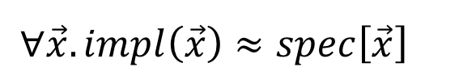


Solution Fitting Problem
Program Synthesizer
$$spec\left[\vec{x}\right]$$
$$impl$$
$$G$$
$$impl∈ℒ\left(G\right)$$
$$∀\vec{x}.impl\left(\vec{x}\right)≈spec\left[\vec{x}\right]$$
Circuit Synthesis
SQL queries
ISA Reduction

Slide 4
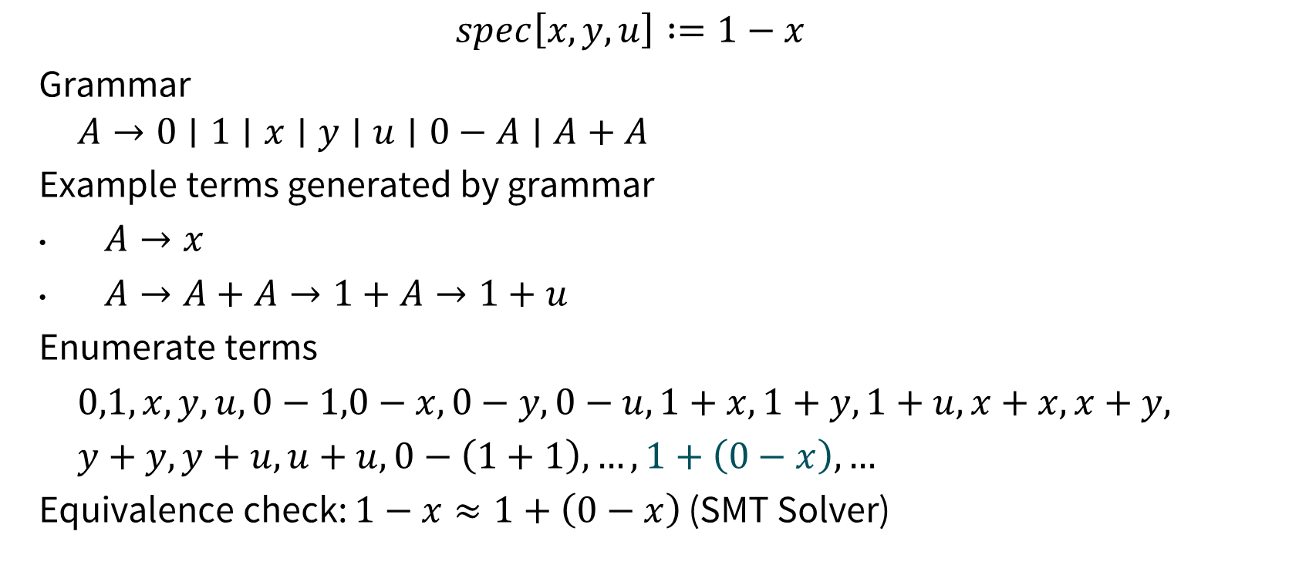
Grammar and Enumeration
$$spec\left[x,y,u\right] :=1−x$$
Grammar
$$A→0∣1∣x∣y∣u∣0−A∣A+A$$
Example terms generated by grammar
$A→x$
$A→A+A→1+A→1+u$
Enumerate terms
$0,1,x,y,u,0−1,0−x,0−y,0−u,1+x,1+y,1+u,x+x,x+y,$
$y+y,y+u,u+u,0−\left(1+1\right),…,1+\left(0−x\right),…$
Equivalence check: $1−x≈1+\left(0−x\right)$ (SMT Solver)
Notes:
5 + 5 + 25 + (5 + 25) + 25 + 5*25 + (5 + 25) + 3

Slide 5
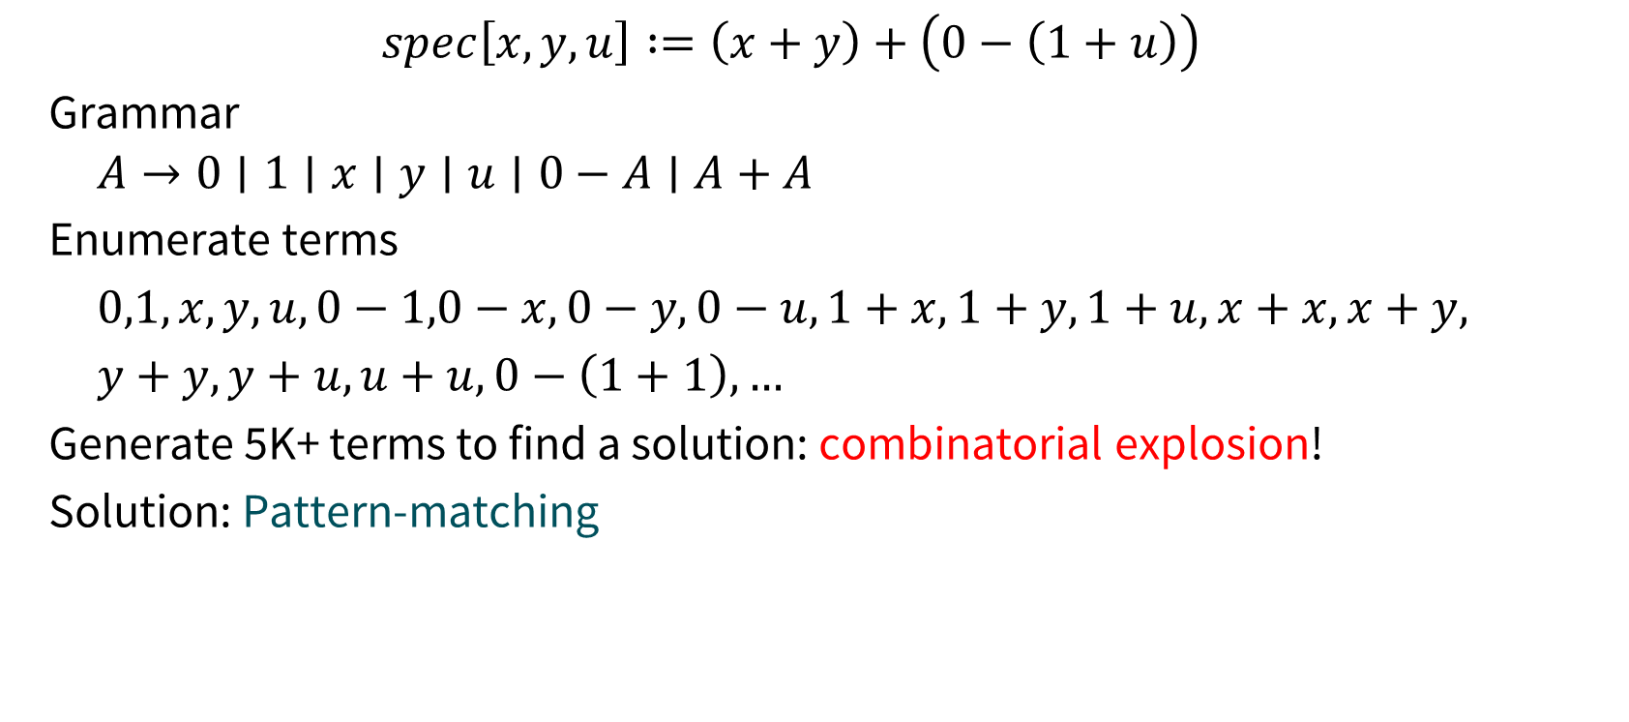
Enumeration Drawback
$$spec\left[x,y,u\right] :=\left(x+y\right)+\left(0−\left(1+u\right)\right)$$
Grammar
$$A→0∣1∣x∣y∣u∣0−A∣A+A$$
Enumerate terms
$0,1,x,y,u,0−1,0−x,0−y,0−u,1+x,1+y,1+u,x+x,x+y,$
$y+y,y+u,u+u,0−\left(1+1\right),…$
Generate 5K+ terms to find a solution: combinatorial explosion!
Solution: Pattern-matching
Notes:
Backus normal form (BNF) Grammar

Slide 6













Pattern Matching
$$A→0∣1∣x∣y∣u∣0−A∣A+A$$
$$−$$
$$+$$
$$A$$
$$0$$
$$1$$
$$x$$
$$y$$
$$u$$
$$0$$
$$A$$
$$A$$
$$A$$
$$\left(x+y\right)+\left(0−\left(1+u\right)\right)$$
$$+$$
$$+$$
$$+$$
$$+$$
$$A$$
$$+$$
$$+$$
$$+$$
$$+$$
$$A$$
$$−$$
$$−$$
$$A$$
$$A$$
$$+$$
$$−$$
$$x$$
$$x$$
$$x$$
$$y$$
$$y$$
$$y$$
$$0$$
$$0$$
$$+$$
$$A$$
$$x$$
$$y$$
$$0$$
$$+$$
$$1$$
$$u$$
$$1$$
$$u$$

Slide 7
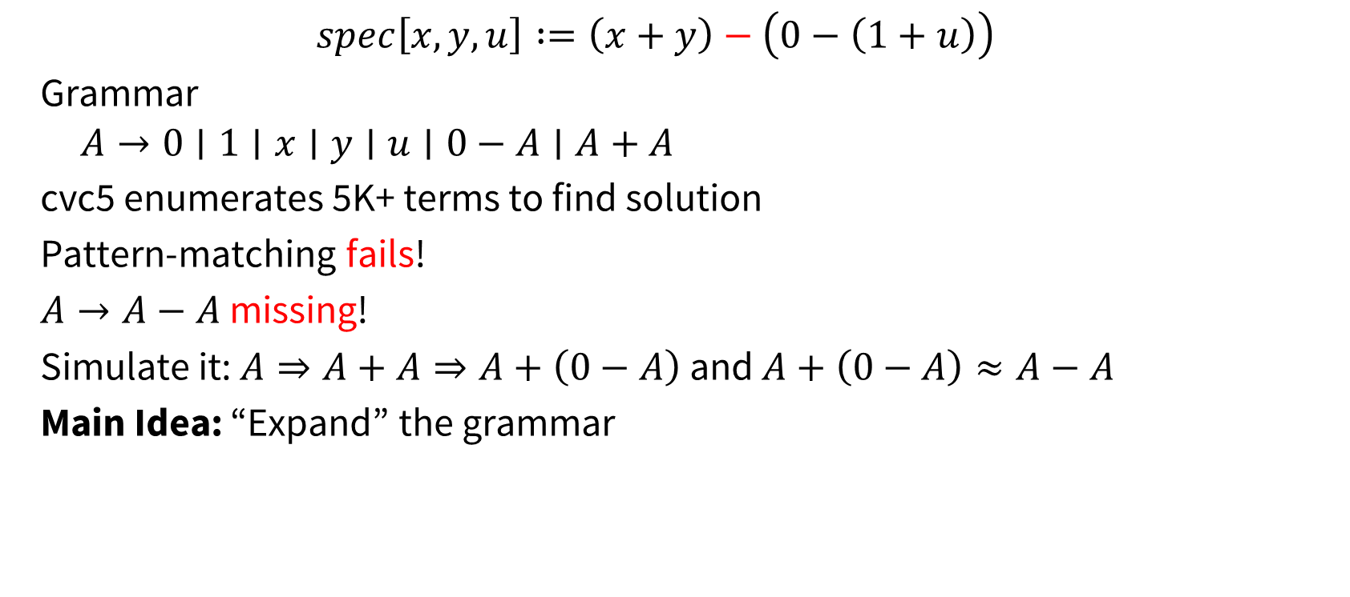
Pattern Matching Drawback
$$spec\left[x,y,u\right] :=\left(x+y\right)−\left(0−\left(1+u\right)\right)$$
Grammar
$$A→0∣1∣x∣y∣u∣0−A∣A+A$$
cvc5 enumerates 5K+ terms to find solution
Pattern-matching fails!
$A→A−A$ missing!
Simulate it: $A⇒A+A⇒A+\left(0−A\right)$ and $A+\left(0−A\right)≈A−A$
Main Idea: “Expand” the grammar
Notes:
Backus normal form (BNF) Grammar

Slide 8


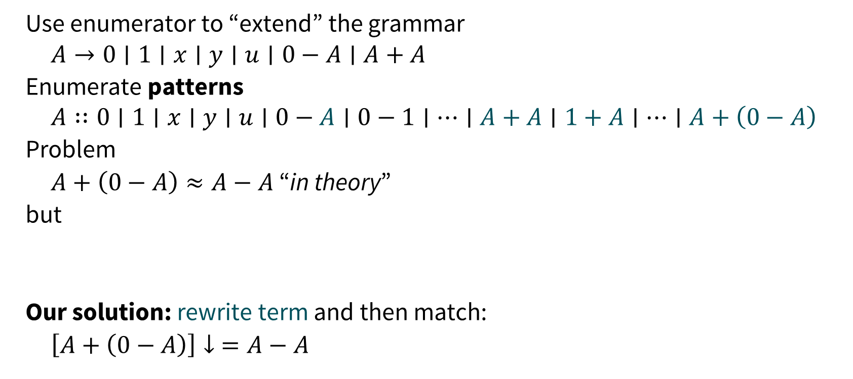




Expanding Grammar
Use enumerator to “extend” the grammar
$$A→0∣1∣x∣y∣u∣0−A∣A+A$$
Enumerate patterns
$$A∷0∣1∣x∣y∣u∣0−A∣0−1∣⋯∣A+A∣1+A∣…∣A+\left(0−A\right)$$
Problem
$A+\left(0−A\right)≈A−A$ “in theory”
but
Our solution: rewrite term and then match:
$\left[A+\left(0−A\right)\right]↓ =A−A$
$$+$$
$$−$$
$$A$$
$$−$$
$$A$$
$$A$$
$$0$$
$$A$$

Slide 9
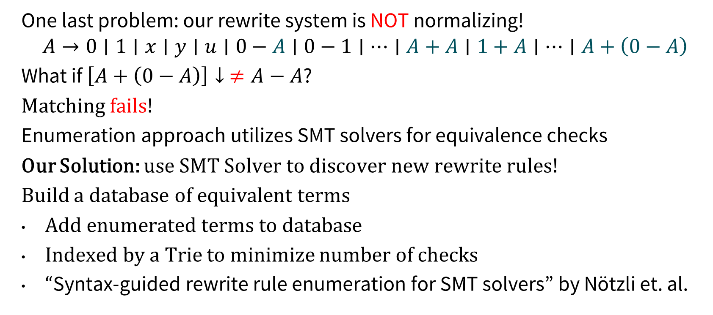
Rewrite Rule Discovery
One last problem: our rewrite system is NOT normalizing!
$$A→0∣1∣x∣y∣u∣0−A∣0−1∣⋯∣A+A∣1+A∣…∣A+\left(0−A\right)$$
What if $\left[A+\left(0−A\right)\right]↓ ≠A−A$?
Matching fails!
Enumeration approach utilizes SMT solvers for equivalence checks
Our Solution: use SMT Solver to discover new rewrite rules!
Build a database of equivalent terms
Add enumerated terms to database
Indexed by a Trie to minimize number of checks
“Syntax-guided rewrite rule enumeration for SMT solvers” by Nötzli et. al.

Slide 10
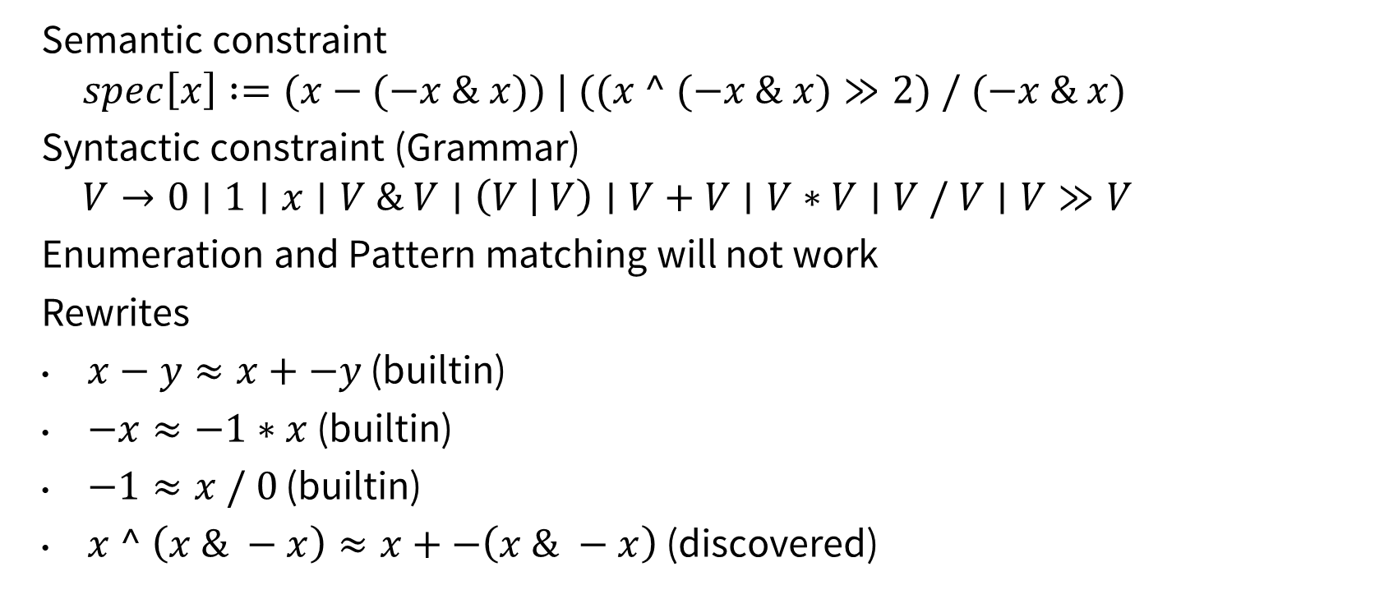
Application: Bitvector Circuit
Semantic constraint
$$spec\left[x\right] :=(x−(−x \& x)) | ((x ^ (−x \& x)≫2) / (−x \& x)$$
Syntactic constraint (Grammar)
$$V→0∣1∣x∣V \& V∣\left(V | V\right)∣V+V∣V∗V∣V / V∣V≫V$$
Enumeration and Pattern matching will not work
Rewrites
$x−y≈x+−y$ (builtin)
$−x≈−1∗x$ (builtin)
$−1≈x / 0$ (builtin)
$x ^ \left(x \& −x\right)≈x+−\left(x \& −x\right)$ (discovered)

Slide 11
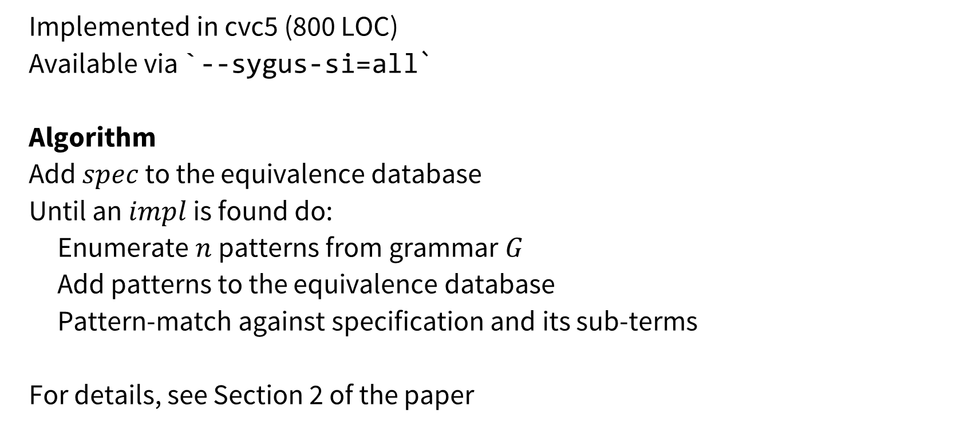
Reconstruction Procedure
Implemented in cvc5 (800 LOC)
Available via `--sygus-si=all`
Algorithm
Add $spec$ to the equivalence database
Until an $impl$ is found do:
Enumerate $n$ patterns from grammar $G$
Add patterns to the equivalence database
Pattern-match against specification and its sub-terms
For details, see Section 2 of the paper

Slide 12
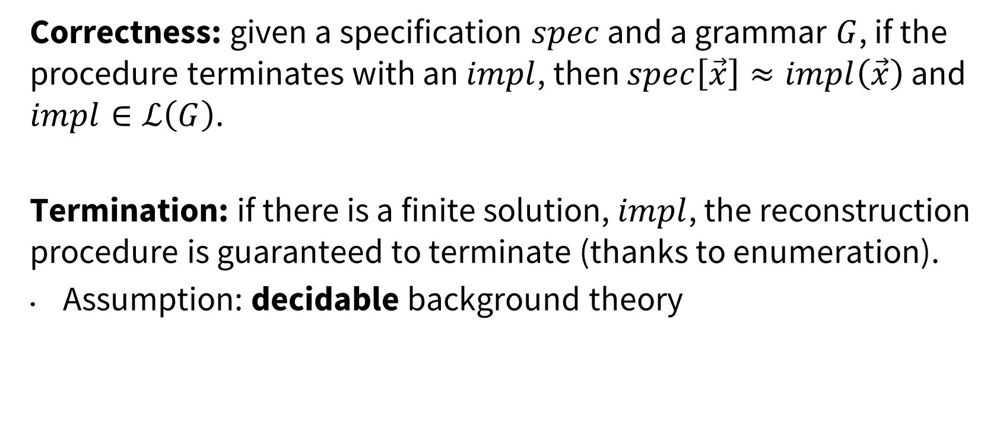
Reconstruction Procedure: Guarantees
Correctness: given a specification $spec$ and a grammar $G$, if the procedure terminates with an $impl$, then $spec\left[\vec{x}\right]≈impl\left(\vec{x}\right)$ and $impl∈ℒ\left(G\right)$.
Termination: if there is a finite solution, $impl$, the reconstruction procedure is guaranteed to terminate (thanks to enumeration).
Assumption: decidable background theory

Slide 13
Experimental results: Crafted Benchmarks
Benchmark generation steps
Wrote large grammars for BV, NIA, and SLIA
Generated random specs from large grammars
Generated random grammars from large grammars
Ran Experiments on StarExec with 30 mins timeout
Solver\Fragment | BV (1000) | NIA (1000) | SLIA (1000) | Total (3000)
cvc5-match (parser) | 17 | 6 | 6 | 29
cvc4-enum | 518 | 90 | 248 | 856
cvc4-rcons (old) | 427 | 113 | 66 | 606
cvc5-enum | 529 | 227 | 303 | 1059
cvc5-rcons (new) | 944 | 823 | 595 | 2362
EUSolver | 498 | 243 | 405 | 1146

Slide 14
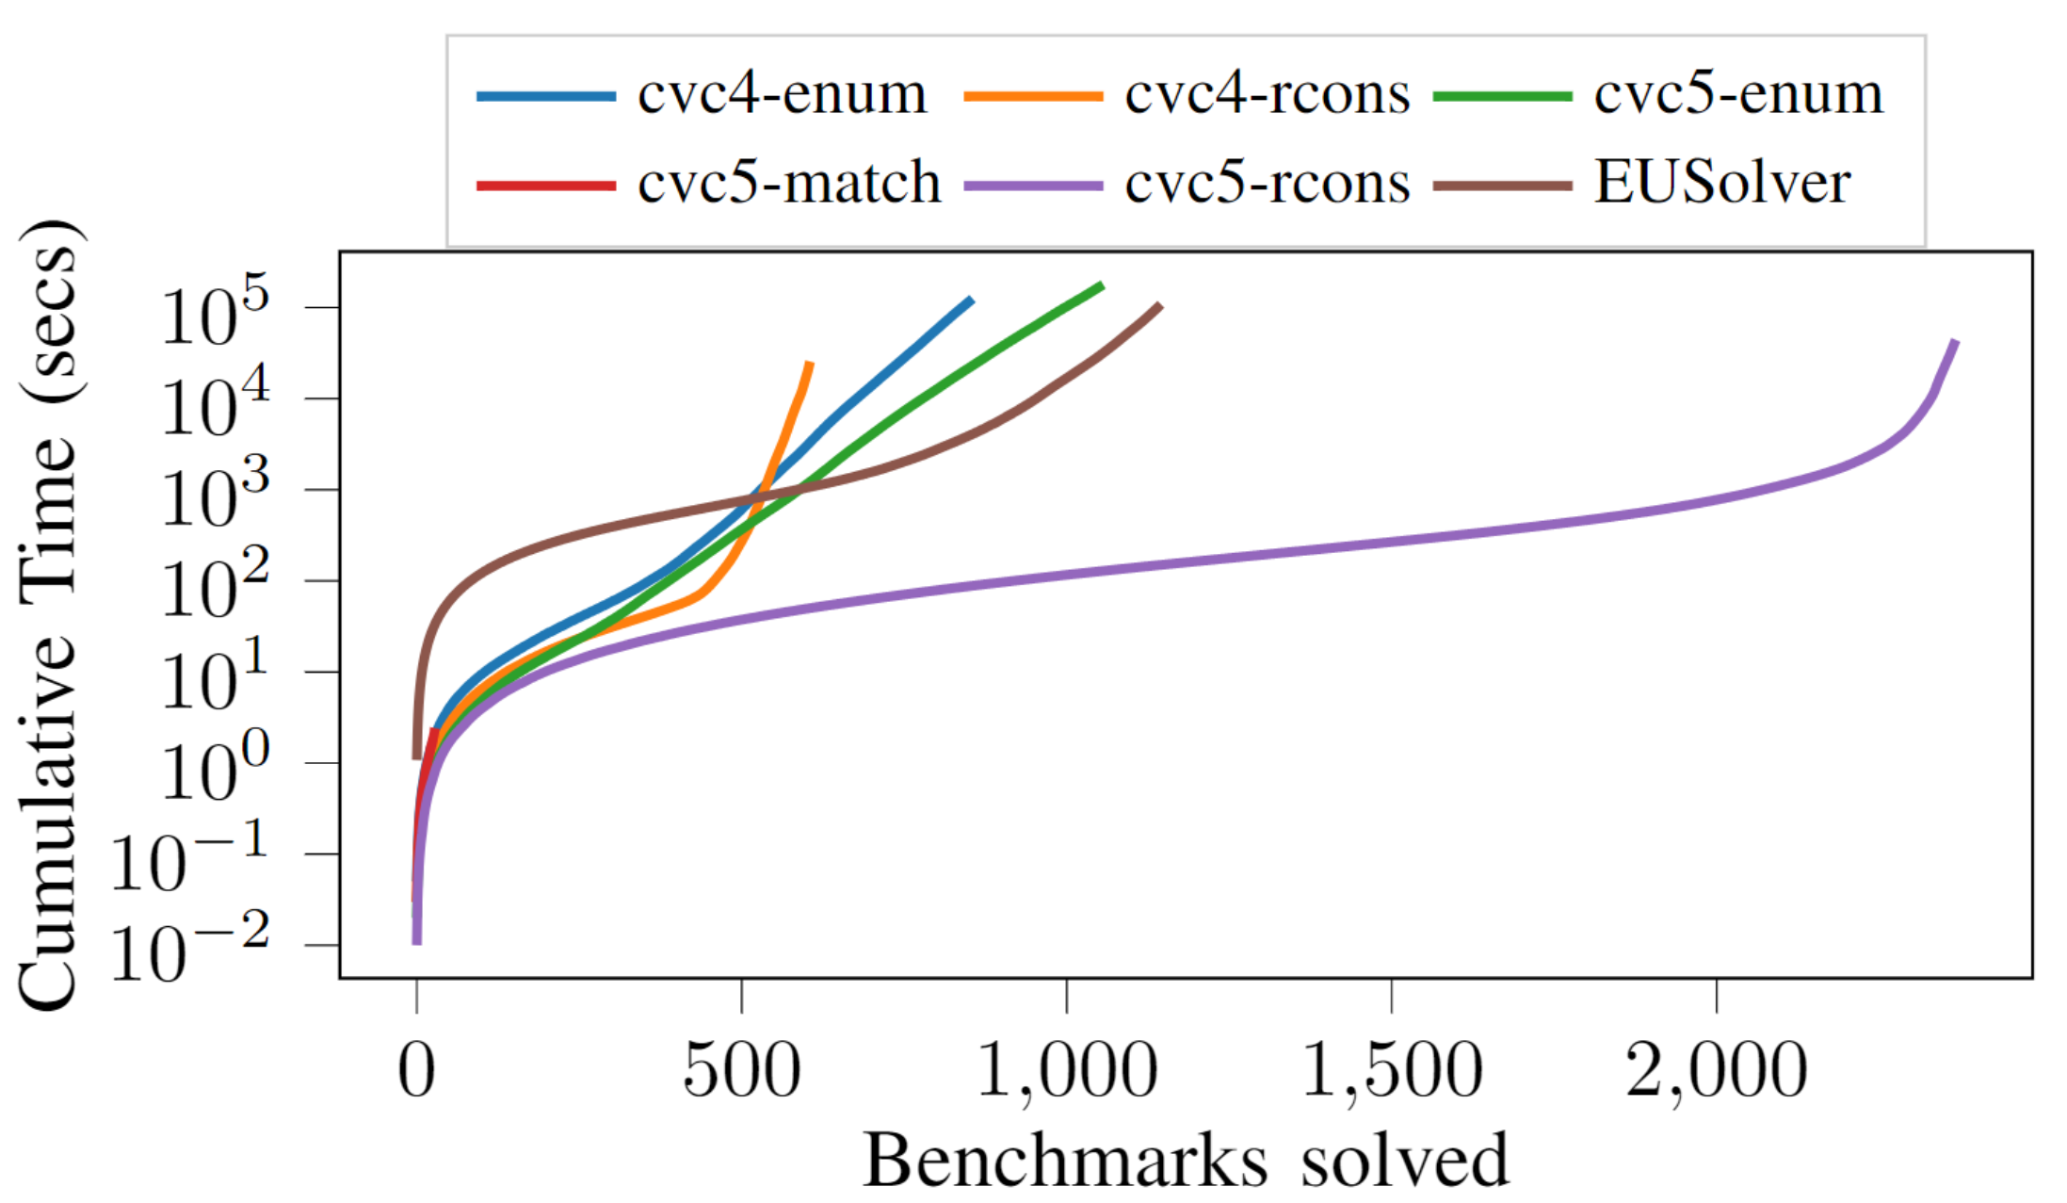
Cactus Plot: Crafted Benchmarks (all theories)

Slide 15
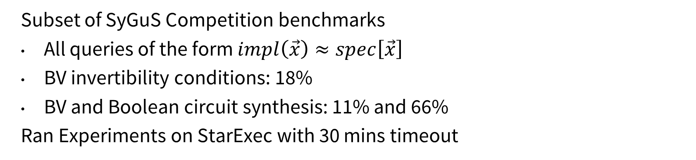
Experimental Results: SyGuS Competition Benchmarks
Subset of SyGuS Competition benchmarks
All queries of the form $impl\left(\vec{x}\right)≈spec\left[\vec{x}\right]$
BV invertibility conditions: 18%
BV and Boolean circuit synthesis: 11% and 66%
Ran Experiments on StarExec with 30 mins timeout
Solver\Fragment | General (822)
cvc5-match (parser) | 82
cvc4-enum | 438
cvc4-rcons (old) | 205
cvc5-enum | 672
cvc5-rcons (new) | 721
EUSolver | 640

Slide 16
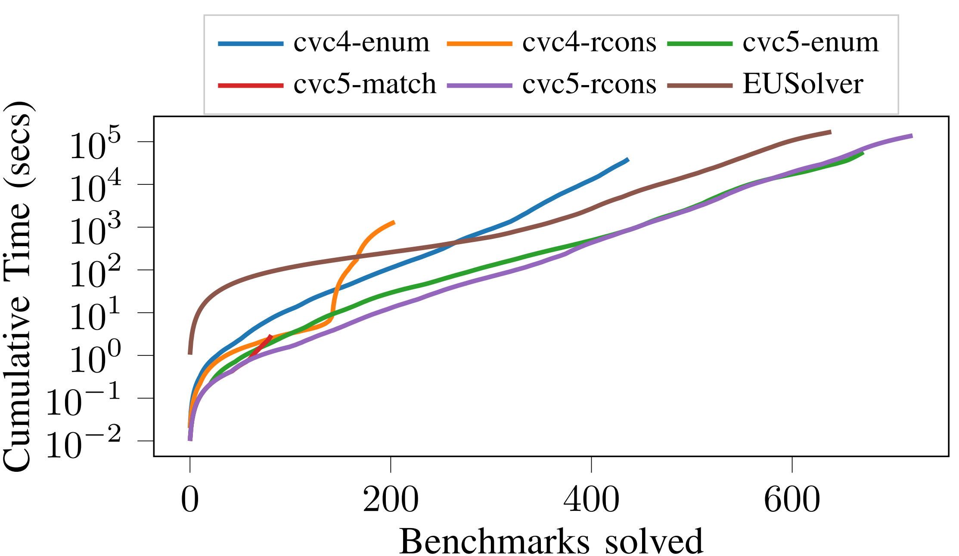
Cactus Plot: SyGuS Competition Benchmarks

Slide 17
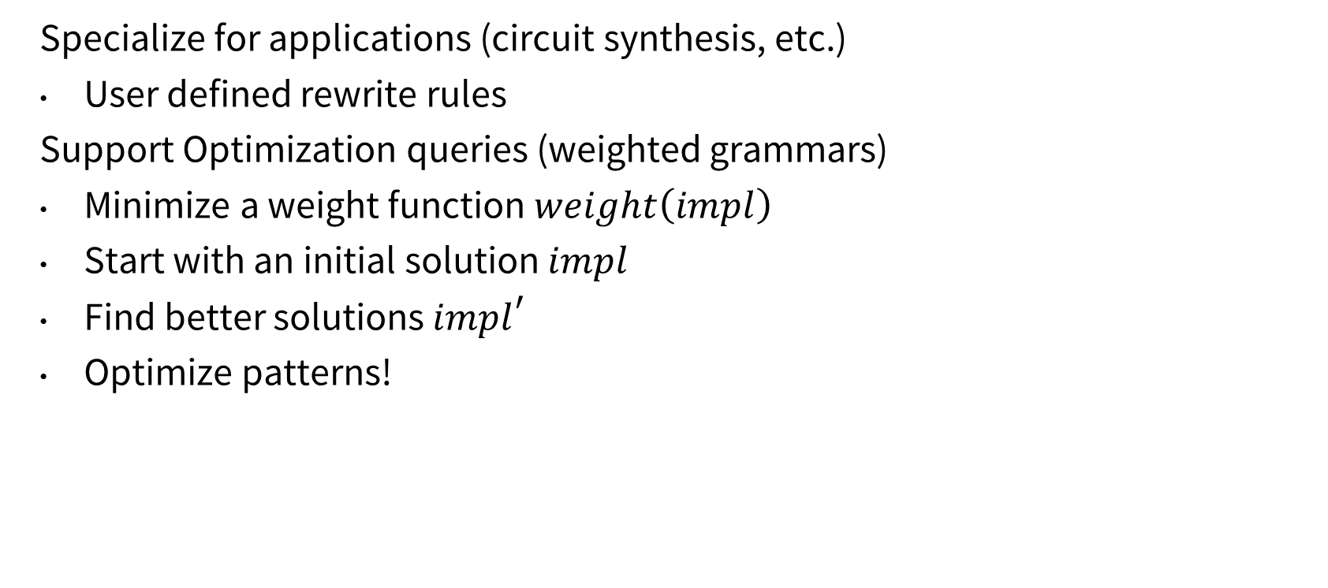
Future Directions
Specialize for applications (circuit synthesis, etc.)
User defined rewrite rules
Support Optimization queries (weighted grammars)
Minimize a weight function $weight\left(impl\right)$
Start with an initial solution $impl$
Find better solutions ${impl}^{′}$
Optimize patterns!

Slide 18
Thank you! Questions?

