Slide 1
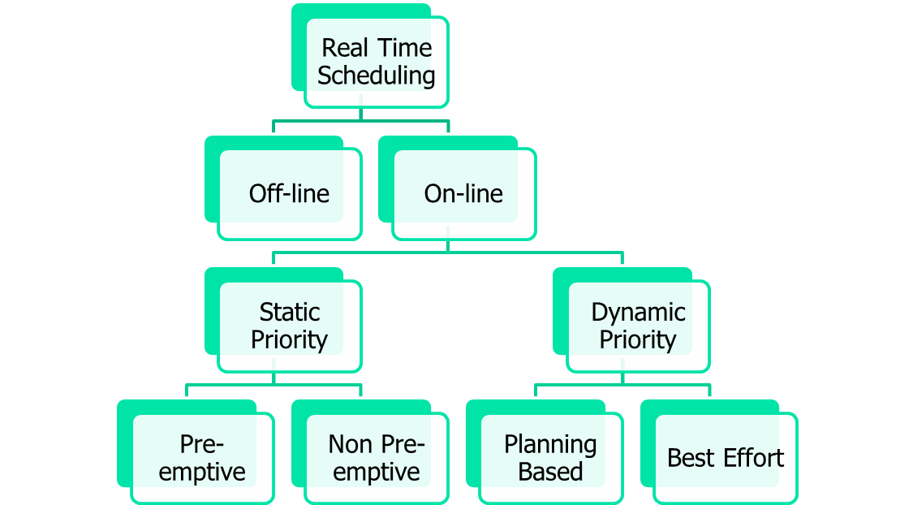
RTOS Scheduling Classification

Slide 2
Real time Scheduling
Number and types of tasks, associated parameters are not known in advance.
Scheduling must accommodate dynamic changes
Online Scheduling are of two types:
  Static Priority
  Dynamic Priority

Slide 3
Real-Time Scheduling
Real-time tasks are executed repeatedly (usually are periodic) under some time constraint
Task
Task
Task
Time
0ms
5ms
10ms
E.g., a task is released to execute every 5 msec, and each invocation has a deadline of 5 msec

Slide 4
Simple Process Model
The application is assumed to consist of a fixed set of processes
All processes are periodic, with known periods
The processes are completely independent of each other
All system's overheads, context-switching times and so on are ignored (i.e, assumed to have zero cost)
All processes have a deadline equal to their period (that is, each process must complete before it is next released)
All processes have a fixed worst-case execution time

Slide 5
Modern Hardware Features
Modern processors increase performance by using:
Caches, Pipelines, Branch Prediction
These features make WCET computation difficult:
Execution times of instructions vary widely
  Best case - everything goes smoothly: no cache miss, operands ready, needed resources free, branch correctly predicted
  Worst case - everything goes wrong: all loads miss the cache, resources needed are occupied, operands are not ready
  Span may be several hundred cycles

Slide 6
Timing Accidents and Penalties
Timing Accident – cause for an increase of the execution time of an instruction
Timing Penalty – the associated increase
Types of timing accidents
  Cache misses
  Pipeline stalls
  Branch mis-predictions
  Bus collisions
  Memory refresh of DRAM

Slide 7
Worst-Case Execution Time - WCET
Obtained by either measurement or analysis
The problem with measurement is that it is difficult to be sure when the worst case has been observed
The drawback of analysis is that an effective model of the processor (including caches, pipelines, memory wait states and so on) must be available

Slide 8
Need for Semantic Information
for I in 1.. 10 loop
if Cond then
-- basic block of cost 100
else
-- basic block of cost 10
end if;
end loop;
Simple cost 10*100 (+overhead), say 1005.
But if Cond only true on 3 occasions then cost is 375

Slide 9
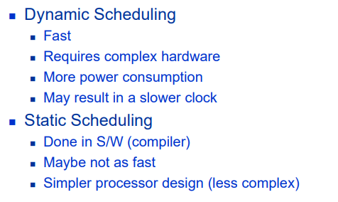
Static vs. Dynamic Scheduling

Slide 10
Real-time scheduling classes
First-in, First-out scheduling
Round robin scheduling
Preemptive fixed priority scheduling
Most frequent first
Earliest deadline first
Notes:
Lists the main categories of scheduling algorithms used in real-time systems:
First-In, First-Out (FIFO) – Tasks are executed in the order they arrive.
Round Robin – Tasks take turns, each getting a short time slice.
Preemptive Fixed Priority – Higher-priority tasks can interrupt lower-priority ones.
Most Frequent First – Tasks that occur more often get higher priority.
Earliest Deadline First (EDF) – The task whose deadline is soonest gets highest priority.

Slide 11
Preemption and Non-preemption
With priority-based scheduling, a high-priority process may be released during the execution of a lower priority one
In a preemptive scheme, there will be an immediate switch to the higher-priority process
With non-preemption, the lower-priority process will be allowed to complete before the other executes
Preemptive schemes enable higher-priority processes to be more reactive, and hence they are preferred
Alternative strategies allow a lower priority process to continue to execute for a bounded time
These schemes are known as deferred preemption or cooperative dispatching
Schemes such as EDF can also take on a pre-emptive or non pre-emptive form
Notes:
🧠 Preemptive Scheduling
If a higher-priority task becomes ready while a lower-priority one is running,
👉 the CPU immediately switches to the higher-priority task.
The lower-priority task is paused (preempted) and will resume later.
This makes the system more responsive to important tasks.
✅ Example:
If a sensor interrupt arrives while a background task is running → the CPU instantly handles the sensor.
⚙️ Non-Preemptive Scheduling
The current task finishes first, even if a higher-priority one becomes ready.
The high-priority task must wait until the current one ends.
✅ Example:
A print task continues until it’s done, even if a critical update task arrives.
⚖️ Deferred Preemption (Cooperative Scheduling)
A mix of both: the low-priority task can continue for a short, bounded time before switching.
Used to reduce frequent task switching.
🟢 In short:
Preemptive: stop now → run high-priority task immediately.
Non-preemptive: finish current → then run high-priority task.
Deferred: switch after a small delay.

Slide 12
FIFO Scheduling
First-in, First-out scheduling
The first enqueued task of highest priority executes to completion
A task will only relinquish a processor when it is completed, yielded, or blocked
Task 1
Task 2
Task 3
Time

Slide 13
Round Robin Scheduling
Among tasks of equal priority:
Rotate through all tasks
Each task gets a fixed time slice
Task 1
Task 2
Task 3
Task 1
Task 2
Task 3
Task 1
Task 2
Task 3
Time

Slide 14
Preemptive Fixed Priority Scheduling
High Priority Task
Time
Low Priority Task

Slide 15
Preemptive Fixed Priority Scheduling
High Priority Task
Time
Low Priority Task

Slide 16
Preemptive Fixed Priority Scheduling
High & low priority jobs arrived together
High & low priority jobs arrived together
High Priority Task
Time
Low Priority Task

Slide 17
Preemptive Fixed Priority Scheduling
High priority job is executed first
High Priority Task
Time
Low Priority Task

Slide 18
Preemptive Fixed Priority Scheduling
High Priority Task
Low priority job is executed later
Time
Low Priority Task

Slide 19
Preemptive Fixed Priority Scheduling
High Priority Task
High priority job arrived
Time
Low Priority Task

Slide 20
Preemptive Fixed Priority Scheduling
High Priority Task
Preempts low priority job
Time
Low Priority Task

Slide 21
Preemptive Fixed Priority Scheduling
High Priority Task
Lower priority job resumes later
Time
Low Priority Task

Slide 22
Preemptive Fixed Priority Scheduling
High Priority Task
Time
Low Priority Task

Slide 23
Preemptive Fixed Priority Scheduling
High Priority Task
Time
Low Priority Task

Slide 24
Real-Time Scheduling
Determines the order of real time task executions
Dynamic
  Dynamic schedule is computed at run-time based on tasks really executing, priorities are computed on the fly
  Earliest Deadline First, EDF, Scheduling
  Least Slack Time ,LST, Scheduling
  Static
Static schedule is done at compile time for all possible tasks, priorities are already known
  Rate Monotonic, RM, Scheduling
  Deadline Monotonic, DM, Scheduling
Notes:
⚡ Dynamic Scheduling
The schedule is decided while the system is running (at run-time).
Priorities are computed on the fly, depending on the current situation.
Examples:
Earliest Deadline First (EDF) → task with the closest deadline gets the highest priority.
Least Slack Time (LST) → task with least remaining time before missing its deadline runs first.
🟢 In short:
Dynamic scheduling = priorities change during execution based on what’s happening right now.
🧩 Static Scheduling
The schedule is predefined (done before running the system, at compile time).
Priorities are fixed and known in advance.
Examples:
Rate Monotonic (RM) → shorter period → higher priority.
Deadline Monotonic (DM) → shorter deadline → higher priority.
🟢 In short:
Static scheduling = priorities are decided once and stay the same during execution.

Slide 25
Real-Time Scheduling
Under static-priority scheduling, different jobs of the same task are assigned the same priority.
Under dynamic-priority scheduling, different jobs of the same task may be assigned different priorities.

Slide 26
Optimal Scheduling Algorithms
Rate Monotonic (RM)
  The higher the rate (the shorter the period) is the higher priority.
  Optimal preemptive static priority scheduling algorithm
Earliest Deadline First (EDF)
  The earlier absolute deadline is the higher priority
  Optimal preemptive dynamic priority scheduling algorithm

Slide 27

Rate Monotonic, RM
Each process is assigned a (unique) priority based on its period; the shorter the period, the higher the priority
I.e, for two processes i and j,
This assignment is optimal in the sense that if any process set can be scheduled (using pre-emptive priority-based scheduling) with a fixed-priority assignment scheme, then the given process set can also be scheduled with a rate monotonic assignment scheme
Note, priority 1 is the lowest (least) priority

Slide 28
Rate Monotonic, RM
Simplest type of real time scheduling
  - Tasks are periodic, with hard deadlines
  - Tasks are completely independent and do not communicate with each other
  - Tasks are scheduled according to priority and task priorities are fixed
  - Computation time is known and constant

Slide 29
Rate Monotonic
Higher priorities usually assigned to tasks with smaller periods
If t(h) < t(l), then PR(h) > PR(l), where t indicated period and PR indicates the priority. This is called rate monotonic priority assignment.

Slide 30
Example Priority Assignment
Process Period, T Priority, P
a 25 5
b 60 3
c 42 4
d 105 1
e 75 2
5 is the highest priority
1 is the lowest priority

Slide 31

Rate Montonic Scheduling
A priority is assigned based on the inverse of its period
Shorter periods = higher priority
Longer periods = lower priority
P1(20,50,50) and P2(40, 100, 100)
P₁ is assigned a higher priority than P₂.

Slide 32

Missed Deadlines with Rate Monotonic Scheduling
P1(25,50,50) and P2(40, 80, 80)

Slide 33
Task Set A
Task Period ComputationTime Priority
T C P
a 50 12 1
b 40 10 2
c 30 10 3

Slide 34
Time-line for task Set A
task
a
Task Release Time
Task Completion Time
Deadline Met
b
Task Completion Time
Deadline Missed
Preempted
c
Executing
0
10
20
30
40
50
60
Time

Slide 35
Gantt Chart for Task Set A
c
b
a
c
b
0
10
20
30
40
50
Time

Slide 36
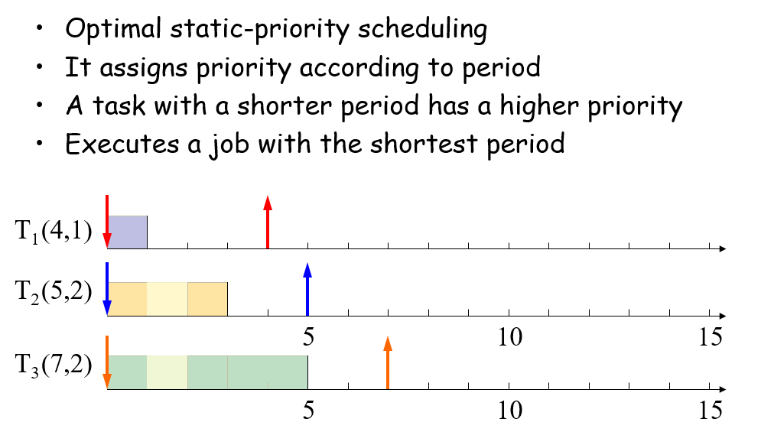
RM Example

Slide 37
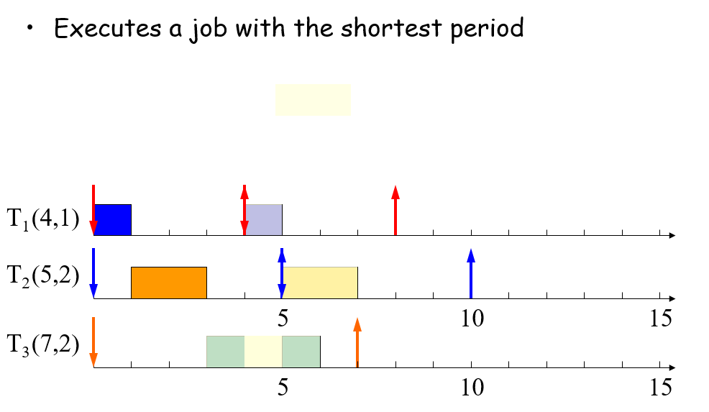
RM Example

Slide 38
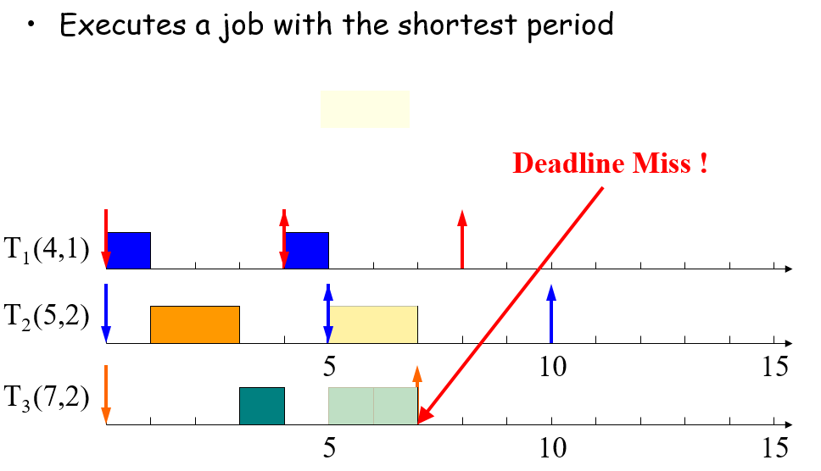
RM Example

Slide 39
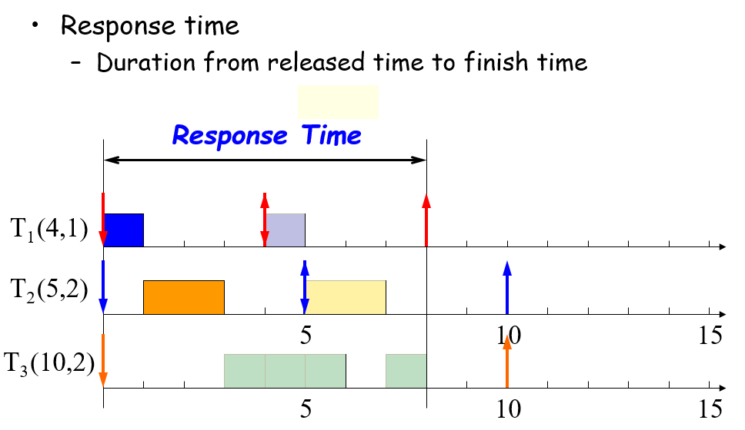
Response Time

Slide 40
Deadline Monotonic
Tasks with shorter deadlines get higher priority.
Static Scheduling.
If D(h) < D(l), then PR(h) > PR(l), where D indicates the deadline. This is called Deadline Monotonic priority assignment.

Slide 41
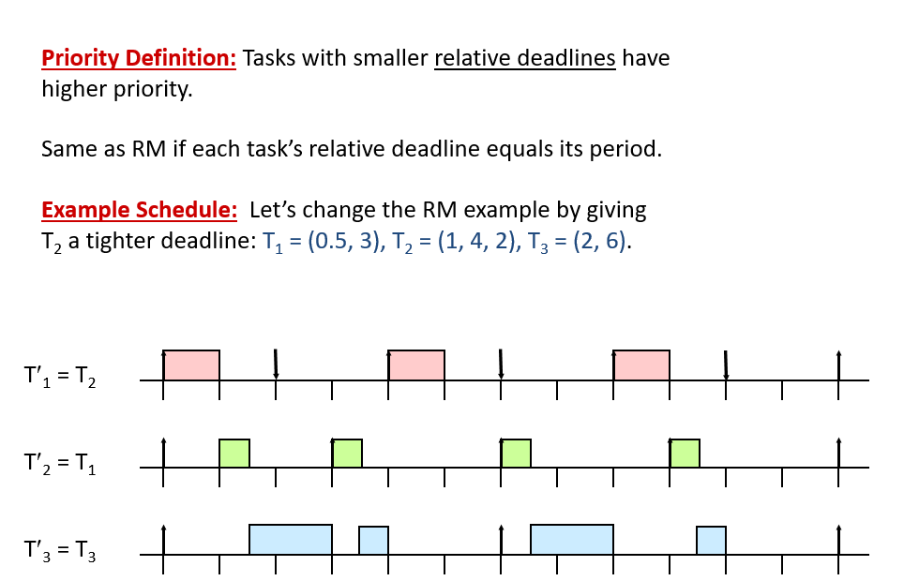
Deadline Monotonic

Slide 42
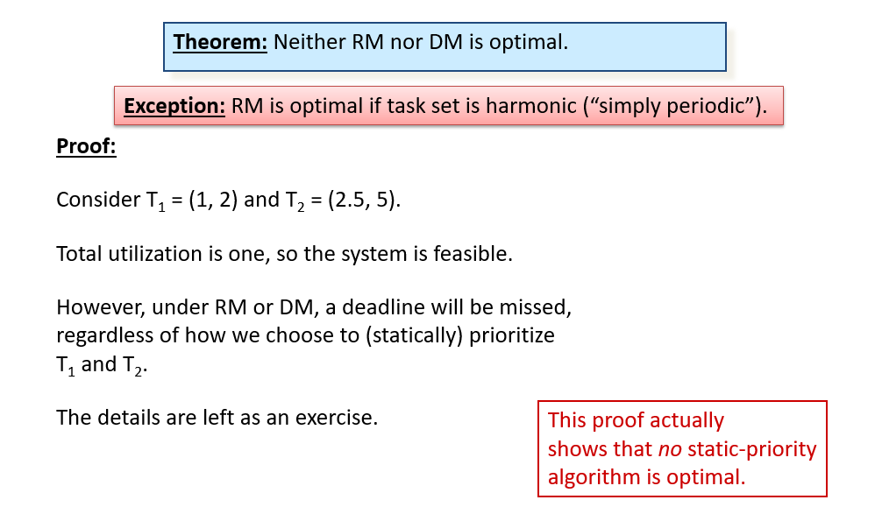
Optimality (or not) of RM and DM

