Slide 1
Game
Hussein Alrubaye

Slide 2
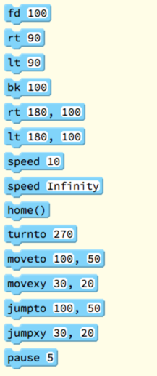
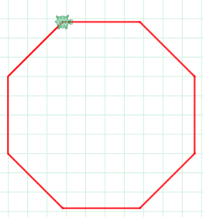
Tortoise moves

Slide 3
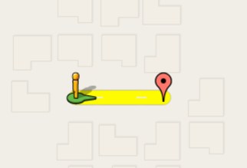
Task 1 : Simple moves
speed 2
pen red
rt 90
fd 100

Slide 4
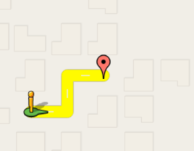
Task (TODO) : Simple moves
//TODO

Slide 5
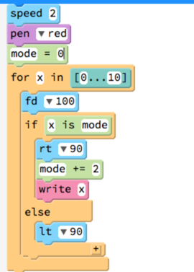
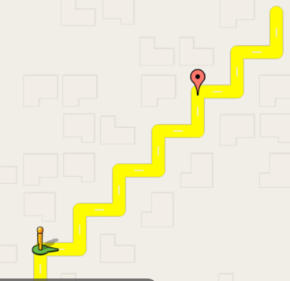
Task 1 : moves need loop control

Slide 6
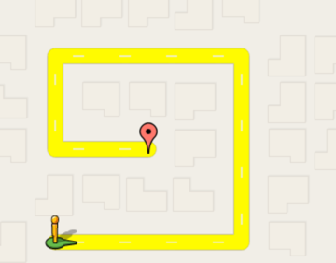
Task (TODO) : move Tortoise on the route

