Slide 1
UDEMY
COURSES
​

Slide 2
AGENDA
Description
Preprocessing
Visualization &Observations
ML Model to classify the subject of the course
Models

Slide 3
DESCRIPTION
This dataset contains 3.682 records of courses from 4 subjects (Business Finance, Graphic Design, Musical Instruments, and Web Design) taken from Udemy. Udemy is a massive online open course (MOOC) platform that offers both free and paid courses. Anybody can create a course, a business model which allowed Udemy to have hundreds of thousands of courses. This version modifies column names, removes empty columns, and aggregates everything into a single CSV file for ease of use.

Slide 4
Column Name | Description
Course ID | Each course has to have a unique ID
Course Title | It provides audiences with a snapshot of what a course is about
URL | Web pages have unique addresses to help people locate them these addresses are called URLs
Is_Paid | It shows whether the course is free or paid
Price | It shows the course’s price
Num_Subscribers | It reflects how many viewers have subscribed the course
Num_Reviews | The number of ratings shown for the best display of information
Num_Lectures | Number of lectures in the course
Level | It shows the degree of difficulty or complexity of the content of a course
Content Duration | The length of the course based on the standard delivery structure for the course
Subject | One unit of study which you enrol in as a part of your course

Slide 5
preprocessing

Slide 6
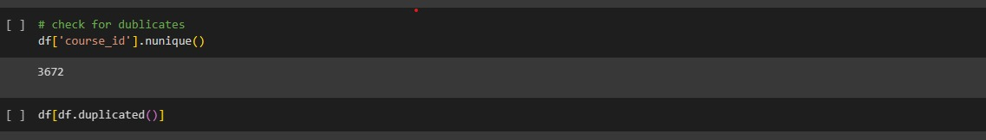
The first line of code returns the number of unique values in the 'course_id' column of the data frame 'df'. This is useful for understanding how many different courses are represented in the dataset.
The second line of code returns a subset of the data frame 'df' containing only rows that are duplicates. This is useful for identifying and removing any duplicate data points in the dataset.

Slide 7
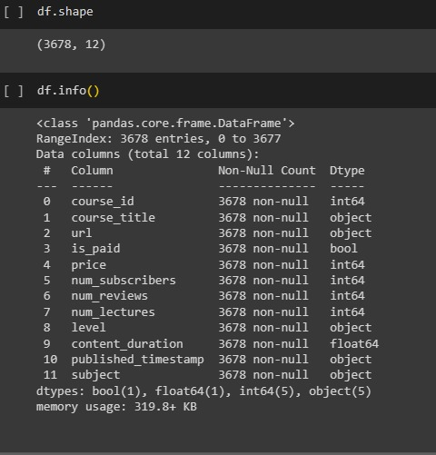
These two methods are important for getting information about the data set, it helps us to understand the structure of the dataset.
The shape method returns the number of rows and columns in the dataset
the info method provides information about the data types of each column and whether there are any missing values.
It’s important for identifying any potential issues that need to be addressed before further analysis.

Slide 8
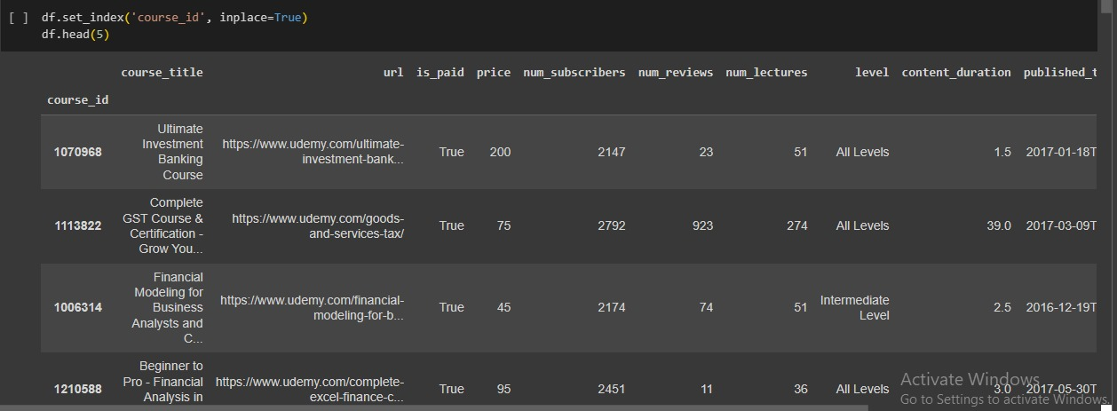
This preprocessing step is useful for organizing and accessing data based on a specific column, which is the course id.
It can also improve the performance of certain operations that involve searching or grouping by this column.

Slide 9
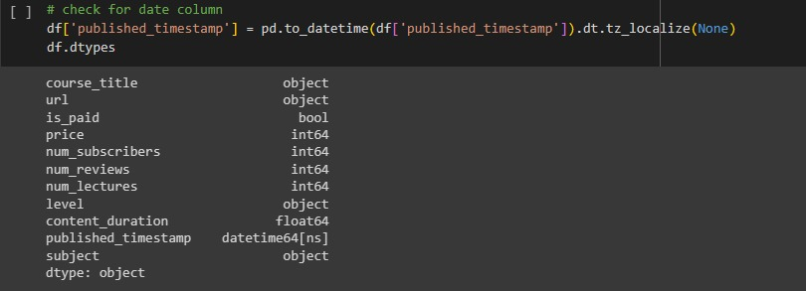
This preprocessing step converts the 'published_timestamp' column in the data frame to a DateTime format and removes any timezone information and then assigns the new datetime values back to the 'published_timestamp’ column.

Slide 10
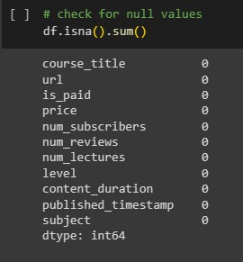
This is used to check the number of missing values in each column of the data frame. This preprocessing step is important as missing values can affect the accuracy of the analysis and predictions made using the data. By identifying the columns with missing values, appropriate measures can be taken to remove those missing values before further analysis.

Slide 11
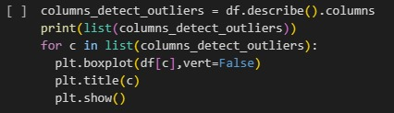
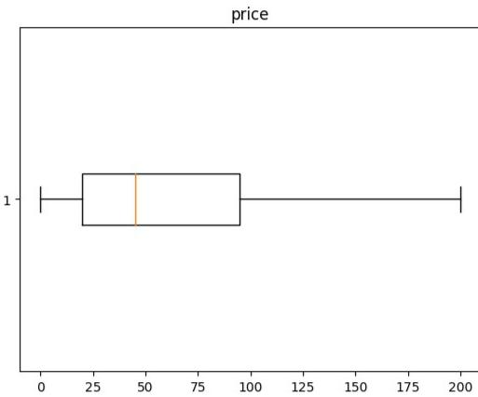
This preprocessing part is aimed to detect outliers in the dataset. It first identifies the columns to be analyzed using the describe() function and then creates boxplots for each column to visually identify any outliers. This step is important as outliers can affect the accuracy of statistical models and should be addressed before proceeding with further analysis.
This boxplot shows the outliers

Slide 12
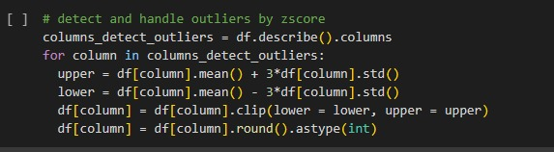
This is another way to detect outliers in the numerical columns of the dataframe by calculating the upper and lower bounds using mean and standard deviation, and then clipping the values outside these bounds. Finally, it rounds off the values to integers. This step helps in removing extreme values that may skew the analysis or modeling results.

Slide 13
Visualization & observations

Slide 14
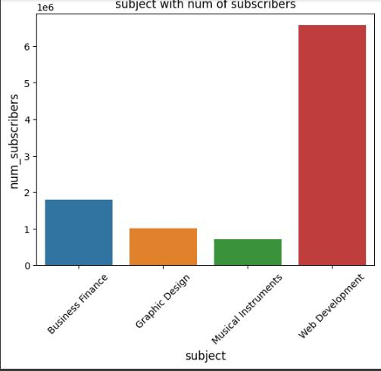
This is a bar chart between the number of subscribers and subjects.
Observation: The bar chart shows that the web development subject has the highest number of subscribers compared to other subjects, while musical instruments have the least number of subscribers.

Slide 15
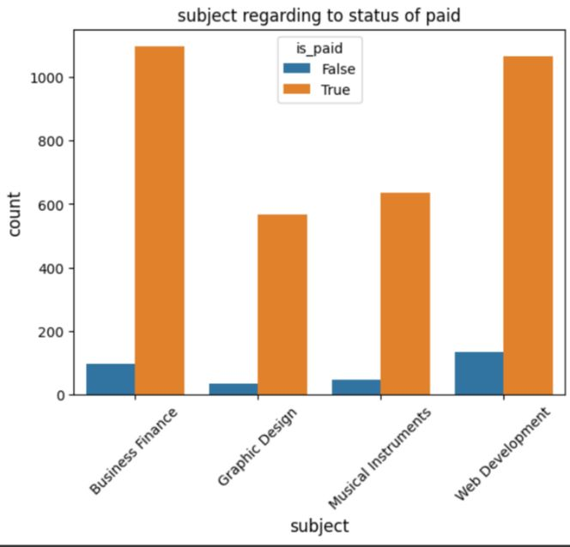
This shows the number of people who joined paid vs free courses
Observation: We observe from this that people joined paid courses rather than free courses which may mean that the quality of the content of paid courses is higher than the quality of the free courses, also many paid courses offer certification upon completion which can be valuable, so this encourages people to choose a paid course over a free one.

Slide 16
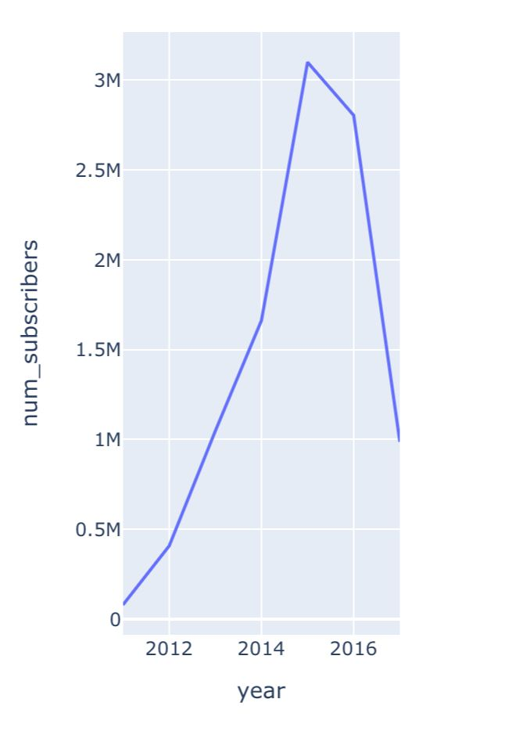
This is a graph that shows the number of subscribers over the years
Observation: There was a significant increase in the number of subscribers in the year 2014 which means that it was gaining popularity and attracting more people, but it was followed by a sharp decline in the year 2016 which means that it was losing people or facing stiff competition by other players in the market.

Slide 17
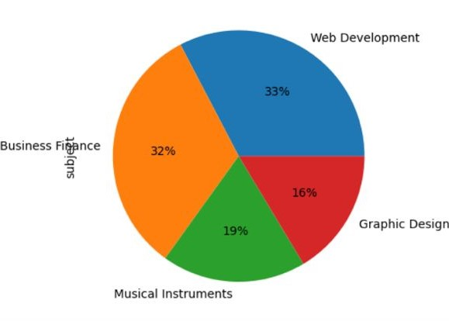
This pie chart shows the percentage of each course in all courses
Observation: The Web Development course has a higher percentage than other courses indicating that is more popular or in higher demand on the other hand the Graphic Design course is the least popular

Slide 18
ML Model to classify the subject of the course

Slide 19
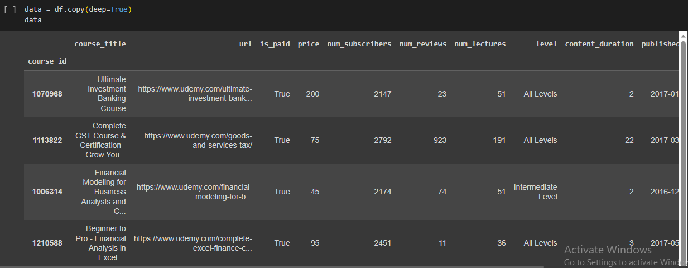
This line of code creates a copy of the DataFrame "df" and assigns it to a new variable called "data". The "deep=True" argument ensures that the copy is a deep copy, meaning that any changes made to the new variable will not affect the original DataFrame.

Slide 20
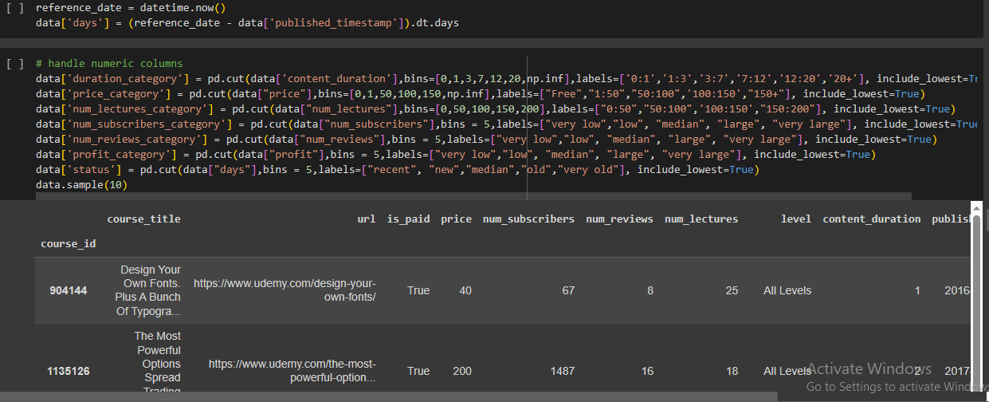
This code is performing a pre-processing step for machine learning by calculating the number of days between the current date (represented by `datetime.now()`) and the date that an article was published (represented by `data['published_timestamp']`). The first line sets a variable `reference_date` to the current date and time. The second line subtracts the `published_timestamp` value from `reference_date`, which results in a new datetime object representing the time difference between the two dates. Finally, `.dt.days` is used to extract only the number of days from this time difference, which is then assigned to `data['days']`. This creates a new feature in the dataset that represents how many days ago an article was published. This feature could be useful for predicting how popular or relevant an article is based on its age, as older articles may be less interesting or less likely to be shared on social media compared to newer ones.

Slide 21
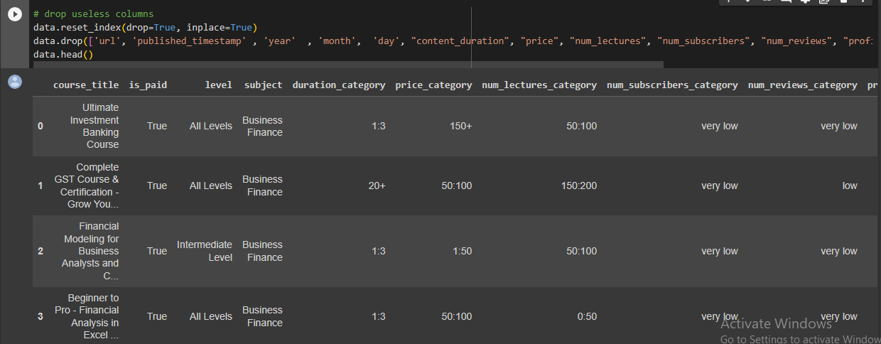
This code is performing several operations on a pandas DataFrame called "data".
The first operation is resetting the index of the DataFrame to default integer values and dropping the original index. This is done using the "reset_index" method with the "drop" parameter set to True and the "inplace" parameter set to True.
The second operation is dropping several columns from the DataFrame. These columns are identified by their column names and are dropped using the "drop" method with the "axis" parameter set to 'columns' and the "inplace" parameter set to True.
Finally, the last operation is displaying the first five rows of the resulting DataFrame using the "head" method.
The columns that are dropped include 'url', 'published_timestamp', 'year', 'month', 'day', 'content_duration', 'price', 'num_lectures', 'num_subscribers', 'num_reviews', 'profit' and 'days'.

Slide 22
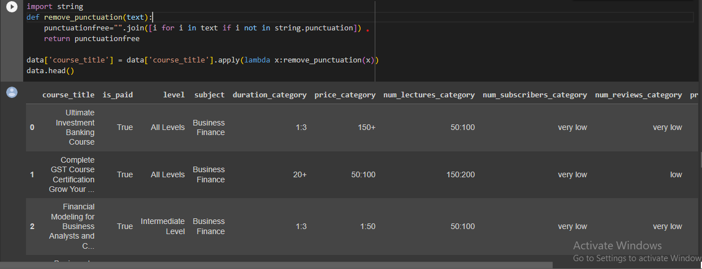
This code is removing all the punctuation marks from the 'course_title' column of a Pandas DataFrame.
The function 'remove_punctuation' takes a string as input and removes all the punctuation marks from it using list comprehension. The resulting string without any punctuation marks is returned.
The apply() method is used to apply this function to each element of the 'course_title' column of the DataFrame.
The lambda function is used to pass each element of the column as an argument to the 'remove_punctuation' function.
Finally, data.head() is used to display the first few rows of the modified DataFrame.

Slide 23
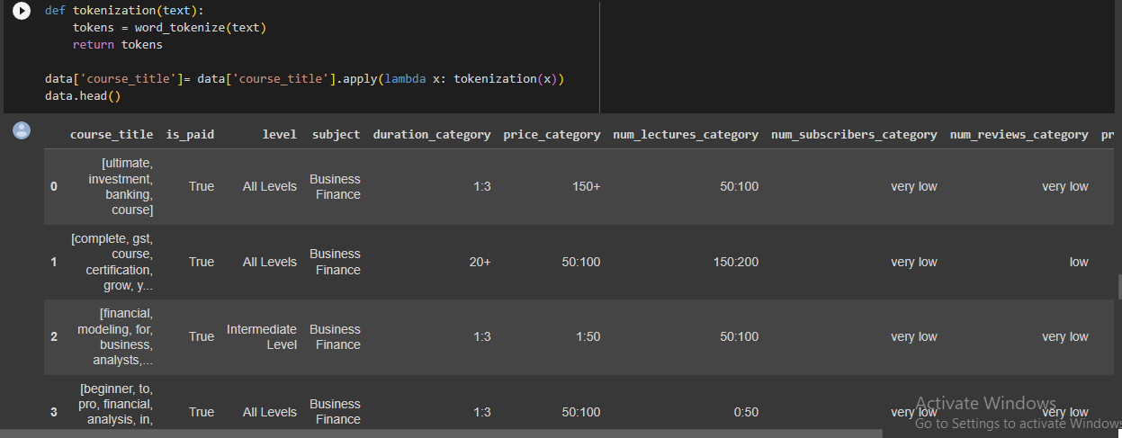
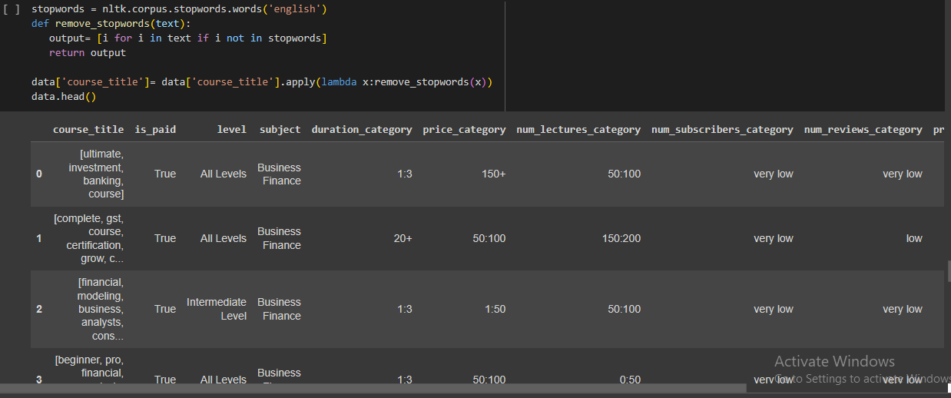
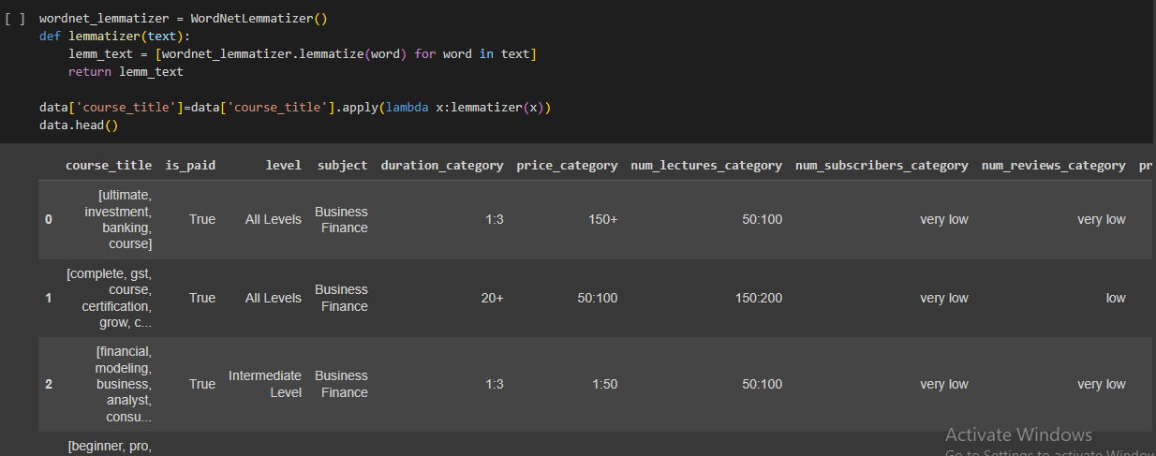
'tokenization', uses the 'word_tokenize' function from the nltk library to split each course title into a list of individual words or tokens.
The second function, 'remove_stopwords, removes any stopwords (commonly used words like 'the', 'and', 'is', etc.) from the tokenized text using a list of stopwords from the nltk library.
The third function,
'lemmatizer', uses the WordNetLemmatizer from the nltk library to convert each word in the tokenized text to its base or root form.
Finally, each of these functions is applied to the 'course_title' column of the dataset using the 'apply' method.

Slide 24
MODELS

Slide 25
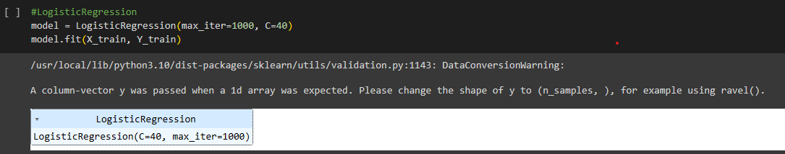
This line of code is creating a logistic regression model and fitting it to the training data.
- `LogisticRegression()` creates an instance of the logistic regression model.
`max_iter=1000` sets the maximum number of iterations for the solver to converge.
- `C=40` sets the inverse regularization strength, where higher values of C correspond to less regularization.- `.fit(X_train, Y_train)` fits the model to the training data, where `X_train` is the feature matrix and `Y_train` is the target variable.
The resulting `LogisticRegression.model` object can then be used to make predictions on new data

Slide 26
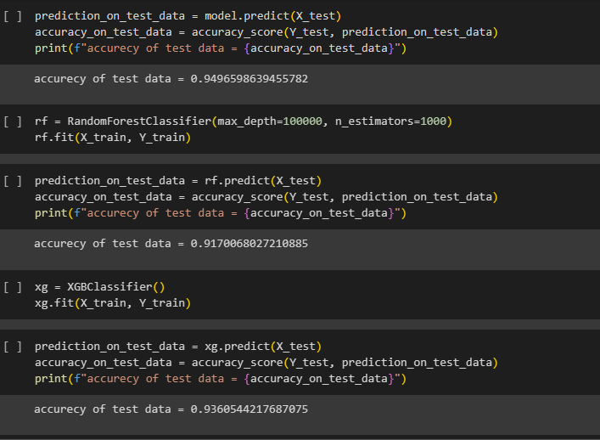
This code is performing machine learning classification on a dataset.
First, the model is trained using X_train and Y_train data.
Then, the accuracy of the model is tested on X_test and Y_test data using the predict() function and accuracy_score() function respectively.
The accuracy score is printed using f-string formatting.Next, a Random Forest classifier is created with a maximum depth of 100000 and 1000 estimators. The same process of training, testing, and printing accuracy score is repeated for this classifier.
Finally, an XGBoost classifier is used to predict on the test data and its accuracy score is printed in the same way as before.Overall, this code compares the performance of three different classifiers on a given dataset by measuring their accuracy scores.

Slide 27
Our team
Ahmed adel
Lamiaa emad
Abdelrahman salah
Karma amr
Salah hossam
Abdelrahman sakr

Slide 28
THANK YOU

