Slide 1

HR ANALYTICS · WHY PEOPLE LEAVE THEIR JOBS
Why Employees
Leave
A look at why people quit — and what the company can do to keep them.
1,406 employees studied
6 reasons explored
5 new warning signs
Based on IBM’s HR data · Built with Python — pandas · seaborn · scikit-learn

Slide 2







CONTENTS
What’s in this deck
Why it matters
01
Preparing the data
02
Losing people costs real money
Getting the file ready to analyze
Cleaning the data
03
What we found
04
Making sure the numbers are reliable
Six clear reasons people leave
New warning signs
05
What to do
06
Extra clues to spot risk early
Practical steps to keep more people
02

Slide 3



01 · WHY IT MATTERS
Losing employees is expensive
More and more people at IBM have been quitting, and HR wants to understand why.
Each person who leaves is costly — hiring and training a replacement, losing their know-how, and piling pressure on those who stay.
≈ 16%
What we wanted to find out
Understand why people leave
of employees left the company
Find which jobs lose the most people
That’s about 1 in every 6 people — and it keeps happening.
Suggest simple ways to keep more of them
03

Slide 4



02 · PREPARING THE DATA
How we got the data ready
01
02
03
04
05
Look at it
Clean it up
Explore it
Add clues
Get it ready
Open the data and see what’s inside
Fix mistakes and remove bad rows
Chart each factor to see what affects leaving
Create new hints that point to risk
Put it in a form a model can use
Python · pandas · NumPy · seaborn / matplotlib · scikit-learn
04

Slide 5






03 · CLEANING THE DATA
Making the data trustworthy
Useless columns
Missing values
Impossible values
Removed 7 columns that added nothing
Filled in the blank cells sensibly
Fixed ages under 18 and extreme pay
Messy labels
Impossible histories
Extreme numbers
Made spellings and categories consistent
Removed 64 rows that made no sense
Reined in 7 columns with wild values
Result 1,406 clean, reliable records — ready to analyze.
05

Slide 6
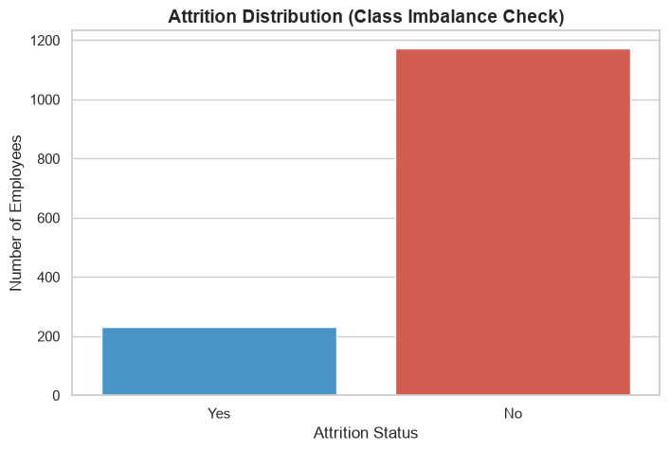
04 · WHAT WE FOUND — 01 / 06
How many people are we losing?
≈ 16%
left the company — the rest stayed
Far more people stay than leave.
So we compare percentages, not just totals, to keep things fair.
If we build a prediction model later, it will need to account for this gap.
06

Slide 7
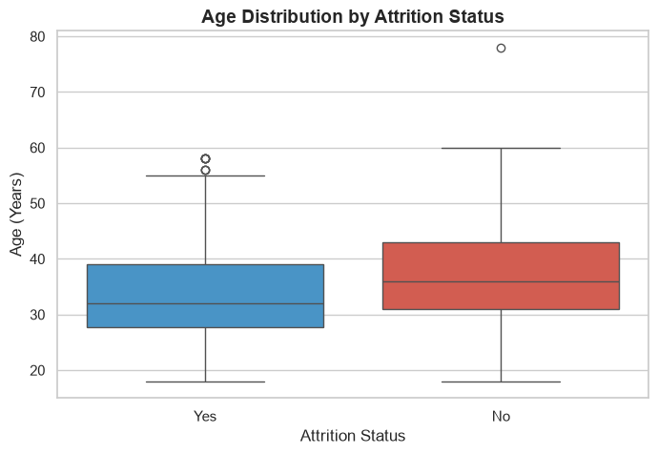
04 · WHAT WE FOUND — 02 / 06
Younger employees leave more often
~32 vs ~36
typical age — those who leave vs. those who stay
People who leave are usually younger than those who stay.
A few older workers (55+) leave too — most likely early retirement.
What to do Give younger employees clear ways to grow so they want to stay.
07

Slide 8
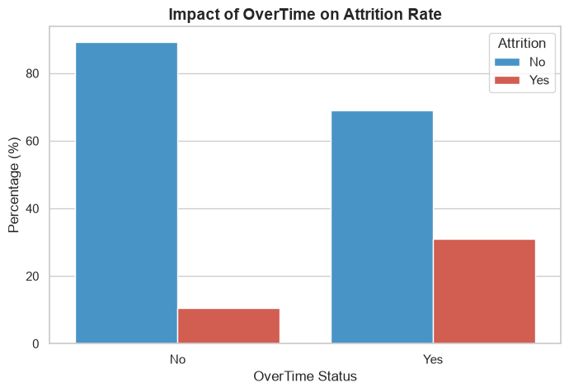
04 · WHAT WE FOUND — 03 / 06
Overtime is the biggest problem
3×
people on overtime leave 3× as often — 30% vs 10%
Working overtime roughly triples how many people quit.
This strongly suggests people are burning out.
What to do Ease workloads, and pay and thank people for any overtime they must do.
08

Slide 9
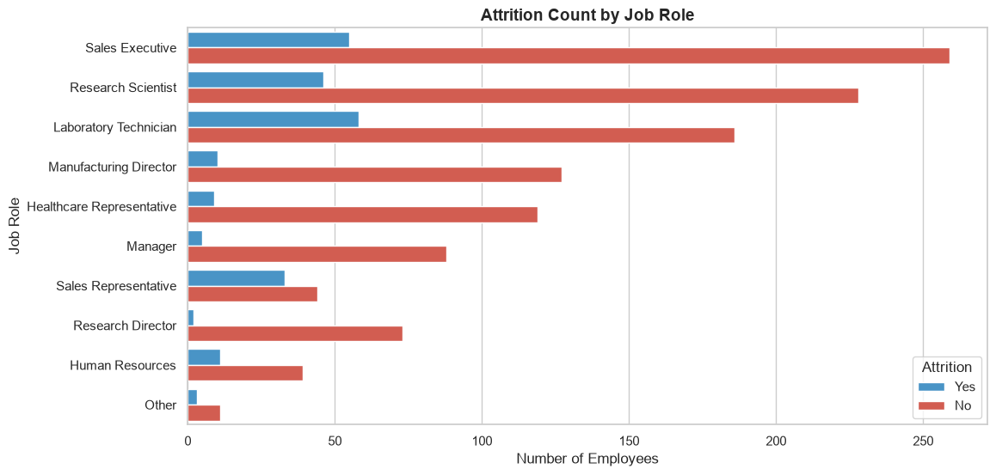
04 · WHAT WE FOUND — 04 / 06
A few jobs lose the most people
Sales Reps and Lab Technicians lose the biggest share of their people.
Senior roles like Directors and Managers rarely leave.
What to do When people in these teams quit, ask them why — and act on what you hear.
09

Slide 10
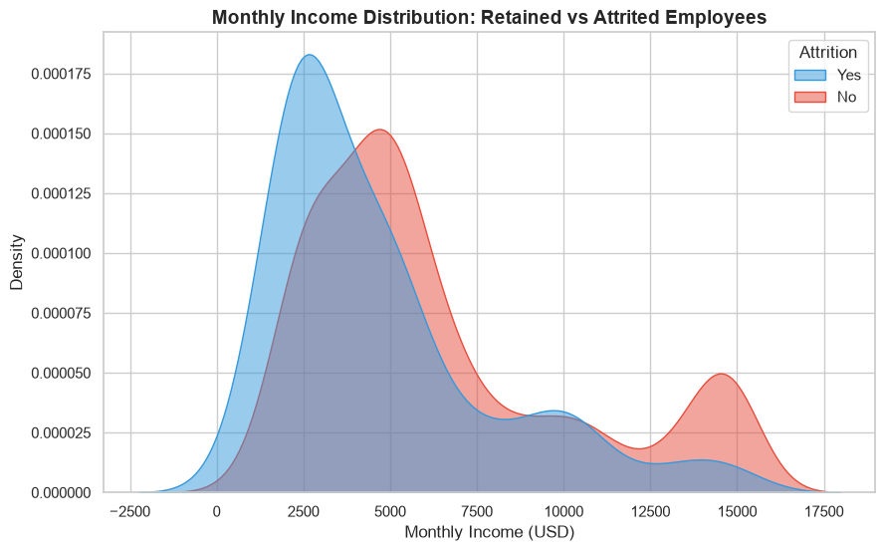
04 · WHAT WE FOUND — 05 / 06
Low pay pushes people out
~$2,500
the monthly pay where most leavers sit
Most people who leave are among the lowest paid.
Quitting drops sharply above ~$5,000 and almost stops above ~$12,500.
What to do Check that lower salaries are fair compared to the job market.
10

Slide 11
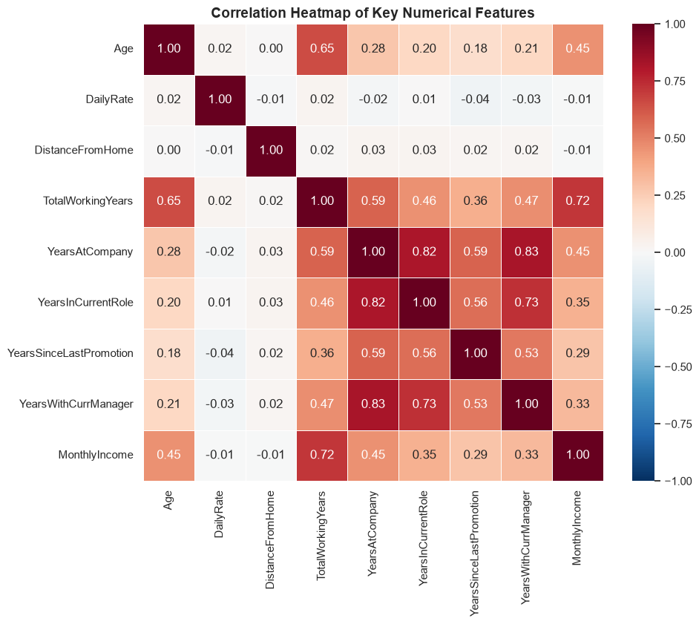
04 · WHAT WE FOUND — 06 / 06
Some columns tell the same story
Years at the company, years in the role, years with the manager and total years worked all rise together.
That makes sense — but using them all at once would confuse a model, since they repeat the same information.
What to do Keep just one of these columns, or use the new clues we built instead.
11

Slide 12





05 · NEW WARNING SIGNS
New clues to spot risk early
Pay for experience
Pay compared to years worked — spots people who are underpaid for their experience.
Experience level
Sorts people into Junior, Mid or Senior by years worked.
Time since promotion
How long since their last promotion — a sign they may feel stuck.
Time-here groups
Groups people by how long they’ve been here (0–1yr, 1–3yr, and so on).
Above or below average pay
A simple flag for whether someone earns more or less than average.
Together, these help spot at-risk employees before they decide to quit.
12

Slide 13


PUTTING IT TOGETHER · WHO IS MOST AT RISK
The employee most likely to leave
Five signs that, together, point to who’s most likely to quit.
Age
Early 30s
Job
Sales Rep or Lab Technician
MOST AT RISK
Monthly pay
Under $3,000
Young · Underpaid · Overworked · New
Overtime
Often
Time here
Less than a year
13

Slide 14


06 · WHAT TO DO
Four ways to keep more people
Fix low starting pay
01
Cut down on overtime
02
Raise junior salaries to match the market — pay is the number-one reason people leave.
Balance workloads and reward any needed overtime so people don’t burn out.
Support the hard jobs
03
Spot risk early
04
Give Sales and Lab teams better tools, more help and fair targets.
Use the new warning signs to reach people before they decide to quit.
14

Slide 15
06 · RESULTS & NEXT STEPS
Turning this into real results
Next steps
What we expect
Start a support program for new hires who are underpaid for their experience.
1
Cutting overtime and raising junior pay should clearly reduce quitting among the group most at risk:
young, underpaid, overworked people who are still in their first year.
Track how many of them leave each month to see if it’s working.
2
Add the warning signs to an HR dashboard to keep watching over time.
3
15

Slide 16
THE BOTTOM LINE
We can keep more people.
Three things make the biggest difference:
Overtime
Fair pay
First year
Ease workloads to stop burnout
Raise low salaries to be fair
Support new hires closely
Thank you
Why Employees Leave · Based on IBM HR data · Built with Python

