Slide 1



Git and GitHub like a Pro!
(Slides adapted from https://github.com/mobile-senegal/dem-training/blob/master/DEM-05-CollaborativeTools.pptx of Thomas Sarlandie by Jan Schoepp, Dr. Christelle Scharff and Dhruv Gandhi - Last update: 4/20/2018)

Slide 2
Agenda
Git for your projects
Collaboration with Git and GitHub

Slide 3
GIT FOR YOUR PROJECT BASICS

Slide 4
What is Software Configuration Management (SCM)?
To manage your source code
To keep an history of your project
To facilitate collaboration on a project

Slide 5
Why you need an SCM
Source code is a valuable asset
One of the most important things in a software company!
You need to protect it from
Physical damages / Theft of hard drives
Human errors
You will save a lot of time
An SCM is the best way to synchronize multiple developers without wasting hours merging
It is a great tool when you need to find when a bug was introduced

Slide 6
SCM History
SCM have been around for decades now
CVS (1986), Subversion (2000), Mercurial, BitKeeper, Git
They evolved from centralized systems to distributed systems
Git is widely recognized as one of the best SCM available today
and GitHub is the number one place to share code

Slide 7
Let’s get started
Install Git
Mac OS: (already installed with Xcode)
Windows: http://git-scm.com/download/win
git config --global user.email email (preferably your GitHub account)
git config --global user.name "Firstname Lastname"
Create a new project / directory
mkdir myproject
cd myproject
git init

Slide 8
Add a file
Create a README.md file with some content
echo This is the readme >> README.md
git status
git add README.md
git commit -m “Adding README.md”
git status

Slide 9
$ git add README.md
$ git status
# On branch master
#
# Initial commit
#
# Changes to be committed:
# (use "git rm --cached <file>..." to unstage)
#
# new file: README
#
.md

Slide 10
$ git commit -m "Adding README.md"
[master (root-commit) dc95b92] Adding README.md
1 file changed, 1 insertion(+)
create mode 100644 README.md
$ git status
# On branch master
nothing to commit (working directory clean)

Slide 11
Recover from problems
Edit your README.md file again
Add something “bad” in it
Rollback your change
git checkout -- README.md

Slide 12
$ echo "Bad developer joker" >> README.md
$ git status
# On branch master
# Changes not staged for commit:
# (use "git add <file>..." to update what will be committed)
# (use "git checkout -- <file>..." to discard changes in working directory)
#
# modified: README.md
#
no changes added to commit (use "git add" and/or "git commit -a")
$ git diff
diff --git a/README.md b/README.md
index bb69143..91a4a14 100644
--- a/README.md
+++ b/README.md
@@ -1 +1,2 @@
This is a README.md file for our git exercise
+Bad developer joker

Slide 13
$ git checkout -- README.md
$ git status
# On branch master
nothing to commit (working directory clean)

Slide 14
Commit a file
Let’s edit the README.md file again
And commit the file again

Slide 15
$ echo ”Good developer joker ;)" >> README.md
$ git status
# On branch master
# Changes not staged for commit:
# (use "git add <file>..." to update what will be committed)
# (use "git checkout -- <file>..." to discard changes in working directory)
#
# modified: README.md
#
no changes added to commit (use "git add" and/or "git commit -a")
$ git add README.md
$ git status
...
$ git commit –m “Adding a good joke”

Slide 16
$ git log
commit 7552e81a4a6770532ee52d344e67557c2f50c460
Author: Thomas Sarlandie <thomas@sarlandie.net>
Date: Wed May 1 16:59:44 2013 +0000
Adding a good joke
commit dc95b9254b81db32a2fa16116e7f774eedc3a332
Author: Thomas Sarlandie <thomas@sarlandie.net>
Date: Wed May 1 16:52:54 2013 +0000
Adding README.md

Slide 17
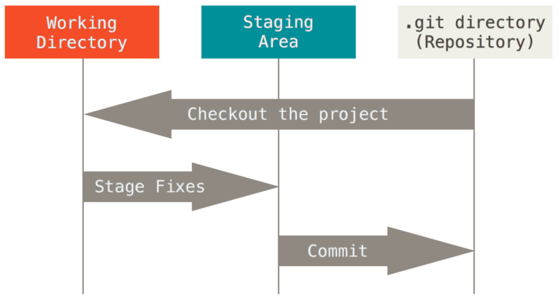
Understanding Git
GitHub Pro book: http://git-scm.com/book/en/Getting-Started-Git-Basics - With permission (CC-BY)

Slide 18
Your essential git basic commands
git init # Creates a new repository
git diff # Diff working directory
git checkout -- FILE # Reverts changes to FILE
git add FILE # Adds a file to staging
git diff --staged # Diff staging
git reset -- FILE # Removes a file from staging
git status # Shows you modified/staged files
git commit # Commits staging
git log # To see the previous commits
git rm FILE # Remove a file
git mv OLD NEW # Rename a file

Slide 19
Basic Git tips
Getting help
git –help
git command –help
Google
Ignoring files
Add names or patterns to .gitignore
Commit messages
First line is a short description
The rest is details of what was done

Slide 20
GIT FOR YOUR PROJECT BRANCHES

Slide 21
Understanding branches
Branches allow you to keep different version of your project in parallel
One stable version – one unstable
Make experiments
To try a new library
To prototype a feature
To work with other developers

Slide 22
Working with branches
$ git branch newFeature # Creates a new branch
$ git checkout newFeature # Switches to the new branch
$ git add ... ; git commit # Add changes to the branch
$ git checkout master # Come back to the main branch
$ git merge newFeature # Merges the branch into current
$ git branch –d newFeature # Deletes a branch
$ git branch # Lists your branches
master#3
master#4
branch#3
branch#4

Slide 23
Demo #1 - Branching
Using branches, jQuery and CDN
Compare loading time and merge if necessary
Code at: https://github.com/mobile-senegal/jquerymobile101

Slide 24
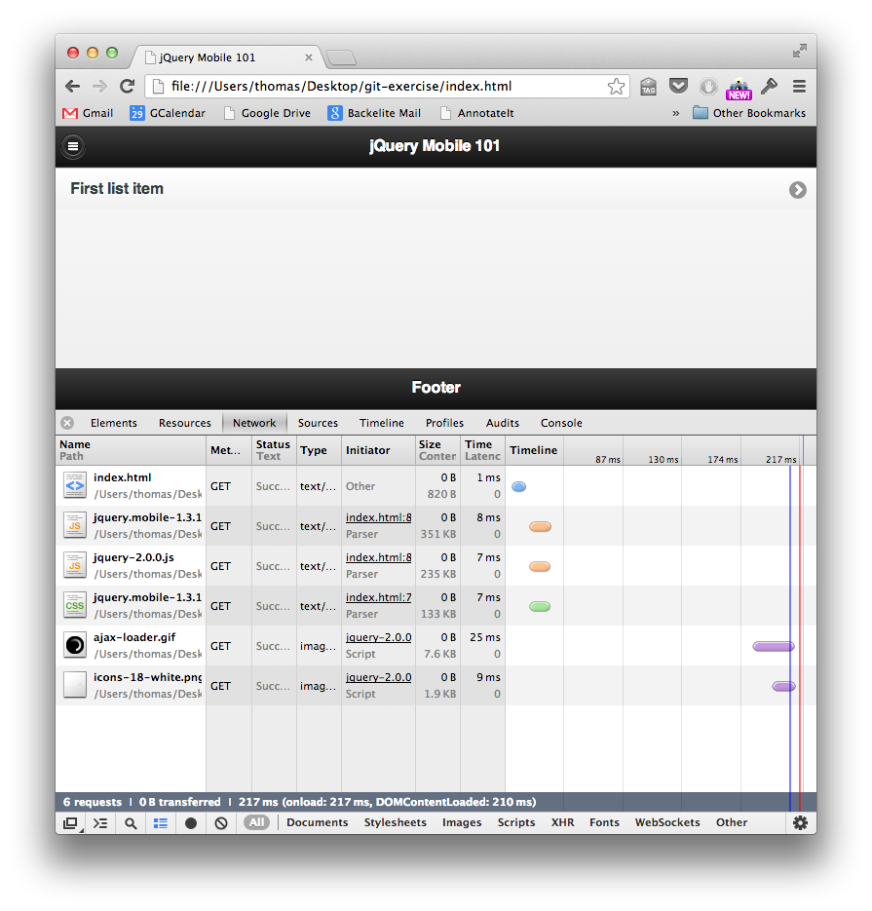

Slide 25
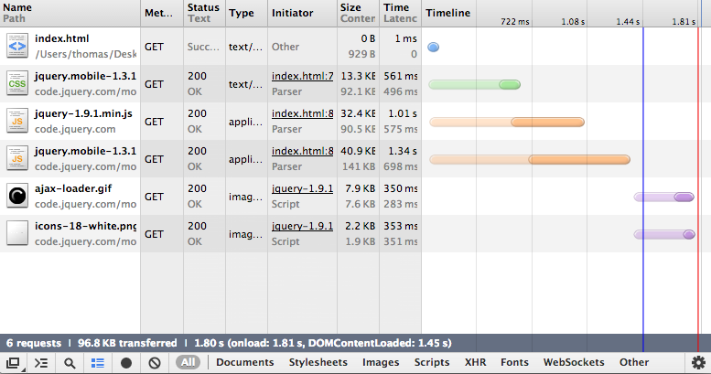

Slide 26
$ less index.html
...
<title>jQuery Mobile 101</title>
<<<<<<< HEAD
<link rel="stylesheet" href="http://code.jquery.com/mobile/1.3.1/jquery.mobile-1.3.1.min.css" />
<script src="http://code.jquery.com/jquery-1.9.1.min.js"></script>
<script src="http://code.jquery.com/mobile/1.3.1/jquery.mobile-1.3.1.min.js"></script>
=======
<link rel="stylesheet" href="jquery.mobile-1.3.1.css">
<script src="jquery-1.9.1.min.js"></script>
<script src="jquery.mobile-1.3.1.js"></script>
>>>>>>> fixjqueryversion
</head>
...
$ vi ...
<title>jQuery Mobile 101</title>
<link rel="stylesheet" href="http://code.jquery.com/mobile/1.3.1/jquery.mobile-1.3.1.min.css" />
<script src="jquery-1.9.1.min.js"></script>
<script src="http://code.jquery.com/mobile/1.3.1/jquery.mobile-1.3.1.min.js"></script>
</head>
$ git add / git commit ...
$ git log
This is what a conflict looks like
To fix it: edit the file
Merge the lines manually
Remove the markers

Slide 27
Regrouping
You have all the basics now
How to work on one branch on your computer
How to create and work with branches
Now let’s do it with friends…

Slide 28
COLLABORATION WITH GIT AND GITHUB

Slide 29



GitHub is a web service that provides Git repositories
GitHub for education. Check it out!
Free service as long as your repo are public
https://github.com/pricing
Developer: 7$ / month for unlimited private repositories (Free for students)
Team: 9$ / user per month for team and user permissions

Slide 30
GitHub Overview
To host your projects
To track issues
To host a web site (static pages only) (GitHub pages)
To get analytics on your projects
To contribute to open source projects
To boost your CV and your portfolio

Slide 31
Remote branches
When working on your computer,
the entire history is saved in your .git folder
Git allows you to connect to remote repositories and exchange code (push/pull)
Code is safer when not on your hard-drive…

Slide 32
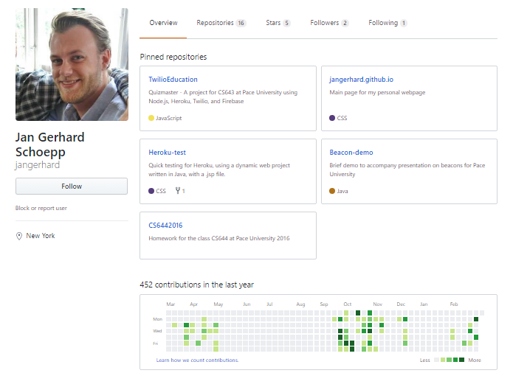

Slide 33
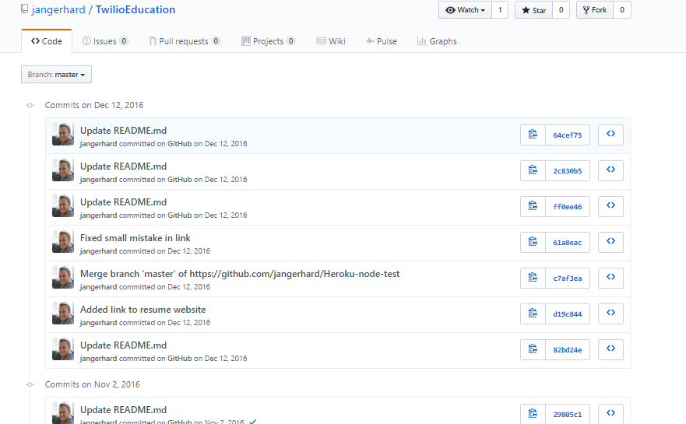
Working with GitHub

Slide 34
Upload your code
Create a new repository on GitHub
Name it whatever you like
Set to public/private
Don’t initialize with a README right now; We are importing existing code
Push to Github
git remote add origin https://github.com/jangerhard/newAwesomeProject.git
git push -u origin master

Slide 35
Maintaining code
Before coding
ALWAYS pull latest changes
git pull origin master
Before pushing commits
ALWAYS pull latest changes
git push origin master

Slide 36
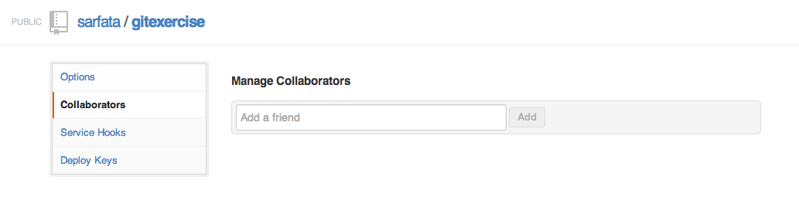
Cloning an existing project
Authorize your right-neighbor as a collaborator of your project
Clone the GitHub project of your neighbor
git clone http://… *[optional] foldername*

Slide 37
ADVANCED GITHUB PULL-REQUESTS

Slide 38
Pull Requests
When you want to contribute to a project but do not have access to it
Fork the project
You will have your own copy of the project in GitHub
Clone your copy on your computer
Commit your changes in a branch
Use the “Pull-Request” button
The author of the project will get a message asking him/her to review those changes
He can discuss it (comments) and merge it online

Slide 39
Removing a file from history
When you want to remove a file from the commit history:
Why
credentials/confidential information
$ git filter-branch --index-filter “git rm -rf --cached --ignore-unmatch path-to-file” HEAD
$ git push --all

Slide 40

Summary
You have learned how to …
Use Git to be a better developer
Use GitHub to collaborate

Slide 41
References
https://github.com/mobile-senegal/jquerymobile101
https://git-scm.com/book/en/v2
https://github.com/jangerhard/GitWorkshop
https://github.com/mobile-senegal/dem-training
https://github.com/sarfata

