Slide 1
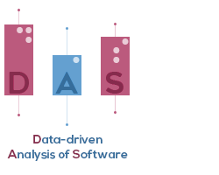

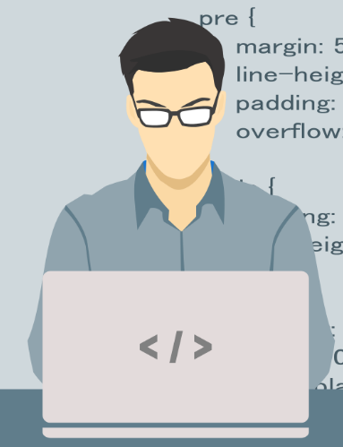

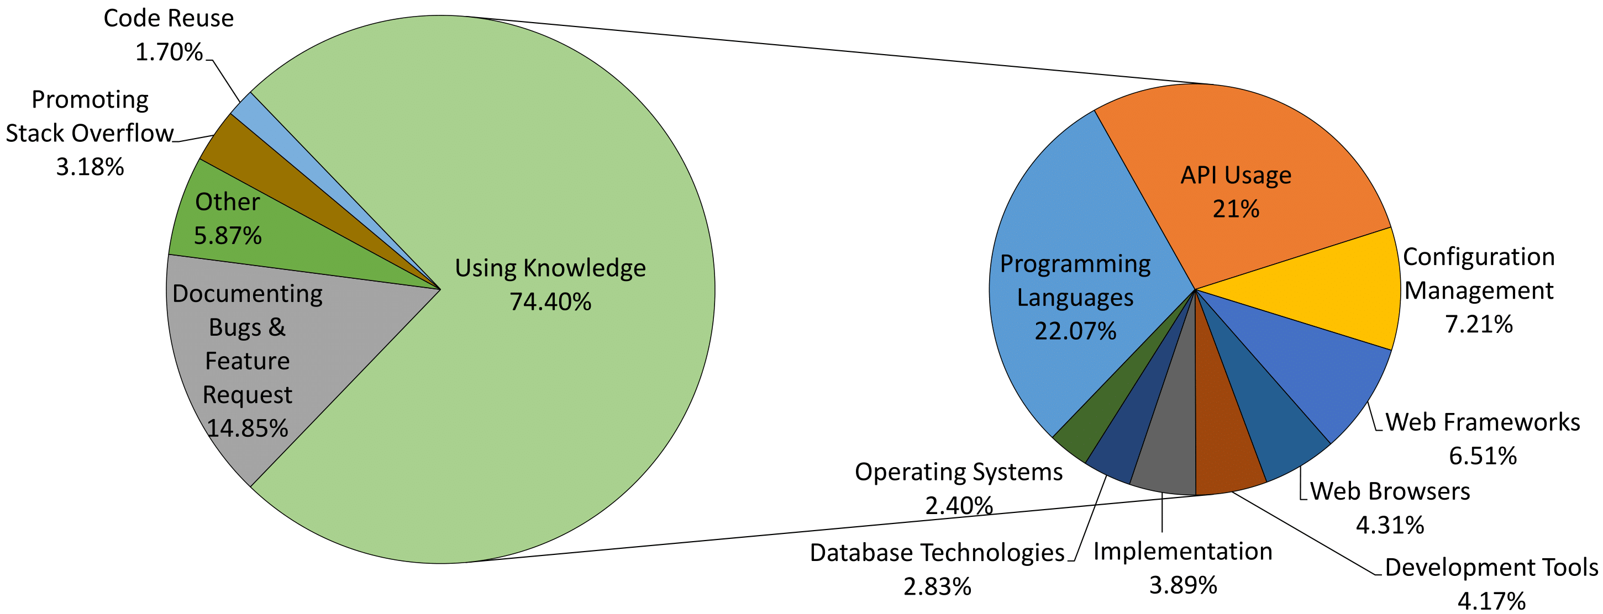


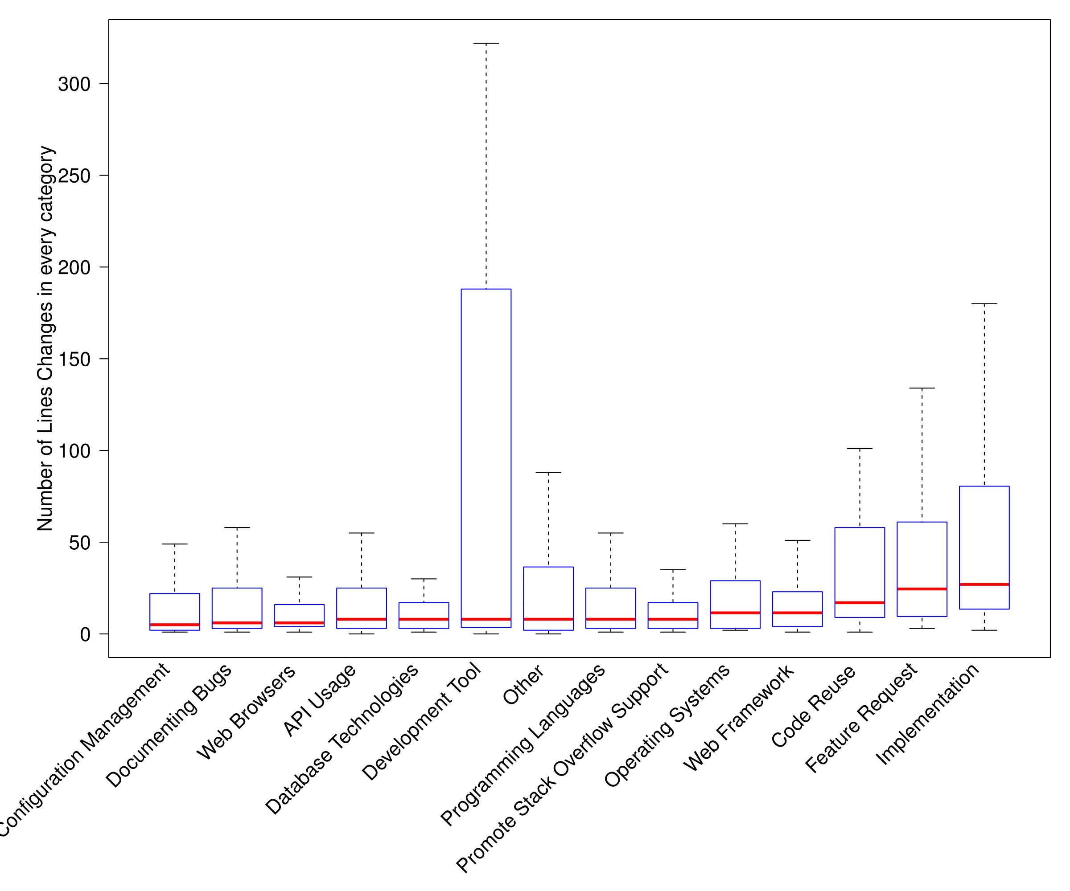
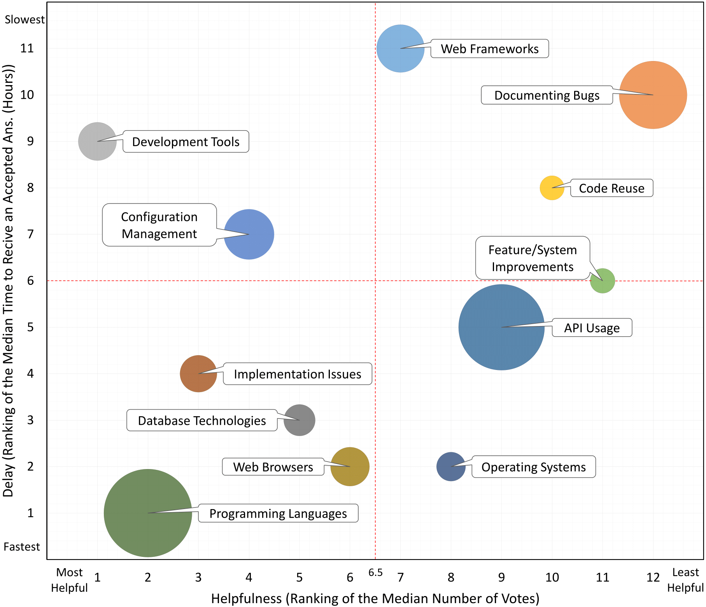
What Do Developers Use the Crowd For?
A Study of the Reasons Developers Use Stack Overflow
Rabe Abdalkareem, Emad Shihab, and Juergen Rilling
Data Collection
What are the main reasons developers resort to Stack Overflow?
Language | # Projects | # Stack Overflow Related Commits
JavaScript | 189 | 307
Python | 179 | 348
Ruby | 132 | 227
Java | 123 | 193
PHP | 99 | 154
C/C++ | 65 | 131
Scala | 21 | 54
Total | 808 | 1,414
Use
Commit
What is the size of commit changes related to Stack Over?
What areas is the crowd most helpful to developers in?
What areas takes longest to attain answers for from the crowd?

