Slide 1

Does the Most Medal Count Mean the Most Successful?
Group 5- Miraitowa
Mengwei, Guessebeogo, Anjali, Yueyang

Slide 2
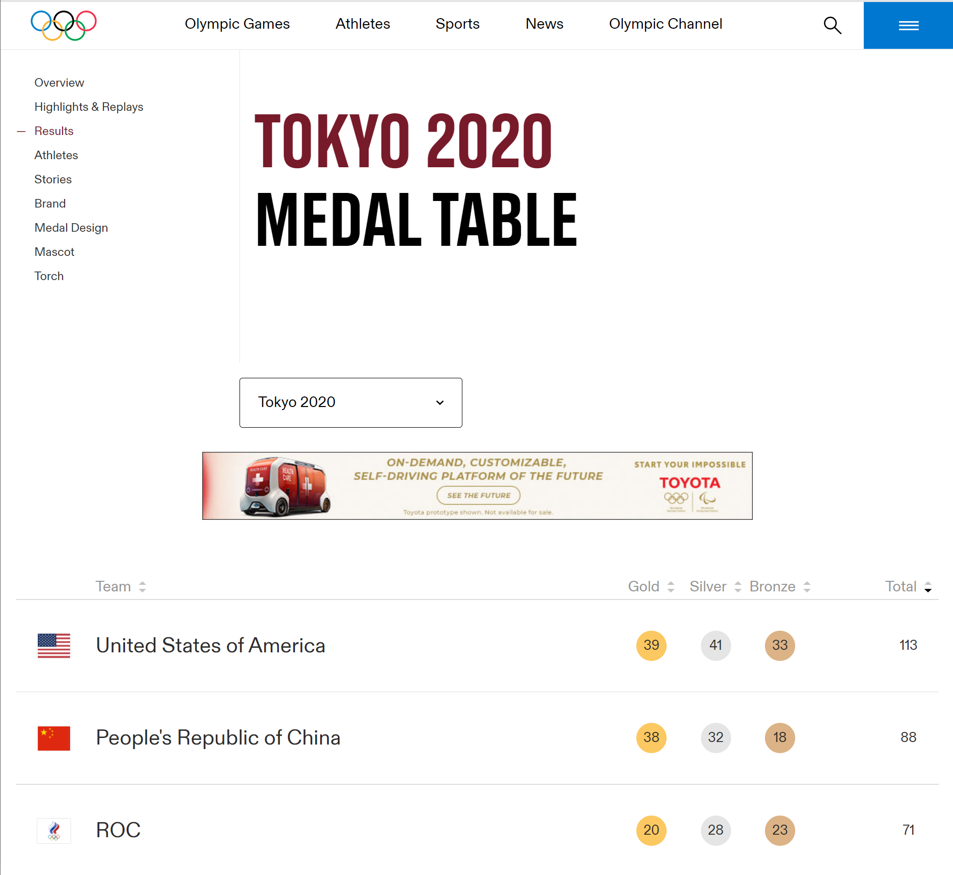


Slide 3

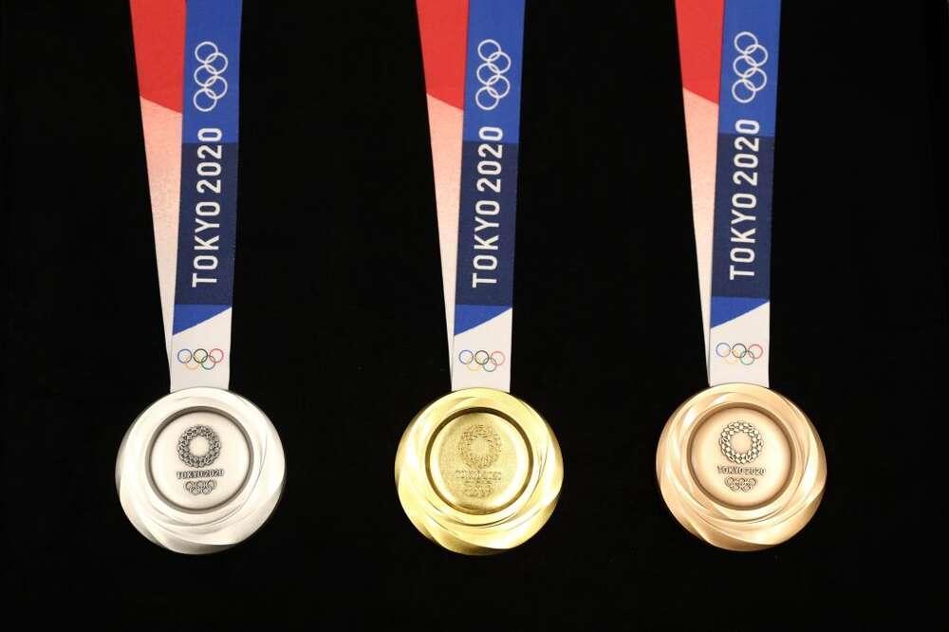
Agenda
Background and Purpose &
Basis and Approach (Guessebeogo)
Abstraction and Aggregation &
Visualization Techniques (Anjali)
Overview of the Visualizations &
Outcome (Yueyang)
Conclusion (Mengwei)

Slide 4
Background and Purpose
Olympics games: sport competition held every 4 years between athletes in individual or team events.
-Ranking based on total number of medals earned by athletes representing different countries, but not based on countries.
-Since 1990, US has taken the most total medals with some minor variations in recent years. Although, usual big winners are USA, China, ROC… which are largely populated with high GDP.
-Is this ranking fair for small countries with low GDP? What’s the point of participating for small countries if there will never lead in medal counts?
-Present the medal count ranking in more revealing ways regarding each participating country’s population and GDP.

Slide 5
Basis and Approach
-merging of the dataset of the total medal count with population and GDP for each participating country.
-addition of 2 columns to demonstrate them in our visualization: medal count in relation to each country’s population and medal count in ratio to each country’s GDP.
-2 visualisations including map and bar charts
Interactive map showing each country’s location, GDP and Population
Bar charts for comparison

Slide 6
Abstraction and Aggregation
Abstraction - Use Mutate to:
Cross Variables from number of medals for each country
Calculate Medals per person (Number of medals/ population) or medals per GDP (Number of medals/ GDP)
Rank the results in a descending order
Aggregation - Use Summarise to
Merge all the datasets that we have
Show data like total counts, counts by athlete number in each team and so on to make a more clear clarification
Analyze the dataset thoroughly

Slide 7
Visualization Techniques
Theme of colors: Picking subtle theme of colors to get the viewers to focus on the length of the bars and all countries.
Patterns over values: Chose not to display the values on the graph.
Proximity Compatibility Principle: The data if the country to be seen right next to the country. Secondary supporting information only presented when want to be viewed.
Motif of Interactive Plot: Avoid cluttering that would have been present in a static graph.

Slide 8
Overview of Visualization
Bar chart--avoid overthinking
Put related data together--Proximity Compatibility
Rank the bar chart --descending order
Reference lines --relative judgment
Use of Map:
engaging, shows spatial connection and familiarity

Slide 9
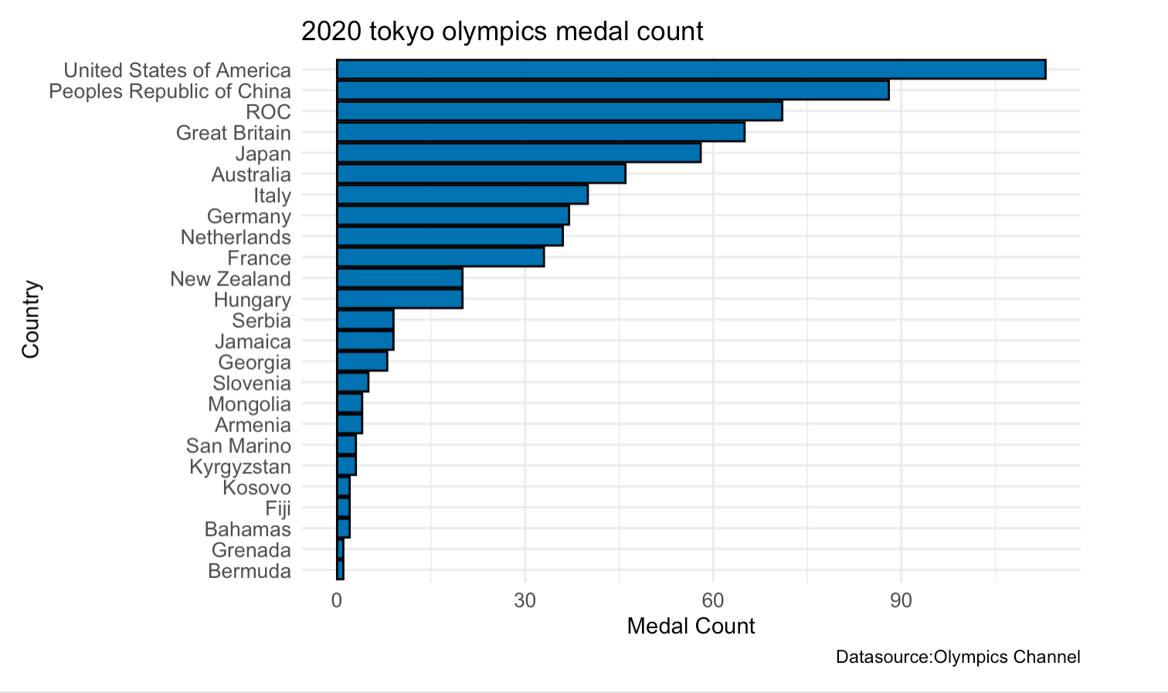

Slide 10
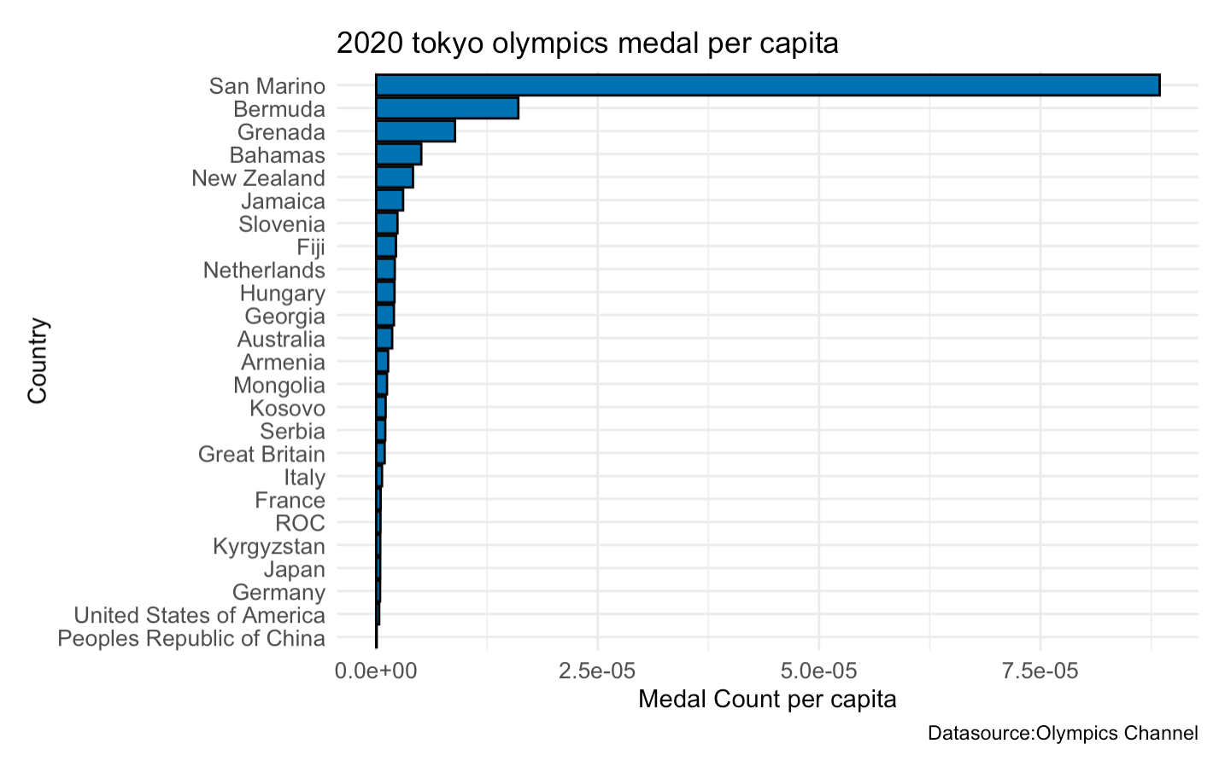

Slide 11
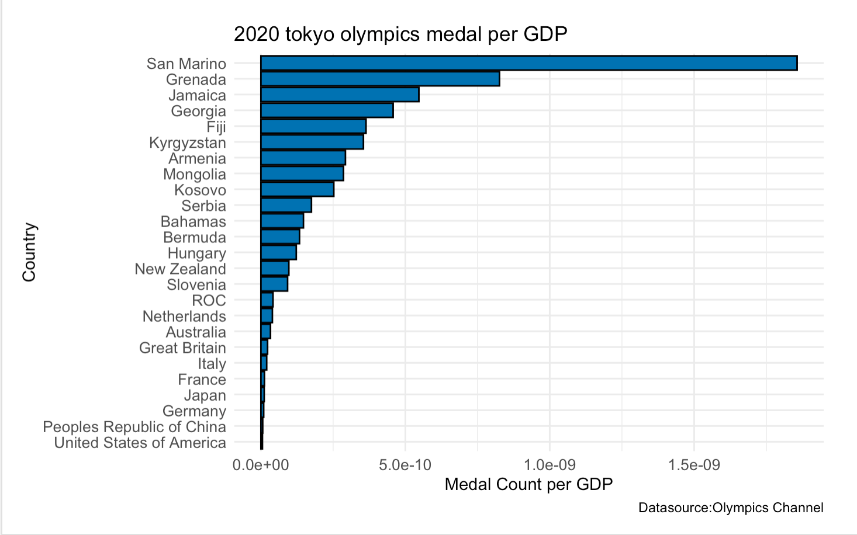

Slide 12
Conclusion
“It's still loud and clear from the patterns that what matters is population, level of income, and political system.”
Many countries like San Marino (33,000 people, 1.6 billion GDP) over-perform given their population size and GDP.
There are cultural and political factors, and sports a country chooses to compete in matter too. More stories are waiting to be told.
Notes:
Take a country like Luxembourg, which has a population of 633,622. It sent 12 athletes to compete in seven sports, and won no medals. Meanwhile the US, which has the third-largest population in the world, sent 613 athletes to compete in 35 sports and took home more medals than any other country.
Admittedly, there are many other factors that may affect the wins that we did not take into account: culture, politics etc. The purpose of this report and the graphs showing alternative ways of ranking the medal count is to show all the Olympic Games audiences that the total number of medals do not mean everything. More importantly, the outcomes remind us to keep our eyes wide open, not to be fooled by a general number, but to look at it in a different way, and to learn about different countries’ demographics and think about how they are related to the ranking. There are still many other graphs we can create in the future to dig into more information of the Olympic Medal Table, for example, comparing the countries that are improving fast or declining fast. We hope more graphs that tell interesting stories about the Olympics can start from here, to put the spotlight on more “nobody” in the story and make them the heros.

Slide 13

Questions?

Slide 14
Thank you!

