Slide 1
Alta Labs HR Dashboard
Data Analysis Life Cycle Project
Created by: Abdelrahman Alarqan

Slide 2
Table of Content
Who is Alta Labs
Business Understanding
Data Understanding
Data Modeling
Data Transformation
Data Visualization
Put it all together (Dashboard)
Tools and Project Sources

Slide 3
01
Who is Alta Labs

Slide 4
Who is Alta Labs
It is a software company specialized in sales and software development. There are a large number of employees in this company and it has three departments:
Sales
HR
Technology

Slide 5
02
Business Understanding

Slide 6
Business Understanding
Display the performance and rating of employees.
Display the attrition rates for all departments and job roles.
Make some statistics and show insights.
Display the distribution of ages, attrition, salaries, …ETC
Employees hiring trends.

Slide 7
03
Data Understanding

Slide 8
Data Understanding
Meta Data
Performance Table 01 (Fact)
Column | Description | Datatype
PerformanceID | A unique ID that identifies an individual performance review. | text
EmployeeID | A unique ID that identifies an employee. Connects to DimEmployee. | text
ReviewDate | Date an employee’s review took place. | date
EnvironmentSatisfaction | Rating for employees' satisfaction with their environment. Connects to DimSatisfiedLevel. | number
JobSatisfaction | Rating for employees' satisfaction with their job role. Connects to DimSatisfiedLevel. | number

Slide 9
RelationshipSatisfaction | Rating for employees' satisfaction with their relationships at work. Connects to DimSatisfiedLevel. | number
WorkLifeBalance | Rating for employees' satisfaction with their work-life balance. Connects to DimSatisfiedLevel. | number
SelfRating | Rating for employees' performance based on their own view. Connects to DimRatingLevel. | number
ManagerRating | Rating for employees' performance based on their manager’s view. Connects to DimRatingLevel. | number
TrainingOpportunitiesWithinYear | Number of training opportunities offered in the last 12 months. | number
TrainingOpportunitiesTaken | Number of training opportunities taken. | number

Slide 10
Employee Table 02 (Dimensional)
Column | Description | Datatype
EmployeeID | A unique ID that identifies an employee. | text
FirstName | First name of an employee. | text
LastName | Last name of an employee. | text
Gender | Self-defined employee gender identity. | text
Age | Current age of an employee. | number
BusinessTravel | Frequency of business travel - three categories: Frequent Traveller, Some Travel, and No Travel. | text
Department | Department an employee works in - three categories: Technology, HR, and Sales. | text
DistanceFromHome | Kilometer distance between an employee’s home and their office. | number

Slide 11
State | State where the employee lives. | text
Ethnicity | Self-defined employee ethnicity. | text
Education | Education level for employees'. Connects to DimEducationLevel. | number
EducationField | Employee field of study. | text
Job Role | Current/latest employee job role. | text
MaritalStatus | Current/latest employee marital status. | text
Salary | Current/latest employee salary. | number
StockOptionLevel | The banding level for stock options that the employee has. | number
Overtime | Contains "Yes and No to indicate whether an employee is expected to work overtime in their role. | text
HireDate | Date the employee joined the company. | date
Attrition | Contains "Yes and No to indicate whether an employee has left the organization. | text

Slide 12
YearsAtCompany | Number of years since the employee joined the organization. | number
YearsInMostRecentRole | Number of years the employee has been in their most recent role. | number
YearsSinceLastPromotion | Number of years since the employee last got promoted. | number
YearsWithCurrManager | Number of years the employee has been with their current manager | number

Slide 13
Satisfied Level Table 03 (Dimensional)
Column | Description | Datatype
SatisfactionID | A unique ID that connects to EnvironmentSatisfaction, JobSatisfaction, RelationshipSatisfaction, and Work-Life Balance in FactPerformanceRating. | number
SatisfactionLevel | Provides meaning to the satisfaction level: Very Satisfied, Satisfied, Neutral, Dissatisfied, and Very Dissatisfied | text
Rating Level Table 04 (Dimensional)
Column | Description | Datatype
RatingID | A unique ID that connects to SelfRating and ManagerRating in FactPerformanceRating | number
RatingLevel | Provides meaning to the rating level: Above and Beyond, Exceeds Expectation, Meets Expectation, Needs Improvement, and Unacceptable. | text

Slide 14
Education Level Table 05 (Dimensional)
Column | Description | Datatype
EducationLevelID | A unique ID that connects to Education in DimEmployee. | number
EducationLevel | Provides meaning to the education level: Doctorate, Masters, Bachelors, High School, and No Formal Qualifications. | text

Slide 15
04
Data
Modelling

Slide 16
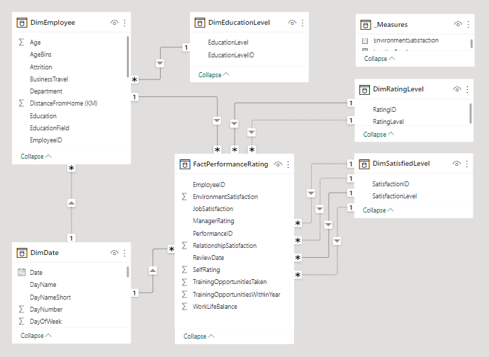
Data Modelling
Dim Tables connects with fact table with one to many relationship, Example:
DimRatingLevel Table and FactPerformanceTable, these tables connect together by one Dim and many Facts
Live Example:
One | Many
RatingID | ManagerRating

Slide 17
05
Data Transformation

Slide 18
Data Transformation 01
Create sixteen Measures (Calculated Measures)
% Attrition Rate | Relationships Satisfaction | Last Review Date
% Attrition Rate Date | Environment Satisfaction | Next Review Date
Active Employees | Job Satisfaction | Total Employees
Inactive Employees | Manager Raring | Total Employees Date
Inactive Employees Date | Self Rating
Average Salary | Work Life Balance

Slide 19
Data Transformation 02
Classify the tables to (Dimensional, Fact) Tables, Example:
Performance => FactPerformance
RatingLevel => DimRatingLevel
Add conditional column which classify the ages, Example:
Age between 20 and 30 => 20-30
Age between 30 and 40 => 30-40
Age older than 50 => >50
Merge two columns (First Name, Last Name) => Full Name
Create Dimensional Date Table

Slide 20
06
Data Visualization

Slide 21
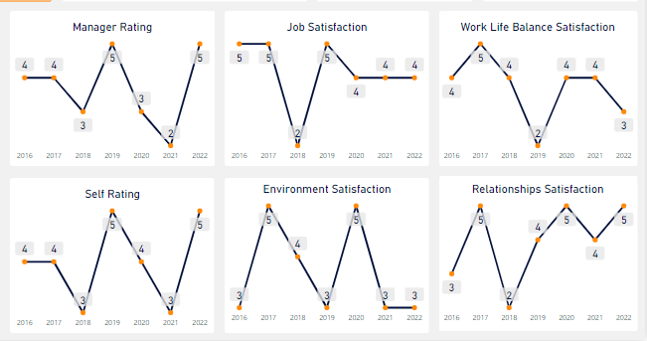
Data Visualization 01 (Performance Tracker)

Slide 22
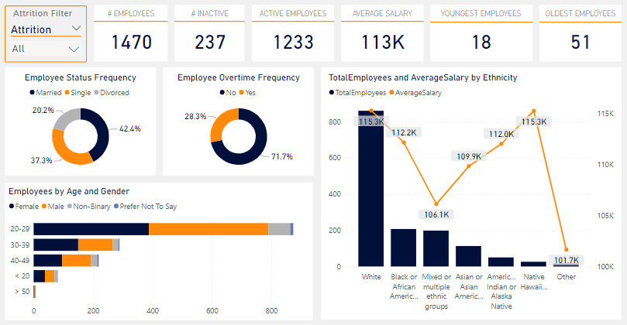
Data Visualization 02 (Demographics)

Slide 23
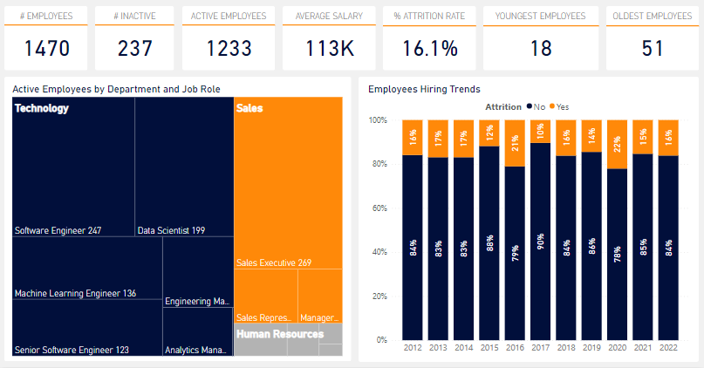
Data Visualization 03 (Overview)

Slide 24
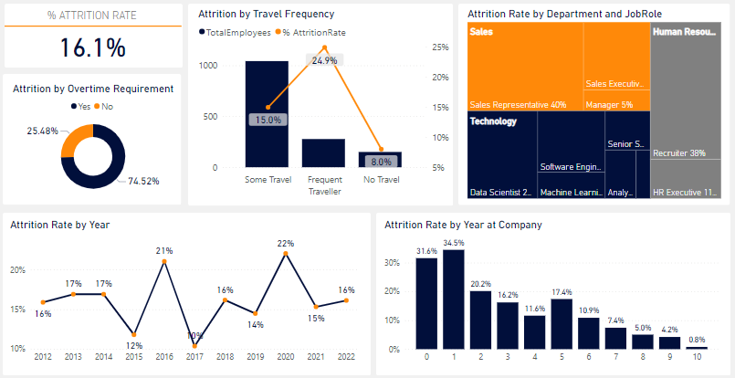
Data Visualization 04 (Attritions)

Slide 25
07
Put it all together (Dashboard)

Slide 26
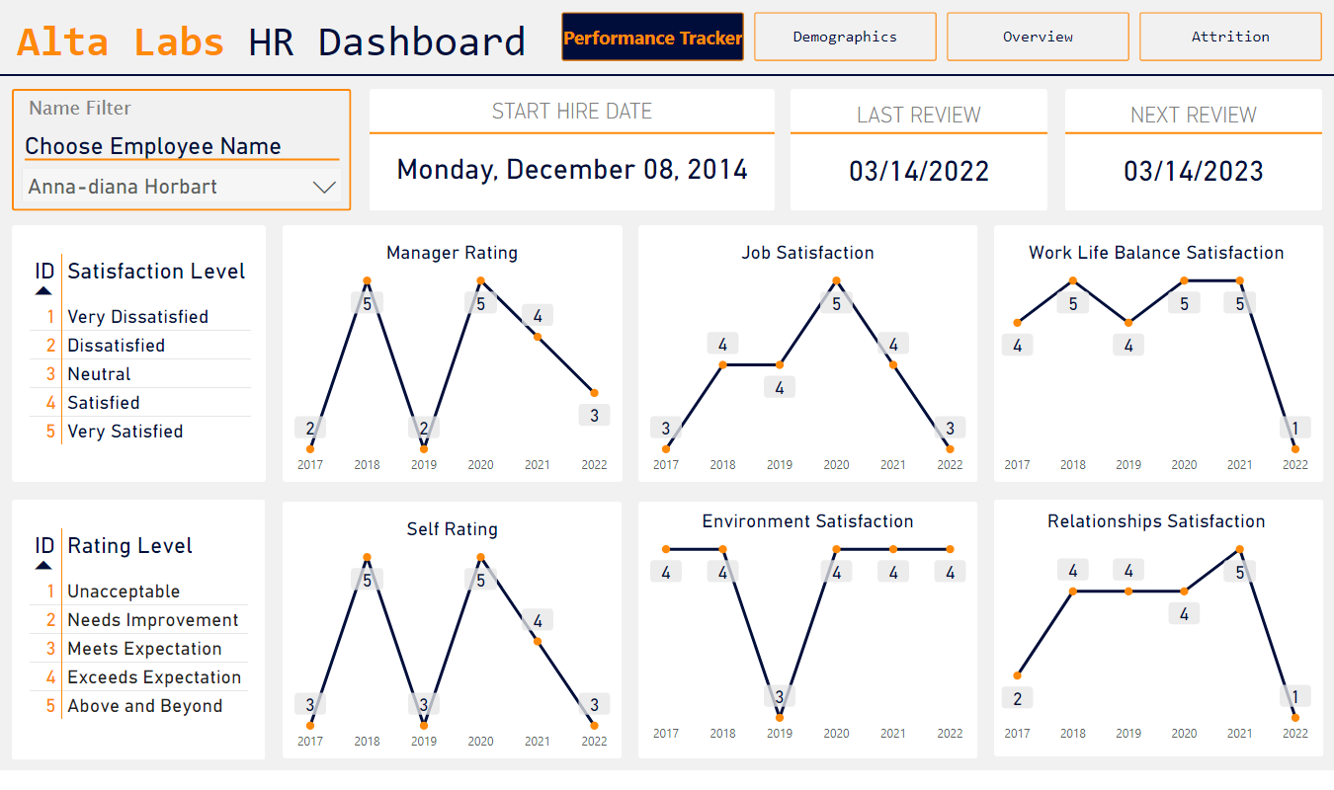
Notes:
shape
No alt text provided
textbox
No alt text provided
shape
No alt text provided
shape
No alt text provided
shape
No alt text provided
shape
No alt text provided
LAST REVIEW
No alt text provided
shape
No alt text provided
shape
No alt text provided
shape
No alt text provided
shape
No alt text provided
NEXT REVIEW
No alt text provided
Satisfaction Levels
No alt text provided
Rating Levels
No alt text provided
shape
No alt text provided
shape
No alt text provided
Manager Rating
No alt text provided
shape
No alt text provided
shape
No alt text provided
shape
No alt text provided
shape
No alt text provided
Self Rating
No alt text provided
Job Satisfaction
No alt text provided
Environment Satisfaction
No alt text provided
Relationships Satisfaction
No alt text provided
Work Life Balance Satisfaction
No alt text provided
START HIRE DATE
No alt text provided
shape
No alt text provided
Select Employee
No alt text provided
textbox
No alt text provided
Navegator
No alt text provided

Slide 27
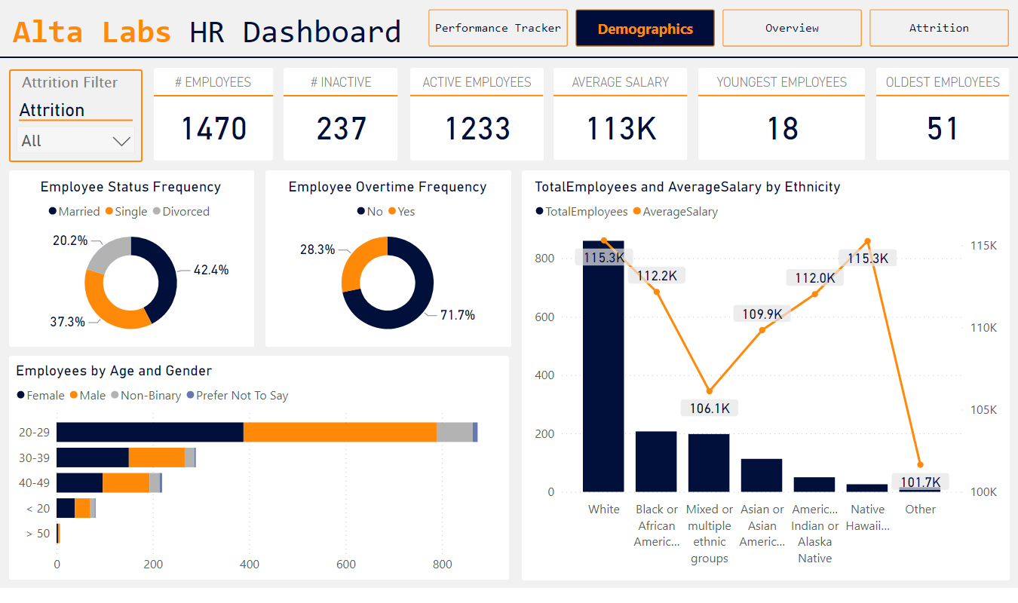
Notes:
shape
No alt text provided
textbox
No alt text provided
shape
No alt text provided
# EMPLOYEES
No alt text provided
shape
No alt text provided
shape
No alt text provided
shape
No alt text provided
# INACTIVE
No alt text provided
YOUNGEST EMPLOYEES
No alt text provided
OLDEST EMPLOYEES
No alt text provided
shape
No alt text provided
AVERAGE SALARY
No alt text provided
shape
No alt text provided
shape
No alt text provided
ACTIVE EMPLOYEES
No alt text provided
shape
No alt text provided
shape
No alt text provided
shape
No alt text provided
shape
No alt text provided
shape
No alt text provided
shape
No alt text provided
shape
No alt text provided
shape
No alt text provided
Employee Status Frequency
No alt text provided
lineStackedColumnComboChart
No alt text provided
Employee Overtime Frequency
No alt text provided
shape
No alt text provided
shape
No alt text provided
Employees by Age and Gender
No alt text provided
slicer
No alt text provided
textbox
No alt text provided
Navegator
No alt text provided

Slide 28
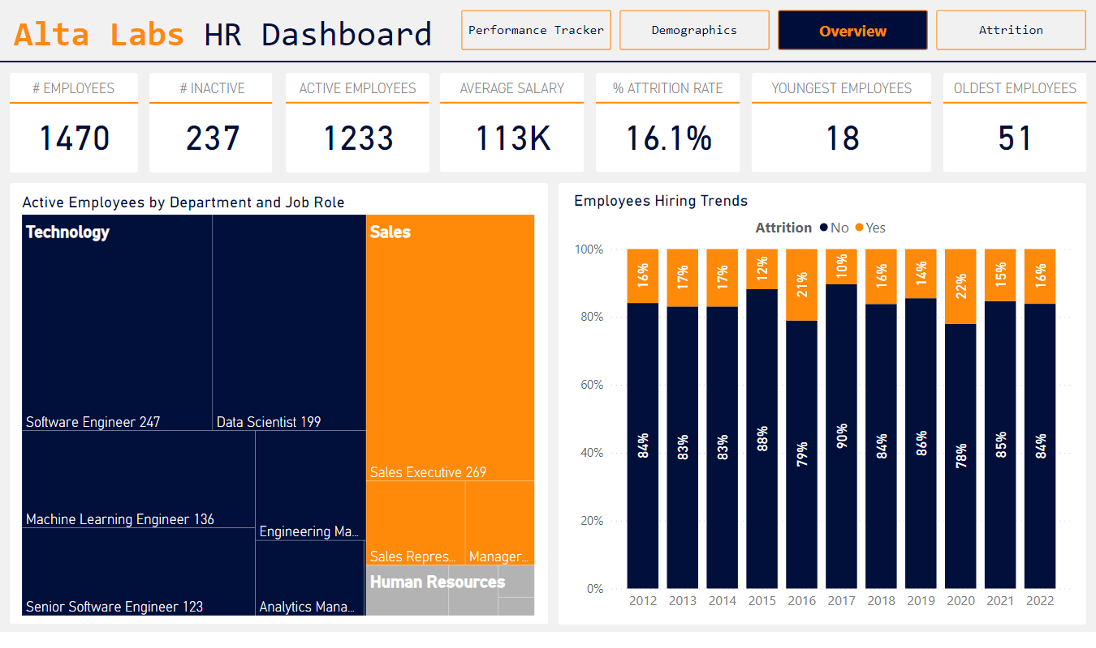
Notes:
shape
No alt text provided
textbox
No alt text provided
shape
No alt text provided
# EMPLOYEES
No alt text provided
shape
No alt text provided
shape
No alt text provided
shape
No alt text provided
# INACTIVE
No alt text provided
YOUNGEST EMPLOYEES
No alt text provided
OLDEST EMPLOYEES
No alt text provided
shape
No alt text provided
AVERAGE SALARY
No alt text provided
shape
No alt text provided
% ATTRITION RATE
No alt text provided
shape
No alt text provided
ACTIVE EMPLOYEES
No alt text provided
shape
No alt text provided
Active Employees by Department and Job Role
No alt text provided
shape
No alt text provided
Employees Hiring Trends
No alt text provided
shape
No alt text provided
shape
No alt text provided
shape
No alt text provided
shape
No alt text provided
shape
No alt text provided
shape
No alt text provided
shape
No alt text provided
Navegator
No alt text provided

Slide 29
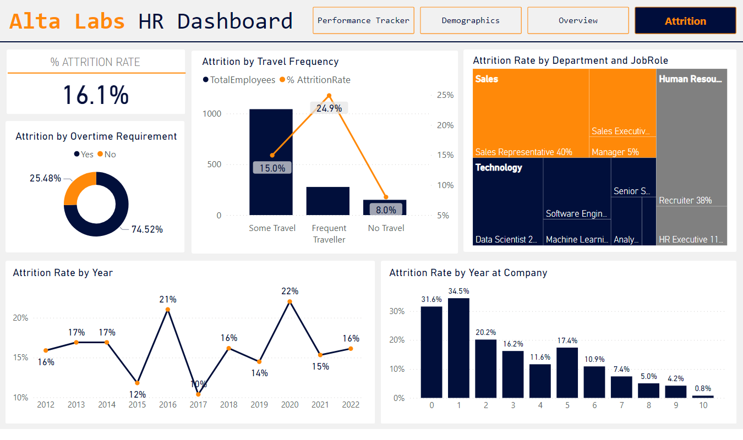
Notes:
shape
No alt text provided
textbox
No alt text provided
Navegator
No alt text provided
shape
No alt text provided
shape
No alt text provided
shape
No alt text provided
Attrition by Overtime Requirement
No alt text provided
Attrition Rate by Year
No alt text provided
shape
No alt text provided
% ATTRITION RATE
No alt text provided
shape
No alt text provided
Attrition Rate by Year at Company
No alt text provided
shape
No alt text provided
shape
No alt text provided
Attrition by Travel Frequency
No alt text provided
Attrition Rate by Department and JobRole
No alt text provided

Slide 30
08
Tools and Project Sources

Slide 31
Tools And Data Sources
Tool | Used for
Google Slides | Presentation
Power BI (Model View) | Create Data Model and Relationships
Power BI (Power Query) | Transforming the Data
Power BI (Report View) | Create visualization
Github | Host the Project Files
Power BI Files: Github Alta-Labs-HR-Repo Power BI Files
Dataset Files: Github Alta-Labs-HR-Repo Dataset Files
Dashboard PDF File: Github Alta-Labs-HR-Repo Dashboard PDF File

Slide 32
THANKS FOR YOUR INTEREST

