Slide 1

Capstone Project
The Battle of the Neighborhoods (Week 2)
Askhat Abdrassilov May 2020

Slide 2
Introduction
1.1 Client:
US based company with main business of letting individuals or small companies rent workplace or even whole rooms in company's so called co-working offices.
1.2 Problem:
Company wants to grow and enter new market. It's required to identify safe and secure location in Vancouver, Canada, to open commercial establishment, specifically, co-working office.
1.3 Solution:
Identification of the safest borough is done thru analyzing crime data and shortlisting neighbourhood, where co-working offices are not amongst the most common venues, and yet as close to the city as possible. Data science tools will be used to analyze data and focus on the safest borough and explore its neighborhoods and the 10 most common venues in each neighborhood so that the best neighborhood where co-working offices are not amongst the most common venue can be selected.

Slide 3
Data and Strategy
Geographical coordinates of Vancouver will be used to plot neighbourhoods in a borough that is safe and in the city's vicinity, and finally cluster our neighborhoods and present our findings.
Using a real-world data set from Kaggle containing the Vancouver Crimes from 2003 to 2019: A dataset consisting of the crime statistics of each neighbourhood in Vancouver along with additional information such as type of crime, recorded year, month and hour.
Gathering additional information of the list of officially categorized boroughs in Vancouver from Wikipedia: Borough information will be used to map the existing data where each neighbourhood can be assigned with its respective borough.
Creating a new consolidated dataset of the neighborhoods, along with their boroughs, crime data and the respective neighbourhood's co-ordinates: This latitude and longitude data will be fetched using OpenCage Geocoder to explore the neighbourhood by plotting it on maps using Folium and perform exploratory data analysis.
Creating a new consolidated dataset of the neighborhoods, boroughs, and the most common venues and the respective neighbourhood along with co-ordinates: This data will be fetched using Foursquare API to explore the neighbourhood venues and to apply machine learning algorithm to cluster the neighbourhoods and present the findings by plotting it on maps using Folium.

Slide 4
Methodology
Categorized the methodology section into two parts:
Exploratory Data Analysis: Visualise the crime repots in different Vancouver boroughs to idenity the safest borough and normalise the neighborhoods of that borough. We will Use the resulting data and find 10 most common venues in each neighborhood.
Modelling: To help stakeholders choose the right neighborhood within a borough we will be clustering similar neighborhoods using K - means clustering which is a form of unsupervised machine learning algorithm that clusters data based on predefined cluster size. We will use K-Means clustering to address this problem so as to group data based on existing venues which will help in the decision making process.

Slide 5
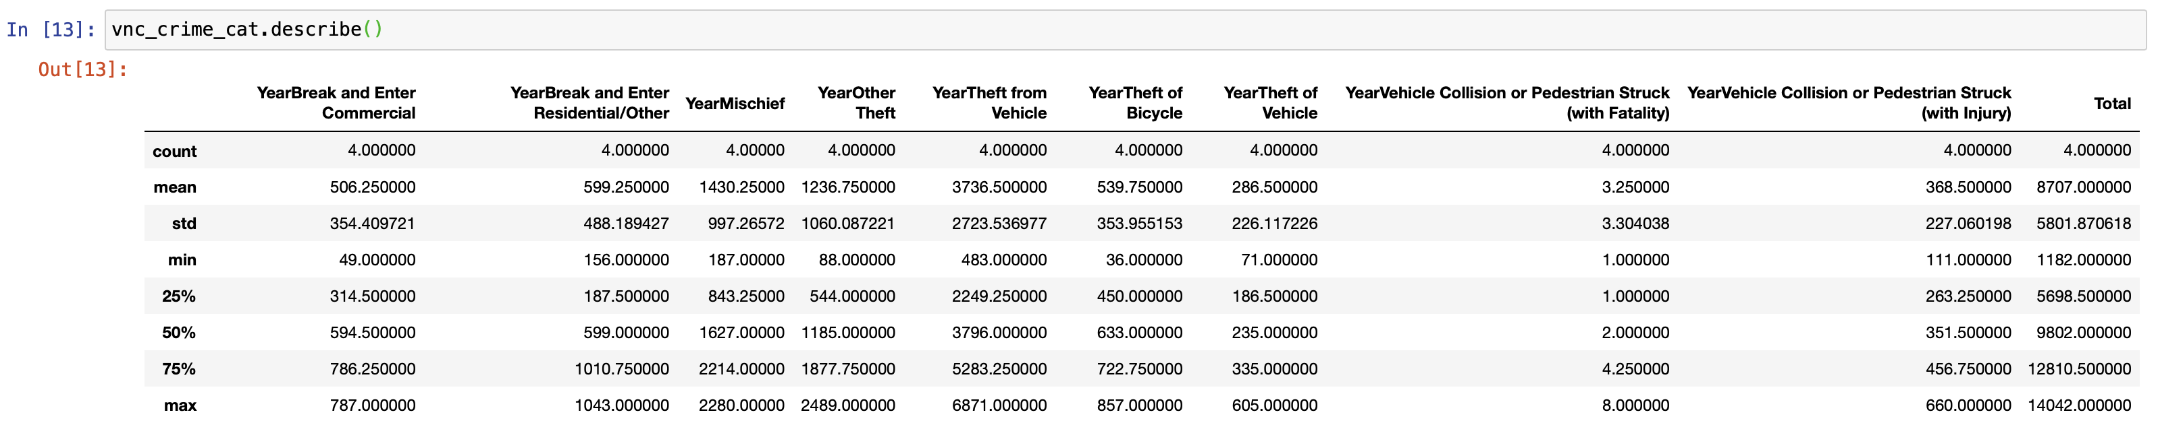
Statistical summary of crimes

Slide 6
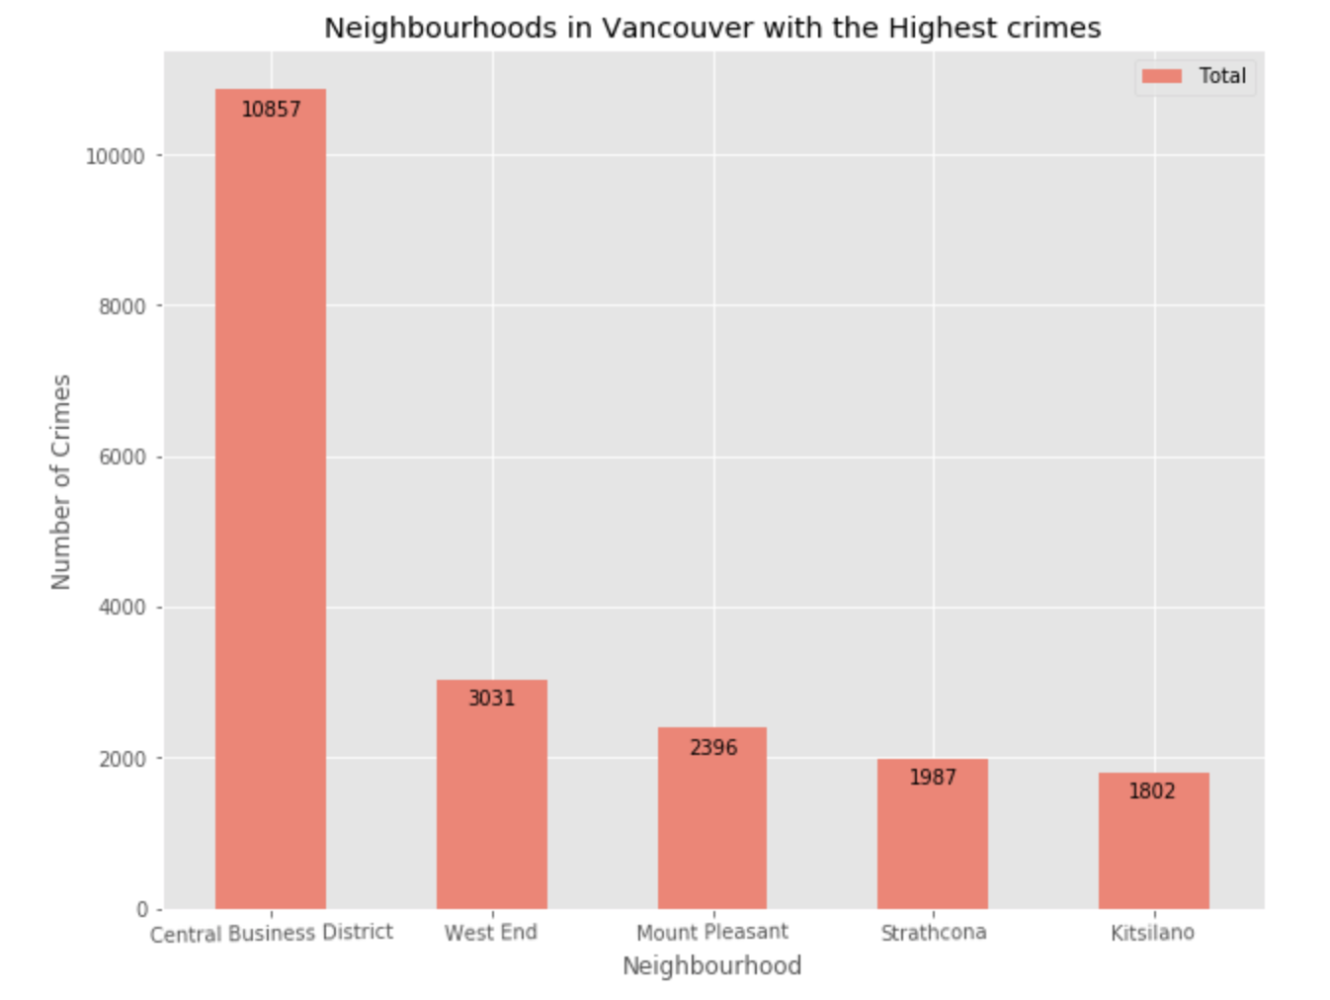
Five Neighborhoods with highest crime

Slide 7
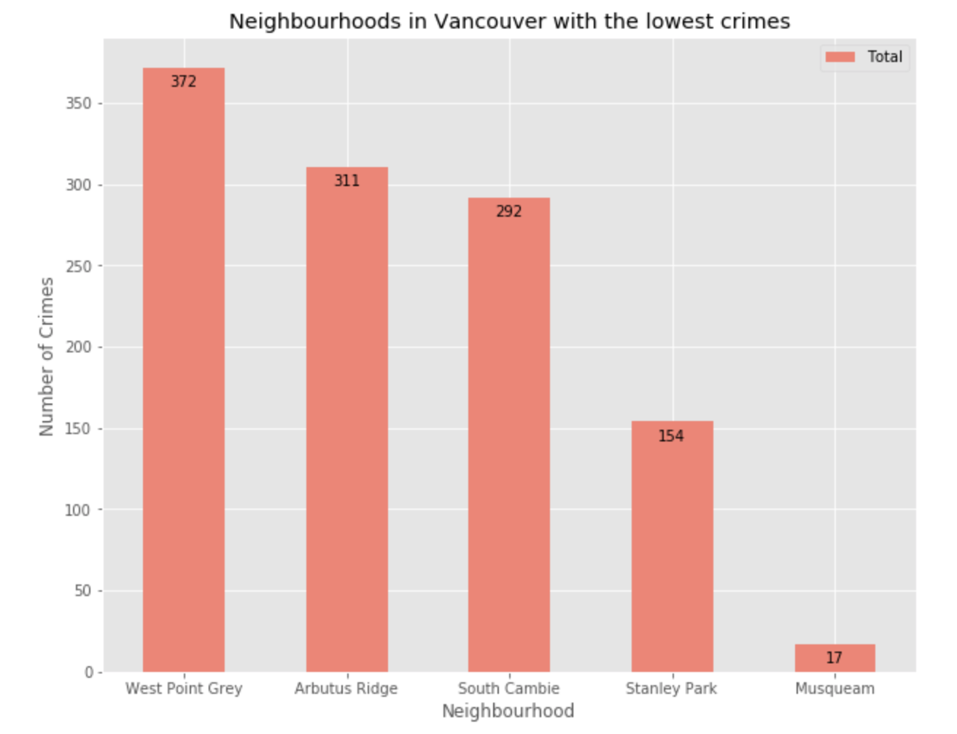
Five Neighborhoods with lowest crime

Slide 8
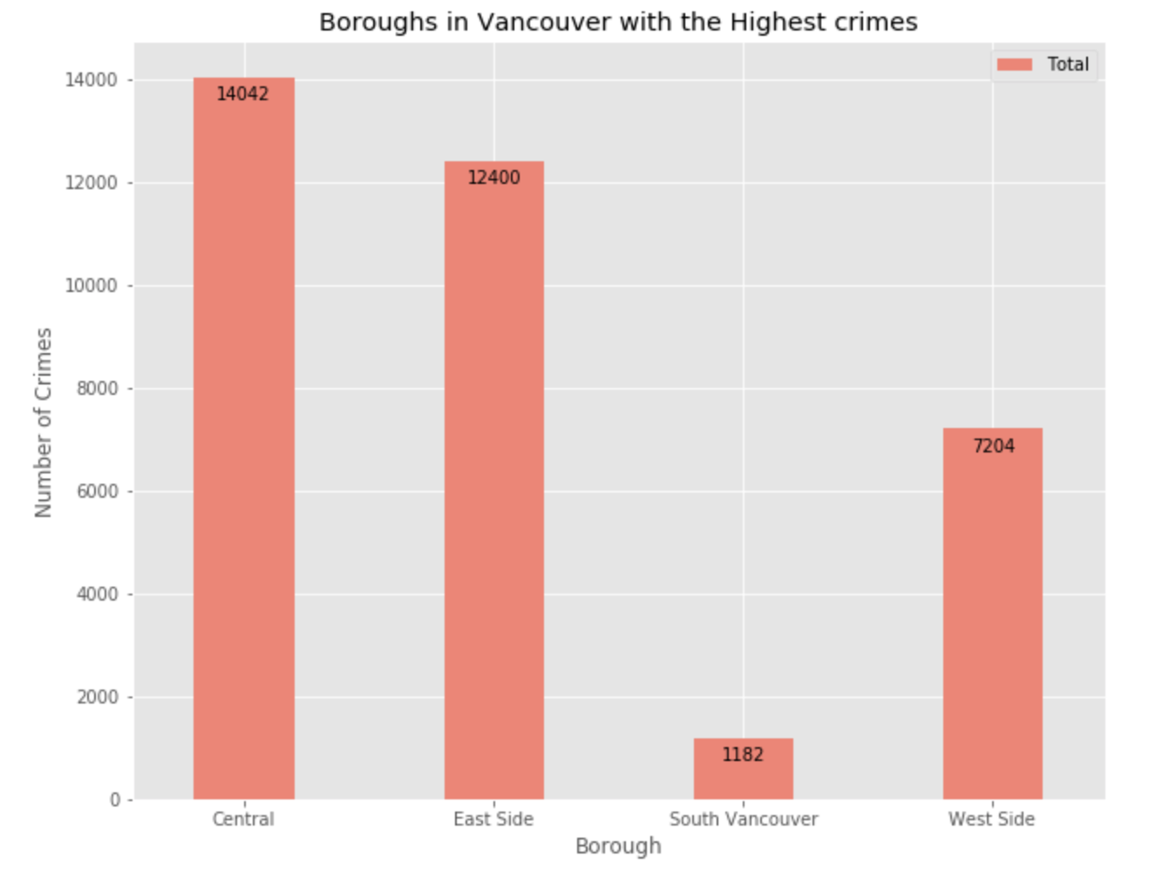
Borough is Vancouver with Highest Crime

Slide 9
Based on exploratory data analysis it is clear that South Vancouver has the lowest crimes.
Since South Vancouver has very little number of neighborhoods and opening a commercial establishment would not be viable, we can choose the next borough with lowest crime which is West Side.
Different types of crimes recorded in the West Side Borough
West side was chosen because crime type Break and enter Commercial is also low amongst other crimes types which makes West Side ideal destination for opening of commercial establishments

Slide 10
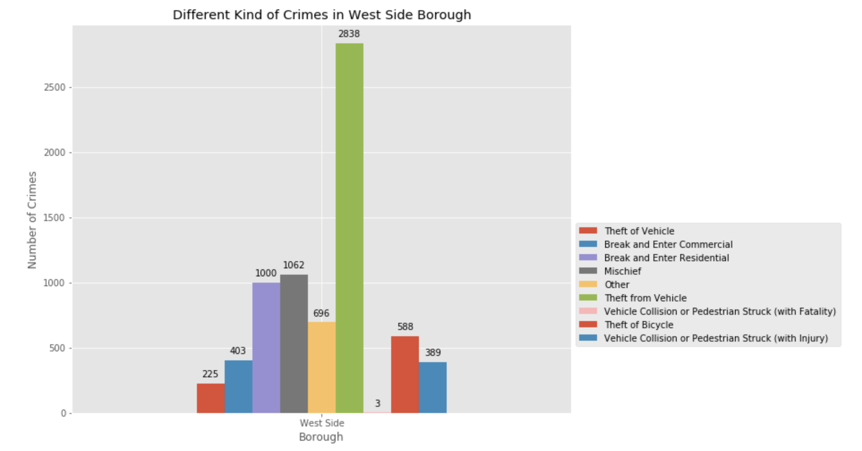
Different Kind of Crimes in West Side Borough

Slide 11
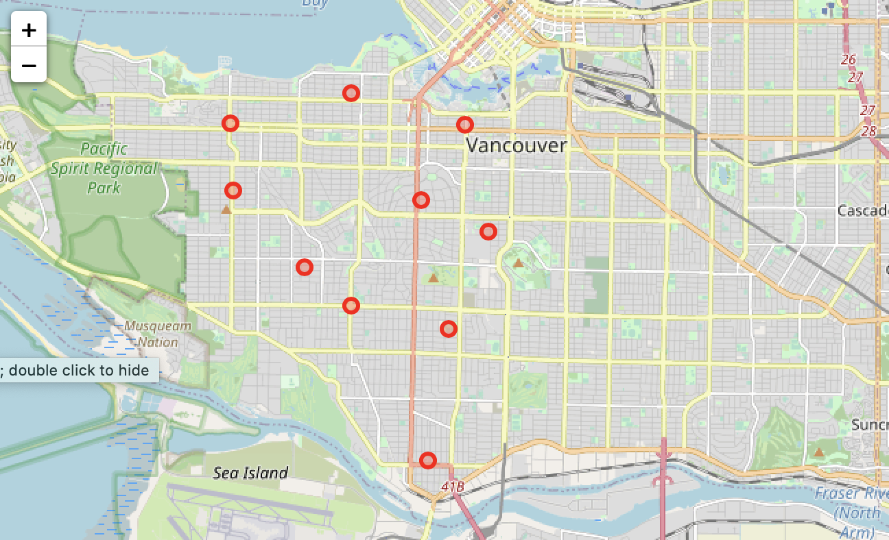
Using Folium to plot Vancouver City's West Side Borough and its Neighborhoods

Slide 12
Creating a new consolidated dataset of the Neighborhoods, boroughs, and the most common venues and the respective Neighbourhood along with co-ordinates.
This data will be fetched using Foursquare API to explore the neighbourhood venues and to apply machine learning algorithm to cluster the neighbourhoods and present the findings by plotting it on maps using Folium.

Slide 13
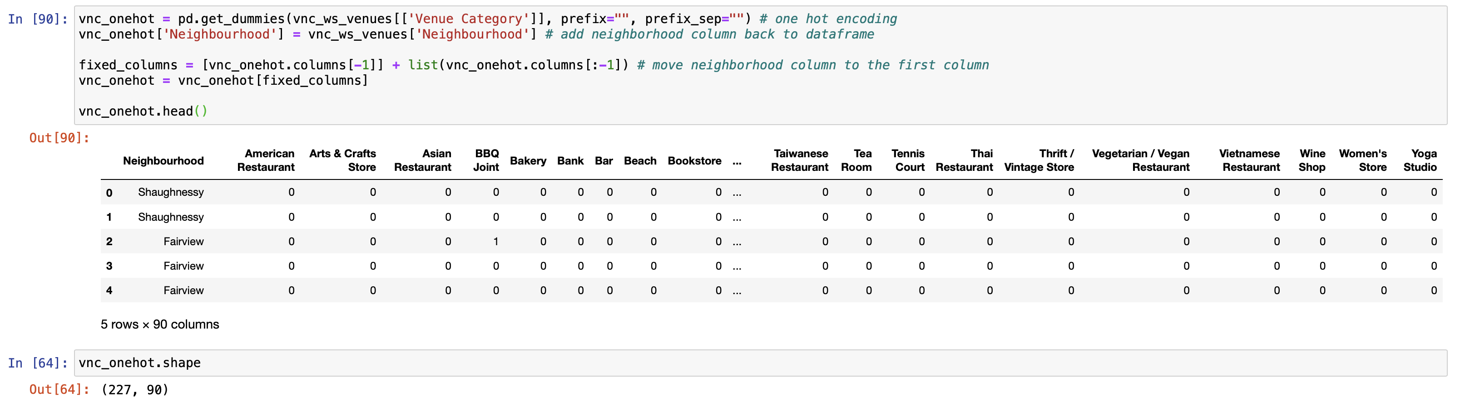
Modelling

Slide 14
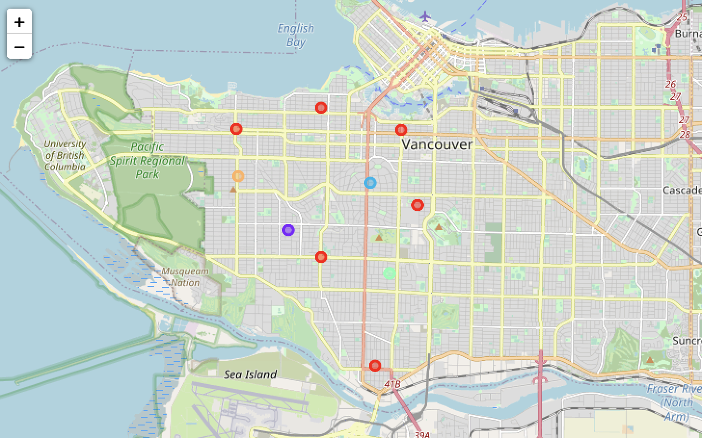
Clustering Neighbourhoods

Slide 15
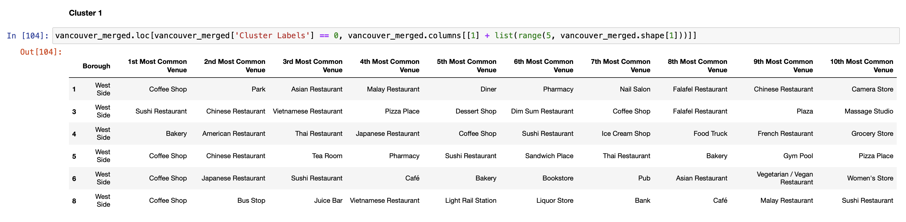
Examining the resulting Clusters

Slide 16
Results and Discussion
The main business problem was to help to Client to identify safe and secure borough in Vancouver, Canada, and most suitable neighbourhood within the borough in order to set up a commercial establishment, specifically, co-working office. It has been achieved by using open-source data, data analysis tools and technics - based on crime data safest borough with reasonably high number of neigbourhoods was identified. Additionally, by grouping the neighborhoods into clusters to assist the stakeholders, relevant data about venues and safety of a given neighborhood was provided.

Slide 17
Conclusion
Exploring an open-source data overall picture of crime types and location in Vancouver and its neighbourhoods was obtained. By categorizing them into different boroughs by crime rate, safest one was identified and eventually safest neighbourhoods within it was identified.

