Slide 1
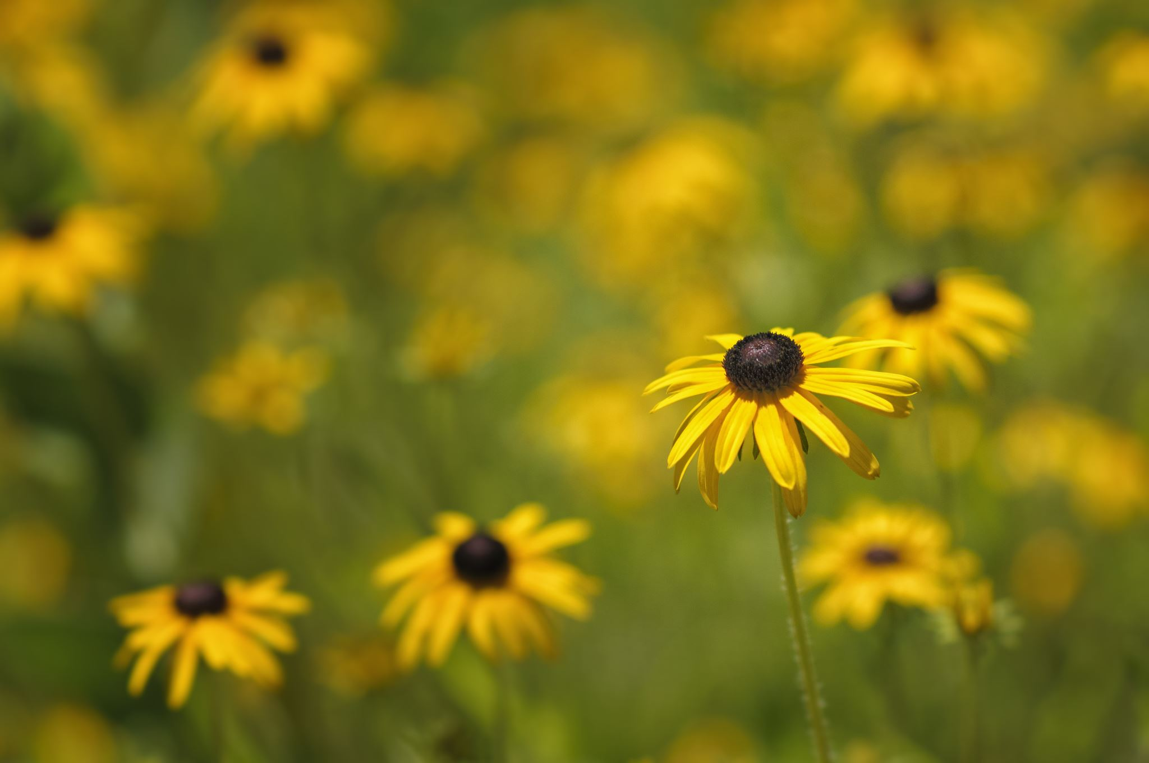
Title :
flowers

Slide 2
Chapter 1: about flowers

Slide 3
Out door flowers
Outdoor flowers are the vibrant, colorful blossoms that bloom outside, adding beauty and life to gardens, yards, and landscapes. They are the reproductive structures of flowering plants, and play a vital role in attracting pollinators like bees and butterflies, facilitating seed production and ensuring the continuation of plant life.

Slide 4
Indoor flowers
Indoor blooming plants can brighten your home for years and are relatively easy to care for. The key to their success lies in providing the right lighting. Because most houseplants are tropical plants, they thrive in bright, indirect light, ideally from east-, west-, or south-facing windows

Slide 5
Ending about flowers
A flower is a bright-coloured, fragrant and attractive part of a plant. It is composed of petals, sepals, stamen and carpels, where stamen and carpels are the male and female reproductive part of the plant, respectively. Flower is the major reproductive part of any plant bearing it.

