Slide 1

Project-Prime-Generator-241

Slide 2
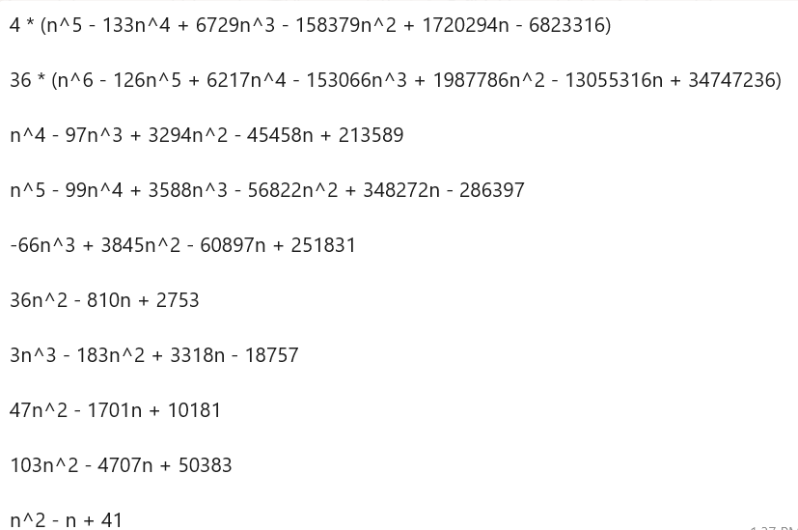
ForMUlas

Slide 3

ForMUlas
These formulas represent diverse polynomial expressions designed to generate prime numbers for specific integer values of n. By carefully selecting coefficients, these polynomials aim to maximize the likelihood of producing primes, particularly for smaller values of n. While they showcase mathematical ingenuity in approximating prime patterns, no formula guarantees primes for all inputs, and verification is necessary. Among these, simpler forms like n2−n+41n^2 - n + 41n2−n+41 are notable for reliably producing primes at small n, highlighting the elegance of prime-generating equations despite inherent limitations.

Slide 4

Methods explanation
This program provides a comprehensive analysis of several polynomial functions, focusing on prime number generation, execution time, and non-prime detection. It allows the user to explore different functions' statistical performance, including the most primes generated, the largest prime found, and the function with the fastest execution time. Additionally, it identifies the first non-prime number generated by each function. The program utilizes efficient prime-checking algorithms and offers a detailed breakdown of results through charts and tables, providing valuable insights into the performance and characteristics of each function. This facilitates a deeper understanding of prime number behavior across various mathematical formulas.

Slide 5

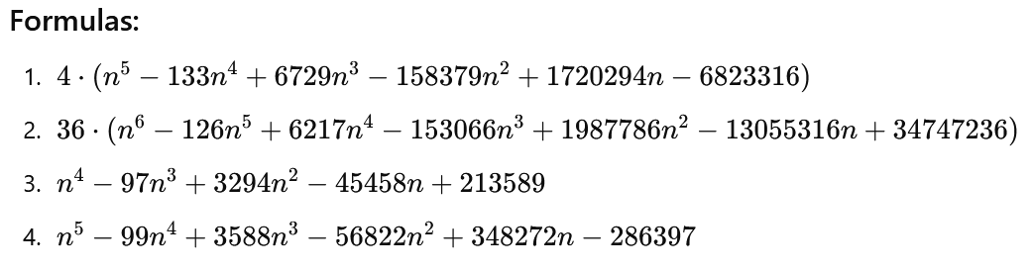
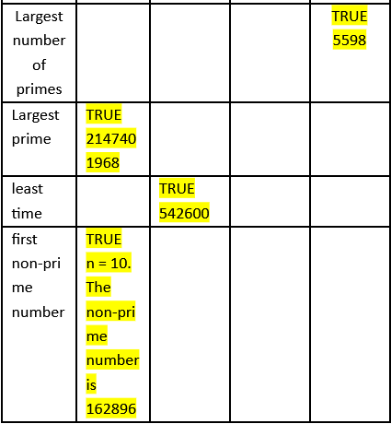
Results
Formula 1: It produces the largest prime number 2147401968, and its first non-prime occurs when n=10 with the non-prime value being 162896.
Formula 4: It has the highest count of primes generated, with 5598 primes. fifth-degree polynomial.
Formula 2: achieves the least computational time (denoted by "TRUE 542600").

Slide 6
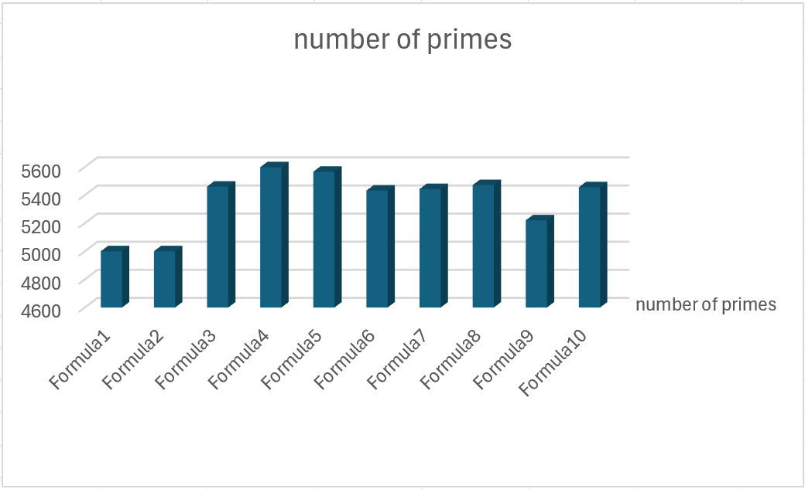
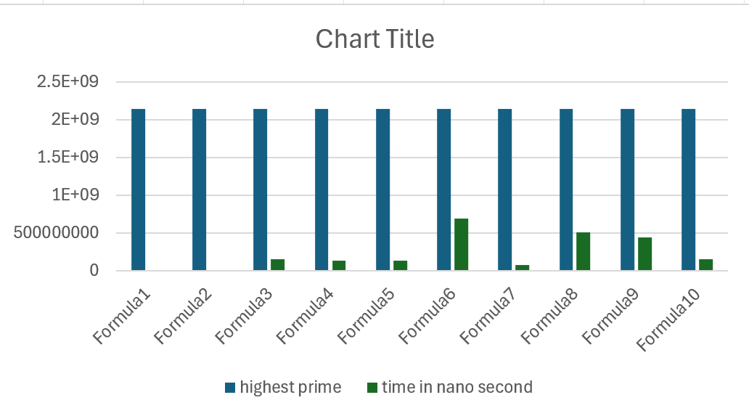
statistics

Slide 7

THANK YOU
عبد الرحمن ممدوح عبد الملك محمدن

