Slide 1
FitSense AI
BEST Istanbul Yıldız Hackathon 2026
Your Phone is Your Personal Trainer
MATLAB Mobile
Deep Learning
Signal Processing
Sensor Fusion
App Designer
NighQuest | May 2026

Slide 2


Fitness trackers cost $200+
but everyone already has a phone
THE PROBLEM
Smartphones have accelerometers, gyroscopes, and GPS — the same sensors used by expensive wearables. We built an AI-powered system that turns your phone into a professional fitness tracker using MATLAB.
📱
Multi-Sensor Data
Accelerometer + Gyroscope + GPS captured via MATLAB Mobile
🧠
AI Classification
Deep Learning LSTM identifies what activity you' re doing in real-time
📊
Smart Analytics
Steps, calories, distance, and a unique "Workout DNA" fingerprint

Slide 3


OUR APPROACH
End-to-End Pipeline
📱 MATLAB Mobile
Sensor Logging
🔧 Preprocessing
Bandpass Filter
📊 Features
44 Time+Freq
🧠 BiLSTM
Deep Learning
🔥 MET Calories
Regression
📈 Dashboard
App Designer
→
→
→
→
→
Signal Processing
Feature Engineering
→ 4th-order Butterworth bandpass (0.5–15 Hz)
→ 10 time-domain features × 4 channels
→ Zero-phase filtering (filtfilt)
→ FFT spectral energy & entropy
→ Gravity removal & magnitude computation
→ Dominant & mean frequency
→ Adaptive peak detection for steps
→ Sliding windows (2s, 50% overlap)

Slide 4

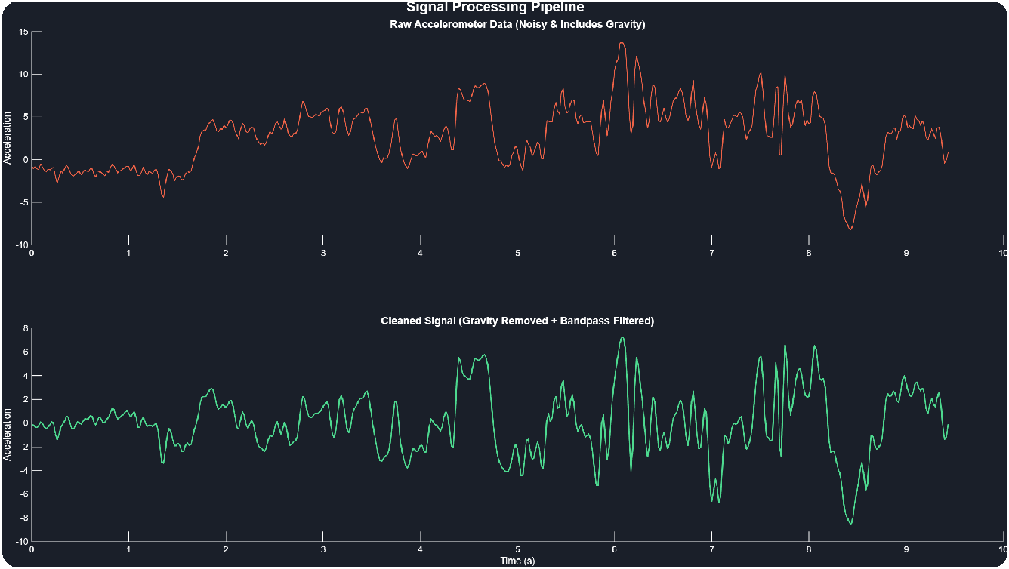


SIGNAL PROCESSING
From Noisy Data to Clean Signals
Raw accelerometer data is noisy and contains gravity. Our preprocessing
pipeline:
% Butterworth bandpass filter
[b, a] = butter(4, [0.5 15]/(Fs/2)); accelClean = filtfilt(b, a, rawAccel);
% Orientation-independent magnitude mag = sqrt(ax.^2 + ay.^2 + az.^2);
% Adaptive step detection
[peaks, locs] = findpeaks(mag, ... 'MinPeakHeight', std(mag)*0.8, ... 'MinPeakDistance', round(Fs*0.35));

Slide 5
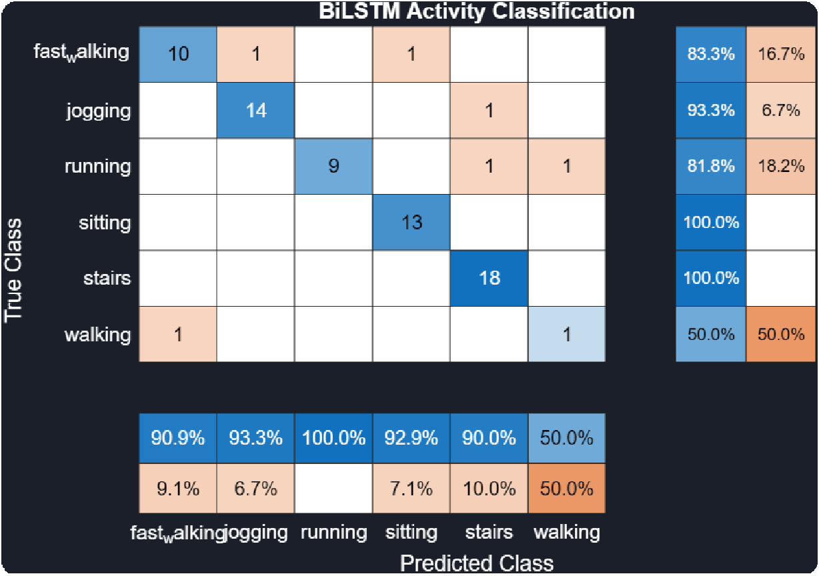
Bidirectional LSTM Activity Classifier
DEEP LEARNING
Why LSTM over Classic ML?
→ Captures temporal patterns in movement
→ Walking has a rhythm — LSTM learns it
→ Processes raw sequences directly
→ Bidirectional = reads forward AND backward
sequenceInputLayer(4) — ax, ay, az, magnitude
↓
bilstmLayer(128) — captures temporal patterns
↓
dropoutLayer(0.3) → bilstmLayer(64)
↓
fullyConnected(32) → softmax → classification

Slide 6

LSTM vs Classic ML
MODEL COMPARISON
We trained 5 models to compare deep learning against traditional approaches:
🌳
Decision Tree
🎯
KNN (k=5)
📐
SVM (RBF)
🌲
Random Forest
🧠
BiLSTM
94.4%
88.7%
38.0%
94.4%
95.77%
★ Advanced AI
The comparison demonstrates mastery of multiple ML paradigms. The Bidirectional LSTM (BiLSTM) outperformed the classic ML models, proving its ability to capture complex temporal sequence dynamics.

Slide 7

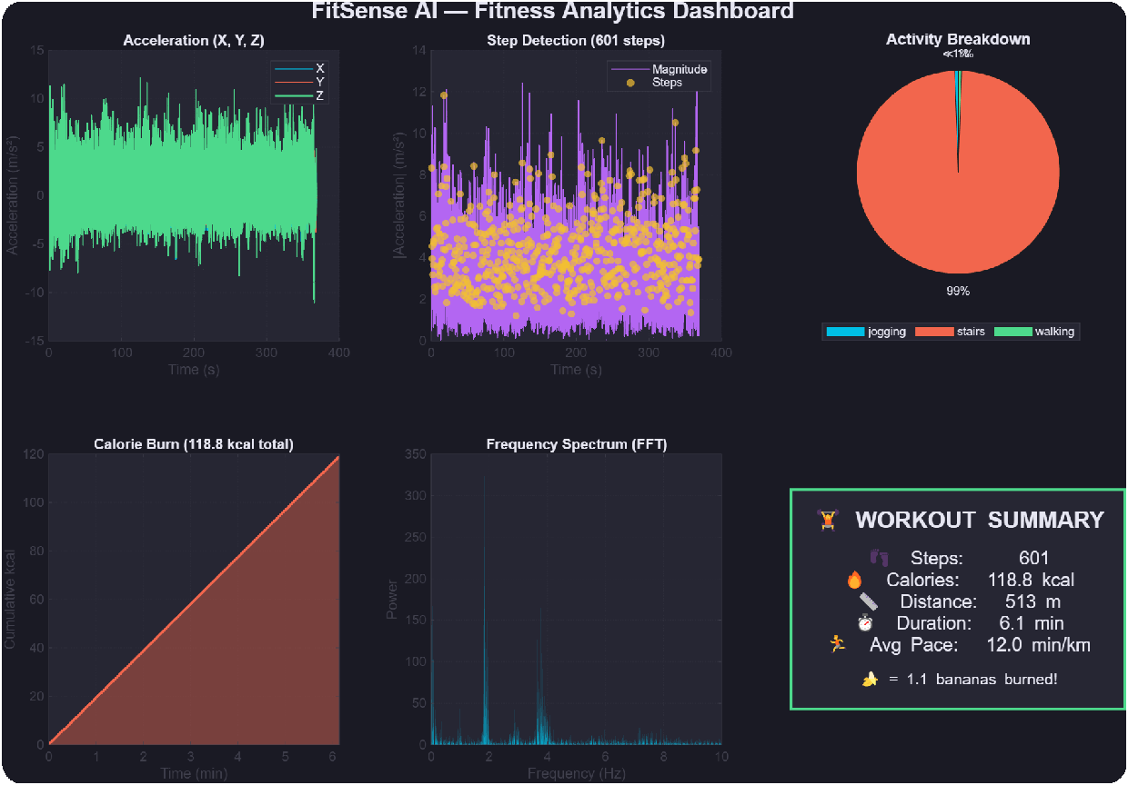
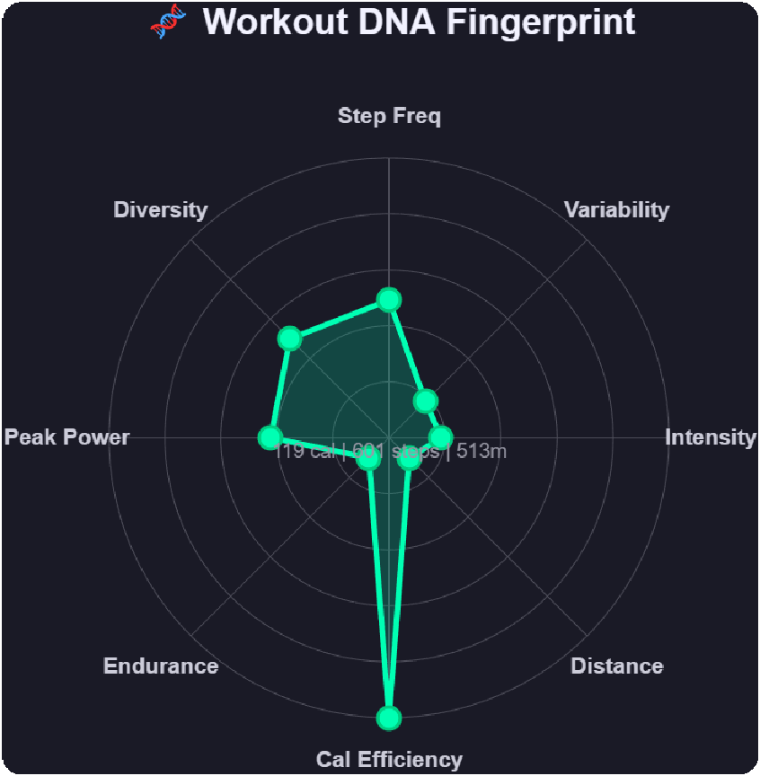
VISUALIZATION
Professional Dashboard & Workout DNA
Comprehensive Analytics Workout DNA Fingerprint
A unified, dark-themed dashboard presenting raw signals, step detection, spectrum analysis, and activity breakdown.
A unique polar radar chart that creates a visual "fingerprint" for each workout based on 8 metrics.
12+ Plot Types
Dark Theme
Interactive Tabs
Animated Plots
3D Trajectory

Slide 8
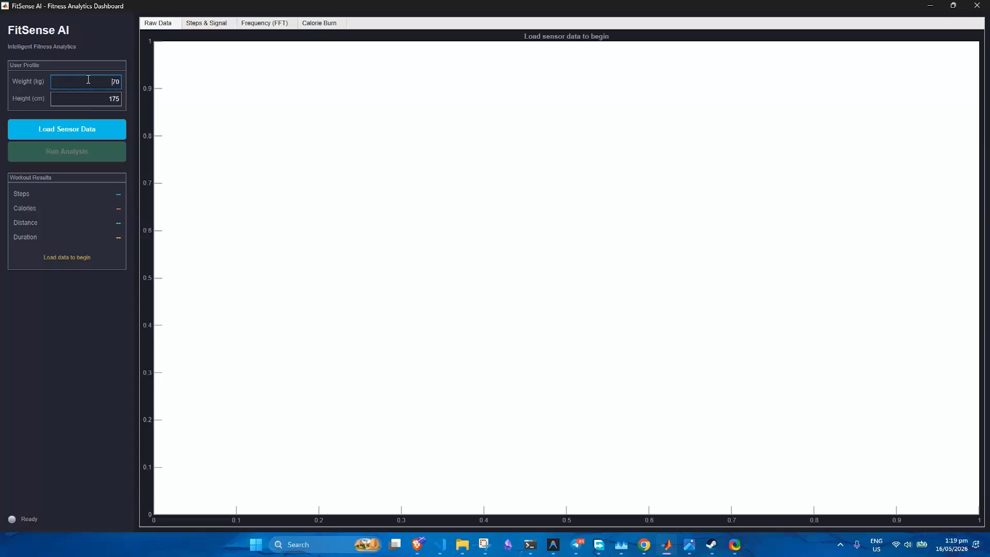
DEMO
Live Demo & Execution
Watch the FitSense AI app in action, processing real-time sensor data and displaying analytics.
→ Real-time activity recognition
→ Live step counting & calorie estimation
→ Interactive data visualization

Slide 9
RESULTS & IMPACT
Workout Summary
601 119.5
Steps Detected Calories Burned (kcal)
513
Distance (meters)
6.1
Duration (min)
That's equivalent to...
🍌 1.1 bananas
🍕 0.4 pizza slices
Anyone with a smartphone can now have a professional fitness tracker
Built with MATLAB Online • MATLAB Mobile • Deep Learning Toolbox • App Designer

