Slide 1
QEEMA INTERNSHIP PROJECT
NYC Mobility Analytics
Platform
From raw trip data to a structured analytical warehouse and business insights
Abdullah Mohamed Elsherif
November 2026

Slide 2
Project Agenda
WHAT I WILL COVER
• Project overview and objective
• Dataset source, structure and reading method
• Tools and technologies
• ETL pipeline and data quality checks
• PostgreSQL warehouse design
• SQL analysis and business insights
• Performance optimization
• Airflow validation and Superset dashboard
• Final results and conclusion
Qeema Internship Project | NYC Mobility Analytics Platform
2

Slide 3
Project Overview and Objective
01 — PROJECT PURPOSE
Build an end-to-end data engineering platform that turns raw NYC mobility records into reliable data for analysis.
Understand
Process
Deliver insights
Inspect source files, fields, volume and quality.
Read, validate, transform and load trip records.
Organize the warehouse and present findings in a dashboard.
Qeema Internship Project | NYC Mobility Analytics Platform
3

Slide 4
Dataset Source and Structure
02 — UNDERSTANDING THE RAW DATA
Source: NYC Taxi and Limousine Commission — High-Volume For-Hire Vehicle (HVFHV) trip records.
20 monthly files
Approx. 9.35 GB
One row per trip
January 2025 through August 2026.
Total downloaded Parquet file size.
Each record describes a single trip.
• Pickup/drop-off timestamps and zone IDs
• Trip distance and duration
• Base fare, tips and provider/trip attributes
Qeema Internship Project | NYC Mobility Analytics Platform
4

Slide 5
How the Data Was Read
03 — EXTRACTION APPROACH
PyArrow
Pandas
Batch processing
Opened Parquet files and read their row groups efficiently.
Converted each row group into a DataFrame for processing.
Processed smaller chunks instead of loading all 9.35 GB into memory.
• Loop through the 20 monthly files.
• Iterate through each file's row groups.
• Read required columns and convert each group to a DataFrame.
• Pass each batch to validation and loading.
Qeema Internship Project | NYC Mobility Analytics Platform
5

Slide 6
Tools and Technologies
04 — WHAT I USED AND WHY
• Python — main language for the ETL pipeline.
• PyArrow — efficient Parquet reading and row-group access.
• Pandas — tabular transformations and data quality checks.
• PostgreSQL — storage and analytical warehouse.
• Apache Airflow — workflow execution and database validation.
• Apache Superset — dashboard and visualizations.
• Docker — runs supporting application environments.
Qeema Internship Project | NYC Mobility Analytics Platform
6

Slide 7
ETL Pipeline and Data Quality
05 — EXTRACT, TRANSFORM AND LOAD
EXTRACT
TRANSFORM
LOAD
Read monthly Parquet files in row groups using PyArrow and Pandas.
Validate required fields and trip rules; reject invalid rows and flag suspicious values.
Insert accepted records into PostgreSQL staging and fact tables.
• Reject missing timestamps, invalid trip sequence, nonpositive trip time, missing/negative distance, or missing location IDs.
• Flag negative fares, zero distance and duration mismatches over 300 seconds.
• Outcome: 20/20 files processed; 411,760,137 loaded; 16,258 rejected.
Qeema Internship Project | NYC Mobility Analytics Platform
7

Slide 8
PostgreSQL Database Design
06 — ORGANIZING THE WAREHOUSE
I organized the trip data using a star-schema structure.
fact_trips
Trip-level measures: distance, duration, fares, tips and dimension keys.
dim_date
dim_location
dim_license
dim_provider
Date context
Zone context
License context
Provider context
Fact table = trip measurements | Dimension tables = descriptive context
Qeema Internship Project | NYC Mobility Analytics Platform
8

Slide 9
SQL Analysis and Business Insights
07 — WHAT THE DATA REVEALED
• LaGuardia and JFK airports were the top two pickup locations.
• Saturday had the highest volume (about 68.2 million); Monday was lowest (about 51.0 million).
• 6 PM was the busiest hour (about 24.1 million); 3 AM was lowest.
• Provider distribution: B03404 about 72.21%; B03406 about 27.79%.
• Average fares and trip durations varied by borough.
• Manhattan had the highest tipping frequency among major boroughs (about 24.47%).
Qeema Internship Project | NYC Mobility Analytics Platform
9

Slide 10
Performance Optimization
08 — IMPROVING QUERY EFFICIENCY
Materialized monthly summary
Pickup-date index
Full monthly aggregation: about 142.90 seconds. Reading the precomputed 20-row summary: about 0.040 ms in the recorded test.
January 2026 query used a parallel Index Only Scan and completed in about 2.07 seconds, with zero heap fetches.
• The summary test compares full aggregation with reading precomputed results — not identical work.
• The index was confirmed in the query plan; a before-index timing was not recorded.
Qeema Internship Project | NYC Mobility Analytics Platform
10

Slide 11
Airflow Validation and Superset Dashboard
09 — VALIDATION AND PRESENTATION
Airflow validation
Superset dashboard
The DAG connected to PostgreSQL and checked that fact_trips was not empty. Validated count: 411,760,137.
Eight charts: monthly trends, pickup locations, fares, weekday and hourly trips, duration, providers and tips.
Important clarification
The main Python ETL ran separately. Airflow validated the PostgreSQL connection and fact-table contents; it did not orchestrate the full ETL.
Qeema Internship Project | NYC Mobility Analytics Platform
11

Slide 12
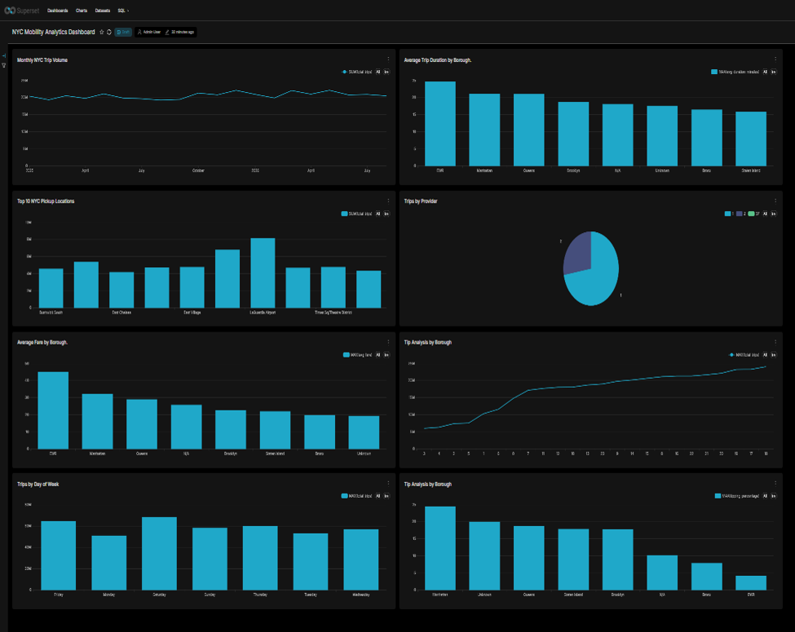

Slide 13
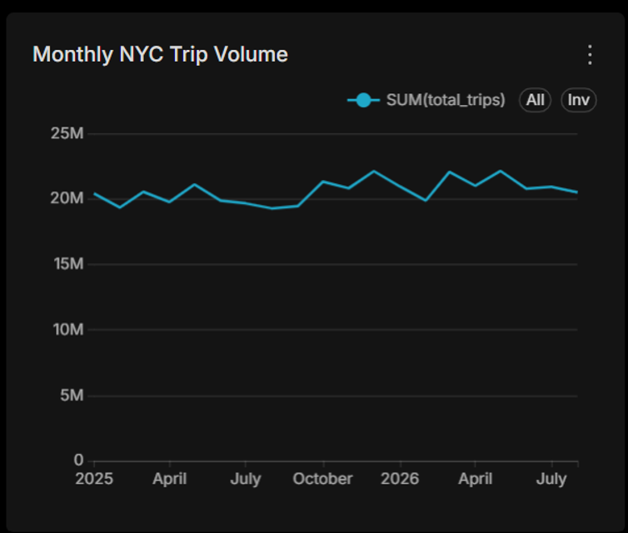
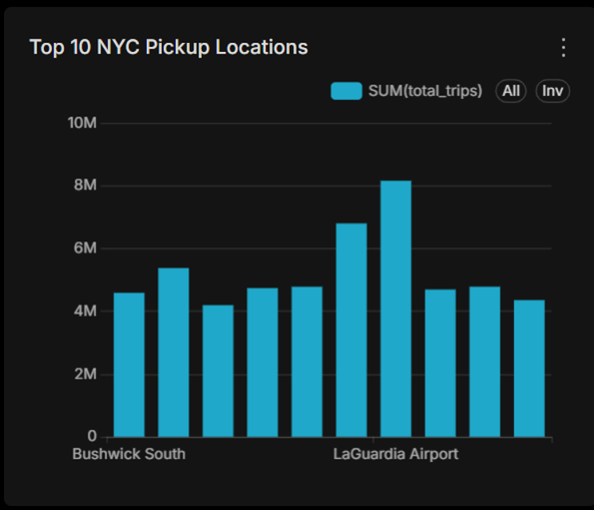

Slide 14
Project Results and Conclusion
• Processed 20 monthly Parquet files (approximately 9.35 GB).
• Loaded 411,760,137 records and rejected 16,258.
• Built a PostgreSQL analytical warehouse and SQL analysis objects.
• Applied materialized summaries and a pickup-date index.
• Validated the database with Airflow and delivered an eight-chart Superset dashboard.
THANK YOU
Questions & Discussion
Abdullah Mohamed Elsherif

