Slide 1
Multi-Group SEIR Disease Transmission
and Intervention Simulation
Using Monte Carlo Methods
Abdulkarim Noorzaie (100748590) | Abdullah Hanoosh (100749026)
Group 2
SOFE 4820U - Modeling & Simulation | Ontario Tech University | March 2026

Slide 2
Problem Description and Motivation
The Challenge
Key Numbers
Infectious disease outbreaks spread differently across age groups
Public health interventions must be evaluated before deployment
Real outbreaks involve detection delays before response begins
Deterministic models miss stochastic variation in transmission
1,000,000
Model Population
3 Groups
Children, Adults, Elderly
300 Runs
Monte Carlo Simulations
Our Approach
Multi-group SEIR model with 3 demographic groups
Monte Carlo simulation (300 runs) for uncertainty
6 intervention scenarios with 14-day detection delay
Validated against Ontario COVID-19 first wave data
6 Scenarios
Intervention Strategies
14 Days
Detection Delay

Slide 3
Related Work
Li et al., 2020 (NEJM)
Early COVID-19 transmission dynamics. Source for incubation period (~5.2 days) and basic reproduction number.
Mossong et al., 2008 (POLYMOD)
Large-scale contact survey across 8 European countries. Foundation for age-specific contact rates.
Prem et al., 2017
Projected contact matrices to 152 countries. Basis for our multi-group contact structure.
Alimohamadi et al., 2020
Meta-analysis of R0 estimates for COVID-19 (range: 2.0-3.5). Used for validation benchmarks.
Levin et al., 2020
Age-specific infection fatality rates. Used for severity and mortality analysis.
JHU CSSE COVID-19 Repository
Archived time series case data. Ontario first wave data used for model validation.

Slide 4
Methodology: SEIR Model
S
Susceptible
E
Exposed
I
Infected
R
Recovered
▶
▶
▶
Key Parameters (vary by age group):
Parameter | Children (0-17) | Adults (18-64) | Elderly (65+)
Beta (transmission) | 0.030 | 0.035 | 0.040
Sigma (1/incubation) | 1/5.2 | 1/5.2 | 1/5.2
Gamma (recovery) | 1/7 | 1/10 | 1/12
Population | 200,000 | 600,000 | 200,000
Incubation ~5.2 days (Li et al., 2020). Recovery varies: 7 days (children), 10 days (adults), 12 days (elderly).

Slide 5
Multi-Group Structure and Contact Matrix
Contact patterns drive differential transmission between age groups
From \ To | Children | Adults | Elderly
Children | 10.0 | 3.0 | 1.5
Adults | 3.0 | 8.0 | 2.0
Elderly | 1.5 | 2.0 | 4.0
Key Observations
Children have highest within-group contacts (10/day) from school settings
Adults have 8 daily within-group contacts from workplaces
Elderly have lowest contact rate (4/day), reflecting more isolated lifestyles
Cross-group contacts are lower, with children-elderly being least frequent (1.5/day)
Table: Average daily contacts per person (based on POLYMOD)
Population Distribution (1,000,000 total)
Children (0-17)
Adults (18-64)
Elderly (65+)
200,000 (20%)
600,000 (60%)
200,000 (20%)

Slide 6
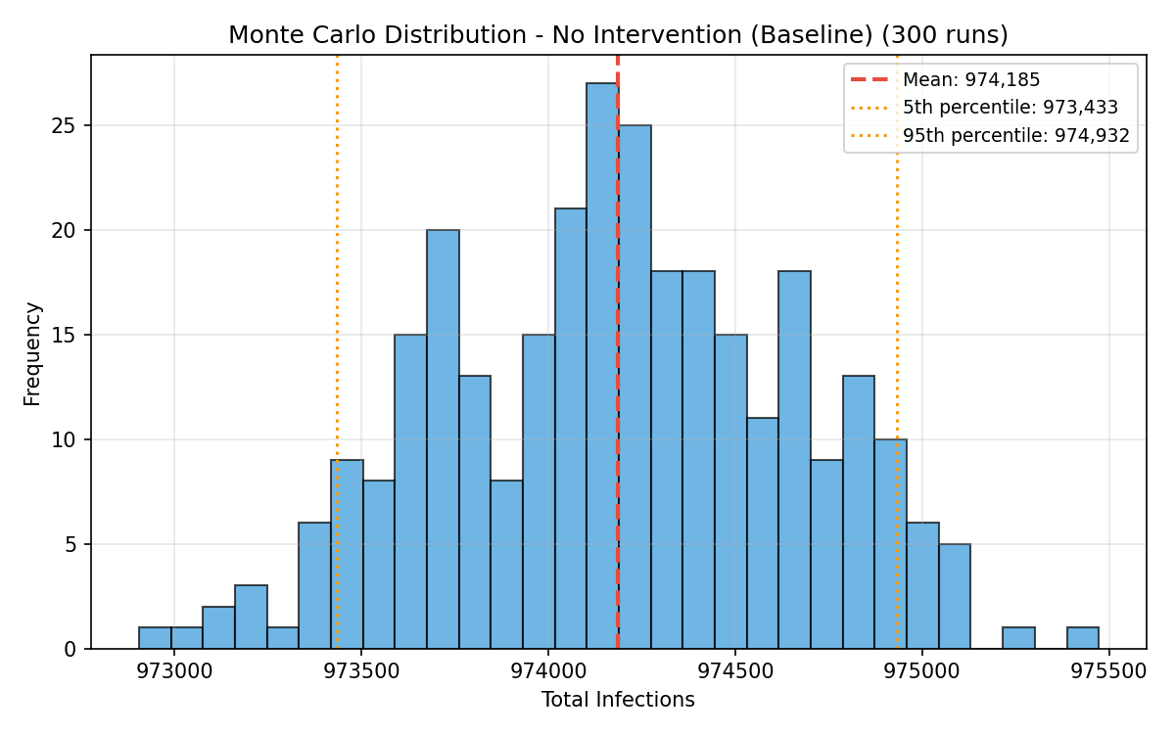
Monte Carlo Simulation Approach
300 simulations per scenario with stochastic parameter perturbation
Gaussian noise (5% standard deviation) applied to transmission rates at each time step
Captures real-world randomness in contact patterns, susceptibility, and environmental factors
Produces mean, median, and 90% confidence intervals (5th-95th percentile)
Per-run summary metrics: total infections, peak active infections, peak day
Why Monte Carlo?
Monte Carlo distribution (baseline, 300 runs)
Deterministic models give a single trajectory, missing variability
Monte Carlo provides probability distributions of outcomes
Confidence intervals quantify uncertainty for decision-makers

Slide 7
Intervention Scenarios
All interventions activate after a 14-day detection delay
1
No Intervention
Uncontrolled spread, no changes to contact patterns
Baseline
2
School Closures
70% reduction in all contacts involving children
-70% children
3
Workplace Restrictions
50% reduction in all contacts involving adults
-50% adults
4
Elderly Isolation
60% reduction in all contacts involving elderly
-60% elderly
5
Combined Moderate
Schools -50%, Workplaces -30%, Elderly -40%
Multi-target
6
Full Lockdown
75% reduction in all contacts across all groups
-75% all

Slide 8
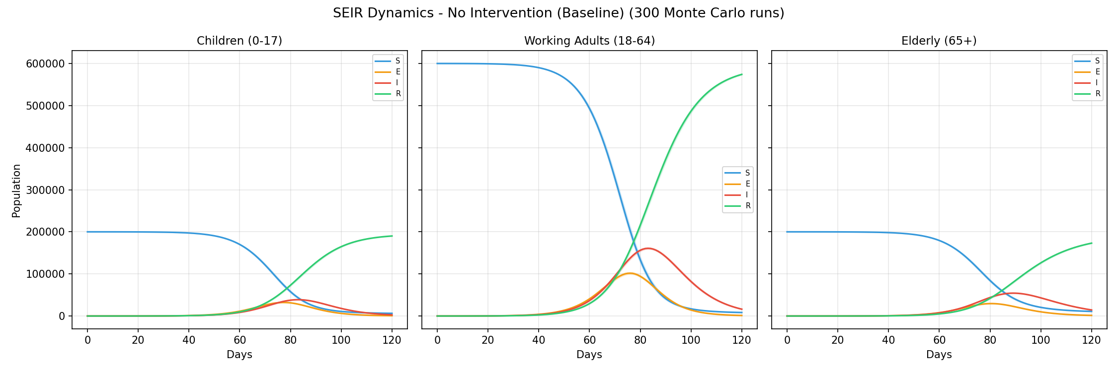
Results: Baseline (No Intervention)
97.4%
974,185
Day 84
Without intervention, virtually the entire population becomes infected
Attack Rate
Total Infected
Peak Infection
SEIR dynamics for baseline scenario (300 Monte Carlo runs, 90% confidence bands)

Slide 9
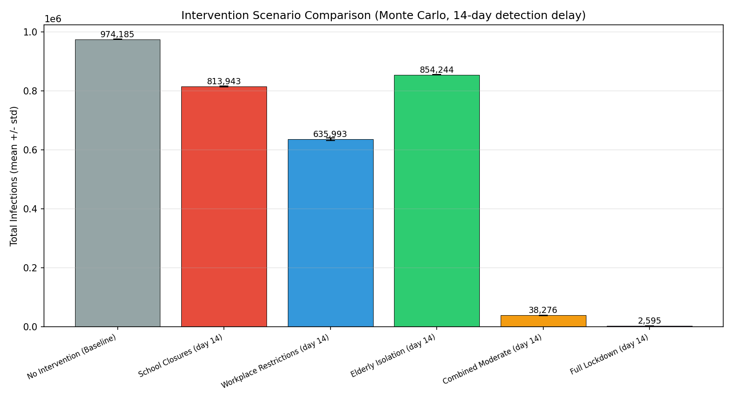
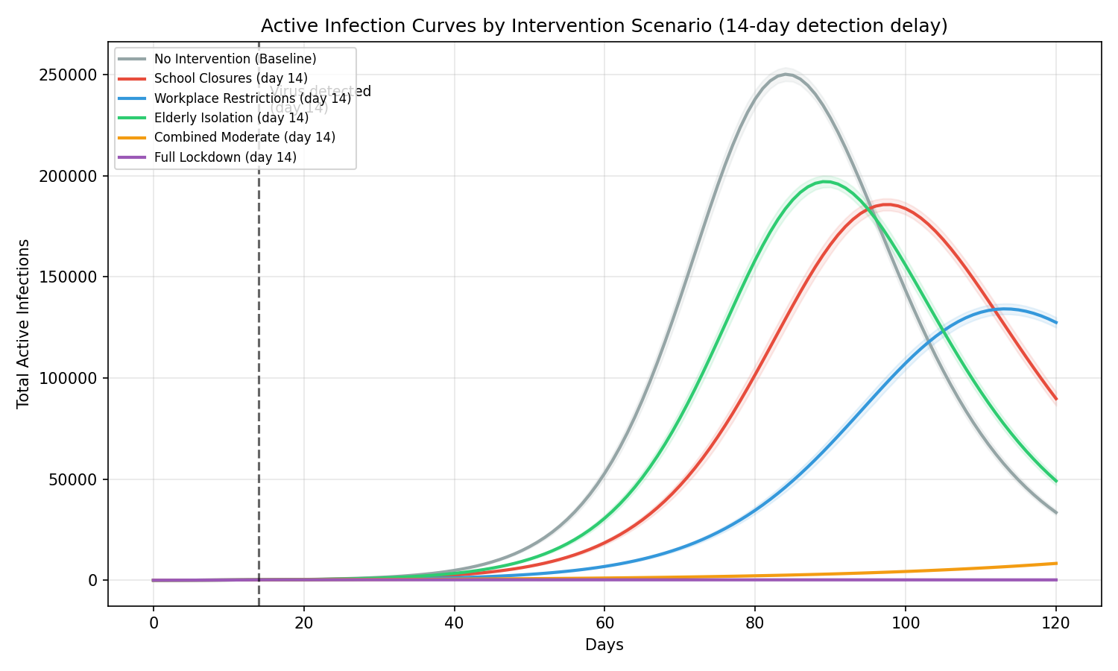
Intervention Comparison
Key Findings
Full lockdown: 0.3% attack rate (most effective single measure)
Combined moderate: 3.8% attack rate (synergistic multi-target approach)
Single-target interventions alone are insufficient (63-85% attack rates)
Workplace restrictions most effective among single-target approaches

Slide 10
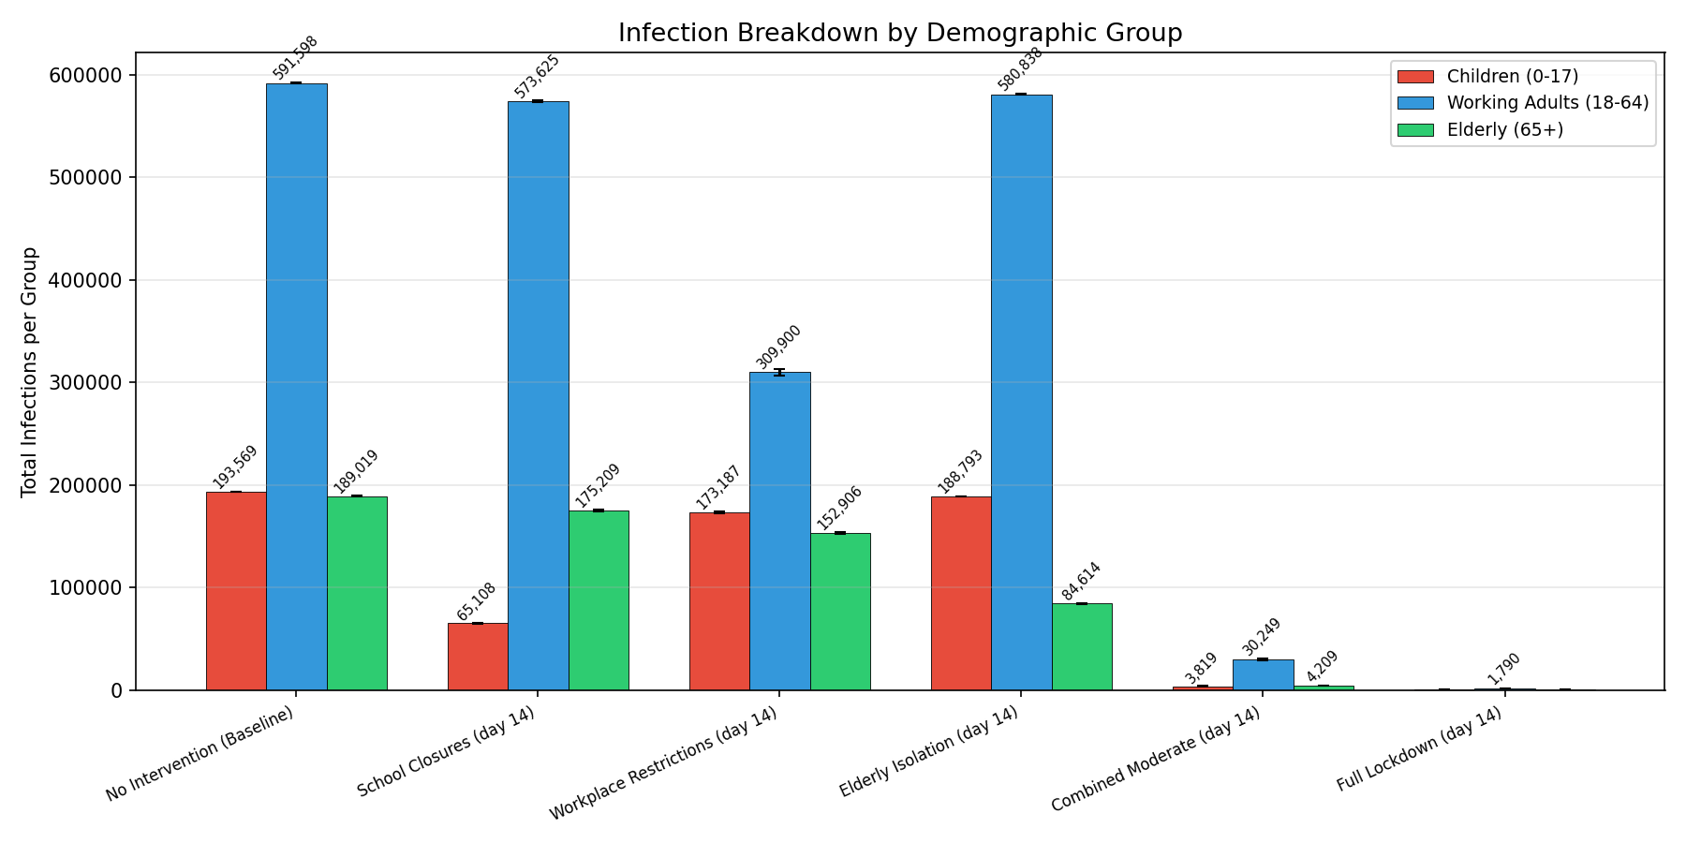
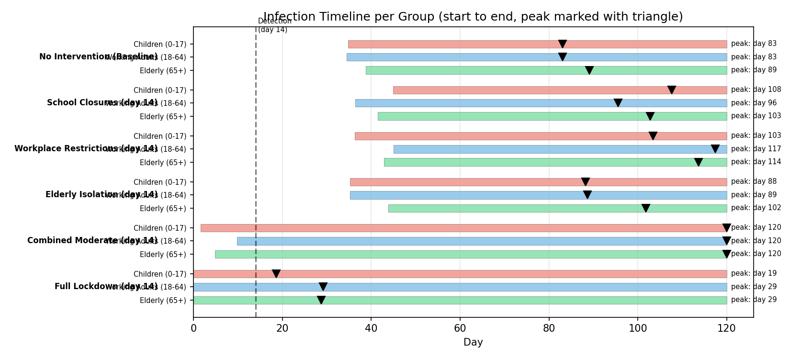
Per-Group Infection Analysis
Per-Group Breakdown (Baseline)
98.6%
Adults
Most infected group
96.8%
Children
High school contacts
93.4%
Elderly
Slower but severe

Slide 11
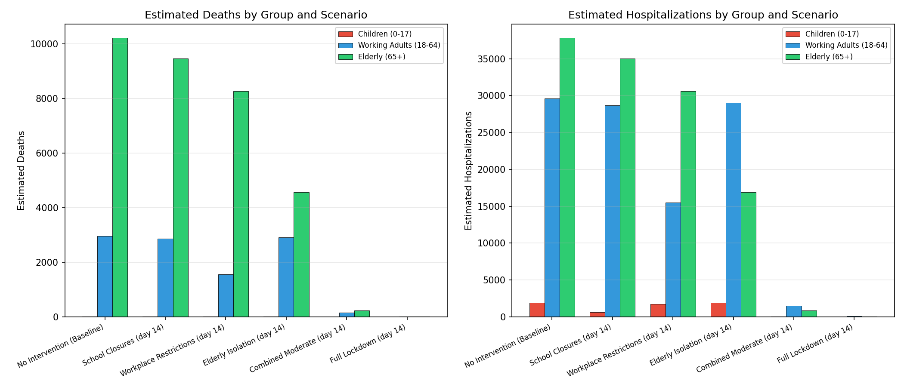
Severity and Mortality Estimates
Baseline Impact
13,184
Estimated Deaths
62,690
Hospitalizations
77%
Deaths from Elderly
5.4%
Elderly IFR
0.01%
Children IFR
Elderly account for 77% of deaths despite being only 20% of the population
IFR sources: Levin et al. (2020) - Children 0.01%, Adults 0.5%, Elderly 5.4%

Slide 12
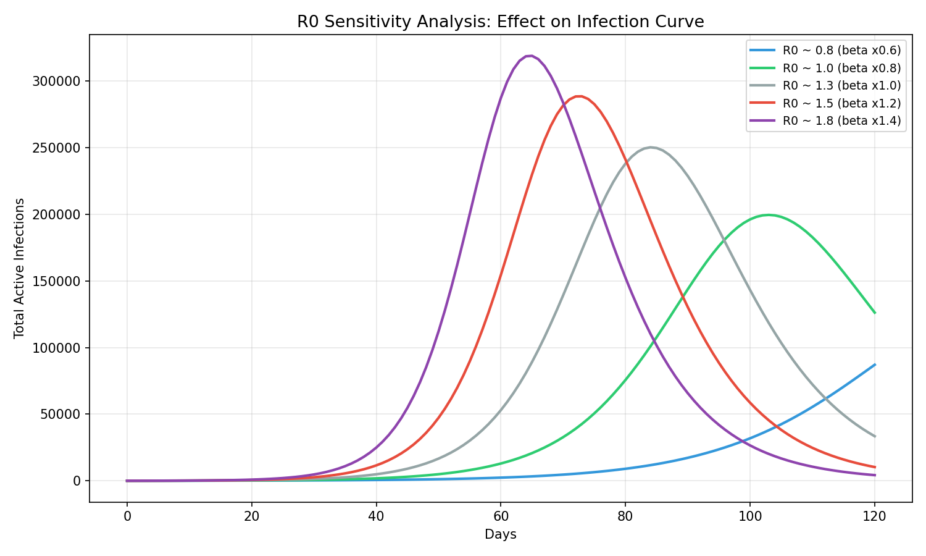
R0 Sensitivity Analysis
Findings
R0 estimated at 2.83 (within accepted range of 2.0-3.5)
Higher R0 produces faster growth, higher peaks, and earlier peak timing
Lower R0 flattens the curve and reduces total infections
Even small changes in R0 have large effects on outbreak dynamics
Supports investment in interventions that reduce effective transmission
Estimated R0: 2.83
Expected range: 2.0 - 3.5 (PASS)

Slide 13
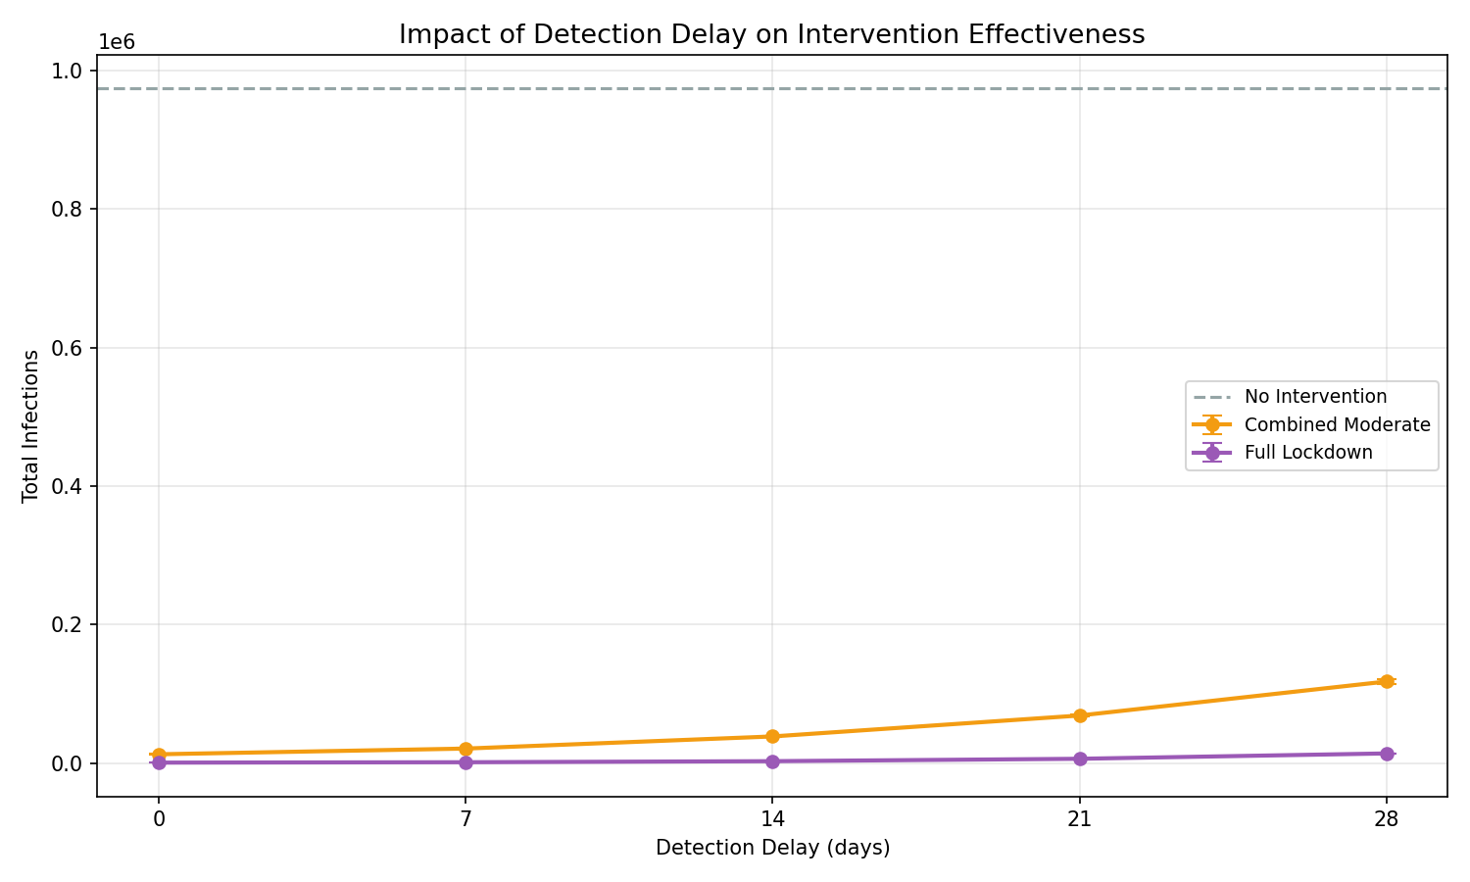
Detection Delay Analysis
Impact of Early Detection
Tested delays of 0, 7, 14, 21, and 28 days
Earlier detection significantly improves intervention effectiveness
Even full lockdown loses value if implemented too late
Surveillance and early warning systems are critical complements to policy
Every additional week of delay allows exponential growth before interventions begin

Slide 14
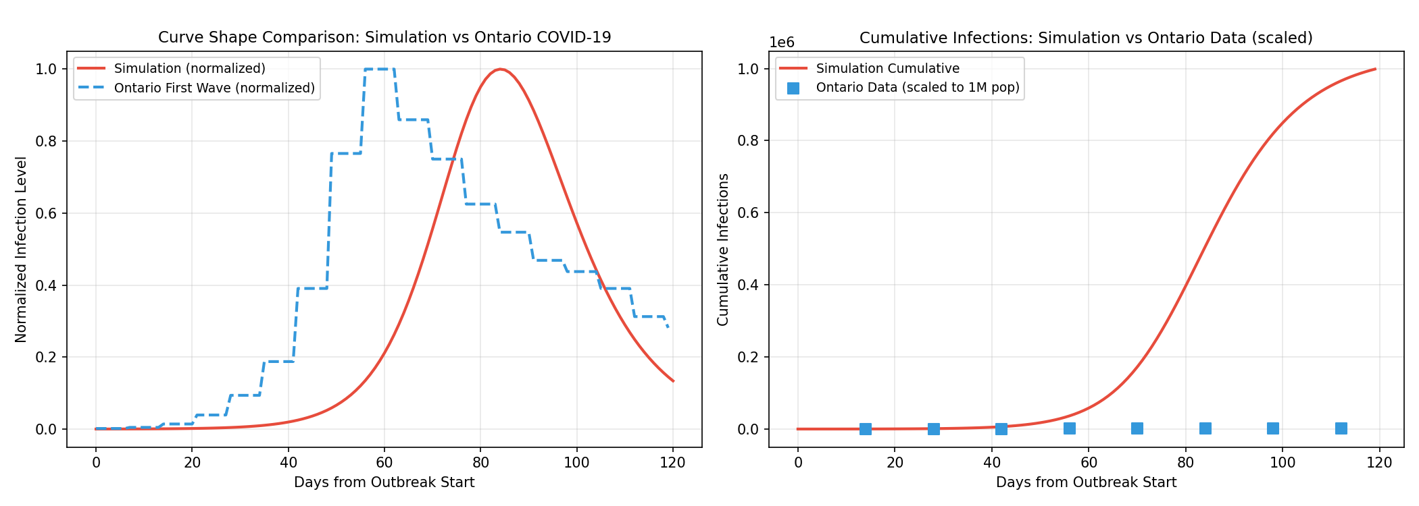
Model Validation
Validation Results
R0
PASS
2.83 (expected: 2.0-3.5)
Doubling Time
PASS
5.5 days (expected: 3.0-7.0)
Incubation
PASS
5.2 days (expected: 4.0-7.0)
Simulation vs Ontario COVID-19 first wave (normalized shape and cumulative)
Gen. Time
CHECK
14.4 days (expected: 5.0-8.0)
Generation time exceeds range because it sums incubation + full infectious period, while the benchmark refers to the narrower serial interval.

Slide 15
Discussion: Key Findings
Single-target interventions are insufficient
School closures, workplace restrictions, and elderly isolation each reduce infections in the targeted group but the disease spreads through other groups (63-85% attack rates)
Combined interventions produce synergistic effects
Combined moderate measures achieve 96% reduction in infections. Simultaneous partial reductions across all groups break transmission chains more effectively.
Detection delay critically impacts outcomes
Even the most effective interventions lose substantial value if implemented too late. A 14-day delay allows exponential growth before response begins.
Severe disparity in mortality burden
Elderly account for 77% of deaths despite being 20% of the population. Higher IFR (5.4%) and longer infectious period drive this disparity.

Slide 16
Limitations
Closed population: no births, deaths (non-disease), or migration
Static contact matrix within each phase (pre and post intervention)
No asymptomatic transmission modeled
No waning immunity or reinfection
No emergence of new variants
Monte Carlo noise applied only to transmission rates, not incubation or recovery
Homogeneous mixing within each age group
No spatial structure or geographic spread
These limitations represent opportunities for future model refinement.

Slide 17
Future Work
More Demographic Groups
Spatial Structure
Separate young adults from older adults for finer-grained analysis
Geographic spread across regions or cities
Vaccination Modeling
Real-Time Data Assimilation
Add vaccination as an additional intervention to model immunization campaigns
Update parameters as new case data becomes available for live forecasting
Time-Varying Contacts
Economic Modeling
Dynamic contact matrices that change during an outbreak
Couple with economic model to estimate costs and benefits of interventions

Slide 18
Conclusion
1
Multi-group SEIR model with Monte Carlo simulation successfully evaluates disease transmission and intervention effectiveness across demographic groups
2
Combined multi-target interventions reduce infections by 96% compared to baseline (from 97.4% to 3.8% attack rate)
3
Detection delay significantly impacts outcomes, supporting investment in early surveillance systems
4
Elderly populations bear 77% of the mortality burden, justifying targeted protection measures
5
Model validation confirms epidemiologically realistic dynamics (R0 = 2.83, doubling time = 5.5 days)
6
Framework can be adapted to model other infectious diseases by adjusting parameters

Slide 19
References
[1] Q. Li et al., "Early Transmission Dynamics in Wuhan, China, of Novel Coronavirus-Infected Pneumonia," NEJM, vol. 382, 2020.
[2] J. Mossong et al., "Social Contacts and Mixing Patterns Relevant to the Spread of Infectious Diseases," PLOS Medicine, vol. 5, 2008.
[3] K. Prem et al., "Projecting social contact matrices in 152 countries," PLOS Computational Biology, vol. 13, 2017.
[4] Y. Alimohamadi et al., "Estimate of the Basic Reproduction Number for COVID-19," J. Prev. Med. Public Health, vol. 53, 2020.
[5] I. Voinsky et al., "Effects of age and sex on recovery from COVID-19," Journal of Infection, vol. 81, 2020.
[6] Johns Hopkins University CSSE, "COVID-19 Data Repository," GitHub, github.com/CSSEGISandData/COVID-19
[7] A. T. Levin et al., "Assessing the age specificity of infection fatality rates for COVID-19," European J. Epidemiology, vol. 35, 2020.

Slide 20
Thank You
Questions?
Abdulkarim Noorzaie | Abdullah Hanoosh
SOFE 4820U - Modeling & Simulation | Ontario Tech University

