Slide 1
E
EduMatch
HACKMIT 2026 · LIVE PRODUCT
The colleague who
teaches like you
is out there.
ALICE · PROJECT-BASED CS
“My students memorize the syntax
and freeze on the first real bug.”
Then stop teaching syntax and start
teaching the bug.
EduMatch turns teaching context into the right people,
resources, techniques, and grounded guidance.
↳ Grounded in an educator’s published material
LIVE · EXPLAINABLE · CITED
1,000
5,000
6
educators
resources
visible factors
edumatch-web.onrender.com
EDUMATCH · HACKMIT 2026
01
Notes:
Open with the problem in one sentence: great teaching is everywhere, but the right educators rarely find each other. EduMatch connects educators by how they teach, then carries that context into resources, planning, and grounded AI guidance.

Slide 2
E
EduMatch
THE PROBLEM
Teachers do not have an information problem.
They have a context problem.
The useful answer is usually inside another educator’s experience—but today’s tools strip away the details that make it transferable.
01
02
03
Generic directories
Knowledge stays isolated
AI loses provenance
Same subject does not mean the same classroom, learners, constraints, or philosophy.
Lesson plans and hard-won teaching techniques rarely travel beyond one institution.
Generic answers sound confident even when they are detached from educator evidence.
The missing layer: how this educator teaches this class, for these learners, under these constraints.
EDUMATCH · HACKMIT 2026
02
Notes:
Frame the problem as context loss, not a lack of content. Directories match titles. Resource libraries match keywords. Generic AI answers without knowing the class. EduMatch preserves teaching context across the entire workflow.

Slide 3
E
EduMatch
THE EDUMATCH CONTEXT ENGINE
One teaching profile powers an entire support system.
Describe the classroom once. Use that meaning everywhere.
PROFILE
01
People
TEACHING
CONTEXT
02
Resources
Semantic educator matches
with six visible factors
Materials ranked for subject,
level, and teaching style
philosophy · class · constraints
03
Techniques
04
Grounded mentors
Peer-rated methods and
common classroom pitfalls
CLASSROOM
Cited educator personas
that decline when unsure
EDUMATCH · HACKMIT 2026
03
Notes:
This is the core product insight. One semantic teaching profile and one class profile become reusable context. They power people matching, resource ranking, technique search, planning-mode pitfalls, and grounded mentor conversations.

Slide 4
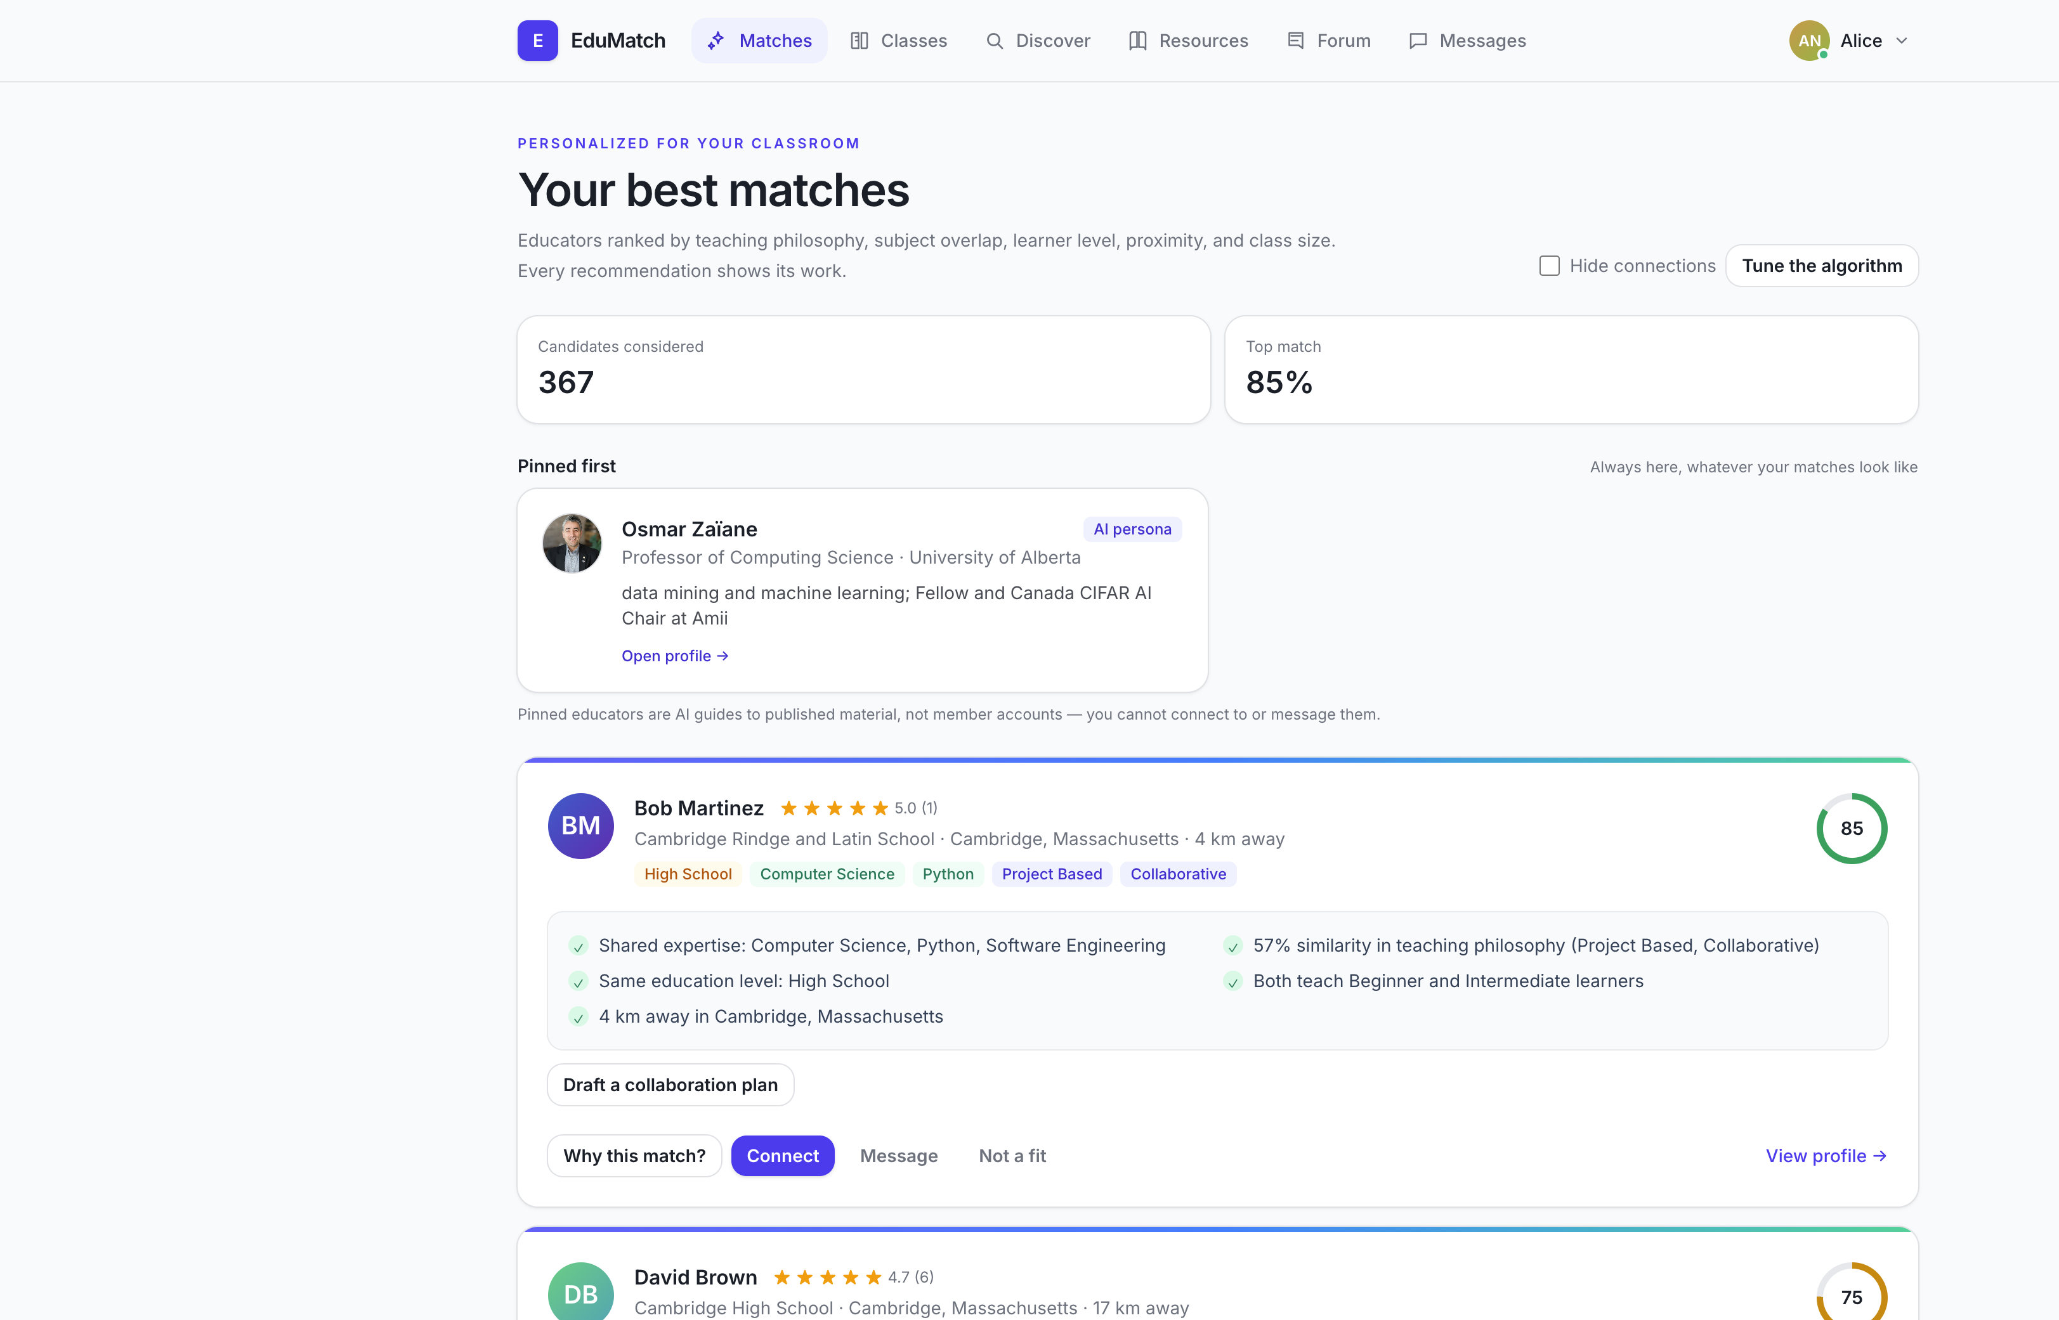
E
EduMatch
WORKING PRODUCT · PERSONALIZED MATCHING
A recommendation that explains itself.
Alice is a project-based high-school CS teacher in Boston. EduMatch scores 367 candidates and surfaces Bob—not because they share a title, but because their classrooms fit.
85%
top match
✓
Shared expertise
✓
Teaching philosophy
✓
Learner level + distance
✓
One-click collaboration brief
Not a black box: users can open every factor and tune the weights live.
EDUMATCH · HACKMIT 2026
04
Notes:
Demo Alice’s match page. Point to Bob, the 85% score, and the reason list. Then open “Why this match?” or mention that users can tune the algorithm and watch the ranking reorder live. The score is inspectable and actionable.

Slide 5
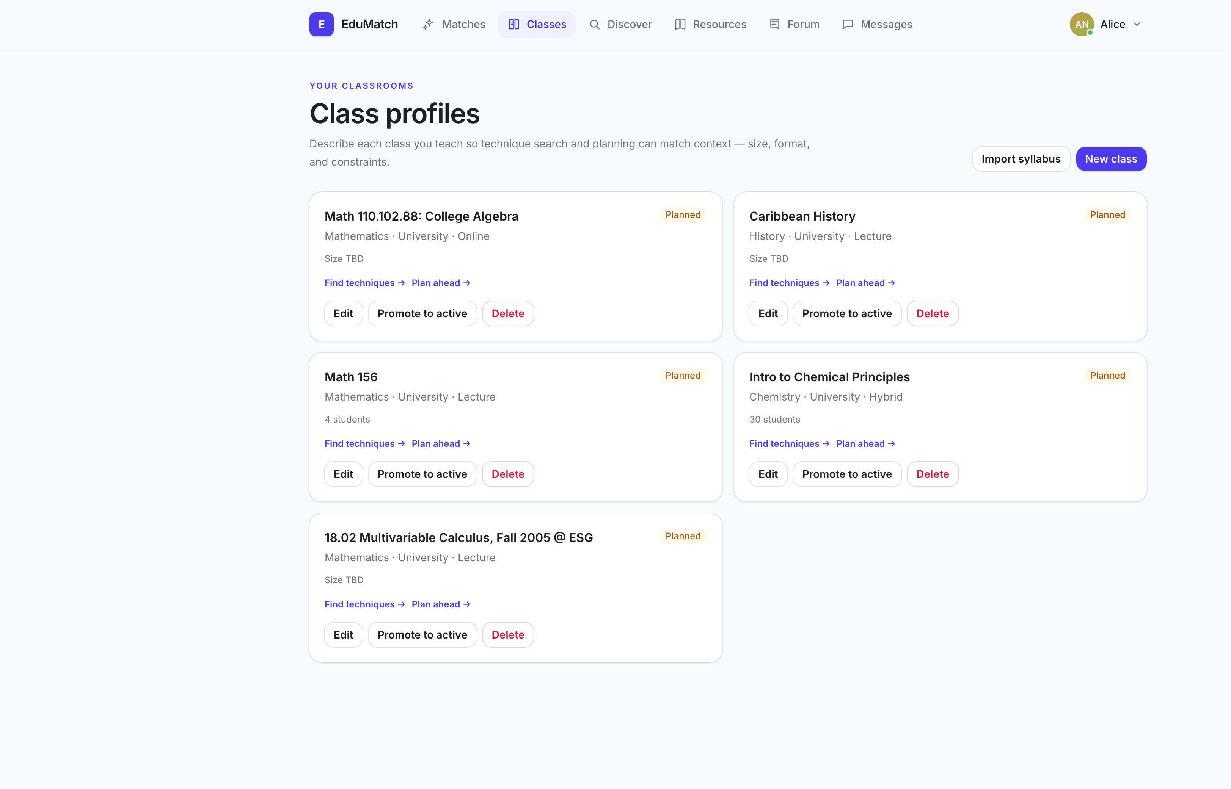
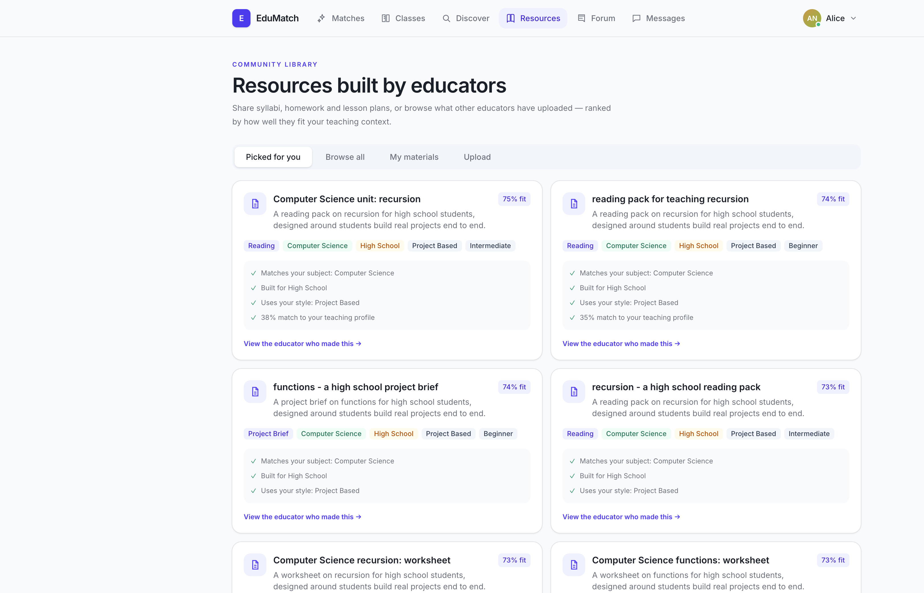
E
EduMatch
BEYOND NETWORKING
From “who should I meet?” to “what should I teach Monday?”
EduMatch carries context from the educator profile into real classroom work.
1 · CLASS CONTEXT
2 · MATCHED MATERIALS
Import a syllabus → create a class profile → find peer techniques and likely pitfalls.
Rank lesson plans, readings, and projects by subject, level, style, and classroom fit.
EDUMATCH · HACKMIT 2026
05
Notes:
Show that EduMatch is not only a social graph. Teachers can import a syllabus or create a class profile. That class context powers technique search and planning mode, while the resource library ranks materials for actual fit.

Slide 6
E
EduMatch
TRUST IS A PRODUCT FEATURE
AI that shows its working.
EduMatch is designed to be useful without pretending certainty.
01
02
03
Explainable ranking
Grounded mentors
Bounded by design
Six weighted factors
Claims carry citations
No source? It says so.
Teaching philosophy
“Open every lecture with broken code.”
✓ Refuses unsupported answers
Expertise
✓ Marks outside research
Education + learner level
↳ Guest lecture · 09:51
✓ City-level location only
Location + class size
The user can inspect the score, inspect the source, and inspect the system’s limits.
EDUMATCH · HACKMIT 2026
06
Notes:
Trust is our differentiation. The recommendation score is decomposed. Mentor claims include sources. The server validates citations, marks outside research, and a persona without supporting material declines instead of hallucinating.

Slide 7
E
EduMatch
BUILT AND LIVE
A production-shaped prototype, not a mockup.
1,000
5,000
367
85%
demo educators
shared resources
candidates scored
Alice ↔ Bob match
CONTEXT PIPELINE
React + TypeScript
→
FastAPI
→
PostgreSQL + pgvector
→
Optional Elasticsearch
Experience
Application
Meaning + data
Hybrid search
LIVE WEB APP
edumatch-web.onrender.com
Auth · messaging · uploads · CI · migrations · smoke tests
EDUMATCH · HACKMIT 2026
07
Notes:
This is live now. The demo includes 1,000 educators and 5,000 resources. The stack is React, FastAPI, Postgres with pgvector, and optional Elasticsearch. The repository includes migrations, authorization checks, uploads, CI, and end-to-end smoke tests.

Slide 8
EDUMATCH
Better teaching
already exists.
TRY IT LIVE
Alice’s profile
is ready.
EduMatch helps it travel.
No setup. No card.
Start with the top match.
01
02
03
Describe
Meet
Build
how you actually teach
the people who fit
for the classroom together
Open EduMatch ↗
edumatch-web.onrender.com
Thank you.
Questions?
EDUMATCH · HACKMIT 2026
08
Notes:
Close with: Better teaching already exists—in the experience of educators everywhere. EduMatch helps that knowledge travel to the right person, in the right classroom, with evidence attached. Invite the judges to open the live demo and start with Alice.

