Slide 1
BigData – Advance

Slide 2
Class & sessions agenda
Session 1 - Overview and Use Cases
Quick overview of trends and use cases
Tools and Eco-system projects we will cover
Perform quick health check of Hadoop cluster
Setup Nifi streaming engine
Create - Setup Twitter application API
Session 2 - Ingestion and Data manipulation
Setup Nifi ingestion stream info HDFS
Create table on RAW twitter dataset
convert Raw data into structure dataset
Ingest data into HDFS via raw text file
Session 3 - Overview and Use Cases
Install R and R studio server
Install Rhadoop libraries
Experiment with Twitter Data from HDFS
Find top user
Find top keywords
Find Positive and negative
Setup Nifi streaming engine
Create - Setup Twitter application API
Session 4 - Overview and Use Cases
Why Spark?
Install Spark on Yarn
What is Spark-Submit, Spark-Shell and pyspark
Spark toolkit in field - Jupyter notebook, Levy server, H20, SparkR
Read data from existing file in HDFS and display 10 values
Query existing Hive table via SparkSQL
Session 5 – Visual and Data analytics
Install Solr service on HDFS cluster
cre

Slide 3
Typical use cases of BigData
What is Big Data?
Why use Big Data?
How can Big Data help your enterprise? Should you use Big Data?
Do you have Big Data problem?
Industry typical use case for Big Data
Data Lake
Data offloading – Hybrid environment
Data analytics – Data discovery
Machine learning – deep learning

Slide 4
What is Big Data?
Extremely large datasets (Terabytes > Petabytes > Exabytes > Zettabytes)
Exceeds the processing capacity of conventional database systems
As far back as 2001, industry analyst Doug Laney (currently with Gartner) articulated the now mainstream definition of big data as the three Vs of big data: volume, velocity and variety¹.
Volume. Many factors contribute to the increase in data volume. Transaction-based data stored through the years. Unstructured data streaming in from social media. Increasing amounts of sensor and machine-to-machine data being collected. In the past, excessive data volume was a storage issue. But with decreasing storage costs, other issues emerge, including how to determine relevance within large data volumes and how to use analytics to create value from relevant data.
Velocity. Data is streaming in at unprecedented speed and must be dealt with in a timely manner. RFID tags, sensors and smart metering are driving the need to deal with torrents of data in near-real time. Reacting quickly enough to deal with data velocity is a challenge for most organizations.
Variety. Data today comes in all types of formats. Structured, numeric data in traditional databases. Information created from line-of-business applications. Unstructured text documents, email, video, audio, stock ticker data and financial transactions. Managing, merging and governing different varieties of data is something many organizations still grapple with.

Slide 5
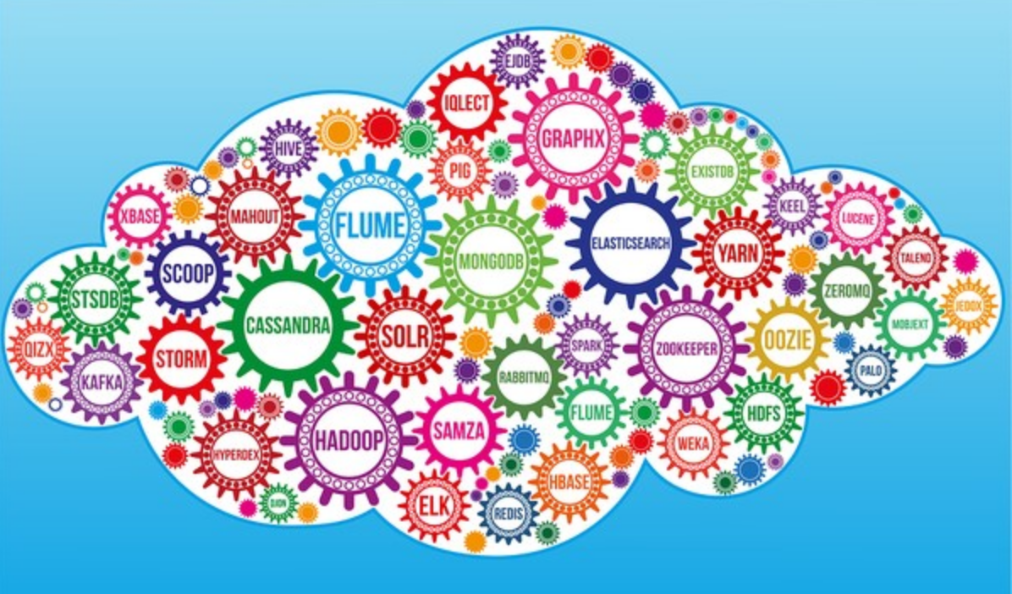
Bigdata Stack
Distributed processing
Handles various datasets
Low Cost no license fee
Bright Future
OpenSource
Near real-time response

Slide 6
Big Data use cases
Predictive analytics
Machine learning (Mllib)
Anomalies detection
Fraud detection
Retail customer 360 customer view
Scalable and cost effective storage
Health Care and Genomics

Slide 7
Data Engineer Vs Data Scientist
Data Engineer
Data Scientist
Role
To engineer software solutions.
To solve business problems using data.
Skills
More of programing and technical skills and ability to architect technical solutions.
Strong of Mathematical Skills and understanding of statistical Models.

Slide 8
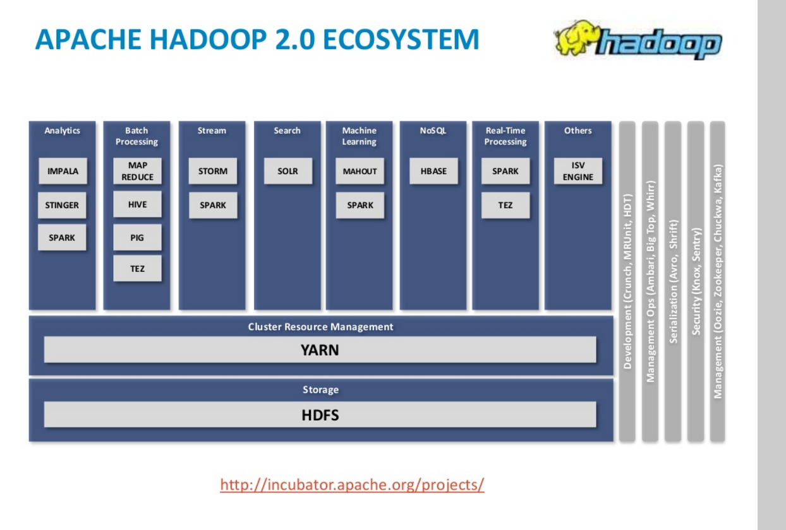
Hadoop 2.0 Ecosystem ..cont

Slide 9
Toolkit we will use
Twitter application API for data ingestion
Nifi – streaming packet delivery system to capture tweets
Hive/Impala – Hadoop Query engine
R – data discovery, filter dataset
Spark – In Memory data processing
Spark via Scala
Spark via PySpark
Solr – Data discovery and visualization

