Slide 1
DAY 3
ASP.NET Core API Basics
with Clean Boundaries
Request / Route
From C# language basics into simple backend thinking in .NET 10.
Validation / DTO
.NET 10
ASP.NET Core
API Controllers
Web API workshop
The goal is not a full backend course. The goal is to show how requests, endpoints, services, validation, and responses fit together.
Service / Dependency
Response / Review
Day 3
Notes:
Speaker notes: This opening slide should make Day 2 feel like a continuation, not a new course. Connect it explicitly to Day 1: now the language moves into a simple backend surface. [Sources] - User-provided theme guide and template used as the visual basis for this deck. - ASP.NET Core documentation hub: https://learn.microsoft.com/en-us/aspnet/core/?view=aspnetcore-10.0

Slide 2
AGENDA
Day 3 · ASP.NET Core
What we will cover today
Request lifecycle in Asp.Net Core
Today we will cover
Training intention
How an HTTP request reaches an endpoint
Minimal APIs vs controllers at a beginner level
DTOs, validation, and response thinking
Dependency injection and service boundaries
Exercise and workshop
Team should leave with a simple, explainable model of how an ASP.NET Core API is shaped. The win is architectural clarity, not framework trivia.
Request flow
Clean boundaries
Demo and review
Training deck · Day 3
Notes:
Speaker notes: Set the expectation that today is about seeing the shape of a backend. That keeps students from getting lost in setup details. [Sources] - None. Session design and sequencing are original for this training.

Slide 3
MENTAL MODEL
Day 3 · ASP.NET Core
A simple API mental model
This is the backbone of the whole session.
1
2
3
4
5
Request
Endpoint
Validation
Service
Response
JSON or route data comes in from the client.
The route handler receives the request and decides what to do next.
Reject bad input early, before business work starts.
Push business logic into a focused service or method.
Return the right HTTP result with a clear shape.
Rule: if team can narrate the request lifecycle, the framework becomes much less intimidating.
Training deck · Day 3
Notes:
Speaker notes: Say the flow out loud three times: request, endpoint, validation, service, response. This will anchor the rest of the deck. [Sources] - ASP.NET Core fundamentals overview: https://learn.microsoft.com/en-us/aspnet/core/fundamentals/?view=aspnetcore-10.0 - APIs overview: https://learn.microsoft.com/en-us/aspnet/core/fundamentals/apis?view=aspnetcore-10.0

Slide 4
BOUNDRIES
Day 3 · ASP.NET Core
Three boundaries team should understand first
These boundaries make even a tiny API easier to reason about.
Route / endpoint
DTO / validation
Service / logic
Receives HTTP input
Maps URL and verb
Returns an HTTP result
Should stay thin
Defines expected request shape
Rejects invalid input early
Prevents messy data from flowing inward
Improves clarity for clients and tests
Owns the business decision
Avoids route-level duplication
Improves reuse and testability
Keeps endpoints readable
Training deck · Day 3
Notes:
Speaker notes: If students remember only one architecture rule, let it be this: endpoints coordinate, DTOs shape input, services own business logic. [Sources] - Dependency injection in ASP.NET Core: https://learn.microsoft.com/en-us/aspnet/core/fundamentals/dependency-injection?view=aspnetcore-10.0 - Model validation in ASP.NET Core MVC and Razor Pages: https://learn.microsoft.com/en-us/aspnet/core/mvc/models/validation?view=aspnetcore-10.0

Slide 5
COMPARISON
Day 3 · ASP.NET Core
Routes and path design
This slide answers both how routes are defined and what route naming practices are worth teaching.
Avoid
Prefer
Action names in URLs: /api/getTasks
Mixed casing or unstable naming
Putting filters into path segments unnecessarily: /api/tasks/status/open
Hidden route conventions developers cannot explain
One-off route patterns across controllers
Resource-oriented routes: /api/tasks
Use route parameters for identity: /api/tasks/{id:int} or /api/tasks/{id:int}/history
Use query strings for filtering or paging: /api/tasks?staus=open
Prefer attribute routing for REST APIs
Keep route templates consistent across the project
Routing rule: the route should tell a predictable story before developers ever read the method body.
Training deck · Day 3

Slide 6
CONTROLLERS
Day 3 · ASP.NET Core
Use the right HTTP verb for the job
API semantics help humans and clients understand intent faster.
GET
POST
PUT
PATCH
DELETE
Read data or fetch a representation
Create a new resource or trigger creation behavior
Replace or update a full resource representation
Apply a partial change when the contract is truly partial
Remove a resource or mark it deleted
Why this matters
When verbs match intent, the frontend and testers can predict API behavior with less explanation.
Semantics are part of the contract. Inconsistent verb usage usually signals deeper design confusion.
Training deck · Day 3
6

Slide 7
CONTROLLERS
Day 3 · ASP.NET Core
Status codes that matter most
Use the most common response outcomes intentionally and consistently.
200 OK
Successful read or successful action with a body
201 Created
New resource created; often return the created representation
204 No Content
Successful update/delete with no response body needed
400 Bad Request
Client sent invalid data or malformed input
404 Not Found
Requested resource does not exist
500 Internal Server Error
Unexpected unhandled server failure
You do not need every status code memorized. You do need predictable meaning across the API surface.
Training deck · Day 3
7

Slide 8
COMPARISON
Day 3 · ASP.NET Core
Minimal APIs vs controllers
The trade-off
Minimal APIs
Controllers
Small surface area and less ceremony
Great for fast, focused HTTP endpoints
Easy to demonstrate
Best for health checks and liveness probes
Useful when teams want explicit structure and many actions
Familiar to teams using attributes and controller conventions
Can become easier to standardize in larger API surfaces
Choose the approach that makes the requirements objective clearer, not the one that wins style debates.
Training deck · Day 3
Notes:
Speaker notes: Keep this balanced. Microsoft documents both approaches, and the current APIs overview recommends Minimal APIs for new fast HTTP APIs. That makes Minimal APIs a strong choice for a short workshop, but controllers are still valid and common. [Sources] - APIs overview: https://learn.microsoft.com/en-us/aspnet/core/fundamentals/apis?view=aspnetcore-10.0 - Create web APIs with ASP.NET Core: https://learn.microsoft.com/en-us/aspnet/core/web-api/?view=aspnetcore-10.0

Slide 9
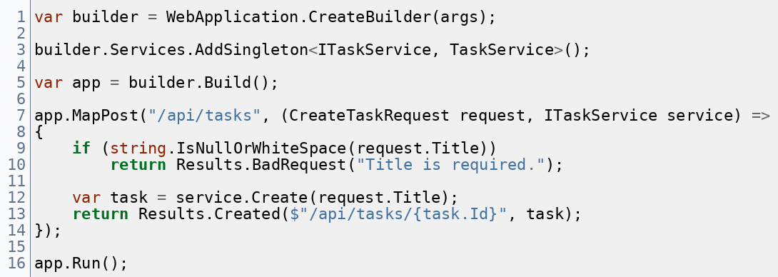
MINIMAL API
Day 3 · ASP.NET Core
A tiny Minimal API example with one clear service boundary
The basic code example for understanding purpose.
What to notice
The service is registered once at startup.
The endpoint accepts a DTO and a service, not database plumbing.
Validation happens before the create action.
The response communicates both result and location.
Callout
Use the route to orchestrate. Use the service to own business work.
Training deck · Day 3
Notes:
Speaker notes: Read only the important lines. The real teaching value is not the full syntax. It is the separation between startup, endpoint, validation, service, and response. [Sources] - Tutorial: Create a Minimal API with ASP.NET Core: https://learn.microsoft.com/en-us/aspnet/core/tutorials/min-web-api?view=aspnetcore-10.0 - Minimal APIs quick reference: https://learn.microsoft.com/en-us/aspnet/core/fundamentals/minimal-apis?view=aspnetcore-10.0

Slide 10
CONTROLLERS
Day 3 · ASP.NET Core
Controllers and actions
Controller-based APIs organize endpoints into classes, with actions handling individual requests.
What belongs here
Typical controller shape
A controller is a class that derives from ControllerBase.
Actions are methods that respond to HTTP requests.
Attributes such as [HttpGet] or [HttpPost] connect actions to routes and verbs.
Keep the controller focused on HTTP coordination, not heavy business logic.
[ApiController] + [Route("api/[controller]")]
constructor injection for needed services
actions such as GetById, Create, Update, Delete
ActionResult or Typed response returned to caller
Training deck · Day 3

Slide 11
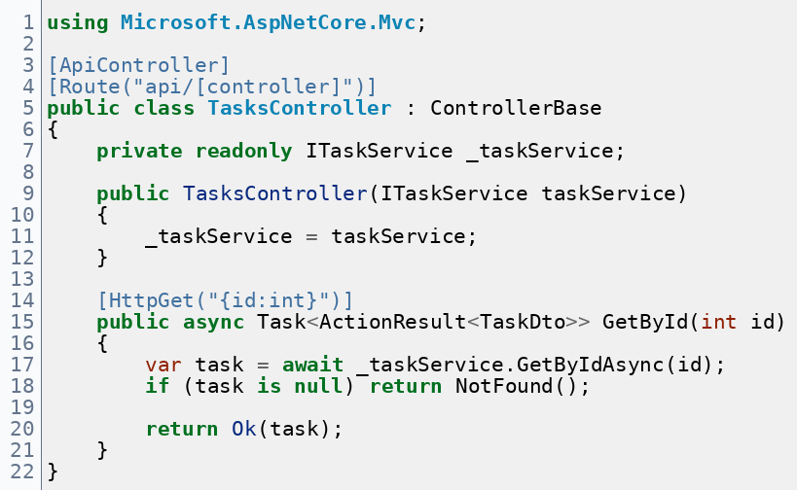
CONTROLLERS
Day 3 · ASP.NET Core
Controller code example
The basic code example for understanding purpose.
What to look for
Attributes declare routing and controller intent.
The controller receives its dependency by constructor injection.
The action method stays readable because the service owns the business work.
The response uses status codes instead of ad hoc strings.
Callout
A controller is strongest when it reads like HTTP orchestration, not a dumping ground for logic.
Training deck · Day 3

Slide 12
DEPENDENCY INJECTION
Day 3 · ASP.NET Core
Why dependency injection matters here
DI is less about syntax and more about keeping responsibilities replaceable and testable.
Simple explanation
A route handler or controller usually needs other services to do useful work.
Register those dependencies once and let ASP.NET Core provide them.
That keeps code cleaner and makes substitution easier during testing or refactoring.
Endpoint
ITaskService
Repo
DI container
Registrations
Short rule
Do not new-up core dependencies inside the endpoint when the platform can supply them.
Training deck · Day 3
Notes:
Speaker notes: Do not go deep into lifetimes unless the audience is already familiar with backend concepts. In a short workshop, DI should feel like a clean handoff mechanism. [Sources] - Dependency injection in ASP.NET Core: https://learn.microsoft.com/en-us/aspnet/core/fundamentals/dependency-injection?view=aspnetcore-10.0 - Dependency injection overview in .NET: https://learn.microsoft.com/en-us/dotnet/core/extensions/dependency-injection/overview

Slide 13
DEPENDENCY INJECTION
Day 3 · ASP.NET Core
Dependency injection and scopes
Keep the lifetime story simple: singleton, scoped, transient.
Singleton
Scoped
Transient
One instance for the app lifetime. Good for stateless shared services.
One instance per request scope. Common for DbContext and request work.
A new instance each time requested. Good for lightweight helpers.
Scope caution: scoped services should not be forced into singleton behavior. For middleware, scoped services are injected into Invoke/InvokeAsync or factory-based middleware.
Training deck · Day 3

Slide 14
DEPENDENCY INJECTION
Day 3 · ASP.NET Core
Common dependency types and their uses
What kinds of objects usually get injected.
Application service
Repository / data access
DbContext
Owns business rules and orchestration
Reads or writes data sources
Unit-of-work style database access
ILogger<T>
IOptions<T>
HttpClient / factory
Cross-cutting diagnostics and tracing
Typed configuration values
Calls external HTTP services
Dependencies are collaborators. They should be injected because the endpoint or controller needs a capability, not because injection is fashionable.
Training deck · Day 3

Slide 15
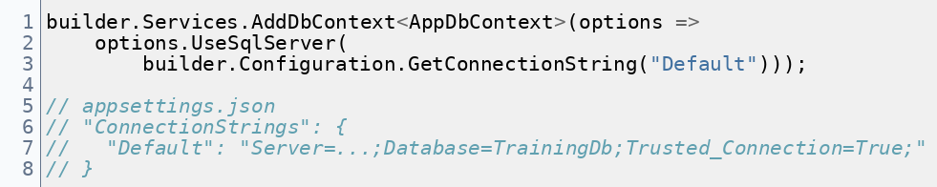
DATABASE
Day 3 · ASP.NET Core
Database and connection registration
Configuration + provider + scoped DbContext setup.
What matters most
AddDbContext registers the DbContext into DI.
The provider call chooses the database provider, such as SQL Server.
The connection string usually comes from configuration.
DbContext is typically scoped per request.
Callout
Avoid hardcoding production secrets in source code or training screenshots.
Training deck · Day 3

Slide 16
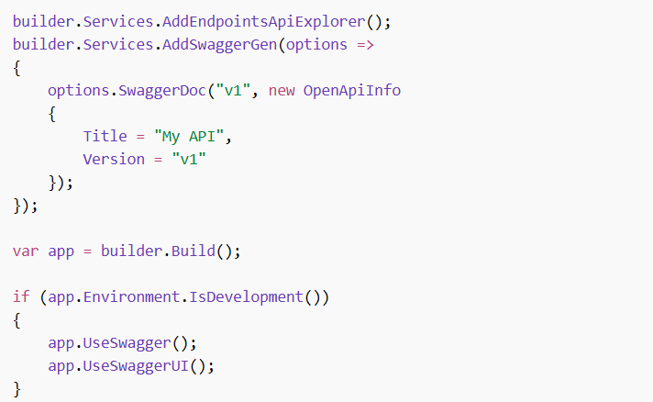
Open API
Day 3 · ASP.NET Core
OpenAPI and Swagger
OpenAPI is the contract; Swagger UI is one way to visualize and test it.
OpenAPI
contract
Swagger UI
/ other tools
OpenAPI describes the HTTP contract of the API.
It helps humans, tools, and generated clients understand the endpoints.
In modern ASP.NET Core, built-in OpenAPI generation is available.
Interactive UIs such as Swagger UI are separate visualization/testing tools.
Training deck · Day 3

Slide 17
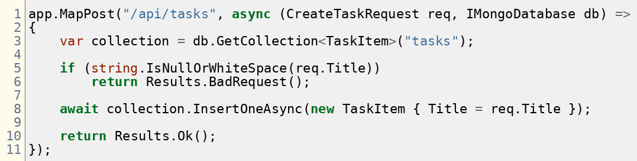
EXCERCISE
Day 3 · ASP.NET Core
Exercise: inspect this endpoint and move the responsibility
Prompt: What belongs in a service here, and what would you change first to make the endpoint easier to test?
Training deck · Day 3
Notes:
Speaker notes: This code is intentionally mixed: endpoint logic, validation, database use, and response all sit together. The class should discuss which responsibility to move first. [Sources] - None. Original workshop example for this training.

Slide 18
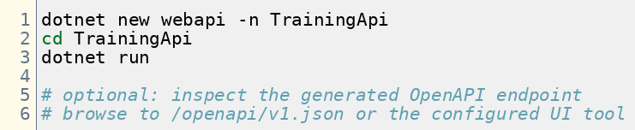
WORKSHOP
Day 3 · ASP.NET Core
Workshop setup commands
This is the CLI setup slide with project creation, cd, and run.
Prompt: have the room create the API project first, run it, then inspect the generated startup and OpenAPI output before adding custom code.
Facilitator pattern
Create and run before customizing.
Point out Program.cs immediately.
Verify the generated docs or UI endpoint.
Then split into minimal vs controller tracks.
Training deck · Day 3

Slide 19
WORKSHOP
Day 3 · ASP.NET Core
Workshop path: Minimal API
Keep the practice small and focus on the route handler, DTO, and service boundary.
1
Map a GET or POST endpoint
2
Add a DTO
3
Inject one service
Use MapGet or MapPost with a clear /api/... path.
Create a request or response type with a focused purpose.
Pass a service into the route handler instead of doing all work inline.
4
Validate one rule
5
Return a meaningful result
6
Explain the route flow
Reject empty or invalid input early and visibly.
Use Ok, Created, BadRequest, or NotFound deliberately.
Make each student say what happens from request to response.
Training deck · Day 3

Slide 20
WORKSHOP
Day 3 · ASP.NET Core
Workshop path: Controllers
Mirror the minimal workshop, but now the developers practice controller structure and route attributes.
Build the controller
Review the shape
Create a TasksController class that derives from ControllerBase.
Add [ApiController] and [Route("api/[controller]")].
Inject one service through the constructor.
Implement one GET or POST action with an HTTP attribute.
Return ActionResult or a specific typed response clearly.
Keep validation and business rules out of the controller when possible.
Compare the shape to the Minimal API version.
Test using swagger tool
Training deck · Day 3

Slide 21
WRAP-UP
What team should leave with
A practical definition of REST in ASP.NET Core
Confidence with controllers, actions, and route design
A working mental model for DI, scopes, and middleware
Two workshop paths: Minimal API and controller-based API
Q&A

