Slide 1
DAY 2
.Net and C# Foundations for
Professional Developers
.Net Platform
From syntax to structured thinking in .NET 10.
C# Programing Language
.NET 10
C#
A short, practical session that helps team understand the core pieces of .Net and C#, write cleaner code, and debug with intent.
Coding Jugement
Wrap-up / Next step
Day 2
Notes:
Speaker notes: Open the training by setting the expectation clearly: this is not an attempt to cover all of C# in one sitting. The value is the mental model, the coding habits, and the debugging mindset. [Sources] - User-provided theme guide and template used as the visual basis for this deck.

Slide 2
AGENDA
Day 2 · .Net Foundations
What we will cover today
A short session prioritizing signal, not volume.
Today we will cover
Training intention
What C# and .NET each mean
The mental model behind readable code
Core language essentials that matter first
Clean-code habits team should practice immediately
A small console-app demo and review exercises
Practice projects
Team should leave with a clear picture of how code is shaped, why good naming and method boundaries matter, and how to investigate bugs instead of guessing.
Mindset first
Build live
Review mistakes
Training deck · Day 2
Notes:
Speaker notes: Spend less than five minutes here. Your job is to show that the session is curated. Students should feel that the path is deliberate and realistic. [Sources] - None. Session design and sequencing are original for this training.

Slide 3
.Net
Day 2 · .Net Foundations
What is .Net?
Think of .NET as the application platform and runtime that lets you build many styles of software with a shared ecosystem.
4
Platform + Runtime
One ecosystem, many workloads
Shared developer model
Provides the runtime, core libraries, SDK, tooling, and workloads used to build and run apps.
Projects, packages, dependency injection, configuration, logging, testing, and deployment concepts carry across app types.
The same platform can power console tools, web APIs, websites, desktop apps, services, cloud apps, mobile, and more.
.NET gives you the foundation to run and structure the application.
ASP.NET Core gives you the web stack for HTTP APIs and web apps.
C# is the main language we will use to express the application logic.
Training deck · .Net foundations

Slide 4
.Net
Day 2 · .Net Foundations
What can you build with .NET?
Breadth of .Net platform.
4
Console app
Web API
Web app
CLI tools, scripts, jobs, and utility programs.
HTTP endpoints for React, mobile, integrations, and services.
Server-rendered or component-based sites and internal portals.
Desktop app
Mobile app
Worker / cloud service
Windows client software, admin tools, and LOB apps.
Cross-platform app development using .NET mobile workloads.
Background processing, schedulers, and cloud-hosted services.
Training deck · .Net different apps

Slide 5
Languages on the .NET platform
Day 2 · .Net Foundations
Some programing flavors in .Net platform
C#
F#
Visual Basic
General-purpose, modern, and the strongest fit for ASP.NET Core Web APIs, services, and most line-of-business app work.
Functional-first language on .NET. Useful when modeling domains with immutability, pipelines, and functional patterns matters.
Still supported on .NET and useful for existing teams and some business apps, but less common for modern web API greenfield projects.
Training decision
We acknowledge the platform supports multiple languages, but we focus on C# because it is the most relevant language for modern ASP.NET Core backend teams.
Slide 4

Slide 6
CORE IDEA
Day 2 · C# Foundations
What C# and .NET each mean
Developers often mix the language and the platform together. Separate them early.
Simple explanation
One stack, many layers
C# is the programming language students write.
.NET is the platform, runtime, SDK, and base libraries that run and support those programs.
The same ecosystem can be used for console apps, web APIs, web apps, cloud services, desktop apps, and more.
For this training, the stack is .NET 10 with C# as the main language.
C# language
.NET runtime + libraries + SDK
Apps: console, Web API, web, cloud, desktop
Good language skills improve code. Good platform knowledge improves how that code is packaged, run, debugged, and deployed.
Training deck · Day 2
Notes:
Speaker notes: Keep this very plain. C# is the language. .NET is the platform. Students need this separation because it helps them understand tooling, runtime, libraries, and frameworks later. [Sources] - Microsoft Learn: Introduction to .NET — https://learn.microsoft.com/en-us/dotnet/core/introduction - Microsoft Learn: C# documentation — https://learn.microsoft.com/en-us/dotnet/csharp/

Slide 7
PROCESS
Day 2 · C# Foundations
How a developer should think about code
Use a stable mental model so team stop treating code as magic.
1
2
3
4
5
6
Input
Types
Flow
Method
Objects
Output
What data came in?
What shape is that data?
What decisions and loops happen?
What work belongs together?
Which data and behavior belong together?
What result do we return, print, or store?
Rule: do not jump to syntax first. First identify the data, the decision flow, and the boundaries of responsibility.
Training deck · Day 2
Notes:
Speaker notes: Walk slowly through the six steps. This gives students a reusable checklist they can apply even when they do not yet know much syntax. [Sources] - None. Original instructional model for this session.

Slide 8
C# fundamentals: anatomy of a small program
Day 2 · C# Foundations
Application main entry point.
1 using System; 2 3 class Program 4 { 5 static void Main() 6 { 7 string name = "Team"; 8 int count = 5; 9 10 Console.WriteLine($"Hello {name}, total = {count}"); 11 } 12 }
Namespace import
Bring framework types into scope.
Entry point
Execution begins at Main.
Variables
Strongly typed data stored in memory.
Method call
A function runs work and produces output.
Training deck · Day 2

Slide 9
🛠 Workshop: Hello World Console App
Day 2 · C# Foundations
Follow these steps to create your first .NET console application
STEP 01
Install .NET SDK
Download and install from https://dot.net/download
Verify: dotnet --version
STEP 02
Create a New Console App
dotnet new console -n HelloWorld
STEP 03
Navigate & Review Code
cd HelloWorld
Open Program.cs → Console.WriteLine("Hello, World!");
STEP 04
Run the Application
dotnet run
Expected output: Hello, World!
STEP 05
Modify & Re-run
Change text to "Hello from .NET!"
dotnet run again to see the update
STEP 06
Explore Further
Try adding variables, user input,
or a second Console.WriteLine
💡 Tip: Use dotnet run to compile and execute in one step!
Training deck · Day 2

Slide 10
C# fundamentals: classes, objects, and collections
Day 2 · C# Foundations
These are the shapes your code will keep using for DTOs, entities, and service methods.
1 public sealed class TaskItem 2 { 3 public string Id { get; set; } = Guid.NewGuid().ToString(); 4 public string Title { get; set; } = ""; 5 public string Status { get; set; } = "New"; 6 } 7 8 var tasks = new List<TaskItem> 9 { 10 new TaskItem { Title = "Create API", Status = "InProgress" }, 11 new TaskItem { Title = "Wire React", Status = "New" } 12 };
Class definition
A blueprint used to create objects.
Properties
Hold the object state your API cares about.
Collection
A List<T> stores many items of the same type.
Object initialization
Set values when creating instances.
Training deck · Day 2

Slide 11
COMPARISON
Day 2 · C# Foundations
Beginner code vs professional code
Team improve faster when they see what “better” actually looks like.
Weak pattern
Stronger pattern
Generic names like a, x, temp, or data
One method doing input, calculation, formatting, and printing
Hardcoded values scattered through the code
Repeated logic copied into many places
Guessing at bugs instead of inspecting runtime state
Names that reveal intent: customerName, totalAmount, isApproved
Small methods with one obvious responsibility
Constants or variables for values that may change
Shared methods for repeated work
Breakpoint, inspect, explain, then fix
Training deck · Day 2
Notes:
Speaker notes: This is a high-value discussion slide. Read one weak example, then ask the class how they would improve it before you reveal the stronger side. [Sources] - None. This comparison is instructional guidance based on standard software engineering practice.

Slide 12
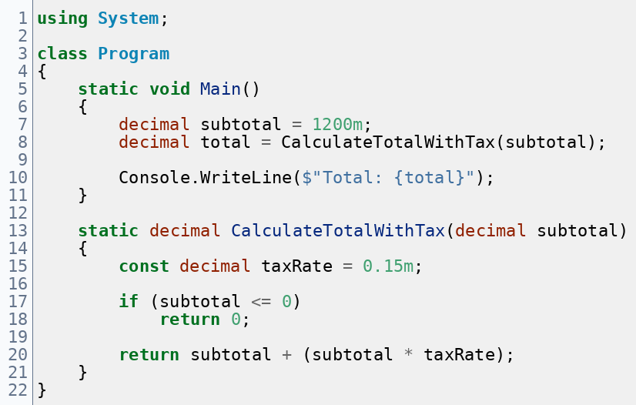
STANDARD CONTENT
Day 2 · C# Foundations
A small C# example with clean boundaries
How boundaries are defined, and responsibilities are implemented
What to notice
Clear method name
Input and output stay separate from printing
One small rule handled with a simple if
Main stays easy to scan
Callout
Even a tiny example should model clean naming and method boundaries.
Training deck · Day 2
Notes:
Speaker notes: Read this code from top to bottom. The teaching point is not the calculation itself. The teaching point is separation: Main orchestrates; the method performs focused work. [Sources] - None. Original instructional example for this session.

Slide 13
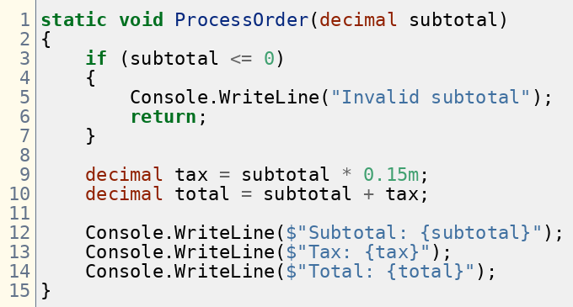
WORKSHOP
Day 2 · C# Foundations
Exercise: review this method and fix it
What you have learned apply now
Prompt: What responsibility is misplaced here, and how would you make the code easier to read and test?
Training deck · Day 2
Notes:
Speaker notes: Pause here and let the room work. The key idea is misplaced responsibility: calculation and console output are mixed together. Ask students how they would split those concerns. [Sources] - None. Original workshop example for this session.

Slide 14
SECTION
From syntax knowledge
to coding judgment
Model behavior clearly
Each topic should answer a practical question team face when they start building real features.
Transform data readably
Wait for I/O safely
Verify with tests

Slide 15
OOP
Day 2 · C# Foundations
Model behavior, not just data
Good object-oriented design gives each class one reason to exist and a small surface that is easy to explain.
A class should own state and the behavior that keeps that state valid
Favor composition when a class needs help from another service
Use small methods and good names so the object tells a story
Do not make classes that only store data while all behavior leaks elsewhere
Simple example
C# example
public class Order
{
private readonly List<OrderLine> _lines = new();
public IReadOnlyList<OrderLine> Lines => _lines;
public void AddLine(string sku, int qty, decimal price)
{
if (qty <= 0) throw new ArgumentException();
_lines.Add(new OrderLine(sku, qty, price));
}
public decimal Total() => _lines.Sum(x => x.Qty * x.Price);
}
Best question: who should own this behavior?
Training deck · OOP

Slide 16
COLLECTIONS + LINQ
Day 2 · C# Foundations
Most business code is data selection and transformation
Developers become faster when they learn which collection fits the job and how to express filtering, projection, and grouping clearly.
Collection instincts
LINQ flow
✓
List<T> for ordered sequences
var summaries = orders
.Where(o => o.Total() > 100)
.OrderByDescending(o => o.Total())
.Select(o => new
{
Customer = o.CustomerName,
Amount = o.Total()
})
.ToList();
✓
Dictionary<TKey,TValue> for lookup
✓
HashSet<T> for uniqueness
Readable LINQ beats clever LINQ.
Learning point
Use query steps as a narrative: filter → sort → project.
Projection is where you shape data for output or UI
If a query becomes hard to explain, split it into named steps
Training deck · collections and LINQ

Slide 17
ASYNC/AWAIT
Day 2 · C# Foundations
Use async to wait on I/O without blocking the flow
This topic is easier when developers see it as a control-flow tool for database, API, and file operations—not a magic speed button.
Mental model
Async example
1
public async Task<OrderDto?> GetOrderAsync(int id)
{
var entity = await _db.Orders.FindAsync(id);
if (entity is null) return null;
return new OrderDto(entity.Id, entity.CustomerName, entity.Total);
}
Start I/O
Call database, HTTP, or file work
2
Await
Free the thread while work is in flight
Avoid .Result and .Wait() in normal application flow.
Name asynchronous methods with the Async suffix
Keep the whole call chain async when the dependency is async
Use async primarily for I/O-bound work, not as decoration
3
Resume
Continue when the result returns
Training deck · async and await

Slide 18
TESTING
Day 2 · C# Foundations
Testing is fast feedback on behavior
Developers do not need a giant testing taxonomy first. They need to see one focused test that checks a clear rule.
What to test first
Pure business rules with clear inputs and outputs
Validation branches and edge cases
Small service methods before wide end-to-end flows
Code that would be painful to verify manually every time
xUnit example
[Fact]
public void Total_returns_sum_of_order_lines()
{
var order = new Order();
order.AddLine("A-1", 2, 10m);
order.AddLine("B-2", 1, 25m);
var total = order.Total();
Assert.Equal(45m, total);
}
Rule: the test name should read like a requirement.
Arrange the object
Act once
Assert one meaningful outcome
Training deck · testing

Slide 19
COMPARISON
Day 2 · C# Foundations
Team habits vs maintainable habits
This is where team becomes explicit across all fundamentals.
Common early habit
Maintainable habit
One large class that does everything
Loops and if-statements scattered everywhere
Blocking async calls because “it works”
No tests until the end, if any
Tiny exercises that never grow into projects
Classes with focused responsibility and explicit behavior
Collections and LINQ used as clear data narratives
End-to-end async flow for I/O-bound work
Small, fast tests around behavior changes
Projects that combine design, data flow, and verification
Training deck · comparison

Slide 20
SMALL PROJECTS
Day 2 · C# Foundations
Projects assignments
The best practice projects are small enough to finish but rich enough to exercise design, data work, async flow, and tests.
1
2
3
4
5
Task Tracker API
Book Catalog
Budget Planner
Order Console App
File Import Tool
Classes, List<T>, filtering, async repository, unit tests
Search and projection with LINQ, validation, test coverage
Domain rules, grouping, totals, edge-case tests
OOP modeling plus collections before web work
Async I/O, parsing, validation, testable helpers
Good rule for project scope
One domain, one main workflow, one small data model
At least one query or transformation with LINQ
At least one async path if the project touches files, HTTP, or data access
At least three tests that prove real behavior
Finishing a small project is more valuable than starting a large one.
Training deck · project ideas

Slide 21
WRAP-UP
What team should leave with
Next step for Day 2
A clear distinction between C# and .NET
Move from language basics into how .NET is used to build simple backend APIs with good boundaries and beginner-friendly structure.
A simple mental model for shaping code
Stronger habits for naming, methods, and separation of responsibilities
Repeat the core message:
write code that you can explain.
Strong maintainable code habits
Q&A
Notes:
Speaker notes: End with confidence, not with another content dump. Restate the core rule of the day: write code you can explain and debug, not code you only copied. [Sources] - None. Original summary slide.

