Slide 1

Data Analysis of Fatalities in the Israeli-Palestinian Conflict
Abdul Munaf
Anika Bushra
Eric Lantz
Deepak Vemula

Slide 2
Overview
Abstract
Introduction
Dataset
Preprocessing
Literature Review
Architecture/Methodology
Results
Conclusion
References
Github Repository for Code

Slide 3
Abstract
Throughout this project, our team has examined a dataset compiled by B’Tselem, the Israeli Information Center for Human Rights in the Occupied Territories, detailing fatalities from the Israeli-Palestinian conflict since the second Intifada in 2000. We’ve analyzed:
Demographic and circumstantial details such as age, gender, citizenship, etc.
Statistical analysis and visualizations to uncover insights.
An overall understanding of conflict-related human impact.

Slide 4
Introduction
The Israeli-Palestinian conflict is long-standing and has been marked by repeated acts of violence, especially since the second intifada.
Our dataset includes statistics on all human beings impacted including Palestinians, Israelis, and foreign nationals.
Our team’s analysis focuses on the patterns and demographics associated with the fatalities.
As a group, we aim to reveal information on the cost of human life in this conflict.

Slide 5
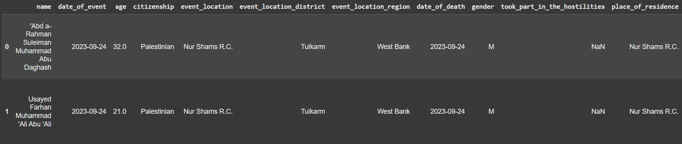
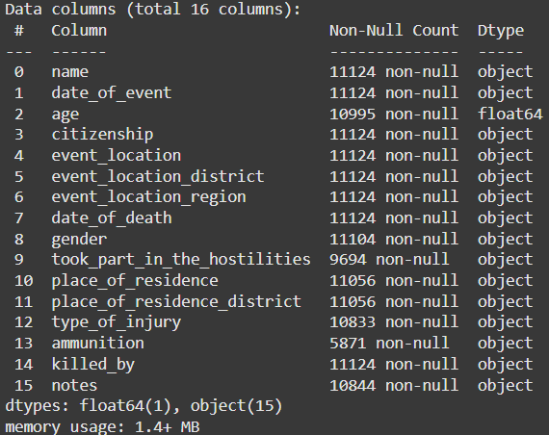
Dataset
This dataset provides information on the individuals killed during the Israeli-Palestinian conflict since the second intifada, which began in September 2000. The data has been meticulously collected and investigated by B’Tselem – The Israeli Information Center for Human Rights in the Occupied Territories.
The Dataset contains, 16 columns & 11124 rows.
The columns provide specific information about each individual's death, including:
age: Age of the individual.
citizenship: Citizenship or nationality (e.g., Palestinian).
event_location: The location of the event.
event_location_district and event_location_region: More detailed geographic
categorization of the event's location.
date_of_death: The date on which the individual died.
gender: Gender of the individual.
took_part_in_the_hostilities: Whether the individual was involved in hostilities.
place_of_residence: Where the individual lived.
place_of_residence_district: District of residence.
type_of_injury: The type of injury that led to death.
ammunition: Type of ammunition used.
killed_by: The responsible party (e.g., Israeli security forces).
notes: Additional contextual details about the incident.
Fig 1: Head of the Dataset
Fig 2: Details of 16 columns in a dataset

Slide 6

Preprocessing
Data Exploration: Exploring dataset, its rows and columns and getting familiar with the data and its variables used.
Individual Null handling: Addressed missing values on a column-by-column basis, applying unique treatments aligned with analysis goals also depends on the importance of each column and the proportion of missing values. (e.g., filling with 'Unknown' where participation status was ambiguous).
Consistency Check: Ensured uniform formats across features for cohesive analysis and visualization.

Slide 7
Literature Review
S.NO | Author(s) | Paper and publication | Findings
1 | Garen J Wintemute | Injury Mortality and Socioeconomic Development: An Exploratory Analysis | EDA techniques identify demographic patterns in injury mortality, highlighting high-risk groups.
2 | Julia Almeida Calazans, Inaki Permanyer | Levels,trends,and determinants of cause-of-death diversity in a global perspective: 1990-2019 | Compares injury types, finding the strongest fatality.
3 | Jie M. Zhang, Mark Harman, Lei Ma, Yang Liu | Machine Learning Testing: Survey, Landscapes, and Horizons | Reviews machine learning techniques for predicting injury risk and severity.
4 | Davies Adeloye , Kirsty Bowman, Kit Yee Chan, Smruti Patel, Harry Campbell, Igor Rudan | Global and regional child deaths due to injuries: An assessment of the evidence | Examines the global burden of child injury mortality and identifies risk factors.

Slide 8
Architecture/Methodology
DATA COLLECTION AND LOADING
DATA PROCESSING AND CLEANING
DATA ANALYSIS
DATA VISUALIZATION
INSIGHTS AND REPORTING

Slide 9
RESULTS

Slide 10
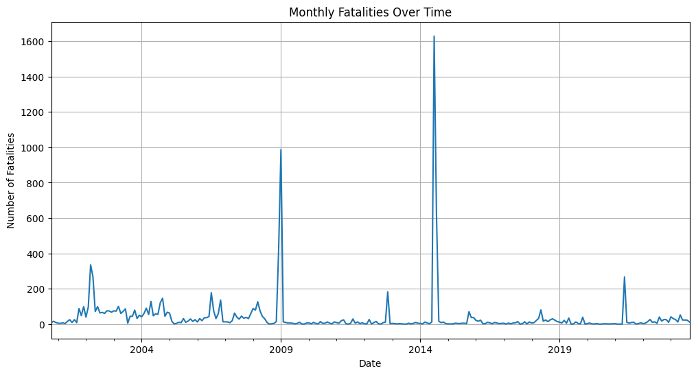
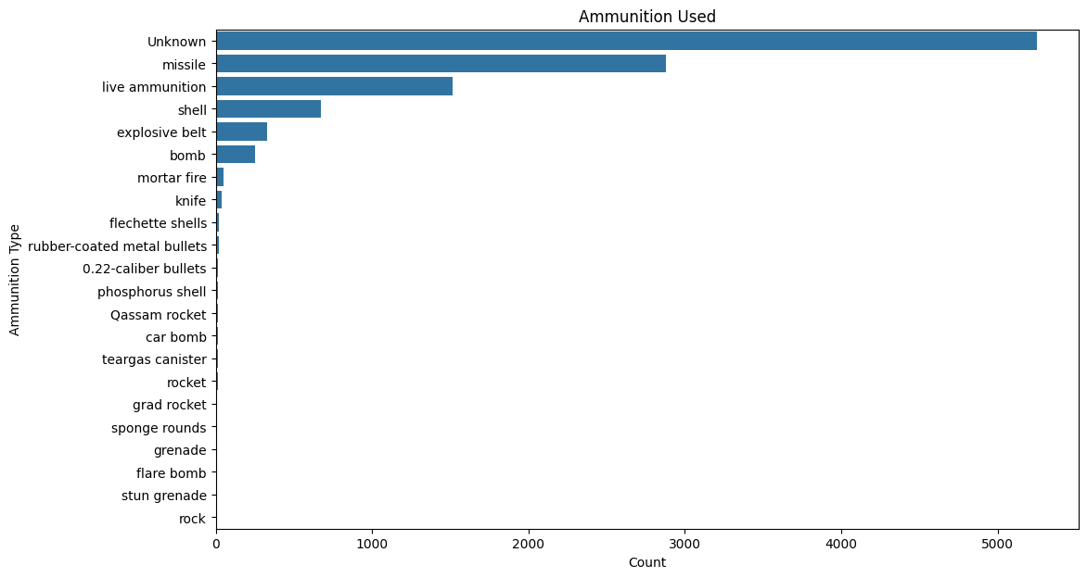
1. Fatality Trends Analysis
Objective: Track trends in fatalities over time, examining any spikes, declines, or significant changes.

Slide 11
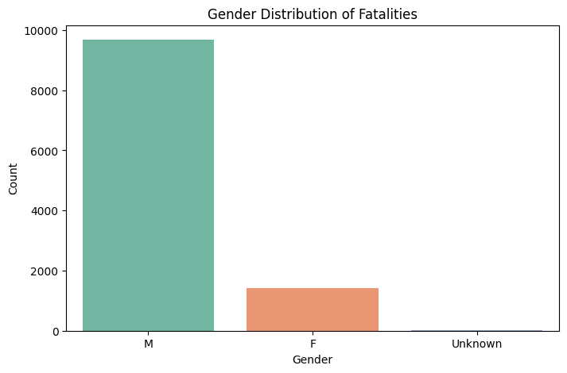
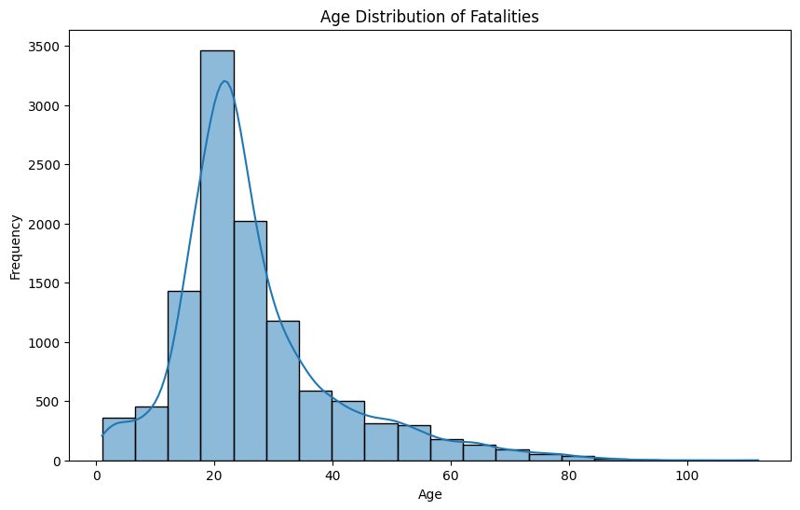
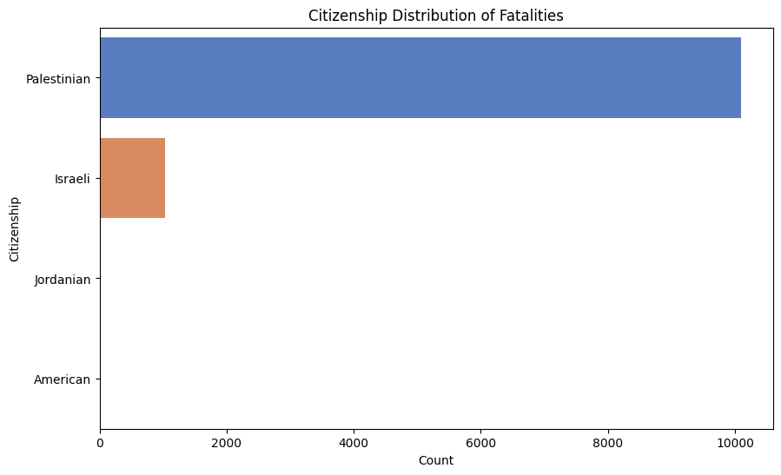
2. Demographic Analysis
Objective: Examine age, gender, and citizenship patterns.

Slide 12
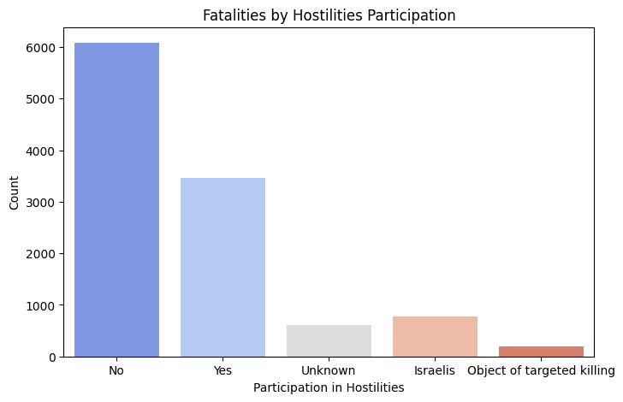
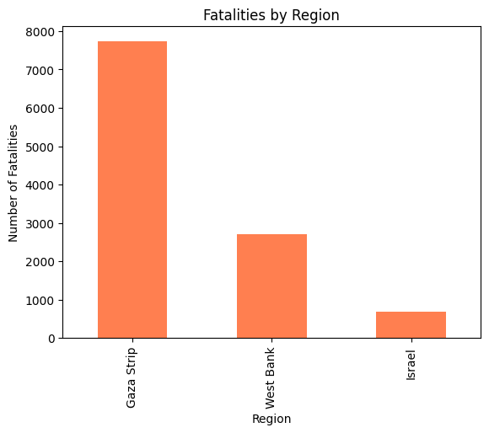
3. Geospatial and Hostilities Participation Analysis
Objective: Compare hostilities-related facilities and visualize locations to identify high-violence areas

Slide 13
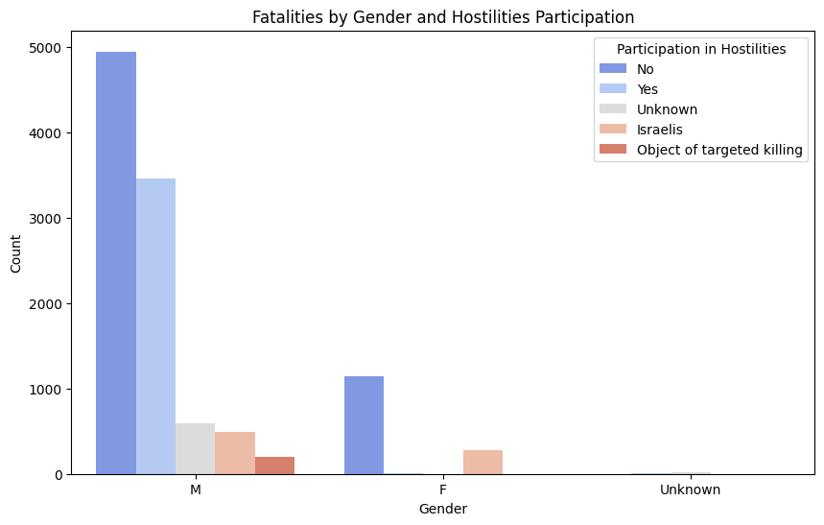
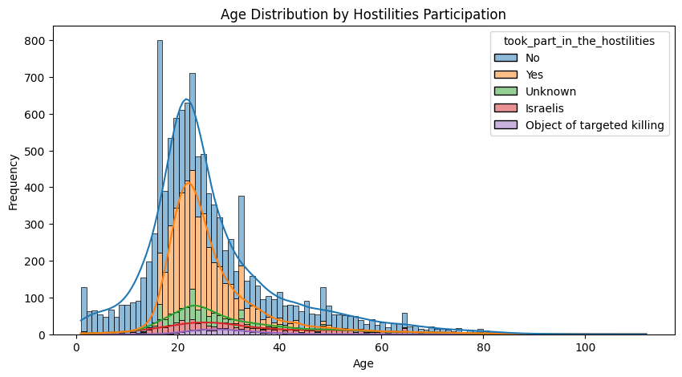
4. Hostilities Participation Analysis
Objective: Age distribution and fatalities by hostilities participation

Slide 14
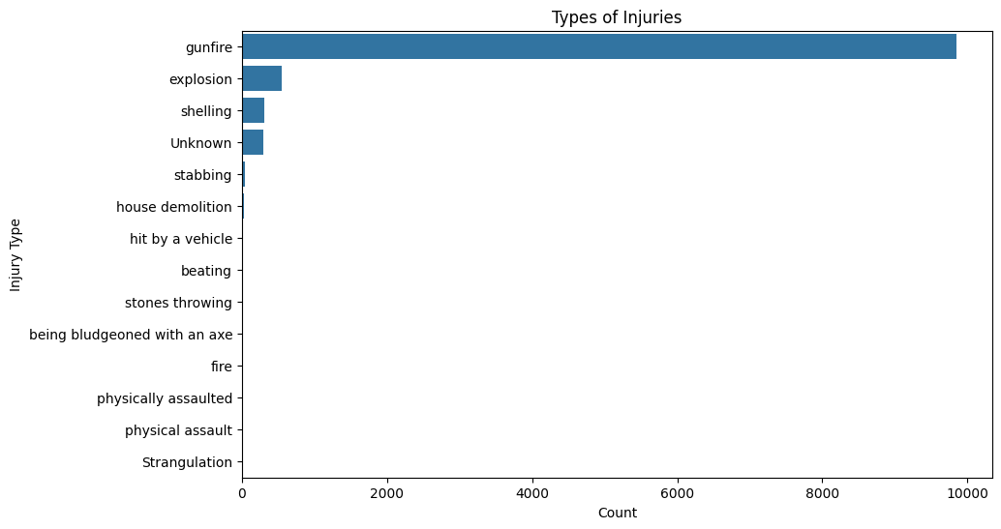
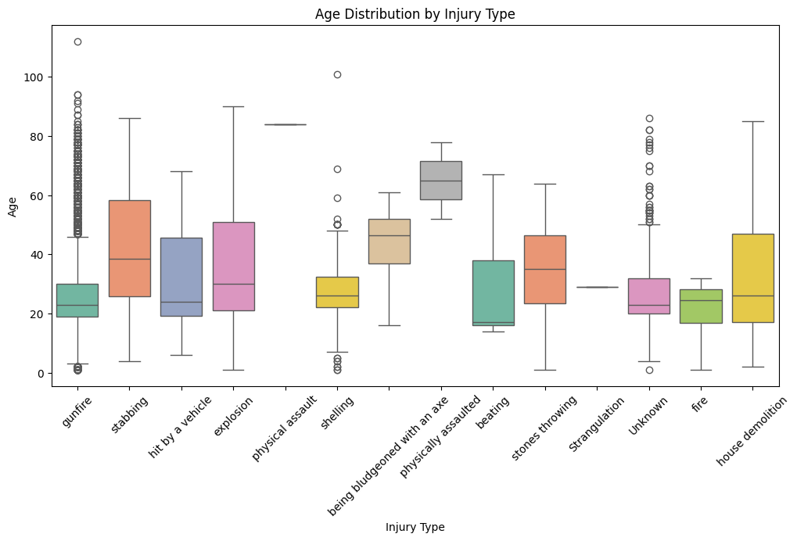
5. Injury Analysis
Objective: Examine age and types of injuries

Slide 15
Conclusion
An analysis of this dataset identifies multiple trends regarding the fatalities during the Israeli-Palestinian conflict.
The data frequently reveals that a significant portion of casualties consists of civilians, indicating the humanitarian toll on non-combatants, especially in densely populated areas where military engagements are likely to impact bystanders.
It was also apparent that typically, female participation in direct combat roles is lower, especially within formal military operations or militias, though there may be some involvement depending on the faction and specific circumstances.
Trends seem to show that younger and older populations are disproportionately affected, particularly within non-hostile groupings. This insight highlights the vulnerabilities of non-combatant groups within the conflict.
In review, this dataset can help us to understand the nuanced and often multi-dimensional effects of this prolonged conflict, and how they relate to different demographics, regions, and time periods.

Slide 16
References
Adeloye, D., Bowman, K., Chan, K. Y., Patel, S., Campbell, H., & Rudan, I. (2018). Global and regional child deaths due to injuries: an assessment of the evidence. Journal of global health, 8(2), 021104. https://doi.org/10.7189/jogh.08.021104
Calazans, J.A., Permanyer, I. Levels, trends, and determinants of cause-of-death diversity in a global perspective: 1990–2019. BMC Public Health 23, 650 (2023). https://doi.org/10.1186/s12889-023-15502-4
CristianDMG. (2023). Fatalities in the Israel-Palestine conflict: 2000 to 2023 [Code and data set]. Kaggle. https://www.kaggle.com/code/cristiandmg/fatalities-isr-pse-conflict-2000-to-2023
Wintemute G. J. (1986). Injury mortality and socioeconomic development: an exploratory analysis. International journal of epidemiology, 15(4), 540–543. https://doi.org/10.1093/ije/15.4.540
Zhang, J. M., Harman, M., Ma, L., & Liu, Y. (2019). Machine Learning Testing: Survey, Landscapes and Horizons. arXiv. https://arxiv.org/abs/1906.10742

Slide 17
GitHub Repository for Code
https://github.com/abdul-munaf/CS661-Midterm/tree/main

