Slide 1
ASSIGNMENT III · DEEP LEARNING FOR COMPUTER VISION
May 2026
AlexNet.
A deep convolutional network.
With a comparison to LeNet-5 on CIFAR-10.
Group 1 · AI Stream · AAiT
Abdulmunim Jundurahman Jemal · UGR/8625/14
Elizabet Yonas · UGR/6912/14
Eyob Derese · UGR/6771/14

Slide 2
02 / 12
On the agenda
Six steps from 1998 to 2012 — and what changed.
01
02
Why CNNs?
LeNet-5 (1998)
Vision before deep learning
The blueprint
03
04
AlexNet (2012)
Five key innovations
The breakthrough
ReLU, dropout, augmentation, GPU, LRN
05
06
Implementation on CIFAR-10
Results and analysis
PyTorch + Google Colab
What we expect to see
AlexNet vs LeNet-5 · CIFAR-10 · Group 1
Page 2

Slide 3
03 / 12
Why CNNs matter
From hand-crafted features to learned representations.
Before 2012
After AlexNet, 2012
Hand-crafted descriptors (SIFT, HOG)
Classifiers (SVM, boosting) on top
Performance plateaued on ImageNet
Each task needed new feature engineering
End-to-end learned features
Same backbone reused across tasks
ImageNet top-5 error: 26.2% → 15.3%
Restarted deep learning as a field
“AlexNet did not invent the CNN. It made the CNN inevitable.”
AlexNet vs LeNet-5 · CIFAR-10 · Group 1
Page 3

Slide 4
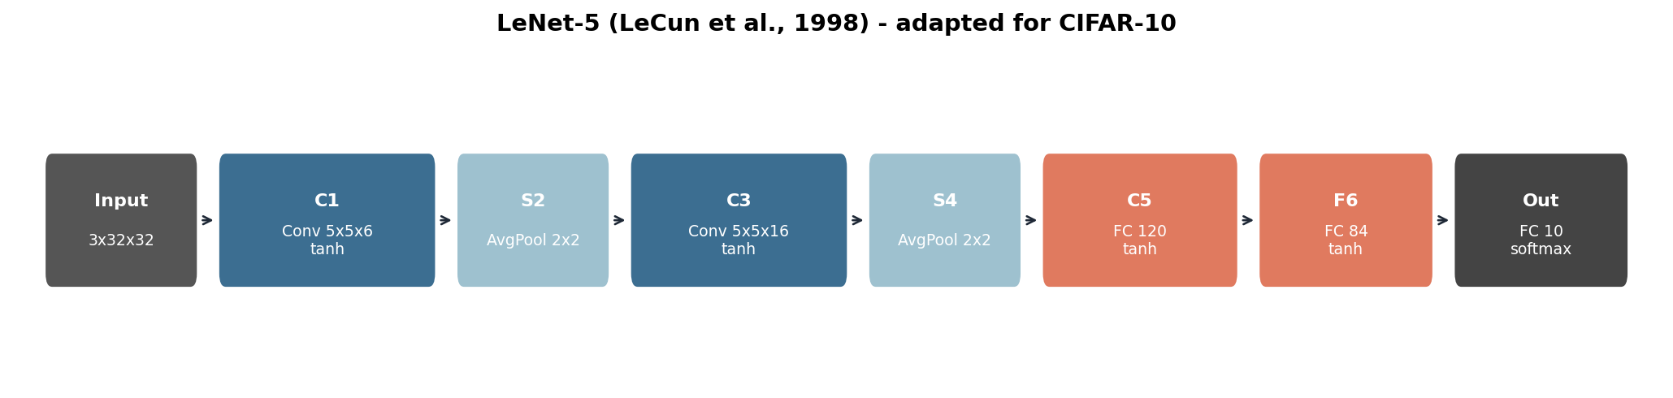
04 / 12
LeNet-5 (LeCun et al., 1998)
The convolutional blueprint, born to read handwritten digits.
PARAMETERS
ACTIVATION
POOLING
DATASET
~60k
tanh
avg
MNIST
Trained on a Sun SPARCstation in ~3 days. Read U.S. Postal ZIP codes in production.
AlexNet vs LeNet-5 · CIFAR-10 · Group 1
Page 4

Slide 5
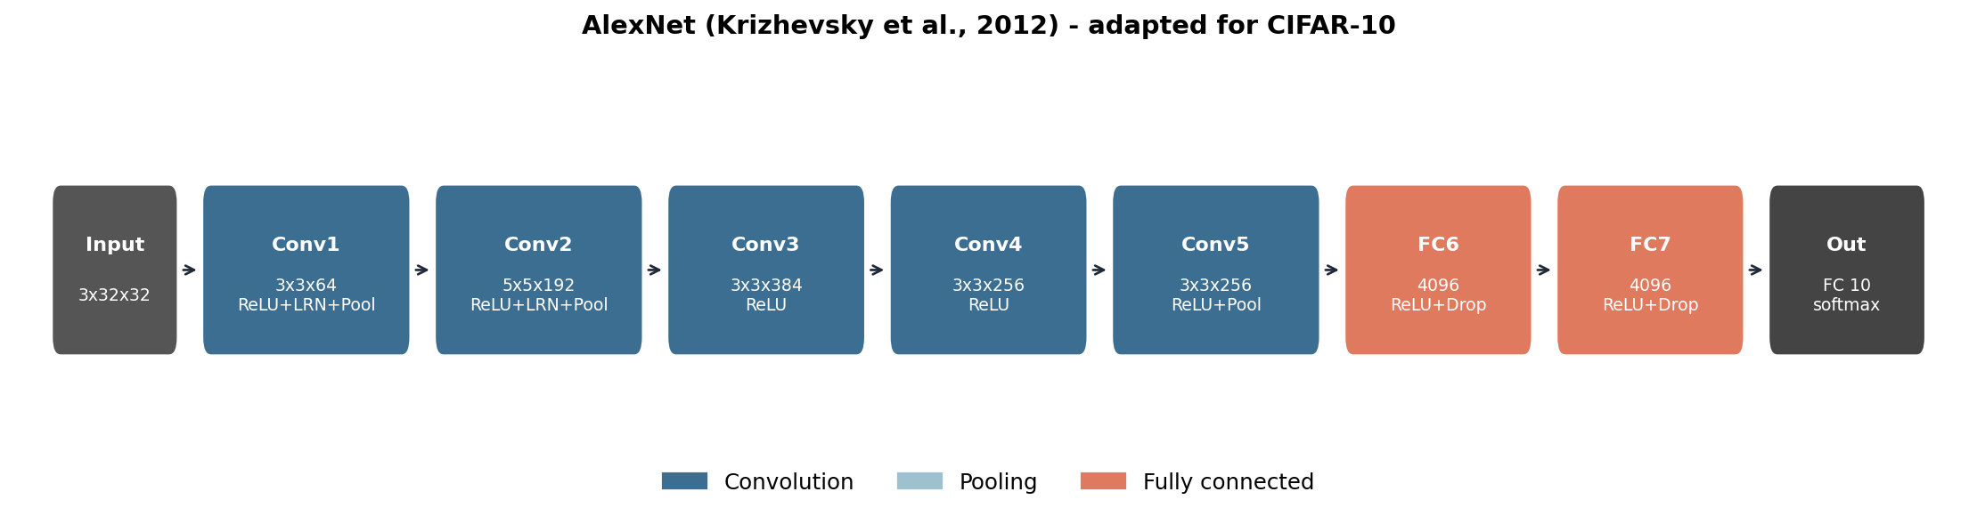
05 / 12
AlexNet (Krizhevsky et al., 2012)
Eight learnable layers, ~60M parameters, two GPUs in parallel.
CONV LAYERS
FC LAYERS
PARAMETERS
IMAGENET TOP-5 ERROR
5
3
~60M
15.3 %
AlexNet vs LeNet-5 · CIFAR-10 · Group 1
Page 5

Slide 6
06 / 12
Five innovations that changed everything
Each idea is incremental on its own. Together they reset the field.
I
II
III
IV
V
ReLU
Dropout
Augmentation
GPU training
Overlap + LRN
Replaces tanh — gradients flow, training ~6× faster.
Stochastically zeroes FC units — regularizes 40M parameters.
Crops, flips, PCA jitter — multiplies the dataset ~2000×.
Two GTX 580s in parallel — model fits, training is tractable.
Max pool with overlap and lateral inhibition between maps.
“The combination — not any single piece — is what reset the field.”
AlexNet vs LeNet-5 · CIFAR-10 · Group 1
Page 6

Slide 7
07 / 12
Side by side
Every architectural decision, in one table.
Aspect | LeNet-5 · 1998 | AlexNet · 2012
Depth | 5 learnable layers | 8 learnable layers
Parameters | ~60,000 | ~36,000,000
Activation | tanh | ReLU
Pooling | average, non-overlapping | max, overlapping
Regularization | none | Dropout + augmentation
Hardware | CPU | 2 × GTX 580 GPUs
Dataset | MNIST (~70k digits) | ImageNet (~1.2M images)
AlexNet vs LeNet-5 · CIFAR-10 · Group 1
Page 7

Slide 8
08 / 12
Implementation
PyTorch on Google Colab — CIFAR-10, 20 epochs, T4 GPU.
Dataset
alexnet.py
CIFAR-10 — 10 classes, 32×32 RGB
50,000 train / 10,000 test images
AlexNet-style augmentation: random crops + flips
class AlexNet(nn.Module): self.features = nn.Sequential( nn.Conv2d(3, 64, 3, padding=1), nn.ReLU(inplace=True), nn.LocalResponseNorm(5), nn.MaxPool2d(3, 2, padding=1), nn.Conv2d(64, 192, 5, padding=2), nn.ReLU(inplace=True), nn.LocalResponseNorm(5), nn.MaxPool2d(3, 2, padding=1), nn.Conv2d(192, 384, 3, padding=1), nn.ReLU(inplace=True), nn.Conv2d(384, 256, 3, padding=1), nn.Conv2d(256, 256, 3, padding=1), nn.ReLU(inplace=True), nn.MaxPool2d(3, 2, padding=1), )
Training setup
SGD, momentum 0.9, weight decay 5e-4
Batch size 128, cosine LR (init 0.01)
Cross-entropy loss
He / Kaiming initialisation
AlexNet vs LeNet-5 · CIFAR-10 · Group 1
Page 8

Slide 9
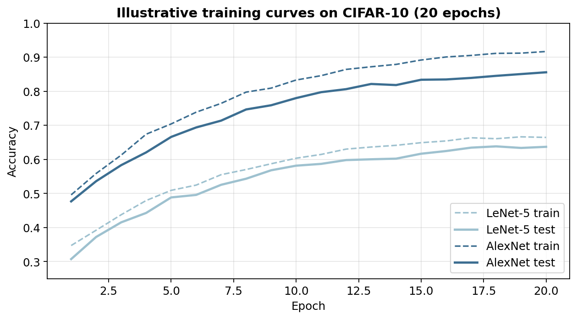
09 / 12
What we expect to see
Same data, same optimiser, same epochs — only the architecture changes.
60-70 %
LeNet-5 test accuracy
Limited capacity saturates fast.
80-90 %
AlexNet test accuracy
Capacity × ReLU × regularisation.
~+20 pp
Absolute accuracy gain
Headroom across the whole run.
Numbers are envelopes from published reimplementations — the notebook overwrites them with measured values.
AlexNet vs LeNet-5 · CIFAR-10 · Group 1
Page 9

Slide 10
10 / 12
Why does AlexNet win?
Three effects compound — and removing any one closes the gap.
I
II
III
Capacity
Optimisation
Regularisation
~400× more parameters can represent richer features.
ReLU + Kaiming keep gradients flowing through eight layers.
Dropout and augmentation prevent the bigger model from memorising.
Capacity without optimisation = vanishing gradients. Optimisation without regularisation = overfitting. You need all three.
AlexNet vs LeNet-5 · CIFAR-10 · Group 1
Page 10

Slide 11
11 / 12
Limitations · Legacy
What AlexNet still gets wrong — and what it set in motion.
Limitations
Legacy
~96% of params live in the FC layers
LRN superseded by batch normalisation
11×11 conv1 wastes compute vs stacked 3×3s
Shallow by modern standards — no residual learning
Heavy memory footprint at training time
Made deep learning mainstream
ReLU + dropout + augmentation = still the recipe
Inspired VGG, GoogLeNet, ResNet, DenseNet, EfficientNet
First proof that GPUs train deep nets
Over 130,000 citations as of 2025
AlexNet vs LeNet-5 · CIFAR-10 · Group 1
Page 11

Slide 12
Thank you.
Questions and discussion.
Group 1 · AI Stream · Assignment 3 · May 2026
Abdulmunim Jundurahman Jemal · Elizabet Yonas · Eyob Derese

