Slide 1
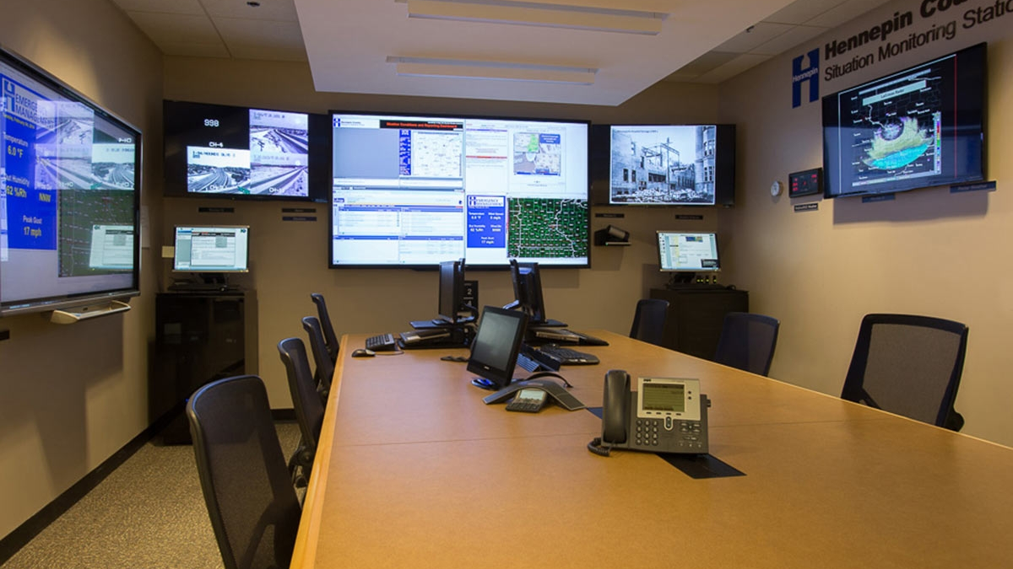
ENTERPRISE NETWORK
24/7
Mission Critical
PESI
Pakistan Emergency
Smart Infrastructure
Enterprise Network Infrastructure Analysis
Prepared by: Abdul Wahid
December 24, 2025
Project: PESI Network Architecture
Network Analysis Report

Slide 2
NAVIGATION
Network Architecture Overview
01
Head Quarter (HQ)
02
Branch 2
Core Network Infrastructure
Redundant Remote Office
9 VLANs
Dual Core
Area 0
6 VLANs
HSRPv2
Area 1
03
Branch 1
04
(E-Site)
Distributed Offices
Emergency Response System
6 VLANs
NAT/PAT
Area 3
10 VLANs
Load Balance
Area 2
05
Central Distribution System
Network Hub & Security Layer
Dual Firewall
DMZ
VPN
Multi-Area OSPF
5 Sites
4 OSPF Areas
Zero Single Point of Failure

Slide 3
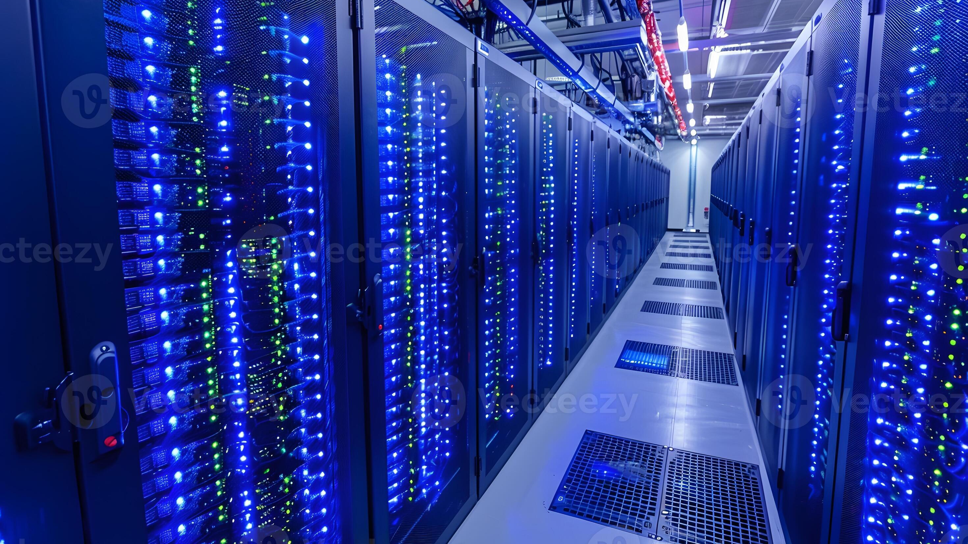
Head Quarter
Network
01
Enterprise-level core infrastructure with 9 VLANs,
dual redundancy, and comprehensive services
9
2
7
Department VLANs
Core Switches
Critical Servers
Complete segmentation
Active-Standby HSRP
Full service stack

Slide 4
HEAD QUARTER
HQ: Network Core Architecture
Hierarchical 3-tier design with dual redundancy at every layer
Core Layer Infrastructure
OSPF Configuration
Core-Active (Primary L3 Switch)
Area 0 (Backbone)
Router ID: 1.1.1.1 | HSRP Priority: 110 (Active)
• 4 routers in OSPF domain
Core-Standby (Backup L3 Switch)
• Passive interfaces on host networks
Router ID: 5.5.5.5 | HSRP Priority: 90 (Standby)
• Point-to-point network types on links
LACP Port-Channel 1
4
9
• 3x GigabitEthernet links bundled
OSPF Routers
VLAN Networks
• Load balancing & redundancy
• 3 Gbps aggregate bandwidth
Edge Routing Layer
Redundancy Features
HQ-Router (Main Router)
HSRP: Active-Standby gateway redundancy
Router ID: 3.3.3.3 | Internet connectivity
LACP: Link aggregation with load balancing
Standby-HQ (Backup Router)
RAPID-PVST: Spanning tree optimization
Router ID: 4.4.4.4 | Redundant internet
OSPF: Dynamic routing failover
Topology: Hierarchical 3-Tier (Core → Distribution → Access)
IP Scheme: 50.50.0.0/16

Slide 5
HEAD QUARTER
HQ: VLAN Segmentation & Services
Department-wise network isolation with comprehensive service infrastructure
VLAN Segmentation Table
Critical Servers (VLAN 10)
VLAN | Department | Network | Gateway
10 | Servers | 50.50.10.0/24 | 50.50.10.1
20 | HR Department | 50.50.20.0/24 | 50.50.20.1
30 | Finance Department | 50.50.30.0/24 | 50.50.30.1
40 | Sales Department | 50.50.40.0/24 | 50.50.40.1
50 | IT Department | 50.50.50.0/24 | 50.50.50.1
60 | Management | 50.50.60.0/24 | 50.50.60.1
70 | Voice (VoIP) | 50.50.70.0/24 | 50.50.70.1
80 | IoT Devices | 50.50.80.0/24 | 50.50.80.1
90 | Wireless/WiFi | 50.50.90.0/24 | 50.50.90.1
📧 EMAIL Server
IP: 50.50.10.12 | Domain: pesi.com
🌐 DNS Server
IP: 50.50.10.11 | A Record: pesi.com
📡 DHCP Server
IP: 50.50.10.10 | 9 DHCP Pools
📁 FTP Server
IP: 50.50.10.14 | Department-wise access
🕒 NTP/SYSLOG
IP: 50.50.10.16 | Centralized sync
🔐 AAA/RADIUS
IP: 50.50.10.18 | Port: 1645
🏠 IoT Server
IP: 50.50.10.17 | Registration server
Network Capacity
9
~2,000
VLANs
Devices
HSRP: Virtual IP as default gateway | Preempt: Enabled | Root Bridge: Core-Active (Priority 24576)

Slide 6
HEAD QUARTER
HQ: VoIP, IoT & Security Implementation
Integrated communication and automated security systems
VoIP/Telephony System
IoT Security System
Voice-Path Router
System Components
IP: 50.50.100.2
System: Cisco CME (Call Manager Express)
Camera
Motion Detector
Capacity: 42 IP Phones max
Always ON (24/7)
Trigger based
5
6001-6005
Siren
Smart Door Locks
IP Phones
Extensions
Motion activated
Auto lock
Dial-Peer Configuration
Automation Logic
External calling configured with proper dial-peers for outbound call routing
Motion Detected
Siren: ON
All Doors: LOCK
IoT Server
IP: 50.50.10.17 | Function: IoT Registration Server | Username: pesi123
Security Implementation
SSH Access Control
• SSH version 2 (secure)
• Access-list: SSH-ADMIN-ACCESS
Authorized SSH Hosts (4)
• 50.50.50.23
• 50.50.50.22
• 50.50.90.126
• 50.50.60.21
AAA Authentication
Local & RADIUS authentication with enable secret and privilege level 15 for admin
Management: Centralized Syslog (50.50.10.16) | NTP Synchronized | HSRP State Tracking

Slide 7

Branch
Networks
02
Remote office configurations with
scalable architecture and redundant connectivity
3
100%
1,200+
Branch Sites
Redundancy
User Capacity
Remote offices
Dual everything
Per branch

Slide 8
BRANCH NETWORKS
Branch 2: Scalable Remote Office
Enterprise-grade remote site with HSRPv2, serial backup, and inter-branch connectivity
Network Infrastructure
VLAN Structure (6 VLANs)
Dual L3 Core Switches (HSRPv2)
VLAN | Department | Network | Gateway
10 | Management | 10.20.10.0/24 | 10.20.10.1
20 | IT Department | 10.20.20.0/24 | 10.20.20.1
30 | Sales | 10.20.30.0/24 | 10.20.30.1
40 | CEO-Admin | 10.20.40.0/24 | 10.20.40.1
50 | Voice | 10.20.50.0/24 | 10.20.50.1
100 | Servers | 10.20.100.0/24 | 10.20.100.1
Core-Main-L3
Core-Standby-L3
RID: 10.20.255.3
RID: 10.20.255.4
Priority: 110 (Active)
Priority: 100 (Standby)
Dual Edge Routers with Backup
Branch-CORE
Primary WAN
RID: 10.20.200.1 | HSRP Priority: 110
Standby-Router
Secondary
Server Infrastructure
RID: 10.20.200.2 | HSRP Priority: 100
Serial Backup: 128 kbps link between routers (10.20.2.0/30)
📡 DHCP Server
IP: 10.20.100.10 | 6 DHCP pools | 245 users per pool
LACP Port-Channel 1
🌐 DNS Server
IP: 10.20.100.11 | Domain: b2pesi.com
3x GigabitEthernet links bundled between core switches for load balancing and redundancy
📧 EMAIL Server
OSPF Area 1 with Summarization
IP: 10.20.100.12 | Domain: pesi.com
Route summarization configured on Branch-CORE: 10.20.1.0/24 and 10.20.2.0/24 summarized
VoIP System
4
2001-2004
IP Phones
Extensions
Inter-Branch Calling: Branch 2 ↔ HQ (6001-6005) via OSPF routing
IP Scheme: 10.20.0.0/16 | OSPF Area: Area 1 | Capacity: ~1,200 users

Slide 9
BRANCH NETWORKS
Branch 2: Distributed Offices
Contrasting architectures: basic services vs. complex independent connectivity
B2
Branch 2
B2
Branch 2
Network Overview
Advanced Features
IP Range: 172.16.0.0/16
IP Range: 172.16.0.0/16
Domain: b1pesi.com
OSPF Area: Area 3
VLANs: 6 department VLANs
WAN: Dual ISP connectivity
NAT: PAT (Port Address Translation)
Server Infrastructure
📡 DHCP Server
Core Infrastructure
IP: 172.16.60.2 | 6 pools | ~1,200 users
B2-Core-Router
B2-Core-Router-2
🌐 DNS Server
RID: 4.4.4.4
RID: 3.3.3.3 (NAT)
IP: 172.16.60.3 | Domain: b1pesi.com
B2-Core-Switch-1
B2-Core-Switch2
📧 EMAIL Server
RID: 1.1.1.1 (Active)
RID: 2.2.2.20 (Standby)
IP: 192.168.60.2 | Domain: b1pesi.com
Unique Capabilities
Characteristics
Only branch with NAT/PAT
Simple branch with basic services
Direct dual ISP internet
6 VLANs serving 5 departments
Full mesh router-switch connectivity
Centralized server farm
Can function independently from HQ
⚠️ CRITICAL NOTE
Branch 1
Branch 4
B1 & B4 share 172.16.0.0/16
Basic infrastructure
Complex independent

Slide 10
Emergency
Response System
03
Mission-critical network infrastructure
for emergency services with extreme redundancy
10
4
570+
VLANs
Critical Services
Device Capacity
Emergency services
Life-saving teams
Mission-critical
EXTREME REDUNDANCY
Zero single point of failure for life-critical emergency response operations

Slide 11
EMERGENCY RESPONSE
Branch 3 (E-Site): Emergency Network
Life-critical infrastructure with load-balanced HSRP and dedicated emergency services
Emergency Services VLANs
Emergency Server Farm (VLAN 90)
🚑 Ambulance
VLAN 10
📡 DHCP Server
Network: 10.10.10.0/24 | Gateway: 10.10.10.1
IP: 10.10.90.11 | 9 pools | 570+ device capacity
🏥 Medical
VLAN 20
🌐 DNS Server
Network: 10.10.20.0/24 | Gateway: 10.10.20.1
IP: 10.10.90.10 | Domain: emergency.com
👮 Police
📧 EMAIL Server
VLAN 30
IP: 10.10.90.13 | Domain: helpline.centre
Network: 10.10.30.0/24 | Gateway: 10.10.30.1
🔐 AAA/RADIUS Server
🚒 Rescue
VLAN 40
IP: 10.10.90.12 | Port: 1645 | Full AAA implementation
Network: 10.10.40.0/24 | Gateway: 10.10.40.1
📁 FTP Server
Load-Balanced HSRP Configuration
IP: 10.10.90.14 | Department-specific user access
E-Core-1 Active: VLAN 10,20,30,50,70,80,90
🗄️ Database Server
E-Core-2 Active: VLAN 40,60 (Rescue & IT)
IP: 10.10.90.15 | Emergency records management
Additional VLANs
Voice: 10.10.50.0/24 | IT: 10.10.60.0/24 | Wireless: 10.10.70.0/24
Emergency VoIP System
IoT: 10.10.80.0/24 | Servers: 10.10.90.0/24 | Management: 10.10.99.0/24
E-Voice-Path (10.10.90.20)
Cisco CME | Max 20 ephones | 10 emergency hotlines
Hotlines
Inter-Site
115, 2101, 3001
→ HQ (6001-6005)
4001, 5001, 15
→ Branch 2 (2001-2005)
1151, 1122, 10001
Emergency calls routed
Network Range: 10.10.0.0/16 | OSPF Area: Area 2 | Domain: emergency.com / helpline.centre

Slide 12
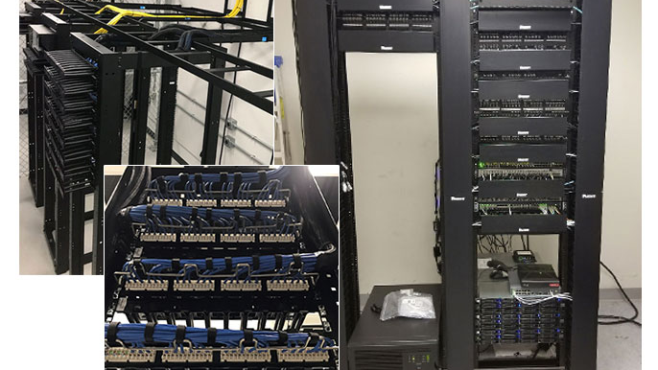
Central
Distribution System
04
Enterprise hub connecting all sites with
dual firewalls, ISPs, and DMZ services
5
2
4
Sites Connected
ISP Links
OSPF Areas
Full mesh topology
PTCL + Nayatel
Multi-area routing
DUAL SECURITY LAYER
Cisco ASA firewalls with DMZ isolation and IPSec VPN connectivity

Slide 13
CENTRAL DISTRIBUTION
Central: Hub Architecture & Security
Enterprise distribution with dual firewalls, DMZ, and multi-area OSPF routing
Core Distribution Layer
DMZ & Public Services
Central-1 (Primary)
DMZ Switch & Servers
RID: 1.1.1.1 | Area 0 | Connects HQ, Branch 1
VLAN 10: 172.16.0.0/24 | Gateway: 172.16.0.254
Web: 172.16.0.10
Mail: 172.16.0.11
Central-2 (ABR)
DNS: 172.16.0.12
FTP: 172.16.0.13
RID: 2.2.2.2 | Connects Areas 0,1,2,3
Port-channel LACP: 10.255.255.0/30 between Central-1 and Central-2
NAT Configuration
Dual Firewall Security
VPN Connectivity
FIREWALL-1 (Primary ASA)
Outside1: 203.0.113.6/30 (PTCL) | DMZ: 172.16.1.1/30
IPSec Site-to-Site VPN
Encryption: AES 256-bit | Auth: Pre-shared key
FIREWALL-2 (Secondary)
DH Group: Group 5 | Tunnel: EDGE-1 ↔ EDGE-2
Outside2: 203.0.114.2/30 (Nayatel) | DMZ: 172.16.1.5/30
Security Zones
Inside (100) → DMZ (50) → Outside (0)
Connected Sites: HQ (Area 0) | Branch 2 (Area 1) | Emergency (Area 2) | Branch 4 (Area 3) | Branch 1 (Area 0)

Slide 14
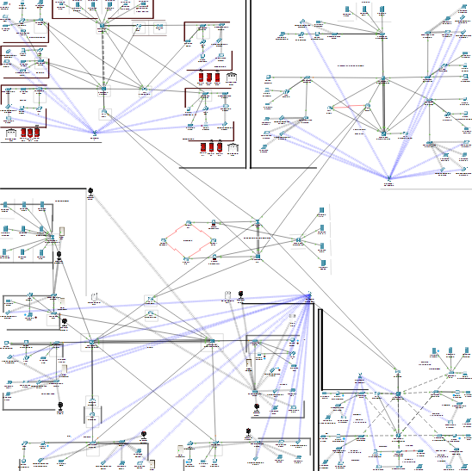
PESI NETWORK
Complete Network Topology
Enterprise-wide infrastructure interconnecting all sites through central distribution
OSPF Multi-Area Architecture
Site Comparison Overview
Site | IP Range | Area | VLANs
HQ | 50.50.0.0/16 | Area 0 | 9
Branch 2 | 10.20.0.0/16 | Area 1 | 6
Emergency | 10.10.0.0/16 | Area 2 | 10
Branch 4 | 172.16.0.0/16 | Area 3 | 6
Branch 1 | 172.16.0.0/16 | Area 0 | 6
Key Features Comparison
Redundancy
All sites: Dual core switches, dual routers, HSRP/LACP
Security
HQ & Emergency: AAA/RADIUS | Branch 4: NAT/PAT
VoIP
HQ: 5 phones | Branch 2: 4 phones | Emergency: 10 hotlines
Special Features
HQ: IoT Security | Emergency: Load-balanced HSRP | Branch 4: Dual ISP
5
4
37
~5,000
Total Sites
OSPF Areas
Total VLANs
Device Capacity

Slide 15
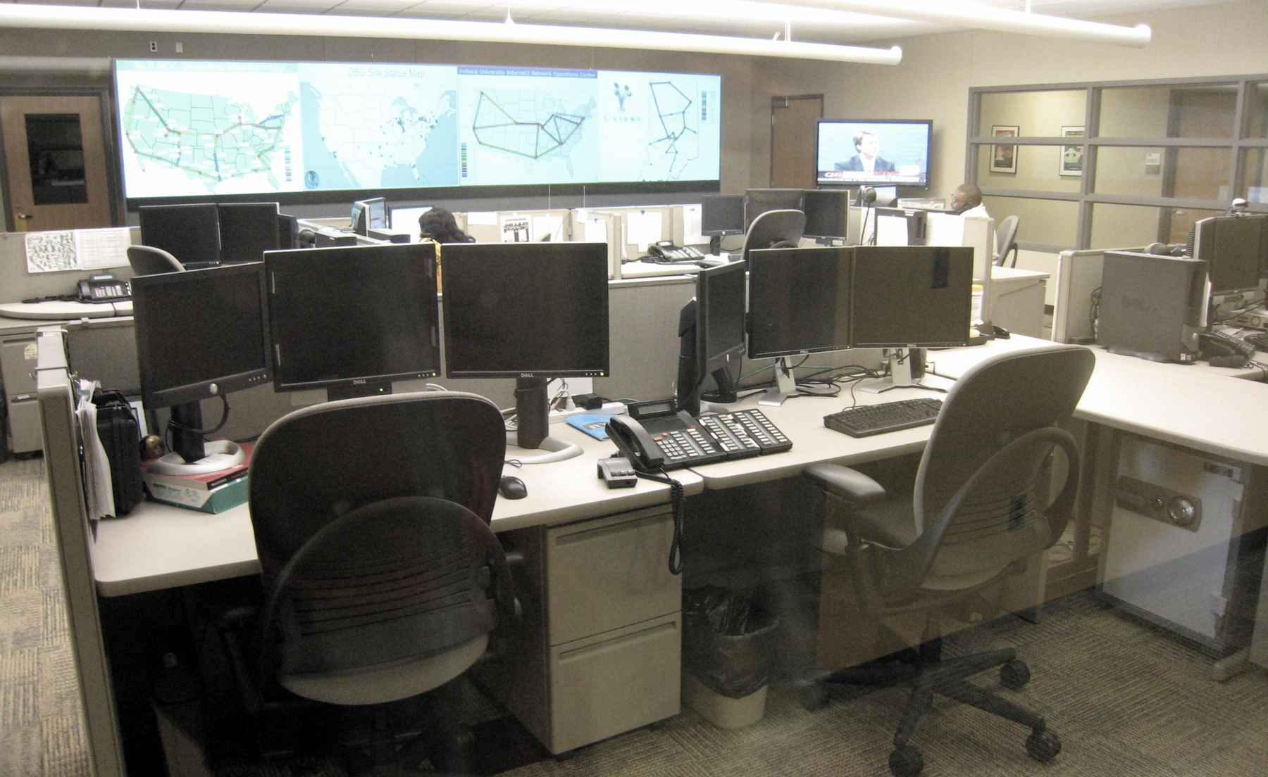
ENTERPRISE COMPLETE
PESI: Enterprise-Grade
Infrastructure
Comprehensive network delivering mission-critical emergency services across Pakistan
with zero single points of failure, maximum uptime, and scalable architecture
37
100%
~5,000
24/7
Total VLANs
Redundancy
Device Capacity
Mission Critical
Department segmentation
No single point of failure
Enterprise scale
Always operational
Scalable Design
Maximum Security
Future Ready
Hierarchical 3-tier architecture enabling seamless expansion across all emergency services
Multi-layered security with dual firewalls, AAA/RADIUS, and network segmentation
Advanced VoIP, IoT integration, and converged network services for next-gen emergency response
Prepared by: Abdul Wahid | Project: PESI Network Infrastructure
December 24, 2025

