Slide 1



Zero Trust UTM
Enterprise-Grade 5-Machine Cybersecurity Infrastructure
Network
Identity
Intelligence
Deception
Endpoint
NEVER TRUST · ALWAYS VERIFY · ALWAYS MONITOR · ALWAYS RESPOND
Project Members
Abdul Wahid
Abdul Rafay Aziz
Hafsa
Usman

Slide 2
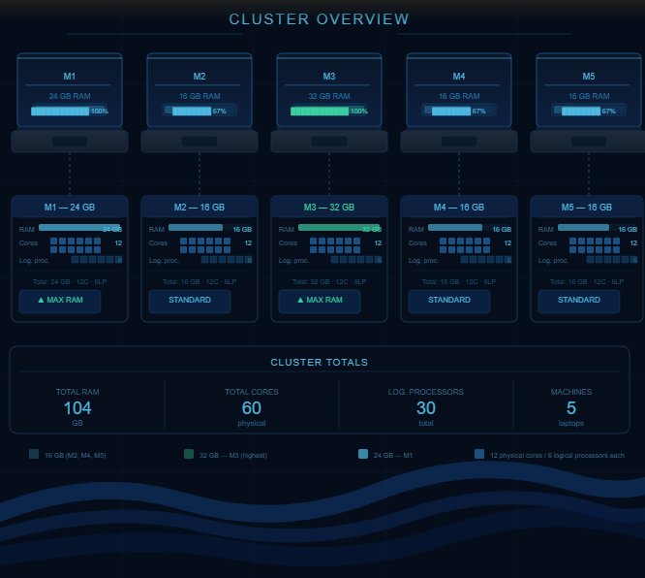

Slide 3
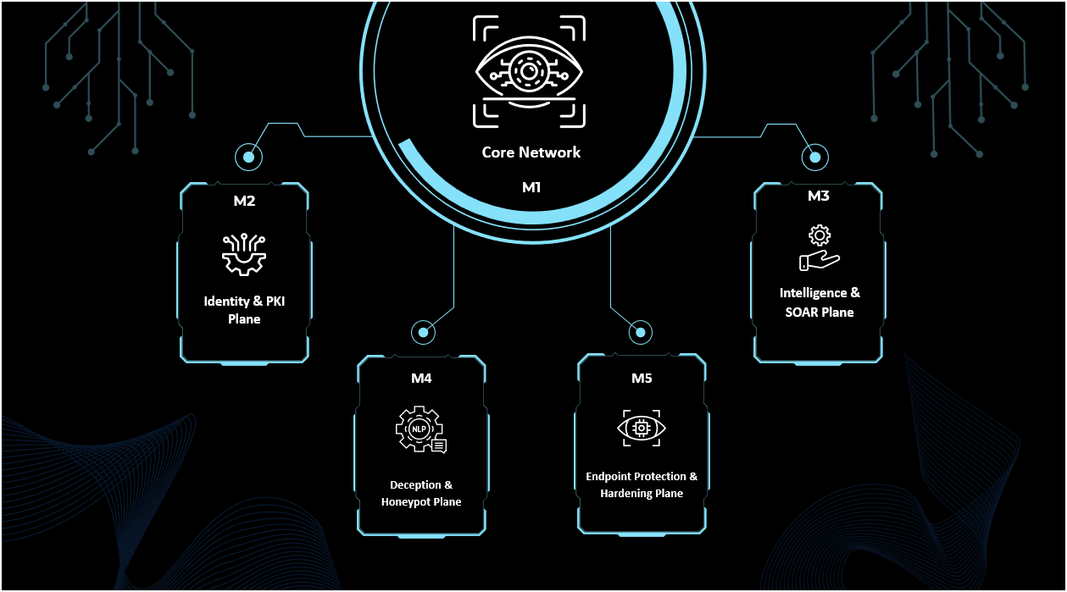


Slide 4
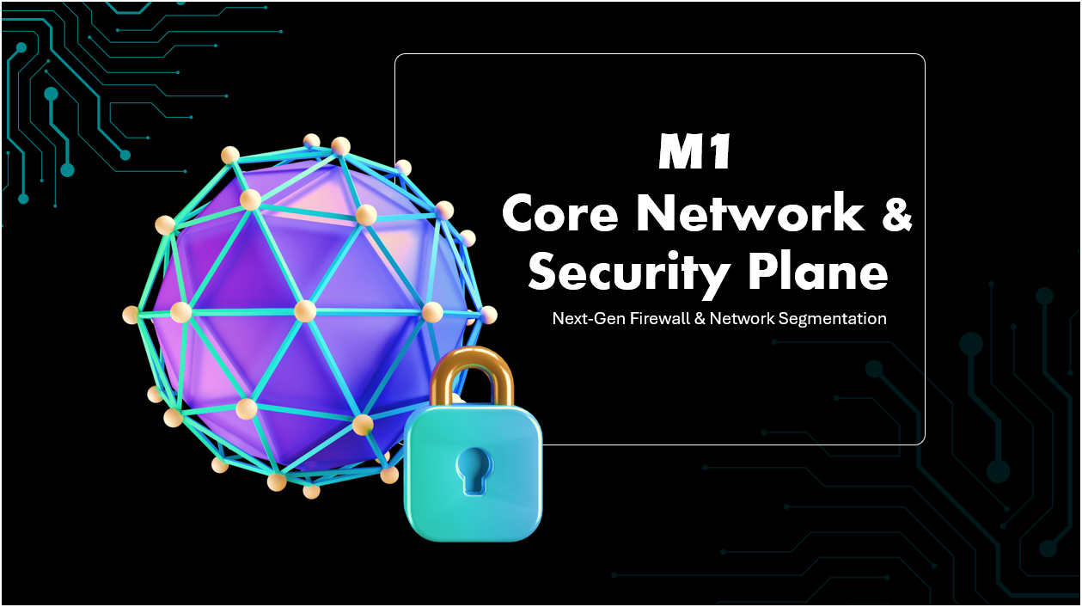

Slide 5
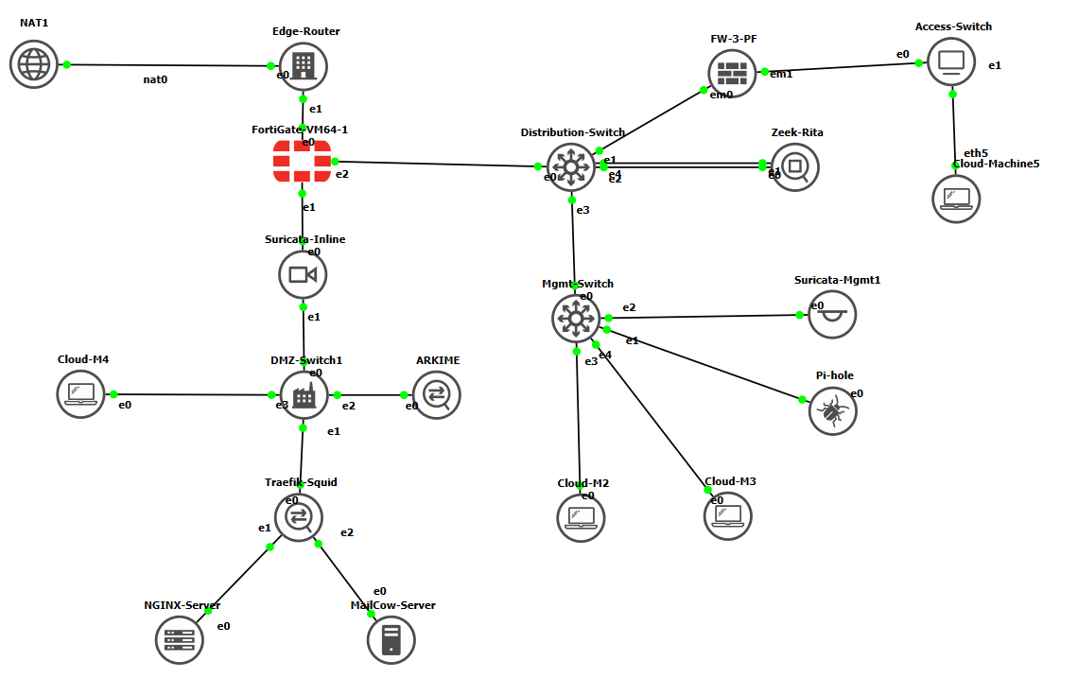
M1-GNS3 Network Topology

Slide 6
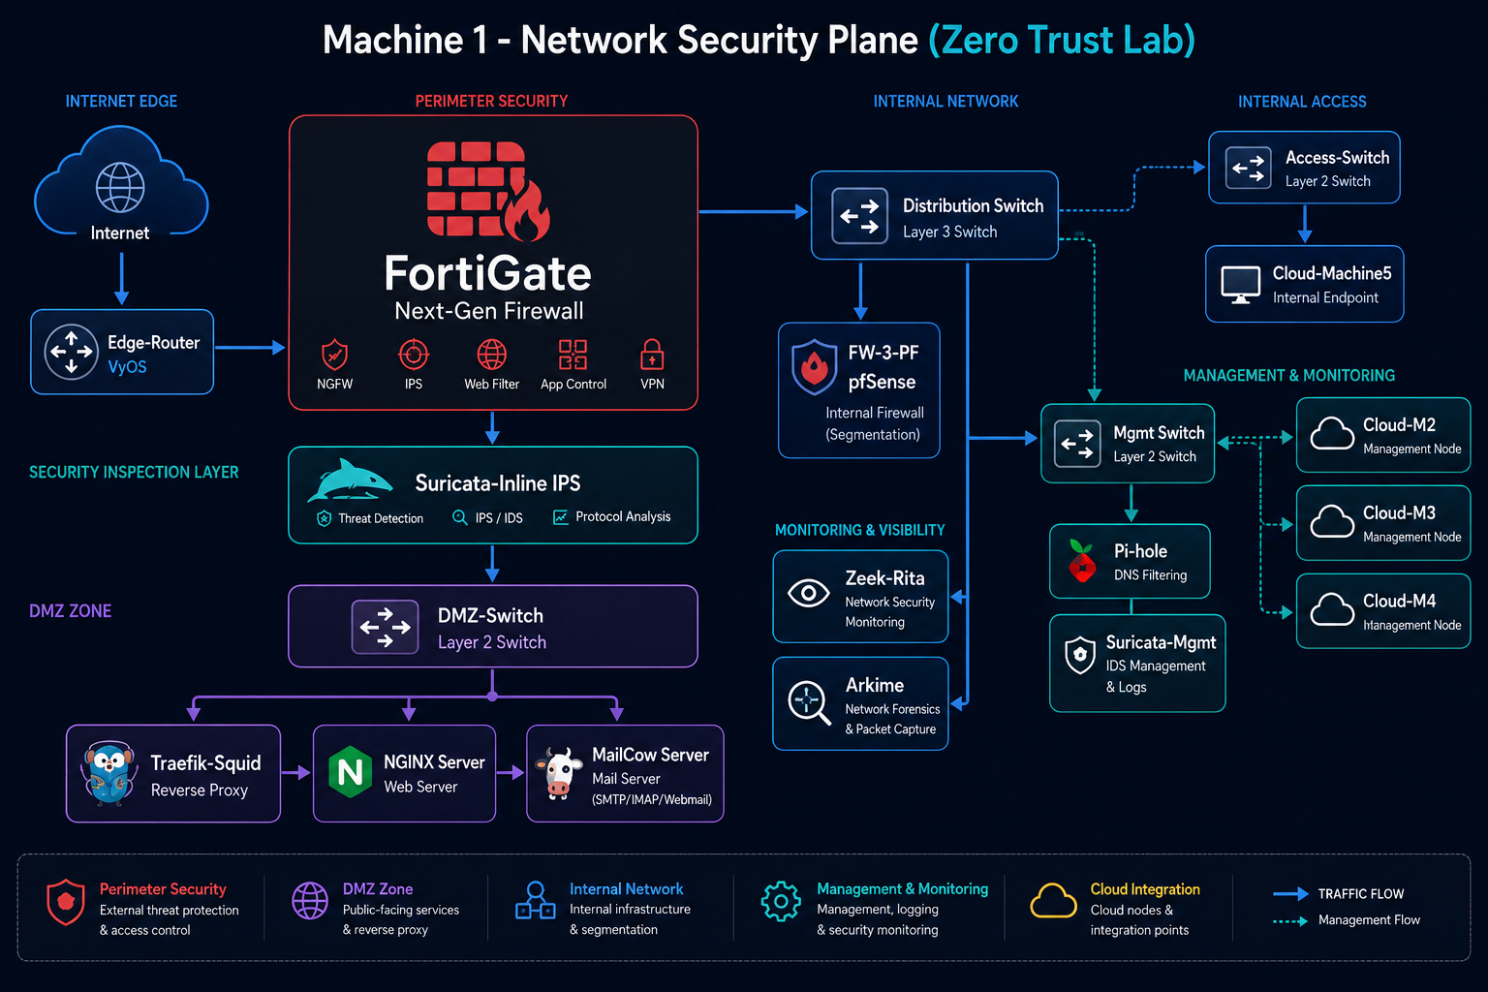

Slide 7
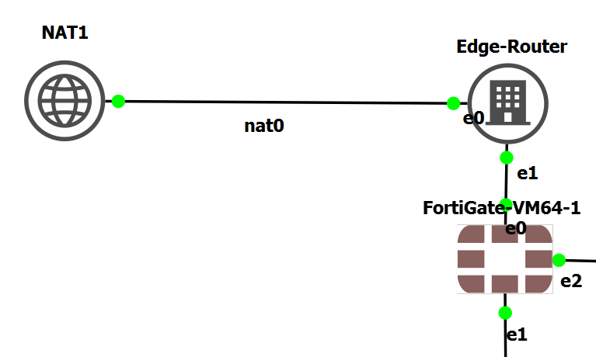

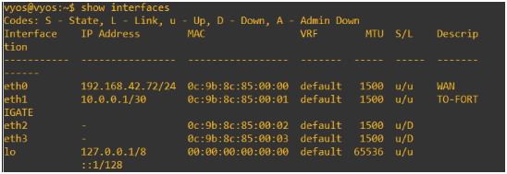

Edge Router (VyOS) – Internet Gateway
Acts as WAN Edge with NAT
Provides internet connectivity to entire lab
NAT + Route config
Network Check
Interfaces

Slide 8
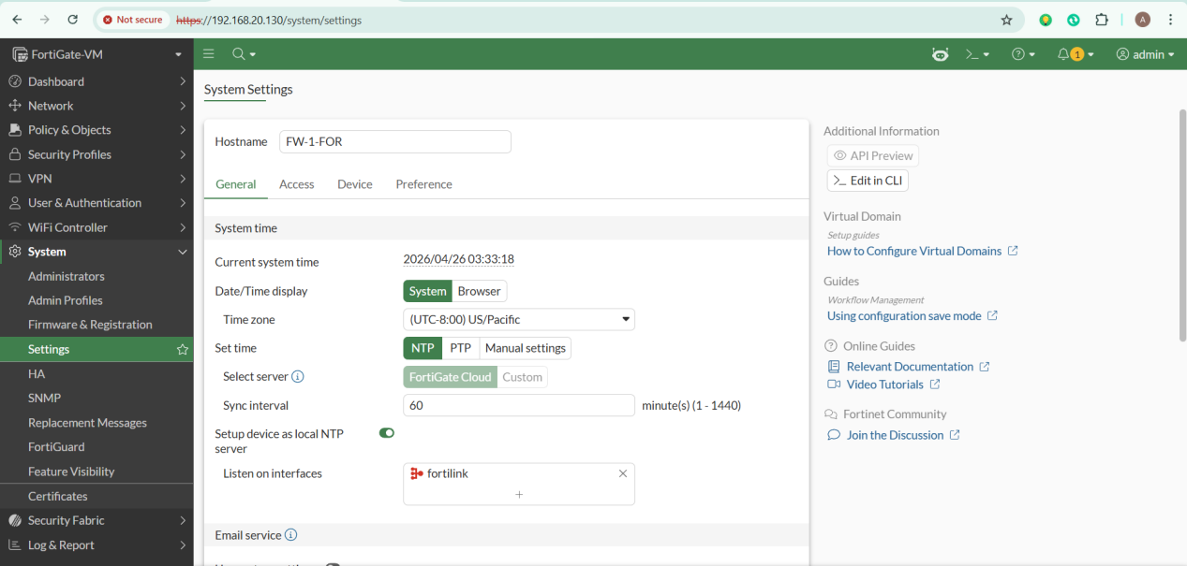
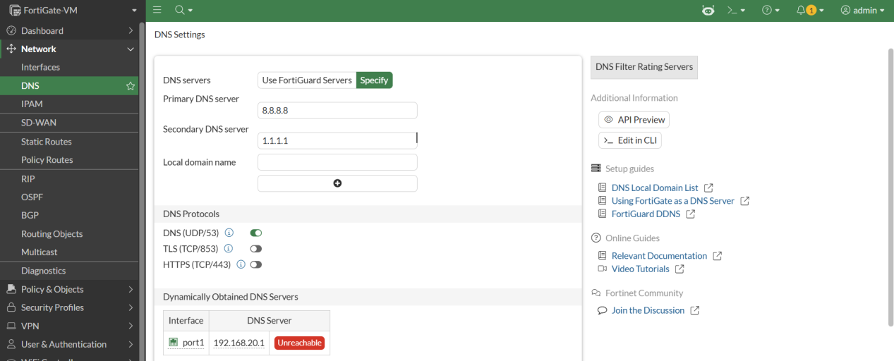
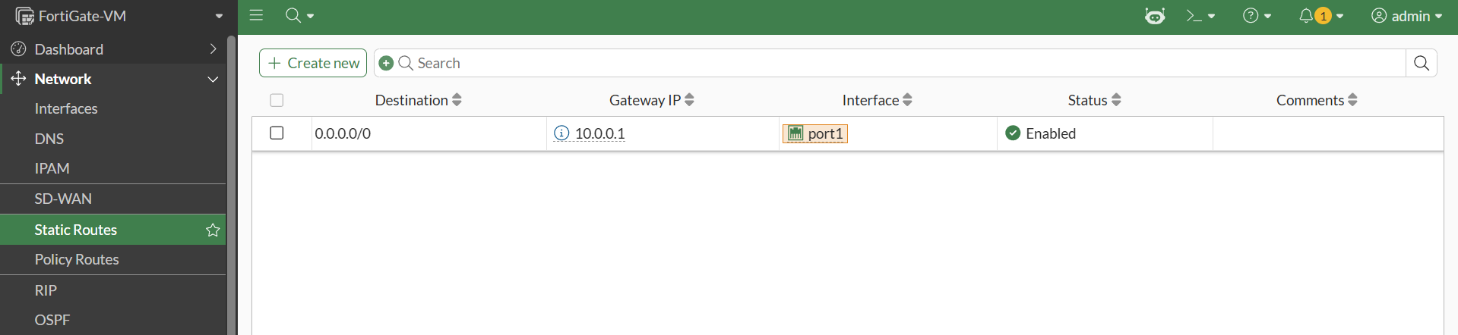
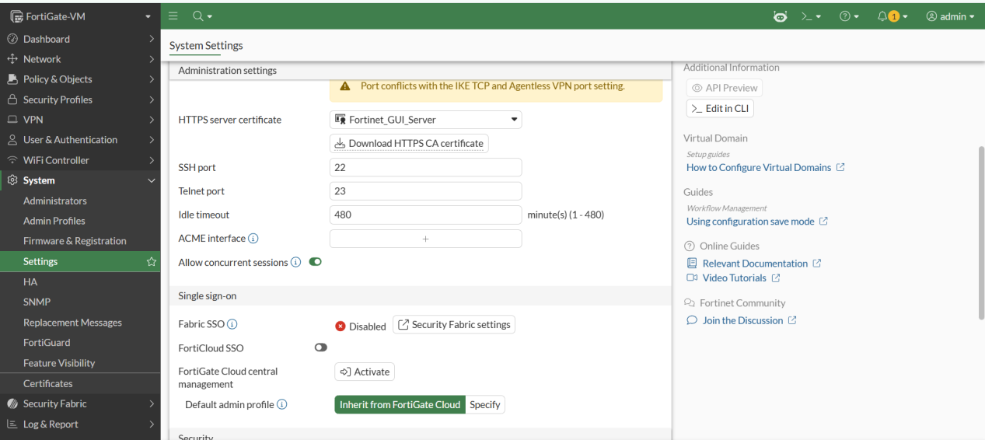
FortiGate – Next Generation Firewall
Core Security Engine of the Lab Zones, Policies, User Authentication
DNS
Host Name + NTP
Routes Setup
Idle timeout

Slide 9
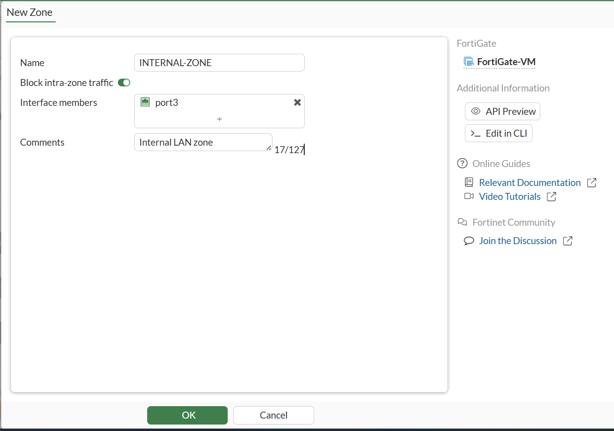
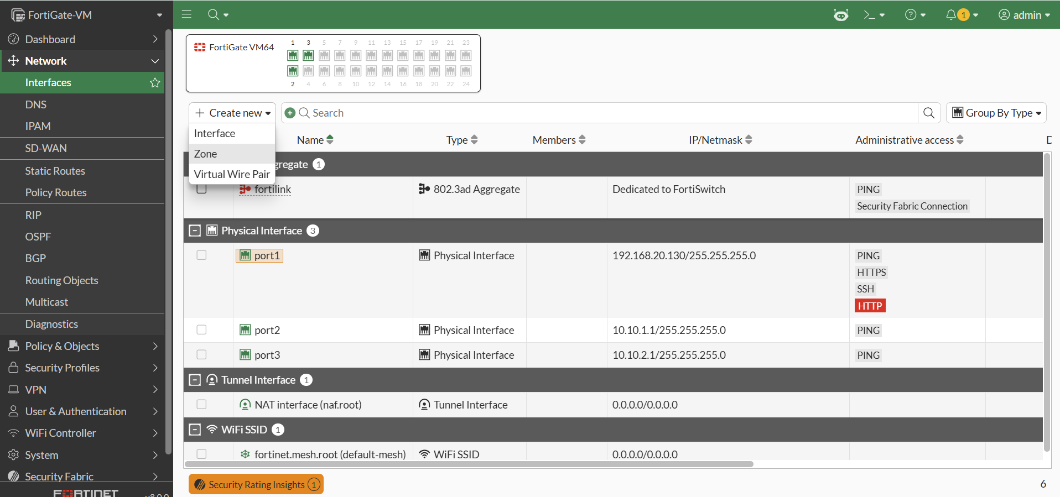
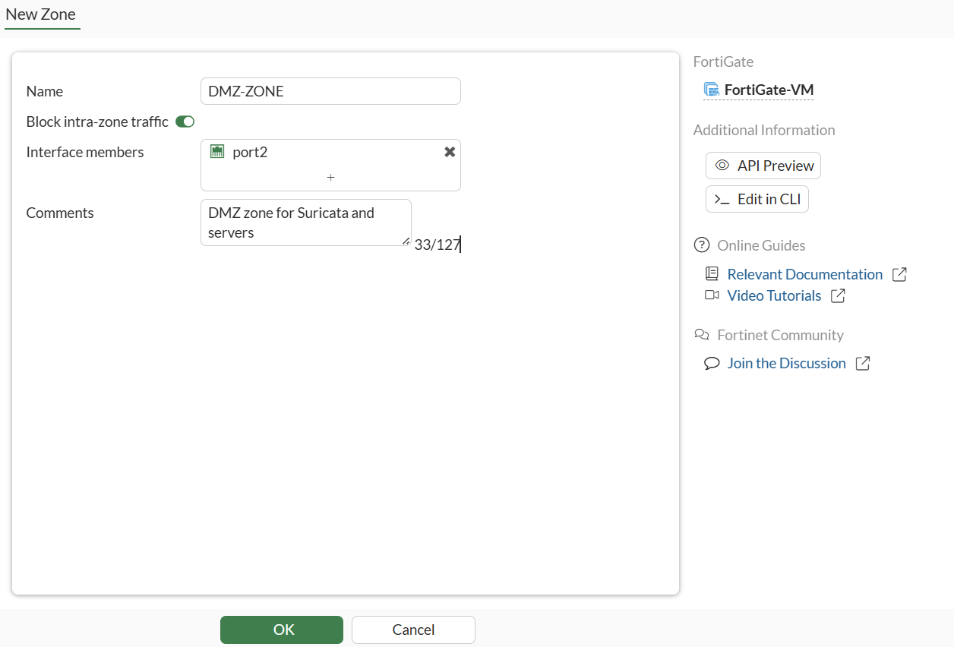

FortiGate – Next Generation Firewall
INTERNAL
Zone Setup for better performance
DMZ
WAN

Slide 10
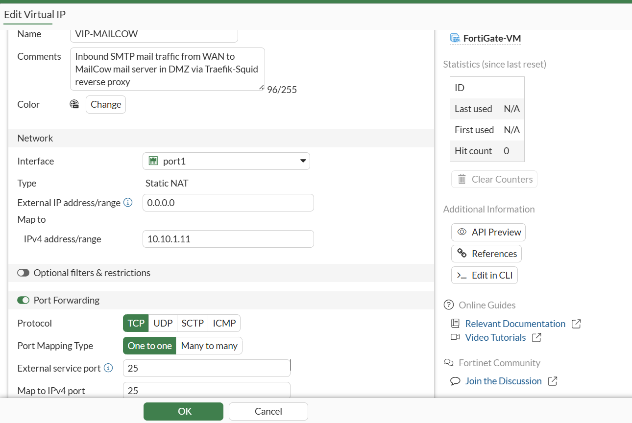
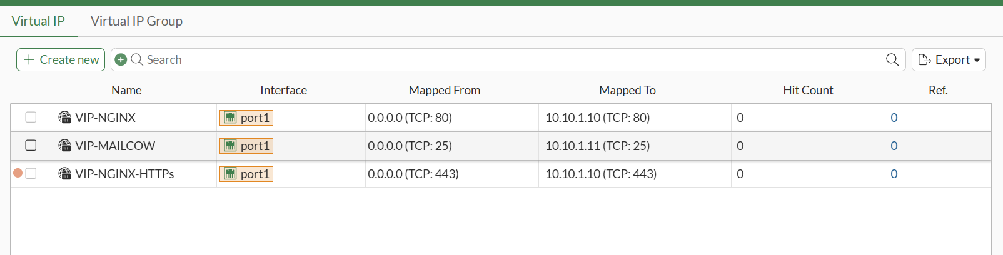
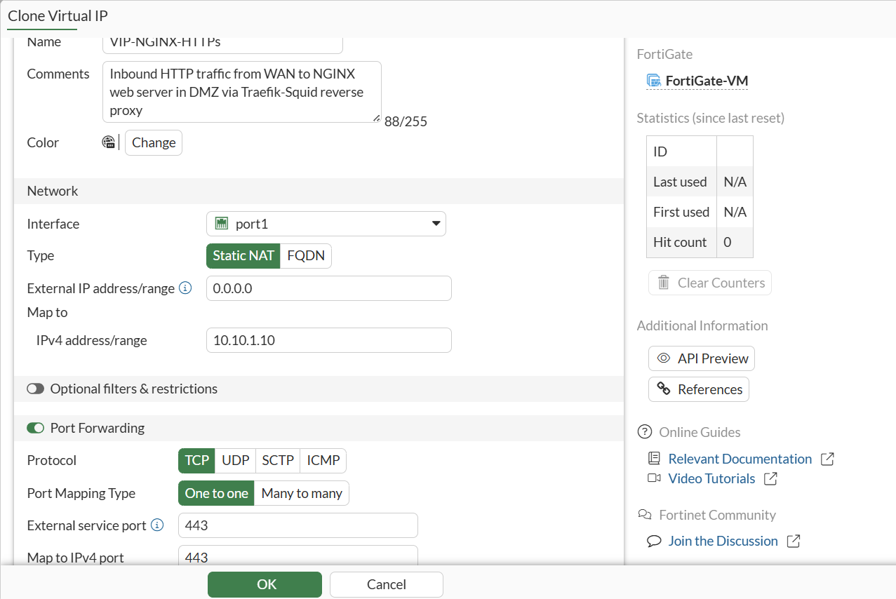
FortiGate – Next Generation Firewall
Virtual IP Setup for inbound/outbound traffic
Inbound traffic setup for Nginx-> Http
Inbound traffic setup forMailCow

Slide 11
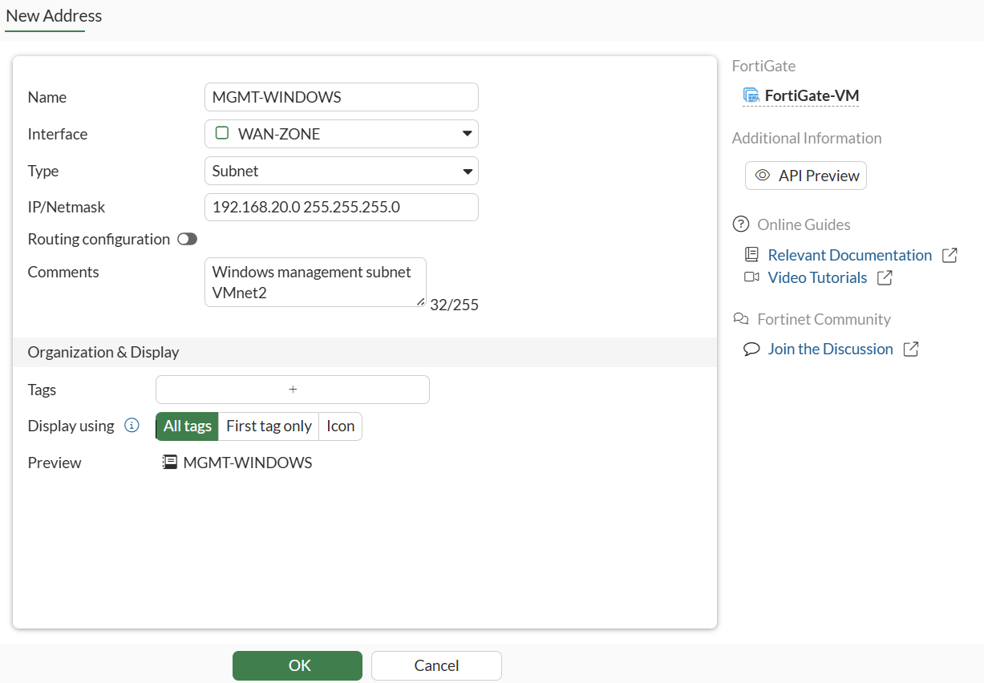
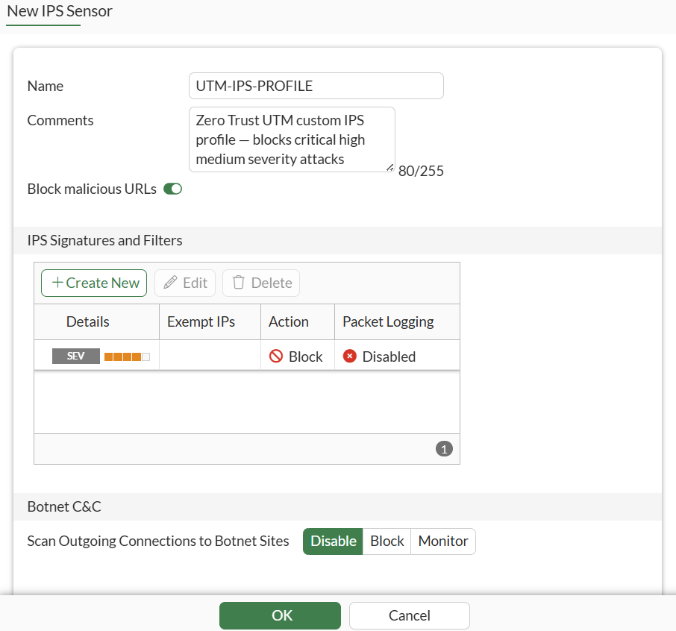
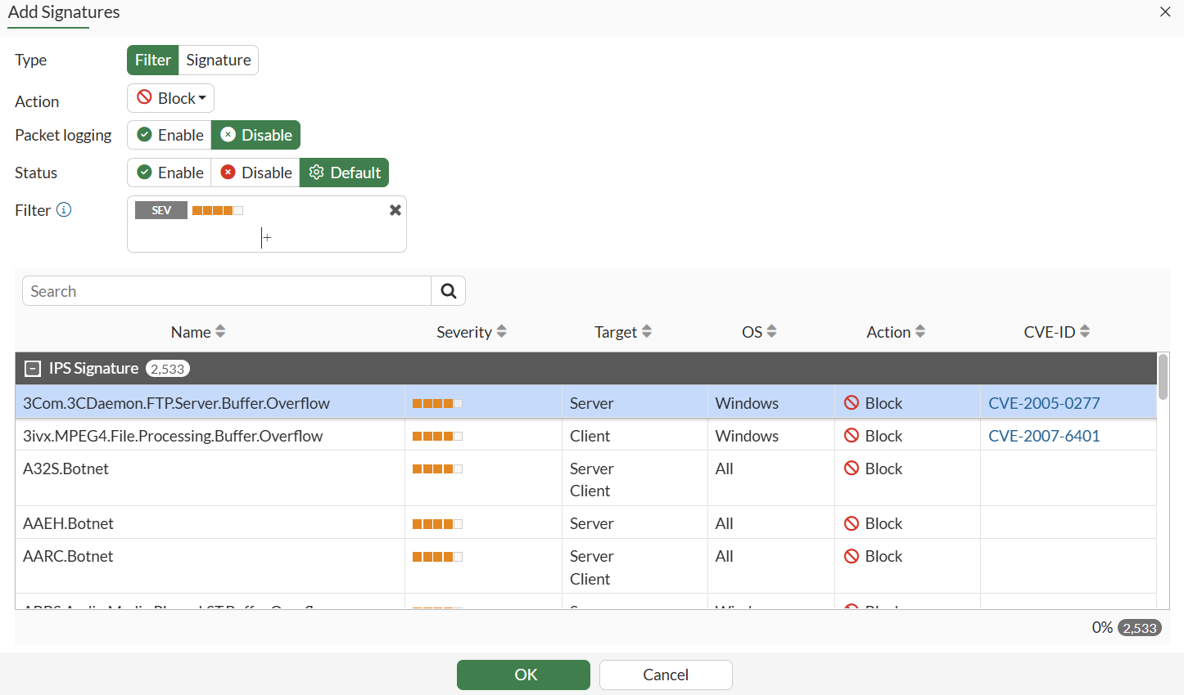
FortiGate – Next Generation Firewall
IPS Sensor Example/Addressing GUI
IPS Setup
Adding Address for GUI Access
IPS Setup

Slide 12
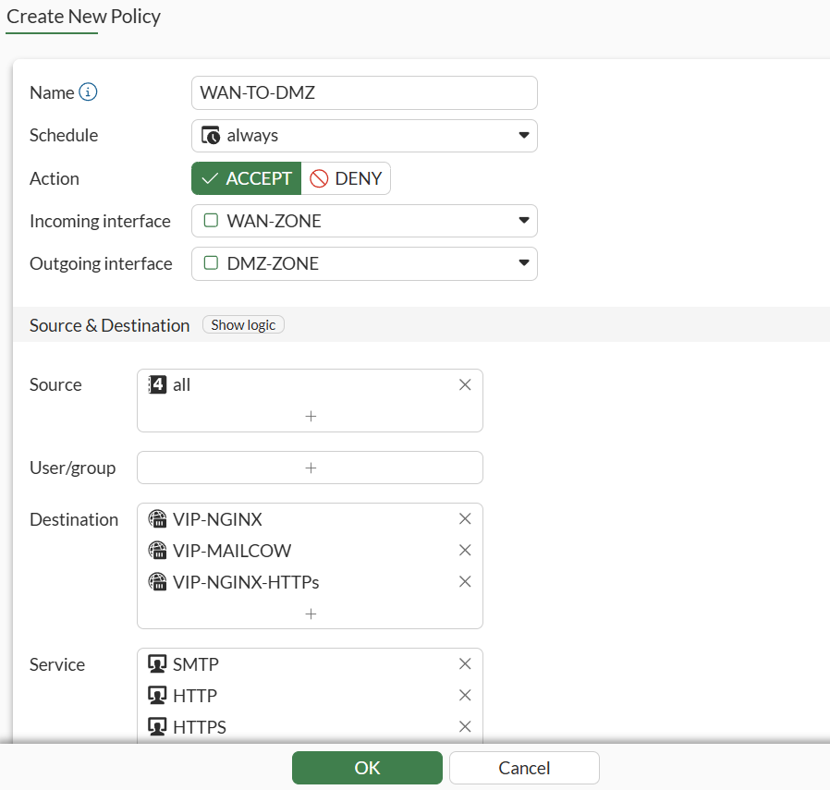
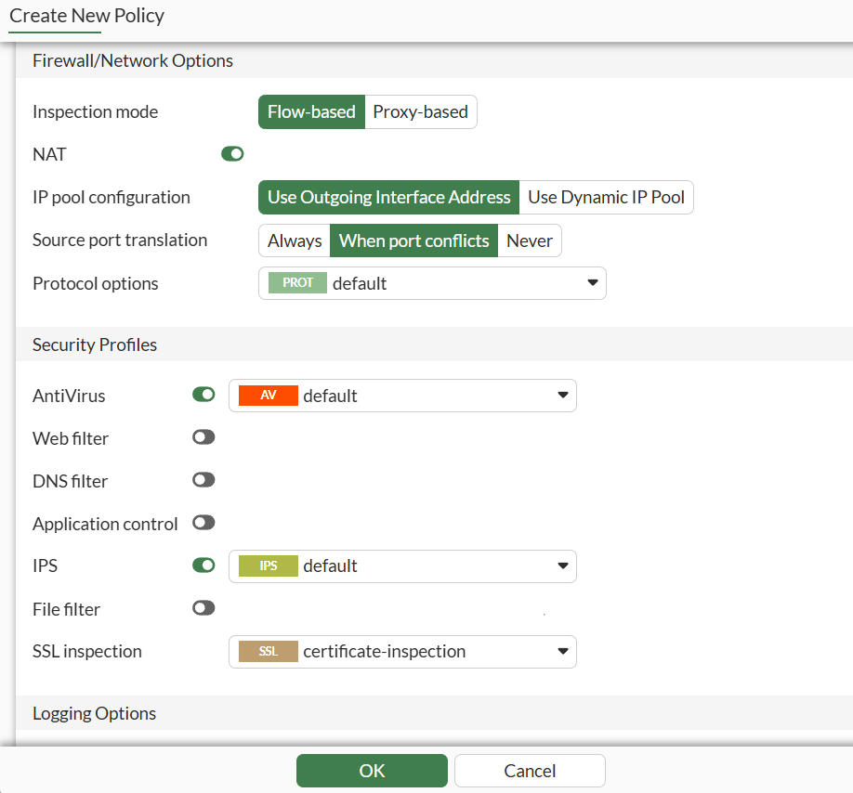
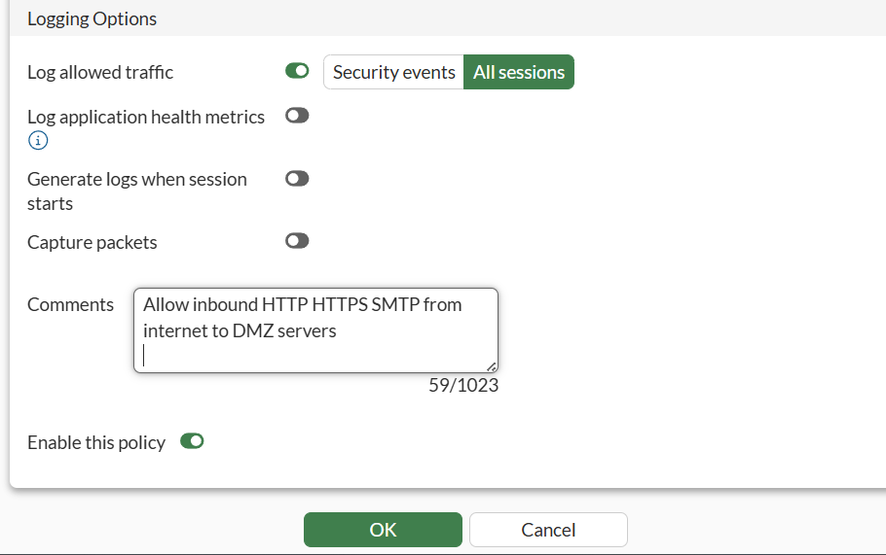
FortiGate – Next Generation Firewall
Example Firewall Policy

Slide 13
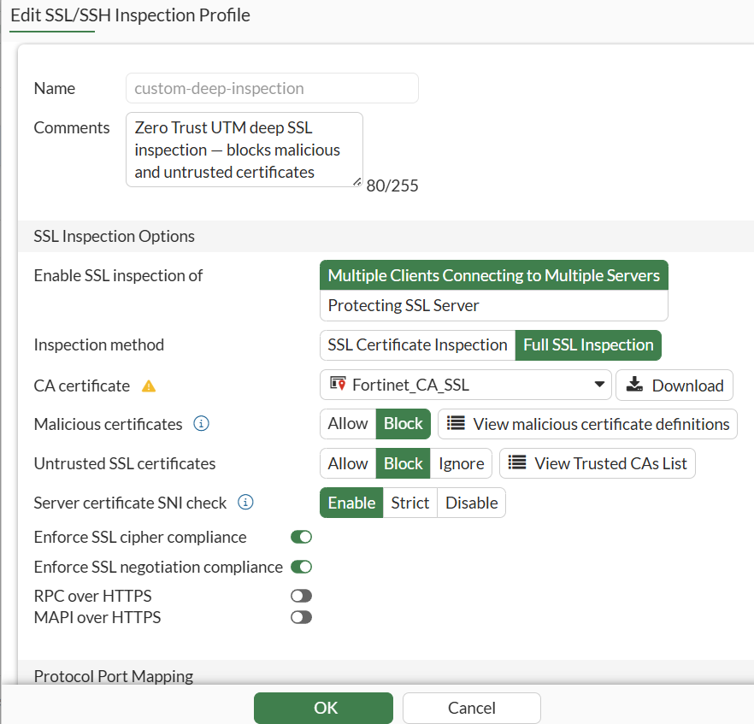
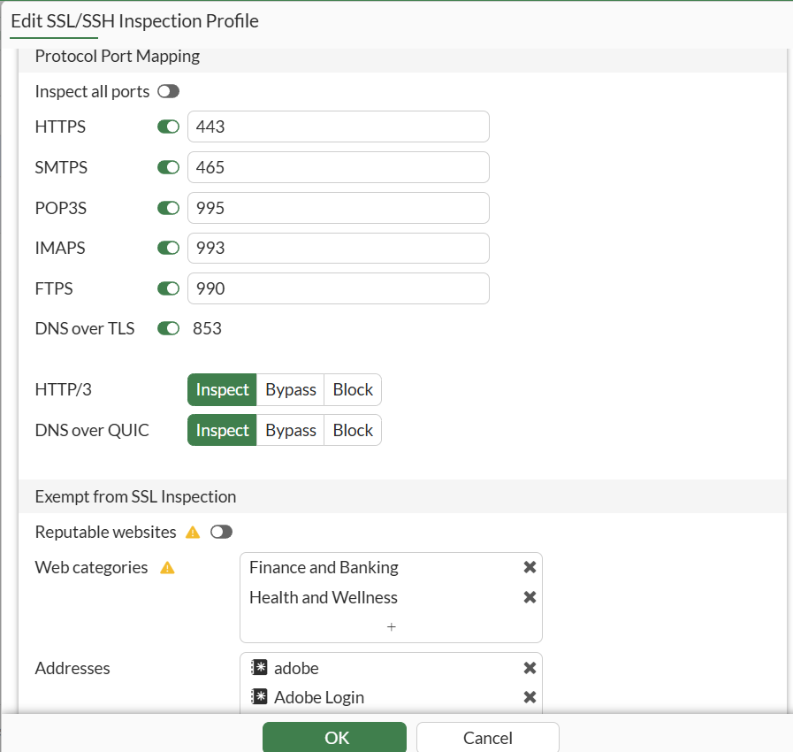
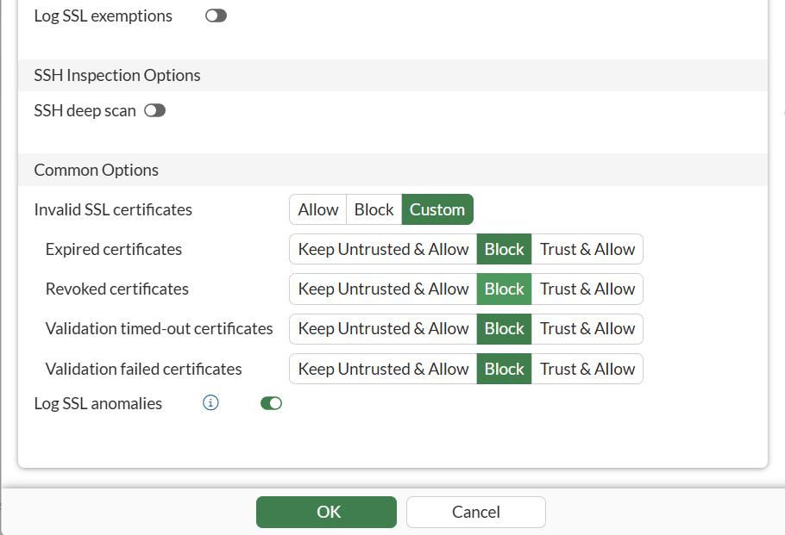
FortiGate – Next Generation Firewall
SSL Inspection-> Stop Malicious Certificates

Slide 14
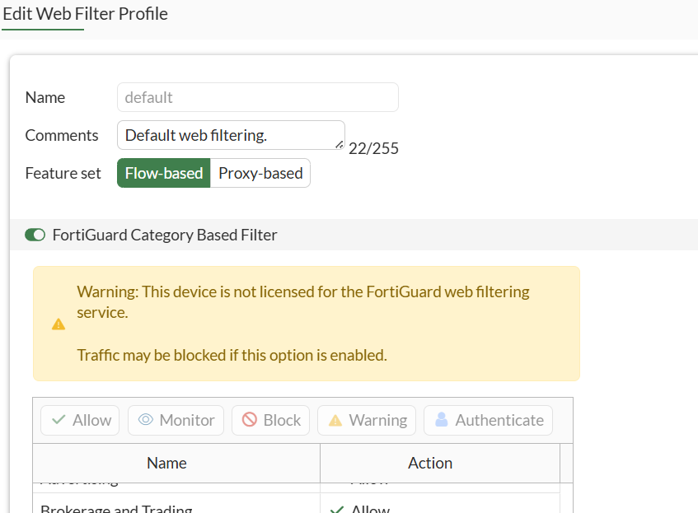
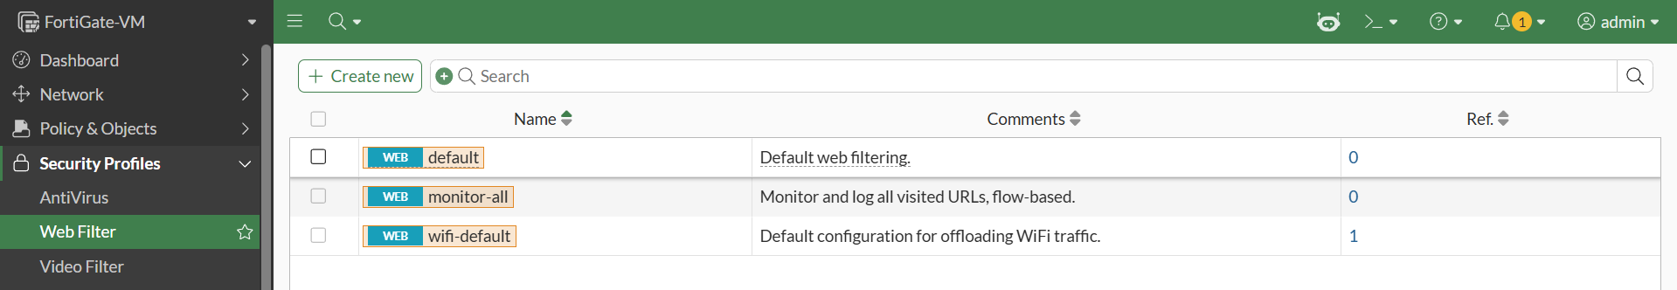
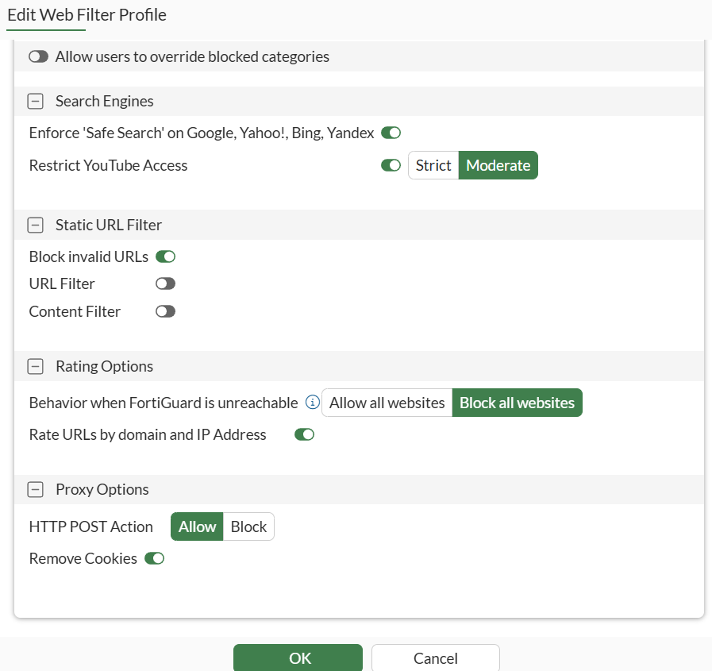
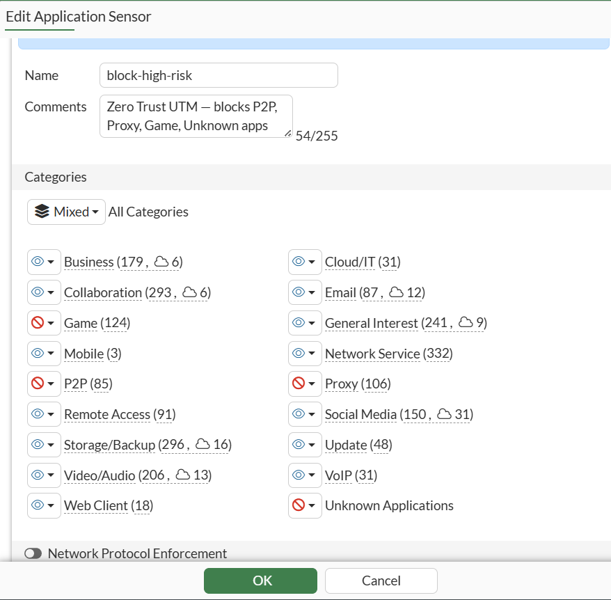
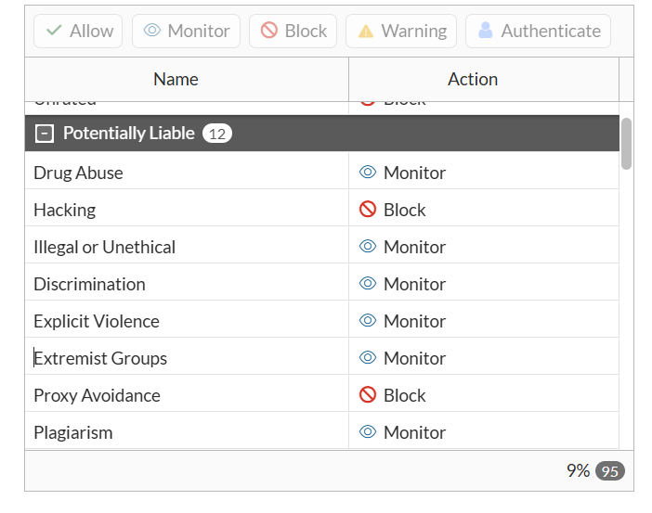
FortiGate – Next Generation Firewall
WEB Filteration

Slide 15
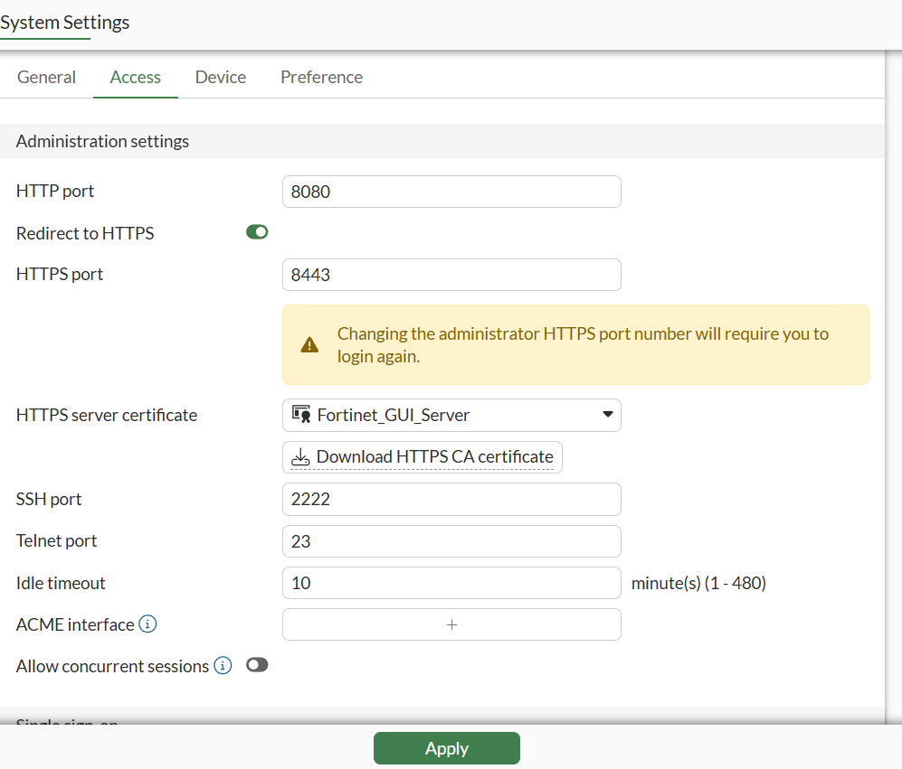
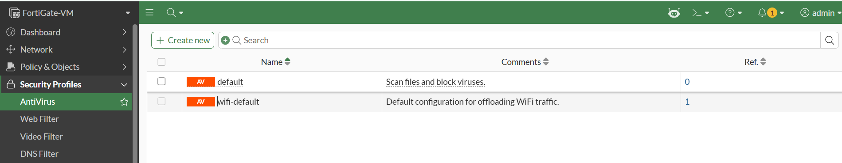
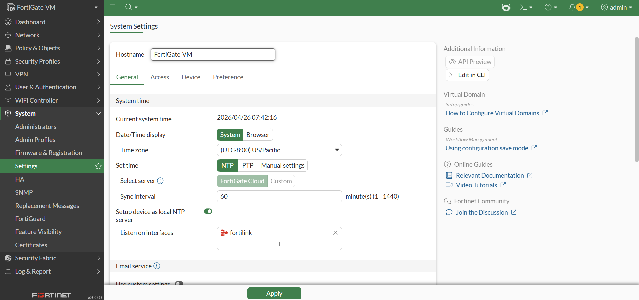
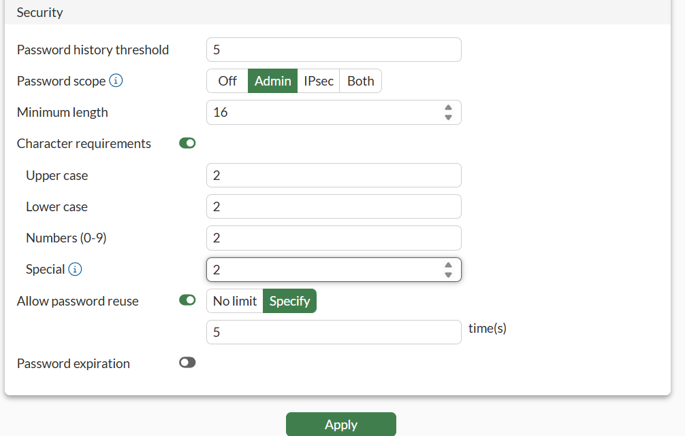
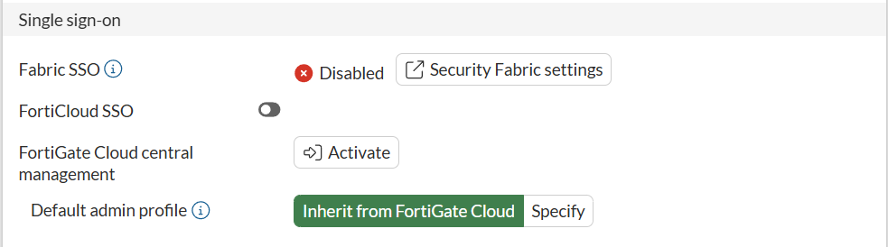
FortiGate – Next Generation Firewall
Password Hardening

Slide 16

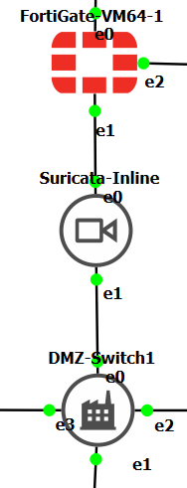



Suricata-Inline
Inline mode between FortiGate and DMZ
Real-time threat detection
Suricata service status - Active
AF_PACKET support
Suricata logs showing DNS queries

Slide 17
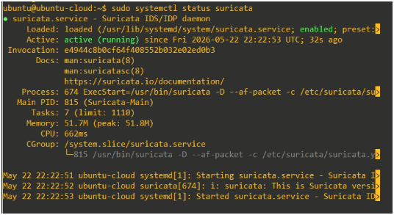
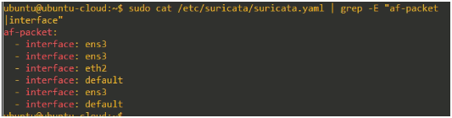

Suricata-Mgmt
Monitors Management VLAN traffic (10.10.3.0/24)
Passive monitoring on ens3
Logs to fast.log & eve.json

Slide 18

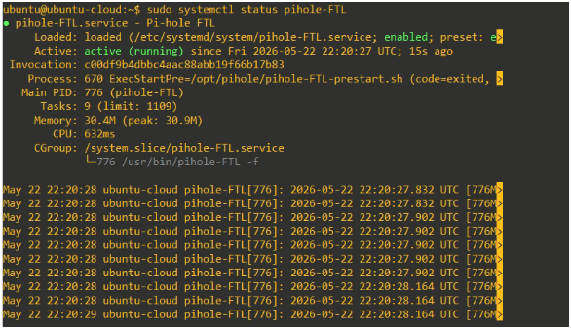
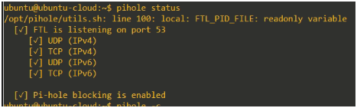
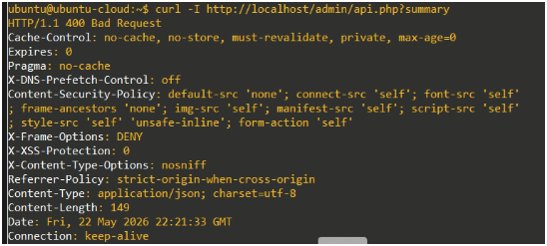
Pi-hole – DNS Security Layer
Primary DNS for Internal + DMZ networks
Blocks ads, trackers, and malware domains
Integrated with FortiGate DHCP
High availability with backup DNS (8.8.8.8)

Slide 19
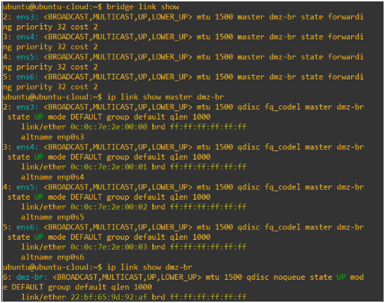

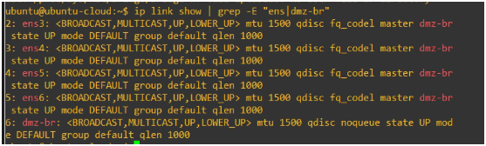
DMZ-Switch – Layer 2 Bridge
Transparent bridging for DMZ devices

Slide 20
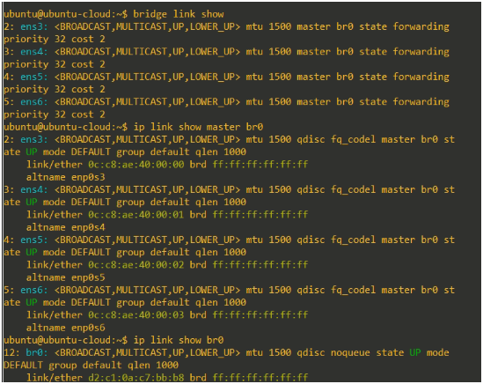
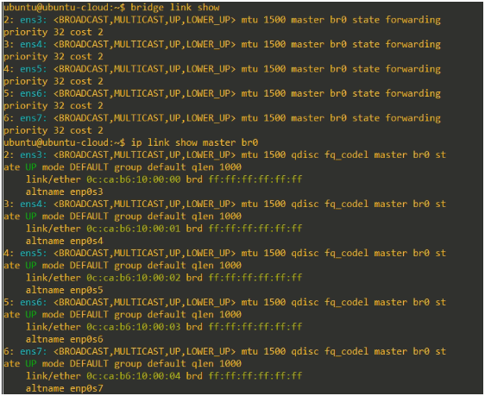
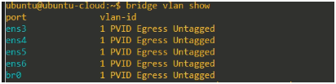
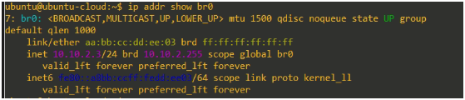

Distribution Switch & Management Switch

Slide 21
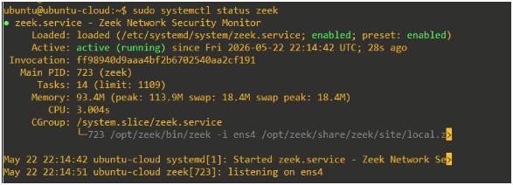
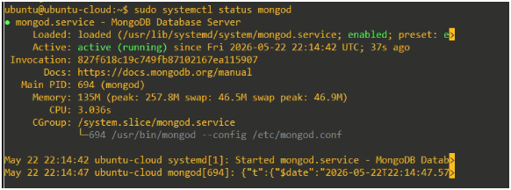

Zeek-Rita – Network Monitoring
Zeek (Network Security Monitor): Passively captures and logs all internal network traffic on ens4 mirror port
RITA (Real Intelligence Threat Analytics): Analyzes Zeek logs to detect C2 beaconing, long connections, and suspicious behavior
MongoDB Backend: Stores parsed data for advanced threat hunting and visualization
Key Role: Provides deep network visibility and anomaly detection in the Internal/Management network
Zeek Running
Data base Server Working Perfectly
Database

Slide 22



Traffic Squid (Traefik + Squid)
Traefik: Acts as modern Reverse Proxy and Load Balancer for DMZ services (automatic TLS & routing)
Squid: Forward Proxy with caching and content filtering capabilities for outbound traffic
Combined Role: Controls and inspects both inbound and outbound web traffic in DMZ zone
Key Achievement: Docker-based, auto-start on boot, handles HTTP/HTTPS traffic efficiently
Open ports for listening
Squid Logs
Traffic Logs

Slide 23



Arkime – Full Packet Capture
Full Packet Capture: Captures and stores 100% of network traffic passing through DMZ
Elasticsearch Backend: Indexes packet metadata for fast searching and session reconstruction
Web Interface: Allows easy searching, filtering, and replaying of network sessions
Key Role: Provides forensic-level visibility and evidence collection for security incidents
Arkime services status
arkimecapte procuress

Slide 24



NGINX Server
Serves web content and acts as reverse proxy
curl localhost
nginx status
nginx -t success
nginx ports

Slide 25




MailCow Server
Complete email solution

Slide 26

Centralized Authentication, Authorization, Certificate Authority, and Secrets Management for the Zero Trust Architecture

Slide 27









Technology Stack

Slide 28


Slide 29


Slide 30


Directory-M2 – Samba Active Directory + Consul
Samba AD Domain Controller (zerotrust.lab)
Consul Service Mesh (5/5 nodes healthy)
Directory Status
Central directory for users, groups & policies
Consul Running

Slide 31


Slide 32


Operational Status & Hardening
Hashi Corp Vault
Step ca for small certificates
Conjur x EJBCA

Slide 33
Identity-Core-M2
Keycloak Identity Provider (OIDC/SAML)
FreeRADIUS (802.1X Network Authentication)
OpenLDAP Directory Service
Kerberos KDC

Slide 34


Status? ->Test User
Ldap/keycloak/kerberoes/radius
Identity Check by Keycloak

Slide 35


Keycloak Admin Console
Master + ZeroTrust Realm
Admin & Test Users Configured

Slide 36


M2–Teleport Zero Trust Access
Session Recording & Audit
SSH, Kubernetes & Database Access Proxy
Just-in-Time Access

Slide 37


BloodHound
when our data is highly interconnected and the relationships between data points are as important as the data itself.

Slide 38



Consul Service Mesh
Centralized SSO & Federation

Slide 39

Hardening & Verification
Passwordless SSH between all VMs
All services reboot persistent
Full lab connectivity verified
Auto-unseal Vault configuration

Slide 40
Integrations with Machine 1 (Core Network)
Integration | Purpose | Protocol/Method
FortiGate | 802.1X NAC | FreeRADIUS
FortiGate Admin | AAA | TACACS+
Network Devices | Device Auth | EAP-TLS (Step-CA)
Keycloak | SSO for management | OIDC/SAML
Vault | Dynamic Secrets | API

Slide 41

The Brain of the Lab Log Collection, Threat Intelligence, Analysis & Automated Response 3 Dedicated VMs:
SIEM-M3 | MONITOR-M3 | CTI-M3

Slide 42


Slide 43


Slide 44




Wazuh SIEM – Custom Rules & Agent Deployment
Integrated Log Collection from Network, Security Tools & Honeypots

Slide 45


Kafka Topics & Logstash Pipelines
Centralized Log Streaming, Parsing & Enrichment for Zero Trust SIEM

Slide 46



MISP – Threat Intelligence Feeds & Events
Automated Feed Ingestion, Event Management & IOC Enrichment

Slide 47






Slide 48


IntelOwl Dashboard & Connectors
MISP (auto-create events) + OpenCTI (observables sync)

Slide 49


IntelOwl – Live Scan & Analysis
Real-time Observable Enrichment using Analyzers & Connectors

Slide 50


Automated Open Source Intelligence Gathering & Target Analysis

Slide 51


TheHive – Case Management & MISP Integration
Automated Incident Response with Enriched Observables from MISP Feeds

Slide 52


TheHive – Alerts & Case Management
Automated Case Creation & Enrichment via MISP Integration

Slide 53




Cortex – Analyzer Engine Setup
Organization, User Management & TheHive Integration

Slide 54

Self-Hosted SOAR for Automated Incident Response & Workflow Orchestration

Slide 55
01
Wazuh Critical Alert → FortiGate Block
02
Trigger: Wazuh alert (level ≥ 10) Action: Block IP via FortiGate API Result: IP blocked in under 2 seconds
Honeypot Alert → Multi-Layer Block
Trigger: Wazuh alert from Machine 4 honeypot Actions: Block on FortiGate + OPNsense + Add to MISP + Create TheHive case Result: Multi-layer blocking + IOC shared
03
Critical Alert → TheHive Case
Trigger: High severity Wazuh alert Action: Auto-create TheHive case Auto Enrichment: Cortex (AbuseIPDB + GeoIP) Result: Case created with full context
04
Automated Response — Shuffle SOAR
MISP IOC → Pi-hole DNS Block
Real-time Threat Blocking from Alert to Enforcement in Under 2 Seconds
Trigger: New malicious domain in MISP Action: Auto block domain in Pi-hole Result: Domain blocked on all lab systems

Slide 56



Shuffle SOAR — Automated Response Workflows

Slide 57


Slide 58


Slide 59


Dark Web Threat Intelligence — CTI Project ZeroTrust
Powered by Llama-3.3-70b-nvidia (Local Ollama) + Custom Scraping Engine

Slide 60


Dark Web Analysis — Key Insights (Wanacry Ransomware)

Slide 61


Slide 62


Slide 63


Slide 64



Honeypot Network Configuration
OpenCanary, Deception VM & Tor Honeypot Network Setup

Slide 65

Wazuh Agents – Machine 4 Honeypots
Deception Plane Integration with Centralized SIEM Monitoring

Slide 66


Slide 67


Slide 68


Slide 69


Slide 70


