Slide 1
Patient Drug-Switch Prediction
Solution Approach
By,
Mohammed Abdul Qavi
Senior Data Scientist @ ADP

Slide 2
EDA
Training Data | Test Data
We have ~14.5 millions records and ~16k patients 50% records are duplicate rows (this looks high number) No missing values 6 independent variables (2 numeric and 4 categorical) Patient_payment is skewed and 80% zero values 13% people with drug switch (target variable) negative value in patient payment. Might be discounts. | We have ~6 millions records and ~7k patients 50% records are duplicate rows (this looks high number) No missing values 6 independent variables (2 numeric and 4 categorical) Patient_payment is skewed and 80% zero values

Slide 3
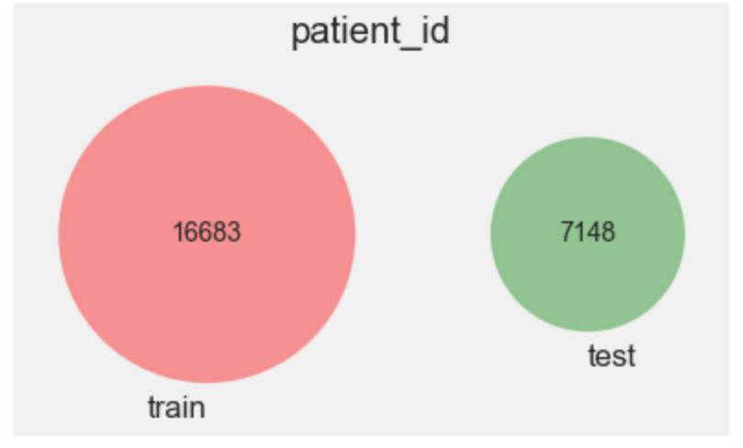
EDA
Looks like the patients between the training and test data are different

Slide 4
Feature ENGINEERING
Creating a Boolean feature to determine if payment amount was zero or less
Creating average time difference between two events
Generating similarity between patients using Tfidf on the events
Aggregated features at patient level
Recency (with event time deviation)
Frequency
NormChange
Max payment amount

Slide 5
Time and MEMORY REDUCTION
Performed memory reduction during data processing using a useful the below kaggle kernel function.
https://www.kaggle.com/rinnqd/reduce-memory-usage
Performed multiprocessing using 4 cores
Garbage collection as and when necessary

Slide 6
MODELING
Trained Lightgbm model on 16k records (total patients)
Used Group K Fold (10 folds) for CV based on patient_id
Final prediction was average based predictions of the 10 Folds

Slide 7
THINGS TO TRY
I might have tried the below things if I had more time
Experience of the Specialist in terms of number of patients
Events bins based on total number of patients visited
Taking recent event time and generating features (may be only last one year)

Slide 8
Thank You
A SPECIAL THANK YOU FOR THE AMAZING COMPETITION. I have had lot of learnings.
Sorry for the brief details on the approach. I was very occupied with office work. ☺

