Slide 1
EMPLOYEE
ROLE AND BACKGROUND
PRESENTORS:
Cabungcag, Chilla
Peliño, Hannah Mae
Torres, Leonilo

Slide 2
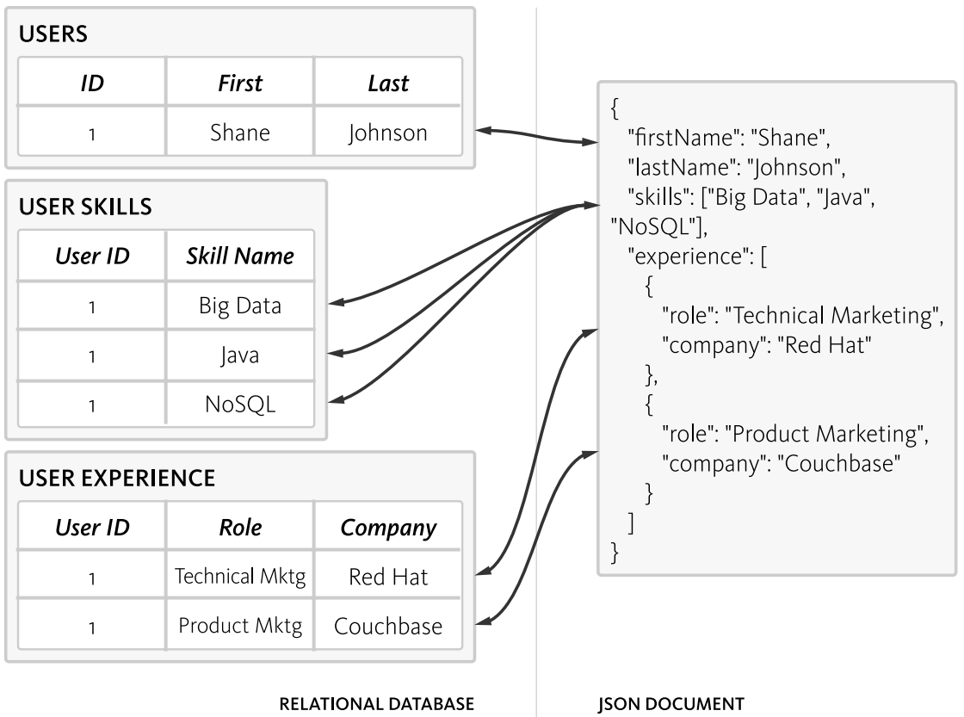
RDBMS vs. NoSQL Schema Sample

Slide 3
CRUD Demo

Slide 4
CREATE(RDBMS)
CREATE TABLE table_name (
<Column name> datatype,
<Column name> datatype,
<Column name> datatype,
…...
);

Slide 5
CREATE(RDBMS)
INSERT INTO `tblusers` (
`Firstname`,
`Lastname`
)
VALUES (
'Shane',
'Johnson'
)
INSERT INTO `tbluserskills` (
`UserId`,
`SkillName`
)
VALUES(
'1',
'Web Development'),
('1', 'Java'),('1', 'Big Data')
INSERT INTO `tbluserexperience` (
`UserId`,
`Role`,
`Company`
)
VALUES (
'1',
'Developer',
’TrustArc’
),
(
'1',
Database Manager,
’Icomm’
)

Slide 6
CREATE(NoSQL)
db.createCollection('users')
db.users.insert({
"firstname": "Yol",
"lastname": "Torres",
"skills": [
"Web development",
"Python" ]
})
db.users.insert({
"firstname": "Shane",
"lastname": "Johnson",
"skills": [
"Web development",
"Java",
"Big Data"
],
"experience": [
{
"role": "Developer",
"company": "TrustArc" },
{
"role": "Database Manager",
"company": "Icomm"
}
]
})

Slide 7
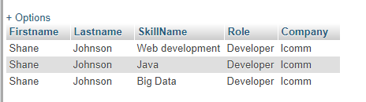
RETRIEVE(RDBMS)
RESULT:
SELECT
`Firstname`,
`Lastname`,
skills.SkillName ,
ex.Role,
ex.Company
FROM tblusers users
LEFT JOIN tbluserskills
skill ON users.ID = skill.UserId
LEFT join tbluserexperience
ex ON ex.UserId = users.ID

Slide 8
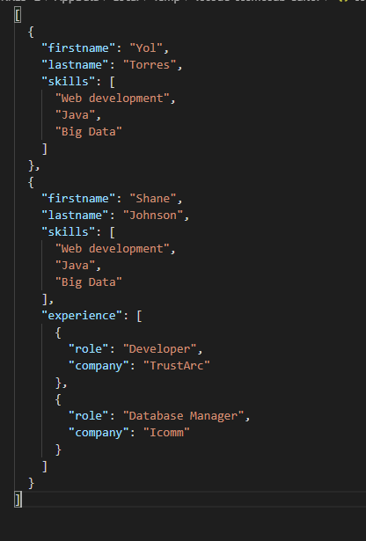
RETRIEVE(NoSql)
RESULT:
db.users.find({},{_id: false})

Slide 9
UPDATE(RDBMS)
UPDATE `tblusers`
SET `ID`=1,
`Firstname`=’Hannah’,
`Lastname`='Pelino'
WHERE 1

Slide 10
UPDATE(NoSQL)
db.users.update({_id:ObjectId("5da95b973068151a64aabb69")},{$set:{
"firstname": "Hannah",
"lastname": "Pelino",
}})

Slide 11
DELETE(RDBMS)
DELETE
FROM `tbluserskills`
WHERE ID = 4;

Slide 12
DELETE(NoSQL)
db.users.remove({_id:ObjectId("5da95b973068151a64aabb69")})

Slide 13
ANALYTICS

Slide 14


TIME
RDBMS
NoSQL
SELECT
`Firstname`,
`Lastname`,
skills.SkillName ,
ex.Role,
ex.Company
FROM tblusers users
LEFT JOIN tbluserskills
skill ON users.ID = skill.UserId
LEFT join tbluserexperience
ex ON ex.UserId = users.ID
db.users.find({},{_id: false})

Slide 15
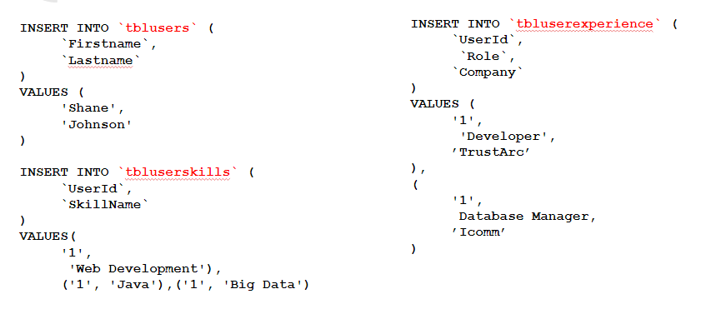
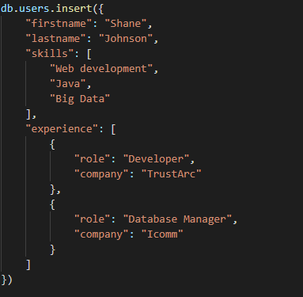
D
RDBMS
NoSQL

Slide 16
Performance
100 rows
mysql insert: 8171ms
mysql select: 10ms
mongo insert: 167ms
mongo select: 60ms
10 rows
mysql insert: 1702ms
mysql select: 11ms
mongo insert: 47ms
mongo select: 12ms

Slide 17
Comparison
1000 rows
mysql insert: 94813ms (1.58 minutes)
mysql select: 13ms
mongo insert: 1013ms
mongo select: 677ms
10.000 rows
mysql insert: 924695ms (15.41 minutes)
mysql select: 144ms
mongo insert: 9956ms (9.95 seconds)
mongo select: 4539ms (4.539 seconds)

Slide 18
As we examine the results of our queries,we found out that it took more time for MySQL to load queries than in NoSQL. As well as in retrieving data, queries and time are simpler in NoSQL way.

Slide 20
Reflections & Discussions . . .

Slide 21
Thank You !!!

