Slide 1


Slide 2

Maritime Education System & Job Portal

Slide 3
Group Members Introduction
Group Id: F230296634
Fazal Khurram: BC180403321
Abdullah Sarwar: BC180402472

Slide 4

INTRODUCTION OF PROJECT
The Maritime Education System and Job Portal is a web-based platform aimed at serving as a comprehensive resource for maritime education and job opportunities. This proposal outlines the development of a website that offers diverse maritime courses, training programs, and industry-specific job postings.
This central platform facilitates administrators in managing courses, training programs, and job listings, while providing students and job seekers with a user-friendly interface to explore, apply, and secure relevant courses and employment opportunities.

Slide 5
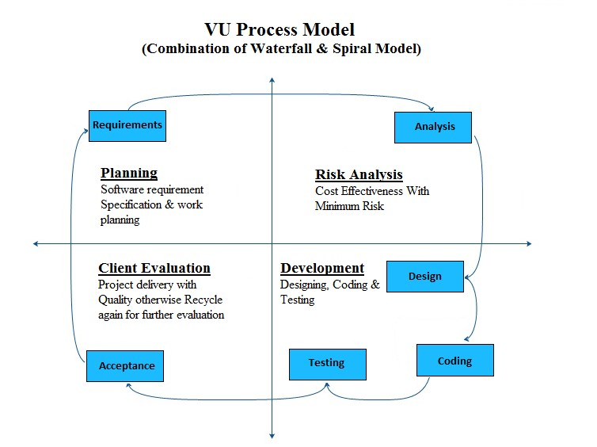
Process Model

Slide 6
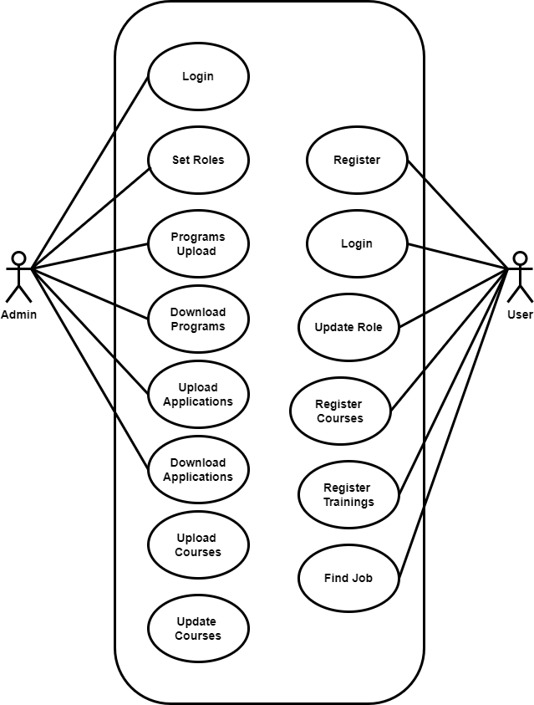
Use Case Diagram

Slide 7
Business Rules Catalog
Maritime Education System:
• Course and training program management
• User registration and profile creation
• Course and program search and filtering
• Application for courses and programs
Maritime Job Portal:
• Job posting and management
• Employer registration and profile creation
• Job search and advanced filtering
• Job application submission
User Roles
• Administrator
• Student (Course Applicant)
• Job Seeker
• Employer

Slide 8
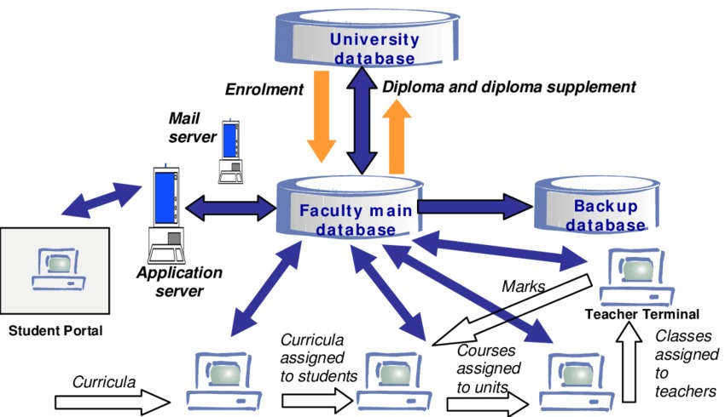
Architectural Design

Slide 9
Team Structure
Group Id: F230296634
Student Id: BC180403321
Student Id: BC180402472

Slide 10
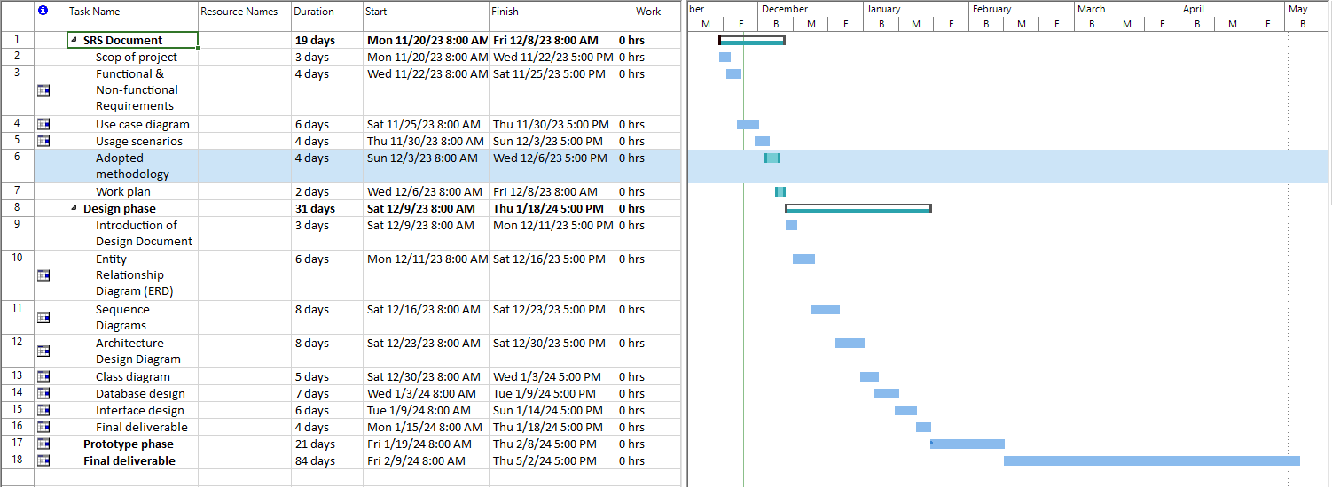
Project Schedule

Slide 11
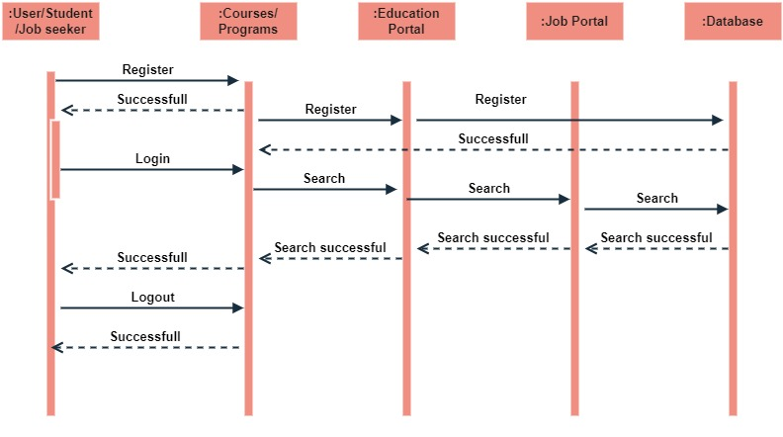
Sequence Diagrams

Slide 12
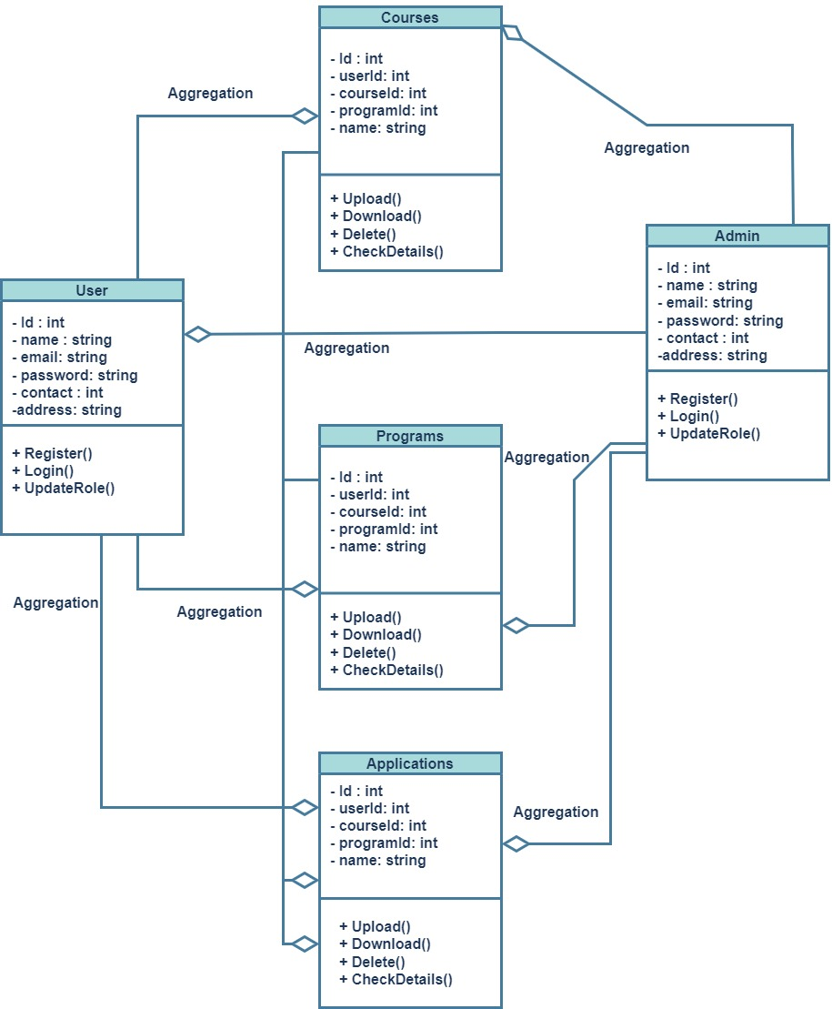
Logical Model/Class Diagram

Slide 13
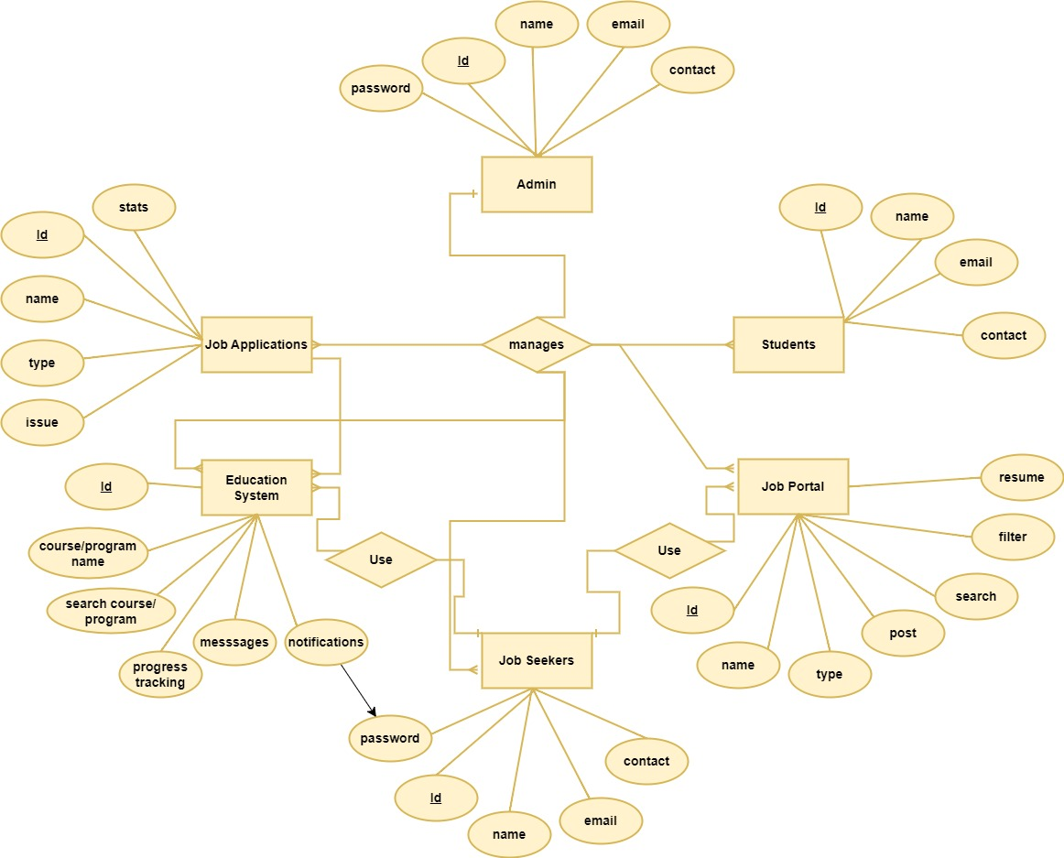
Entity-Relationship Diagram

Slide 14
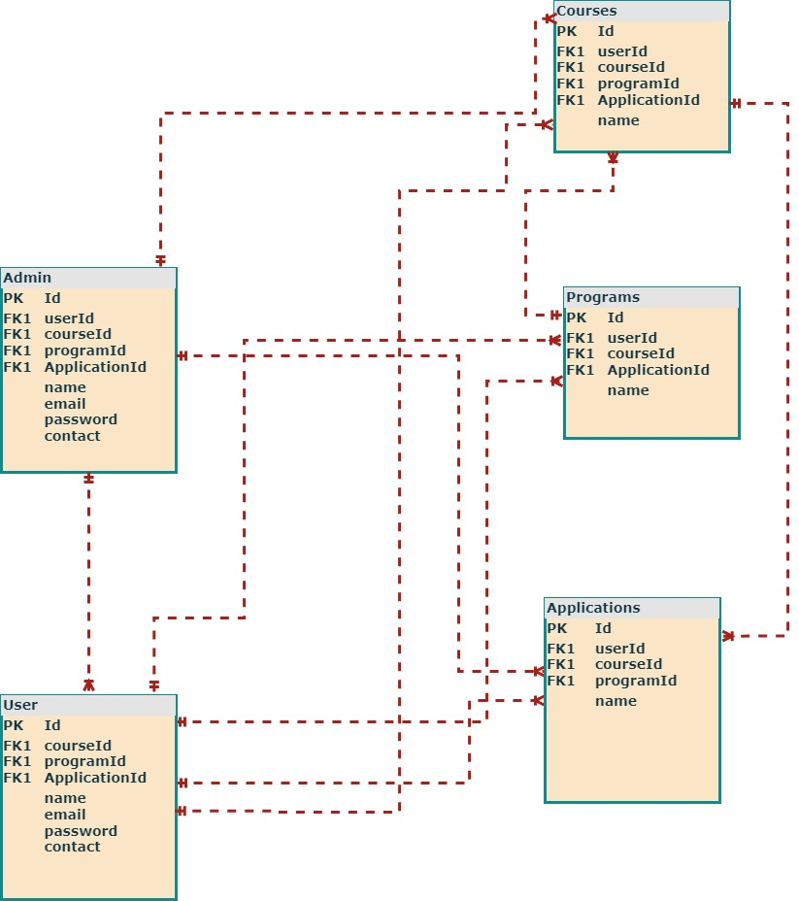
Database Diagram

Slide 15
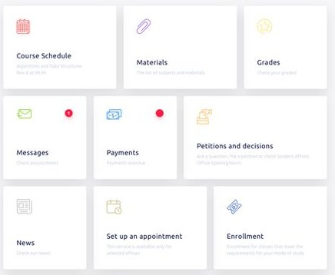
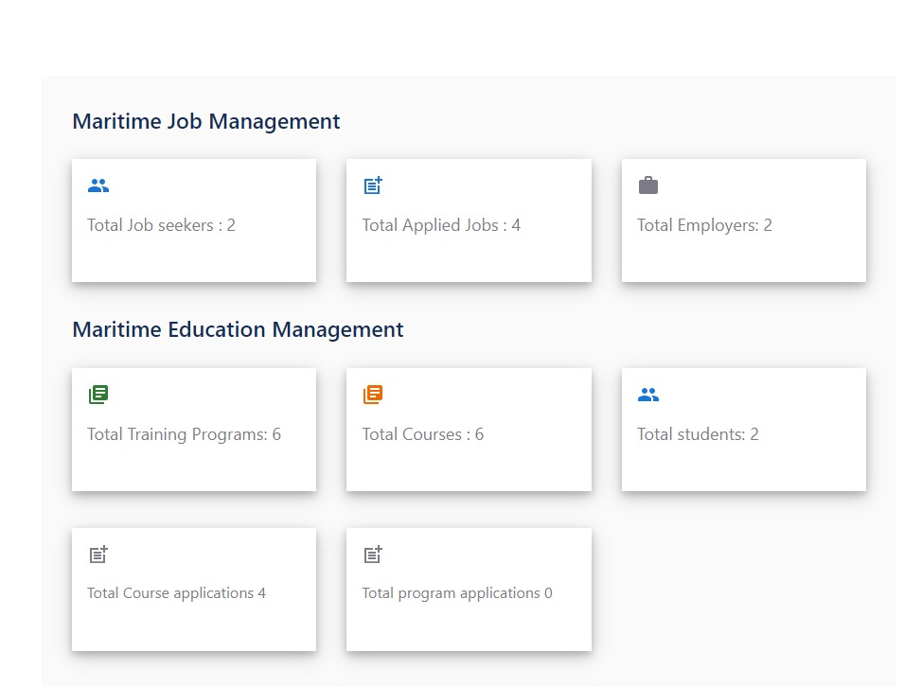
User Interfaces

Slide 16
Tools
• Frontend: HTML5, CSS3, JavaScript, React
• Backend: Node.js, Express.js
• Database: MySQL
• Authentication: JWT (JSON Web Tokens)
• Hosting: AWS
Version Control: Git

