Slide 1
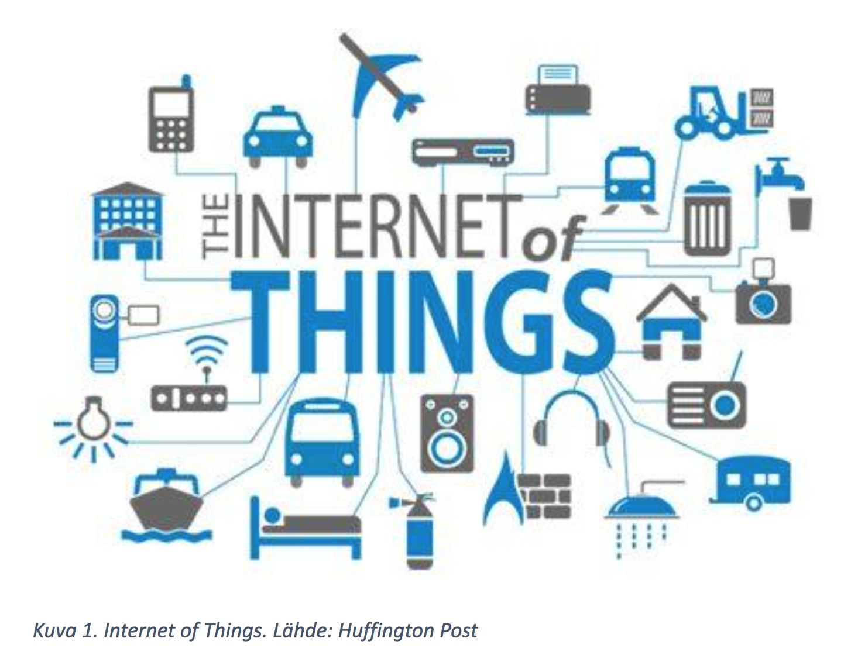
WIRELESS CONNECTIVITY FOR INTERNET OF THINGS
Presented By
Hassan Illyas (037)
Abdullah Iftikhar (014)
Abdul Majeed Rana (035)
Rana Muzzammil khan(126)

Slide 2
CONTENTS
• Introduction
• Frequency bands and world wide regulations
• Communication protocols
• Network range
• Network topology and size
• Different technologies
• Advantages
• Disadvantages
• Conclusion

Slide 3
INTRODUCTION
A system in which objects in the physical world could be connected to the Internet by sensors.
Coined by British technology pioneer Kevin Ashton in 1999.
The actual idea of connected devices had been around longer at least since the 70s.
The idea was often called “embedded internet” or “pervasive computing”
The power of connecting Radio-Frequency Identification (RFID) tags.
A popular term for describing scenarios in which internet connectivity.

Slide 6
FREQUENCY AND WORLD WIDE REGULATIONS
Regulated by ITU-R.
ISM bands vary from country to country.
Popular are 433MHz,868MHz,915MHz,2.4MHz.
Higher frequency bands offer more channels and more bandwidth.
Lower frequency radio waves propagate better than higher frequency.

Slide 7
FREQUENCY BANDS AND WORLD WIDE REGULATIONS

Slide 8
COMMUNICATION PROTOCOLS
Most common model is OSI model.
Breaks communication into functional layers allowing easier implementation.
The IOT is all about connecting things to internet.
So that a IP address is desired.
Non IP address devices can also be communicated

Slide 9
STANDARD MODELS

Slide 10
NETWORK RANGE

Slide 11
NETWORK TOPOLOGY AND SIZE

Slide 12
6LOWPAN
Acronym for IP v6.
First wireless connectivity standard crated for internet of things.
Based on 802.15.4 .
Can communicate with any other ip based devices.
Mesh topology.
Low power consumption.

Slide 14
DISADVANTAGES
Still many of them runs on IP v4.
This require a protocol converter from IP v4 to IP v6.
No industry standard.
There is no standard organization to run certificate programs

Slide 15
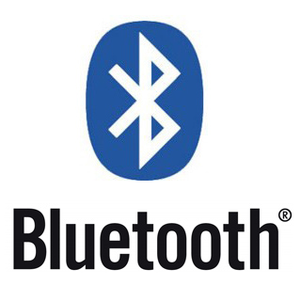
BLUE TOOTH
Proposed by Ericson in 1994.
Data rate upto 1 mbps to 24 mbps.
The rules regarding the implementation is present Bluetooth protocol stack.
Bluetooth 4.2 version specification enables IOT through low power IP connectivity.
Uses Frequency hopping spread spectrum technique.
The Bluetooth is related to IOT by means of acting as internet gateway.

Slide 16
It uses a frequency hopping spread
spectrum technique (FHSS) - which is
one of two basic modulation
techniques used in spread spectrum
signal transmission

Slide 17
DISADVANTAGES
Data sent between two Bluetooth devices is very slow compared with Wi-Fi transfer Rate.
Range Of a Bluetooth Device is 15-30 feet depending upon the Device.
Security is Biggest Disadvantage as transfer takes place through radio waves and a hacker can easily hack it.
Battery usage is also a problem, it will make device out of power.

Slide 18
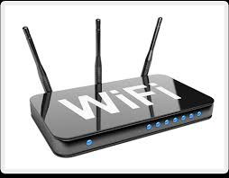
Wi-fi
A popular wireless communication technique.
Follows IEEE 802.11 Standard.
Supports Internet protocol based communication.
The hardware part of it is known as Wi-Fi radio.
Data rates ranging from 1 mbps to 1300 mbps.
Requires an intermediate agent called wifi router.

Slide 19
DISADVANTAGES
Spectrum assignments & operational limitations.
Power consumption is fairly high.
Degradation in performance.
Networks have limited range.
Used to steal personal and confidential information.

Slide 20
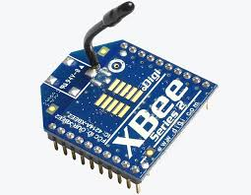
ZIG BEE
Low cost wireless network communication .
Operates world wide at unlicensed bands of radio spectrum.
Covers upto 100 meters distance.
Data rate 0f 20 to 250 Kbps .
Zig bee pro offers an optional new and innovative feature Green power

Slide 21
DISADVANTAGES
Replacement with Zigbee compliant appliances can be costly.
No more secure than a typical 802.11 wireless network.
Zigbee compliance certification for appliance manufacturers mandates lithium battery use.
Can be confusing at first for the homeowner.

Slide 22
CONCLUSION
There is no substitute for connecting of things but the only challenge resides in proper selection of connectivity technology for the effective implementation.

Slide 23


