Slide 1
Background
BSc Hons Computing from University of Kent & Masters in from Loughborough University
Working as a Platform Engineer at Bankable and previously worked in Prepay Solutions as Infrastructure Engineer
Certified Google Associate Cloud Engineer

Slide 2
Tech Stack
Cloud: Google Cloud Platform (GCP), Amazon Web Services (AWS)
Infrastructure as Code: Ansible, Terraform
Containerisation: Docker, Kubernates
CI/CD: Jenkins
Monitoring Tools: Prometheus, Nagios
Virtualization: VMWare ESXi, Hyper-V
Scripting Langugages: Java, Bash, Python,
Firewalls: Palo Alto NGFW, SSL, IPSec VPN
Networking: TCP/IP, IPv4, DHCP, DNS, NAT, SMTP, POP3, IMAP, VPN, Access Control List (ACL), Load Balancing

Slide 3
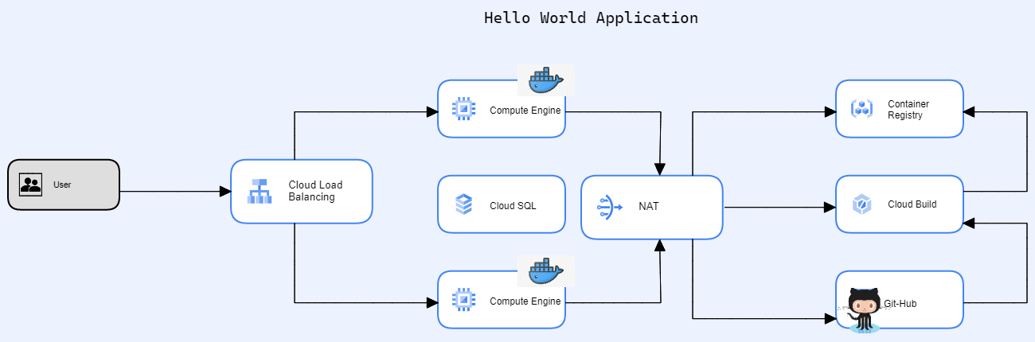
Technical Assessment

Slide 4
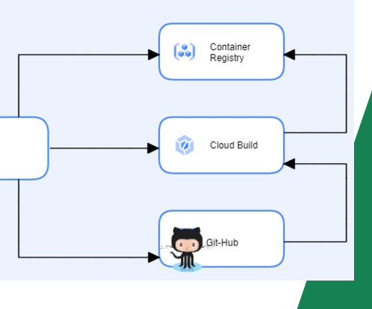
Task One
Developed a Hello World Application on GCP
Created flask/python based web application
Made a docker image of the project
Pushed it to Repo ( Container Registry)
Utilised Cloud Build to build the image
Created a Build Trigger for any changes
Pushed the image on to the VM using
terraform

Slide 5
Task 2
Provisioned SQL database via Terraform
Associated Private Network (terraform-network) and IP Address

Slide 6
Task 3
Provisioned the following for traffic management and utilisation
  Virtual Private Cloud
  Router
  NAT
  Load Balancer
  Health Checker

Slide 7
Task 4
Created Billing Alerts to manage bills and to avoid any excess payments
Dedicated VMs
Storage Options such as Nearline, Cold Line, Archive (Backup/ Disaster Recovery)
Cloud Run

Slide 8
Task 5
Created Service Account for Project (Least Privilege Access)
Key rotation policy of 90 days or less for both KMS encryption keys and API keys.
Enabling multi-factor authentication (MFA) and security key enforcement for all admin accounts.
Setting up a Waf
Multi Zone, Multi Region
Auditing

Slide 9
Reflections
Re-designing Google Kubernetes Engine (GKE) Two-Tier Application
Difficult Faced
  Setting private IP for SQL
  Virtual Private Cloud

