Slide 1

Spring Boot and RESTful web services
Bartosz Jedrzejewski
Bristech 2016

Slide 2
What is Spring Boot and what it does?
It is a part of Spring Framework
It helps with automatic configuration
It helps with dependencies with its starter dependencies
The Command Line Interface (Optional)
The Actuator
It is not a web server!

Slide 3


Why is it such a big deal?
It makes developing with Spring much easier
It makes it much faster
It helps with building microservices architecture
And…

Slide 4
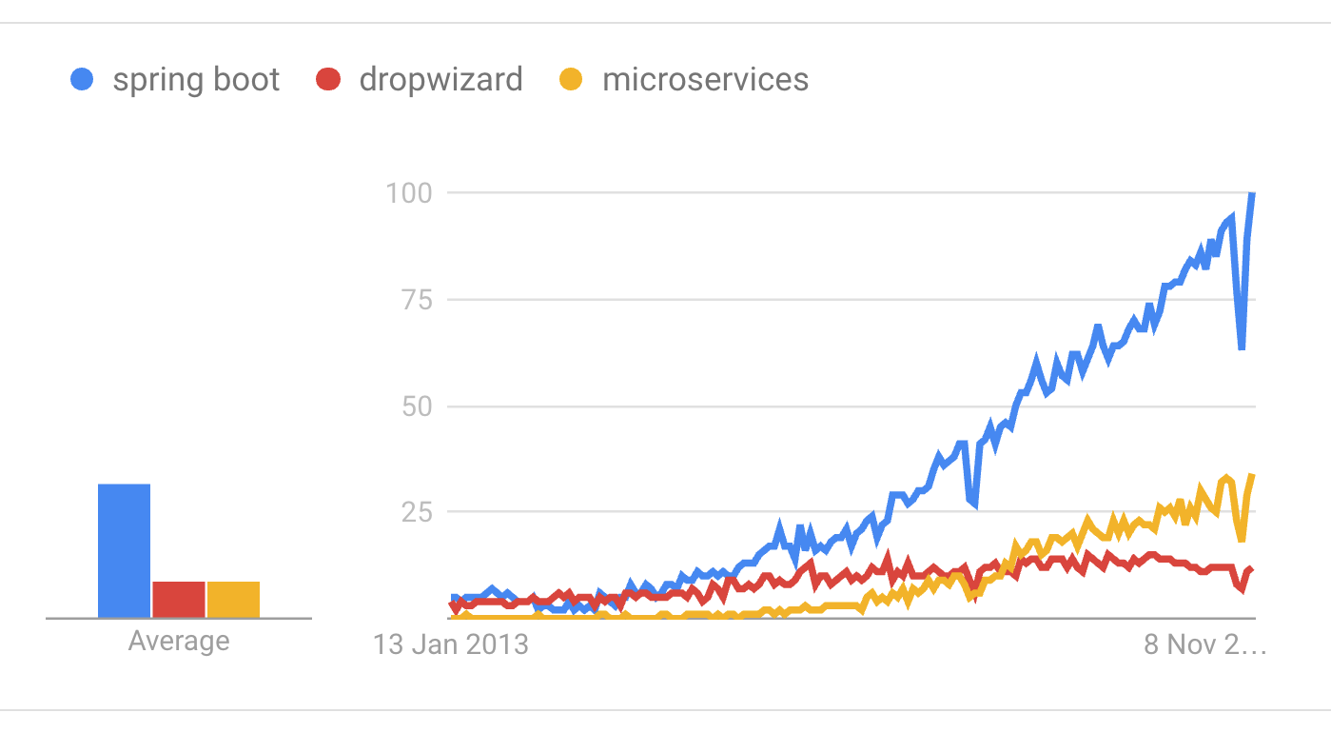
It is getting really popular!

Slide 5
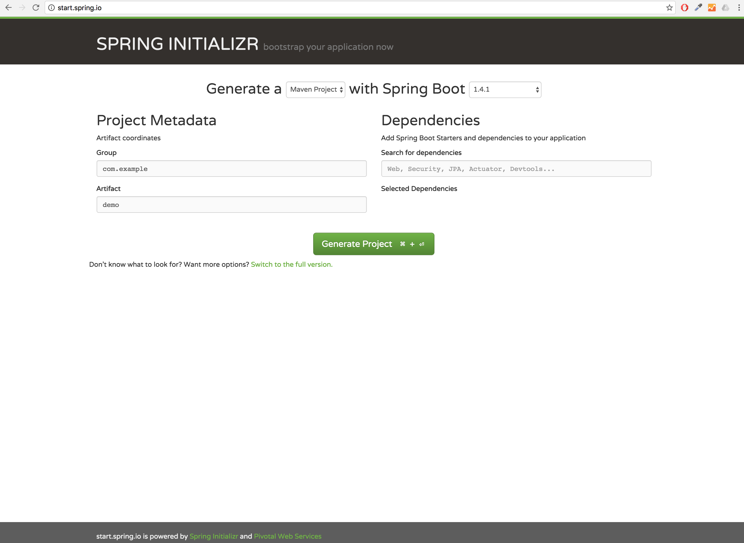
Let’s get started with the Initializer
https://start.spring.io

Slide 6
It is time to write some controllers
@RestController let’s you easy define a class to be a Controller
@RequestMapping defines the mapping
You can use dynamic path
Returning objects are automatically serialized with Jackson

Slide 7
How is it actually working?
Spring-Boot-Starter projects are bringing everything together
You can see exactly what is being used with mvn dependency:tree command
Auto-configuration and being opinionated are core to the Spring Boot philosophy
… you can still override anything if you have to

Slide 8
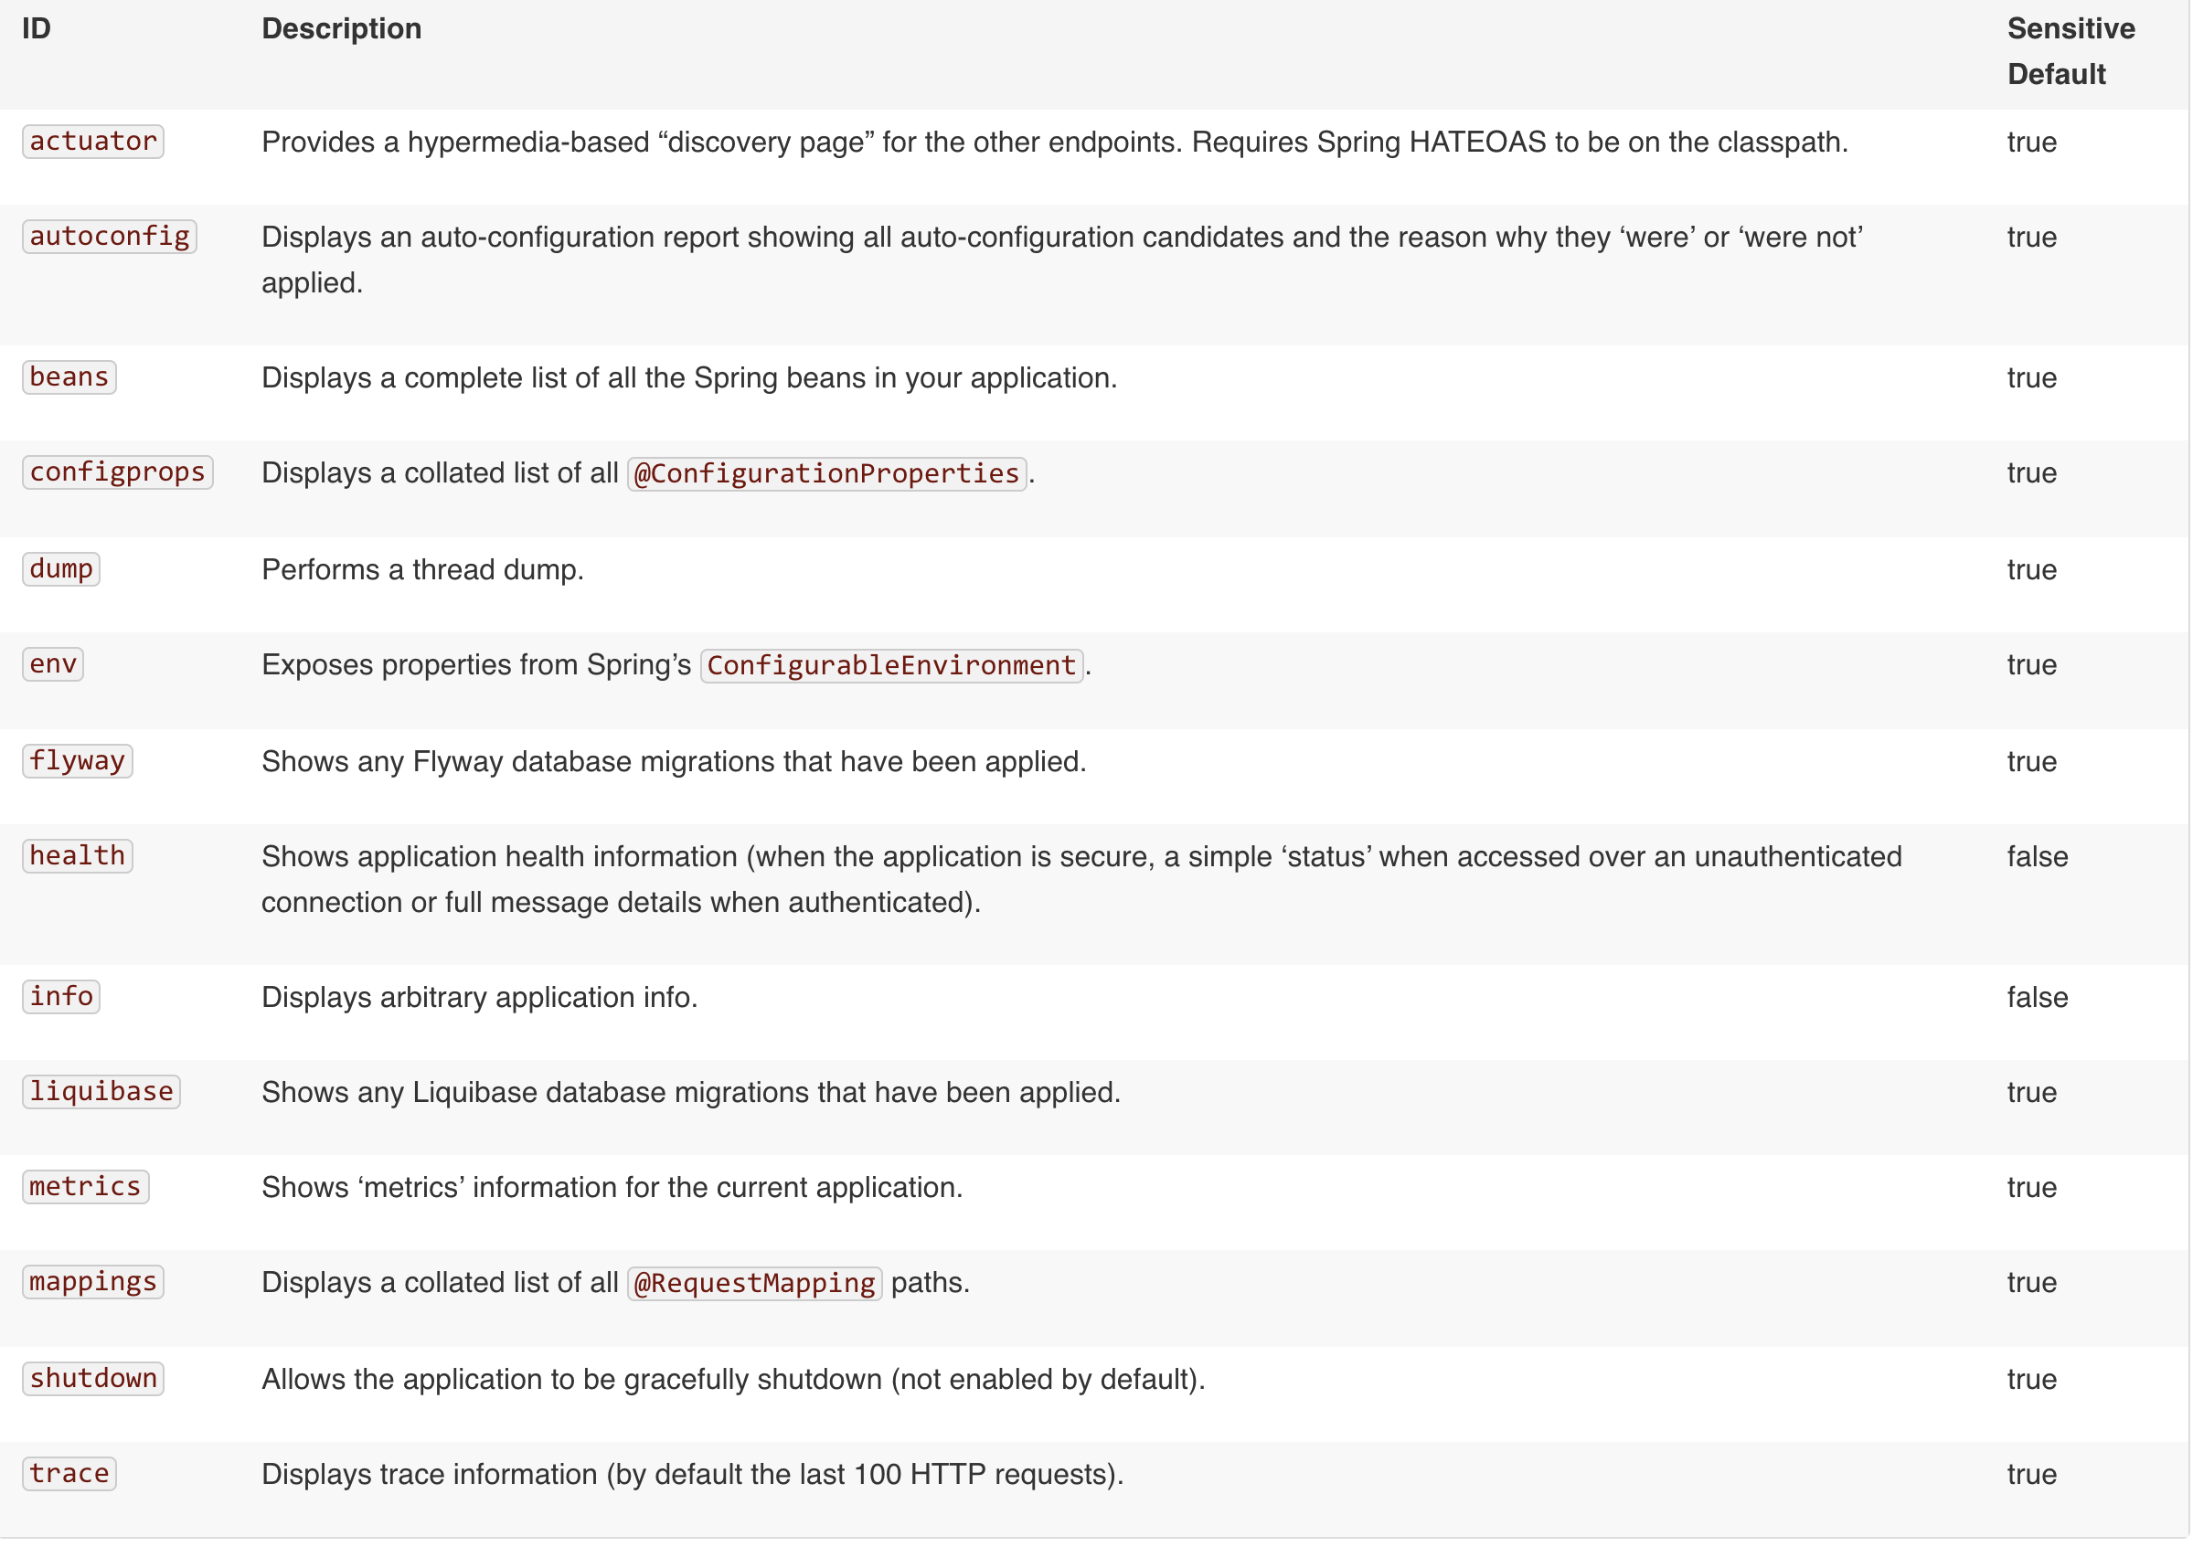
A quick look at Actuator
http://docs.spring.io/spring-boot/docs/current/reference/html/production-ready-endpoints.html

Slide 9
Writing other requests
It is just as easy with @PostMapping, @DeleteMapping etc.
Serialization from JSON to Java is handled automatically
We can try it ourselves using Postman

Slide 10
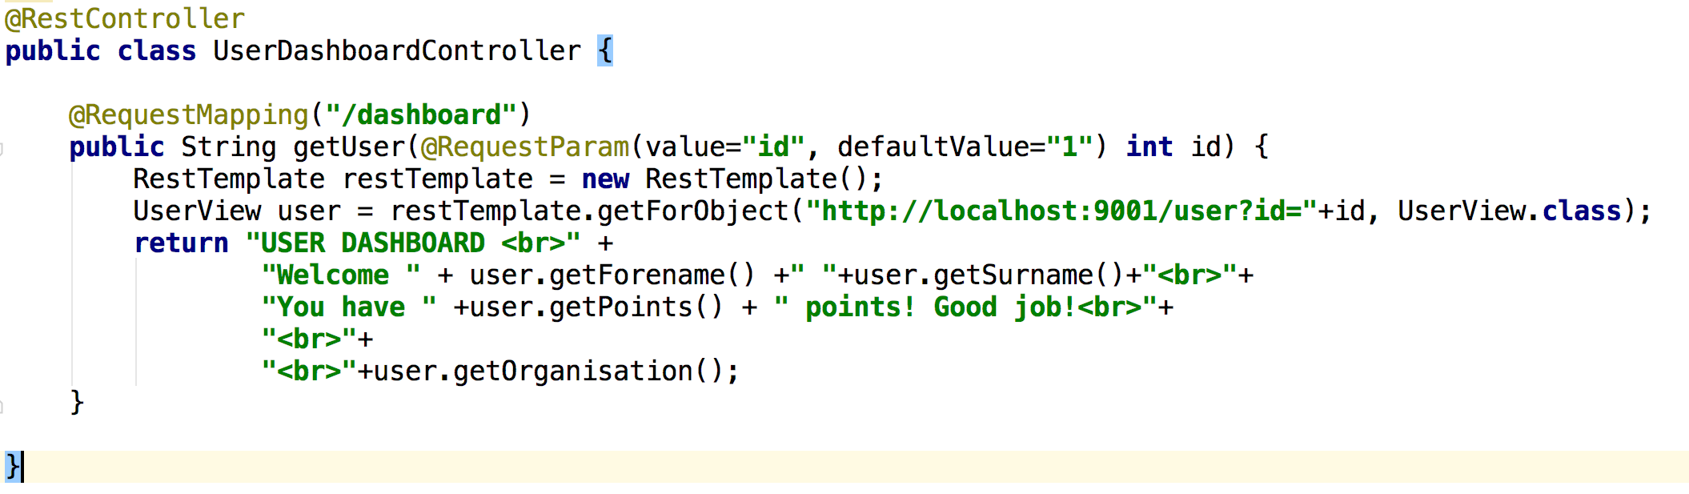
How to call one service from the other?
Orchestration – there is a single point of control for the services
Choreography – no single point of control (checkout Spring Cloud Stream)
Example request:

Slide 11

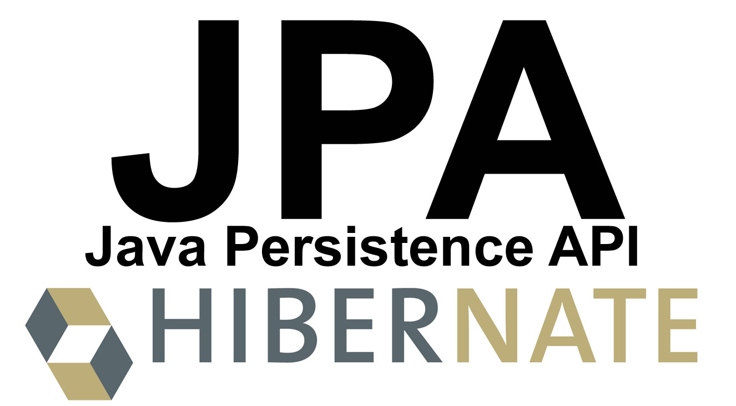

Spring Boot Data
+ Autoconfiguration
=

Slide 12
Thank you!

