Slide 1
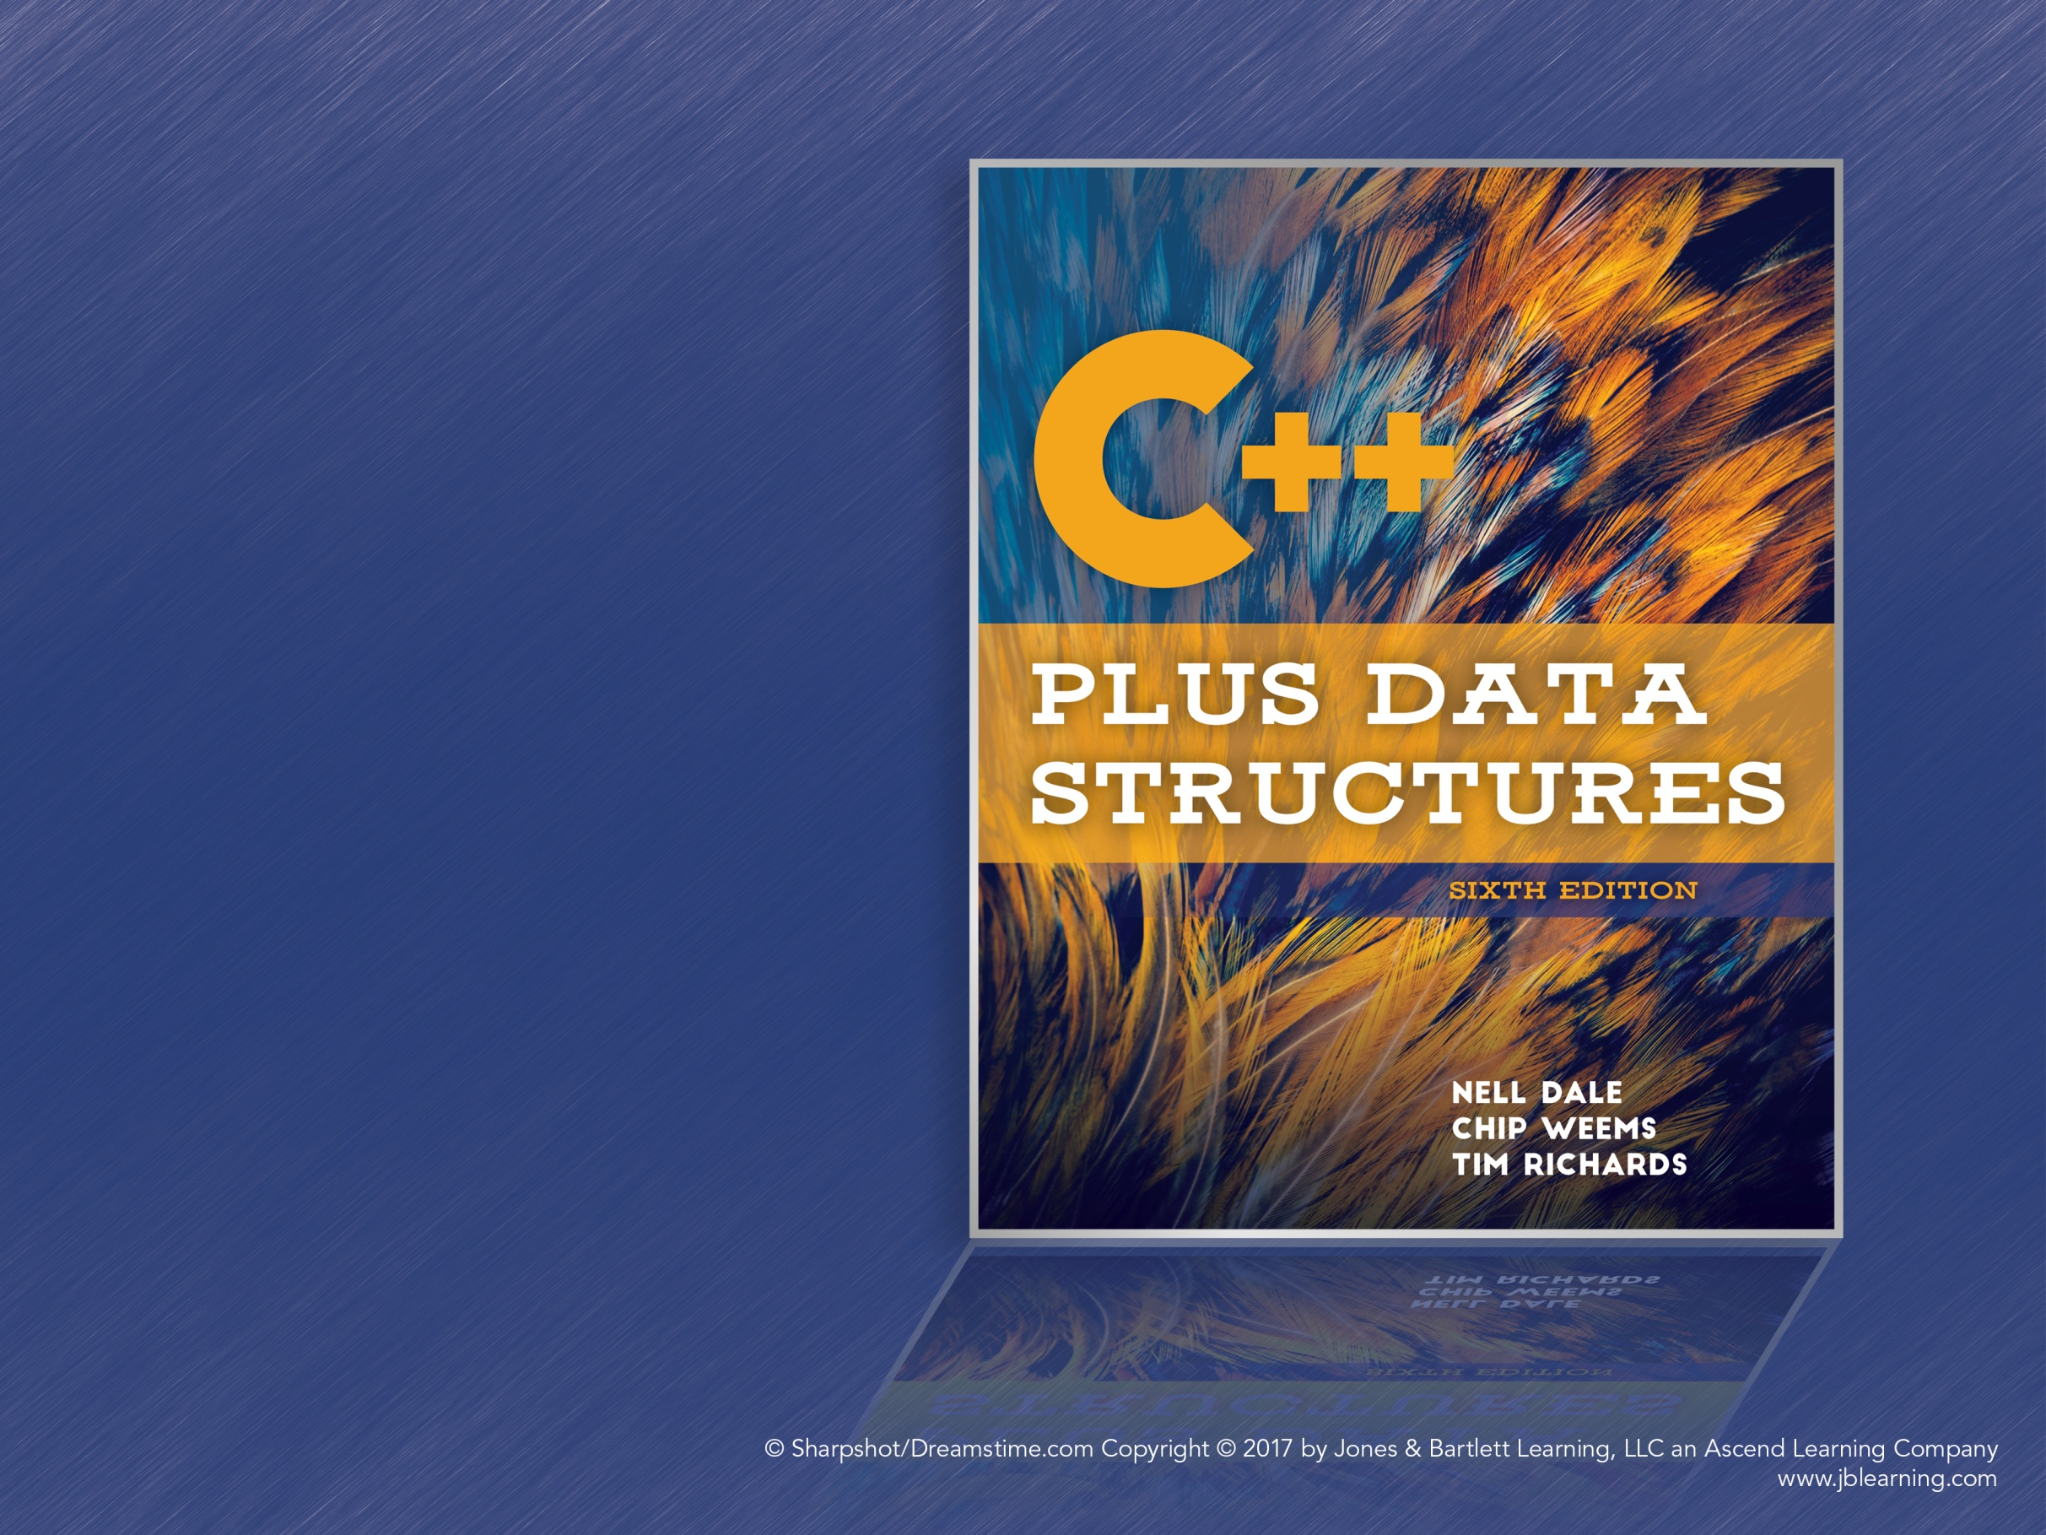
Chapter 2
Data Design and Implementation

Slide 2
Different Views of Data
Data are the nouns of the programming world:
The objects that are manipulated
The information that is processed
Data abstractions separate our logical view of data from the computer’s implementation view

Slide 3
Data Abstraction
Logical view:
What are the possible values?
What are the operations on this data?
Implementation view:
How is this data used?
How is it stored in memory?
How can it be implemented in C++?

Slide 4
Data Encapsulation
Encapsulation separates the representation of data from applications that use the data at the logical level
The physical representation is hidden behind an interface for interacting with the data
Abstract Data Type: A data type whose operations and domain of values are specified independently of any implementation

Slide 5
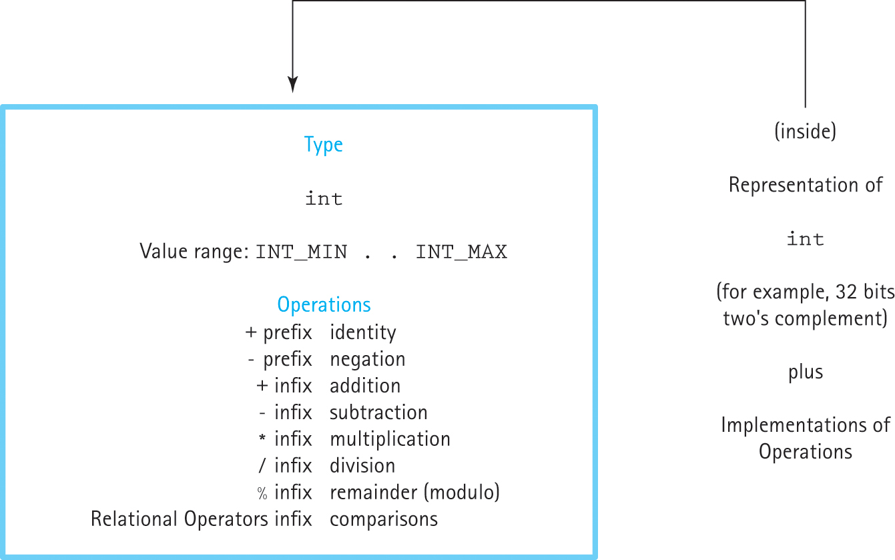
Data Encapsulation (cont.)
Figure 2.1 A black box representing an integer

Slide 6
Data Structures
A collection of data elements with operations that store and manipulate individual elements
Can be decomposed into individual elements
The arrangement of elements in the structure is significant
Arrangement and access of elements can be encapsulated
Used to implement ADTs

Slide 7
Example: Library as an ADT
A library’s data elements are the books
ADT interface: Users can check books in or out, reserve books, and pay fines
Data structure: Can order books randomly, alphabetically by title, or use the Dewey Decimal System
Users don’t need to know how the library organizes the books

Slide 8
Data From Different Levels
Application (user) level: The problem domain; modeling real-life data in the problem’s context
Logical (abstract) level: Abstract view of data values and operations on data
“What” questions: What do we do to the data?
Implementation level: Specific representation of data in the program
“How” questions: How do we implement the ADT?

Slide 9
Data Levels of a Library
Application level: Library of Congress or Baltimore County Public Library
Logical level: The domain is a collection of books
- Operations include: check a book out, check a book in, pay a fine, reserve a book
Implementation level: Representation of the book data structure to hold the library’s data, and the coding for operations

Slide 10
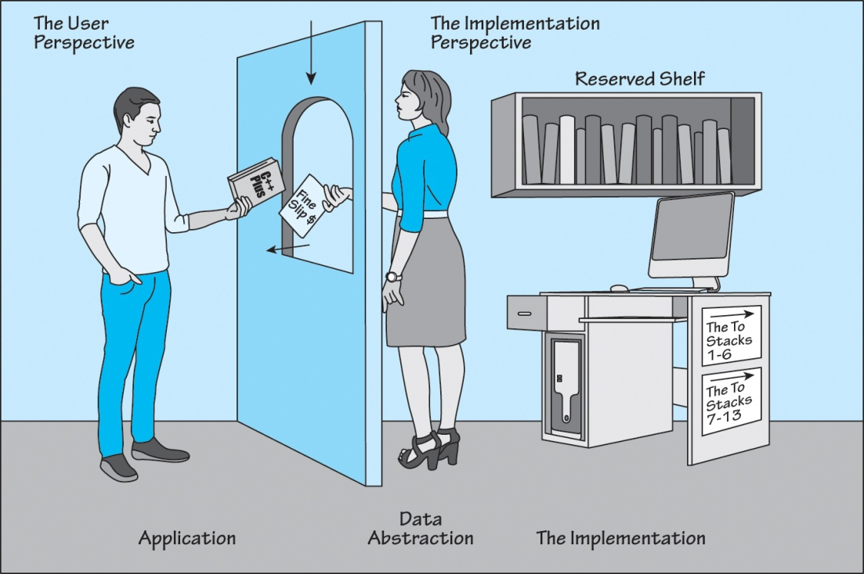
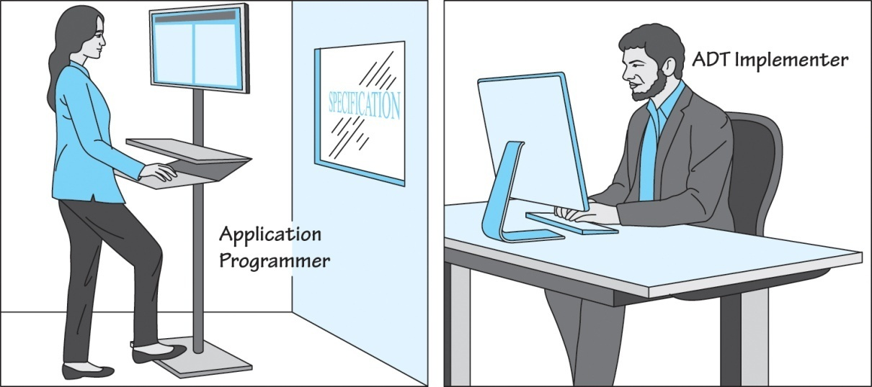
Application and Implementation
Figure 2.3 Communication between the application level and implementation level

Slide 11
ADT Operator Categories
Operations on ADTs can be classified as:
Constructors: Create new instances (objects) of an ADT
Transformers: Change the internal state of the object
Observers: View the state of the object - Observers come in several forms: predicates, accessors, and summaries
Iterators: For the sequential processing of elements

Slide 12
Composite Data Type
A composite data type stores a collection of individual data components under one name and allows access to individual components
Two forms:
Unstructured: Components are not organized with respect to each other (e.g., classes)
Structured: Components are organized and it affects how they are accessed (e.g., arrays)

Slide 13
Records: Logical Level
Record: A finite collection of elements that are called members or fields
Members are accessed using named selectors, such as mystruct.fieldname
Can also be used to assign values to fields

Slide 14
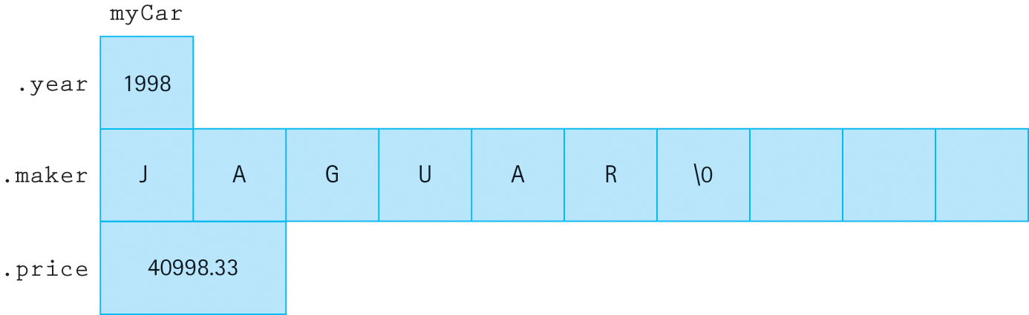
Records: Application Level
Collect related data in one structure
Used to implement other data structures
Figure 2.4 Record myCar

Slide 15
Records: Implementation Level
Records occupy a contiguous chunk of memory
Each member is located at an offset from the beginning of the record
Calculating offsets is handled automatically by the compiler and run-time system
The implementation is structured even though the logical view is not

Slide 16
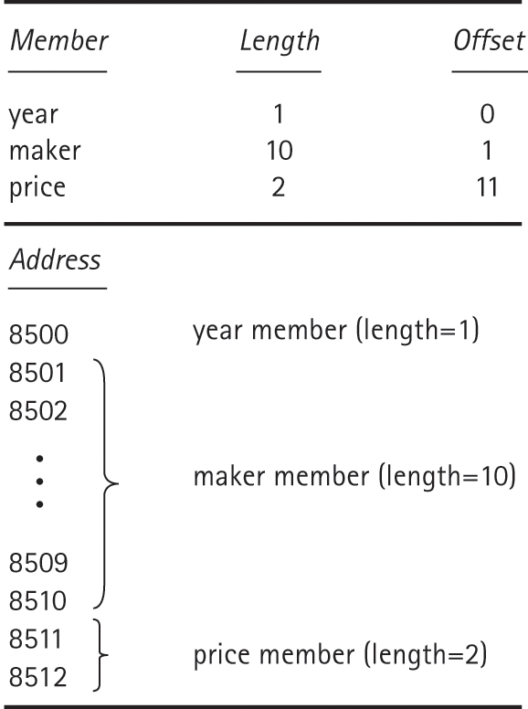
Implementation of a CarType
Figure 2.6 Implementation-level view of CarType

Slide 17
Passing Records to Functions
C++ supports two ways of passing arguments:
By value: A copy of the argument is passed; the original argument cannot be modified by the function
By reference: The function receives the memory location of the argument, allowing changes to be made directly

Slide 18
One-Dimensional Arrays:
Logical Level
Arrays are finite, fixed-size collections of ordered homogeneous elements
Permit direct, random access of elements using indices: myArray[2] accesses the third element
Arrays can only be passed by reference
Functions can change array contents
Can prevent changes by using the const keyword

Slide 19
One-Dimensional Arrays:
Application Level
Used to store lists of data elements
Strings are arrays of characters
Arrays must be homogeneous (all one type)
Operations: Creation and element access

Slide 20
One-Dimensional Arrays: Implementation Level
The array declaration describes the name of the array and the type and number of elements
An array of ten integers: int data[10];
To access an element, calculate the offset from the base address (beginning of the array)
This is automatically handled by the compiler: Address = base + index * size of element

Slide 21
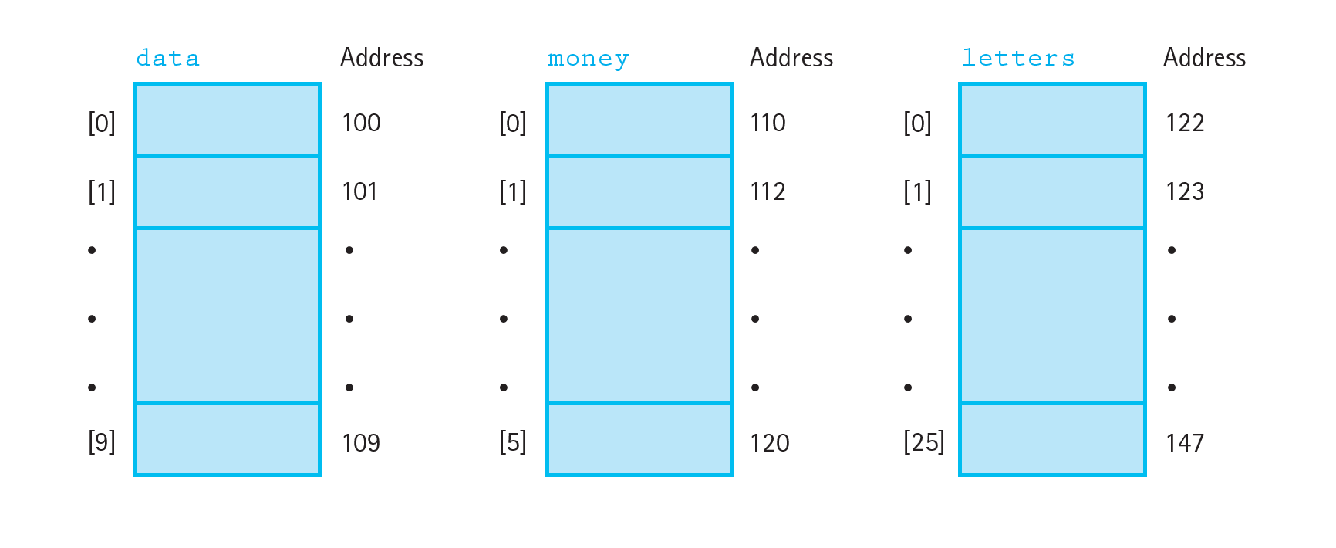
One-Dimensional Arrays:
Memory Layout

Slide 22
Two-Dimensional Arrays:
Logical Level
Finite, fixed-size, ordered collections of homogeneous array elements
Very similar to one-dimensional arrays
Can be thought of as a table of rows and columns: table[row][col]
When used as parameters, must include the size of the second dimension:
int ProcessValues(int values[][5])

Slide 23
Two-Dimensional Arrays:
Application Level
Ideal for representing tables of data
Operations: Creation and element access
Primarily used to implement other data structures
Can be thought of as an array of arrays, or as a two-dimensional matrix

Slide 24
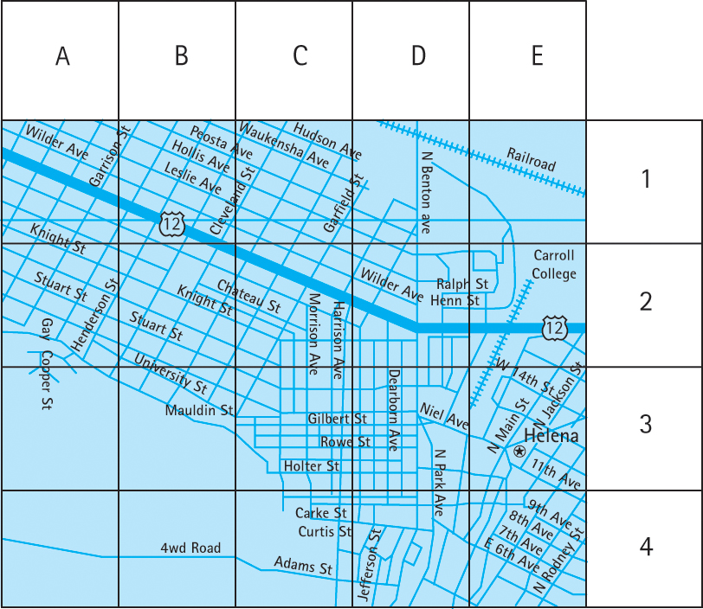
Map as a 2-D Array:

Slide 25
Two-Dimensional Arrays:
Implementation Level
Stored as a single contiguous piece of memory
Row-major order: Two-dimensional arrays in
C++ are stored row-by-row
An NxM array uses (N*M*element size) memory
The first M cells are the first row, and so on
In column-major order, the first N cells would be the first column

Slide 26
C++ Class Type
An unstructured type that encapsulates a fixed number of data components along with functions that manipulate them
Operations: Member access and whole assignment
More operations can be defined per class

Slide 27
Class Specification
Describes data fields and functions of the class
Typically in its own file with “.h” extension
The implementation resides in a separate file
Allows for a cleaner interface
Programmers can focus on designing a class without worrying about implementation details
Can easily change the implementation without touching the interface

Slide 28
Class Implementation
Must define all constructors and methods
Use the scope resolution operator “::” to indicate a function implementation belongs to a class: int DateType::GetMonth() const

Slide 29
Using Classes
A variable of a class type is called an object or instance of the class
Software that uses instances of a class is called a client
Clients must have #include “ClassName.h” in order to be able to use ClassName objects
Clients can only access public members of an object

Slide 30
Using “Self”
Don’t need to qualify member names in class functions
e.g., If a class has a member “foo,” then the name “foo” in the function refers to the object’s field
The “self” keyword can be used to refer to the object on which the member function is called
e.g., In today.GetMonth(), “self” points to today

Slide 31
Classes vs. Structs
Both are unordered collections of members
Structs: All members public by default, typically used as basic container of related data, operations on data are performed by passing struct to global functions
Classes: All members private by default, operations on data are defined as member functions

Slide 32
Inheritance
Classes can inherit properties (data and methods) from other classes
Base class: The class being inherited from
Derived class: The class that inherits
Derived classes are more specialized and typically have more fields
Inheritance creates a hierarchy of classes
Can be viewed as an “is-a” relationship

Slide 33
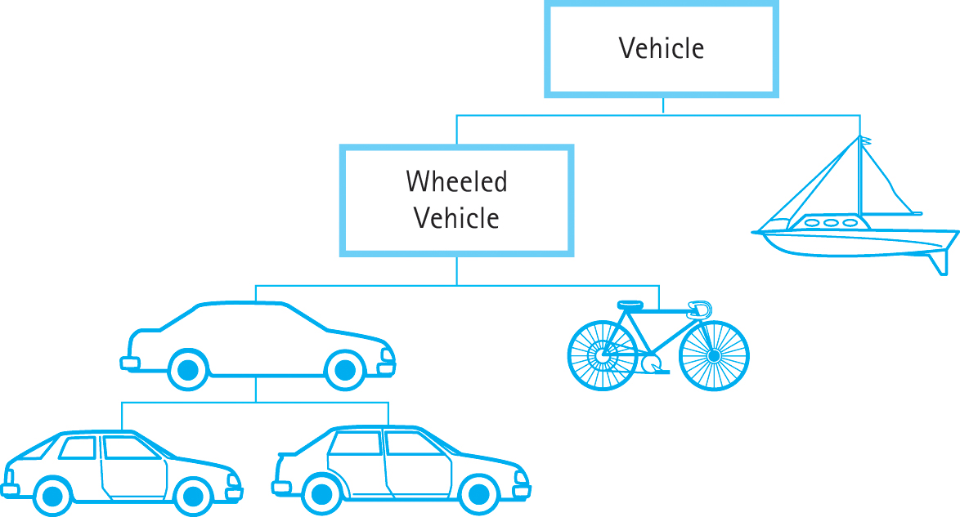
Inheritance Hierarchy
Figure 2.7: Inheritance hierarchy

Slide 34
Polymorphism
Overloading: When multiple functions have the same name
They must have unique signatures, such as different numbers or types of parameters
Polymorphism: The ability to statically or dynamically determine which version of an overloaded function to use

Slide 35
Binding
Binding Time: The time at which a name or symbol is bound to some code
Static Binding: Occurs at compile time
Dynamic Binding: Occurs during run time
Polymorphism can use either kind of binding when determining which function to use

Slide 36
C++ Constructs for OOP
Composition: A class contains an object of another class type; also called containment
Inheritance: In the form of class Derived : public Base
Virtual Methods: Allow for dynamic binding, used to implement polymorphism

Slide 37
Exceptions
Enable programs to gracefully handle exceptional conditions
Try-catch statement: try clause protects code that can cause exceptions, catch clause is executed if an exception is thrown
Keyword throw is used to trigger exceptions
C++ standard library has many predefined exception classes

Slide 38
Try-Catch Block
try {
// code that contains a possible error
// when the error occurs:
throw string(“An error has occurred…”);
}
catch (string message) {
// execution continues here
std::cout << message << std::endl;
return 1;
}

Slide 39
Exceptions in Code
try
{
infile >> value;
do
{
if (value < 0)
throw string("Negative value");
sum = sum + value;
} while (infile);
}
catch (string message)
// Parameter of the catch is type string
{
// Code that handles the exception
cout << message << " found in file. Program aborted."
return 1;
}
// Code to continue processing if exception not thrown
cout << "Sum of values on the file: " << sum;

Slide 40
Namespaces
Common identifier names will be used in multiple libraries
Namespaces prevent repeated names from clashing by scoping the identifiers
Created by using “namespace” keyword before a block:
namespace myNames { … }

Slide 41
Accessing Identifiers
Simplest: Scope resolution operator “::”
myNames::GetData()
Using Declaration: Creates local alias
using myNames::GetData; – all future references to GetData() refer to myNames::GetData()
Using Directive: Provides access to all identifiers in the namespace
using namespace myNames;

Slide 42
Rules for Using Namespace std
Qualify the identifier in the heading of function prototypes and definitions
Use using declarations only if a name is used multiple times in a function block
Use using directives only if multiple names from the namespace are used in the block
Using directives are only used in class and function blocks
Avoid namespace pollution!

Slide 43
Comparison of Algorithms
How do we compare the efficiency of different algorithms?
Comparing execution time: Too many assumptions, varies greatly between different computers
Compare number of instructions: Varies greatly due to different languages, compilers, programming styles...

Slide 44
Big-O Notation
The best way is to compare algorithms by the amount of work done in a critical loop, as a function of the number of input elements (N)
Big-O: A notation expressing execution time (complexity) as the term in a function that increases most rapidly relative to N
Consider the order of magnitude of the algorithm

Slide 45
Common Orders of Magnitude
O(1): Constant or bounded time; not affected by N at all
O(log₂N): Logarithmic time; each step of the algorithm cuts the amount of work left in half
O(N): Linear time; each element of the input is processed
O(N log₂N): N log₂N time; apply a logarithmic algorithm N times or vice versa

Slide 46
Common Orders of Magnitude (cont.)
O(N²): Quadratic time; typically apply a linear algorithm N times, or process every element with every other element
O(N³): Cubic time; naive multiplication of two NxN matrices, or process every element in a three-dimensional matrix
O(2^{N}): Exponential time; computation increases dramatically with input size

Slide 47
What About Other Factors?
Consider f(N) = 2N⁴ + 100N² + 10N + 50
We can ignore 100N² + 10N + 50 because 2N⁴ grows so quickly
Similarly, the 2 in 2N⁴ does not greatly influence the growth
The final order of magnitude is O(N⁴)
The other factors may be useful when comparing two very similar algorithms

Slide 48
Elephants and Goldfish
Think about buying elephants and goldfish and comparing different pet suppliers
The price of the goldfish is trivial compared to the cost of the elephants
Similarly, the growth from 100N² + 10N + 50 is trivial compared to 2N⁴
The smaller factors are essentially noise

Slide 49
Example: Phone Book Search
Goal: Given a name, find the matching phone number in the phone book
Algorithm 1: Linear search through the phone book until the name is found
Best case: O(1) (it’s the first name in the book)
Worst case: O(N) (it’s the final name)
Average case: The name is near the middle, requiring N/2 steps, which is O(N)

Slide 50
Example: Phone Book Search (cont.)
Algorithm 2: Since the phone book is sorted, we can use a more efficient search
Check the name in the middle of the book
If the target name is less than the middle name, search the first half of the book
If the target name is greater, search the last half
Continue until the name is found

Slide 51
Example: Phone Book Search (cont.)
Algorithm 2 Characteristics:
Each step reduces the search space by half
Best case: O(1) (we find the name immediately)
Worst case: O(log₂N) (we find the name after cutting the space in half several times)
Average case: O(log₂N) (it takes a few steps to find the name)

Slide 52
Example: Phone Book Search (cont.)
Which algorithm is better?
For very small N, algorithm may be faster
For target names in the very beginning of the phone book, algorithm 1 can be faster
Algorithm 2 will be faster in every other case
Success of algorithm 2 relies the fact that the phone book is sorted
- Data structures matter!

