Slide 1
Samsung & LG
Log Extractor Tool
Presented by Abdul Rahaman & Musbera Banu

Slide 2

Introduction - AVS Team
The Alexa Voice Service (AVS) team is responsible for integrating the Alexa app with third-party TVs, e.g., Samsung, LG, Philips and Hisense TVs, by providing direct Alexa built-in support for their products.
As a QS team, we perform end-to-end testing on these TVs and sign off on those 3P partners to ensure the highest quality standards for these products.

Slide 3
Problem Statement
Configuration: As part of the prerequisite, setting up Samsung and LG TVs is needed to kick-start the testing. It includes setting the environment, rooting, installing or uninstalling APKs, etc.
Log collection: To raise or validate any defect, we need to extract multiple logs, such as five types of logs in Samsung and three types of logs in LG, for debugging purposes.
The above two processes requires applying different commands across terminals after connecting our PC and TV via ssh(LG)/sdb(Samsung).
Even after applying the respective commands to collect logs, they won't be stored directly, as we need to copy and paste them manually into a text file.
It is not only time consuming & tedious process, it demands manual efforts as well.

Slide 4
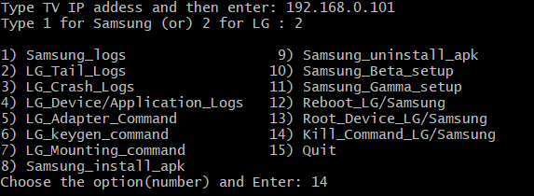
Solution
Developed a unified scripting tool with the help of bash scripting that automates the device configuration and defect log collection processes in Samsung & LG TVs with a single click.
These actions includes log collection and configuration processes such as rooting/rebooting, installing/uninstalling APKs, gamma/beta pointing, and killing crash processes.
In order to use this script team has to install the script and open the terminal and pick up the number to perform the respective action.

Slide 5
Tool Options

Slide 6
Time Savings
Before implementing this Tool, Team taken 187 mins to perform all the device configuration and defects logging.
After incorporating this tool, It takes only 53 mins to perform all actions.
Overall, we are able to save 620 hours during the year 2024.

Slide 7
Thank You
Q&A

