Slide 1
Emirati Human Resources Development Council (EHRDC)
User Journey Template for Integrating with UAE PASS Authentication
version 1.1

Slide 2
Instructions
This template document will guide you through creating your new user journey with UAE PASS.
Please use this template to show how you are integrating UAE PASS within your digital channel.
Please add English and Arabic version of each scenario
Do submit your user journey in PDF format. Submissions that are not in this format will not be processed.

Slide 3
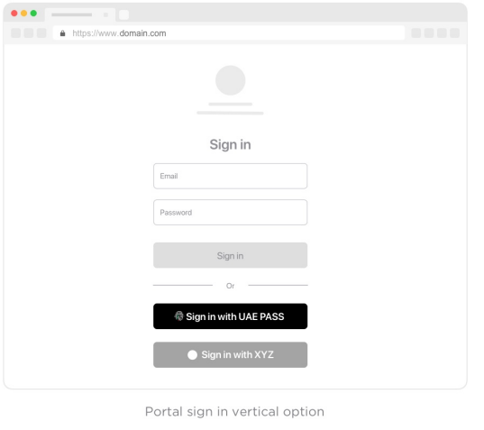
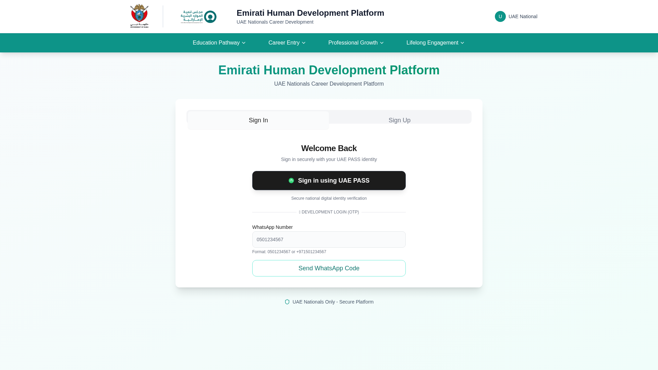
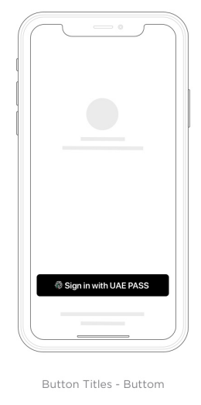
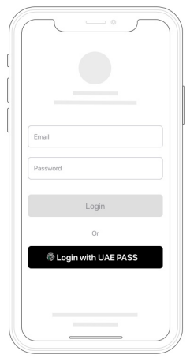
Sign-in with UAE PASS

Slide 4
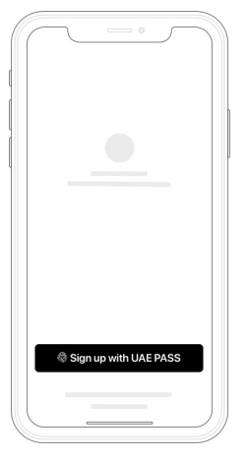
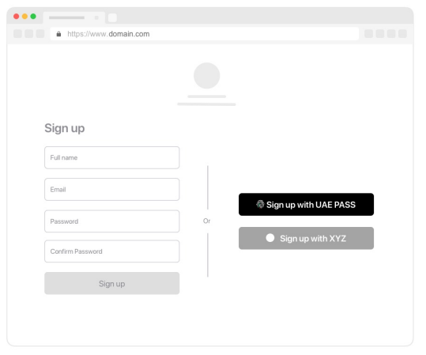
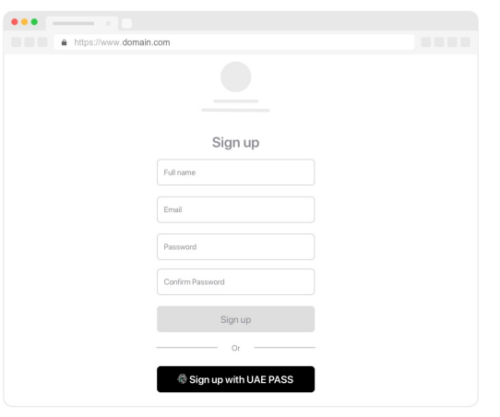
Sign up with UAE PASS (Authentication) If applicable

Slide 5
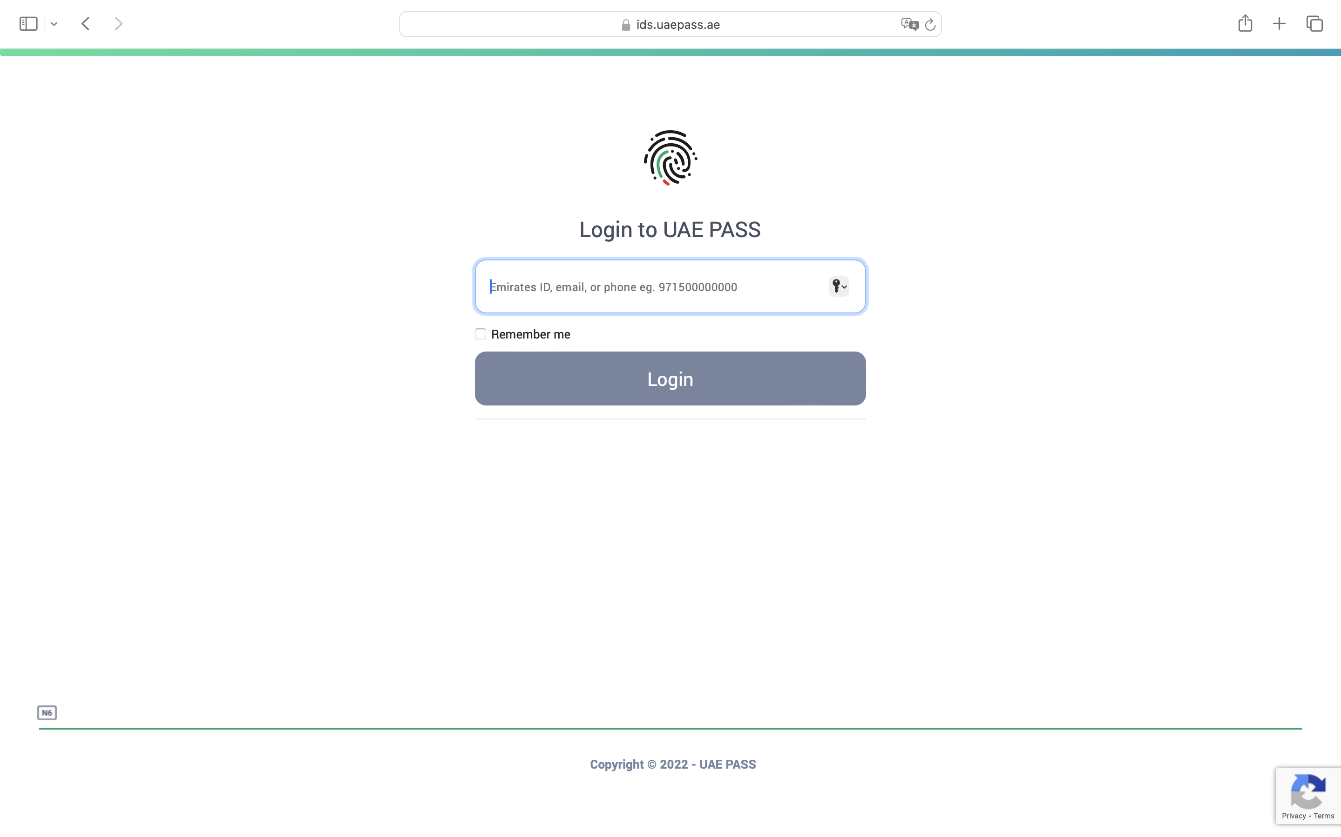
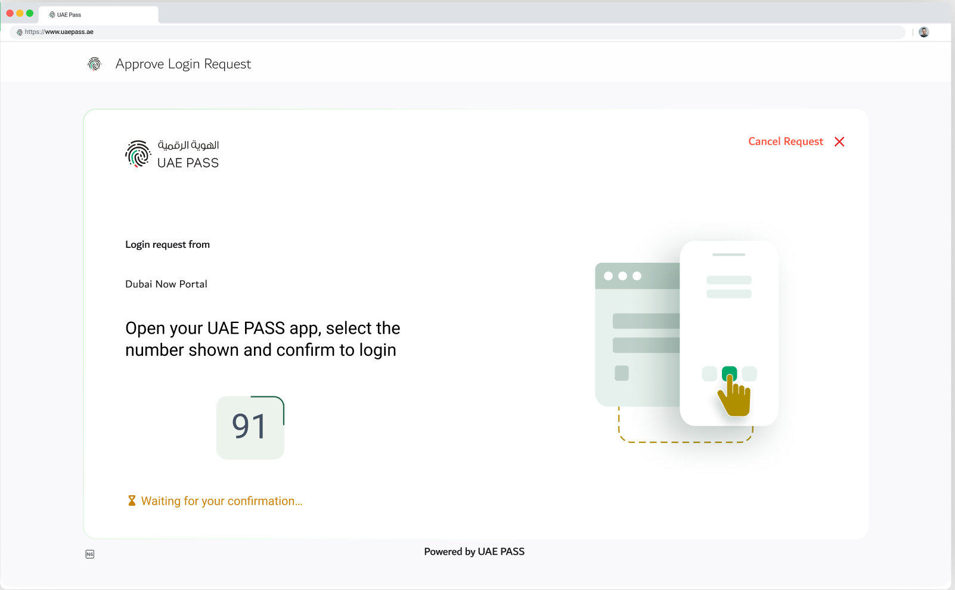
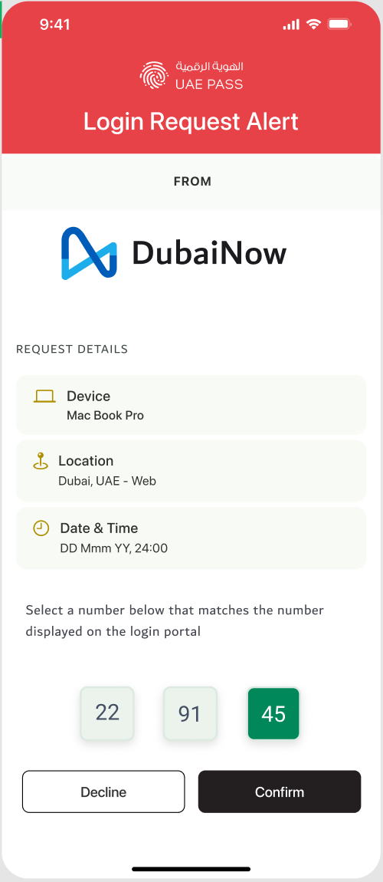
Redirection to UAE PASS Login page (WEB)

Slide 6
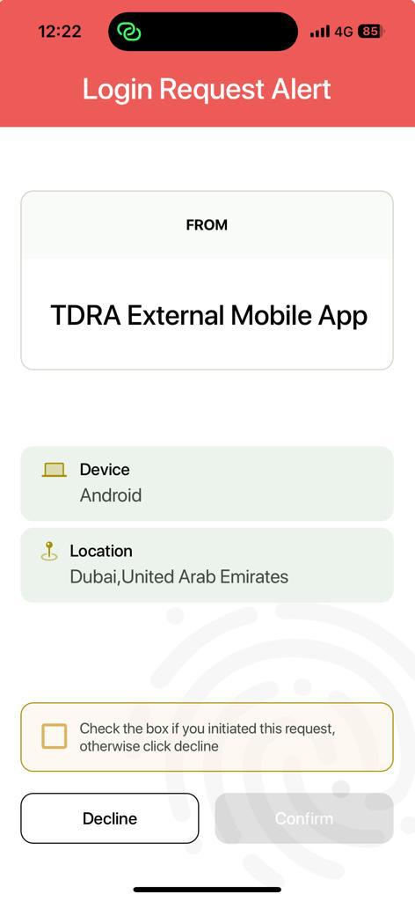
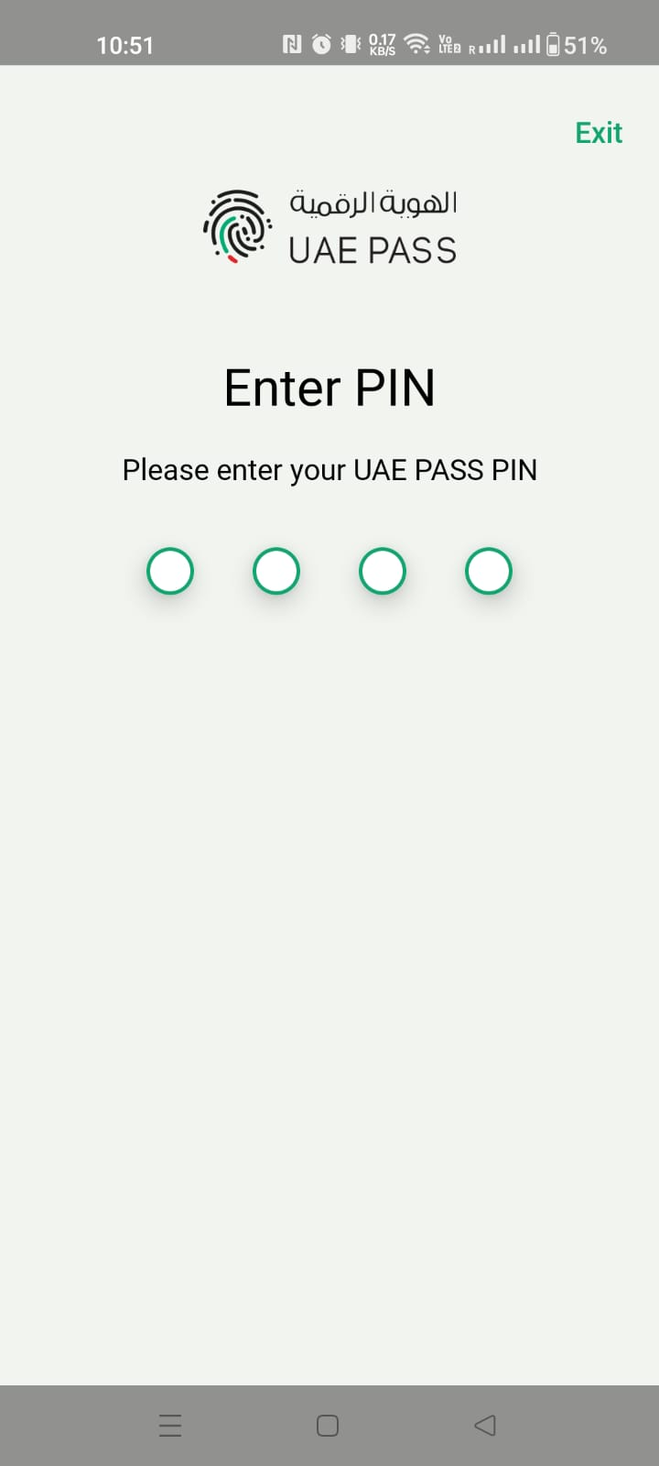
OR Redirection to UAE PASS Login page (App)

Slide 7
SOP1 scenario (If applicable)
Not Applicable — Our platform requires SOP2 level for Emirates ID (Idn) access.

Slide 8
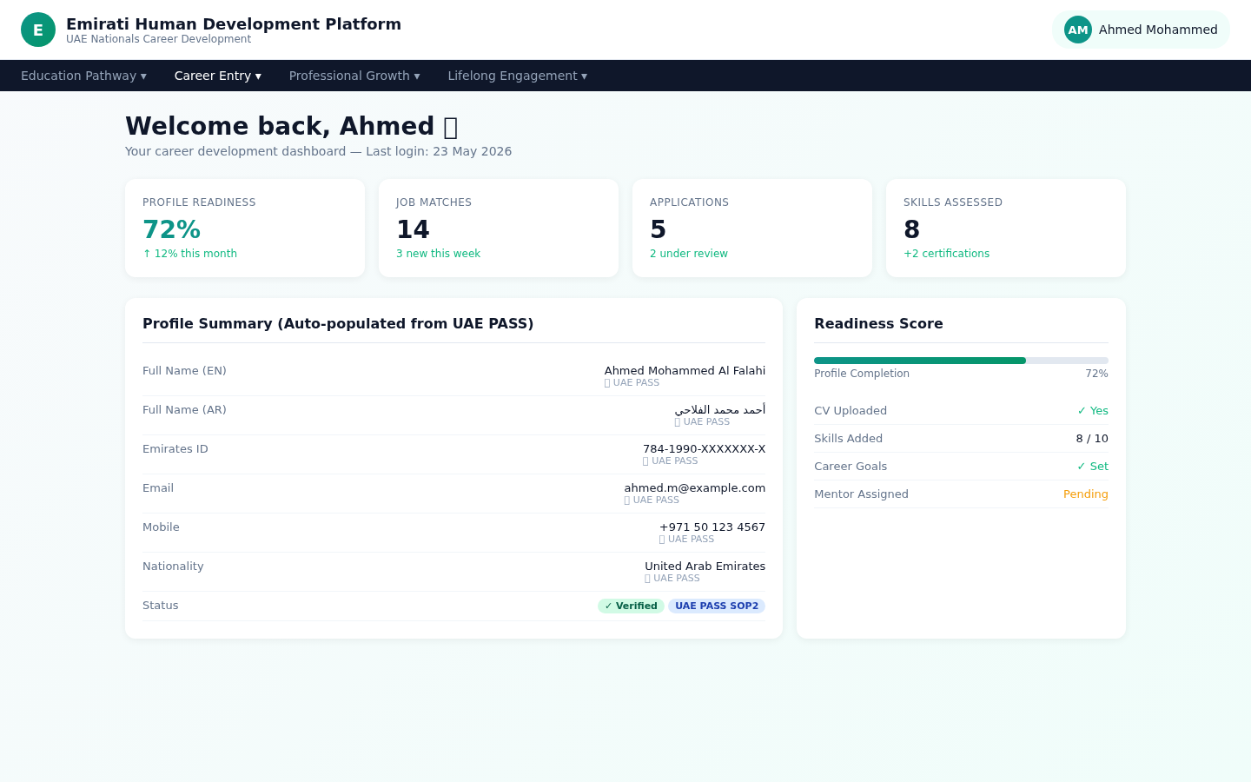
SOP2 scenario (If applicable)

Slide 9
SOP3 scenario
Not Applicable — Our platform uses SOP2, not SOP3.

Slide 10
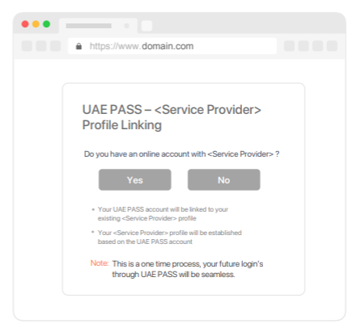
Manual linking page (if applicable)
Not Applicable — Account linking is fully automatic (UUID → Emirates ID → Email → Phone cascade).

Slide 11
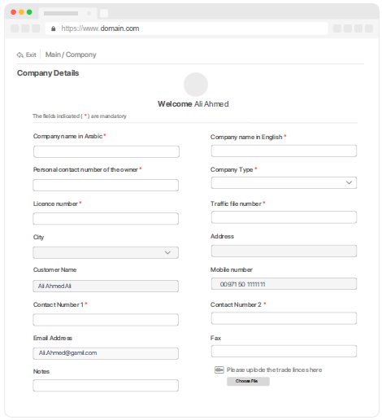
Manual linking (NO) scenario (if applicable)
Not Applicable — No manual linking rejection scenario. All linking is automatic.

Slide 12
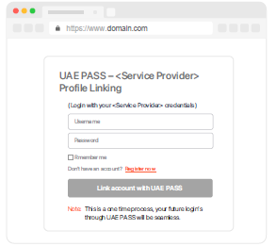
Manual linking (YES) scenario (if applicable)
Not Applicable — No manual linking acceptance scenario. All linking is automatic.

Slide 13
Only registration/Sign up Scenario (If applicable)
Not Applicable — Sign-in and Sign-up are unified via UAE PASS. New users are auto-registered on first login.

Slide 14
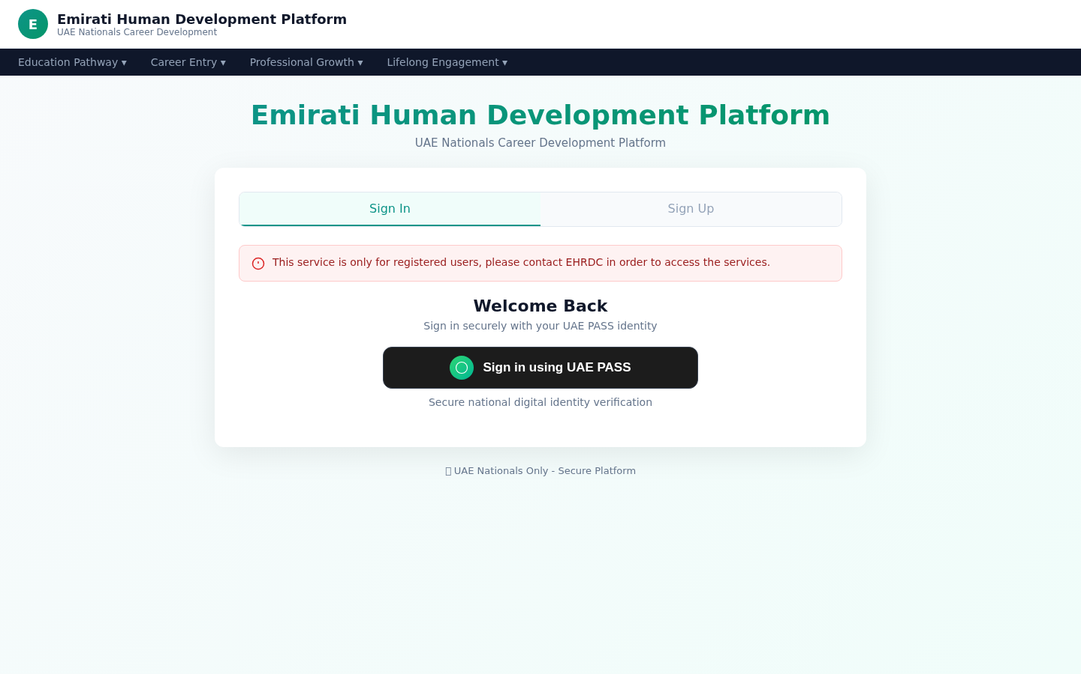
Error Handling Only existing users error message
This service is only for registered users, please contact EHRDC in order to access the services
هذه الخدمة مخصصة فقط للمستخدمين المسجلين، يرجى التواصل مع مؤسسة الإمارات لتتمكن من الوصول إلى الخدمات

Slide 15
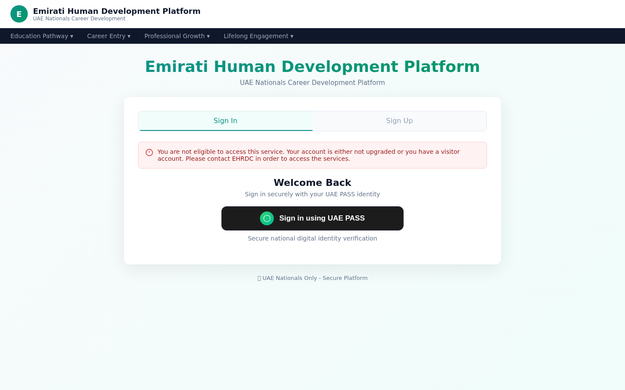
Error Handling Unverified user restriction
You are not eligible to access this service. Your account is either not upgraded or you have a visitor account. Please contact EHRDC to access the services.
أنت غير مؤهل للوصول إلى هذه الخدمة. إما أن حسابك لم تتم ترقيته أو لديك حساب زائر. يرجى الاتصال بـ مؤسسة الإمارات لتتمكن من الوصول إلى الخدمة.

Slide 16

Error Handling Something went wrong during the login
Something went wrong during the login, please try again later!
حدث خطأ ما أثناء تسجيل الدخول، يرجى المحاولة مرة أخرى لاحقًا!

Slide 17

Error Handling User cancel scenario
User cancelled the login
قام المستخدم بإلغاء تسجيل الدخول

Slide 18
Logout scenario

Slide 19
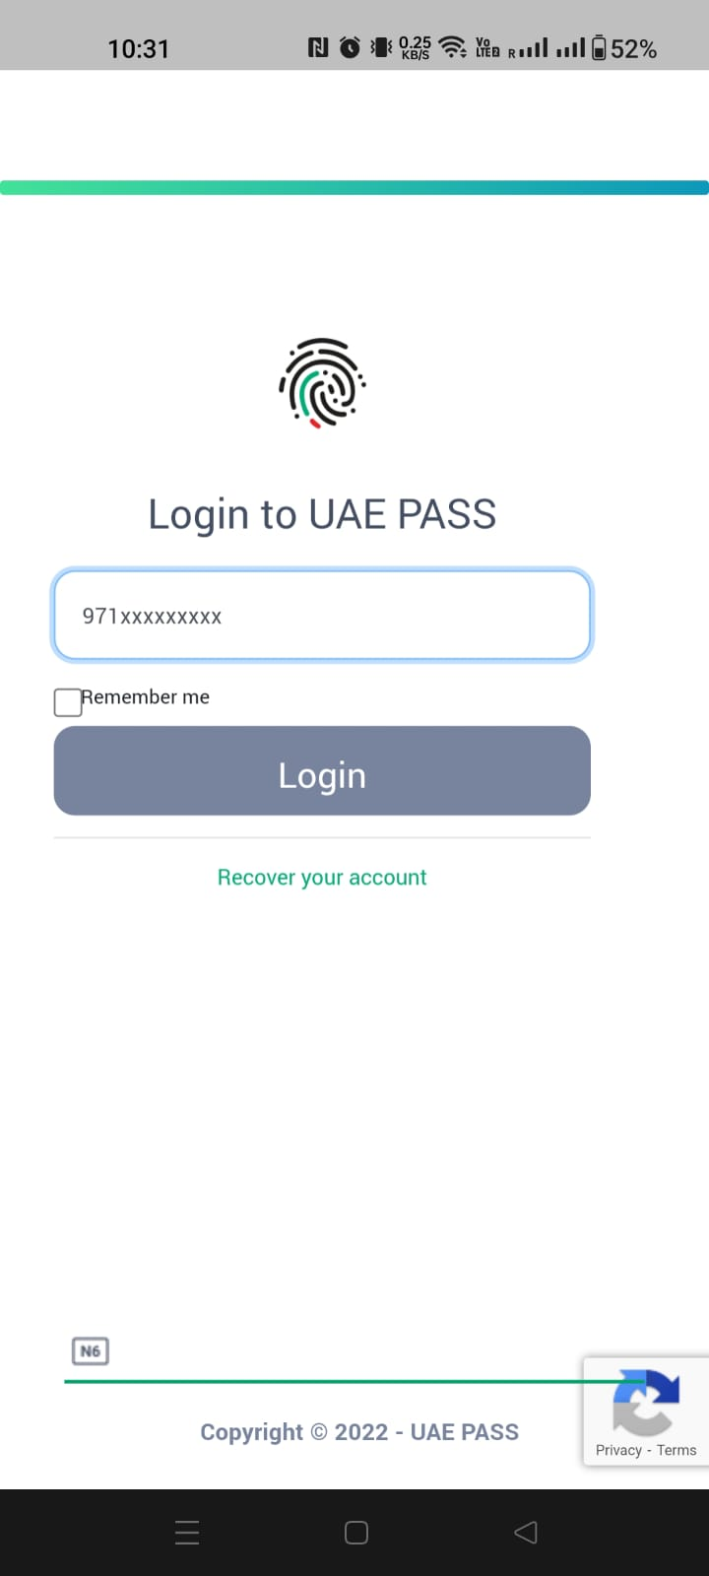
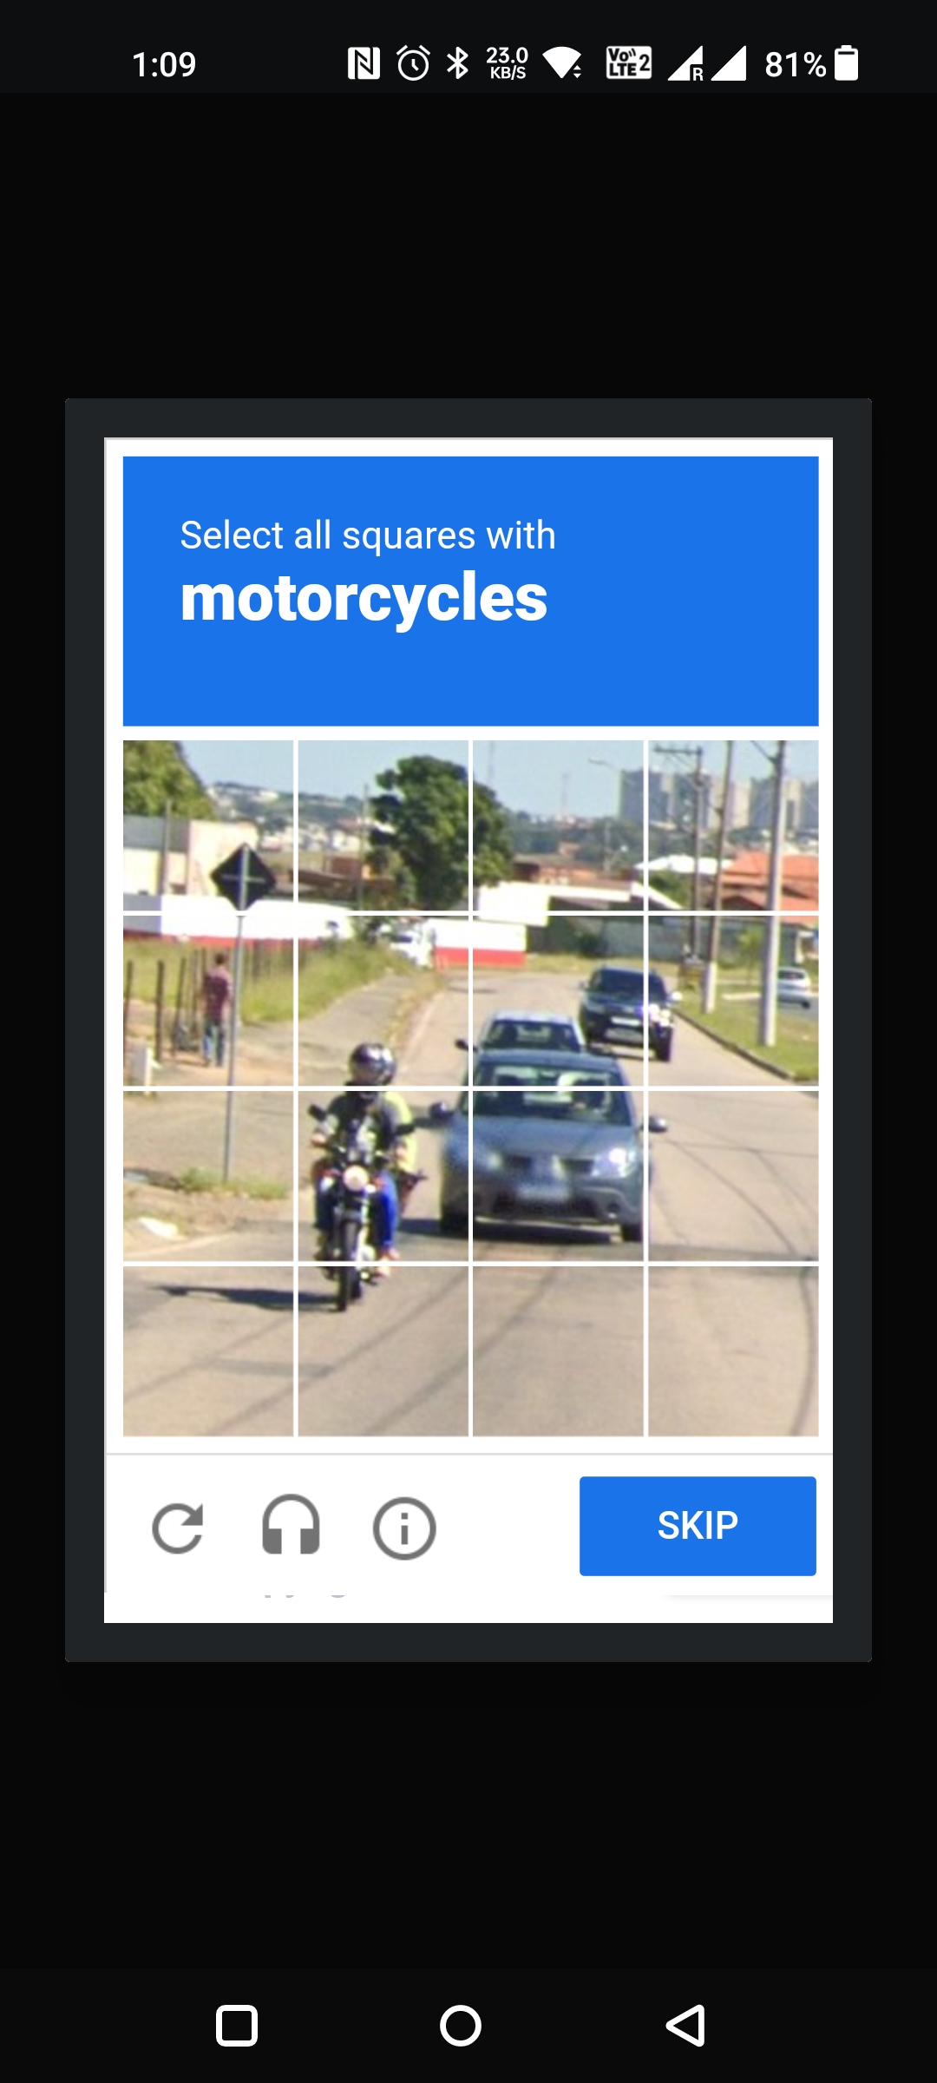
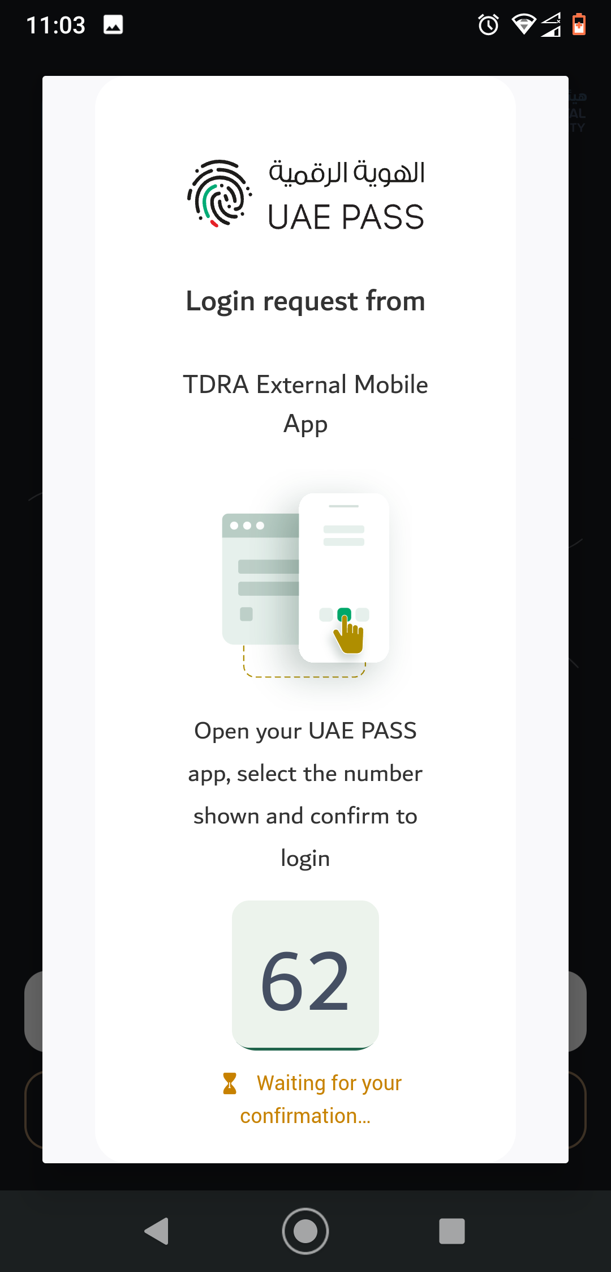
APP to WEB scenario (if mobile integration)
Please add your prototype into this placeholder

