Slide 1
Car Rental System
CPIT-305

Slide 2
CONT ENTS
Overview
Objectives
Interfaces

Slide 3
Overview
/ 01

Slide 4

Overview
We developed a car rental system to allow users to rent cars online using it and being able to choose
car type
date needed
and price according to your choice
Its a user-friendly application that can be used by customers to order online.

Slide 5
Objectives
/ 02

Slide 6

Objectives
Have a user-friendly interface
Add a login feature
Make a reservation feature
View available cars feature

Slide 7
Interfaces
/ 03

Slide 8
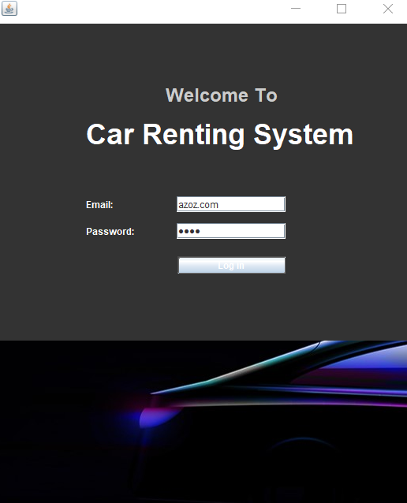
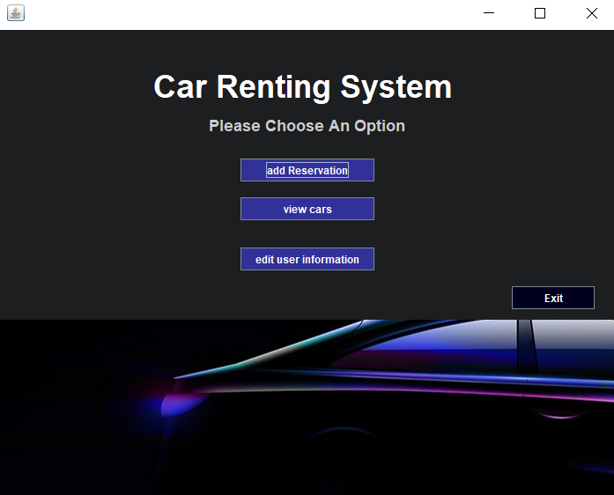
Interfaces

Slide 9
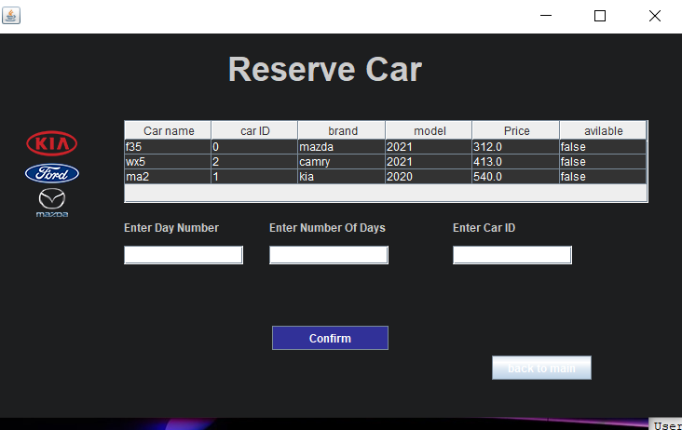
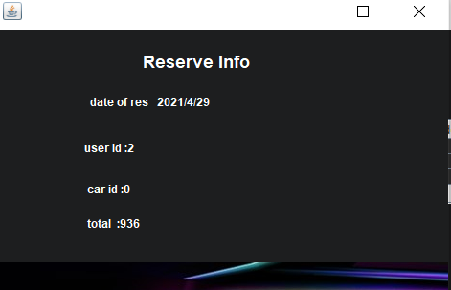
Interfaces

Slide 10
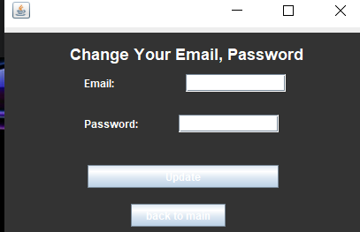
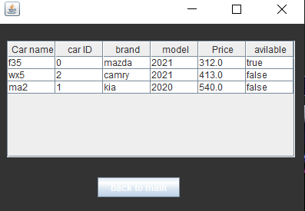
Interfaces

Slide 11
Thanks For Listening

