Slide 1
بسم الله الرحمان الرحيم

Slide 2
CMS:
Title
Complaint Management System

Slide 3
Group Members
Abdulaziz Ansari (2k16/BLCS/2)
Muhammad Saleh (2k16/BLCS/2)

Slide 4
Problems
Student needs to go to the respective office for a tiny issue
It takes so much time for new students to become familiar with the environment of university.
They face many problems like, Electricity Issues, water issues and they don’t know where to go to submit the queries
Lets suppose if a student goes to the respective office and he founds no faculty, the student feels embarassed for being admitted in the uni

Slide 5
Objectives
The main purpose of our project is to serve the students.
It will be helpful for every student to submit their queries within few seconds.
The project is divided into two parts, first is User area and the second part is Admin area
User can submit any kind of issue he face in university in no time.
Admin has all the privileges to maintain the complaints and users

Slide 6
Thank You:
If you have questions just ask.

Slide 7
Tools
HTML
CSS
Bootstrap
jQuery
Ajax
PHP
MySQL

Slide 8
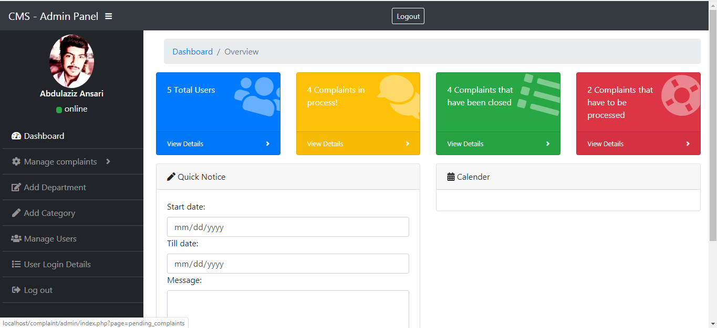
Project is divided into two parts
Admin

Slide 9
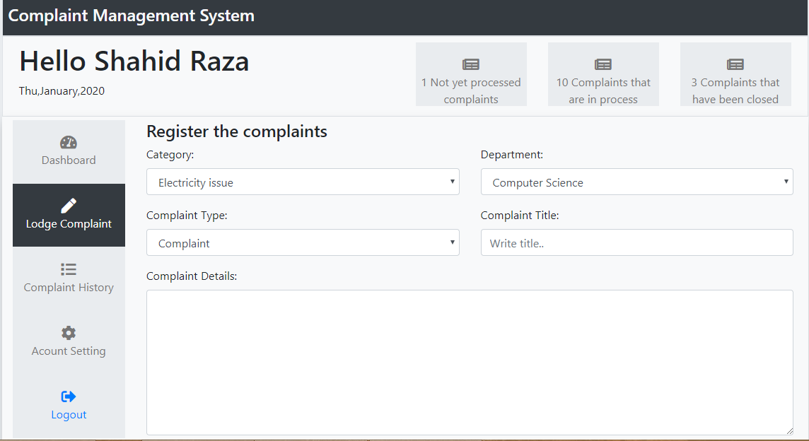
Project is divided into two parts
User

Slide 10
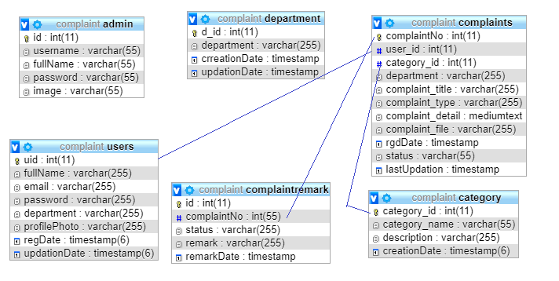
Database Relation

