Slide 1
T U WAIQ T 0 5 1 3
01
NBA DRAFTED

Slide 2

02
Simple way:
PICKING A PLAYER
HARD WAY :
The NBA draft is an annual event dating back to 1947 in which the teams from the National Basketball Association (NBA) can draft players who are eligible and wish to join the league. These are typically college basketball players, but international players are also eligible to be drafted
WHAT is NBA draft
T U W AIQ T 0 5 1 3

Slide 3
What is
Purpose of this project?
03
GOALS
predict what pick a player should be taken
HELPING THE NBA LEAGUE
eliminate bad picks as much as possible
HELPING PLAYERS
what skill should they focus on to get drafted
T U W AIQ T 0 5 1 3

Slide 4


04
the work flow
LOOKING FOR A SPARK
EDA
find a topic
feature engineering
T U W AIQ T 0 5 1 3
WEEK 1
WEEK
2
WEEK
3
WEEK 4
looking for data set
cleaing data
MODEL

Slide 5
05
Dataset
FEATURES AS FOLLOWS (SOME)
it's a data set that takes college player stats from 2009 to 2021
having more than 20+ thousand data points(rows)
POINTS
YEAR OF COLLEGE GAMES PLAYED TEAM
CONF
T U W AIQ T 0 5 1 3

Slide 6



06
Cleaning Process
negative VALUES
Removing it all
duplication
removing it all
Marketing Strategy | Fiscal Year 2020
drop null values
pick =>1
taking only players who got picked

Slide 7
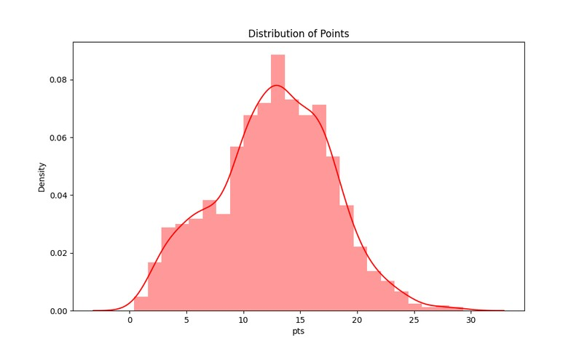
07
some of the finding
points Distrbution
T U W AIQ T 0 5 1 3

Slide 8
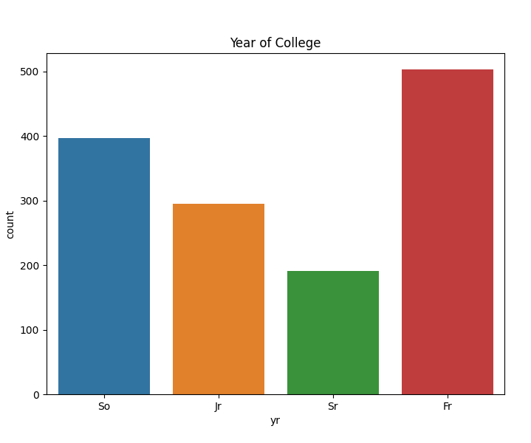
08
some of the finding
college year count
T U W AIQ T 0 5 1 3

Slide 9
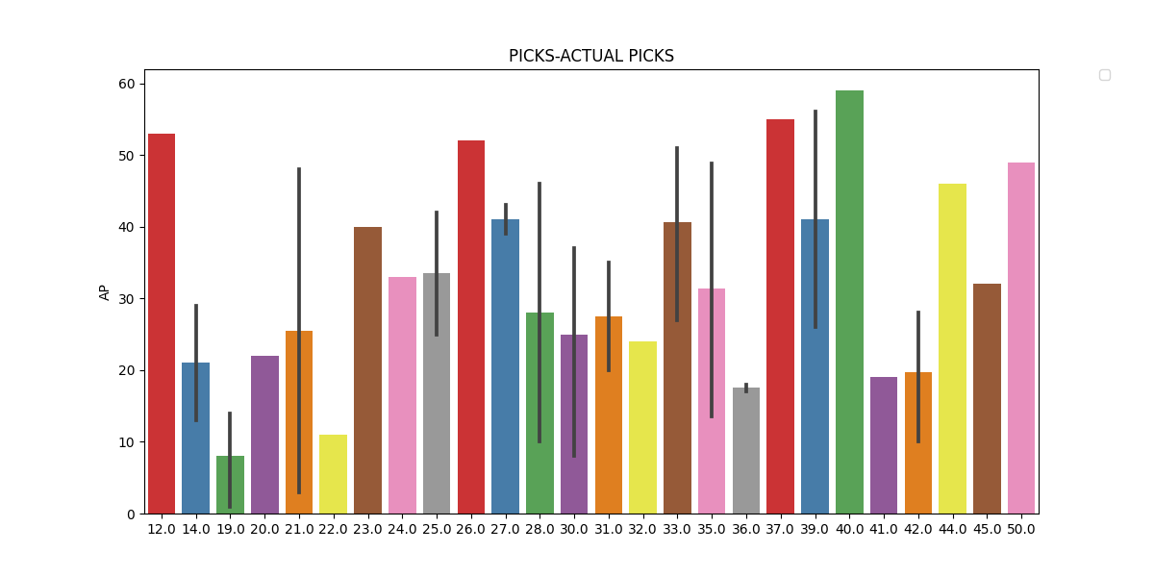
09
model 1
T U W AIQ T 0 5 1 3
using DecisionTreeRegresso

Slide 10
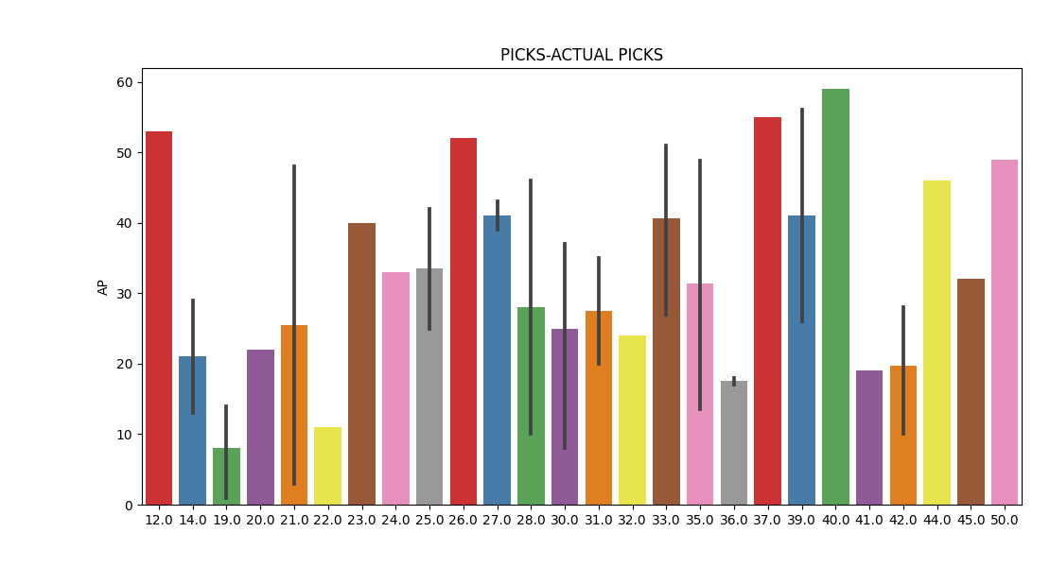
10
model 2
T U W AIQ T 0 5 1 3
using Gboost

Slide 11

future work
11
and closign
IN THE END
in the future, I would like to incorporate the players' NBA data in order to predict stats such as winshares or PER based on college stats
but for true improvement to this model I need to find the right combination of statistics to use.
Also, for this to actually be useful, I would like to extrapolate this to an NBA
T U W AIQ T 0 5 1 3

Slide 12

12
Thank you!
FOR THIS JOURNEY
T U W AIQ T 0 5 1 3

