Slide 1
OneUp
September 20, 2017
Khiem Lu, Justin Lee, Abdulaziz Asiri

Slide 2
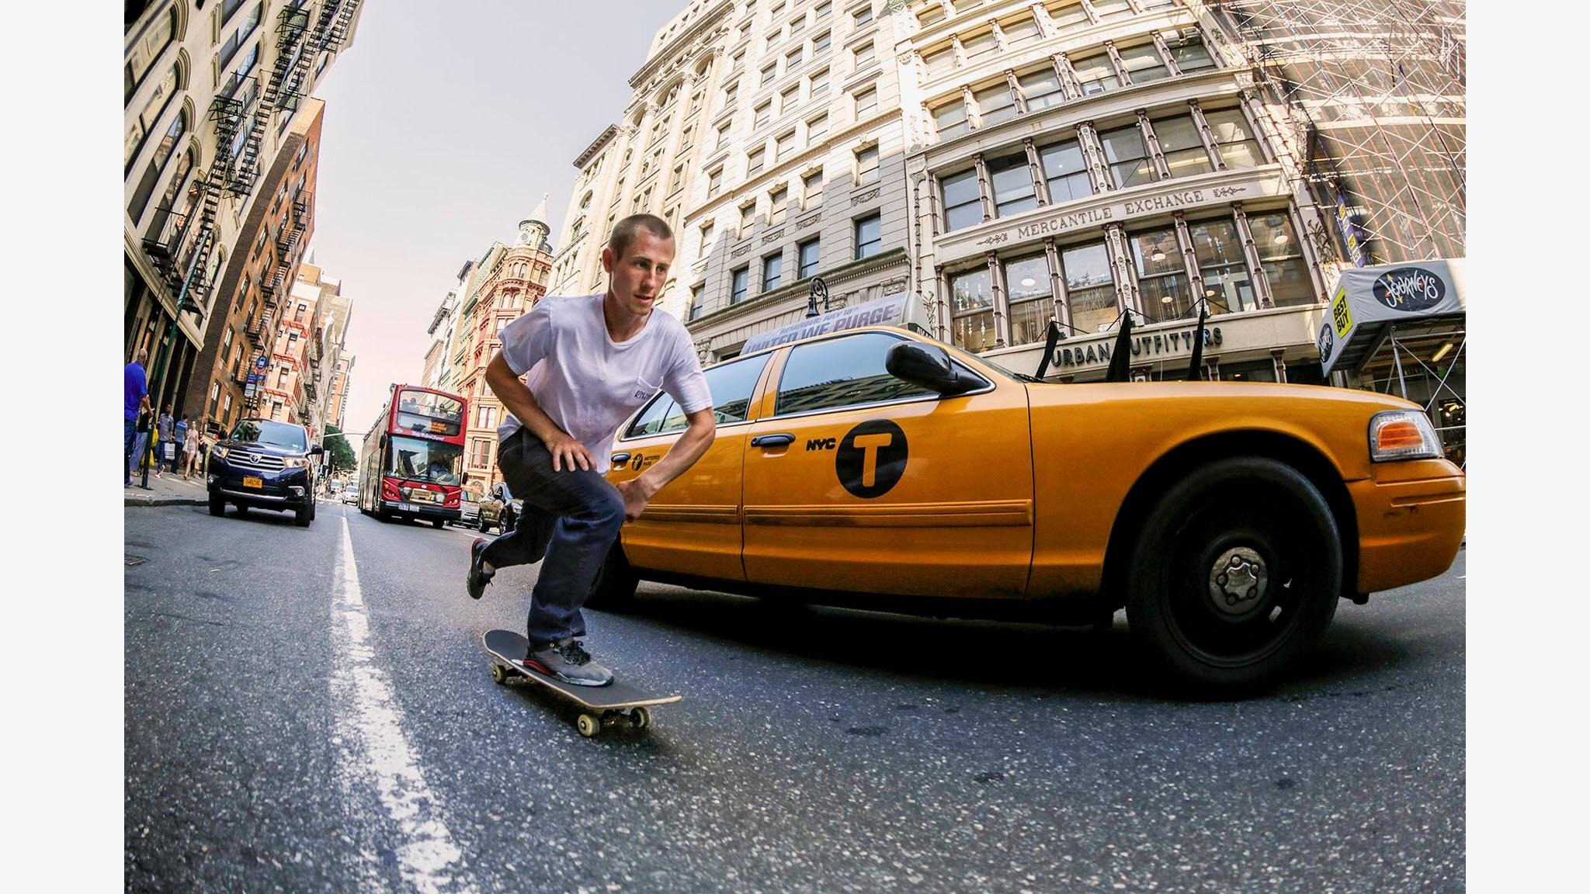
Background
Skateboarding is its own culture
Large & unique community with little innovation
Main problem: Recognition
Notes:
Skaters hold contests for giveaways, can we make this something where pro skaters can have people submit their videos there.

Slide 3
The Idea
Web application that aims to expose young skateboard talent through crowdsource curation
Video database of user uploaded skate clips that are curated by upvotes/downvotes
Space for skaters to surface up democratically
Space for anyone to enjoy top skate videos
Notes:
Refer back to how we won’t be disrupting the skate tradition
Complements how skating will change in the future -- not disrupt it

Slide 4
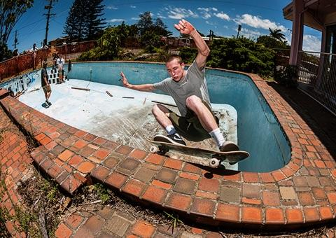
Project objective:
To create a space where skaters can surface up democratically, powered by those who know and love skating

Slide 5
Reasoning & Justification
Targeting the right demographic
Meaningful and feasible for length of semester
Little experience creating a full stack web application
Notes:
Meaningful: believe can gain traction because of how tight knit the skate community is
Team of 3
How skateboarding is traditional.

Slide 6
Features
Various databases for categories of skating
User profile of uploaded & upvoted videos
Ability to share videos
Notes:
User has own page and how they interact with site --- emphasize importance of user profile

Slide 7
Approach
Three-tier web application architecture
React.js
Node.js
MongoDB
Notes:
Explain 3 tier architecture -- front end, web server, backend -- react, mongo, node.js
Explain vague approach
Explain why we plan to use react and mongo

Slide 8
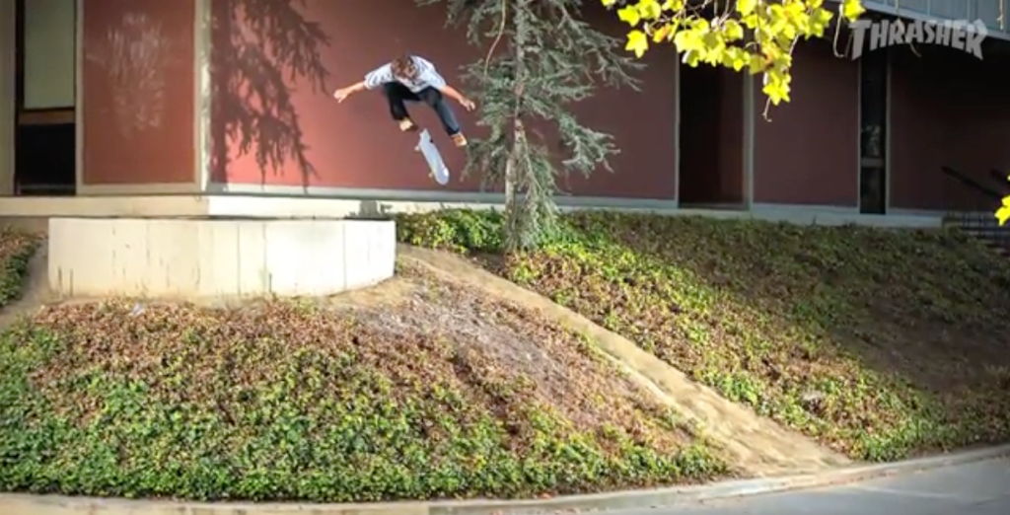
Conclusion
We believe if OneUp is implemented correctly, it can impact the skate community in a great way.
Roles on the Proposal
We all worked on everything together for the most part
Khiem: Idea
Justin: Justification
Aziz: Technicalities
Notes:
Skating is traditional

