Slide 1
DIY Machine Learning A quick intro and implementation of ML solutions Abdul Baruwa

Slide 2
Agenda
Background

Slide 3
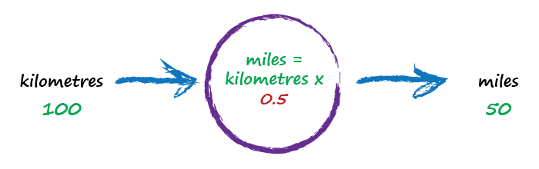
Metric to Imperial Conversion

Slide 4
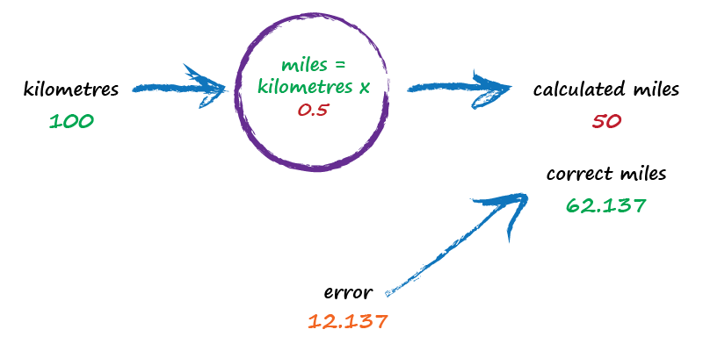
Metric to Imperial Conversion

Slide 5
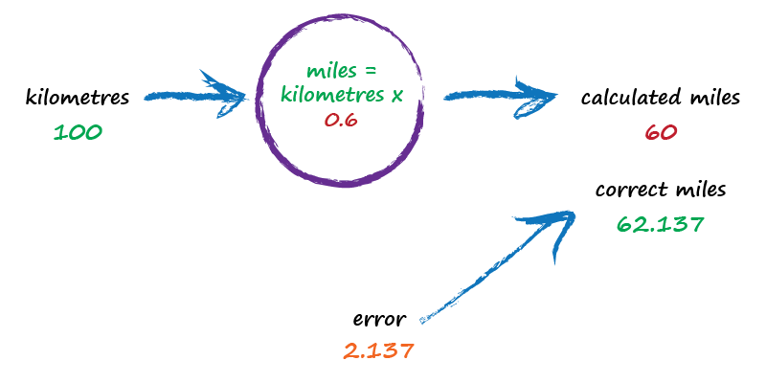
Metric to Imperial Conversion

Slide 6
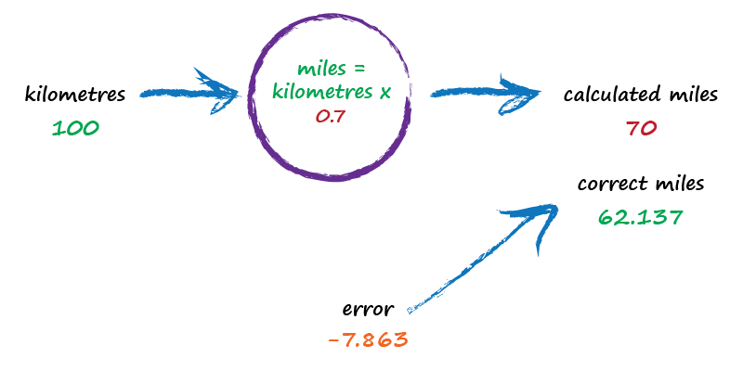
Metric to Imperial Conversion

Slide 7

Metric to Imperial Conversion

Slide 8
Metric to Imperial Conversion
Basic idea:
Not sure how to do something? Try a model with adjustable
Parameters
Use the error to refine parameters

Slide 9
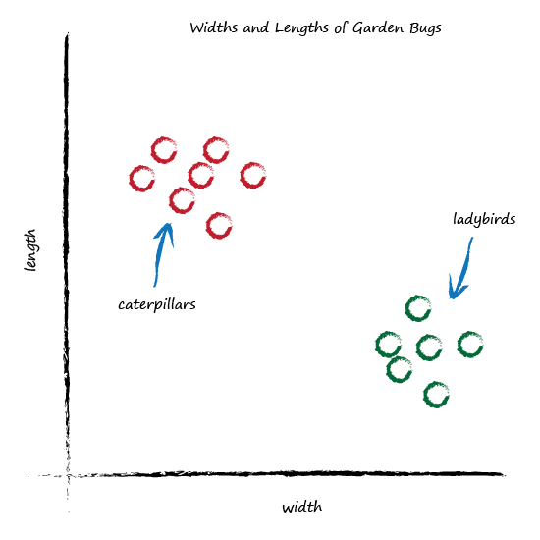
Bugs

Slide 10
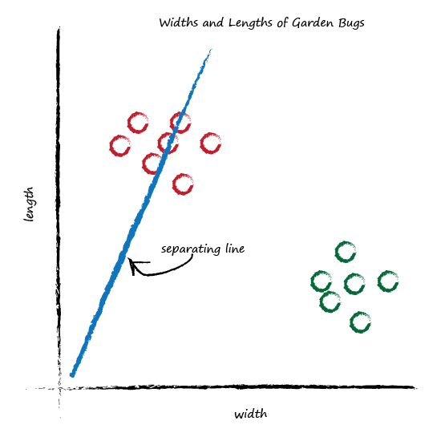
Classifying

Slide 11
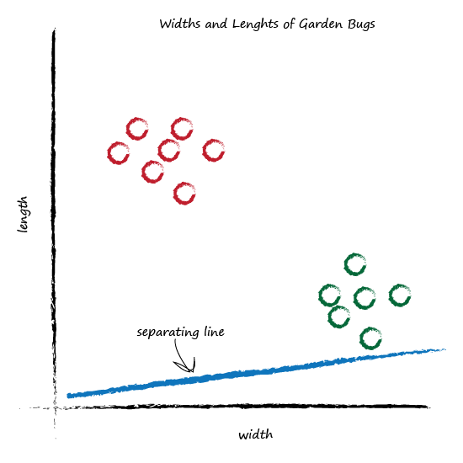
Classifying

Slide 12
Classifying

Slide 13
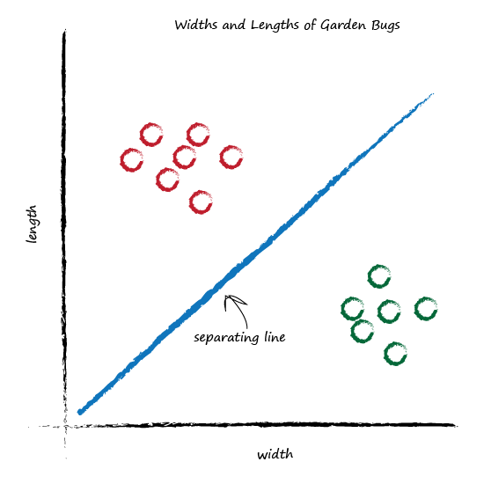
Classifying

Slide 14
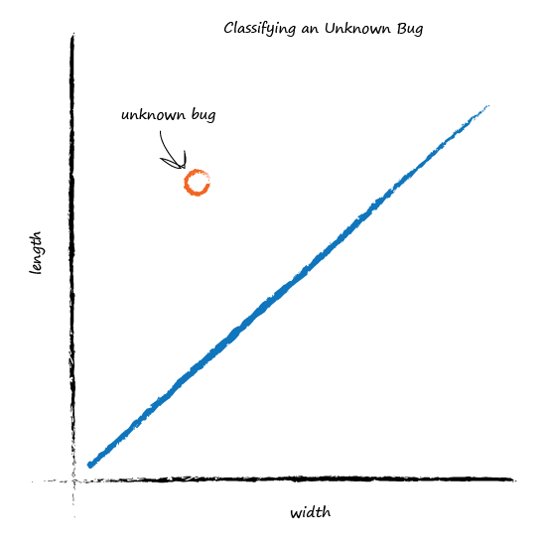
Classifying

Slide 15
Classifying
Classifying is just Prediction

Slide 16
Learning from data
Example | Width | Length | Type
1 | 3.0 | 1.0 | ladybird
2 | 1.0 | 3.0 | Caterpillar

Slide 17
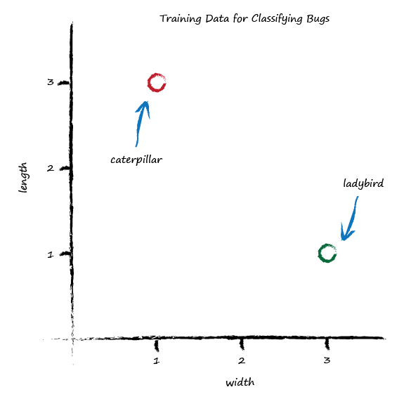
Metric to Imperial Conversion

Slide 18
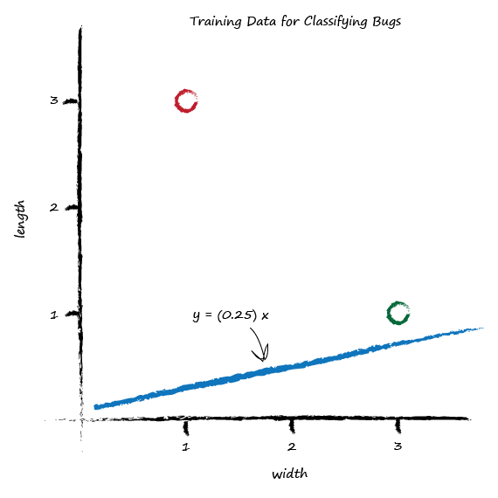
Metric to Imperial Conversion
not a good separator

Slide 19
Metric to Imperial Conversion
shift the line up
just above the training data point

Slide 20
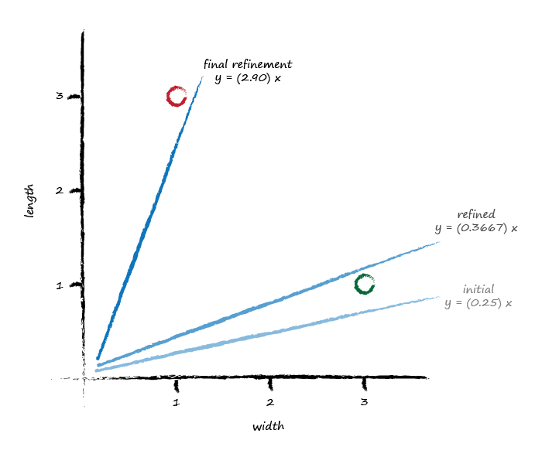
Metric to Imperial Conversion

Slide 21
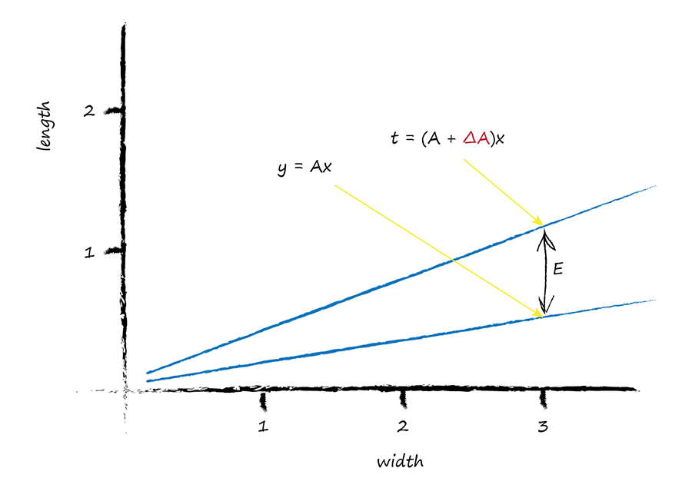
How to update the parameter
error = target - actual
E = (A + ΔA)x - Ax
ΔA = E / x

Slide 22
Metric to Imperial Conversion
Oh no!
each update ignores
previous examples

Slide 23
Metric to Imperial Conversion
ΔA = L · (E / x)
learning rate

Slide 24
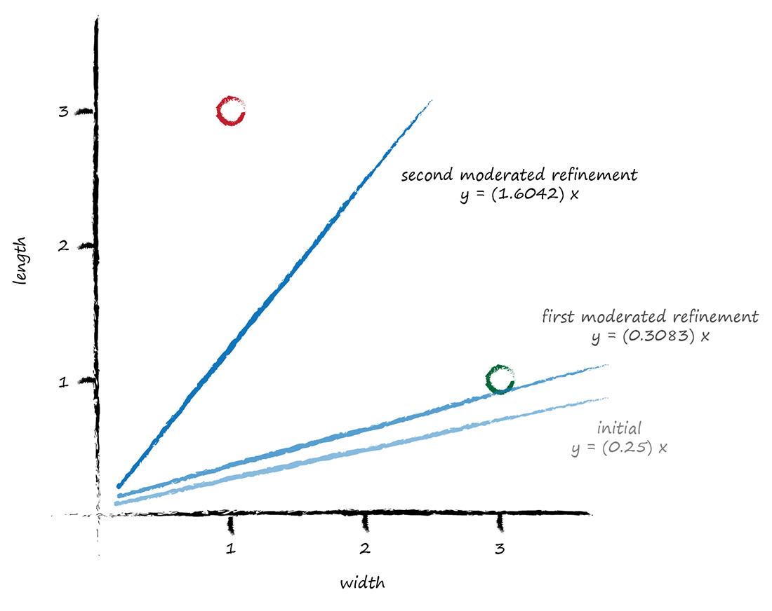
Calm down the learning rate
learning rate = 0.5

Slide 25
Key Points
Moderating learning
ensures you learn from the data
Reduces impact of outliers and noisy data

Slide 26
Boolean logic
Some problems cannot be solved by simple linear classification
But, we know you can use multiple nodes working together to solve such problems.

Slide 27
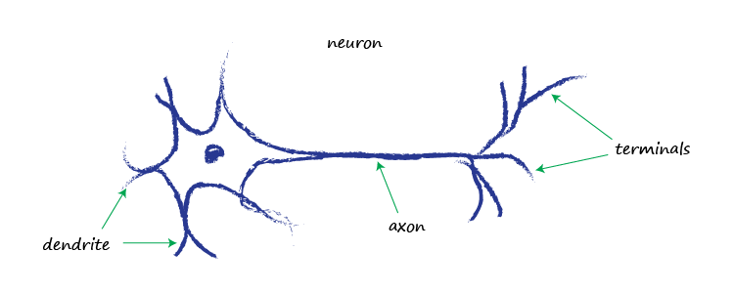
Brains in nature
Notes:
Neurons, Nature’s Computing Machines
Architectural different
* Computes processed data sequentially and pretty concrete terms
* Animals brains though slower could process signals in parallel, fuzziness was feature of their computation.

Slide 28
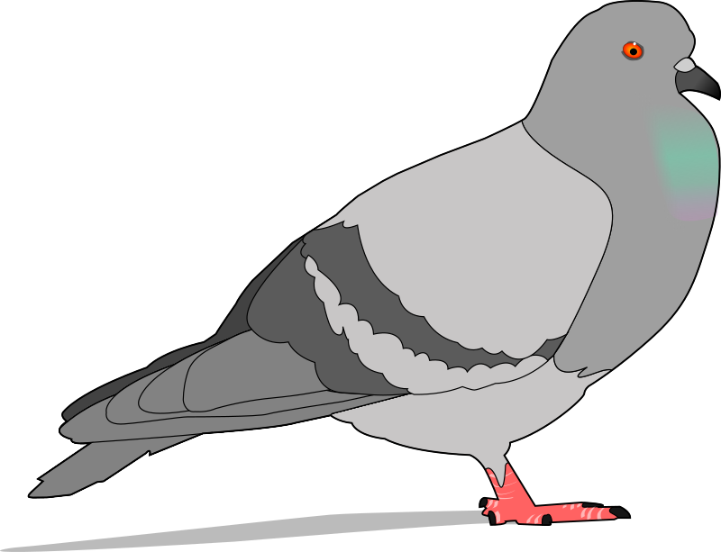
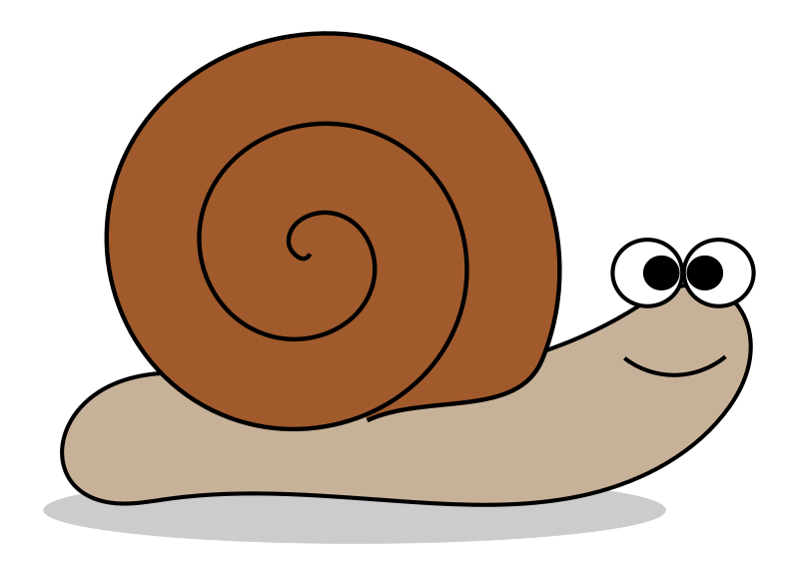


Brains in Nature
brain 0.4 grams
11,000 neurons
nature’s brains can eat, fly, navigate, fight, communicate, play, learn …
.. and they’re resilient
302 neurons
37 billion neurons
(humans 20 billion)
https://en.wikipedia.org/wiki/List_of_animals_by_number_of_neurons
https://faculty.washington.edu/chudler/facts.html
Notes:
Basically transmit electrical signal from one end to another. From dendrite along axons to terminal.
How many neurons are needed to perform complex tasks?
a. nematode : 302
b. Fruit fly: 100,000
c. Human: 100 billion
a & b whilst within the realms of human computing (as per complexity) are still able to perform complex feats like flying and evading prey (fruit fly)

Slide 29
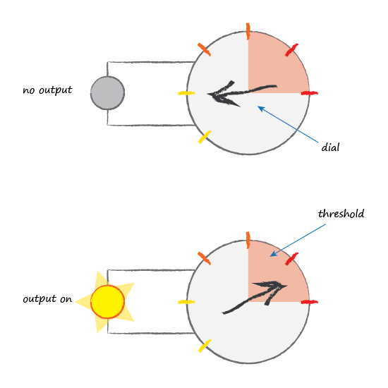
Brains in Nature
Notes:
What is the Secret?
From what we now know. From observations neurons appear to suppress input until it has grown so large that it triggers an output. (I.e a threshold that must be reached before an output is produced)
Fig 1. Neuron threshold
Activation
Mathematically, a function that takes input signal and generates an output signal taking into account some kind of threshold is called an “Activation” function.
There loads of the activation functions.

Slide 30
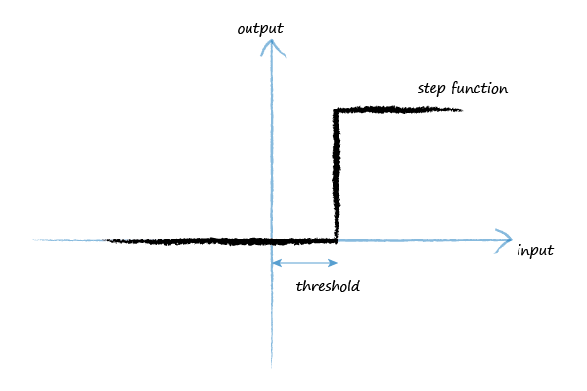
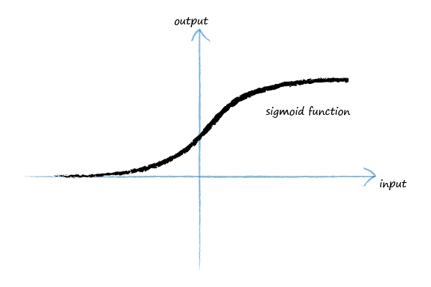
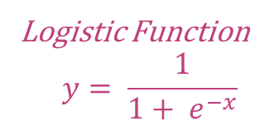
Brains in Nature
Logistic Function
$$y= \frac{1}{1+ e^{−x}}$$
Notes:
S-shaped sigmoid is a common activation function used in AI research.
There are others like “ReLU” etc outside of the scope of an intro talk on ML.
Mathematically it is just the logistic function
e is a mathematical constant = 2.71828

Slide 31
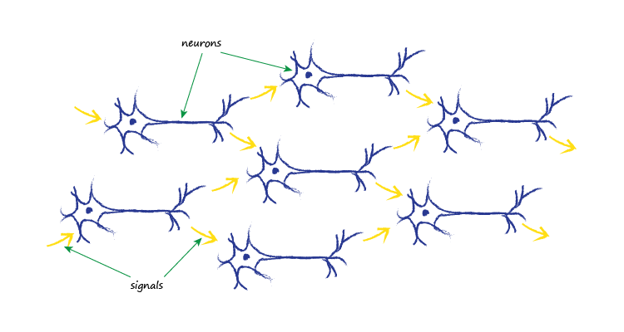
Brains in Nature
Notes:
In nature, real biological neurons take many inputs. Each neuron takes input signals from many other neurons and provide signals to many other neurons.

Slide 32
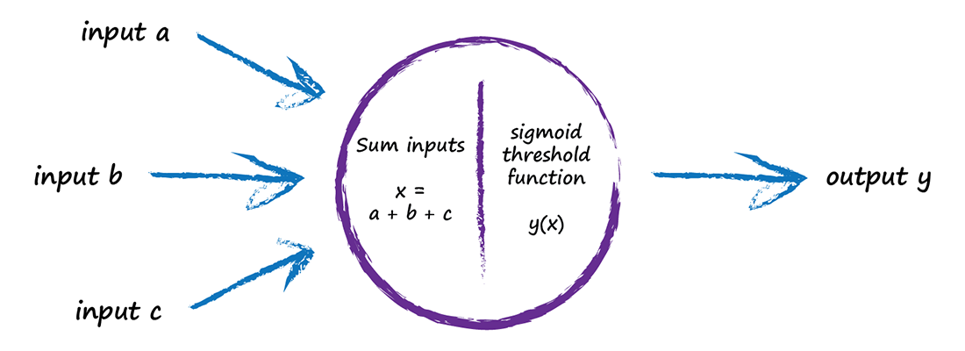
Artificial Neuron
Notes:
So how do we model a neuron artificially.
Given biological neurons take many inputs, so what do we do computationally to model a neuron.
We combine the input signals by adding them up. The resulting sum is then passed in the sigmoid “Activation2 function which ultimately controls the output.

Slide 33
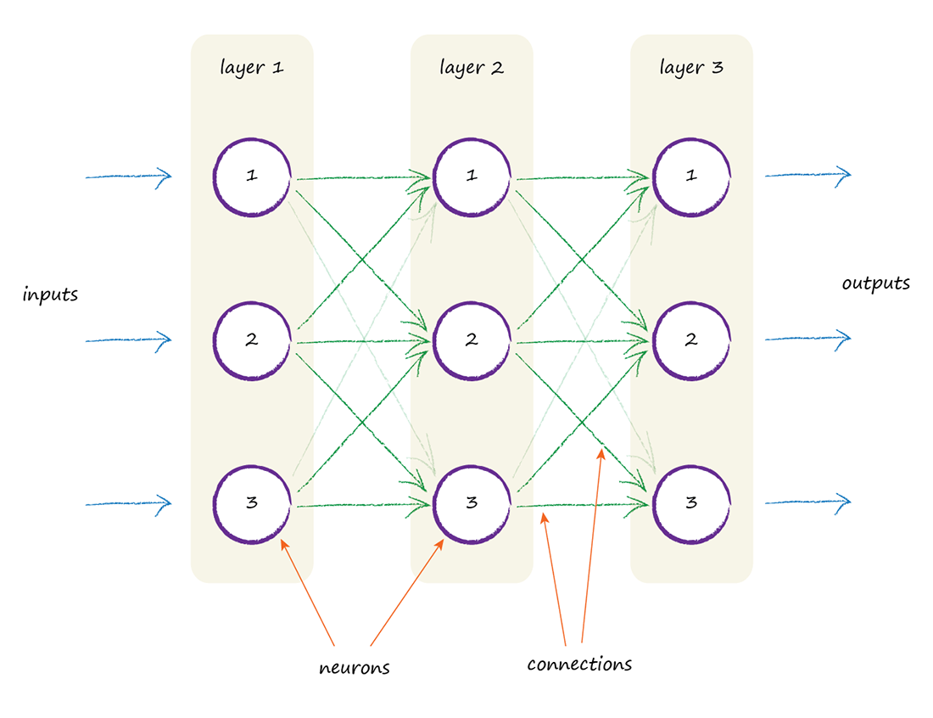
Artificial Neural Network .. finally!

Slide 34
Pause – catch breadth

Slide 35
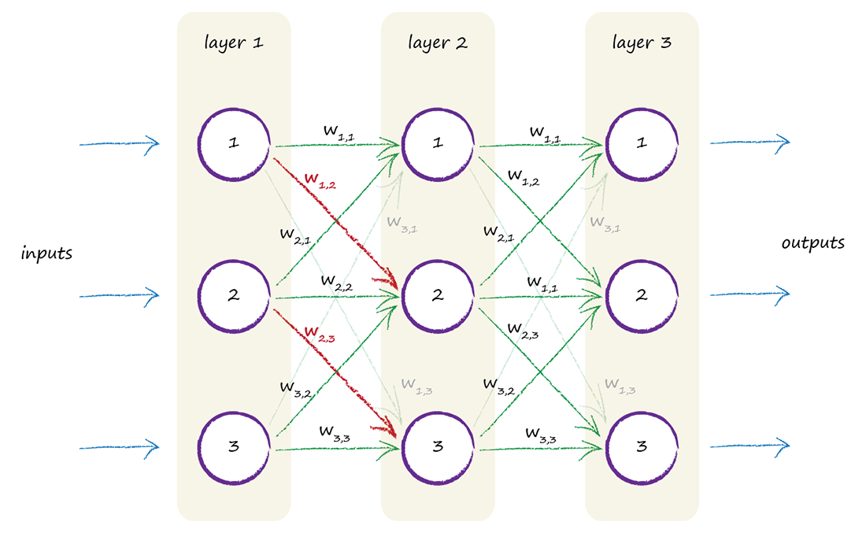
Where Does The Learning Happen?
link weight?
sigmoid function slope?

Slide 36
Metric to Imperial Conversion

Slide 37
Key points
Obviously brains can do sophisticated stuff,
Incredibly resilient to damage and imperfect signals (Unlike traditional computing)
Artificial Neural Networks are partly inspired by biological brains
Link Weights are the adjustable parameter – It is where the learning happens

Slide 38
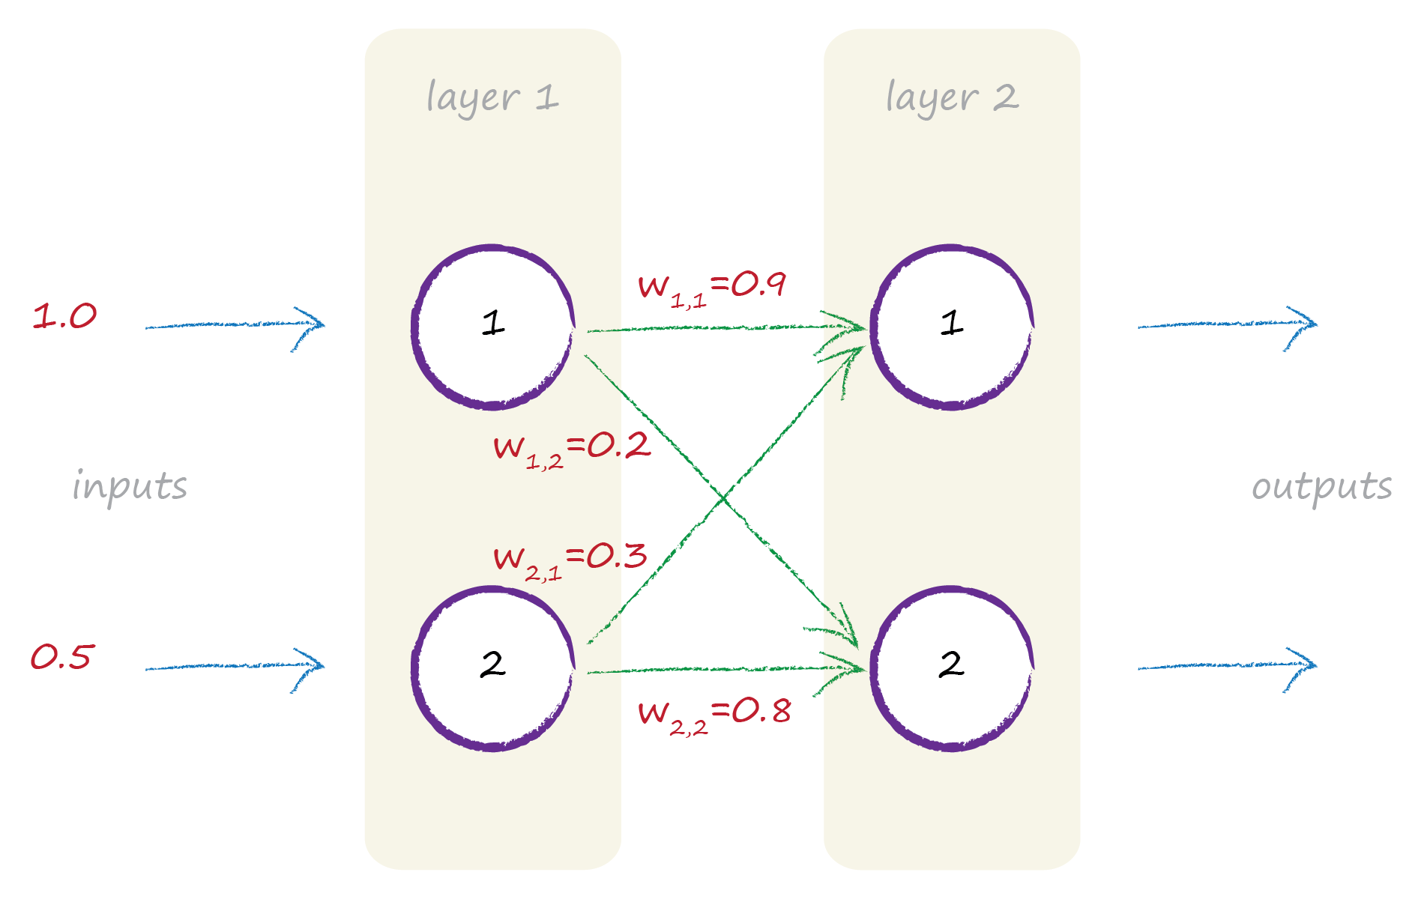
Feeding Signals Forward

Slide 39
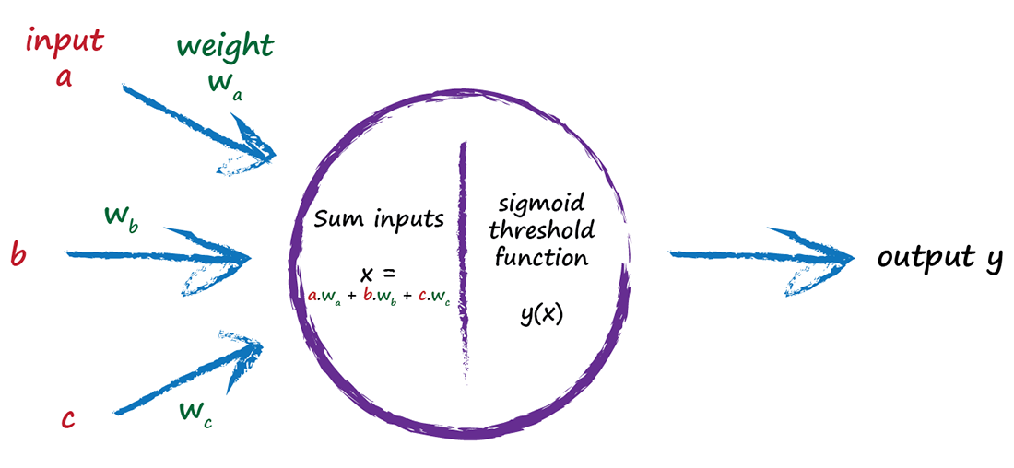
Feeding Signals Forward

Slide 40
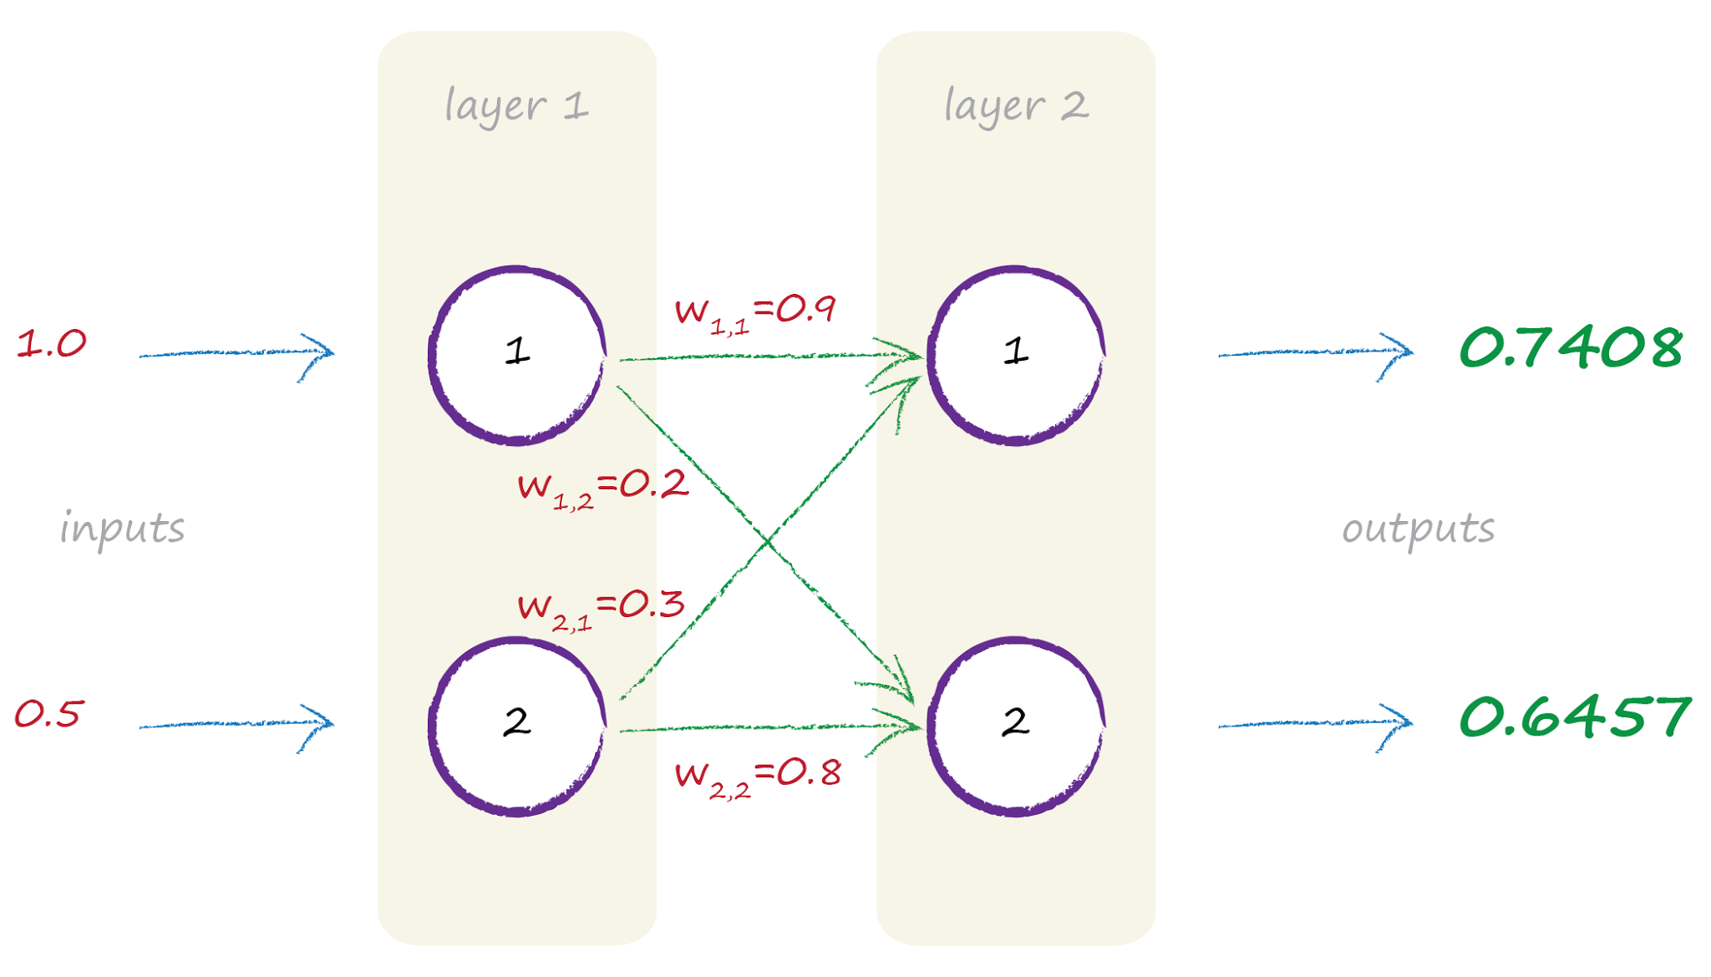
Feeding Signals Forward

Slide 41
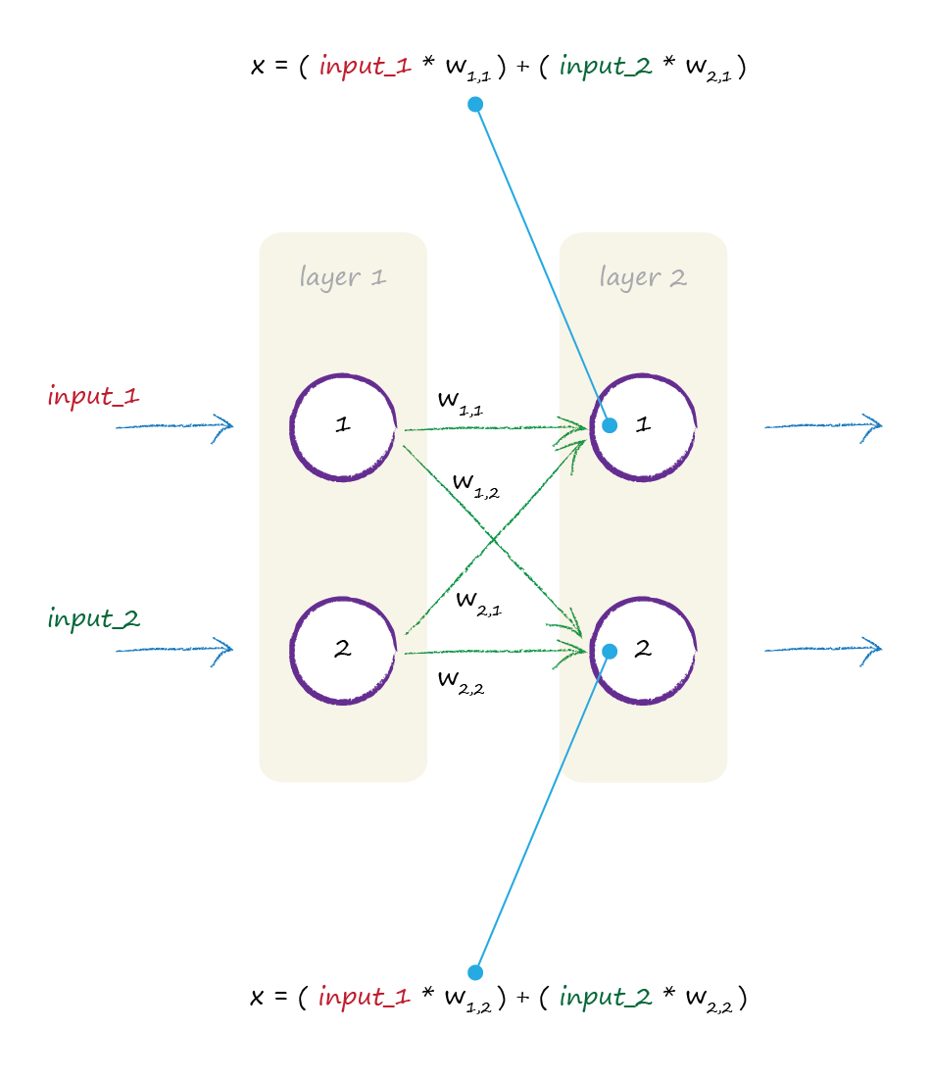
Matrix Multiplication

Slide 42
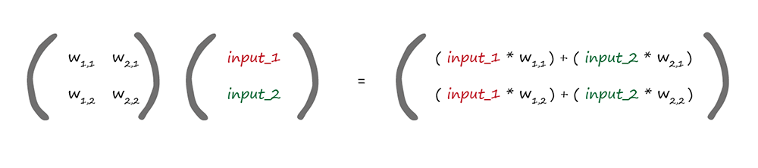
Matrix Multiplication
weights
incoming signals
W·I = X
dot product

Slide 43
The feed forward calculations can be expressed concisely as a matrix multiplication, no matter the shape and size of the network
The choice of languages here matters. (technically libraries) for efficient and quick matrix and linear algebra functions

Slide 44
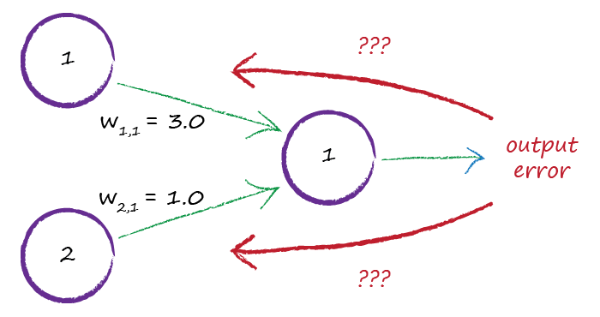
Network Error

Slide 45
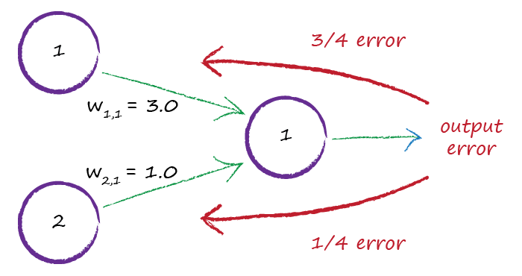
Network Error

Slide 46
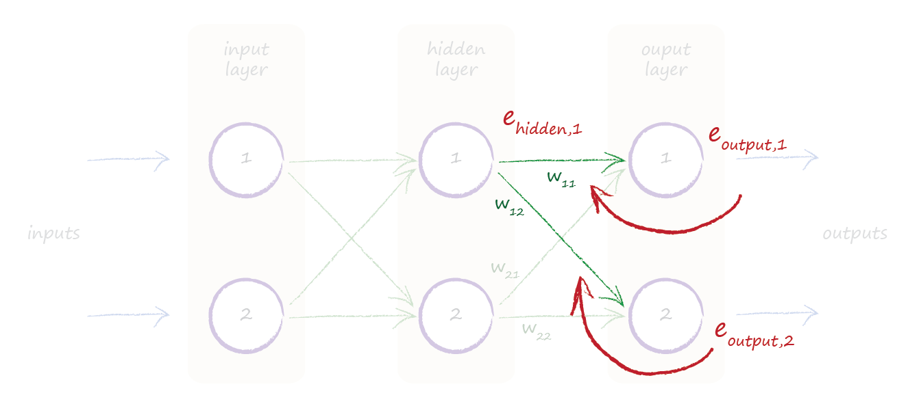
Internal Error

Slide 47
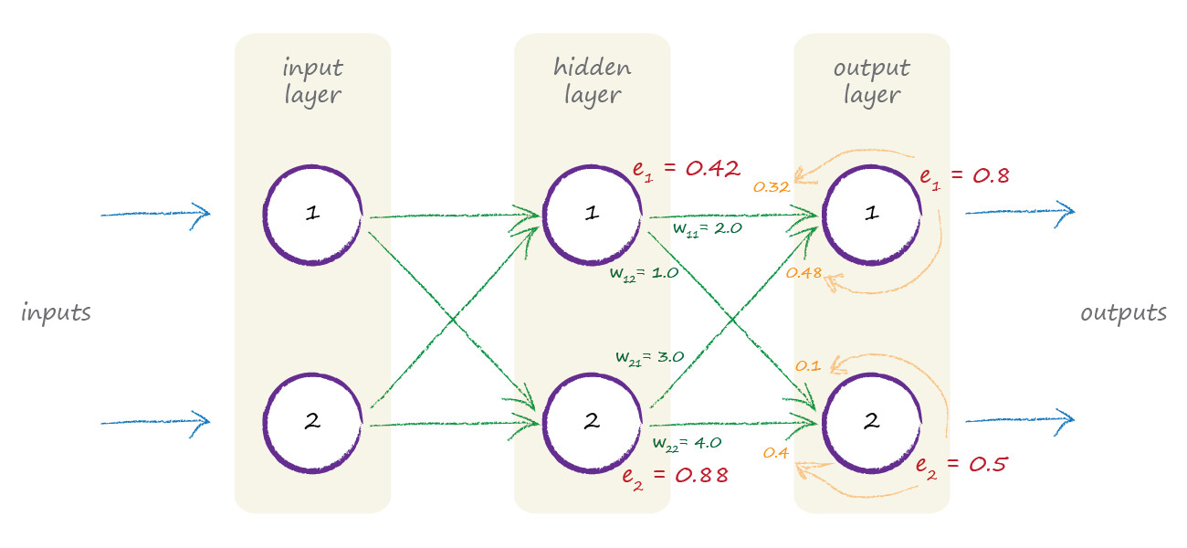
Internal Error

Slide 48
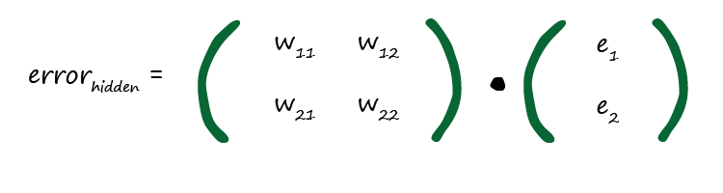

Matrices Again!

Slide 49
Key Points
We use error to guide how the model’s parameter (link weights) are refined
The error at the output nodes is the difference between the desired and actual outputs
The error at internal nodes is not that obvious. A heuristic approach is to split in proportion to the link weights
Back propagating the error can be expressed as a matrix multiplication

Slide 50
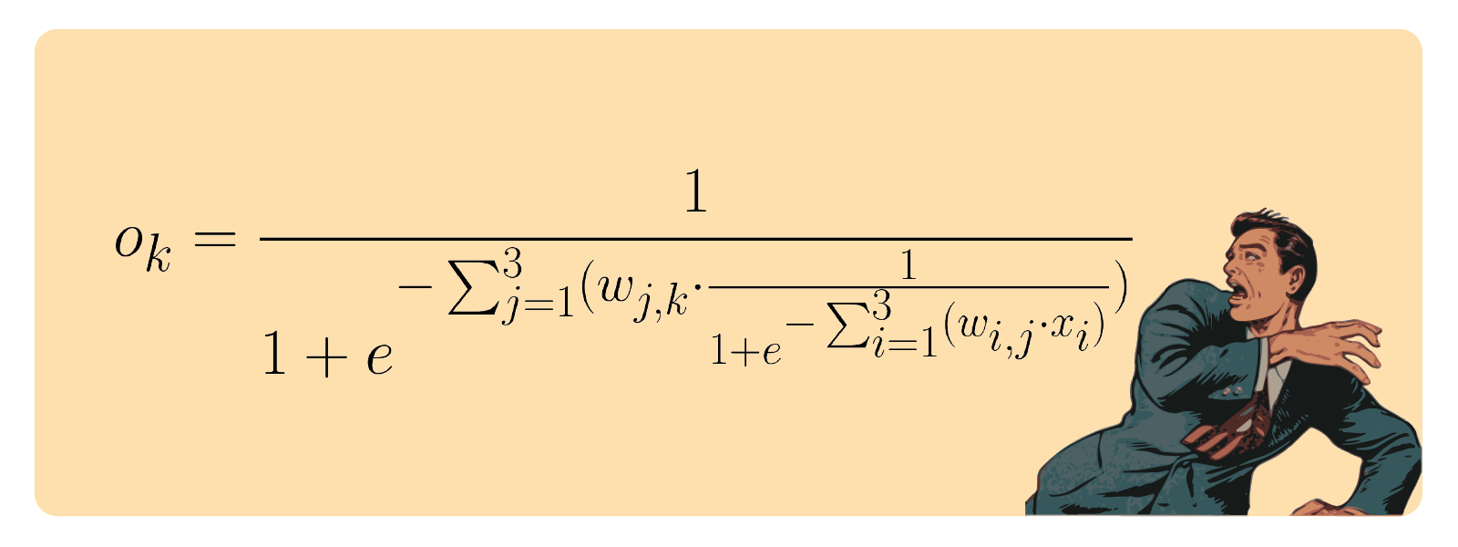
Yes, But How Do We Actually Update The Weights?
Urgh per node!!

Slide 51

Perfect is the Enemy of Good
landscape is a complicated difficult mathematical function ..
… with all kinds of lumps, bumps, kinks …

Slide 52
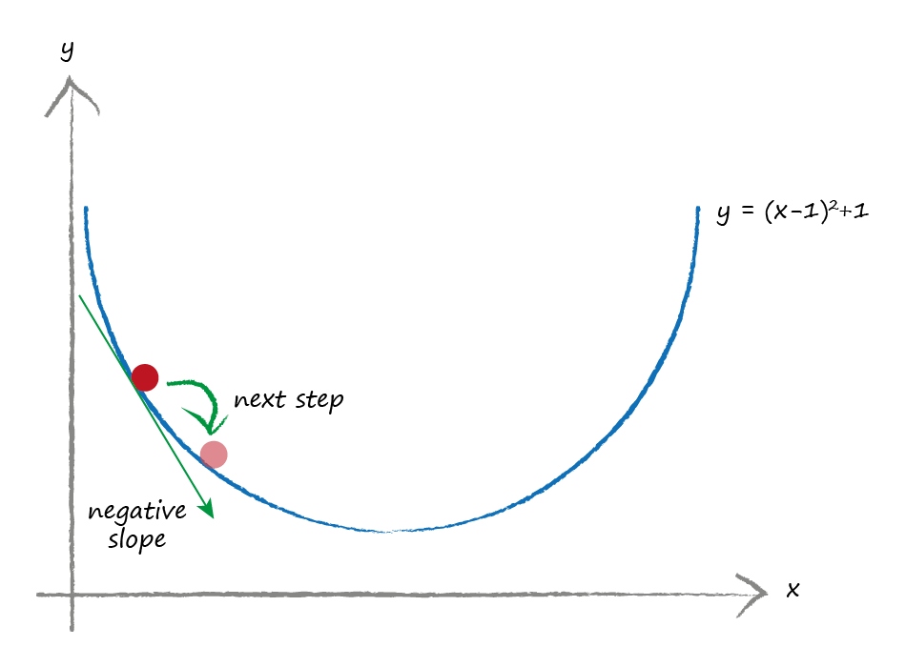
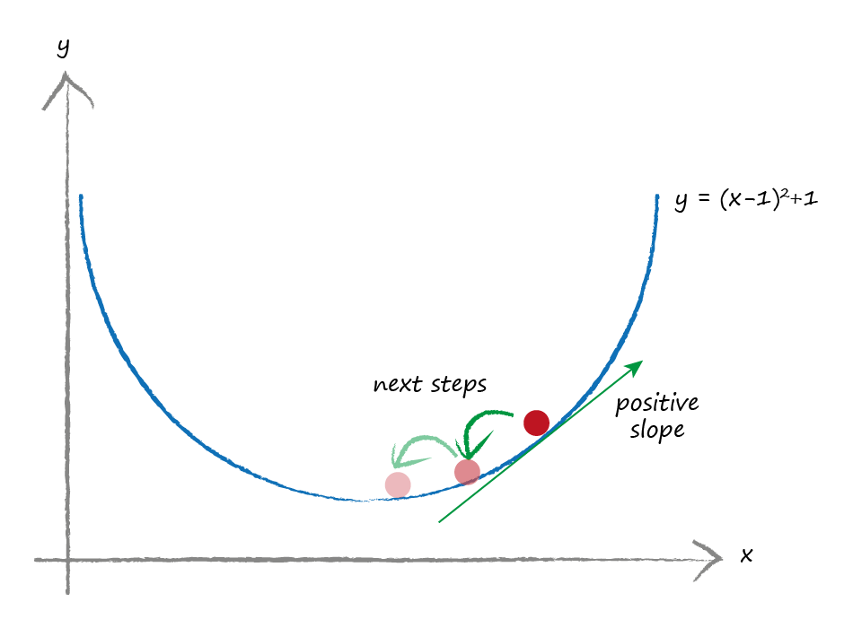
Gradient Descent
smaller gradient .. you’re closer to the bottom … take smaller steps?

Slide 53
Gradient descent is a practical way of finding minimum of difficult functions
You avoid the chance of overshooting by taking smaller steps if the gradient gets shallower.
The error of a neural network is a difficult function of the link weights.. Gradient descent can help.

Slide 54
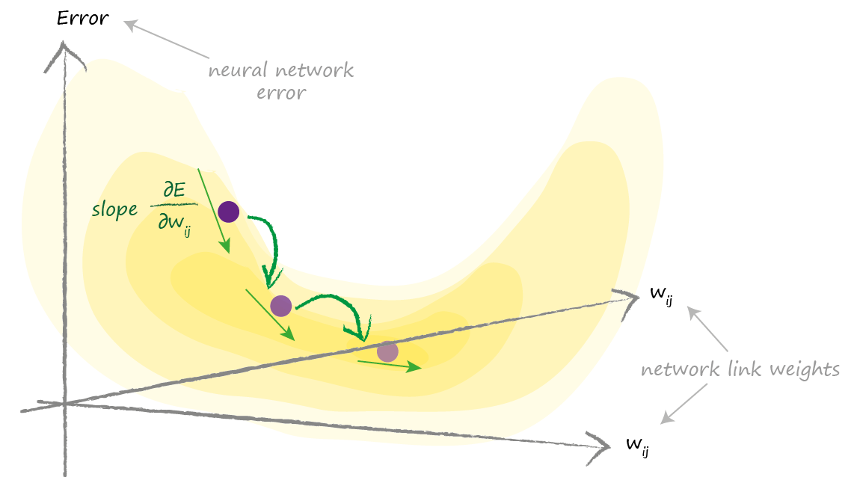
Climbing Down the Network Error Landscape
We need to find this gradient

Slide 55

Error Gradient
E = (desired - actual)²
school level calculus (chain rule)
dE/dw_{ij} = - e_{j} . o_{j} . (1 - o_{j}) . o_{i}
previous node
A gentle intro to calculus
http://makeyourownneuralnetwork.blogspot.co.uk/2016/01/a-gentle-introduction-to-calculus.html

Slide 56
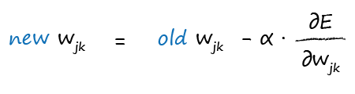
Updating the Weights
move w_{jk} in the opposite direction to the slope
remember that learning rate

Slide 57
Show me the CODE Abs!

