Slide 1
Stationary Managment
Introduction To Computer Science - LAB
1st Semester Project

Slide 2
—Steve jobs
"Innovation distinguishes between a leader and a follower.“

Slide 3
Meet Our Team
Member 1
Member 2
Member 3

Slide 4
Welcome

Slide 5
Table of contents
01
02
03
05
06
07
04
Abstract
Objectives
Project Scope
Main Features
08
System Design
Projects ERD
SWOT
Reference

Slide 6
01
Abstract
..

Slide 7
Abstract
The Stationery Management System is a comprehensive solution designed to automate key operations in a stationery shop. It handles inventory management, sales tracking, supplier information, and order processing. The system helps maintain accurate stock levels, track sales trends, manage supplier details, and streamline the process of order management. Built using Microsoft Access, the project leverages its relational database capabilities to create a seamless workflow. The goal is to minimize manual errors, improve decision-making with generated reports, and enhance operational efficiency by simplifying day-to-day operations.

Slide 8
02
Objectives
..

Slide 9
The objectives of this project are
Automate Inventory Management:
Streamline Sales Processes
Minimize Manual Errors
Optimize Stock Tracking
Improve Operational Efficiency
Provide Data Insights
User-Friendly Interface

Slide 10
Challenges Making Database
1. Data Integrity
Ensuring correct and consistent data
.
2. Database Normalization
Minimizing joblessness and ensuring efficiency. ..
3. Scalability
Designing to handle growing data volume.
4. Security
Protecting sensitive data with proper access control.
5. Performance Optimization
Enhancing query performance for large data sets.

Slide 11
03
Project Scope
..

Slide 12
Scope of the Project
Included
Excluded:
Managing inventory (add, update, delete stock).
Generating invoices.
Maintaining supplier records.
Generating sales and stock reports.
Advanced predictive analytics for sales trends.
A UI/UX Design
Mobile application support.

Slide 13
By using this Database
1. Not Using MS Acces
20%
When only relying on ancient method, the output can be low
2. Basic Technique of MS Acces
43%
When Using the Beginners knowledge of MS Excess productivity can reach upto 43%
3. Full Command Over MS Access
91%
When Using the Full extent of MS Excess and Database Output can be 91%

Slide 14
04
Main Features
..

Slide 15
Main Features
Quires
Search for items by category, stock levels, or price
Reports
Inventory/ supplier Management
Add, update, delete, and view stock items.
Generate reports for sales, stock levels, and supplier data.
Sales Management
User / Customer Records
Maintain details of customer and users for better services
Record customer purchases and generate invoices

Slide 16
05
System Design
..

Slide 17
The Flow of Project
Item Table
Attributes include ItemID, Name,
Category, Price, and StockQuantity
Sales Table
Suppliers
Attributes includes SaleID, ItemID, Date, Quantity, TotalPrice)
Attributes includes SupplierID, Name, Contact, SuppliedItems
Reports
Quries
Sumarrizes Sales and Inventory
Filters the database as per the user requirements

Slide 18
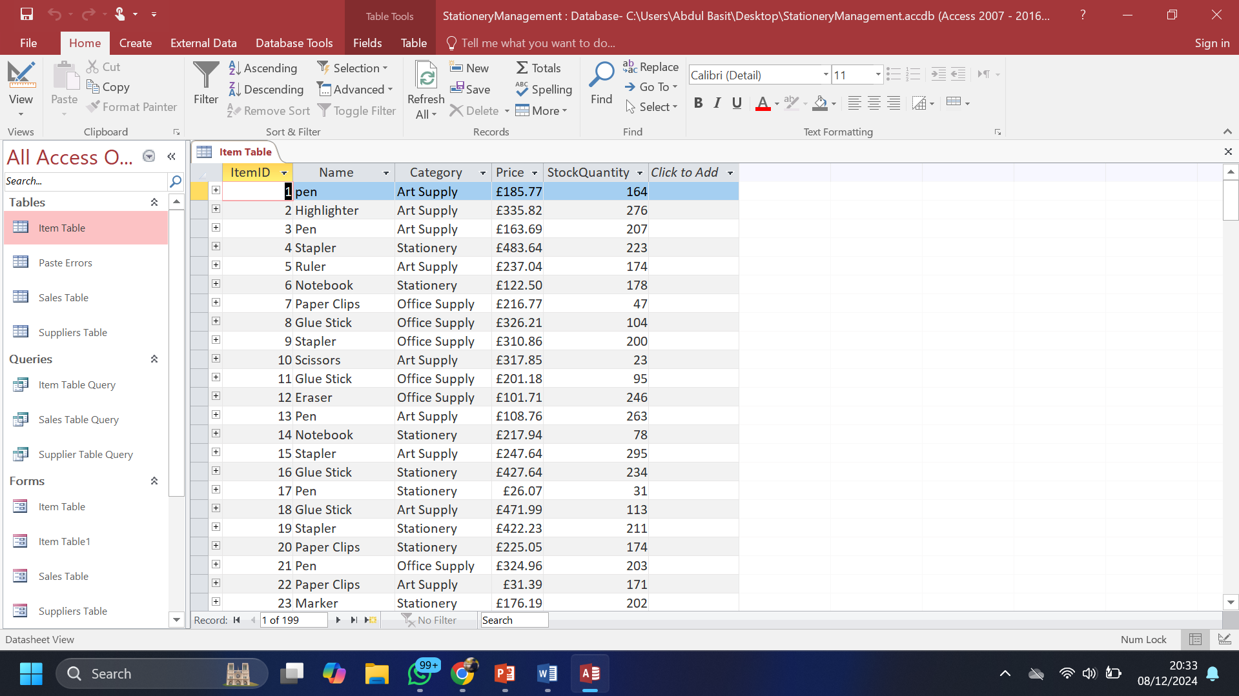
Database Management
Use of MS- Access to maintain Database and provide user with required outputs and filters

Slide 19
06
Project ERD
Entity Relationship Diagram

Slide 20
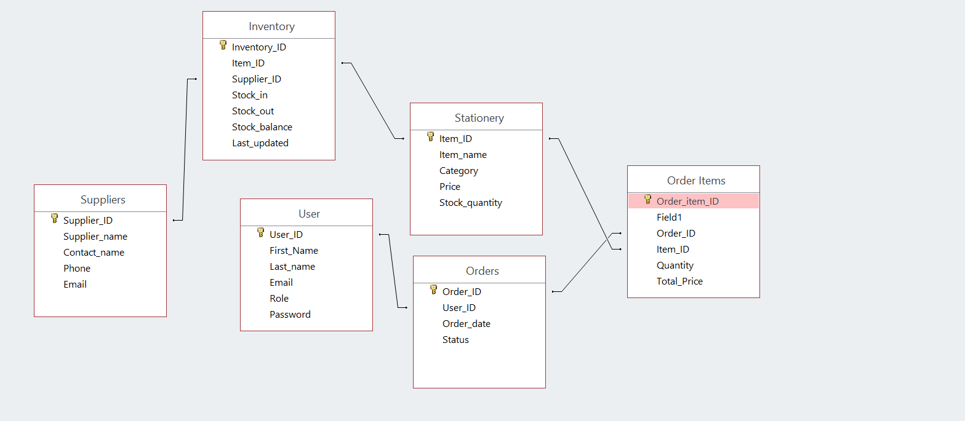

Slide 21
Primary Keys
Foreign Key
Common Relationship
UserID, OrderID, SupplierID, ItemID, InventoryID, OrderItemID.
UserID, OrderID, SupplierID, ItemID.
One – TO - Many

Slide 22
07
S.W.O.T
Strengths, Weaknesses, Opportunities, and Threats

Slide 23
S.W.O.T
Strenght | Automation | User - Friendly | Efficiency
Weakness | Initial Setup Effort | Limited Scope | Human - error
Opertunity | Integration with E-commerce | Advanced Reporting | Mobile Access / Cloud Storage
Threat | Technical Issues | Market Competition | Scalability Challenges

Slide 24
50 to 100 million
Approximatly This number of people use Stationary Managment system

Slide 25
08
Resources
..

Slide 26
Stationary Management System
Content | Resourse
Microsoft Access Guidelines | GCFGlobal, Simplilearn, youtube
Database Content | Google – Browser, Data.gov
Qoutations - Steve Jobs | Wikipedia
Database Management Systems | by Raghu Ramakrishnan

Slide 27
Any Questions???
Thank-you

