Slide 1


FYP-1
SNEAKER VISION
Muhammad Rizwan (2122-2021)
Abdul Basit (2069-2021)
Minahil Khan (2587-2021)
Supervisor: Sir Waqas Pasha
CO Supervisor: Sir Maaz Ahmad
Department of Computing, FEST
Hamdard University

Slide 2
Summary
Group Introduction
Problem Statement
Objective
Project Scope
Big Picture
Project methodology
Responsibilities of the Team Members
Project Milestones
Project Plan
Budget/Costing
Tools/Technology
FYP Deliverables
References

Slide 3
Group Introduction
Group Members.
Abdul Basit Abbasi
Muhammad Rizwan
Minahil khan
Supervisor : Waqas pasha
Why we selected him as supervisor ?
Sir Waqas was nominated as our FYP supervisor due to his effective experience and expertise in teaching varied courses at several universities. His exceptional interpersonal skills and aptitude to manage problems efficiently deserve recognition. Additionally, as a senior faculty member and his industrial connections.

Slide 4
Problem Statement
Problem Statement:
Many consumer face challenges when purchasing sneaker online, including sizing discrepancies and dissatisfaction due to differences between product image and the actual product received.
Impact:
These issues lead to increased return rates, impacting user satisfaction and operation efficiency for retailer.
Market Need:
There is a growing demand for an enhanced online shopping experience that provides accurate preview and reduces the inconvenience of physical store visits.

Slide 5
Objective
Our objective is to enhance user convenience by eliminating the need for physical visits to shoe stores. Using augmented reality (AR), we aim to provide accurate virtual try-ons for confident purchasing decisions, offering a reliable preview of how shoes will look and fit. Additionally, we prioritize a user-friendly design, seamless navigation, and a fully optimized mobile application to elevate the shopping experience. By collaborating with retailers, we strive to boost sales through innovative and engaging shopping solutions

Slide 6
Project Scope
User Experience Enhancement: Develop an intuitive online platform enabling users to seamlessly browse, search, and virtually try on sneakers using augmented reality (AR) technology.
Comprehensive Product Catalog: Create a detailed sneaker catalog with product descriptions, high-quality images, and real-time availability updates.
Secure Transactions: Integrate a secure payment gateway to ensure seamless and safe purchasing experiences.
AR Technology Integration: Implement augmented reality technology to provide users with a virtual try-on feature, enhancing confidence in their purchasing decisions.

Slide 7
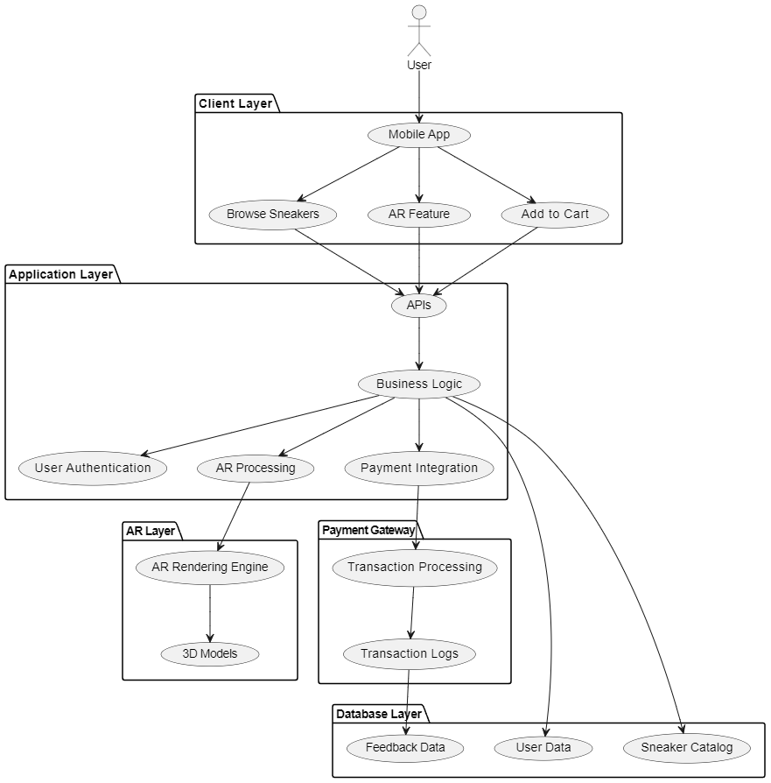
Project Architecture

Slide 8
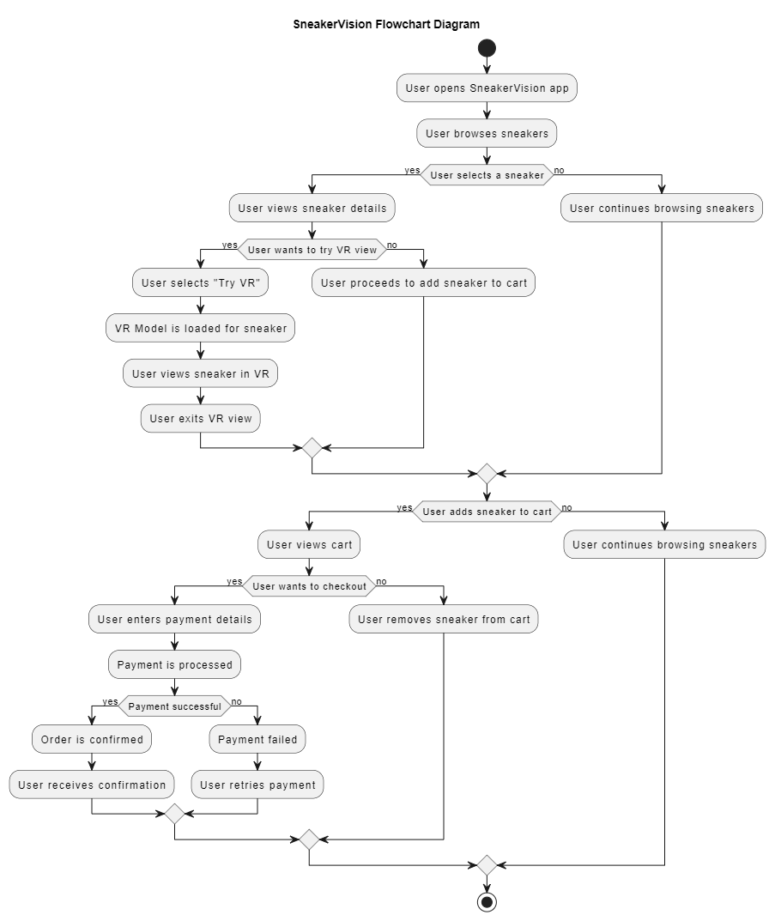
Project Flow

Slide 9
Project Methodology
Prototype Model Project Approach
Early Functional System: Focus on creating an initial version of the system to gather user feedback and refine requirements.
Preliminary Requirements: Identify and prioritize initial requirements to design a quick prototype.
User Interaction: Allow users and stakeholders to interact with the prototype to gather feedback on functionality, usability, and design.
Iterative Improvements: Refine the prototype based on feedback through multiple iterations to align with user needs.
Validation and Development: Use the validated prototype as a blueprint to develop the final system.
Innovation Testing: Ideal for innovative projects like SneakerVision, where features such as AR and virtual try-ons require user-centric evaluation.
Risk Minimization: The iterative process helps identify and mitigate risks early in development.
Enhanced Collaboration: Encourages teamwork among stakeholders to ensure the product meets expectations.
User Satisfaction: Ensures the final product delivers a seamless and user-friendly experience.

Slide 10
Project Methodology Cont…
Why Prototype Model ? The SDLC Prototype Model is used because it allows for the early creation of a working model, enabling stakeholders to visualize the product before it is fully developed. This approach is particularly beneficial for projects like SneakerVision, where user experience and innovative features such as augmented reality (AR) are central. By building a prototype, the development team can gather early feedback, identify potential issues, and refine the product based on real user input, minimizing the risk of major changes later in the development process.
Additionally, it accelerates the validation of key features, such as the virtual try-on capability, and provides a platform for frequent iterations, ensuring that the final product closely aligns with user expectations and requirements.

Slide 11
Responsibilities of the Team Members
RACI Matrix
Task | Abdul Basit | Muhammad Rizwan | Minahil | Supervisor | Co-Supervisor
Project Planning | R,A | R,A | R,A | I,C | I
UI/UX | R,A | A | A | I,C | I
Frontend Development | R,A | R,A | R,A | I,C | I
Backend Development | A | R,A | R,A | I,C | I
AR Development | R | A | R | I,C | I
Testing | A | R | R | I,C | I
Final Deployment | R,A | R,A | R,A | I,C | I

Slide 12
Project Milestones
Project Kickoff
Planning
Requirement Gathering
Design Phase
UI/UX Design
Frontend Development (Implement responsive design for different devices)
Backend Development (Implement server-side logic and database connections)
AR Technology (Deep AR)
User Testing Phase
Deployment
Documentation
Reporting

Slide 13
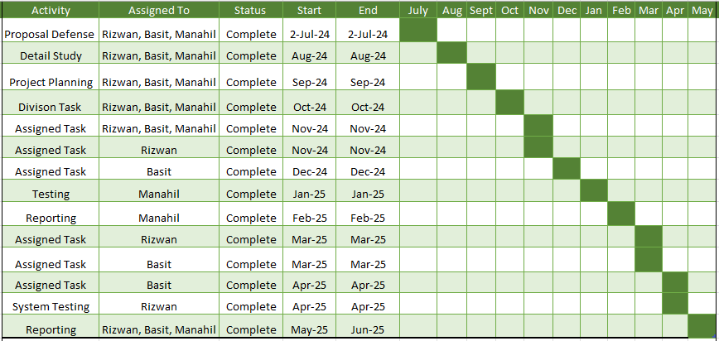
Project Plan
Gant Chart

Slide 14
Budget/Costing
Estimated budget of project major resources
COMPONENTS | PRICES
Laptop | 80,000
USB Flash Drive | 3,500
Domain/Hosting | 10,000
Miscellaneous | 10,000
Total cost | 103,500

Slide 15
Tools/Technology
Software Requirements
Hardware Requirements:
Flutter (Dart)
Firebase
Visual Studio
Android Studio
Figma
Deep AR
Laptop (Core i5, 8GB RAM, 500GB SSD)
Backup Hard drive (250 GB)
USB
Internet Device
SNEAKER VISION

Slide 16
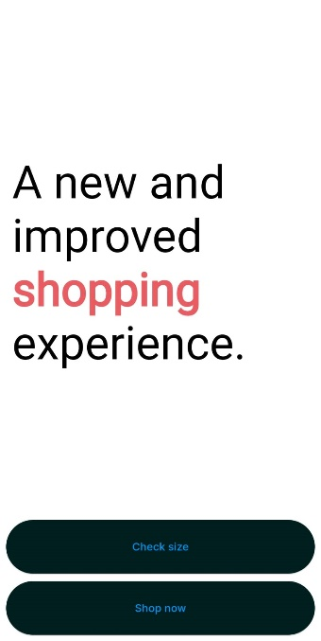
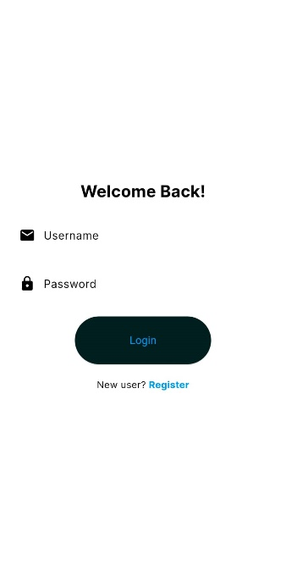
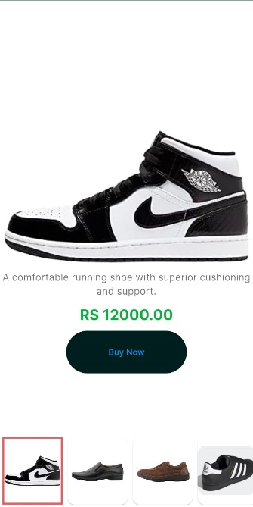
Project Screens
SNEAKER VISION

Slide 17
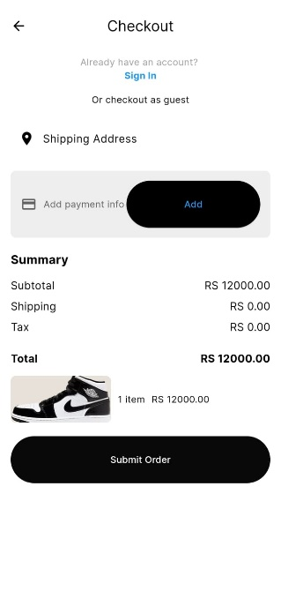
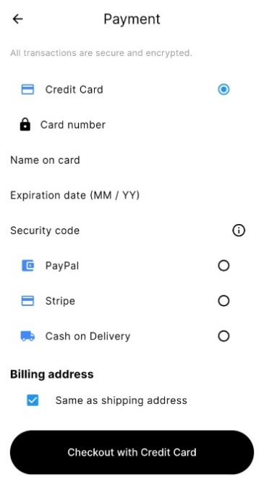
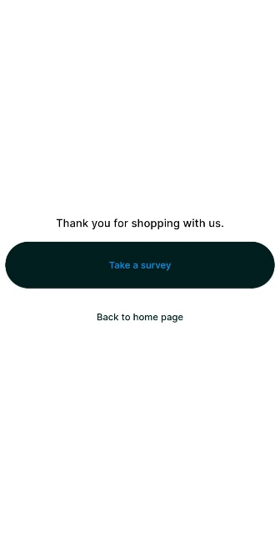
Project Screens
SNEAKER VISION

Slide 18

Project Logo
SNEAKER VISION

Slide 19
Reference
Caboni, F., & Lucia Pizzichini . (2022, June 28). Emerald Insight . Retrieved from Emerald: https://www.emerald.com/insight/content/doi/10.1108/IJRDM-10-2021- 0509/full/html
Chen, S.-C., Tung-Hsiang Chou, Tanaporn Hongsuchon, Athapol Ruangkanjanases, Santhaya Kittikowit , & Tse-Ching Lee. (7, Feb 2022). Emerald Insight . Retrieved from Emerald : https://www.emerald.com/insight/search?q=Tung-Hsiang%20Chou
Wang, C.-H., Yi-Chen Chiang, & Mao-Jiun Wang. (2015, October 23). Evaluation of an Augmented Reality Embedded On-line Shopping System. Retrieved from Science Direct: https://www.sciencedirect.com/science/article/pii/S2351978915007672
Yoo, J. (2023, Feb 15). The effects of augmented reality on consumer responses in mobile shopping: The moderating role of task complexity. Retrieved from Natutal Libray of Medicine: https://www.ncbi.nlm.nih.gov/pm/articles/PMC9981924/

Slide 20
Thank You!

