Slide 1

Exploratory Data Analysis of Suicide Bombing Attacks in Pakistan
Key Insights and Actionable Recommendations
Basit Siddiqui

Slide 2

Introduction
Objective: To analyze attack trends, identify high-risk regions, understand demographic impacts, and provide actionable insights for improving security measures.
1
Dataset Overview
Comprehensive collection of suicide bombing attacks in Pakistan
2
Analysis Goals
Identify trends, high-risk areas, and demographic impacts
3
Actionable Insights
Provide recommendations for improving security measures

Slide 3
Attack Trends Over Time (Yearly Trends)
The visualization shows the frequency of suicide bombing attacks per year.
Key Insight: Certain years have a significant increase in the number of attacks, likely due to political instability or military conflicts.
Actionable Conclusion:
Recommendation: Allocate additional security resources during years when attack frequency spikes are anticipated based on historical trends.
1
2
3
Data Collection
Trend Analysis
Resource Allocation
Gather yearly attack frequency data
Identify years with significant increases
Plan security measures based on historical trends

Slide 4
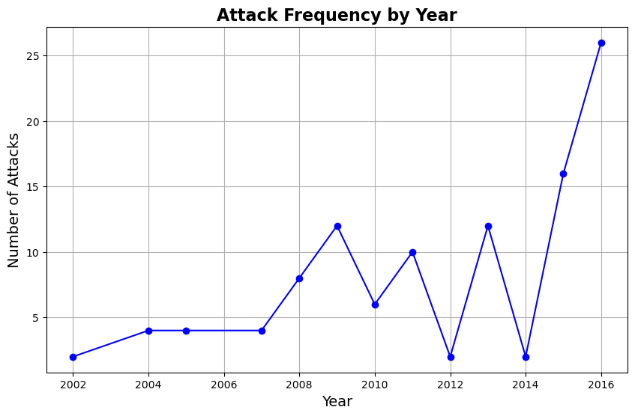
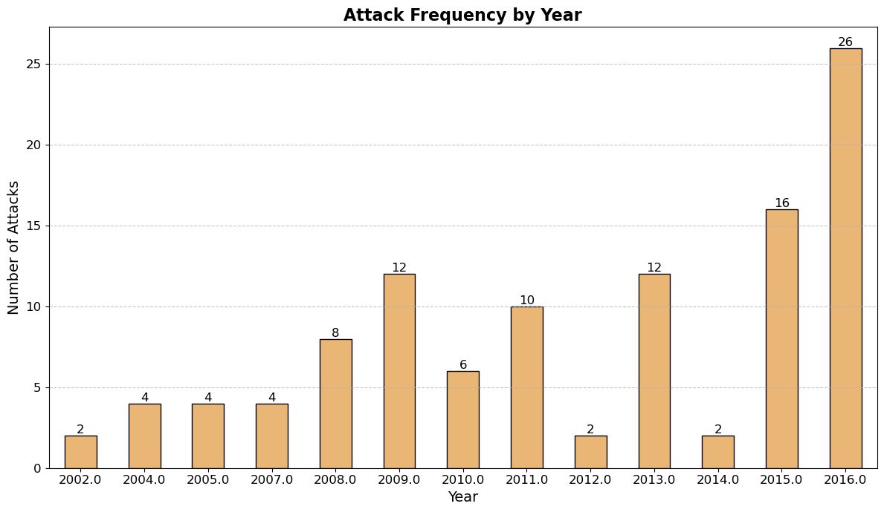

Slide 5
Seasonal Trends of Attacks
The chart highlights the number of attacks that occurred during each month across all years.
Key Insight: Higher attack frequency in specific months could correlate with political events, religious holidays, or other seasonal factors.
Actionable Conclusion:
Recommendation: Implement heightened security measures during months that historically show an increase in attack activity.
Monthly Analysis
Correlation Factors
Security Planning
Examine attack frequency for each month
Identify potential links to events or holidays
Adjust measures based on historical monthly trends

Slide 6
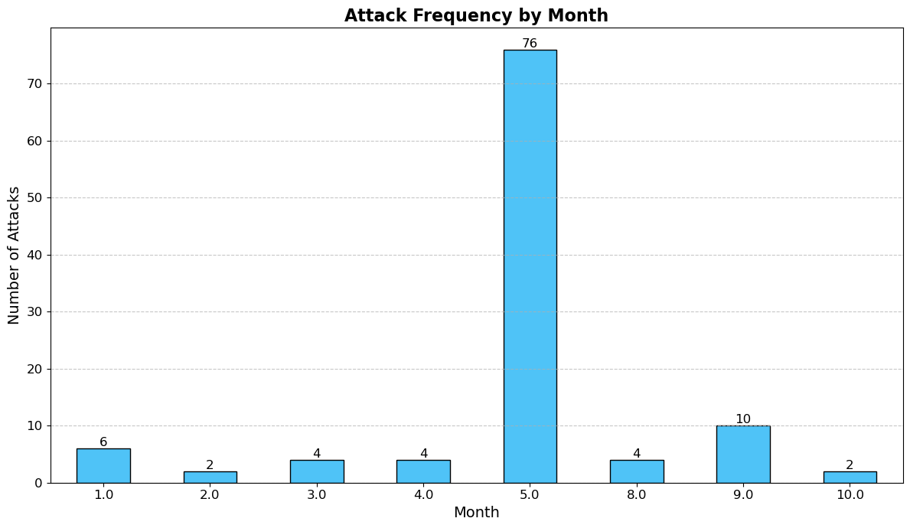

Slide 7
Geographic Distribution of Attacks (By Province)
This visualization illustrates the total number of attacks in each province.
Key Insight: Certain provinces, such as those near conflict zones or borders, have a disproportionately higher number of attacks.
Actionable Conclusion:
Recommendation: Direct security reinforcements and counterterrorism resources toward provinces experiencing the highest frequency of attacks.
Provincial Analysis
High-Risk Identification
Resource Allocation
Examine attack distribution across provinces
Pinpoint provinces with disproportionate attack numbers
Focus security efforts on most affected areas

Slide 8
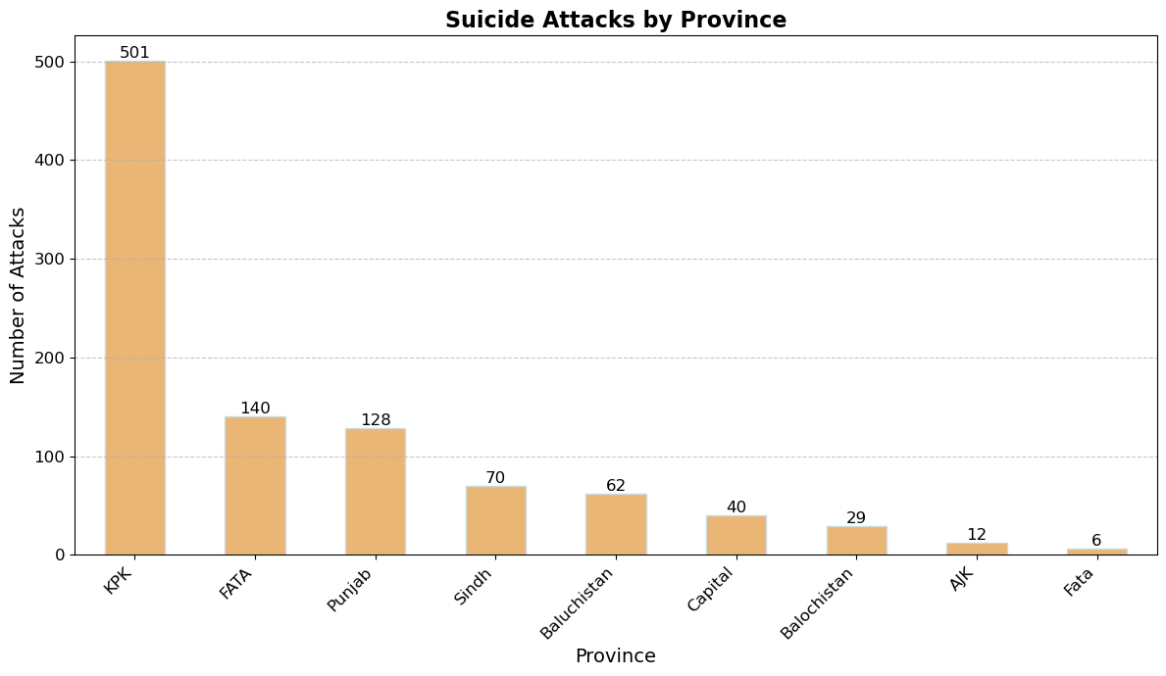
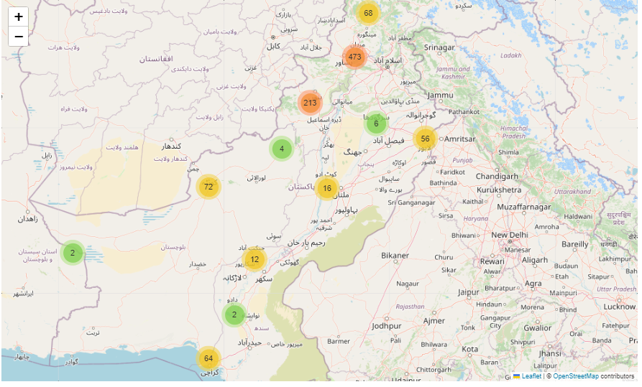

Slide 9



Types of Attacks and Target Groups
This visualization categorizes attacks by method and the targeted groups (e.g., civilians, military).
Key Insight: Bombings are the most common method of attack, and civilians are frequently targeted.
Actionable Conclusion:
Recommendation: Develop specific prevention and protection programs for vulnerable groups (e.g., civilians), focusing on high-risk areas such as public spaces.
Attack Methods
Target Groups
Protection Strategies
Identify most common attack types
Analyze frequently targeted populations
Develop tailored security measures

Slide 10
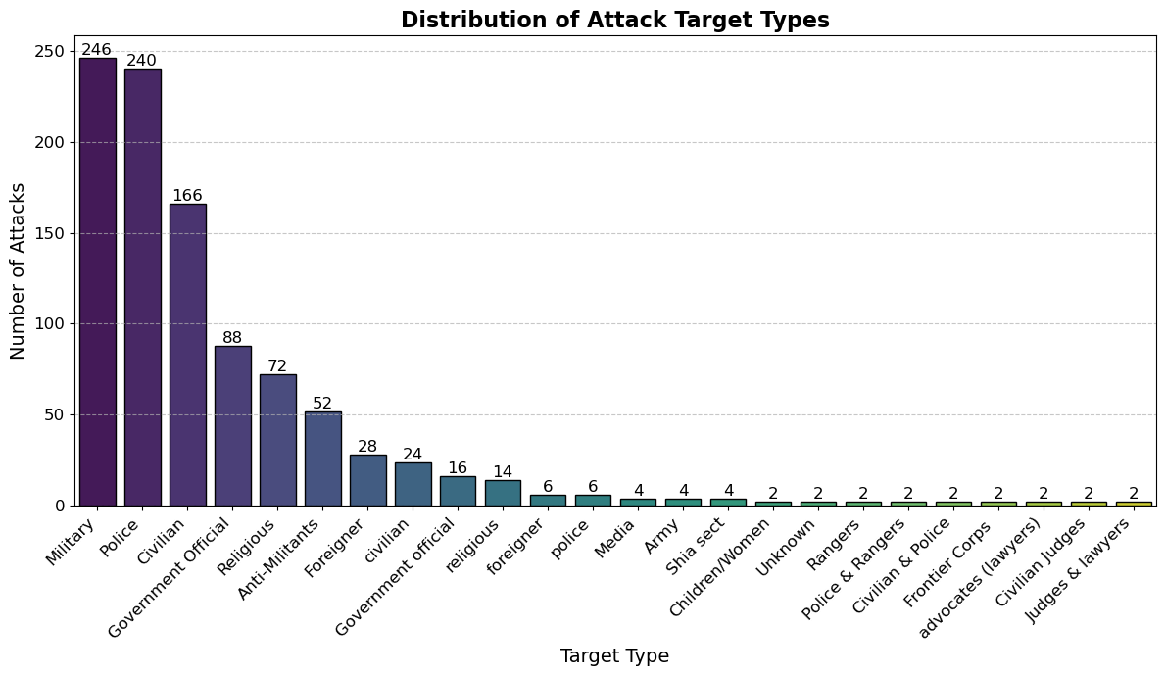

Slide 11
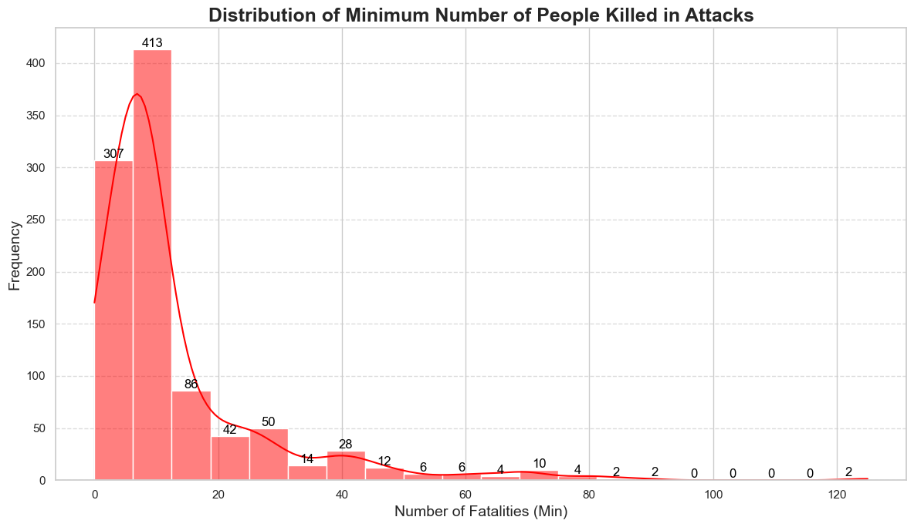
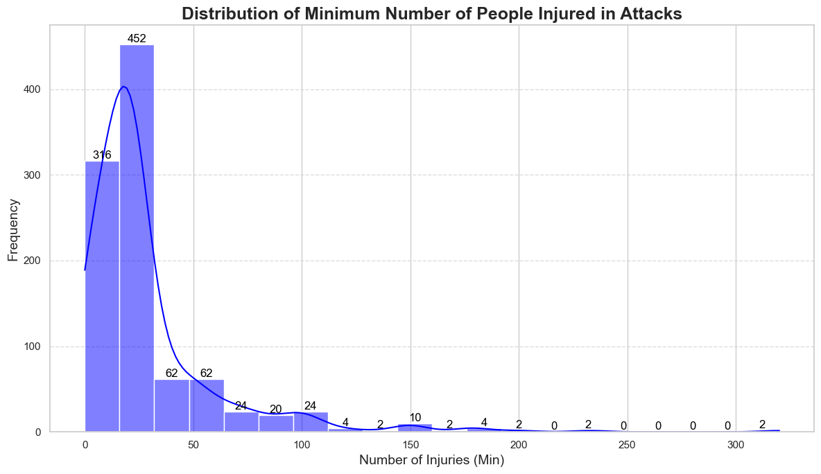
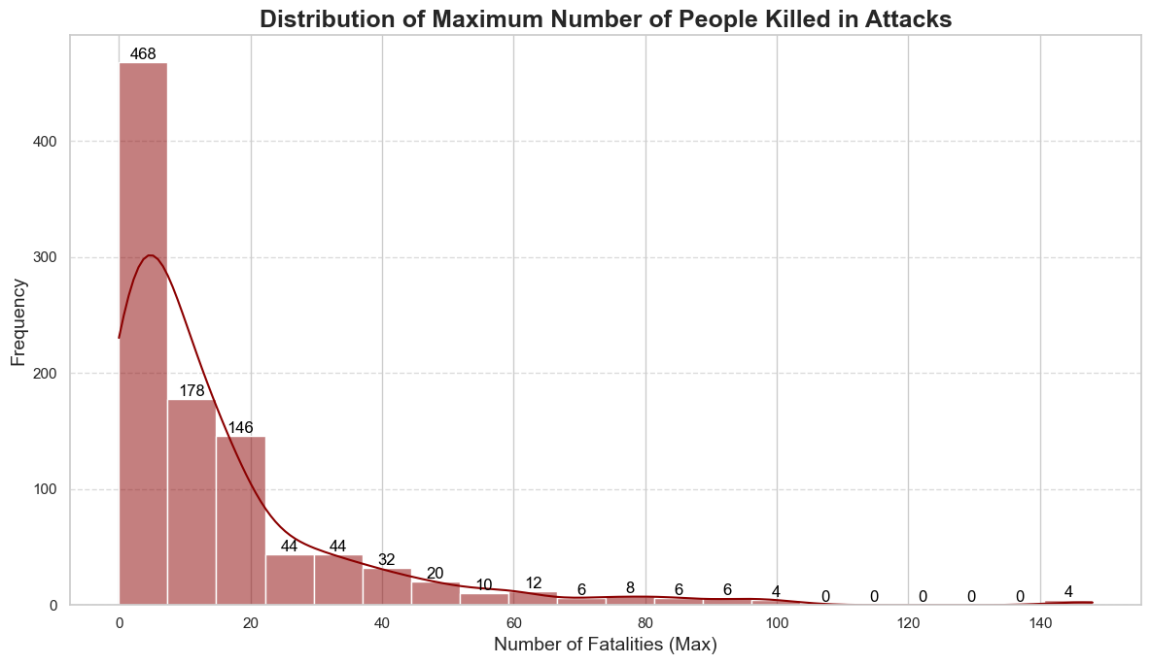
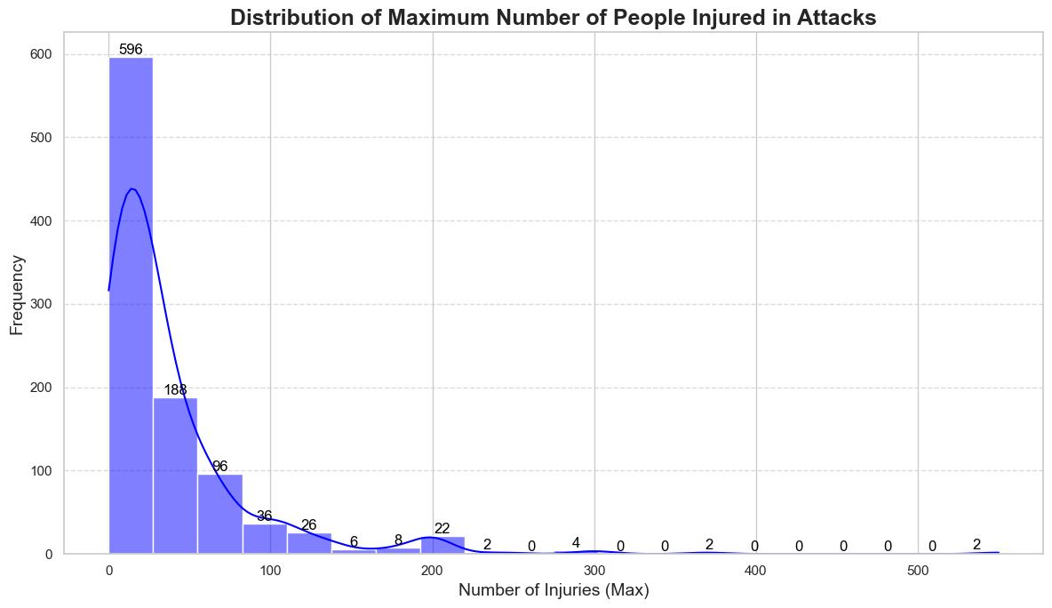

Slide 12
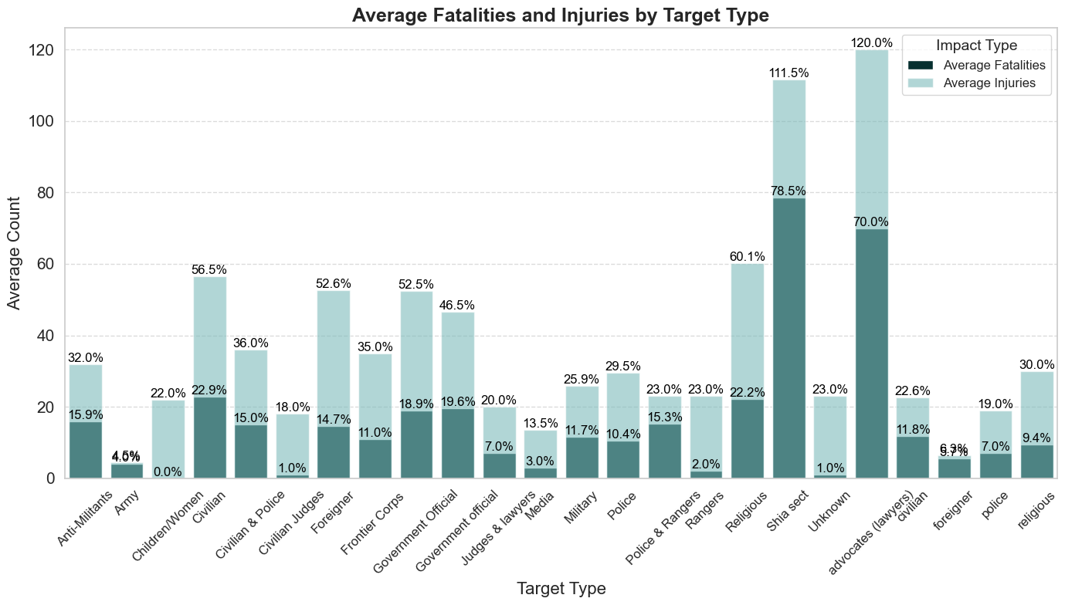

Slide 13
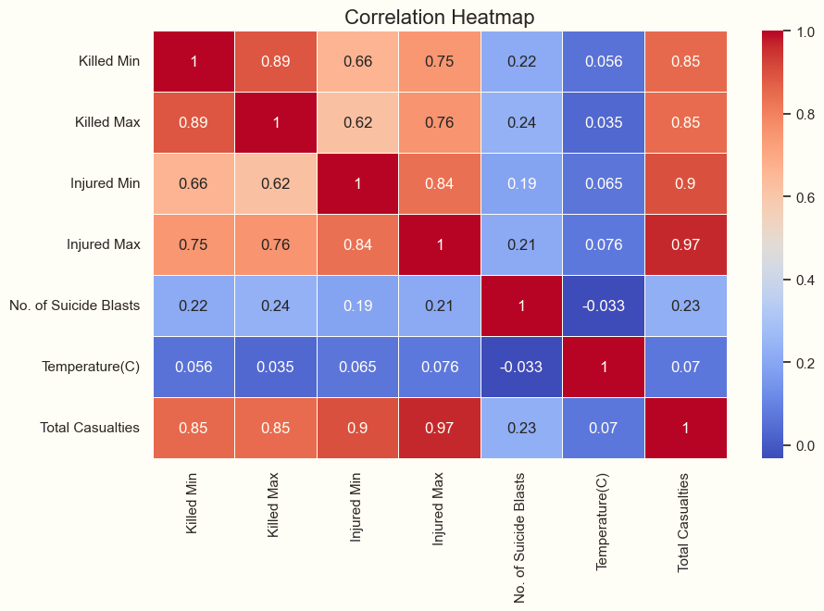
Correlation Between Attack Frequency and Casualty Numbers
This plot shows the relationship between the number of attacks and
the total casualties across various regions.
Key Insight: While more attacks often lead to more casualties,
some regions experience fewer but more deadly attacks.
Actionable Conclusion:
Recommendation: Focus on prevention and rapid response in
regions where a small number of attacks lead to high casualty rates.

