Slide 1
Exploratory Data Analysis on Hotel Booking Data
Analyzing Booking and Cancellation Trends
Basit Siddiqui

Slide 2
Introduction
Introduction to the Dataset: The dataset used in this analysis consists of hotel booking records containing 119,390 entries and 36 columns. It includes various attributes such as booking status, lead time, customer details, room types, and cancellation information.
Objective of the Analysis: The primary objective of this analysis is to investigate booking and cancellation trends among hotel customers. By understanding these trends, we aim to provide actionable insights for hotel management to optimize their marketing strategies, improve occupancy rates, and enhance guest experiences.

Slide 3
Data Overview
Number of Entries: The dataset comprises a total of 119,390 entries, representing individual hotel bookings.
Key Variables
Lead Time
Cancellation Status
Customer Preferences
Booking and Arrival Dates
Market Segment and Distribution Channel etc.

Slide 4
Booking, Cancellation Patterns
Key Findings:
Booking Trends
Total cancellations: 42,093 (approximately 35% of bookings)

Slide 5
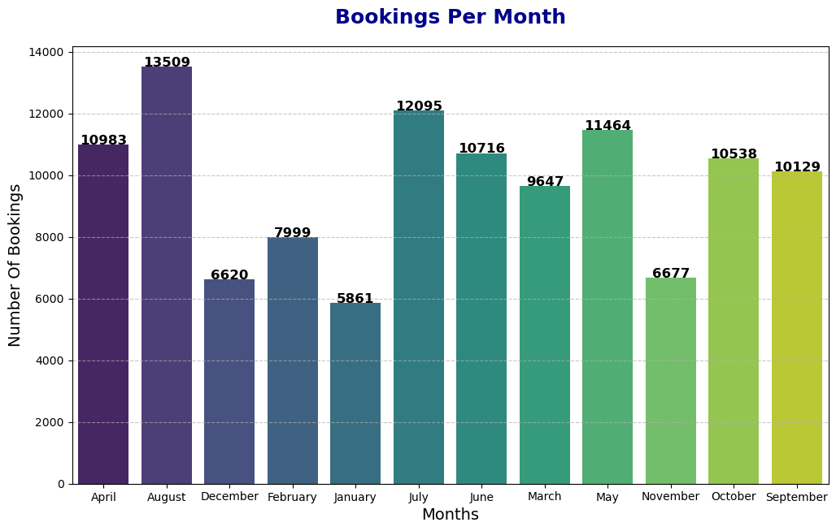
Booking Trends
The analysis reveals distinct booking patterns across the months.
Certain months experience significantly higher booking volumes, particularly during the August, July, April etc.

Slide 6
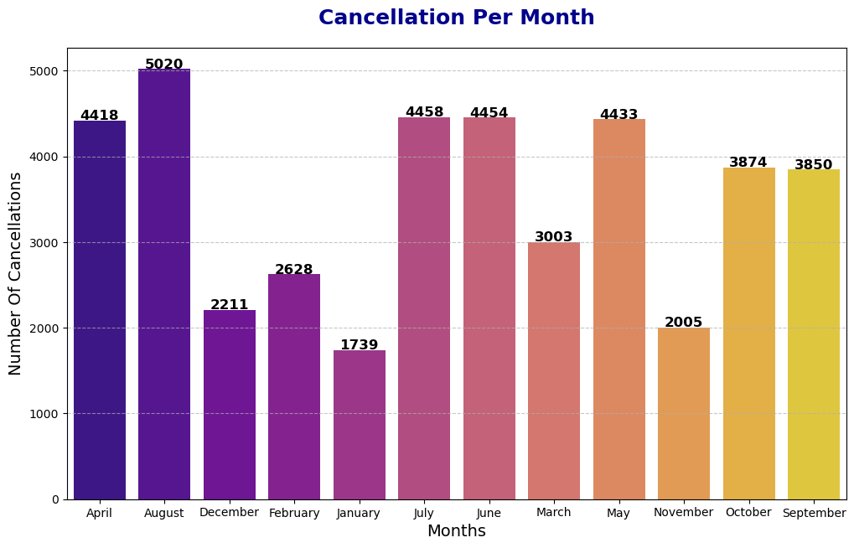
Cancellations Vary By Month
Out of the total bookings, 42093 were canceled of the bookings.
Further, cancellations are particularly high during April, August, July, June etc.

Slide 7
Lead Time Analysis
Key Insights:
Average lead time: 94.9 days.
Bookings with a lead time days are more likely to be canceled.
Lead time vs cancellations

Slide 8
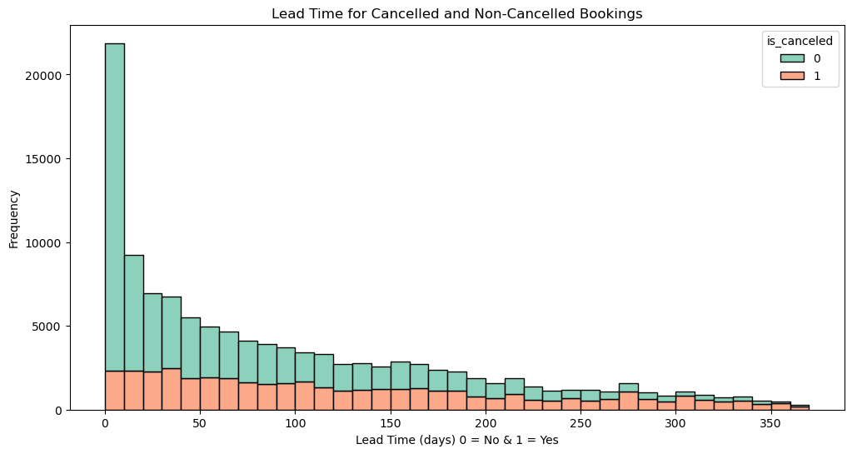
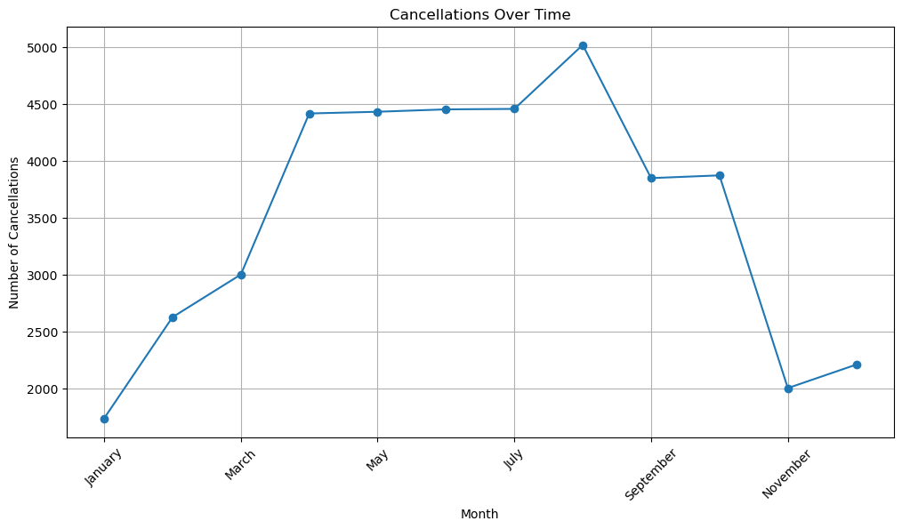
Lead Time Analysis
Lead Time and Cancellations
Cancelation Over Time

Slide 9
Recommendations
Reduce cancellations: Consider implementing stricter cancellation policies during the high-cancellation months to minimize loss.
Early Booking Discounts: Offer discounts or promotions for bookings made early, especially those with long lead times.
Optimize Room Availability: Ensure that preferred room types like are adequately stocked to meet customer demand.
Seasonal Promotions: Tailor marketing strategies around seasonal demand to encourage higher bookings during low periods and reduce cancellations.

Slide 10
Conclusion
The analysis provides valuable insights into customer booking behavior and preferences, as well as factors driving cancellations. By leveraging these insights, hotels can better optimize their operations, reduce cancellations, and enhance customer satisfaction.

