Slide 1
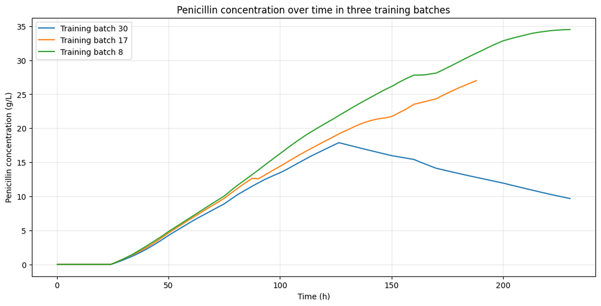
B1 -- Training-batch concentration trajectories

Slide 2
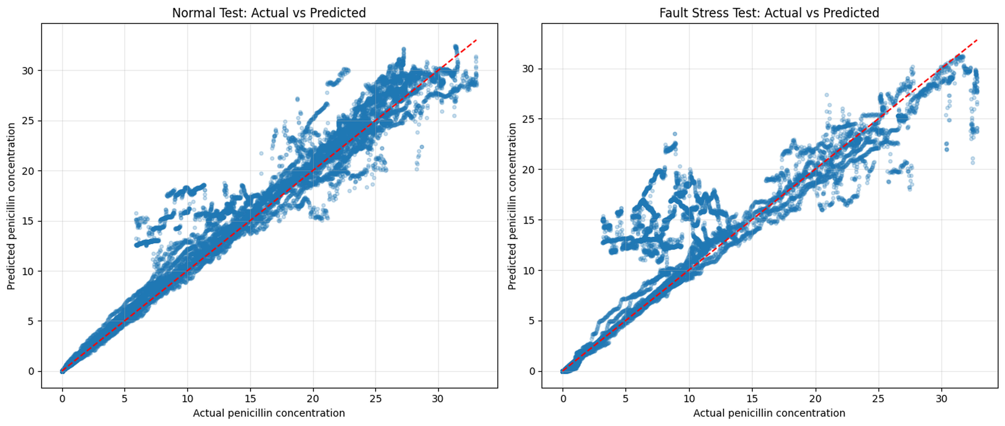
B2 -- Baseline Random Forest: actual versus predicted

Slide 3
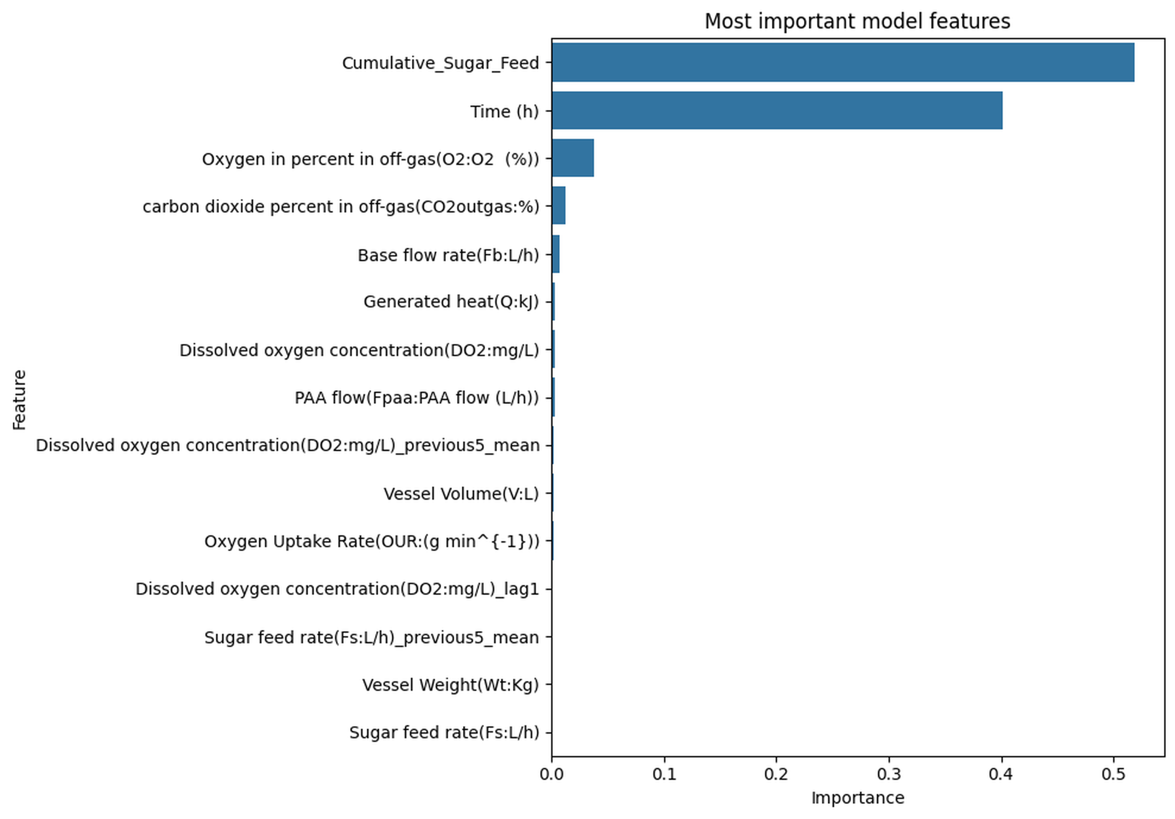
B3 -- Baseline Random Forest feature importance

Slide 4
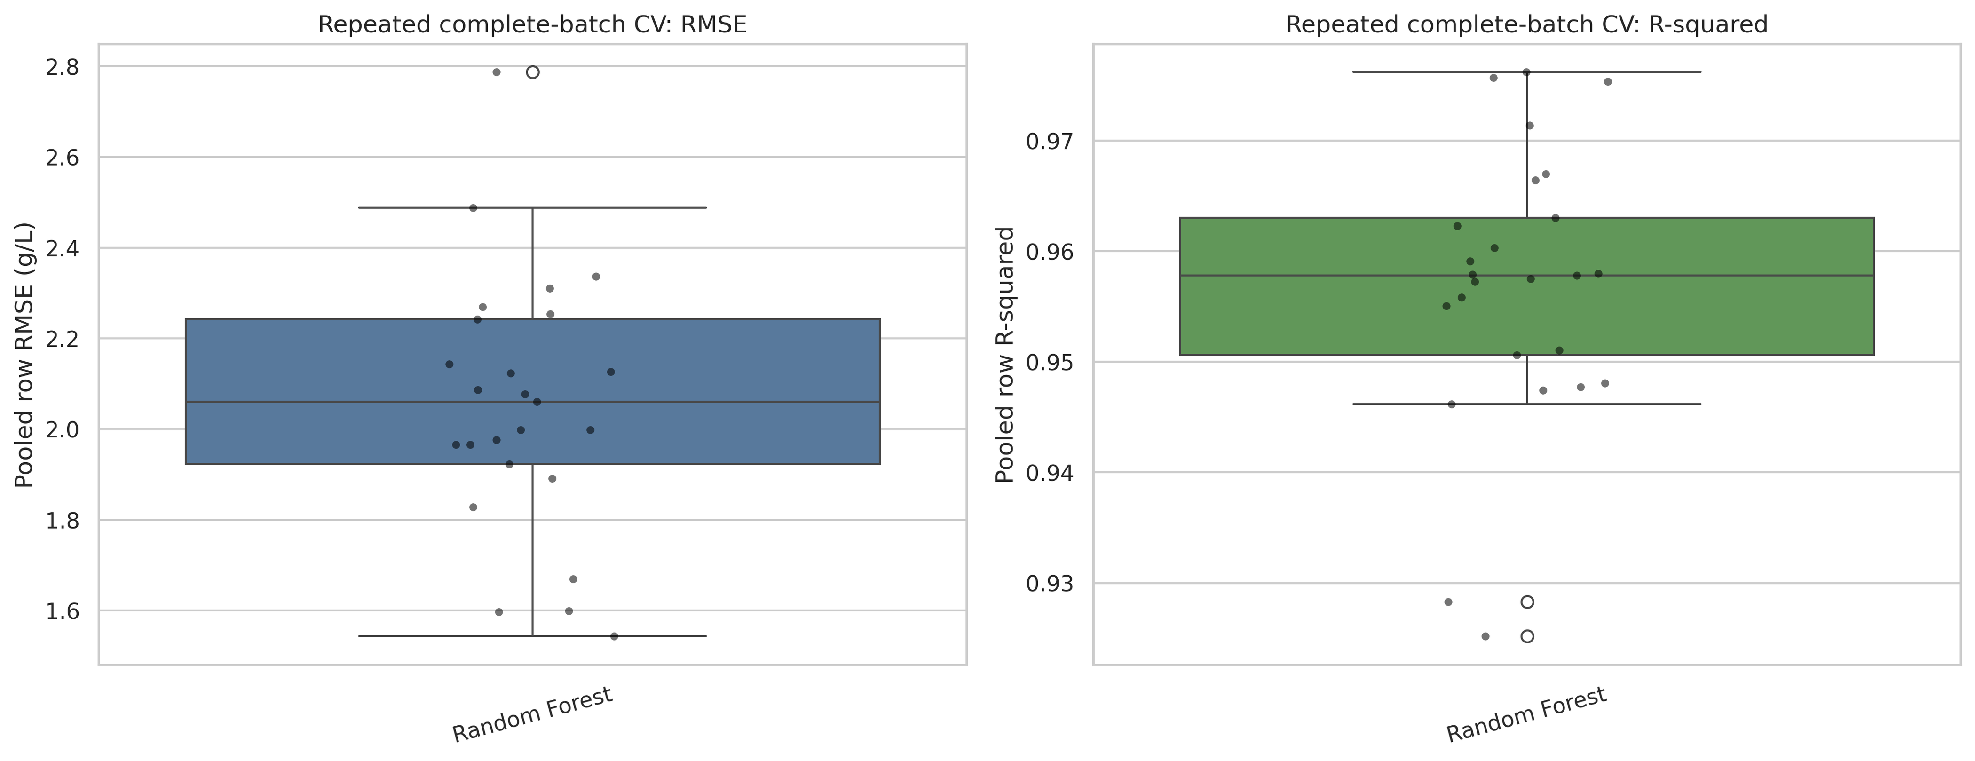
E1 -- Repeated complete-batch cross-validation

Slide 5
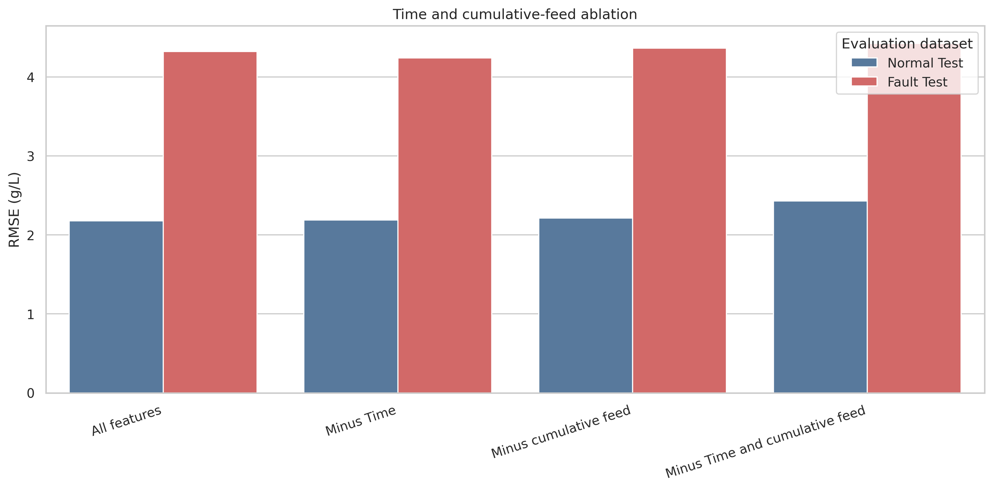
E2 -- Time and cumulative-feed ablation

Slide 6
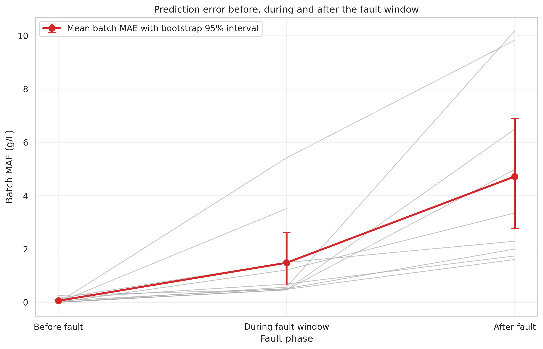
E3 -- Error before, during and after the fault window

Slide 7
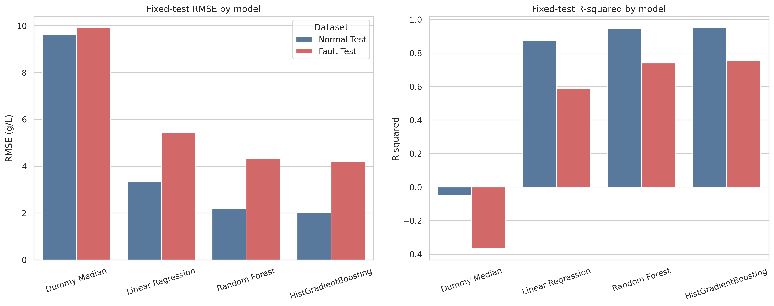
E4 -- Stronger model comparison

Slide 8
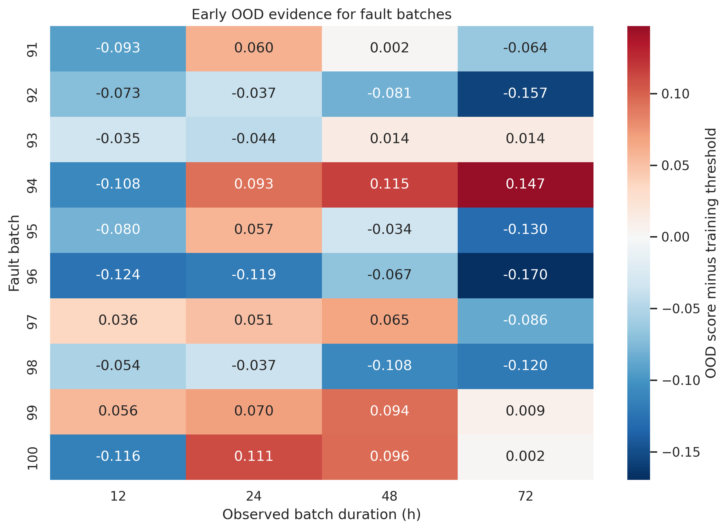
E5a -- Early out-of-distribution warnings

Slide 9
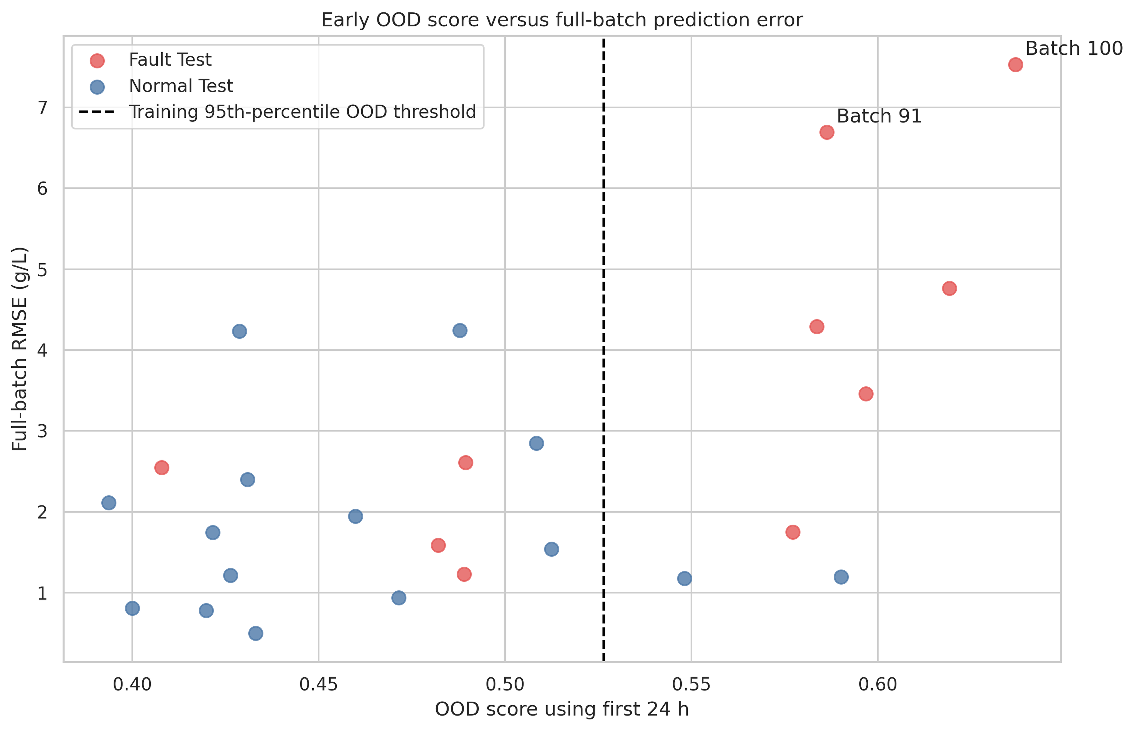
E5b -- Baseline RF: 24 h OOD score vs full-batch RMSE

Slide 10
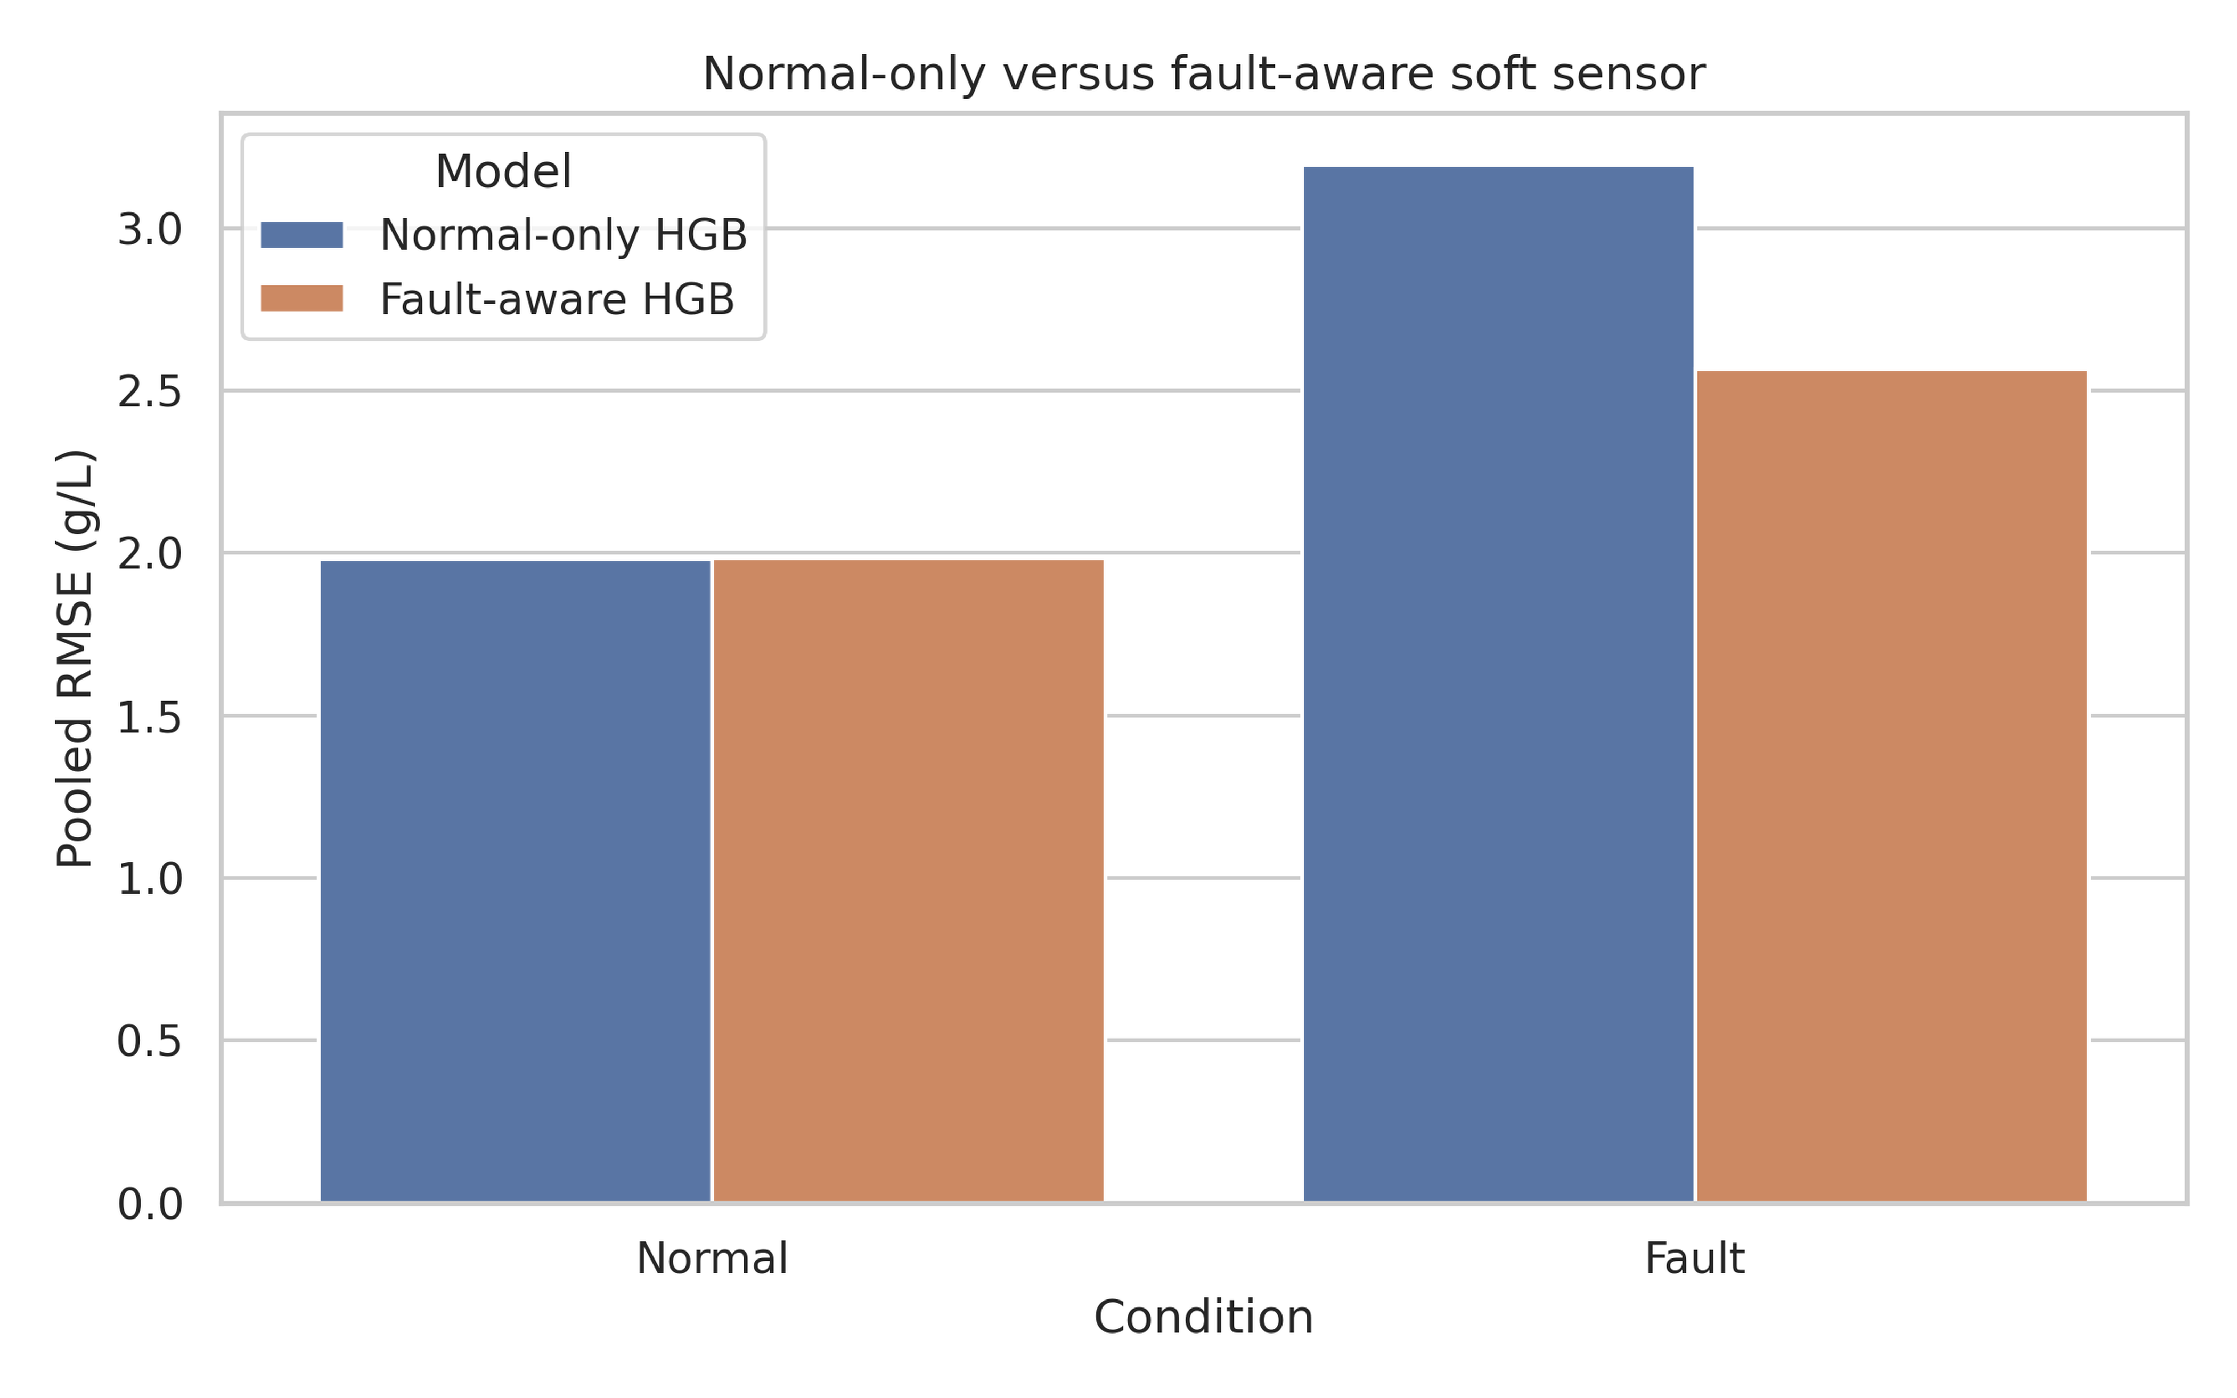
F1 -- Overall held-out RMSE

Slide 11
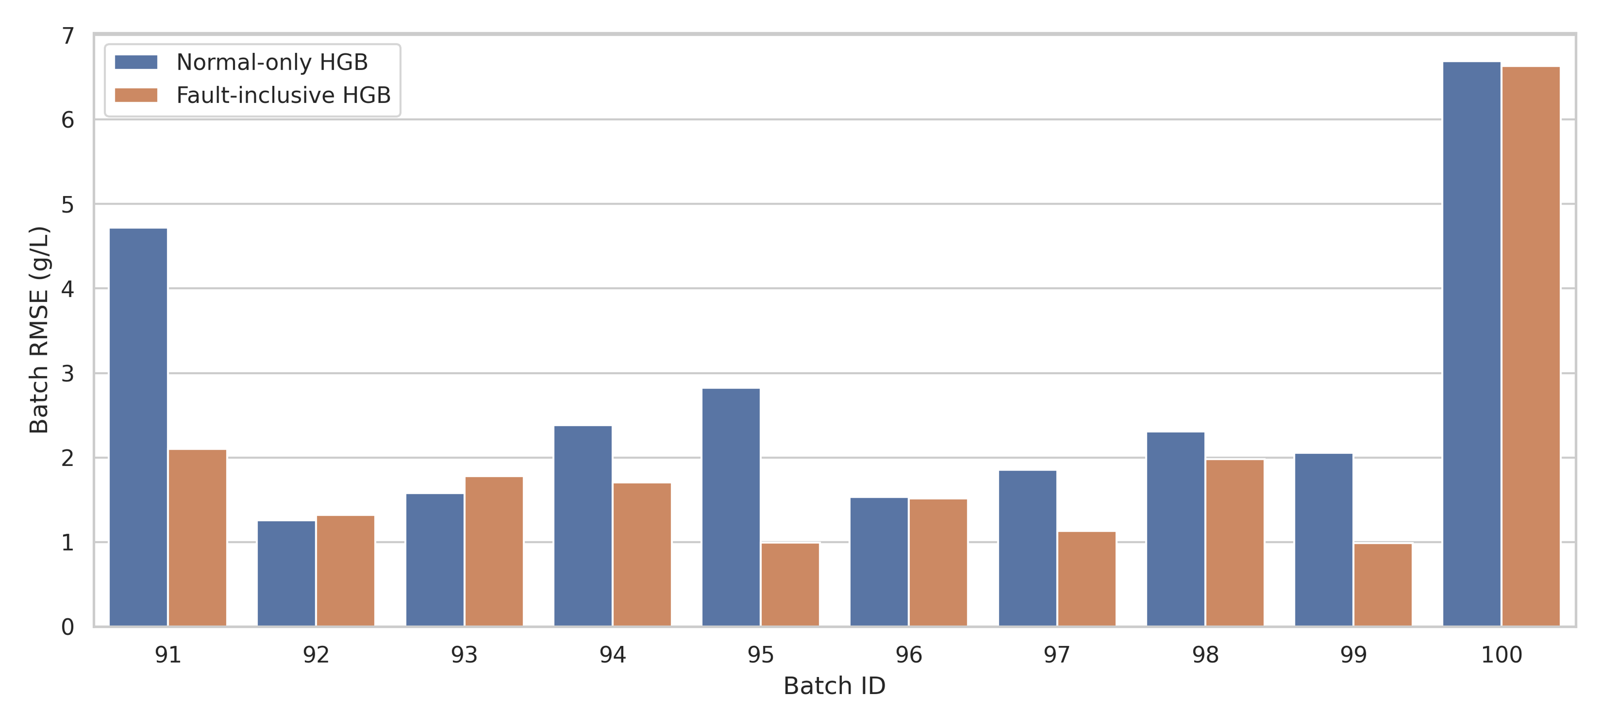
F2 -- RMSE for each held-out fault batch

Slide 12
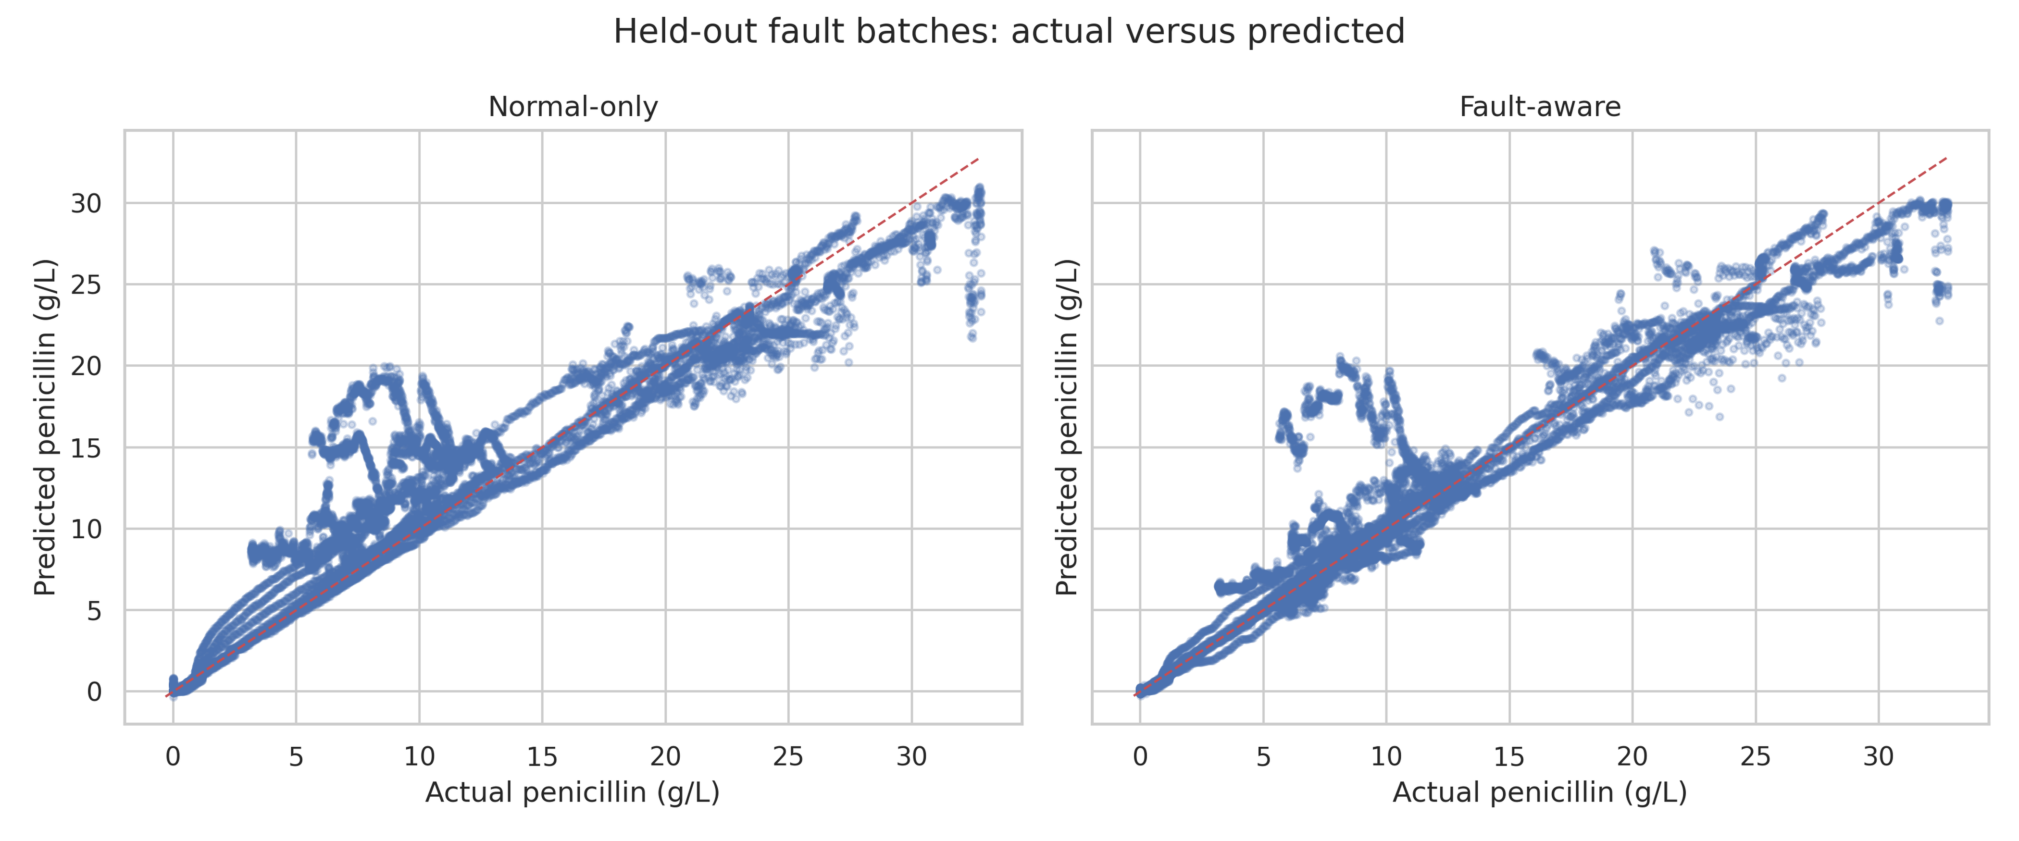
F3 -- Fault-batch actual versus predicted concentration

Slide 13
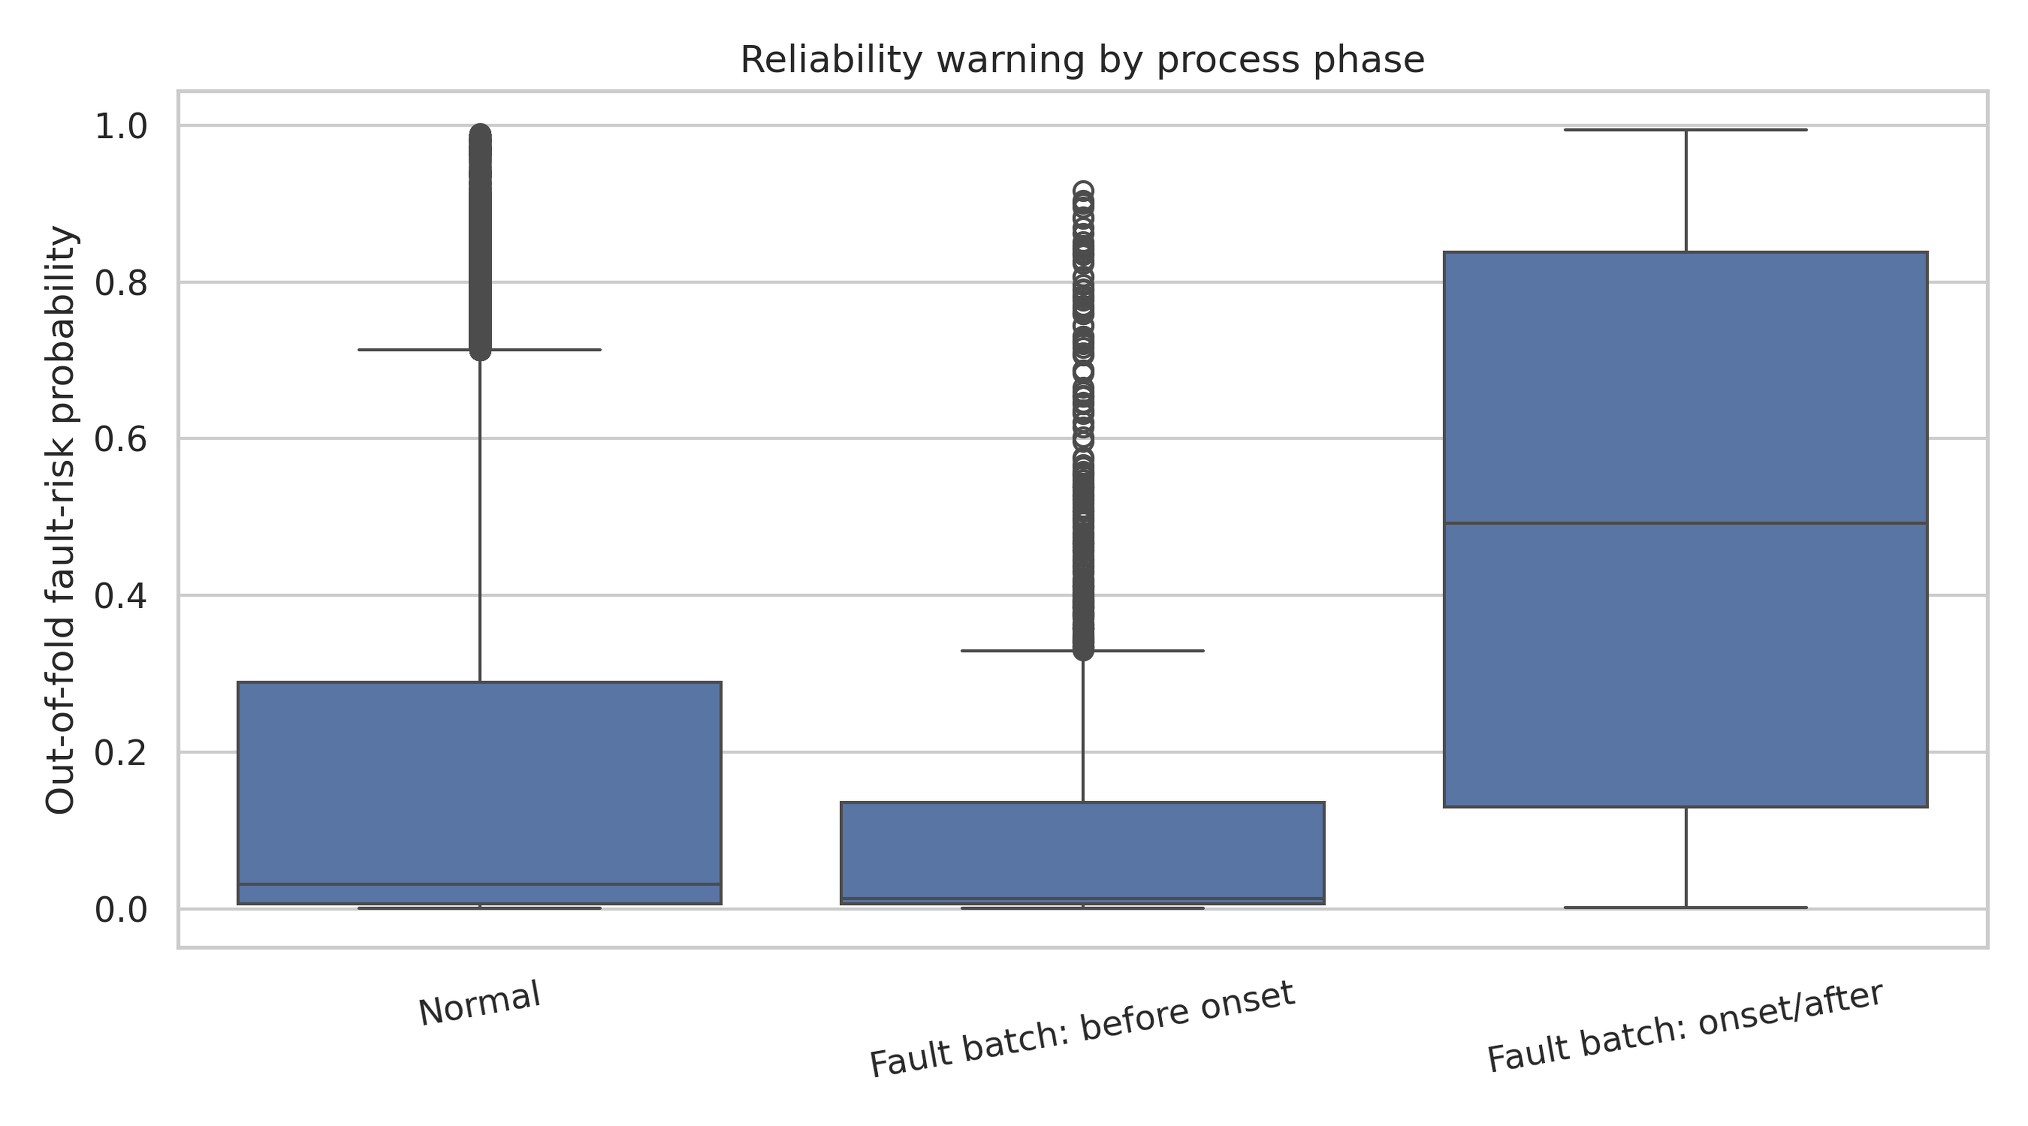
F4 -- Fault-risk warning score by phase

Slide 14
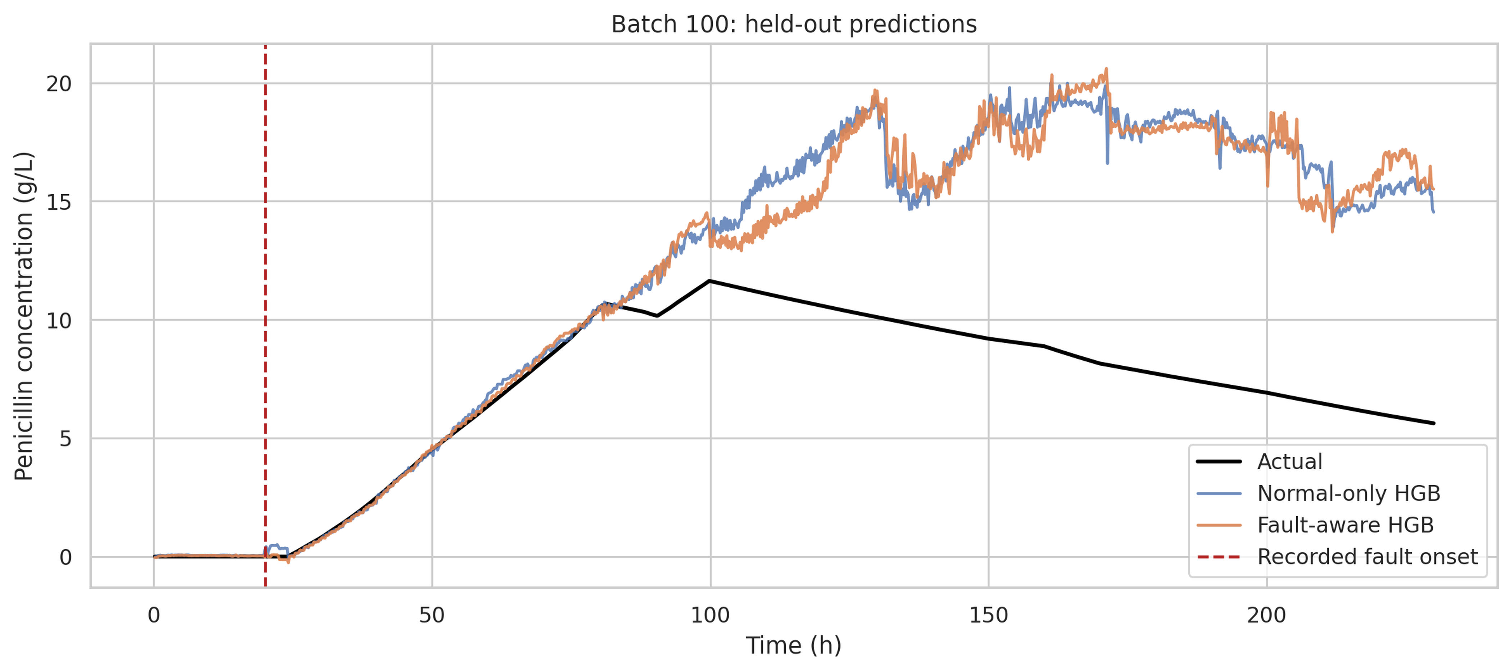
F5 -- Batch 100 held-out trajectory

