Slide 1
IndPenSim Penicillin Soft Sensor Images
Publication-ready 600-DPI figure set

Slide 2
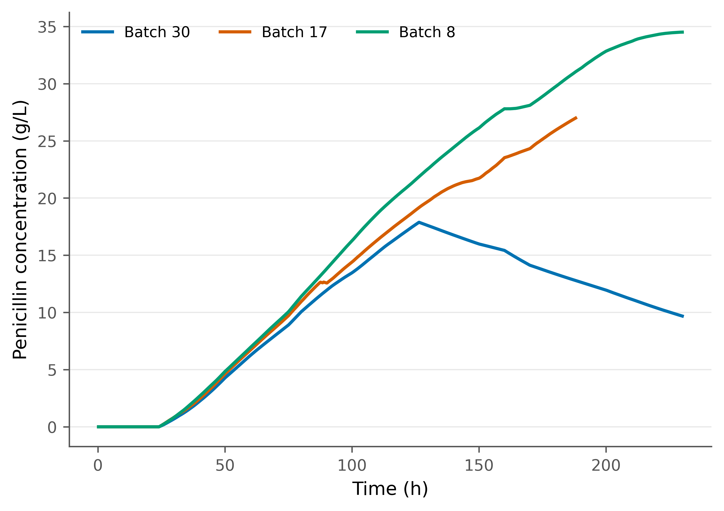
B1 -- Training-batch concentration trajectories
Figure legend. Representative normal training-batch penicillin concentration trajectories.

Slide 3
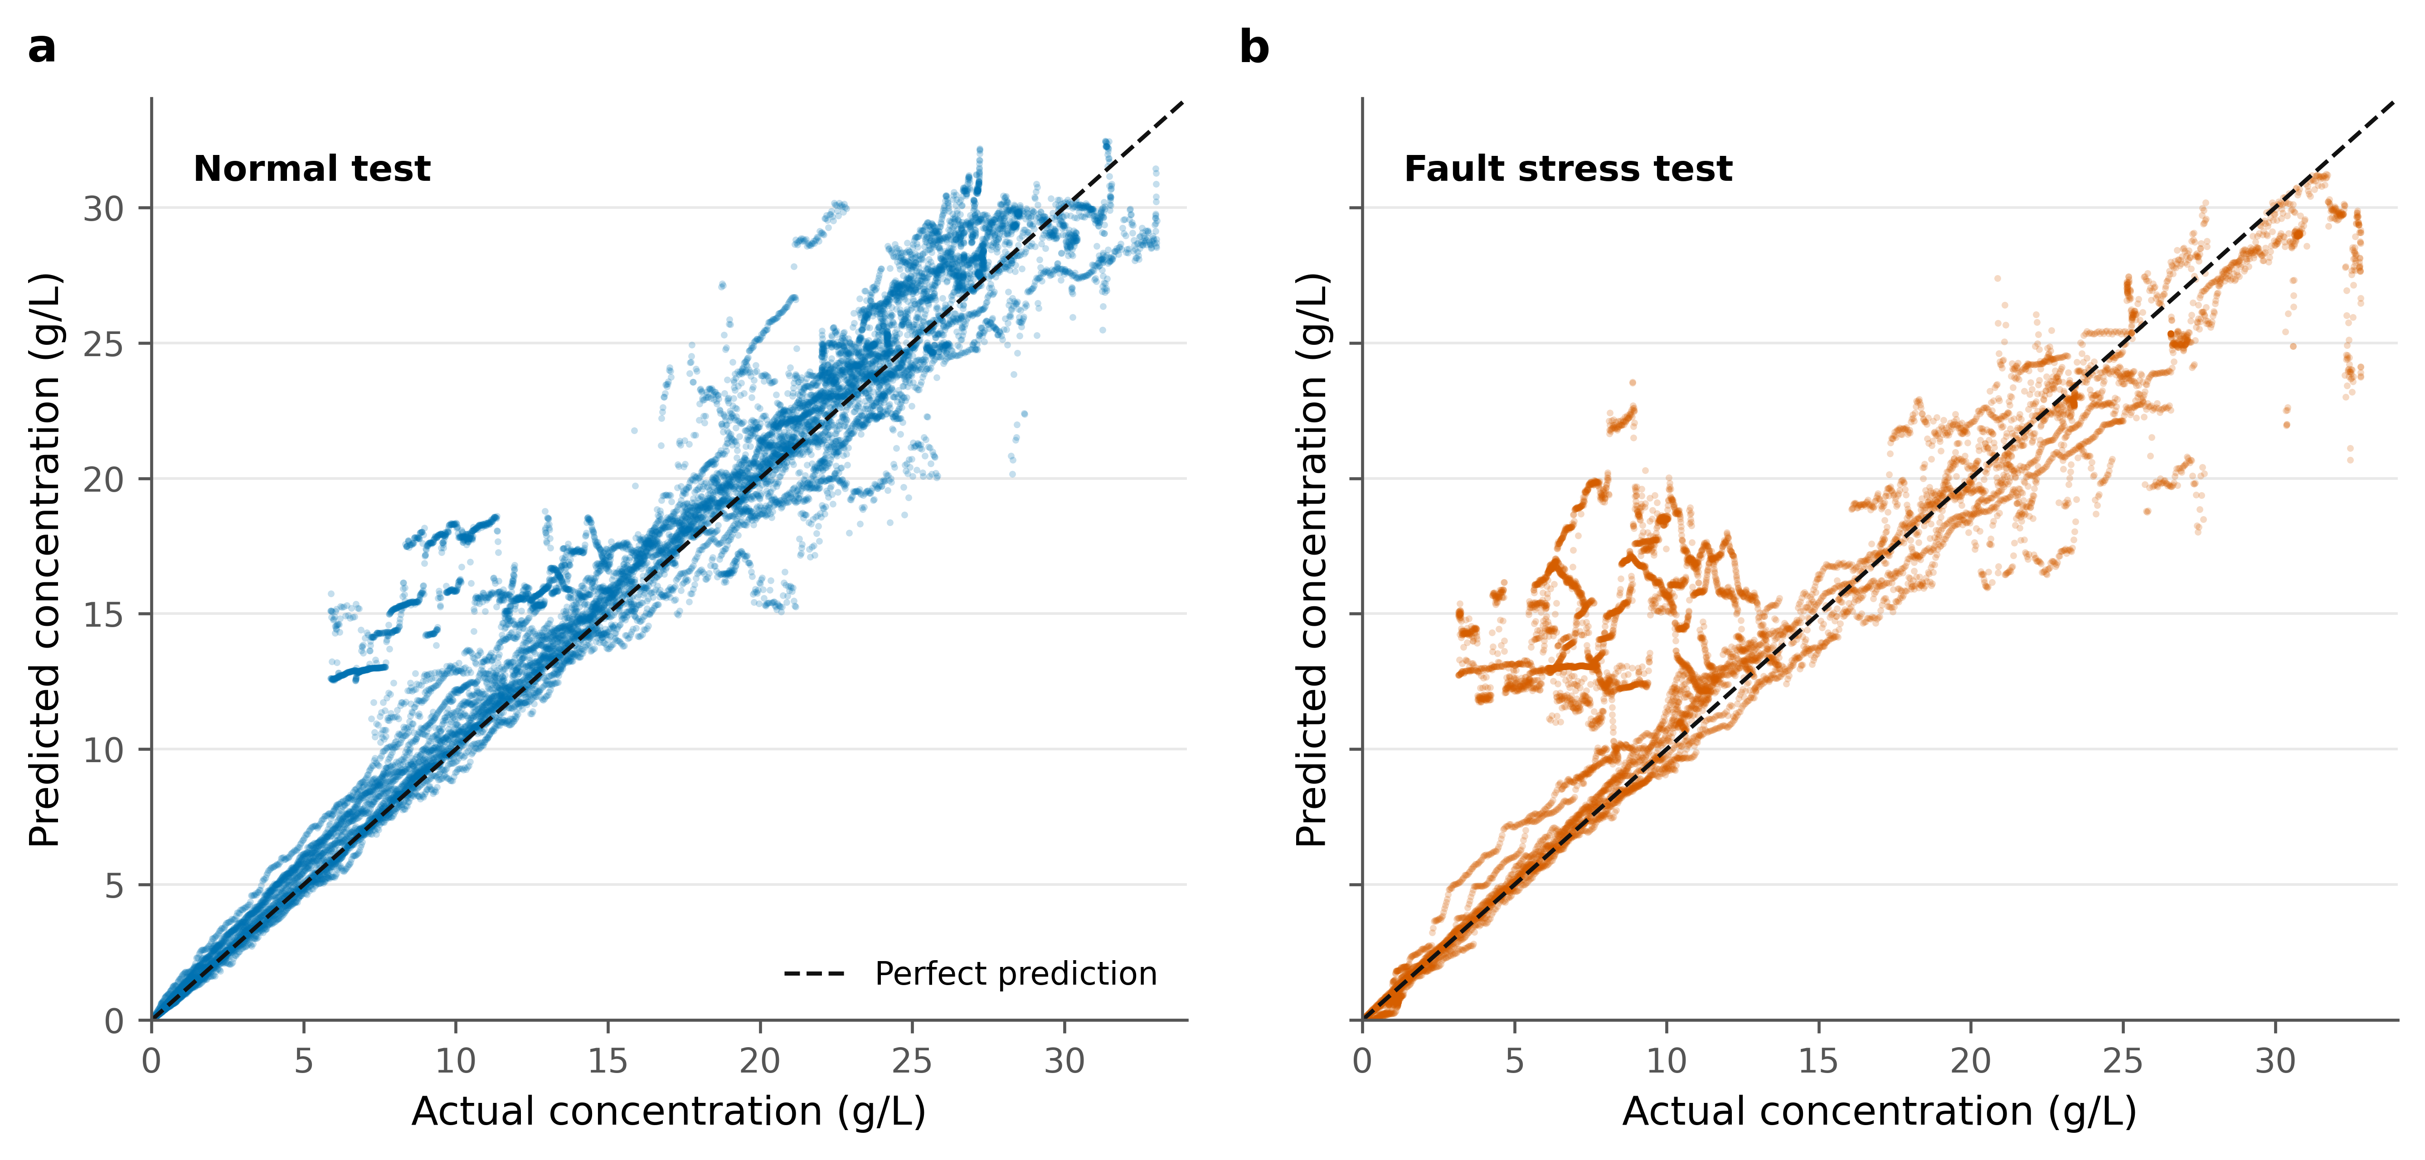
B2 -- Baseline Random Forest: actual versus predicted
Figure legend. Random Forest baseline predictions on normal and fault test batches; the dashed diagonal denotes perfect agreement.

Slide 4
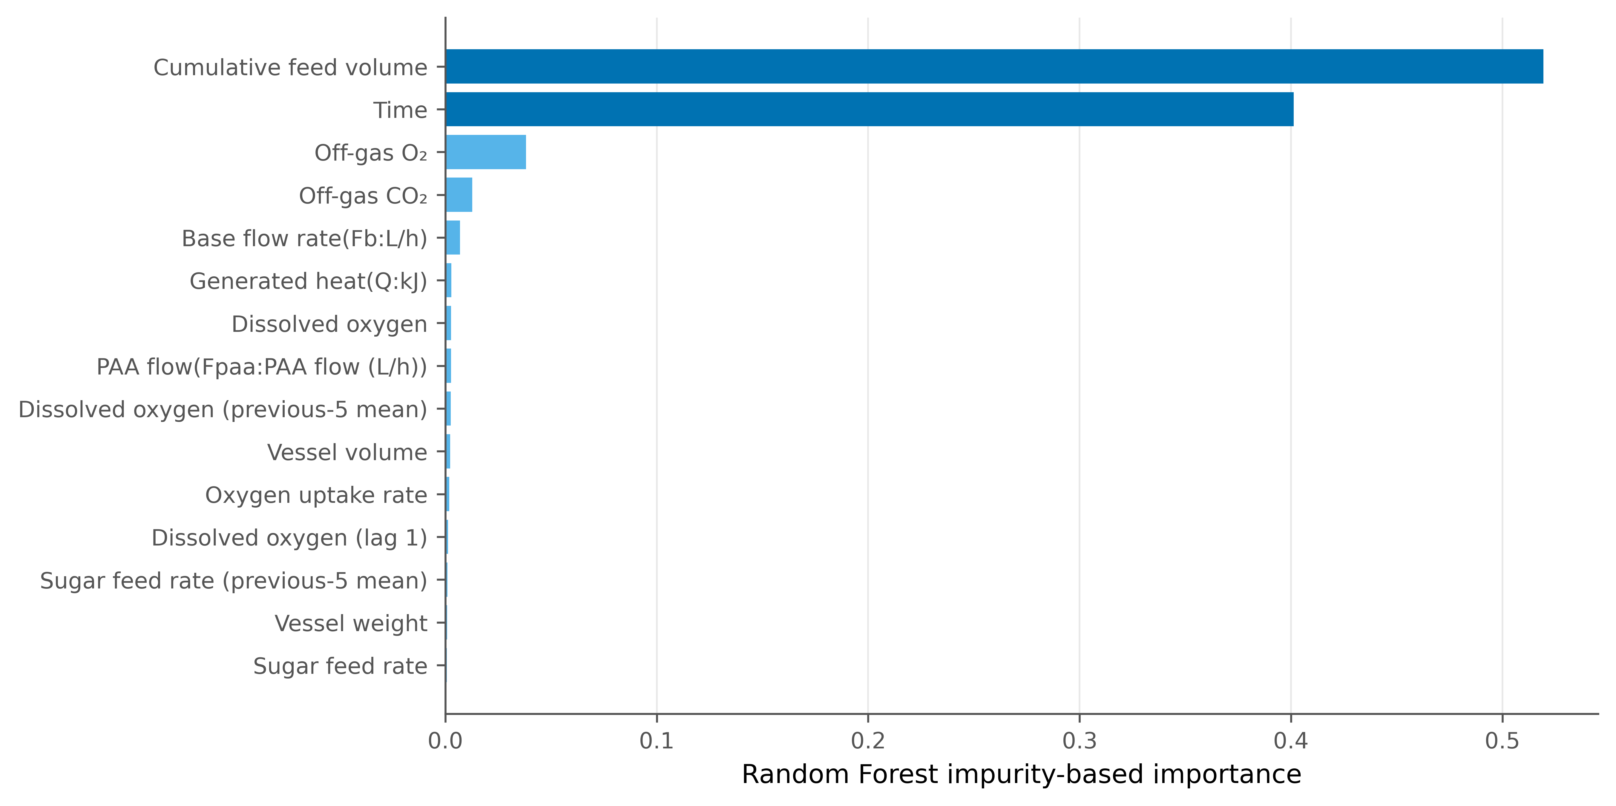
B3 -- Baseline Random Forest feature importance
Figure legend. Random Forest impurity-based feature importance for the highest-ranked baseline predictors.

Slide 5
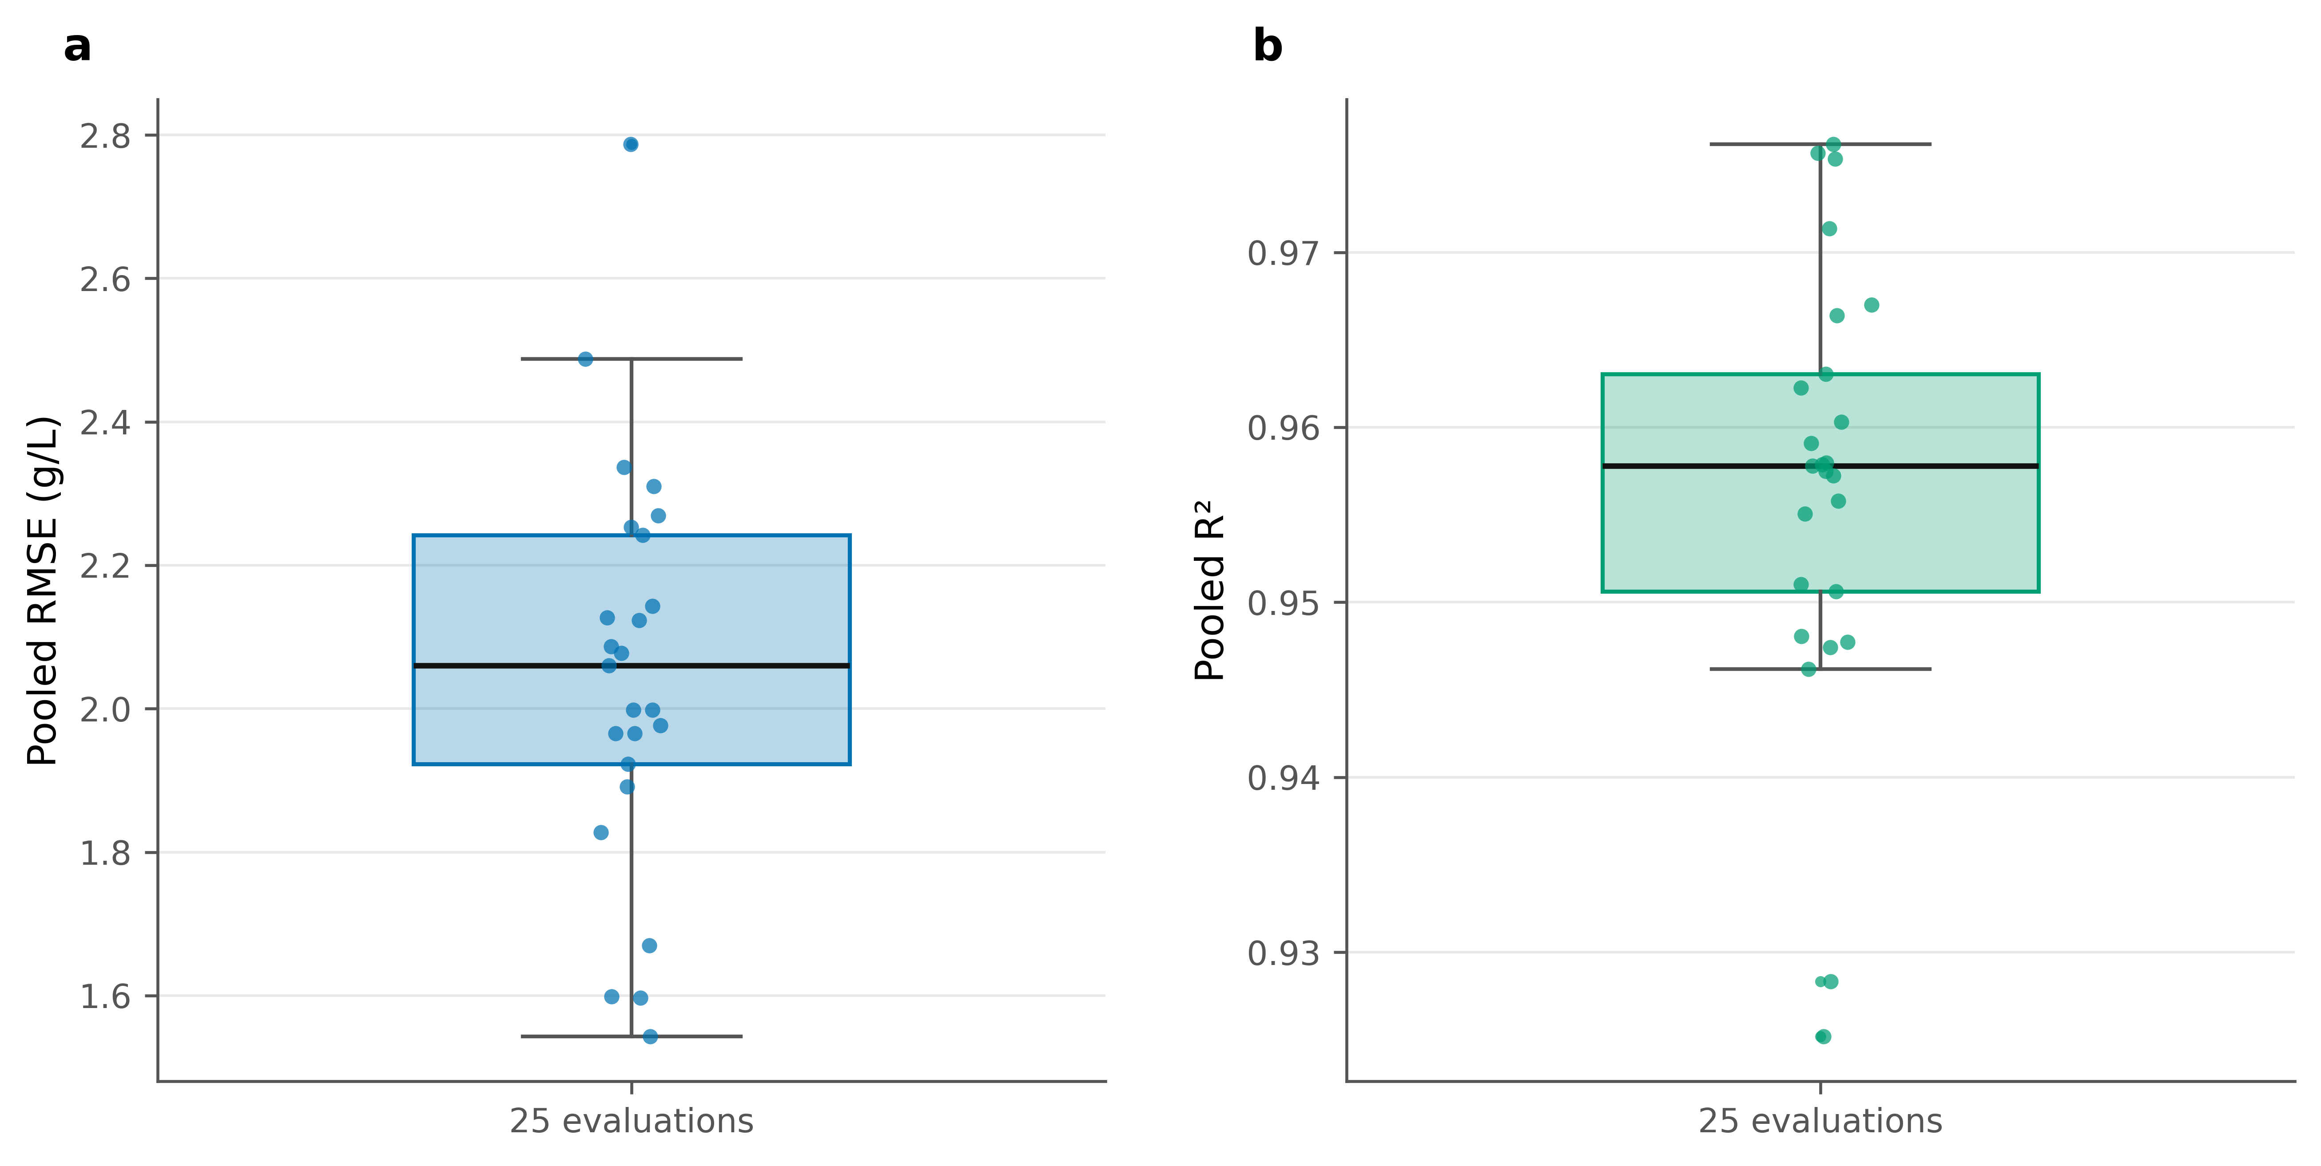
E1 -- Repeated complete-batch cross-validation
Figure legend. Distribution of pooled RMSE and R² across 25 repeated complete-batch Random Forest evaluations.

Slide 6
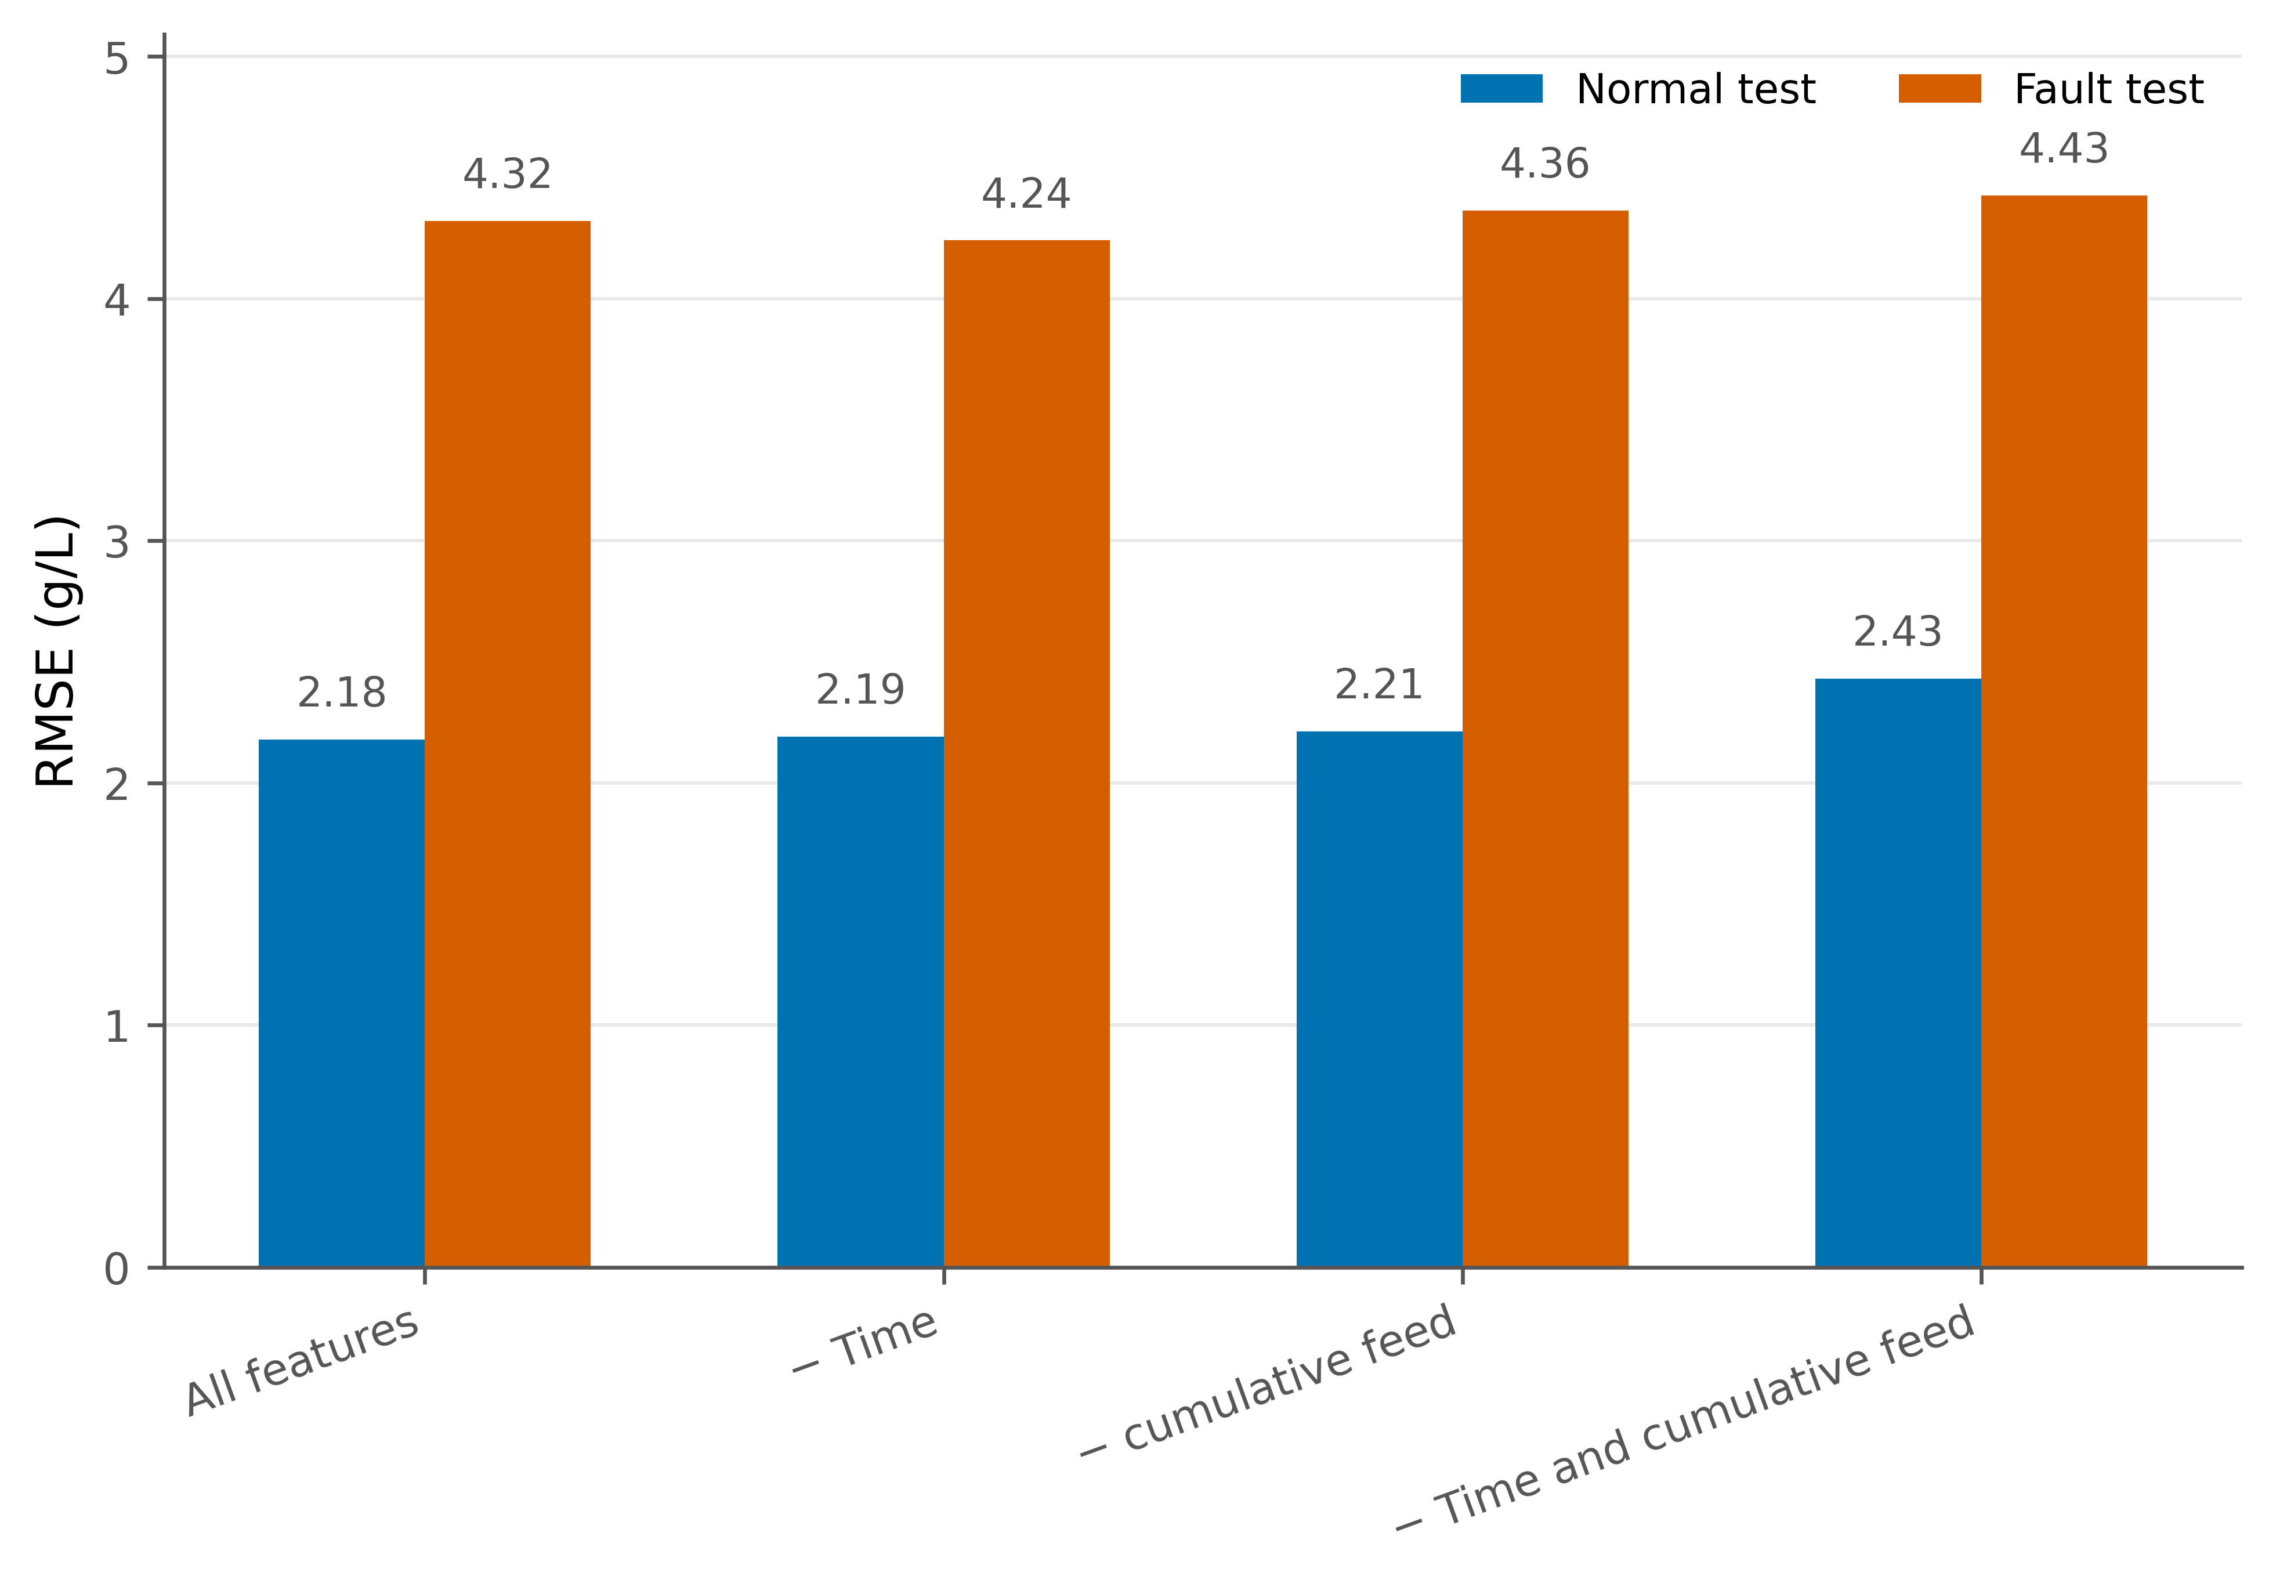
E2 -- Time and cumulative-feed ablation
Figure legend. Normal and fault RMSE for all features and the time/cumulative-feed ablation variants.

Slide 7
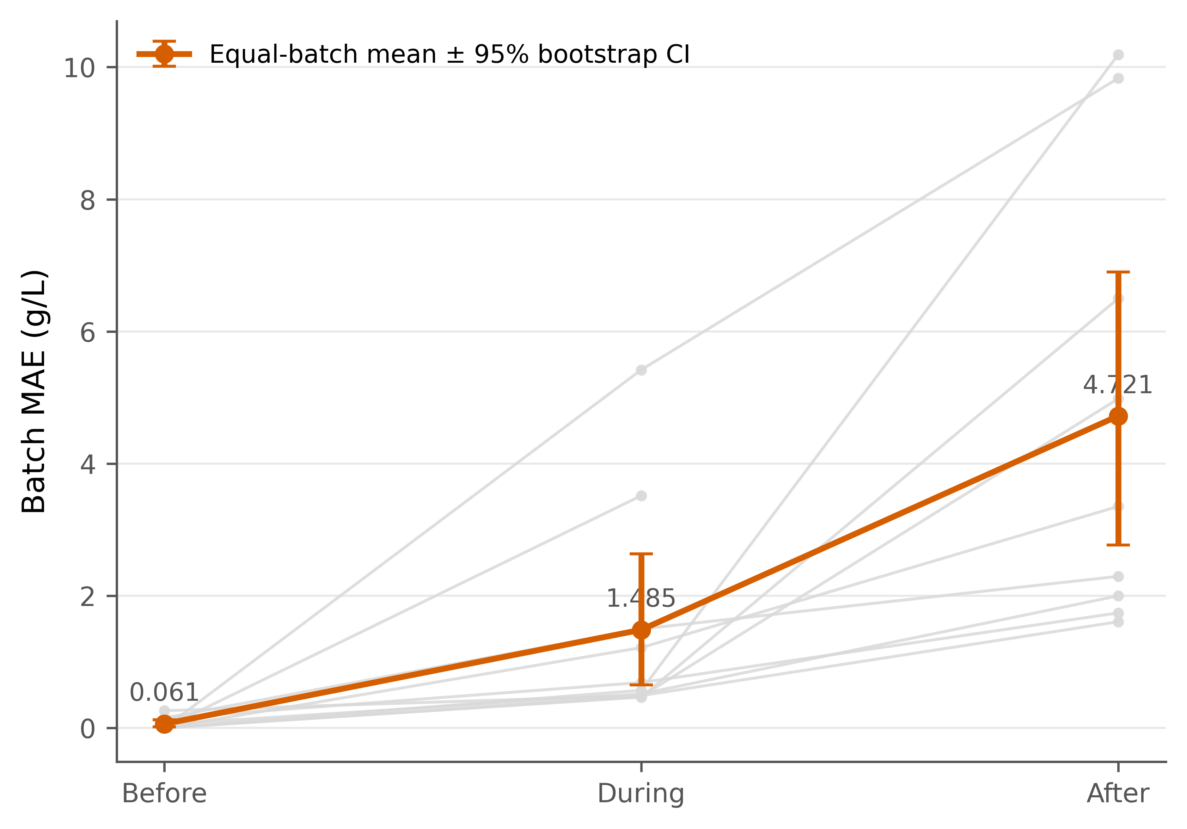
E3 -- Error before, during and after the fault window
Figure legend. Equal-batch mean MAE before, during and after the fault window with the saved bootstrap 95% interval and individual batch traces.

Slide 8
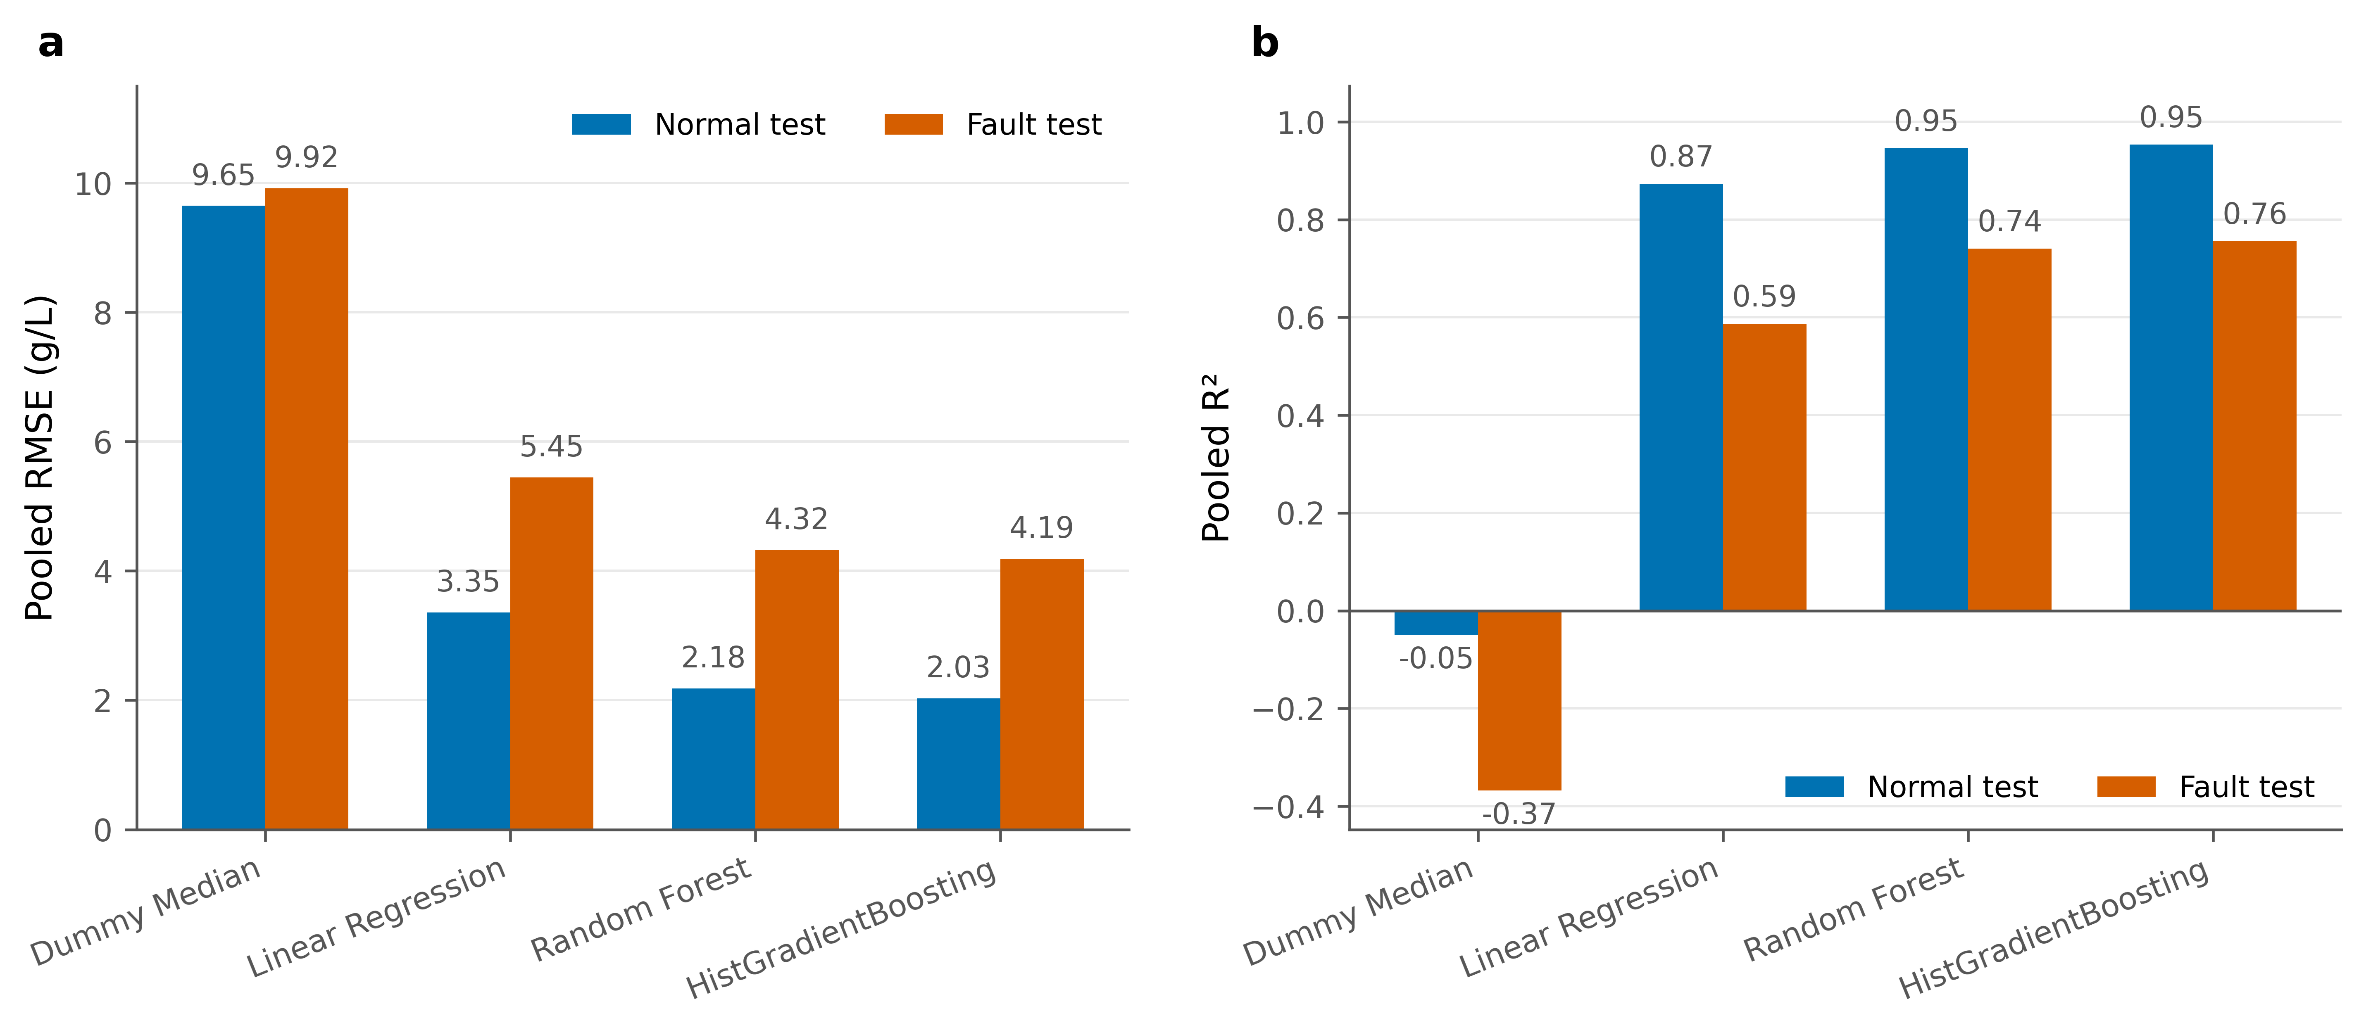
E4 -- Stronger model comparison
Figure legend. Fixed-test comparison of Dummy Median, Linear Regression, Random Forest and HistGradientBoosting.

Slide 9
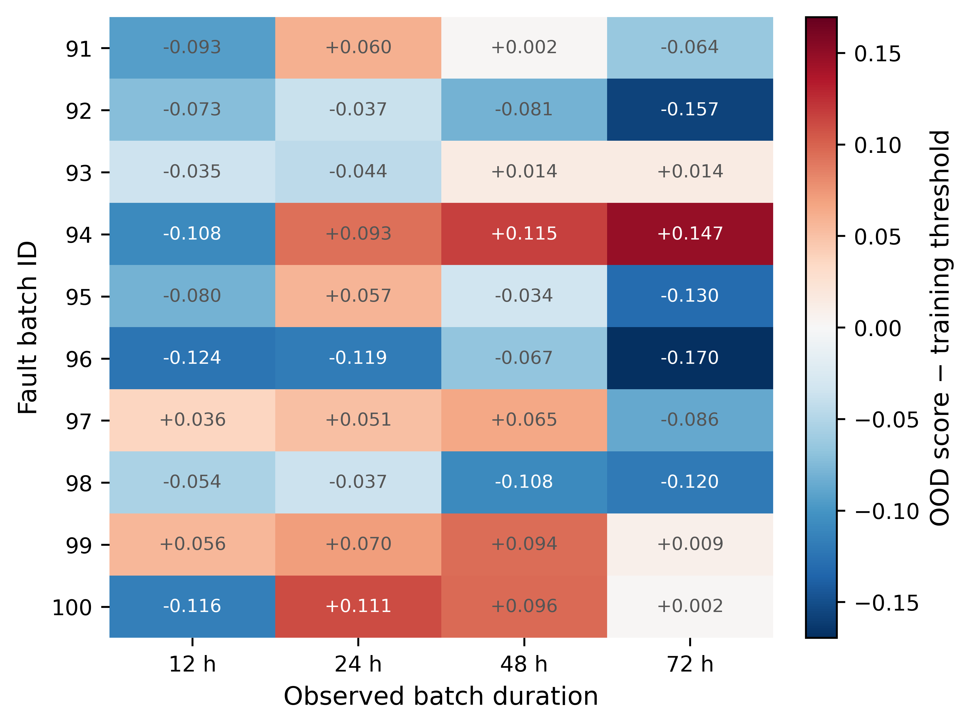
E5a -- Early out-of-distribution warnings
Figure legend. OOD score minus the horizon-specific training threshold at 12, 24, 48 and 72 h; positive values are threshold exceedances.

Slide 10
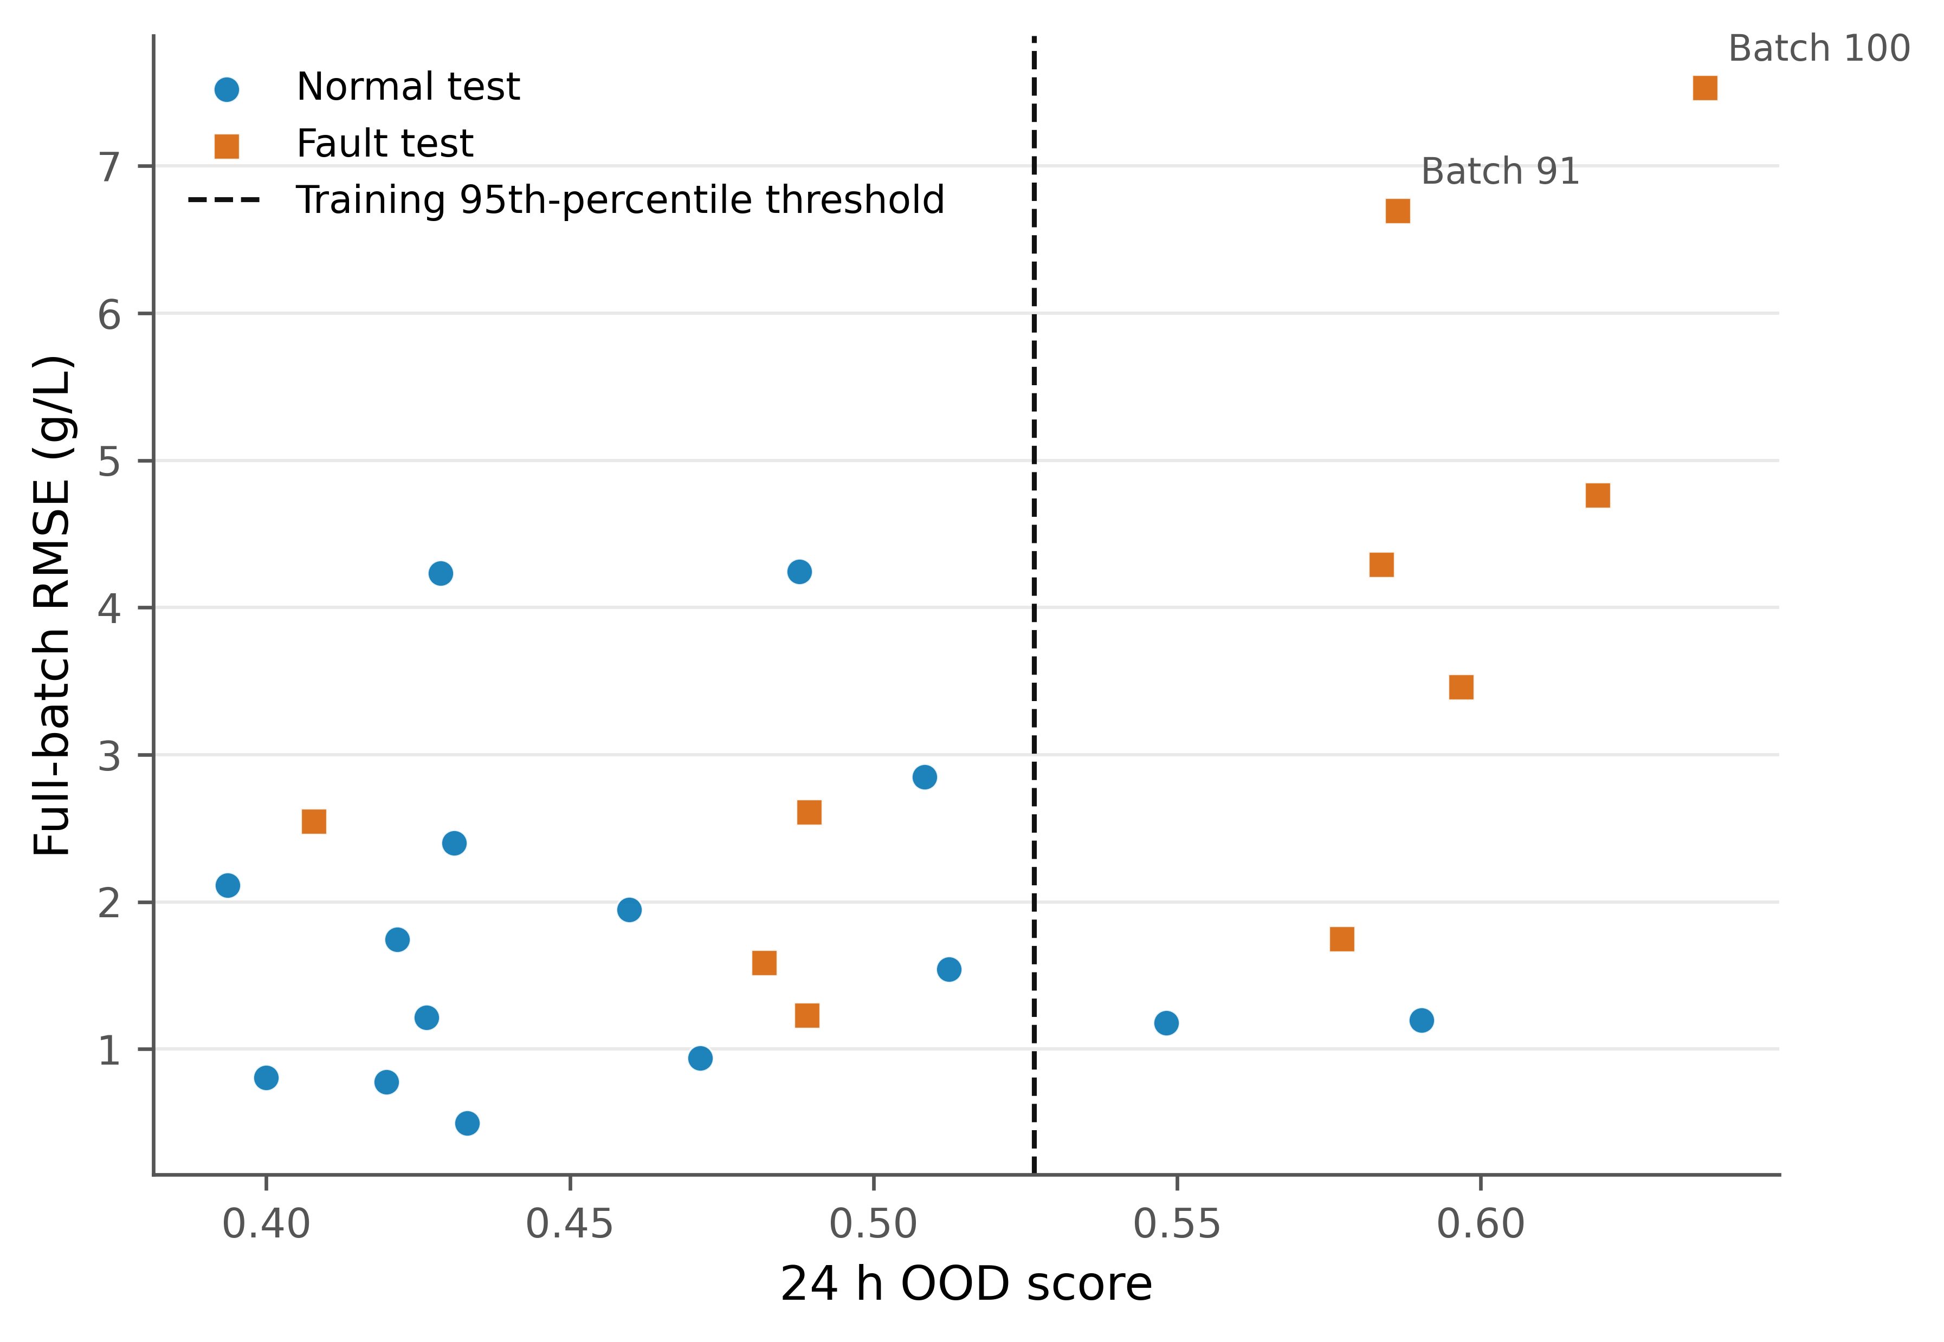
E5b -- Baseline RF: 24 h OOD score vs full-batch RMSE
Figure legend. Baseline Random Forest/OOD experiment: 24 h raw OOD score versus full-batch RMSE; dashed line is the training 95th-percentile threshold.

Slide 11
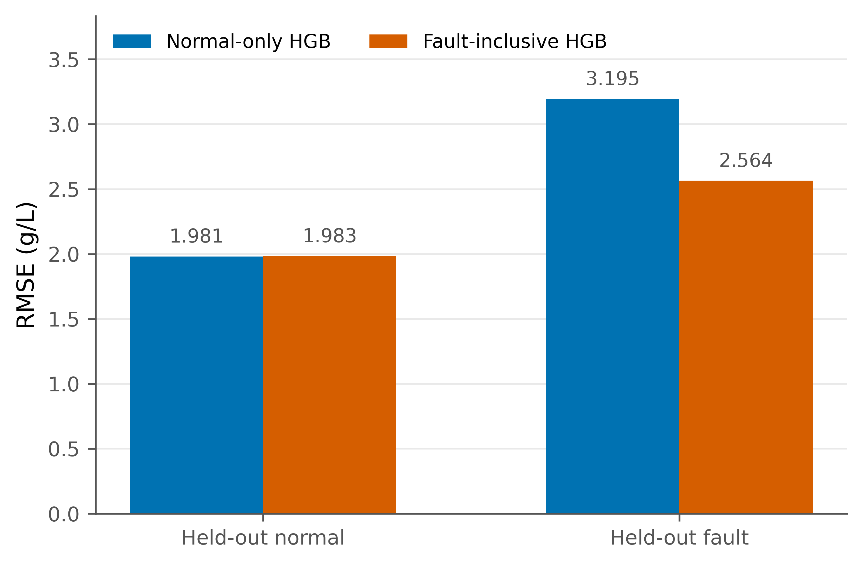
F1 -- Overall held-out RMSE
Figure legend. Pooled held-out RMSE for normal-only and fault-inclusive HGB on normal and fault conditions.

Slide 12
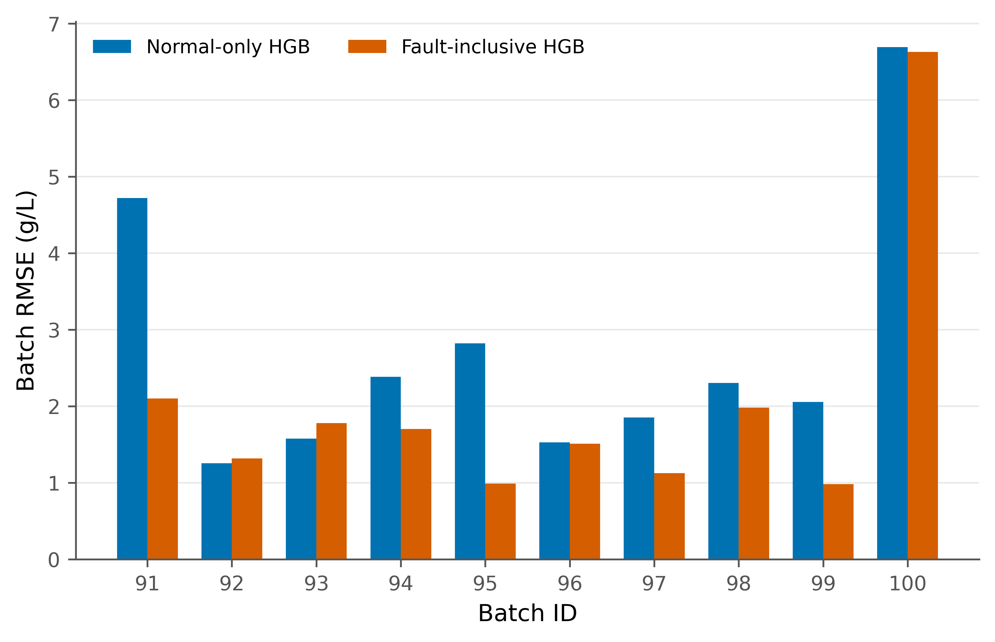
F2 -- RMSE for each held-out fault batch
Figure legend. Complete-batch RMSE for held-out fault batches 91–100, comparing normal-only and fault-inclusive HGB.

Slide 13
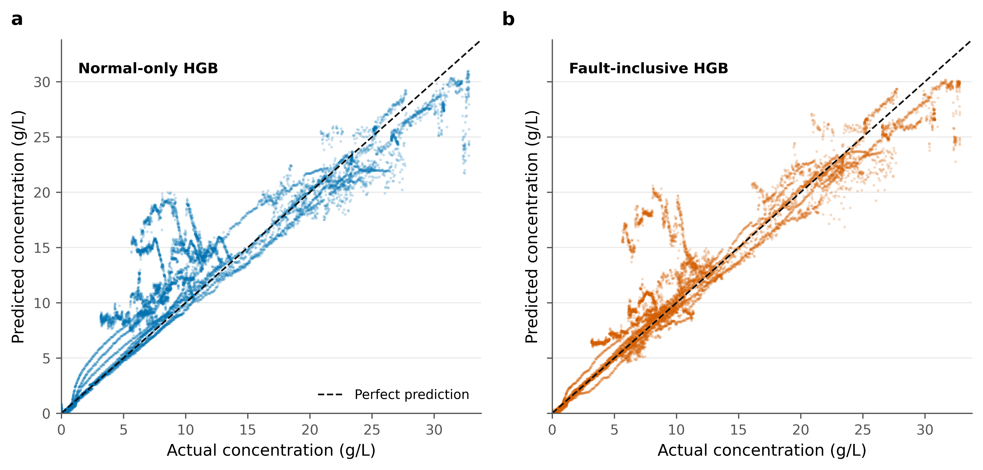
F3 -- Fault-batch actual versus predicted concentration
Figure legend. Held-out fault-batch actual versus predicted penicillin concentration for the two HGB training strategies.

Slide 14
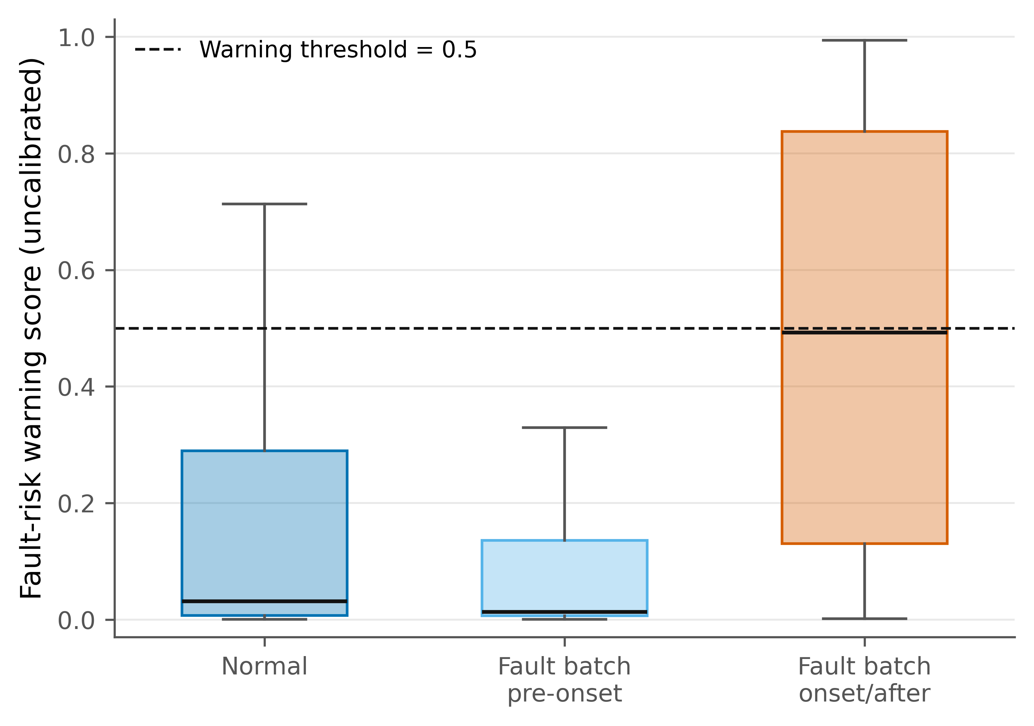
F4 -- Fault-risk warning score by phase
Figure legend. Out-of-fold fault-risk warning score by process phase. Individual outlier markers are suppressed for visual clarity; box/median/whisker summaries are unchanged. The score is uncalibrated.

Slide 15
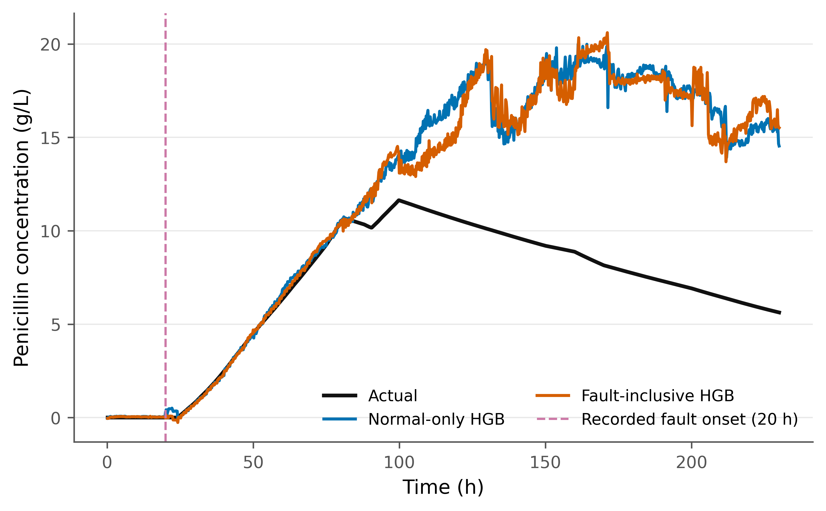
F5 -- Batch 100 held-out trajectory
Figure legend. Held-out batch 100 prediction trajectory; dashed vertical line marks the recorded fault onset.

