Slide 1


Cloud Computing Final
Project
Members:
Anson Tu: 100655482
Owen Musselman: 100657709
Andrew Mikaeel: 100525236
Abdul Bhutta: 100785884
Group: T2

Slide 2

Overview
Components
Content
Implementation
Conclusion

Slide 3
Overview
PART 1

Slide 4

Find Safety of and congestion of the highway
highD Safety and Congestion
People concerned about highway traffic and congestion
Utilize Google Cloud to deduce this information

Slide 5
Components
PART 2

Slide 6

highD: Dataset utilized for project. Deduce safety/congestion stats using numFrames, numLaneChanges, meanXVelocity, driveDirection.
Buckets: Store the dataset(s).
Dataflow: Filter, map, and reduce the data down to needed statistics.
SQL: Store the resulting data.
Front-end: Display the safety/congestion of the highway.

Slide 7
Implementation
PART 3

Slide 8
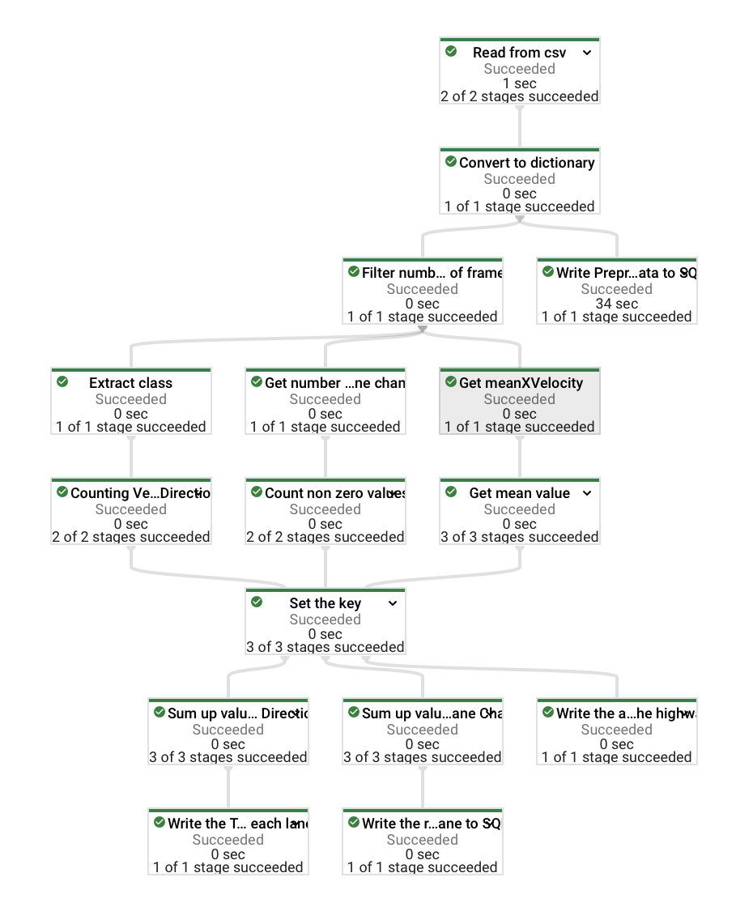
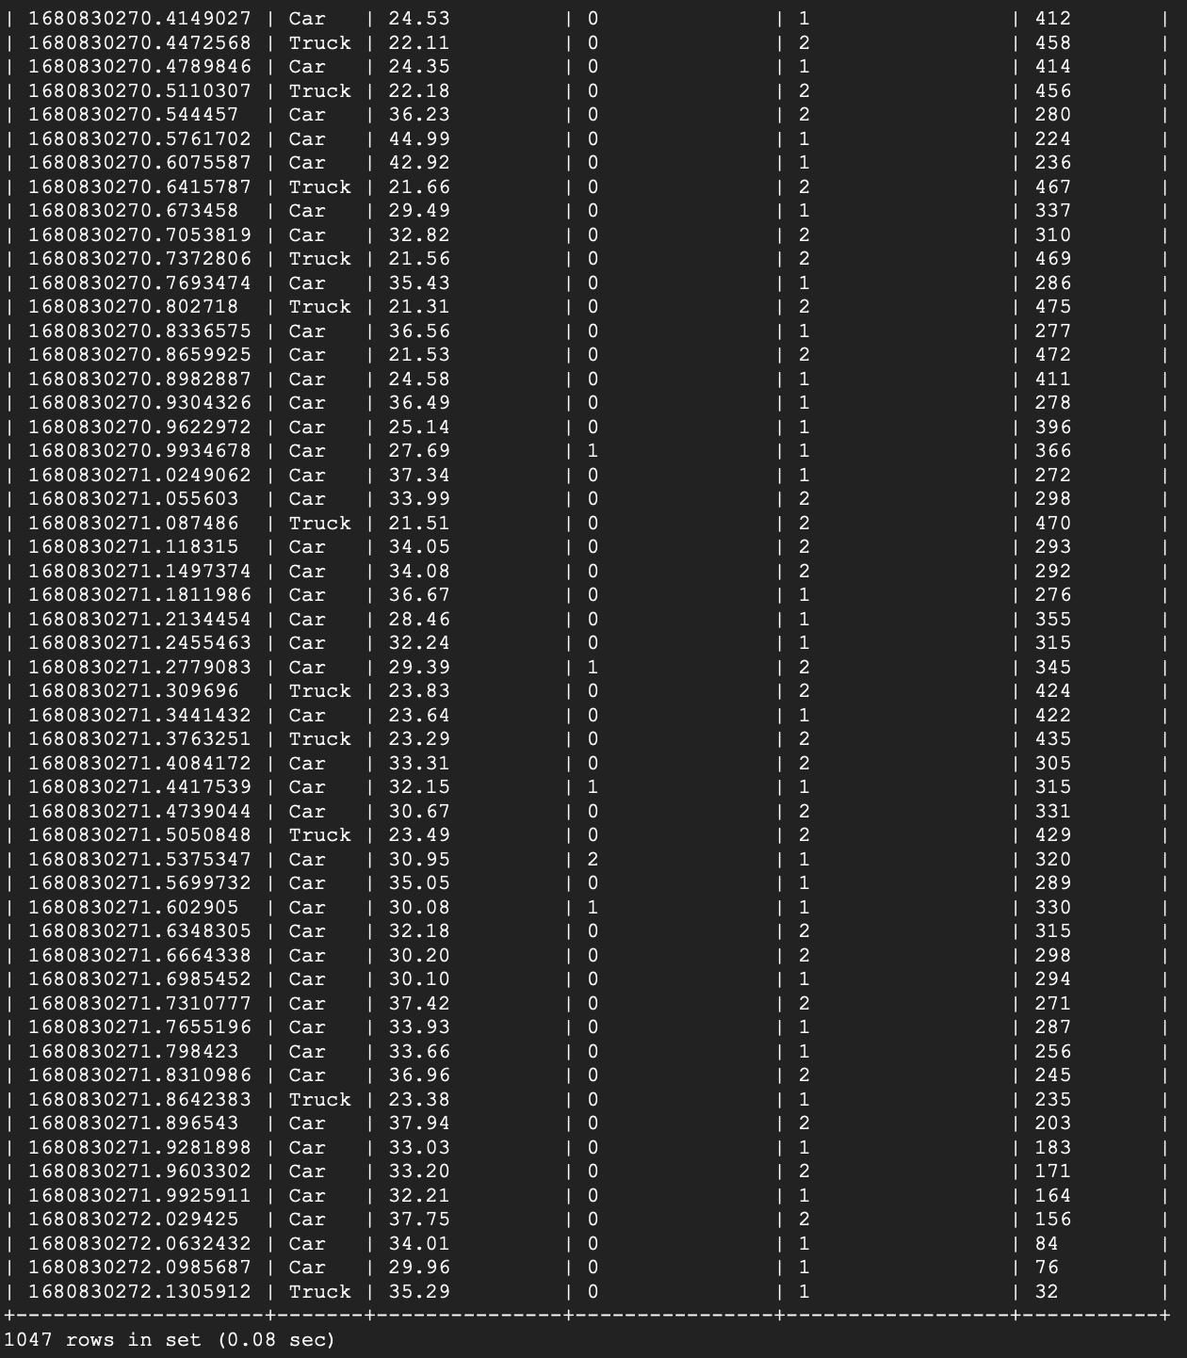
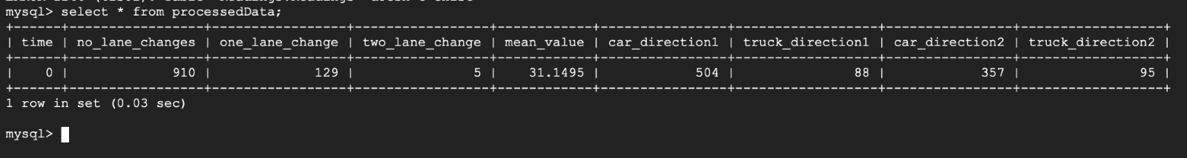
Dataflow
Count total lane changes, count vehicles in each direction, average velocity, filter based on number of frames present.
SQL
Store the raw highD data, resulting safety statistics derived from the dataflow. to separate tables.

Slide 9
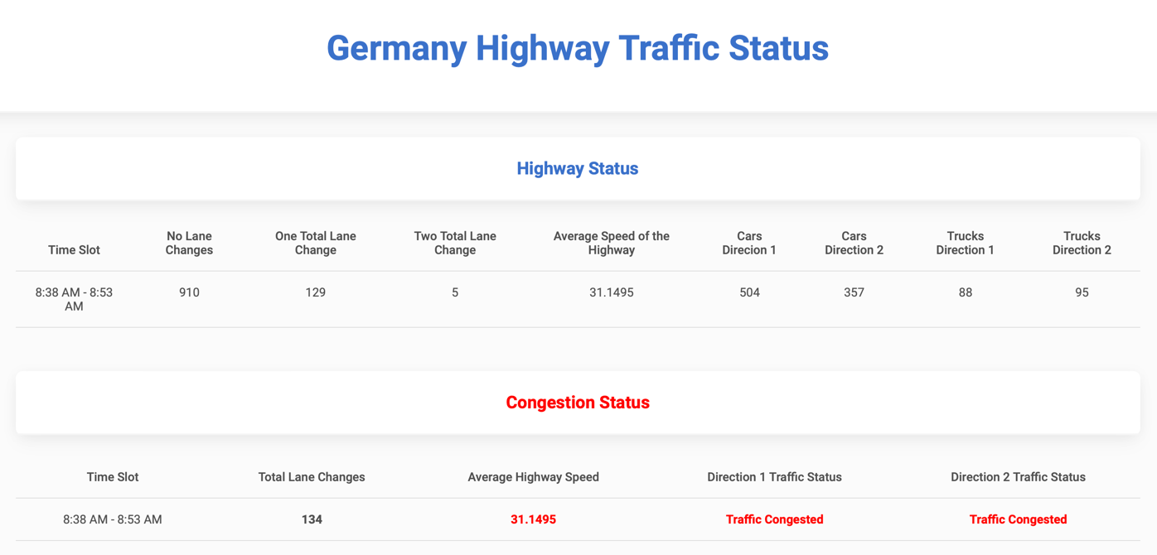
Front-end
Extract the statistics saved in the SQL database. Perform checks to see if statistics meet our set safety requirements.
lane changes < 100 = uncongested
mean velocity < 50 = traffic slow
total vehicles in each direction > 450 = traffic congested.

Slide 10
Conclusion
PART 4

Slide 11
Application filters, and processes data in batch form, saves resulting data to SQL, displays safety to user through webpage.
Improvements: iterate through each tracksMeta file.
A lot was learned with adapting processing in cloud environments.
Debugging cloud based when using dataflow runner takes a lot of time (run locally instead).

Slide 12








THANK YOU

