Slide 1
University Database System

Slide 2
What problem is your project addressing, and why should we care?
What does a University database do for students?
What does a University database do for faculty?
What does this mean for everyone involved?

Slide 3
What were the key challenges?
Complexity
Finding relevant columns/tables/views
Relearning technologies
Notes:
(1:30)
One of the key challenges that we had faced as a group was figuring out how complex the database should be.
When we were in our initial phase of designing the database, we looked into real world educational database systems such as MyCampus or Canvas. We noticed that they were highly complex, holding a lot of information and were capable of doing a lot of tasks that facilitate managing the university.
So when designing this database, we needed to not only think about what were the relevant or core aspects that are required for a functional university database but also think about what is possible within our given timeframe and resource constraint.
This included figuring out what information, tables, and views were relevant and essential for a university database system. When creating the database architecture, we needed to figure out what information was necessary to have as well what information can be obtained or derived from another table or view. Even now, while we’re entering the final phase of this project, when we created the web pages for this database, there were a couple of tables and columns that went unused as they were unnecessary.
We also had to consider the perspective of the users specifically the professors. We had a good understanding of the perspective of a student using the database but we found it quite difficult to figure out what features would be useful for a professor to have as well as how much autonomy should they have in terms of the database.
Finally, the biggest key challenge of them all was relearning the technologies and tools that we used to design the web pages. All of us in our group have not done web design in quite a while so a good portion of our time was spent relearning the tools that we have used such as PHP, Bootstrap, and AJAX.

Slide 4
Requirements
Tools Used HTML, PHP, JS, Bootstrap, AJAX, and CSS
All users must be a member of the university
User login page
Database

Slide 5
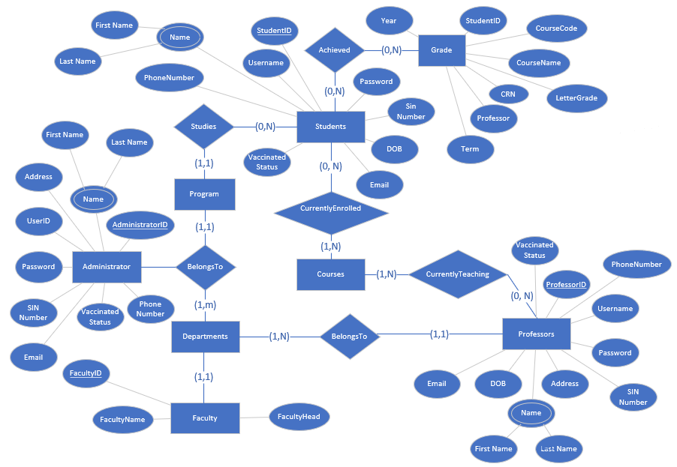
System Overview

Slide 6
Input, Output of the System
User logs in
Access Portal
Registrar Office (Administrator)
Add/Remove/Modify
View courses
View Vaccination Status
Professor
View grades
View students
Student
View Grades
View Courses

Slide 7
Queries and Views
Find all the users(professors/students/administrators) that are vaccinated/unvaccinated
Find all the courses that were offered in 2021 and the term (fall/winter)
View all the grades from a course for a professor
Display User Connected
Search Course by course code or by courses offered in the year/semester
Professors can view the students enrolled in his course
Professor can view all the student grades from the previously taught class
MANY MORE …

Slide 8
Conclusion

