Slide 1

Impact of COVID-19 on Higher Education
Dr. Khalid Hafeez
Abdul Bhutta

Slide 2
AGENDA
Background
Methodology
Key Findings
A Deeper Look
Academic
Student Life
Challenges
What went well?

Slide 3

Background
Limited Research on the Impact of COVID-19 on Higher Education
Distribution of the Survey
Analyzing Students Concerns

Slide 4
Methodology
Creating the Student Survey
Distribution of the Survey
Applying Machine Learning Algorithm
Analyzing Data

Slide 5

Key Findings
385 Total Students Participated
88% Domestic Students
90% Full-Time Student
49% from Faculty of Engineering

Slide 6
Academic Experience
58% used Canvas
67% used Google Meet
43% preferred In-Person Learning
23% Faculty of Engineering Students Grades were Impacted

Slide 7
Student Life
59% of Students had no access to extracurricular activities
67% of Students are concerned with entering the job market.
78% of Students found online learning stressful
45% of Students faced anxiety or depression in an online environment
42% of Engineering Students faced stress

Slide 8

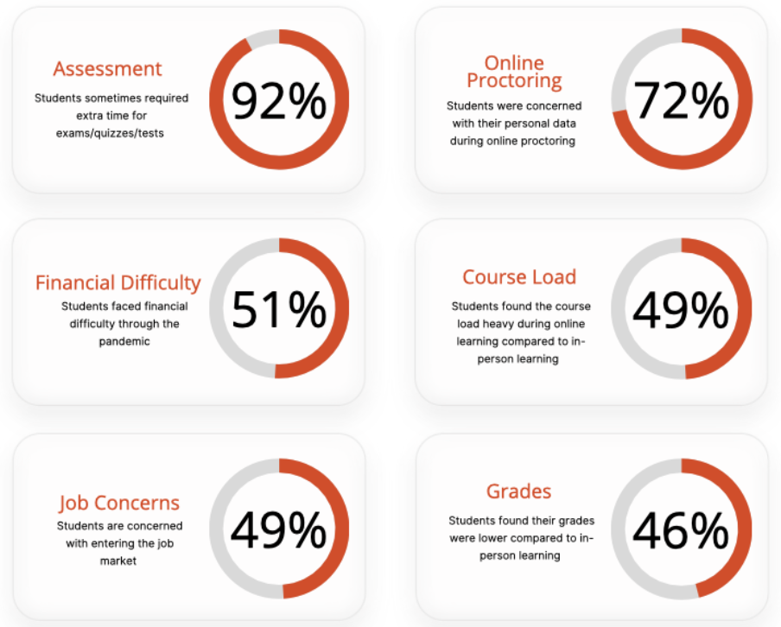
Challenges

Slide 9
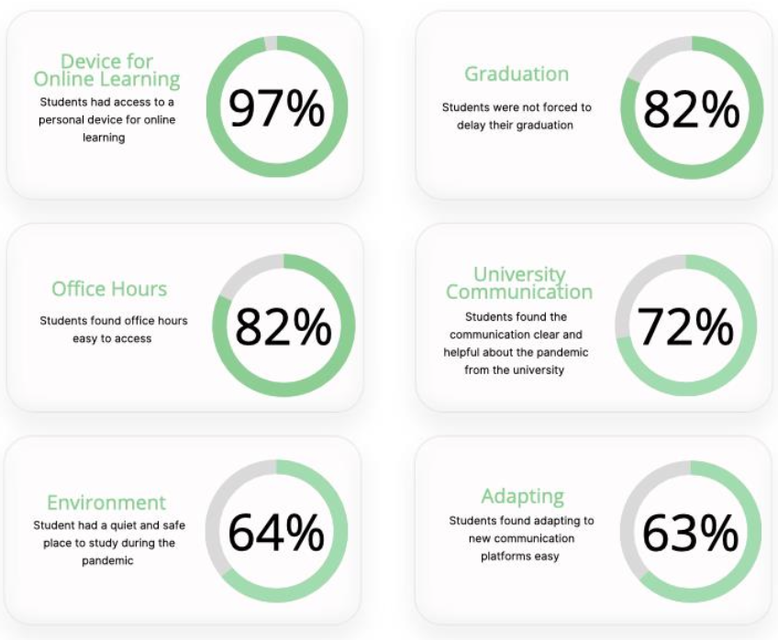
What went well?

Slide 10

A Deeper Look
Did stress from online learning lead to anxiety or depression?
Student’s relationships while facing difficulty managing daily life
What was the leading factor that affected student’s grades?

