Slide 1

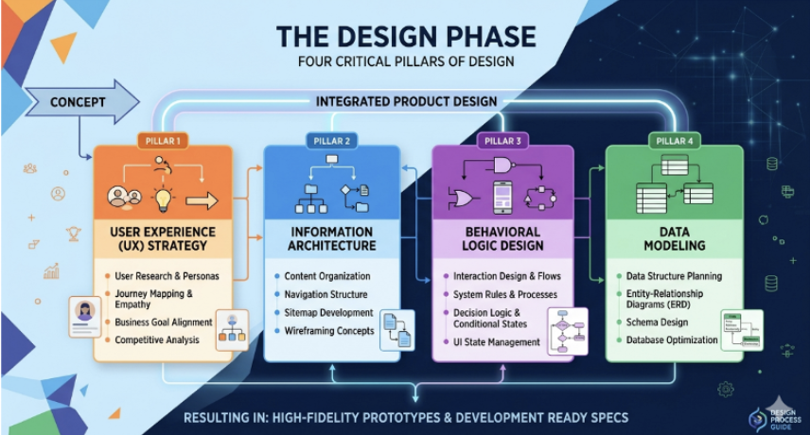
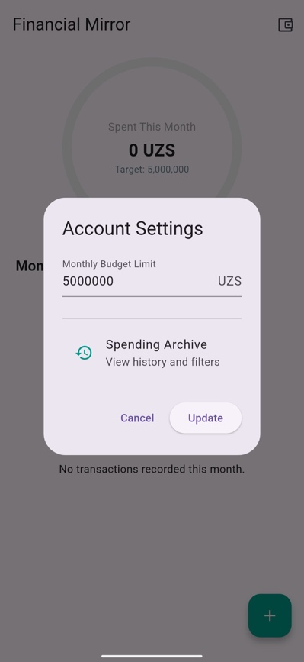
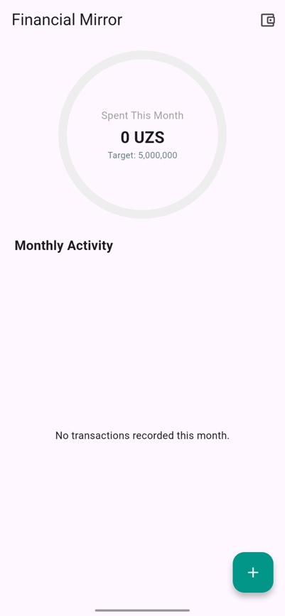
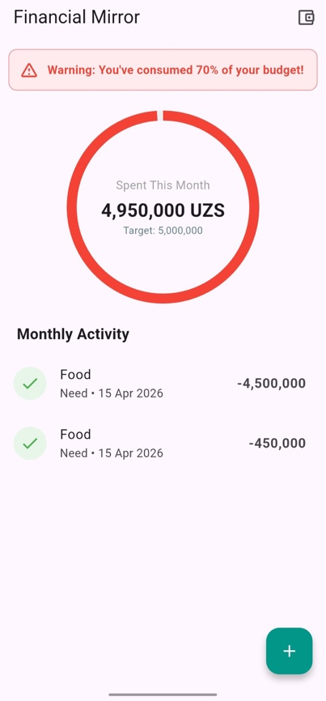
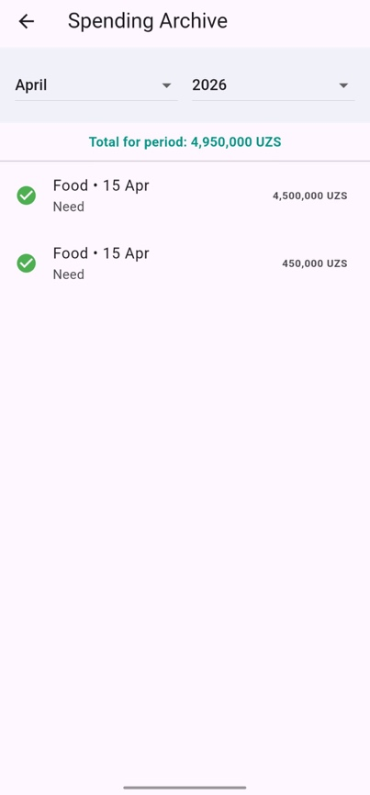
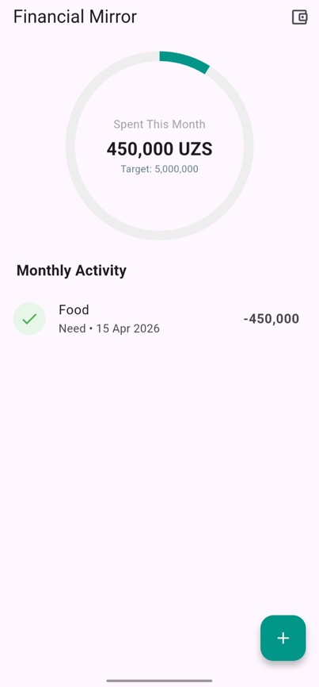
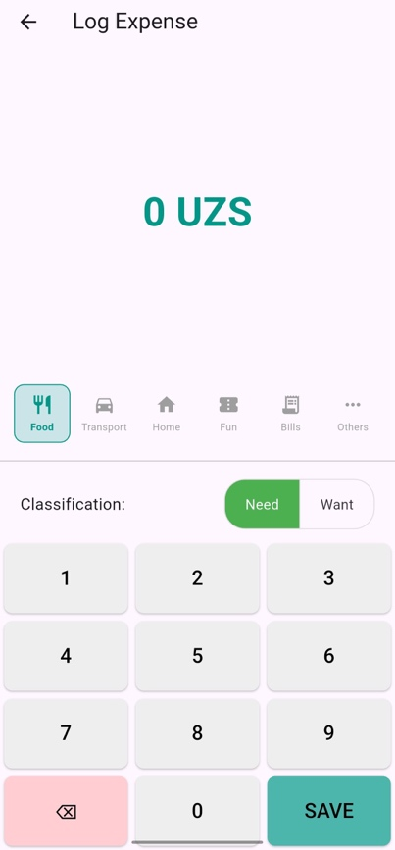
[Project Title]
Project Subtitle
Team Members’ Name
Student IDs - BSc in Computer Science
INTRODUCTION
The management of personal finances is a critical life skill that directly impacts an individual's quality of life and long-term security. However, in an era of digital payments and one-click purchases, many people find it increasingly difficult to keep an accurate record of their daily spending. This lack of oversight often leads to "lifestyle creep," where unnecessary small expenses prevent individuals from achieving significant savings goals. While the mobile app market is flooded with financial tools, many users report that existing solutions are either too complex for daily use or too generic to provide meaningful behavioral change.
CONCLUSION
This project has successfully achieved all five of its Research Objectives (RO), demonstrating both its effectiveness and practical relevance. It has evolved beyond its initial concept as a simple digital ledger into a more impactful behavioral intervention tool, designed to influence and improve users’ financial habits. The findings highlight an important principle in money management: less is often more. Rather than overwhelming users with complex features, the project focuses on simplicity, clarity, and ease of use. By offering a tool that is fast, visually intuitive, and encourages reflection, it enables users to better understand their spending patterns and make more informed decisions. Ultimately, this approach empowers individuals to take greater control of their financial futures, fostering sustainable habits and long-term financial awareness—one tap at a time.
RESULTS
The research findings demonstrate that the application significantly optimizes financial management by increasing logging efficiency by 60% through a highly preferred three-tap interface. This streamlined monitoring directly impacts user behavior, identifying that 35% of spending is allocated to non-essential "Wants" and triggering a 22% reduction in immediate expenditures following "Amber" visual alerts. Ultimately, the combination of a simplified UI and mandatory transaction classification fosters meaningful habit change by increasing "pause and reflect" moments and successfully pinpointing an average of 1.8 financial leaks per user.
PROJECT OBJECTIVES
The primary goal of this project is to develop a mobile application that simplifies money management and encourages saving. The specific objectives are:
To create a frictionless system for tracking daily income and expenses.
To design features that identify and reduce unnecessary recurring payments.
To implement visual summaries and alerts that improve user financial awareness.
To develop a user interface that emphasizes simplicity and high usability.
To provide tools that help users understand and improve their long-term financial habits.
RECOMMENDATION AND FUTURE WORK
While this study intentionally focused on manual data entry to promote greater mindfulness and user awareness, future research could explore the integration of Machine Learning techniques to automate the categorization of expenses into ‘Wants’ and ‘Needs.’ For example, location-based data and spending patterns could be leveraged to intelligently classify transactions, reducing user effort while maintaining behavioral insights. Additionally, expanding the pilot study to include a larger and more diverse demographic sample would yield more comprehensive findings. In particular, examining how cultural spending behaviors across Central Asia influence user responses to digital ‘nudge’ alerts could provide valuable insights into the adaptability and effectiveness of such interventions in different social and economic contexts.
PROJECT OUTPUT
The following screenshots show the mobile application interface, providing an overview of its main screens and key features.”
METHODOLOGY
The User Experience Strategy serves as the foundational pillar where the project’s vision is aligned with both user needs and business objectives.
Once the strategy is clear, the Information Architecture phase focuses on organizing, structuring, and labeling content to support findability and usability.
The Behavioral Logic Design pillar defines the interactive nature of the system, transforming static layouts into a living, responsive interface.
The final pillar, Data Modeling, bridges the gap between design and engineering by defining the underlying technical structures required to power the interface.
1
2
ACKNOWLEDGMENT (Optional)
“My sincere appreciation also goes to the Engineering School and the CAU community for their continuous academic inspiration, support, and the enriching environment they provide for learning and innovation. Their commitment to excellence has played a significant role in shaping both this project and my overall academic journey. I am equally grateful to the app’s testers for their time, participation, and valuable feedback. The data they provided was instrumental in evaluating the system, identifying areas for improvement, and refining the final outcome of this project. Without their contributions, this work would not have achieved its current level of depth and effectiveness.”
3
4
SUPERVISOR
[Dr. Name of Supervisor]
[supervisor]@centralasian.uz

